Slide 1
South Dakota Smarter Balanced System Training
Test Administrator Interface (Interims)
Teacher Handscoring System (THSS)
Assessment Viewing Application (AVA)
Notes:
Welcome to the South Dakota Smarter Balanced System trainings. Today’s webinar will cover three systems that you will use when administering the Smarter Balanced Interim Assessments. The first section will cover the Test Administrator (TA) Interface, the second section will cover the Teacher Handscoring System, and the last section will cover the Assessment Viewing Application. Each section will be about 30 minutes and may include a brief Q&A session which may be 5 to 10 minutes.

Slide 2
Section I.
Test Administrator (TA) Interface for Online Testing
Notes:
Welcome to the Test Administrator Interface for Online Testing training.
This presentation includes details of the Test Administrator (TA) Interface that you will use to administer online tests.
This training module is designed to help you navigate the TA Interface. However, you should consult the Test Administrator User Guide located on the South Dakota portal for more information.

Slide 3
Objectives
After viewing this presentation, you should be able to:
Use the TA Interface to start and run a test session
View student test settings and accessibility resources
Monitor the testing process
Pause and stop a test session
Transfer sessions between computers and mobile devices
Print test session information
Exit and log out of the TA Interface
Notes:
After viewing this presentation, you should be able to:
Use the TA Interface to start and run a test session
View student test settings and accessibility resources
Monitor the testing process
Pause and stop a test session
Print test session information, and
Exit and log out of the TA Interface

Slide 4
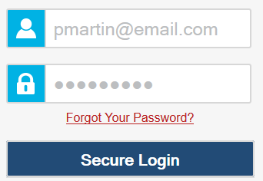
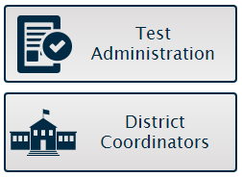
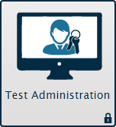
Logging in to the TA Interface
4
Notes:
To log in to the TA Interface, go to your portal. Click the appropriate user role or assessment card. On the next page, click the system card used for operational test administration. Enter your user name and password, and then click Secure Login to continue.

Slide 5
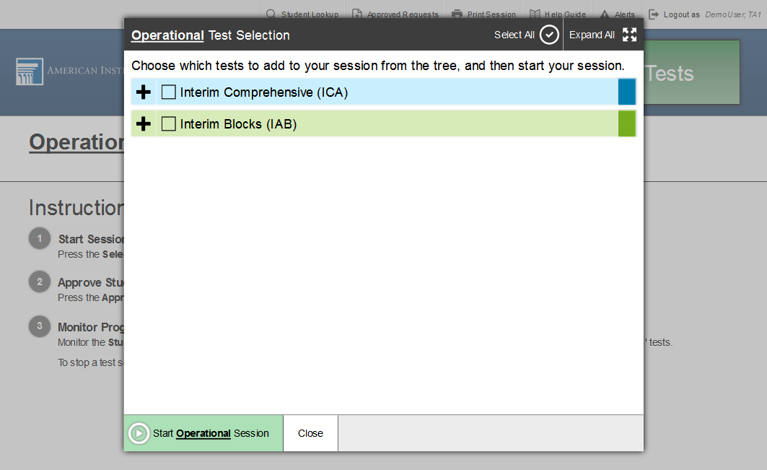
TA Interface: Overview
Notes:
Once you have logged in, you will see the TA Interface with the Test Selection window open by default. From the TA Interface, you can access the features you need to create and manage test sessions, look up students, and access help information. We will begin with an overview of the interface, followed by a more detailed review of each feature.

Slide 6
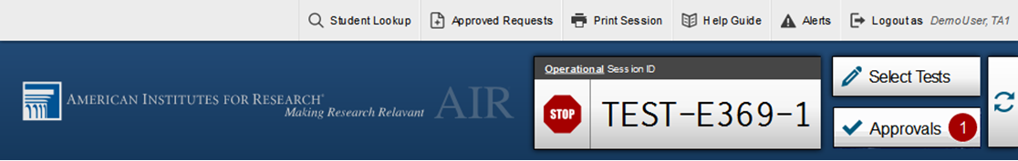
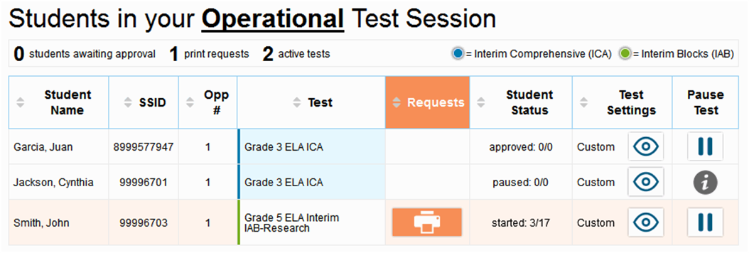
TA Interface: Overview (continued)
Notes:
When you first log in to the TA Interface, the Test Selection window will appear automatically. This window closes when you start the session.
After you start a session, the session ID will appear at the top of the TA Interface along with a Stop button. When students start signing in to the test session, an Approvals button will also appear next to the session ID. Once you approve students for testing, the Test Session table will appear in the center of the TA Interface, displaying students’ testing progress.
Additional features are available in the banner at the top of the screen.

Slide 7
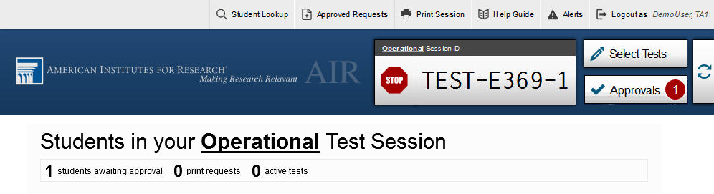
TA Interface: Banner
Notes:
In the banner at the top of the screen, you will see a set of buttons and your user name.
You can click Student Lookup to search for student login information and verify that the student’s login credentials are correct.
Click Approved Requests to view a list of student print requests that you approved during the test session.
Click Print Session to print a screenshot of the TA Interface.
Click Help Guide to access additional information about the TA Interface.
Click Alerts to view messages sent by the South Dakota department of education.
Click the Log Out button when you want to exit the TA Interface.

Slide 8
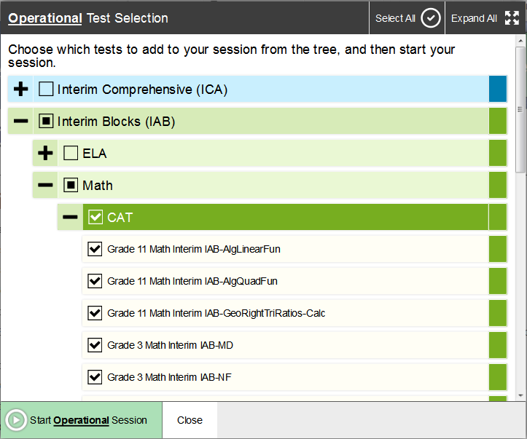
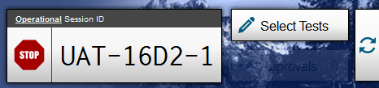
Create a Test Session
Notes:
The first step in administering a test is to create a test session. This should be done less than 20 minutes prior to starting the test in order to prevent the system from timing out. The list of students in the session will generate automatically when the students log in to the session.
You create test sessions in the Test Selection window that appears when you log in. The Test Selection window color-codes the available tests and organizes them into categories. You can click the Plus Sign button next to a category name to view the tests in that category. To create a test session, click one or more tests to administer, or click the checkbox for a category to include all tests in that category. You may select all available tests listed, for all grade levels and all content areas. Students will only have access to the tests you select for them that they are eligible to take.
Once you select your tests, the Start Session button in the lower-left corner of the window activates. Click the Start Session button. The system will automatically generate a session ID. This ID must be provided to students in order for them to log in. You may write it on the board or provide it to students using a printed card or similar method. If you do provide students with the information on paper, be sure to collect and destroy it when the session is complete.
You should also note the session ID for your own records. If you accidentally close your browser, entering the session ID will allow you to resume the session. If you do not have this information when you try to resume, you will be unable to do so.

Slide 9
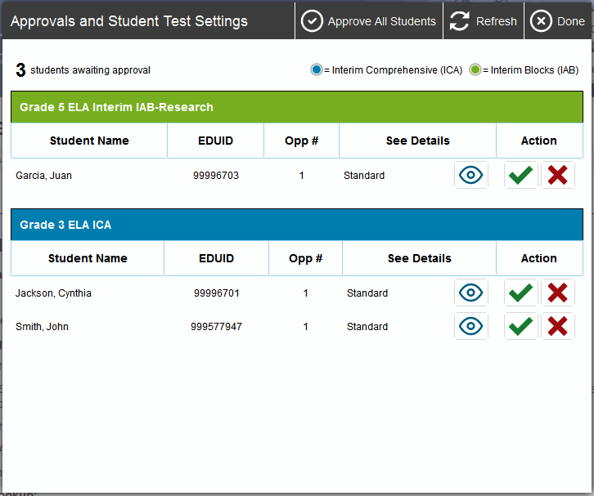
Approving Student Entry
Notes:
Once you start the test session and students log in, you must approve their test settings before they can access their tests. It is very important that you pay close attention to the test name prior to approval to be sure that students have selected the appropriate test. To approve student tests, click the Approvals button. A list of students will display, organized by test name. You should review the list to make sure that all students chose the correct content area and test. You should also ensure that all the settings that each student should have are correct. This is done using the Eye button in the See Details column. We will talk more about that in a few moments.
If no changes are needed, select Approve All Students to admit all students to the session. If a student selected an incorrect test, you must deny that student entry to the test session by clicking the X button in the Action column.

Slide 10
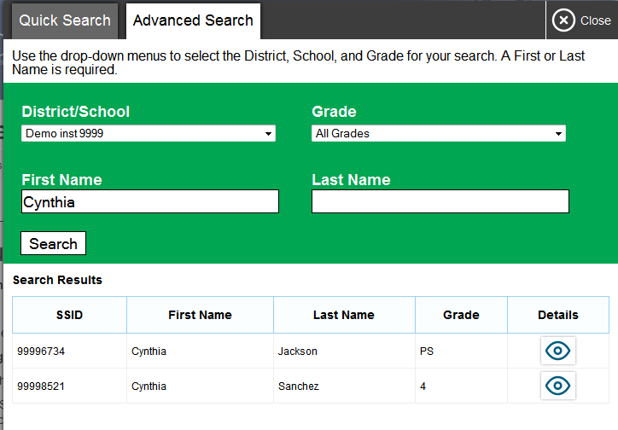
Student Lookup
Notes:
If a student is having trouble logging in, use the Student Lookup feature to verify that the student’s login credentials are correct. You can use either the Quick Search or Advanced Search option to view the information entered for the student in the Test Information Distribution Engine (or TIDE). With Quick Search, you simply enter the student’s state-assigned student ID and click the Submit SSID button. Advanced Search allows you to narrow your search using several filters, including District/School, Grade, and First and Last Name.
When using either Quick Search or Advanced Search, if the search results in matches, the information will appear in the bottom of the window. If there is no match, you will see an error message.

Slide 11
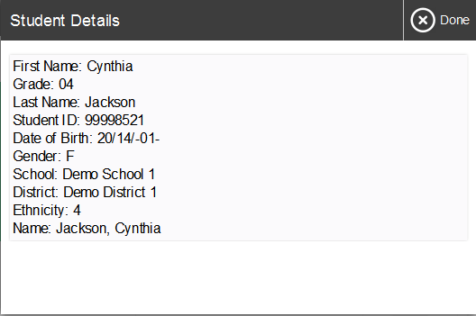
Student Lookup
Notes:
If you see the student you are looking for, click the Eye button next to the student’s name. A new window displaying the student’s information will appear. Note that the information displayed may vary slightly from what is shown here.

Slide 12
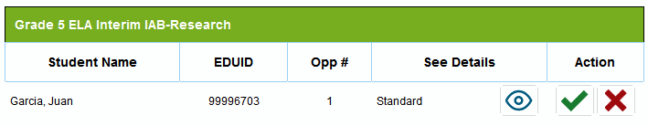
Denying Student Entry
Deny entry to a test session in these circumstances:
The student is not supposed to enter this session.
The student’s demographic information is incorrect.
The student’s required accommodations are incorrect.
Notes:
Although you can approve all students at the same time, students must be individually denied entry into the test session.
You should deny students entry into the session in these circumstances:
• The student is not supposed to enter this session.
• The student’s demographic information is incorrect.
• The student’s required accommodations are incorrect.
Denying the student entry into the test session will not prevent other approved students from beginning their tests.
If the student’s test settings are incorrect, the settings must be updated in TIDE or the TA Interface before the student takes the test. Contact your School or District Test Coordinator to have the settings updated. This will prevent resetting the test for the student later.
Note that no settings can be changed while the student is actively testing. Once a student begins testing, the language option cannot be changed without resetting the test opportunity. Updates to background color or font size will take effect only after the student logs out and then resumes testing.

Slide 13
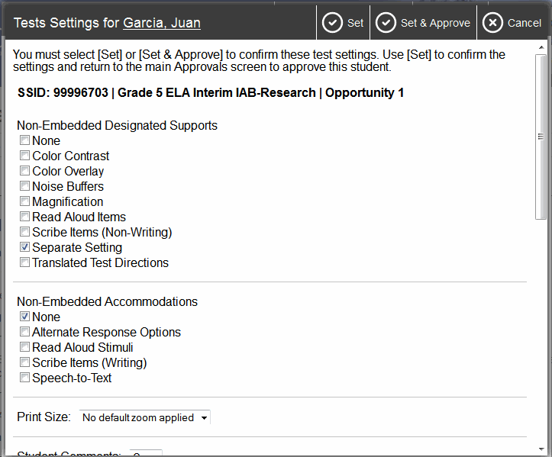
Editing Student Details:
See/Edit Details
Notes:
If you need to change test settings for a student, click the Eye button in the See Details column. The Test Settings screen will appear, with the student’s information at the top. Some settings can be viewed but not changed in this window. These test settings must be set by an authorized user in TIDE prior to testing. See the TIDE User Guide for more information.
Some test settings can be changed in this window. After adjusting settings as desired, click the Set button to change the settings without approving the student. To both change settings and approve the student for testing, click the Set & Approve button. Note that the Test Settings screen may not appear exactly as it does in the screenshot shown, depending on your user role and permissions.

Slide 14
Editing Student Details:
Turn Settings On and Off
Notes:
Some of the universal tools available by default may not be appropriate for some students. If you need to turn a universal tool off or on for a student, you must do so before testing begins. Mark the check boxes in the Test Settings screen to enable or disable the appropriate settings.
Some settings are managed using the TA Interface while other accessibility resources must be set up in TIDE prior to testing. For more information, consult the Usability, Accessibility and Accommodations Guidelines, available on the Smarter Balanced website. As noted previously, the Test Settings screen may not appear exactly as shown here, depending upon your user role and permissions.

Slide 15
Monitoring Student Status
Notes:
Once students log in and are approved for testing, you can monitor their status from this screen. A table shows each student’s name, SSID, Opportunity Number, Test Name, Requests, Student Status, Test Settings, and a Pause Test option.
The Requests column displays a notification when students request a printout. We will discuss this in more detail shortly.
The Test Settings column will display either Standard or Custom. This column displays Custom when a student’s test settings are different from the default settings for that test. Click the Eye button to view a student’s test settings.
The Student Status column indicates the student’s progress through the items in the test. It shows the total number of items completed thus far and the total number of items in the test.

Slide 16
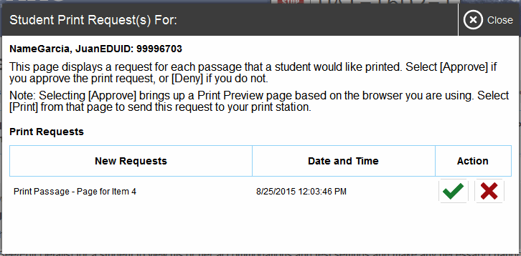
Print on Request
Notes:
The Print on Request feature is available only for students who require it. Please contact your School Test Coordinator if your student needs this accommodation. It is a testing impropriety to apply this restricted resource for a student who does not have an IEP or 504 plan documenting his or her need for the accommodation.
Students with this accommodation can request printouts of stimuli and/or items, depending on their settings.
• When a student sends a print request, the Printer button will appear in the Requests column of the monitoring screen. Click the button to view the request.
• If you click the Check button to approve the print request, a cover sheet containing the student’s name and SSID will display in a new browser window. No test content will ever display on your screen.
• Click Print in the new window to complete the print request. The printer dialog box will display.
• Click OK to send the request to the printer.
• If you click the X button to deny the print request, nothing will be printed.
Before approving the student’s print request, ensure that it will be sent to a printer that is monitored by staff who have been trained in test security. All printed test items, stimuli, and reading passages must be securely stored and destroyed immediately following a test session.

Slide 17
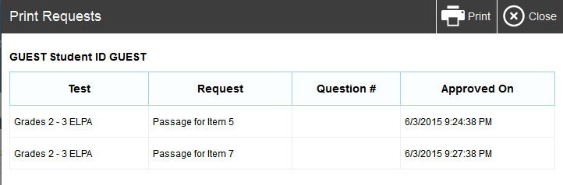
TA Interface: Approved Requests
Notes:
The Approved Requests button allows you to view a list of every print request you approved during the current session. If you wish to print this list for your own records, click Print at the top of the Approved Requests window.

Slide 18

Printing Test Session Information
Notes:
If you wish to print a snapshot of the TA Interface in its current view, click the Print Session button. This can be useful for tracking which students did not complete their tests and may need to be scheduled for another session. It may be necessary to set the page layout to landscape or adjust the margins in the Print Preview screen in order for the list to fit on the page. Remember that any printouts containing personally identifiable student information must be securely stored and should be destroyed after use.

Slide 19
Pausing and Stopping Sessions
Notes:
You have two options within the TA Interface to pause or stop testing once it has begun. You can pause an individual student’s test, or stop the entire session. To pause an individual student’s test, click the Pause button on the monitoring screen for that student. When prompted, click OK to confirm that you want to pause the test. This option would be appropriate if a student becomes ill, for example. In the event of an emergency that requires all students to stop testing, you can pause all students’ tests by stopping the session.
If you stop the session, all in-progress tests will be paused. If a session stops, it cannot be resumed. You will have to create a new session and give the new session ID to students so that they can resume testing. To stop the entire test session for all students:
• Click the Stop button in the upper right corner of the screen. A pop-up message will appear requesting verification to end the session and log students out.
• Click OK to continue.
If you forget to log out before leaving the testing area, the session will close automatically after 30 minutes of inactivity on both the TA and student computers. You would then need to create a new session and provide the new session ID to students in order to resume testing.

Slide 20
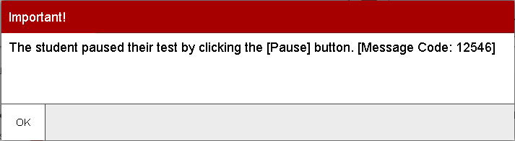
Pausing and Stopping Sessions
Notes:
When the system detects that a student is no longer in a test session, an information icon will appear in the Pause Test column for that student. Click the circular button in the Pause Test column to view a description of the student’s status, including why the student is no longer in the test session. This is a new feature for the 2016–2017 school year.
This information can help you diagnose why a student has unexpectedly left a test session. The information that appears will tell you whether a student’s test has been paused due to the student clicking the Pause button, a session timeout, or some other reason.
For a full list of status descriptions that can appear during a test session, please consult the TA User Guide.

Slide 21
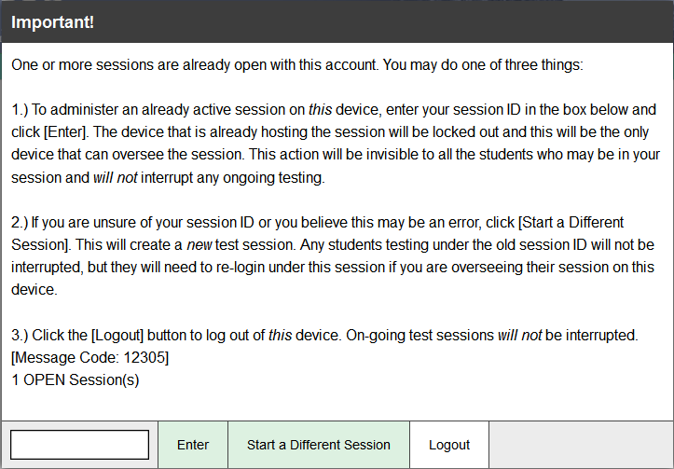
Transferring Sessions
Notes:
In the event that you have problems with your computer or web browser or need to change computers during an active test session, you can transfer the session from one computer, mobile device, or browser to another without stopping the session or interrupting in-progress tests. To transfer a test session to a new device or browser:
• Do not log out of the session you are currently in or stop the test session. If you do, you will end the test session and pause all students’ tests.
• Log in to the TA Interface on the new machine or in the new browser. A session ID prompt will appear.
• Enter the active session ID in the text box and click Enter. When the session ID is validated, you will be able to continue your test administration activities.
The test session on the previous computer or browser will close automatically. This will not stop the session or pause student tests.

Slide 22
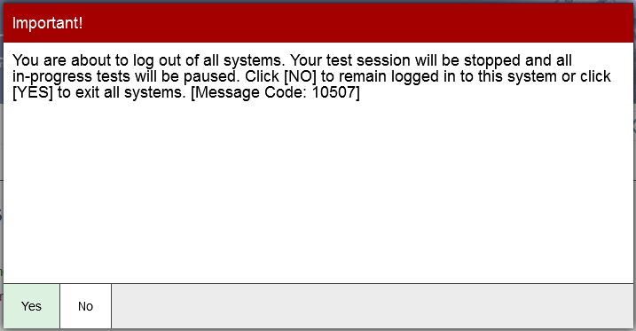
Logging Out of the TA Interface
Notes:
To log out of the TA Interface, click the Logout button in the upper right corner of the screen. It is preferable for you to log out only after stopping your active test session, as logging out will cause all in-progress tests to be paused. A confirmation message will appear, asking you to confirm that you want to exit the site and pause all students’ in-progress tests. This scenario also occurs when you navigate to another site from the TA Interface. However, regardless of when or how you log out or navigate away from the TA Interface, student data will NOT be lost. If you need to access another application, we encourage you to open it in a separate browser window.
Click Yes to proceed. When all students have completed testing, refer to the Test Administration Manual for instructions on destroying any printed testing materials and reporting testing improprieties or irregularities.

Slide 23
Troubleshooting
Description | What to Do
What should I do if a session ends? | Log in and start a new session. Provide the students with a new session ID.
What should I do if a student gets logged out of a test while a session is still active? | If a student’s test session is interrupted, the student should log back in and rejoin the session.
What should I do if forbidden applications are running? | The secure browser will not allow the student to begin testing if forbidden applications are running. You will see messages advising you which applications must be closed before testing can begin.
What should I do if a student’s test freezes? | Force quit the secure browser and log back in. For instructions, refer to the Test Administration Manual.
Notes:
This table presents some of the common issues that you or your students may encounter during a test session. Please take a moment to review this information. For more detailed information and additional technical tips, please refer to the Test Administration Manual and the Technical Specifications Manual for Online Testing.

Slide 24
Section II.
Teacher Hand Scoring System
Notes:
Welcome to the Teacher Handscoring System (THSS) for the South Dakota Smarter Balanced Interim Assessment training.
THSS is a component of the Online Testing System that allows authorized users to hand score designated items included in the Interim assessments.
This training module is designed to help you navigate THSS. However, you should consult the THSS User Guide located on the South Dakota portal for more information.

Slide 25
Teacher Hand Scoring System Overview
The THSS allows local scoring of responses requiring human scoring
Two types of access
  Scorer
  Score Manager
Notes:
The Interim South Dakota Smarter Balanced assessments have some items that cannot be scored by machine and require human scoring. The Teacher Hand Scoring System (THSS) allows authorized users to score item responses that require human scoring.
When students in a test session submit an assessment, the hand-scored items are sent to THSS, where authorized users can view students’ responses to each item and enter scores or mark them with condition codes.
At the end of the training, we will review the technical resources available on the South Dakota Smarter Balanced Assessment portal.

Slide 26
Roles and Permissions
TIDE User Roles
Task or Site | DA* | DC* | SC* | TE* | TA*
Access to Teacher Hand Scoring System** (THSS) Features and Tasks
Scorer |  |  |  | ✓ | ✓
Score Manager | ✓ | ✓ | ✓
*DA—District Administrator; DC—District Test Coordinator; SC—School Test Coordinator; TE—Teacher, TA—Test Administrator **This system only uses the Smarter Balanced Interim Assessments.
Notes:
As shown on the chart, TIDE account has a role, and that role has certain permissions.
The table shows the permissions in THSS by TIDE role. A user can only be a scorer and score manager. Users will not see these roles in TIDE, but they are assigned by user role in TIDE. For example, any user with a School Test Administrator (TA) or a School Teacher (TE) role in TIDE is automatically a Scorer. Any user with the role of District Administrator (DA), District Test Coordinator (DC), or a School Test Coordinator (SC) is automatically a Score Manager. We’ll talk about access as Scorer and Score Manager, but remember that is access not TIDE role.
In addition to limiting tasks, permissions limit scope. A district-level user can work with interim data pertaining to that district, and a school-level user can only work with interim data pertaining to that school.

Slide 27
Teacher Hand Scoring Roles
Scorer
  Score items assigned to them
  Reassign items assigned to them
Score Manager
  Score items assigned to them
  Reassign any items
Notes:
The primary difference between a scorer and a score manager is what items can be reassigned to others to be scored.
Scorers can only reassign items assigned to them. Score Managers can reassign any item in their jurisdiction.

Slide 28
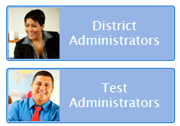
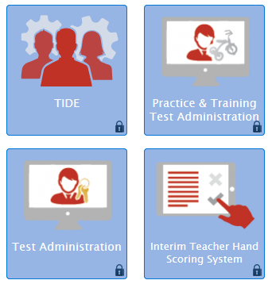
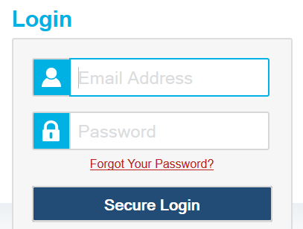
Logging In
Notes:
As with other AIR systems, users log into the THSS by selecting their user card then selecting the Interim Teacher Hand Scoring card from the South Dakota Smarter Balanced Assessment portal. They will be taken to the log in page where they will enter the username and password they use for all AIR systems.

Slide 29
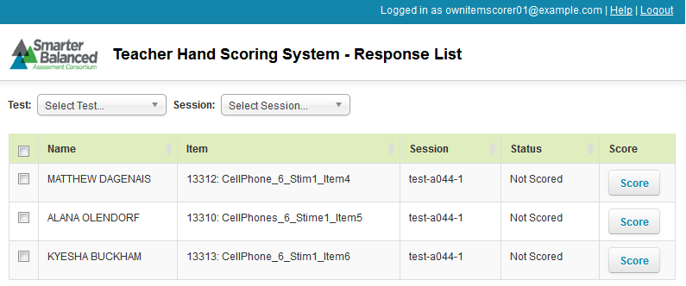
Home Page
Notes:
On logging in users will see the Response List page.
For Scorers this page will populate with all responses assigned to them to score. Responses by default are assigned to the TA who proctored the session where the student submitted the test.
Score Managers will see all responses in their jurisdiction. So district-level users will see responses that require scoring from students in their districts. School Test Coordinators users will see responses that require scoring from students in their schools.

Slide 30
Response List Table
Column | Description
Name | Name of the student.
Item | Name of the hand-scored item.
Session | ID of the session in which the student completed the test containing this response.
Status | “Not Scored” indicates the response still needs to be scored. “Tentatively Scored” indicates the response was scored but still needs to be marked as complete.
Assigned To* | The Scorer to whom the response is currently assigned. This is only visible to users with the Score Manager role.
Score | Click the button in this column to enter a score for the response .If you are a Score Manager, you can only enter scores for responses that are assigned to you.
30
Notes:
The response list contains a number of columns.
The Name column is the name of the student.
The Item column is the name of the hand-scored item.
The Session column shows the session ID the student was in when the test was submitted.
The Status column indicates the current status of the item, either “not scored” indicating that the item has not yet been scored by a user, and “Tentatively scored”, indicating that the item has been scored but not yet marked complete.
The Assigned To column is only available to Score Managers. This column tells a Score Manager the current scorer assigned to an item.
The Score column allows users to enter a score for the selected item when they click the button.

Slide 31
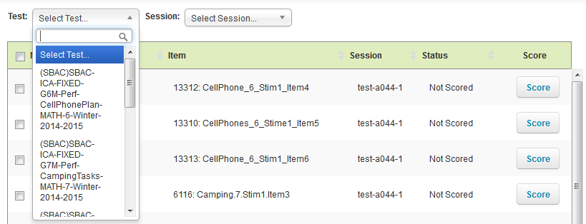
Filtering and Sorting
Notes:
Users can use the drop-down lists on the Response List page to filter the responses that appear in the table. Scorers can filter the table by test and/or session. Score Managers can filter the table by test, session, grade, subject, and/or assigned Scorer.
By opening the drop-down list above the table users can filter the responses they see. Users may either select a response shown when the table is opened or may type in a keyword to search for.
Users may also sort the columns by clicking on the header of the column they wish to sort by.

Slide 32
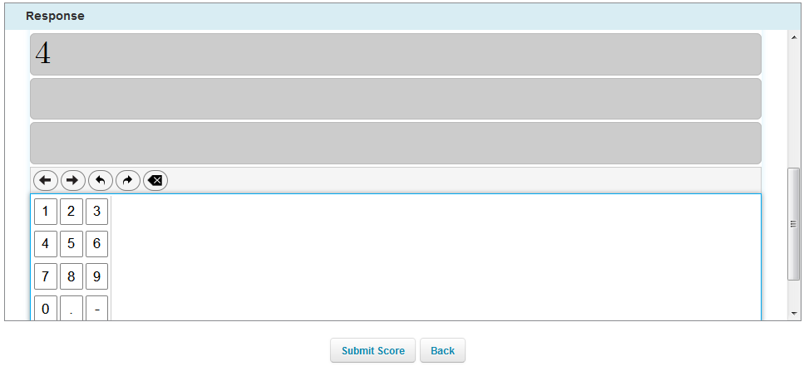
Scoring Responses
Notes:
When a user has clicked the Score button, the Score Response page for that item will appear.

Slide 33
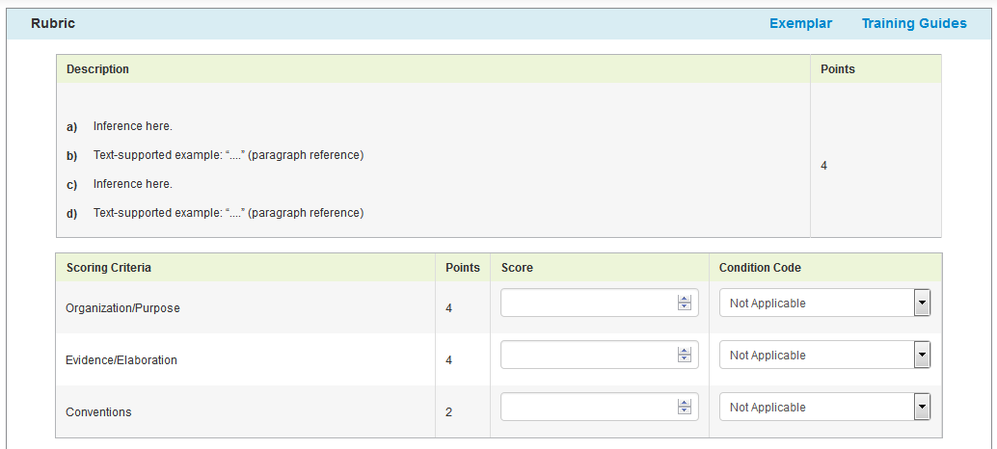
Scoring Responses Continued
Notes:
In the Response section of the Score Response page, the user must review the item stem and the student’s response. In order to view the item’s passage and an example of a perfect response, the user should click Exemplar.
In the Rubric section, the user should review the rubric description and either enter a score for the response by manually entering a numerical score in the Score field or using the arrow button to enter the score in increments of one. The score cannot exceed the value in the Points column.
If the response cannot be scored, the user may assign a condition code to the response by selecting the appropriate option from the Condition Code drop-down list.

Slide 34
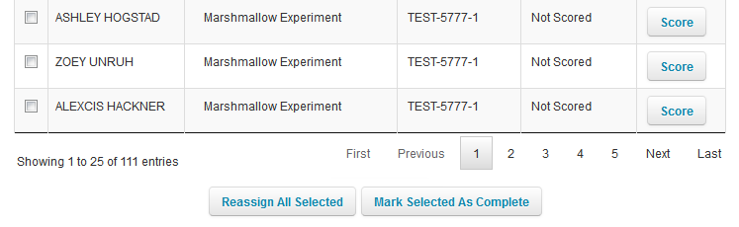
Completing Item Responses
Notes:
When users have finished scoring responses they should complete and submit the item responses.
In order to submit the scored items users will mark the checkbox for all scored responses on the Response page and click the Mark Selected as Complete button.
Once an item is marked complete it is submitted and can no longer be edited or viewed.
Once all of a student’s items for a specific test have been scored and marked complete the student’s score for the entire test will be available in the Online Reporting System (ORS).

Slide 35
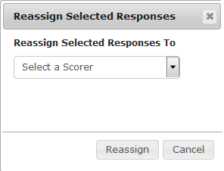
Reassigning Responses
Notes:
By default THSS automatically assigns a response to be scored to the School Test Administrator for the session in which the student completed testing.
Responses can be reassigned to other scorers in the users’ jurisdiction. Scorers can reassign any items assigned to them to other users in their school. Score Managers can assign any response in their jurisdiction to any other user in their jurisdiction. Those users associated with a school can reassign responses in their school and users in a district can reassign a response to anyone within their district.
On the response list table the users should select the response or responses they wish to reassign and select the Reassign All Selected button. A pop up window will appear. The drop down list will contain only users in the same jurisdiction. The new scorer should be chosen and the Reassign button selected. The selected responses will be moved from the previous scorer’s queue to the new scorer and will no longer appear on the original scorer’s Response List.

Slide 36
Section III.
Online Testing System Assessment Viewing Application (AVA)
Notes:
Welcome to the Assessment Viewing Application (AVA) training module.
AVA is a component of the Online Testing System that allows authorized users to view interim assessments for administrative or instructional purposes.
This training module is designed to help you navigate the Assessment Viewing Application. However, you should consult the Assessment Viewing Application User Guide located on the South Dakota portal for more information.

Slide 37
Objectives
After viewing this presentation, you should understand how to:
Log in to AVA
Access the assessments
Navigate through the test
Notes:
After viewing this presentation, you should understand how to:
Log in to AVA
Access the assessments
Navigate through the test

Slide 38
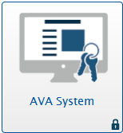
Logging in to AVA
38
Notes:
To log in to AVA, you must have an authorized email address and password, which is the same as the one you use for TIDE and the TA Interface. Contact your School Administrator if you do not have a TIDE account.
To log in to AVA, go to your portal. Click the appropriate user role or assessment card. On the next page, click the AVA System card. Enter your username and password, and then click Secure Login.

Slide 39
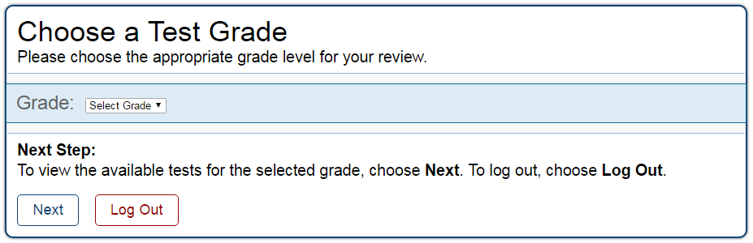
Step 1: Choosing a Test Grade
Notes:
After logging in, the Choose a Test Grade page appears.
From the Student Grade Level drop-down list, select the desired grade level.
Click Next.

Slide 40
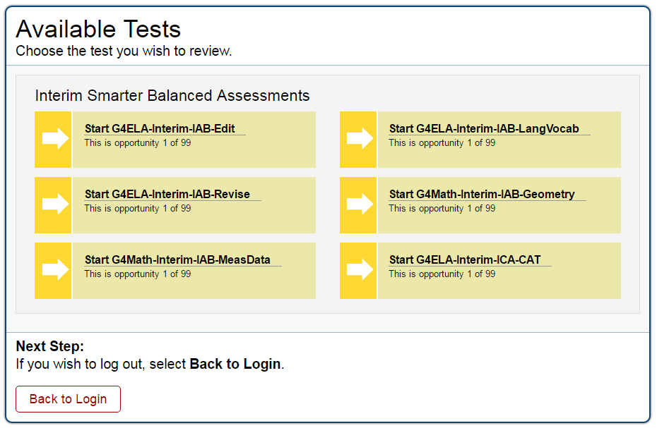
Step 2: Selecting the Test
Notes:
The Available Tests page displays the tests available for the selected grade level. Click the appropriate test name.

Slide 41
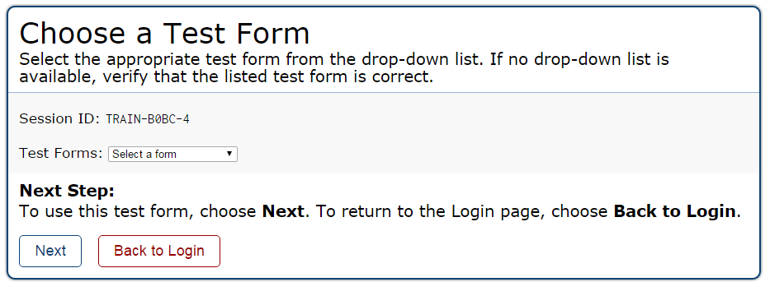
Step 3: Confirming the Test
Notes:
The Choose a Test Form page displays one or more test forms, as well as the Session ID that automatically generates after you select a test.
If the Test Forms drop-down list is available, select the appropriate form. If the drop-down list is not available, verify that the correct test is listed in the Test Forms field.
Click Next. If the test includes audio features, the Sound Check page appears. If the test does not include audio features, the first page of the test appears.

Slide 42
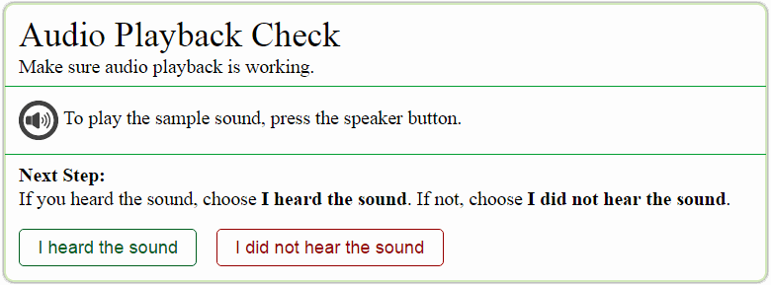
Step 4: Audio Playback Check
Notes:
The Audio Playback Check page allows you to verify the functionality of any audio features that the test may include. To perform the Audio Playback Check:
Unmute the speakers on your computer, if necessary.
Click the speaker icon.
If you hear a sound, click I heard the sound. The first page of the test appears.
If you do not hear a sound, click I did not hear the sound and consult the technology coordinator.

Slide 43
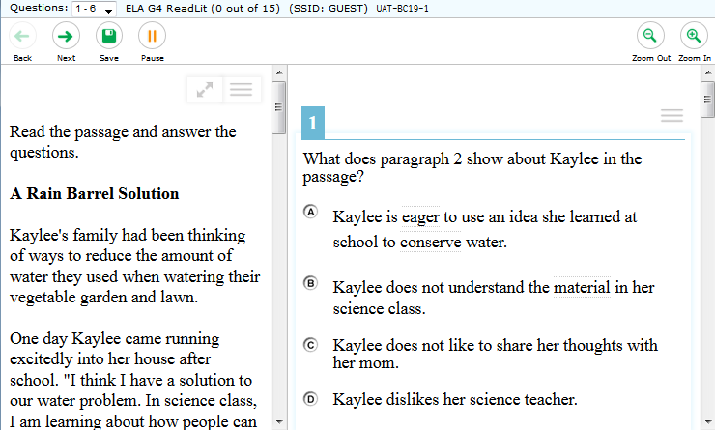
Understanding the Test Page
Notes:
This slide displays a sample test page.
AVA includes several on-screen tools, including global tools and context menu tools.
Global tools are those available on every page in the top banner. These include the Zoom, Pause, Back, and Next buttons.
The context menu displays the tools available for that test item.
For a detailed list of tools, consult your AVA User Guide.

Slide 44
Responding to Items
Notes:
This section describes how to navigate a test, pause a test, and complete a test review.
When viewing a test, you can practice responding to the test items. You must respond to all the items on a page before advancing to the next page. Some pages may have only one item, and others may have multiple items. Any responses you enter will not be scored when you complete the test review.

Slide 45
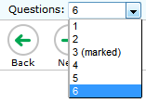
Navigating to Items
Notes:
You can navigate to items page-by-page or jump directly to an item’s page.
To navigate page-by-page, click the Back or Next buttons at the top of the screen.
To jump directly to an item page, select the appropriate item from the Questions drop-down list.

Slide 46
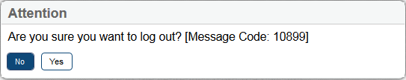
Pausing Tests
Notes:
You may pause the test at any time. Pausing the test automatically logs you out of AVA. To return to the test, you must log back in and select the appropriate test again.
To pause the test:
Click Pause in the top banner. A pause test message appears.
Click Yes to confirm that you want to pause the test.
As a security measure, you are automatically logged out after 20 minutes of inactivity. This also pauses the test.

Slide 47

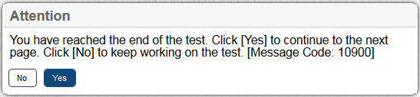
Finishing the Test Review
Notes:
After viewing all the items in a test, the Finished button appears at the top of the page.
When you click Finished, an Attention message appears. Click Yes to complete the test review, or click No to continue reviewing the test.

Slide 48
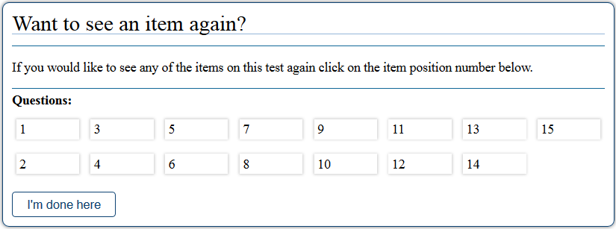
Reviewing Marked Items
Notes:
After confirming in the Attention message, the Want to see an item again? page appears. This gives you one more opportunity to review items. To review items:
Under Questions, click the item number you want to review. AVA displays that item.
You can navigate through the test as you did when initially entering the responses. The Back, Next, Save, Pause, and Finished buttons are all available.
Click Finish to return to the Want to see an item again? page.
To complete the review, click I’m done here.

Slide 49
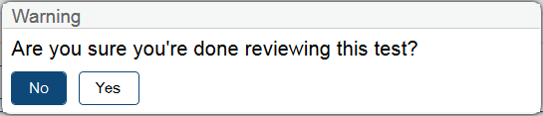
Completing the Review
Notes:
After reviewing the items, AVA displays one last warning message.
The Warning message gives you two options. Click No to return to the Want to see an item again? Page and click Yes to complete the test.

Slide 50
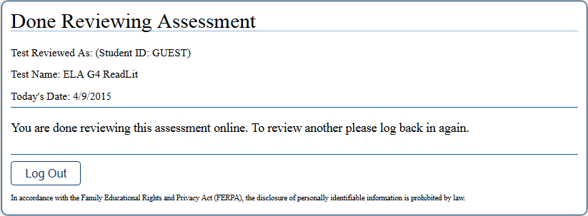
Logging Out
Notes:
The Done Reviewing Assessment page displays a confirmation that the test review is over. Click Log Out to return to the AVA login page.

Slide 51
Section IV. South Dakota Portal
Notes:
Before the training concludes, we want to review some key features of the South Dakota portal.

Slide 52
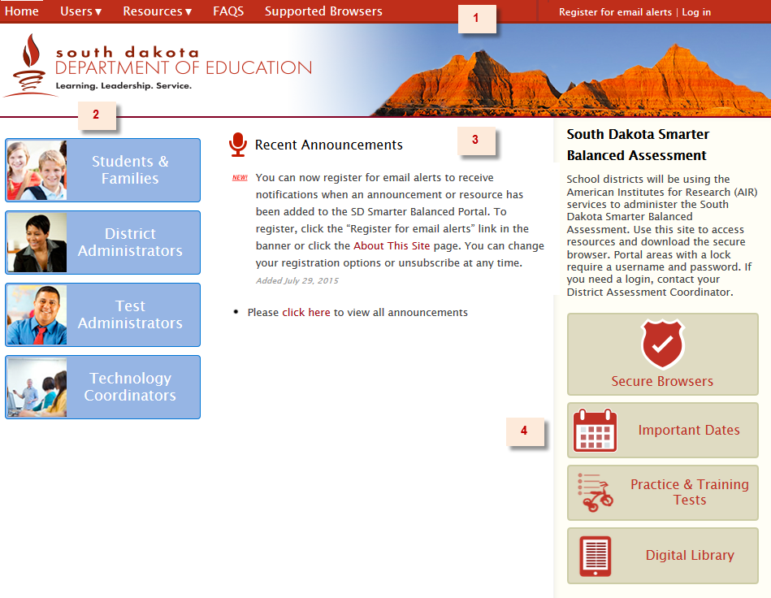
South Dakota Smarter Balanced Assessment Portal
Portal : http://sd.portal.airast.org/
Notes:
The example on the slide is what you see when you access the South Dakota portal home page.
The header (or section 1) contains links to Resources, FAQs, Supported Browser information, and a new option to subscribe for email notification alerts when announcements or resources are added.
The left side (or section 2) contains the user role cards. Individuals can navigate to any page, but some systems are secure will require a valid username or password.
The center (or section 3) contains announcements. New announcements are flagged. Up to five messages will appear on the page and all others are accessible the archive.
The right side (or section 4) contains the links to the Secure Browser, the Important Dates, the Practice & Training Tests, and the Digital Library pages.

Slide 53
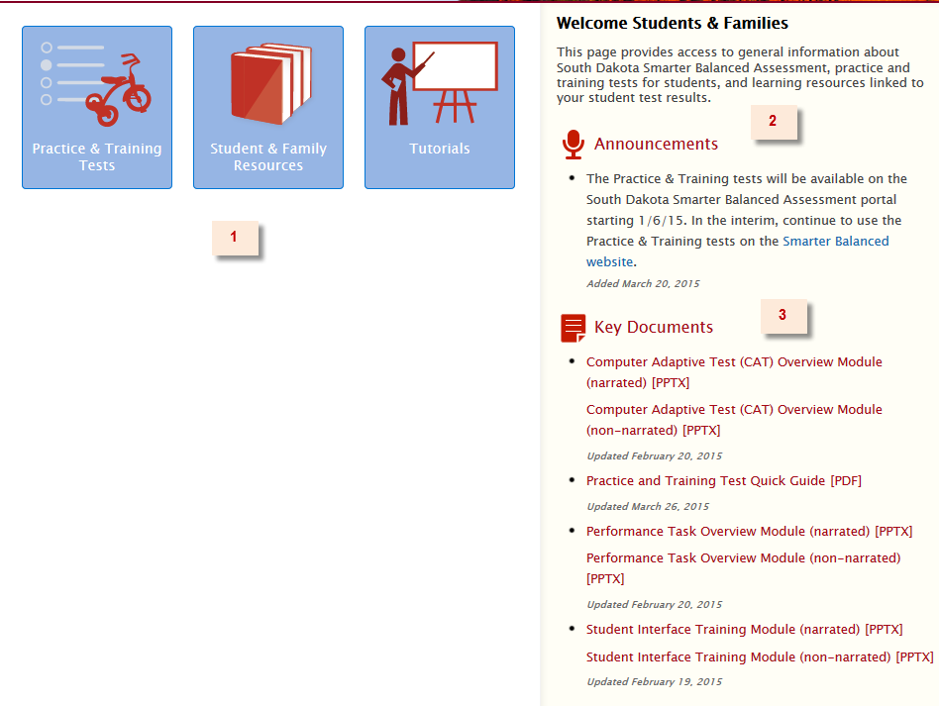
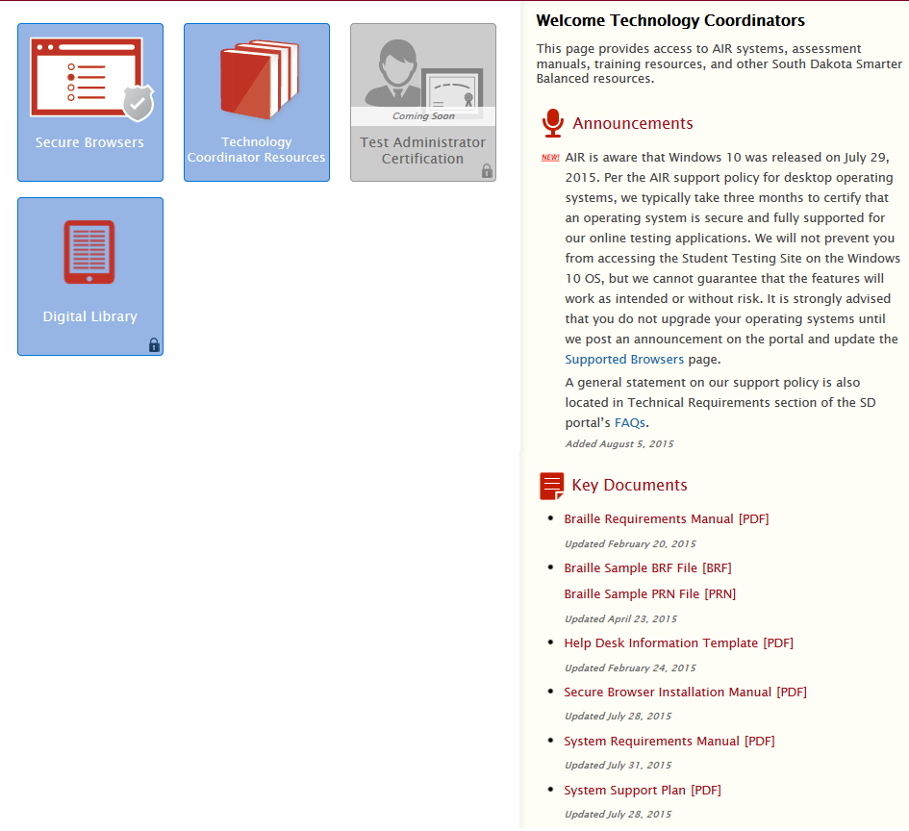
User Home Pages
Students & Families Home Page
Technology Coordinators Home Page
Notes:
This slide provides two examples of the user home pages. The layout is similar for every user.
The left side (or section1) displays cards for systems or resource pages.
The top right side (or section 2) displays announcements that are targeted to the specific user.
The bottom right side (or section 3) displays links to Key Documents along with a last update date.
These documents can also be found in the resources tab.

Slide 54
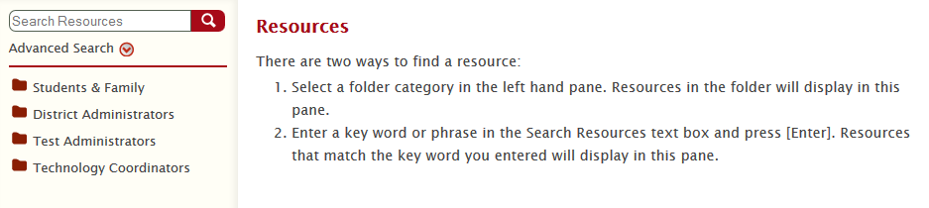
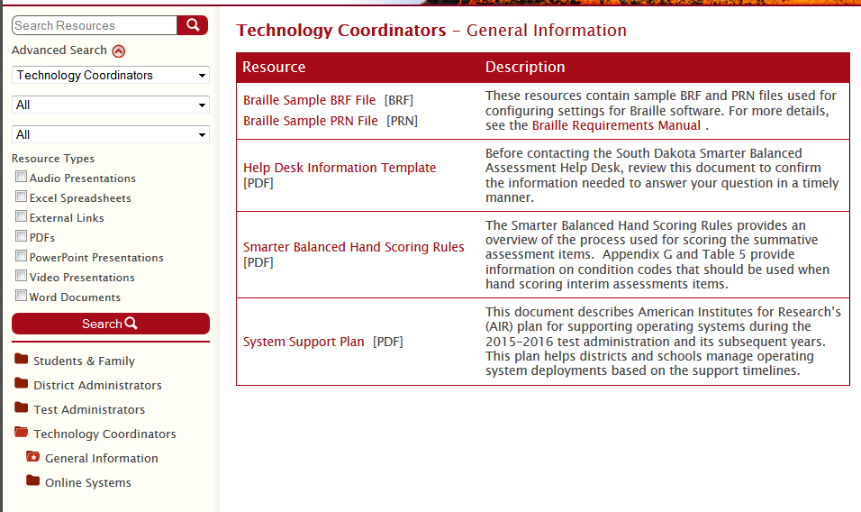
Resources
Sample Resources Page
Notes:
Remember to periodically check the Resources and FAQs.
The resources page contains more documents than what can be shown for users in the Key Documents section on their home page. When navigating to the Resource Page you will be prompted to select a folder category or enter a keyword. You can also filter resources by type such as whether the document is a Power Point, a Training Video, or a Spreadsheet.
Documents related to this system training include:
User Roles and System Access
Test Administrator User Guide
Interim Fact Sheet
Hand Scoring Rules
THSS User Guide
AVA User Guide
Documents for the 2015–16 administration will be labeled with the year and will only be replaced when the revised document for 2017-18 is available.

Slide 55
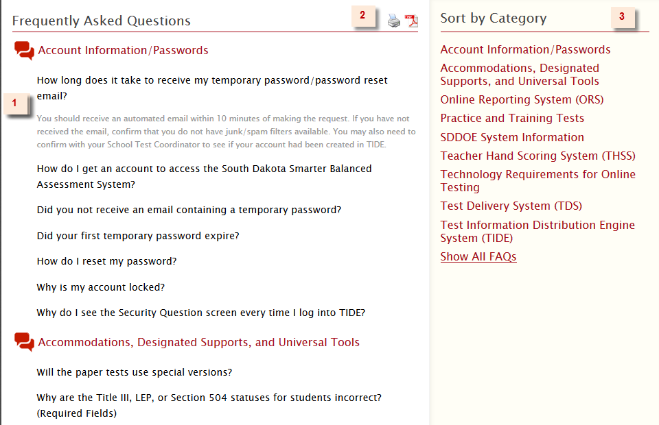
FAQS Page
Notes:
The FAQs page is also a good resource to check when you need a quick answer.
The left side (or section 1) shows the questions included in the category. The answers are revealed when you click on a question.
The center (or section 2) allows you to create a PDF or print the FAQs.
The right side (or section 3) allows you to filter the questions by category or show all questions.

Slide 56
Thank You!
Further Information
South Dakota Portal: http://sd.portal.airast.org/
South Dakota Smarter Balanced Assessment Help Desk
Hours | Monday–Friday 7 a.m.–7 p.m. ET
Phone | 1-855-838-8378
Email | SDHelpDesk@air.org
Notes:
That concludes our presentation on Teacher Hand Scoring System. Contact the Help Desk if you have any additional questions when using the online South Dakota Smarter Balanced Assessment Systems.

