Slide 1
Local Wellness Policy
An Update with the Final Regulation

Slide 2

School Wellness Policy Benefits
School wellness policies allow schools to take an active role in promoting school wellness and preventing obesity. A local policy can be a useful tool in evaluating, establishing, and maintaining healthy school environments.
Additional information and resources will be identified throughout the presentation.

Slide 3
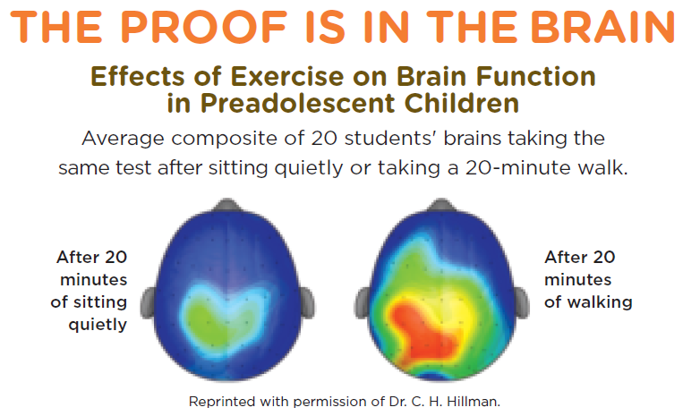
Healthy Students are Better Students!
www.genyouthnow.org

Slide 4

PICKING UP THE TAB: Everybody pays the price when nutrition and physical activity are ignored
http://www.genyouthnow.org

Slide 5
Background
2004: Child Nutrition and Special Supplemental Nutrition Program for WIC Reauthorization Act
2006-2007: LEAs were required to establish a local school wellness policy
2012: Healthy, Hunger-Free Kids Act
2013-14: LEAs are to begin implementing the new requirements
Held accountable for implementation, assessment, and public updates
Final Regulations go into effect on August 29, 2016
LEAs must comply with these requirements by June 30, 2017

Slide 6

Healthy, Hunger-Free Kids Act
Nutrition promotion, nutrition education, physical activity, and other school-based activities
Include nutrition guidelines for all foods
Variety of stakeholders
Inform and update the public
Measure compliance
Designate a school official

Slide 7
Local Discretion
LEAs can determine individual goals based on the needs of their schools
Goals must be evidence-based strategies, that means the strategies you choose have been evaluated, studied, and peer-reviewed.
Law only requires one goal per area:
Nutrition Promotion and Education
Physical Activity
Other School-Based Activities

Slide 8
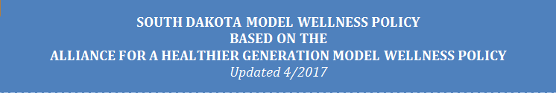
SD Sample Wellness Policy
http://doe.sd.gov/cans/documents/17-SDWell.pdf
Model policy can be used to compare and strengthen your current wellness policy
Word and PDF versions available

Slide 9
Nutrition Education & Promotion
Choose one or more nutrition education and promotion goal(s) for your policy
Some examples from the sample wellness policy:
Student artwork displayed in the service and/or dining areas
Offering contest, surveys, promotions, or taste-testing
Providing information to families to encourage consumption of healthy foods at home
Posting nutrition and health posters

Slide 10
Nutrition Education Resources
MyPlate: www.choosemyplate.gov
Fuel Up to Play 60: www.fueluptoplay60.com
Pick a Better Snack: www.idph.state.ia.us/pickabettersnack
Team Nutrition: http://www.fns.usda.gov/tn/resource-library

Slide 11

Physical Activity
Choose one or more physical activity goal(s) for your policy
Some examples from the sample wellness policy:
Integrating nutrition into health education classes
Promote skill development
Integrating nutrition into core subjects

Slide 12

Physical Activity Resources
Let’s Move! Active Schools: http://letsmoveschools.org
National Heart, Lung, and Blood Institute: http://www.nhlbi.nih.gov/health/educational/wecan/tools-resources/physical-activity.htm
Centers for Disease Control and Prevention: http://www.cdc.gov/physicalactivity/resources/
ChooseMyPlate.gov: https://www.choosemyplate.gov/physical-activity
Fuel Up to Play 60: https://www.fueluptoplay60.com/
Shape America: http://www.shapeamerica.org/

Slide 13
Other School Based Activities
Set specific goals for other school based activities:
Walk or Bike to School
Recess before Lunch
HealthierUS School Challenge
Offer staff wellness training to model a healthy lifestyle
Sponsor health fairs
Incorporate school gardens, Farm to School

Slide 14

Other School-Based Activities
Recess Before Lunch: http://opi.mt.gov/pdf/schoolfood/RBL/RBLGuide2008.pdf
Smarter Lunchrooms: http://smarterlunchrooms.org/
Walk or Bike to School: http://www.walkbiketoschool.org/
Walking Programs: https://www.educateiowa.gov/sites/files/ed/documents/1112_np_sw_WalkingWorksToolkit.pdf

Slide 15
All Food Available on Campus
Standards & nutrition guidelines must be set for all food & beverages provided to students based on school lunch/breakfast meal pattern requirements and Smart Snack requirements
Food Sold to Students:
School Meals
A La Carte Foods
Foods Sold Outside the Meal
Food Given to Students:
Sharing of Foods
Fundraising Activities
Snacks
Rewards
Celebrations

Slide 16
Food Based Marketing
Policy must include permitting the marketing of only those foods and beverages that are consistent with the Smart Snacks standards
Limits the marketing of food and beverages on the school campus during the school day of only those foods and beverages that meet the nutrition standards under the Smart Snack requirements
Does not apply to marketing that occurs at events outside of school hours

Slide 17

Marketing Examples
Applies to:
Does not apply to:
Exterior of vending machines
Posters
Menu boards
Coolers
Trash cans
Cups used for beverage dispensing
Personal clothing
Personal items
Packaging of products brought from home
Educational tools

Slide 18

Local Wellness Policy Process
Assembling Your Team
Needs Assessment
Development
Implementation
Monitoring
Reporting to the Public

Slide 19
Assembling the Team
Certain groups must be permitted to participate in the policy development, implementation, review, and updates.
Physical Education Teachers
School Health Professionals
Parents
Students
Food Service
School Board
School Administrators
Public
Maintain documentation of notifying stakeholder’s ability to participate
District-wide email, flyers, etc.

Slide 20
Needs Assessment
Conduct an assessment of the policy, at least every 3 years
The results of the assessment must be made available to the public
Assessment should determine:
Compliance with the LWP
How the LWP compares to model LWPs
Progress made in attaining the goals of the LWP

Slide 21
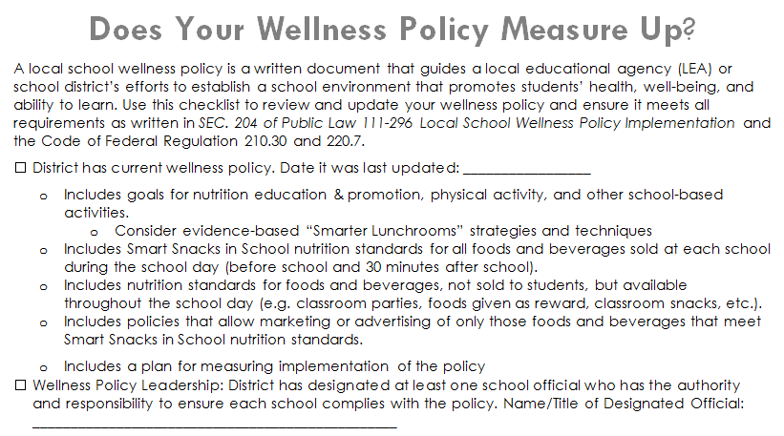
Does Your District Wellness Policy Measure Up?
A checklist to review and update your wellness policy and ensure it meets all requirements is available on the CANS NSLP website (http://doe.sd.gov/cans/nslp.aspx) under the Wellness Policy section.

Slide 22

Needs Assessment
USDA Example implementation tools – Wellness Resources
https://healthymeals.fns.usda.gov/local-wellness-policy-resources/local-school-wellness-policy-process/assessment-needs-assessment
Alliance for a Healthier Generation –Healthy Schools Inventory
https://schools.healthiergeneration.org/
Centers for Disease Control –School Health Index
http://www.cdc.gov/healthyschools/shi/index.htm
Fuel Up to Play60 –School Wellness Investigation
https://www.fueluptoplay60.com/tools#tab_school-wellness-investigation
Evidence-based strategies to establish wellness goals:
https://healthymeals.fns.usda.gov/healthierus-school-challenge-resources/smarter-lunchrooms)

Slide 23
Implementation & Monitoring
Goal | Activities | Lead | Actions | Results | Next Steps
Nutrition Education links with School Meal Programs | Food Service Director will present during staff in service meeting | Mrs. Apple | Food Service Director presented at 8/10/2016 meeting & shared classroom lessons and activities connected to school lunch | Teachers incorporated school meals in their lessons and documented frequency 2016-17 | Based on schedule invite classrooms to visit the food service kitchen or have the food service director visit classrooms
LEAs must update or modify the policy as appropriate
Reports can be monthly, quarterly, annually, etc.
Reinforce the policy goals with school staff
Ensure that new policies are successfully implemented
Assess how well the policy is being managed
Recognize policy success
Update and amend the policy as needed

Slide 24

Recordkeeping
LEAs must maintain records to document compliance.
The written local school wellness policy
Documentation demonstrating compliance with community involvement
Documentation of the triennial assessment
Documentation of public notification

Slide 25
Reporting to the Public
LEAs must inform the public annually about:
The content and implementation of the policy
The assessments
The progress made in attaining the goals of the local wellness policy
Any updates to the policy
Notices in the school newsletter, parent communications, etc.
Electronic posting and distribution is allowable

Slide 26
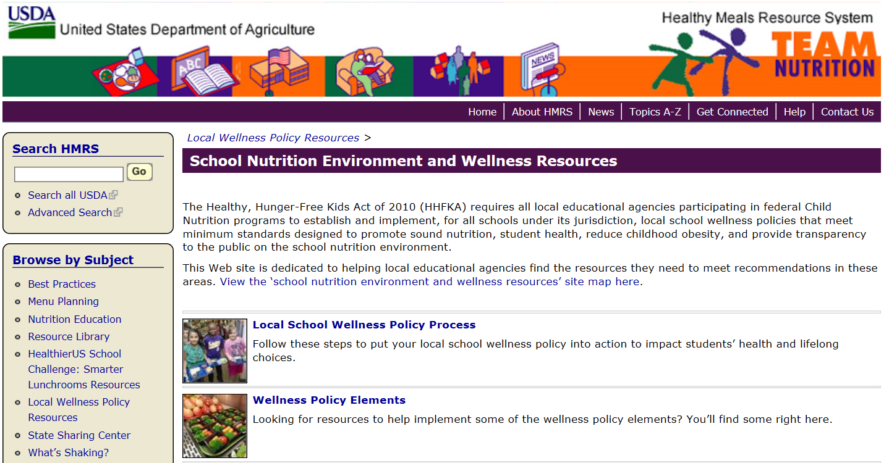
More Wellness Resources: Team Nutrition
http://healthymeals.nal.usda.gov/school-wellness-resources

Slide 27
State Agency Review Process
3 year review cycle, SD is operating under a 5-year waiver until SY 2018-19
The District/Agency keeps the following on file:
A copy of the current Local School Wellness Policy
Documentation demonstrating the policy and most recent assessment has been made available to the public
Documentation of the district’s efforts to review and update the Local School Wellness Policy
Including who is involved (list of invites, sign-in sheet)
Methods the district uses to make stakeholders aware of their ability to participate
A copy of the district’s most recent assessment

Slide 28
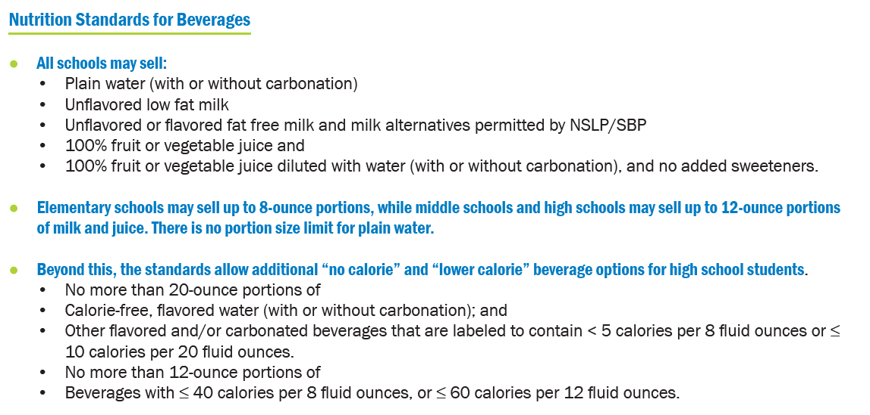
Smart Snack Requirements Beverages

Slide 29
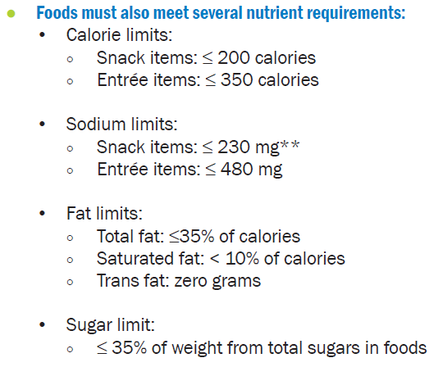
Smart Snack Requirements Food

Slide 30
Local School Wellness Policy Additional Resources
Local School Wellness Policy Final Rule
http://www.fns.usda.gov/school-meals/fr-072916c
Local School Wellness Policy Summary of Final Rule
http://www.fns.usda.gov/tn/local-school-wellness-policy-summary-final-rule
USDA Team Nutrition LWP Implementation Tools and Resources
http://www.fns.usda.gov/tn/implementation-tools-and-resources
Team Nutrition Toolkit
http://www.fns.usda.gov/tn/local-school-wellness-policy-outreach-toolkit
Includes communication tools for administration, parents, school staff, social media
Additional information & resources:
USDA FNS Local School Wellness Policy website http://www.fns.usda.gov/tn/local-school-wellness-policy
CDC Local School Wellness Policy website http://www.cdc.gov/healthyschools/npao/wellness.htm
Alliance for a Healthier Generation Model policy can be found: https://www.healthiergeneration.org/_asset/1xlv2y/Model-Wellness-Policy-USDA_CDC-Comments-2016-09-02-FINAL.docx
USDA LWP Resources website: https://healthymeals.fns.usda.gov/school-wellness-resources

Slide 31

Local Wellness Policy: Final Regulation Update Training Credit
This training credits for 30 minutes of training in
Key Area: 4000 Communications & Marketing
Child & Adult Nutrition Services
This institution is an equal opportunity provider.

Slide 32
Questions?
Email questions to CANS: DOE.SchoolLunch@state.sd.us
Use “Local Wellness Policy question” in the subject line
Phone: 605-773-3413
Fax: 605-773-6846

