Slide 1
Verification
Reporting on Verification Form 742
Child and Adult Nutrition Services – DOE
SY 2018-2019
This institution is an equal opportunity provider
Notes:
The following webinar will discuss reporting verification activities for the National School Lunch Program.
As a friendly reminder, please mute your phones during the webinar.

Slide 2
Verification Summary Report
Verification Collection Report (Form 742)
Can be submitted any time after completion of Verification – via iCAN
CANS submits data to USDA by school name
Due to CANS by
November 15
Notes:
Before we get into the different areas of the form, we will spend a little bit of time discussing the reporting basics, which include due dates, what to report, and what happens with data that is reported.
The reporting form is known as the Verification Collection Report, or the 742. The form is due to the CANS office by November 15. The form can be submitted to the CANS office any time after verification activities are completed.
Please note: SFA staff who currently have access to add and/or modify applications and/or claims have access to the Verification Report. If the person entering verification information does not have these security rights, you have a few options:
The SFA can submit a revised New User Request form for the person’s id if they have other accesses in iCAN; for example, access to Food Distribution only.
The person completing verification can prepare the report on paper and then have someone with access enter the data into the iCAN report. The template can be found on the CANS/NSLP webpage in the Numbered Memos section. PLEASE DO NOT SUBMIT THIS TO CANS-VERIFICAITON DATA MUST BE ENTERED INTO iCAN.
Submit a New User Request form for the person-remember, they must have access to add and/or modify applications and/or claims.
The CANS office complies the data from the schools and submits the information to USDA, organized by school name.

Slide 3

Verification Summary Report
Number of Applications
  Free and Reduced only
Number of Students on applications
  Free and Reduced only
Number of applications verified
Method of Verification used:
  Standard
  Alternate1
  Alternate 2
Notes:
School Food Authorities, or SFAs, will be asked to report:
The number of free and reduced price applications
The number of free and reduced price eligible students found on applications
The number of applications that were verified
Method of Verification that is used
For a quick refresher regarding the verification methods,
Standard Method includes verifying 3% of all approved applications, with first preference on the error prone applications
Alternate 1 includes verifying 3% of all approved applications, with a random selection from all applications
Alternate 2 includes verifying 1% of all approved applications - selected from error prone applications, plus one-half percent of all approved applications that provided a case number on the application

Slide 4
Verification Summary Report
Results of Verification Process
  Report number of applications verified on number of children on those applications
Break down into:
  Categorically eligible free
  Income eligible free
  Eligible reduced-price
Report as no change, benefits went up, benefits went down, did not respond
Notes:
The Verification Summary Report can look intimidating, so lets’ take it one section at a time.
With the applications that are verified, you will be asked to break down the information into categorically eligible free, income eligible free, and income eligible reduced.
As a reminder, categorically eligible free simply identifies the applications in which a case number is provided. As discussed in the process PowerPoint, these applications with case numbers should only be considered if the student featured on the application is NOT found on a direct certification list.
Income eligible free applications identify the households that are eligible for free benefits.
Income eligible reduced price applications identify households that are eligible for reduced price benefits.
The reported information will be the results of the verification activity. For example, how many applications had no change of benefit status, how many instances occurred where benefits were increased and decreased, and how many instances did the participant not respond.

Slide 5
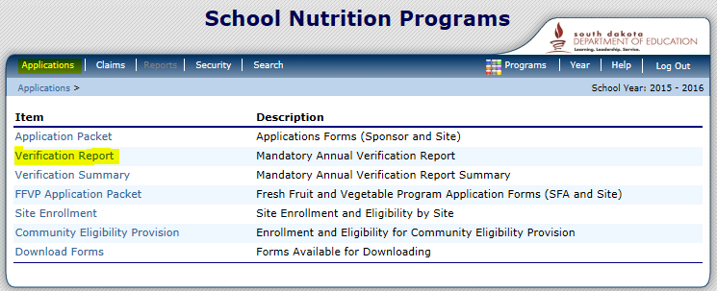
Verification Summary Report in iCAN
Notes:
Beginning with SY15-16, the Verification report will be completed within the iCAN system. You can find the form by logging into iCAN and clicking on Verification Report under the Applications bread crumb.

Slide 6
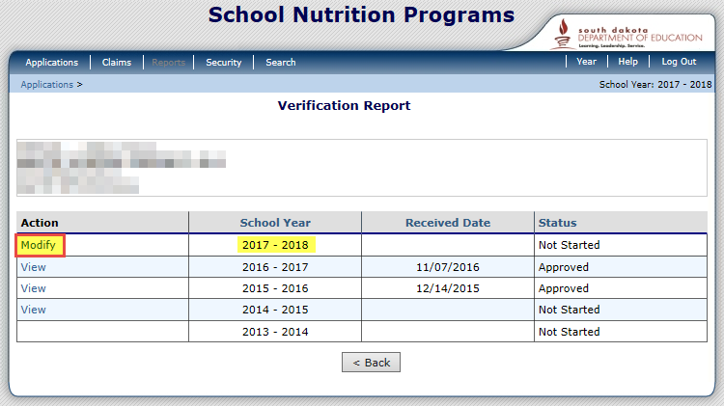
Verification Summary Report in iCAN
Notes:
Clicking on the Verification Report link will bring you to this screen. Click Modify to the left of School Year 2018-2019. This will take you into the report form.

Slide 7
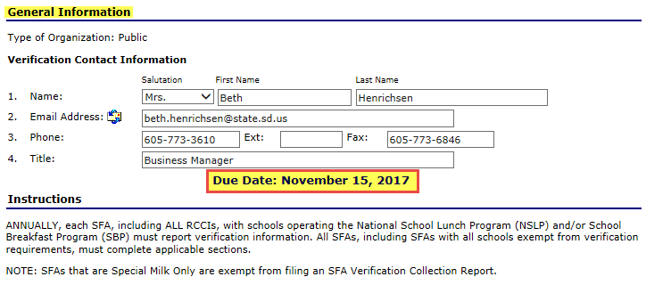
General Information
Notes:
Now, we will get into looking at the actual form.
The top of the report features a section to fill in General Information about the SFA.
This information should prefill
Please review to ensure the correct information is in each field
Update if needed
We really want the contact information for who we should contact with questions about the report.

Slide 8
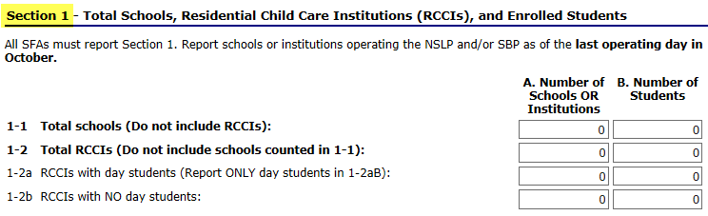
Section 1
Total Schools, RCCIs, Enrolled Students
Notes:
Let’s start with Section 1:
Question 1-1 asks for the number of schools in letter A.
Please enter the number of actual attendance centers as indicted in your site applications
As a reminder, if you are a K-12 school district and house all program participants within a single building, the number of schools to record in letter A depends on how your sites are listed in your SNP application
Letter B of Question 1-1 asks for the number of students that have access to the program
If you are not an RCCI, leave the rest of section 1 blank
Only RCCIs will fill out question 1-2.
RCCI’s complete the number of centers in 1-2, column A
RCCI’s, answer 1-2a if you have day students; Answer 1-2b if do not have day students
Again, we will record the number of schools in column A, and the number of students that have access to the program in column B

Slide 9
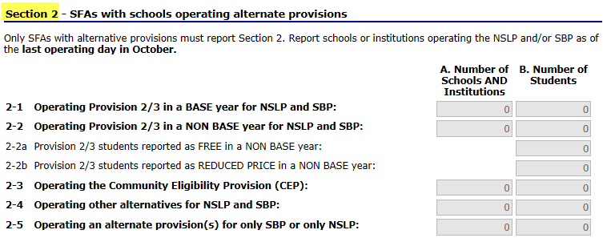
Section 2
SFAs with Schools Operating Alternate Provisions
Notes:
Now we will talk about Section 2.
If your SFA does not operate under a special provision, such as Provision 2, Provision 3, or the Community Eligibility Provision (CEP), you can leave this section blank.
For those that do operate one of the previously listed provisions, this section will be completed.
Answer question 2-1 if you are in a provision 2 or provision 3 base year.
As we described in section 1, please enter the total number of schools in column A, and the total number of students in column B.
As a reminder, if you are a K-12 school district and house all program participants within a single building, the number of schools or institutions to record in letter A depends on how your sites are listed in your SNP application
If you are not in a base year, leave this question blank, and go to question 2-2.
In question 2-2, SFAs that are beyond their base year for provision 2 and 3 will answer.
As we described in section 1, please enter the total number of schools in column A, and the total number of students in column B.
In question 2-2a, report the number of students that are considered Free.
In question 2-2b, report the number of students that are considered Reduced.
For both 2-2a and 2-2b, the SFA will need to apply your percentages to your total enrollment as of October 31st.
In question 2-3, only respond if you are operating the Community Eligibility Provision (CEP).
As we described in section 1, please enter the total number of schools operating CEP in column A, and the total number of students among the CEP sites in column B.
Question 2-4 is specific to Provision 1 and Universal Free, which is not currently being operated in South Dakota. Please leave this question blank.
Question 2-5 is specific to schools that are operating a provision option for only SBP or only NSLP, which is not currently being operated by any SFA in the state. Please leave this question blank.

Slide 10
Section 3
Students Approved Free and Not Subject to Verification
A notice or listing was received directly from:
  Department of Social Services
    SNAP or TANF benefits
  Food Distribution Program on Indian Reservations
    FDPIR benefits
  Certified as eligible for homeless, migrant, runaway, head start
Notes:
Section 3 asks for information regarding Direct Certification.
Directly certified students are those students who are directly identified by a State agency or program coordinator to receive benefits.
Documentation for students that are homeless, migrant, runway, foster, and head start must be on file prior to certifying the child’s eligibility for free meals
Once documentation is on file, these children are now considered directly certified, and you would report them accordingly
Direct Certification supersedes all other forms of eligibility
If a household filled out a free/reduced application, but appears on a direct certification list from iMATCH, the students listed on the application are considered directly certified

Slide 11
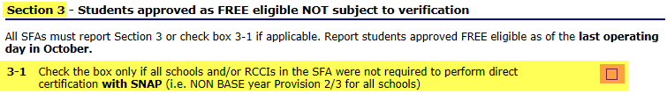
Section 3 – continued
Students Approved Free and Not Subject to Verification
All SFAs must complete this section
Students approved as directly certified free eligible are not subject to verification
Check 3-1 if all sites in the SFA were not required to perform direct certification with SNAP
Report students approved as FREE eligible as of the last operating day in October
Notes:
All SFAs must complete Section 3.
As a reminder, students approved as directly certified FREE eligible are not subject to verification.
If all schools within the SFA were not required to perform direct certification with SNAP, click the box for question 3-1, and leave the rest of Section 3 blank.
This applies only to SFAs that are beyond their Provision 2 or 3 base year.
Report students approved as FREE eligible as of the last operating day in October
We will continue with Section 3 in more detail on the next slide.

Slide 12
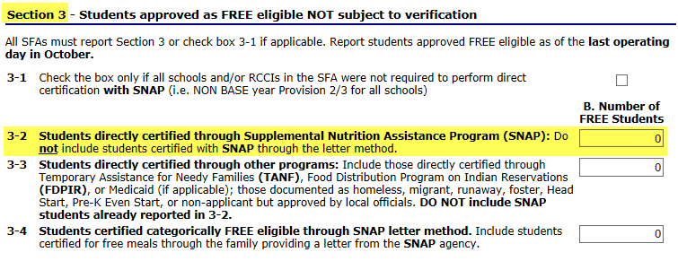
Section 3 – continued
Count Students Directly Certified SNAP Eligible.
Notes:
If you are setting a Provision 2 or 3 base year, or do not operate under a special provision, the rest of Section 3 must be completed.
First, we will look at Question 3-2.
In question 3-2, report the total number of students within the SFA that are directly certified as SNAP eligible.
Students to be counted would include:
Students found on iMATCH listed to be SNAP eligible
Direct notification of a students benefits from the SNAP (DSS) office
As a reminder, do not include students in this count in which a household provided a SNAP letter; this will be specifically reported later
If a student is directly certified with SNAP as well as with another program (for example, TANF or eligible homeless), include the student in the SNAP count in Question 3-2. This would also include any student in the SFA approved as eligible based on extended certification through an eligible student in the primary household who has been directly certified with SNAP.
DO NOT include SNAP letter method certifications in this SNAP count. Report these students in Question 3-4. (SNAP letter method certification means the family submits a letter from the SNAP agency to document receipt of SNAP benefits. This is not considered direct certification and is rarely used.)

Slide 13
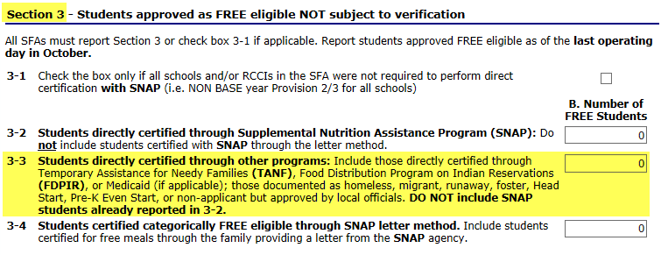
Section 3 – continued
Count Students Directly Certified through other Programs
Notes:
Next, Question 3-3.
In question 3-3, report the total number of students within the SFA that are directly certified though other programs.
This would include TANF, FDPIR, and those with documentation to be eligible for homeless, migrant, runaway, foster, or head start
Do not include SNAP students already reported in question 3-2
Remember, the SFA must have documentation from a State office or program coordinator that a student is eligible for the program to consider the student as directly certified.
Additionally, appropriate documentation must be on file for homeless, migrant, runaway, and head start students prior to providing free meals.

Slide 14
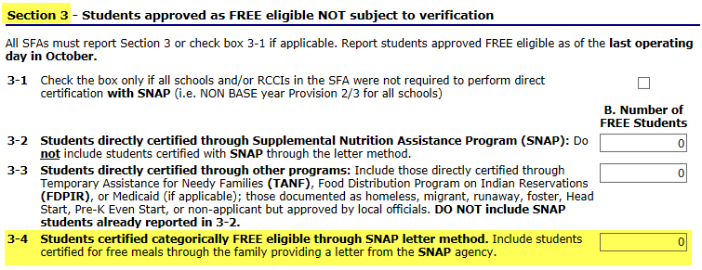
Section 3 – continued
SNAP Letter or Notice from Family
Count students with SNAP letter method
  Considered as categorically eligible
Notes:
Next, Question 3-4.
In question 3-4, report the number of students in which a SNAP letter or notification of benefits was provided, in lieu of filling out a household application.
Include ONLY students certified as categorically free eligible based on a letter submitted by family from the SNAP agency.
Include students in the SFA that are approved as eligible due to extended categorical eligibility of an eligible student in the primary household certified as free categorically eligible with the letter method with SNAP; please note, this is rarely used.
As a reminder, this is not considered as a form of direct certification.
If a household provides a SNAP letter in lieu of filling out an application, the student is to be considered as categorically eligible, and is considered in the verification pool, until the student is directly certified by documentation provided by a State Office or program coordinator.

Slide 15
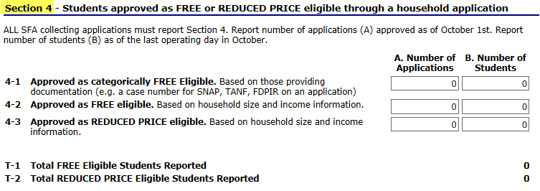
Section 4
SFAs with schools and/or RCCIs collecting household applications must report this section
Includes schools/RCCIs in Provision 2/3 base year
Notes:
Next, we will take a look at Section 4.
Section 4 deals with Household applications.
All SFAs with schools and/or RCCIs collecting individual household applications must report this section.
This includes schools and/or RCCIs in a Provision 2/3 base year.

Slide 16
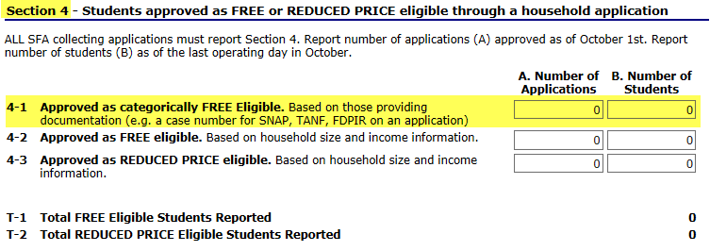
Section 4 – continued
Household Applications
Notes:
Let’s start with Question 4-1,
In Column 4-1A, report the number of applications approved free eligible based on documentation submitted on an application (for example, case number for SNAP, TANF, or FDPIR on an application). Remember to use the number of applications as of October 1.
In Column 4-1B, report the number of students as of the last operating day in October approved free eligible based on documentation submitted on an application (for example, case number for SNAP, TANF, or FDPIR on an application). Additionally, also include students in the SFA who are eligible due to extended categorical eligibility through this method - an eligible student in the primary household categorically FREE eligible with SNAP, TANF, or FDPIR.
As a reminder, please note that if a household application is submitted, and the student also appears on a direct certification list, the student is considered as directly certified, and the application is disregarded. However, please keep the application for recordkeeping purposes. The student would be reported in section 3 – the direct certification section; the household application no longer needs to be reported.
For question 4-1, only report applications and students in which a case number is provided on the application in lieu of income, and the student(s) on the application are not directly certified (not on direct certification list, and no other documentation from a State office is on hand).
We will continue Section 4 on the next slide.

Slide 17
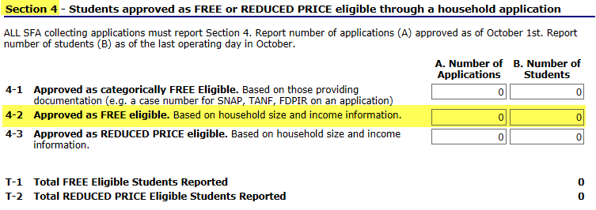
Section 4 – continued
Household Applications
Notes:
In question 4-2, for column A, you are to report the number of applications approved free eligible based on income information submitted by the household on file as of October 1.
In question 4-2, for column B, you are to report the number of students as of the last operating day in October approved FREE eligible based on income information submitted by the household.

Slide 18
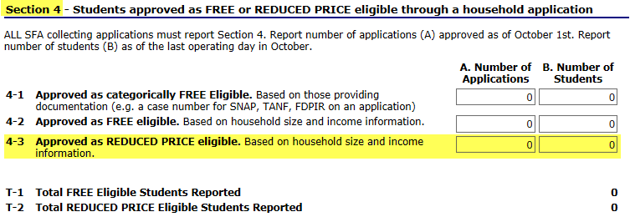
Section 4 – continued
Household Applications
Notes:
For question 4-3, column A, report the number of applications approved REDUCED PRICE eligible based on income information submitted by the household on file as of October 1.
For question 4-3, column B, report the number of students as of last operating day in October approved REDUCED PRICE eligible based on income information submitted by the household.

Slide 19
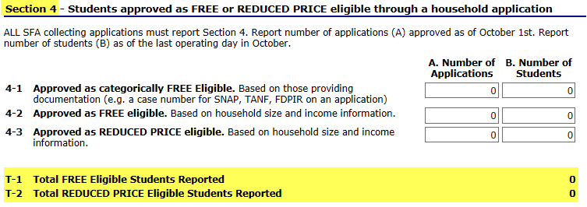
Section 4 – continued
Notes:
The final part of section 4 is at the bottom of the section, T-1 and T-2.
In T-1, the total number of students reported as FREE eligible [(3-2B) + (3-3B) + (3-4B) + (4-1B) + (4-2B) + (2-2aB, if applicable)] will be added by the system.
In T-2, the total students reported as REDUCED PRICE eligible [(4-3B) + (2-2bB, if applicable)] will be added by the system.
These areas should automatically add, however, it is good practice to do a quick edit-check, and make corrections, if needed.

Slide 20
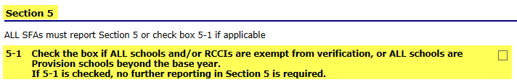
Section 5
If sites within the SFA are exempt from verification, check box 5-1 and no further reporting is required
Notes:
If ALL schools and/or RCCIs in the SFA are exempt from verification activities, check box 5-1 and no further reporting is required in Section 5. Click the red Save button at the bottom of the screen.

Slide 21
Section 5 – continued
Verification activities are NOT required for:
  SFAs where all children have been certified under direct certification
  Community Eligibility Provision (CEP)
  RCCIs that do not have day students
  Schools participating only in the Special Milk Program
  All schools are Provision 2/3 schools in a non-base year
  Schools which do not have any free or reduced price eligible students
  Other FNS determined exemptions on a case-by-case basis
Notes:
Verification activities are NOT required for:
schools/RCCIs in which all children have been certified under direct certification procedures including children documented as eligible foster, migrant, runaway or homeless children
RCCIs that do not have day students
schools electing the Community Eligibility Provision (CEP)
schools participating only in the Special Milk Program
all Provision 2/3 schools in a non-base year
schools which do not have any free or reduced price eligible students
other FNS determined exemptions on a case-by-case basis
Section 5 will continue in the coming slides.

Slide 22
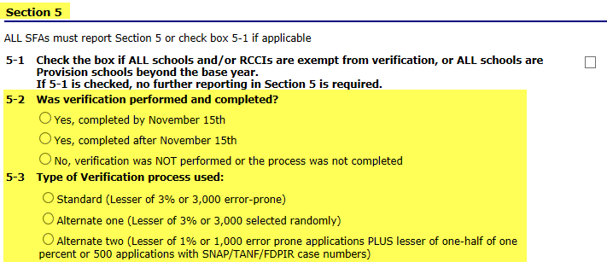
Section 5 – continued
Notes:
In 5-2: Indicate whether verification was performed and completed by the deadline of November 15. If verification was completed after the deadline, report the remainder of Section 5 as applicable. Contact Child & Adult Nutrition Services if verification was not performed or completed and should have been.
In 5-3: Check the method type of verification process used.
As a reminder, if the non-response rate from the previous program year’s verification was 20% or greater, the Standard method of verification must be used
Section 5 will continue on the next slide.

Slide 23
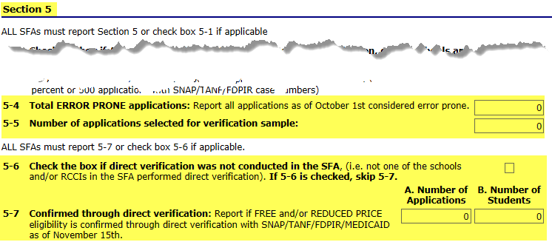
Section 5 – continued
Notes:
If radio buttons 1 or 3 are checked in Question 5-3, report 5-4. If radio button 2 is checked in Question 5-3, leave 5-4 at 0.
If you are to answer 5-4: Report the number of error-prone applications approved as of October 1.
As a reminder, error prone applications have a monthly income within $100 of an eligibility lane change, or annual income within $1,200 of an eligibility lane change from the income eligibility guidelines
For 5-5: Enter the total number of applications initially selected, in accordance with the verification method indicated in 5-3.
Do not report applications that were verified for cause in this question
For 5-6: Check the box if direct verification was not conducted in the SFA.
Direct verification is using records from public agencies to verify income and/or program participation. If direct verification is not used, check 5-6, and skip to 5-8
Only answer 5-7 if direct verification was used to complete verification activities.
For 5-7A: Report the number of applications that are confirmed through direct verification.
For 5-7B: Report the number of students that are confirmed through direct verification.
These numbers ARE NOT direct certification numbers. Please remember that direct verification and direct certification are different processes.
More information about direct verification can be found on page 109 of the eligibility manual.

Slide 24
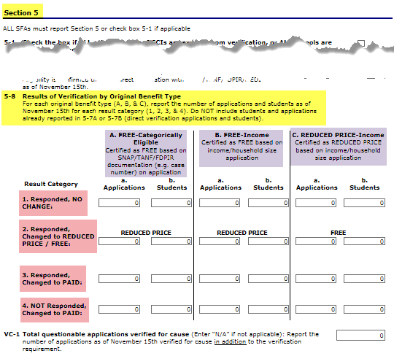
Section 5 – continued
Results
Notes:
In 5-8, you will report the Results of Verification by Original Benefit Type
Report applications and students verified by November 15 in the appropriate category.
If Direct verification was used, do not report the direct verification results in 5-8
There are three sub-sections
A: FREE-Categorically Eligible (applications originally approved free with a case number),
B. FREE-Income (applications originally approved free based on income and family size), and
C. REDUCED PRICE-Income (applications originally approved as reduced-price based on income and family size).
Based on how an application was originally approved will determine which sub-section results will be reported in.
For example, if an application selected for verification was originally approved for reduced-price eligibility, the results of this application will be reported in sub-section C – Reduced Price Income
The final results of verification will determine which result category the application and students from the application are reported in
Additionally, report the results of verification for cause by original benefit type in the appropriate category in 5-8.
We will discuss this more later
Responded, changed to paid means the household provided sufficient documentation. This includes verbal or written notification that the household declines benefits.
NOT Responded, changed to paid means the household did not provide sufficient documentation or the household did not provide a response.
To be continued on the next slide.

Slide 25
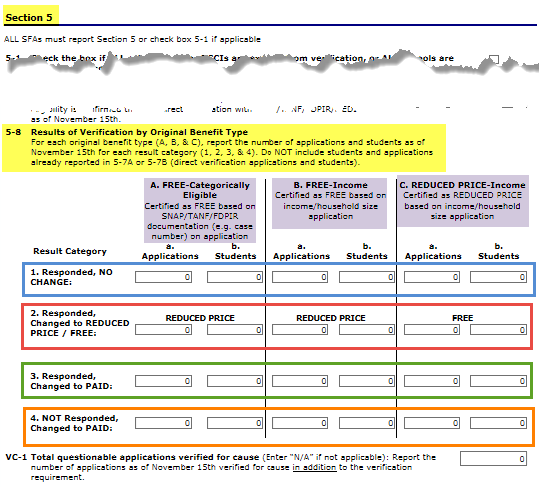
Section 5 – continued
Results
Notes:
As a reminder, you are to report applications based on their original eligibility determination.
First, observe the original eligibility determination prior to verification activities for the verified application.
Next, within section 5-8, locate the sub-set with the corresponding original eligibility determination of the application. The sub-sets are highlighted on the current slide for convenience purposes.
To determine which result category to report the application in, consider the ending result of verification activities for the application.
If the household responded, and verification activities resulted in no change of benefits, choose number 1 of the original eligibility subset for reporting the application (for training purposes, the no change of benefits sections have been identified with a blue border on the current slide)
If the household responded, and verification activities resulted in an increase of benefits, choose number 2 of the original eligibility subset for reporting the application (for training purposes, the increase of benefits sections have been identified with a red border on the current slide)
If the household responded, and verification activities resulted in the identification of paid status, choose number 3 of the original eligibility subset for reporting the application (for training purposes, the increase of benefits sections have been identified with a green border on the current slide)
If the household did NOT respond, and status was changed to paid, choose number 4 of the original eligibility subset for reporting the application (for training purposes, the increase of benefits sections have been identified with an orange border on the current slide)
Include results from verification for cause in Section 5-8.
Verification for Cause will be further discussed on the following slide.

Slide 26
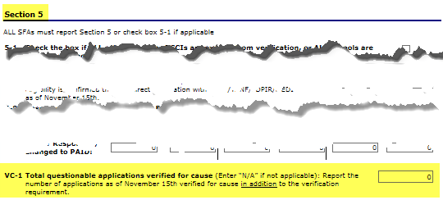
Section 5 – continued
Notes:
For Verification for Cause,
Report the number of applications as of November 15th that were verified for cause in addition to the verification requirement.
Additionally, report the results of verification for cause by original benefit type in the appropriate category in 5-8.
Follow the same procedures as previously discussed with applications selected for the verification process
Report the results, including both applications and students, from applications verified for cause in section 5-8, and additionally include the number of applications verified for cause in VC-1
For example, if the SFA selected 1 application with 2 students to verify for cause, you would report the 1 application and the 2 students in the appropriate category in 5-8, along with the rest of verification activity; additionally, you would indicate 1 application was verified for cause in VC-1 by entering the number ‘1’

Slide 27

Verification Report
Questions and Answers
Each Verification Summary report must be edit checked by CANS personnel
Work together until all edit checks are completed satisfactorily
The SFA must complete verification, complete the established required sample pool, and submit report to CANS
Notes:
Upon receiving the verification report, a CANS program specialist will edit check the report, and contact the verifying official, if needed.

Slide 28
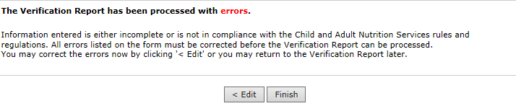
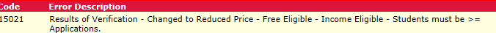
Remember to…
Save your Verification Report once it is completed
If you missed something, you should see this message when you click save:
When you click Edit, the Error(s) will be listed at the top of the screen:
Once all information is entered, you should no longer see error messages
Notes:
Remember to
Save your Verification Report once it is completed
If you missed something, you should see an error message when you click save: The Verification Report has been processed with errors...
You can click on Edit to go back and complete
When you click Edit, the errors will be listed at the top of the screen
Once all information is entered, you should no longer see these error messages

Slide 29
Quick Edit Check
The electronic report should do the math for you
  However, it’s still good to double check some numbers
The number of applications reported should never be greater than the number of students reported
Notes:
For a couple quick edit checks:
The Number of applications reported should never be greater than number of students reported.

Slide 30

Quick Edit Check – continued
T-1 should add up to the total of:
  (3-2B) + (3-3B) + (3-4B) + (4-1B) + (4-2B) + (2-2aB, if applicable)
T-2 should add up to the total of:
  (4-3B) + (2-2bB, if applicable)
Notes:
T-1 and T-2, found at the end of section 4, should add up accordingly.
T-1 should add up to the total of:
(3-2B) + (3-3B) + (3-4B) + (4-1B) + (4-2B) + (2-2aB, if applicable)
T-2 should add up to the total of:
(4-3B) + (2-2bB, if applicable)
The system should calculate this math, but it doesn't hurt to make sure it’s correct!

Slide 31

Questions?
Do I do one?
  Yes! Everyone submits a Verification report
    The information you report varies depending upon your agency and applications
Other questions?
Notes:
If you’re wondering if you have to complete a Verification report, the answer is Yes!
Everyone submits a Verification report.
The information you report varies depending upon your agency and applications.
Other questions?
Please remember-SFAs who have already submitted your verification report: please double check the numbers of applications after the last operating day in October. Some sections of the verification report are reported as of October 1 and some are the last operating day in October.

Slide 32
Verification Process
Professional Standards Training Credit
This training credits as 30 minutes of training in
Key Area: Administration
3100: Free and Reduced Priced Meal Benefits.
Name:
Date of Training:

Slide 33

Questions?
Questions Later? Contact us!
  Email: doe.schoollunch@state.sd.us
  Phone: 605-773-3413
Notes:
We can be reached by email at DOE.SchoolLunch@state.sd.us or by phone at 605-77-3413.
Thank you.

