Slide 1
Office of Assessment
New Assessment Coordinator Workshop
August 30, 2018

Slide 2
Overview of Workshop
General Testing Expectations
NAEP
Home School
ACCESS 2.0
Smarter Balanced
MSAA
Science & Science Alt
SDAP & EOC

Slide 3
First Contacts for Support
Melissa Flor – administration of MSAA and Science Alt
Beth Schiltz – accommodations
Yutzil Becker – EL and ACCESS 2.0
Chris Booth – Science and Science Alt & SDAP
Joe Moran – Smarter Balanced Assessments
Chris Booth– Home School
Jeff Hegge – NAEP

Slide 4
General Testing Expectations

Slide 5
Required Tests to meet state and federal requirements
ACCESS 2.0 or ACCESS Alt for English learners in grades K-12 until student reaches proficiency expectation
Smarter Balanced or MSAA for students in grades 3-8 and 11 for English/language arts and math
South Dakota Science Assessment or Alt for students in grades 5, 8, and 11

Slide 6
Key Elements of Assessment Systems
Security
Reliability
Validity

Slide 7
Why test?
Both state and federal laws require testing students in English/language arts, mathematics and science to ensure that all students are meeting college/career ready standards by the end of high school.
Tests are summative and aren’t designed to be diagnostic.
Students with an IEP or 504 plan can have accommodations designed to support the student but not change the test.
Students with significant cognitive disabilities will take alternate assessments in the content areas.

Slide 8
English Learners
Students identified as English learners are required to be assessed to determine progress in acquiring English skills so they can participate with their peers in the general classroom.
ACCESS 2.0 is the language proficiency test
Students who are first year in country will not take Smarter Balanced ELA test.

Slide 9
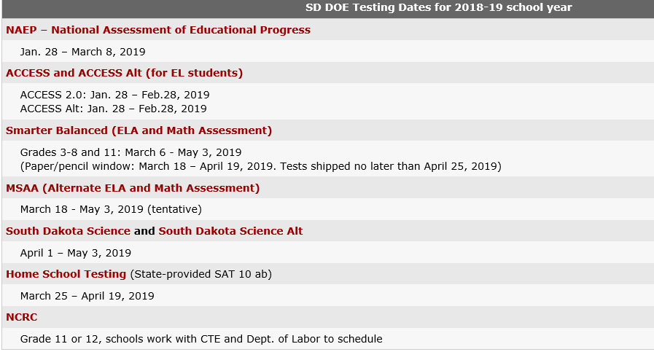
Test Windows

Slide 10
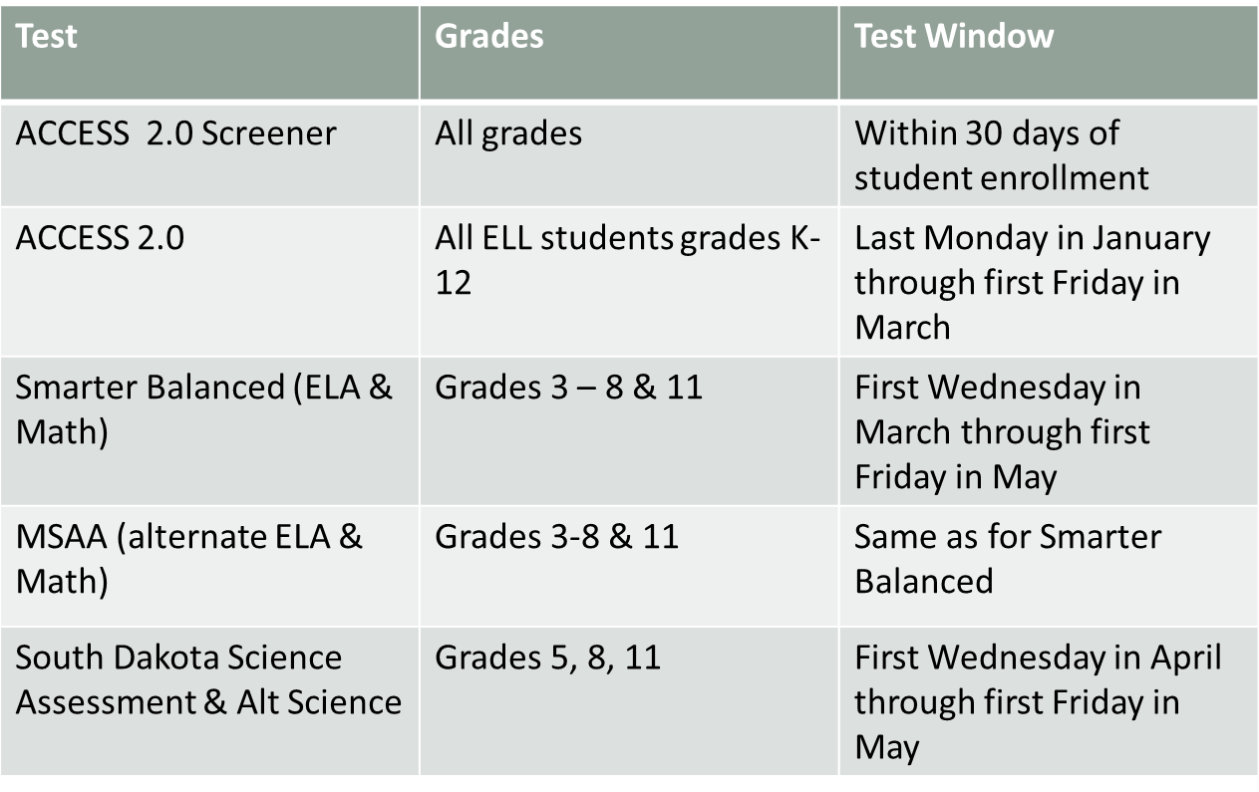

Slide 11
Test Security
Training is key to maintaining test security.
Each assessment has different training expectations for staff administering the assessment.
No personal communication devices can be on a student during a test session including cell phones, personal tablets, iWatches, or other devices that could connect to social media.

Slide 12
Security cont.
Social media is monitored by DOE and test providers
SD is not the only state using the tests except for Science
Careful monitoring of students during test sessions can eliminate most issues
State law prohibits copying or other methods of distributing test materials

Slide 13
During test sessions
Cover any materials that could provide assistance to students
Do not allow backpacks to be under chairs
Collect cell phones, etc.
Post testing in progress signs
Collect all scratch paper at end of a test session
No materials related to testing can leave the room where testing occurs
LAN school will interfere with secure browsers

Slide 14
District Responsibility
13-3-56.1. Cheating on academic achievement test--Investigation. If the superintendent of a school district has sufficient evidence that cheating occurred on a state-required academic achievement test, the superintendent of the school district shall investigate the circumstances. For the purposes of this section, cheating is the unauthorized acquiring of knowledge of the achievement test by a student or providing unauthorized access to secure test questions or tampering or altering of student answer sheets by school district personnel.
Source: SL 2007, ch 85, § 1.

Slide 15
District Responsibility
13-3-56.2. determination of cheating. Following the investigation, the superintendent shall report the results of the investigation to the secretary of the Department of Education. Upon receiving the report, the secretary shall determine whether the alleged cheating occurred and, if so, if it was severe enough to affect the results of the achievement test. If the secretary finds that the cheating did occur, the affected score sheets may not count and shall be discarded. The secretary shall also determine if the cheating was severe enough to affect the school's adequate yearly progress under the terms of the state accountability system established pursuant to § 13-3-62. If the cheating was severe enough to affect the school's adequate yearly progress, the secretary may determine that the school does not meet adequate yearly progress for that school year. The decision of the secretary regarding adequate yearly progress may be appealed to the South Dakota Board of Education.
Source: SL 2007, ch 85, § 2.

Slide 16
Reporting Security Incidents
Each test will have a Test Security Log posted at http://doe.sd.gov/Assessment/
Submit to DOEAssessment@state.sd.us as needed with a final log submitted at end of test window
Follow the security expectations & procedures for Smarter Balanced for all tests

Slide 17
DOE School Visits
DOE staff will be visiting school districts during the test window to monitor administration and test security practices.
Evidence of staff training and test monitoring will be collected.
Criteria for 2019 visits is based on critical issues that emerged in 2018 that impact the reliable and valid administration of tests.
No more than 72 hours notice will be provided and visits could be surprise visits if administration issues emerge during testing.

Slide 18
Training Expectations
Each of the required state assessments has different training expectations based on the nature of the assessment.
ACCESS 2.0 requires training for test administrators when testing online, for kindergarten, and for ACCESS alternate.
MSAA training must be completed before test administrators can access the test directions.

Slide 19
Training cont.
Smarter Balanced has training for test administrators available as an online training module. This module is highly recommended for all educators administering Smarter Balanced. It is updated annually.
Students and test administrators can use the online practice and training tests to learn about all the different tools and supports in the test interface.
Numerous tutorials for the components of the Smarter Balance portal are available to all educators.

Slide 20
Infinite Campus
CAMPUS is our source for all testing information
If a student needs alternate tests and the correct data is not completed, the student won’t be in the pre-id file for MSAA
Student transfers in TIDE take up to 72 hours if all data are correct in TIDE
Districts will be contacted regarding 12th graders needing to test
Do not call help desks for missing students
Instead, contact the appropriate DOE staff for assistance

Slide 21
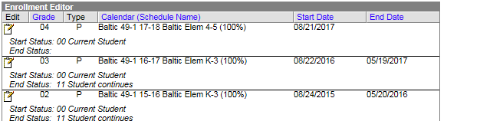
Infinite Campus
Type must be P for a student to be in the appropriate test system!

Slide 22
More Reminders
Students test once – if the student’s IEP indicates alternate assessment, then the student does not take Smarter Balanced or SDSA.
The “participate in alt assessment” box must be checked in Campus for students taking alternate assessments.

Slide 23
First Year in Country
First year in country students are exempt from taking ELA Smarter Balanced or MSAA.
Data must be correct in Campus to get credit for being 1st year in country.
Students must take Math and Science (gr. 5, 8, 11) in order to be a participant.

Slide 24
First Year in County cont.
Math is available in Spanish for Smarter Balanced for 1st year in country students.
Considerations for use:
  Did the student have significant instructional opportunities in math prior to coming to South Dakota?
  Can the student read Spanish so that a test in Spanish is a support?
  Is the student receiving math instruction in Spanish?

Slide 25

Medical Exemptions
Rule of Thumb
If the student can receive instruction; the student can participate in the statewide assessment.

Slide 26
Medical Emergency
In rare instances, a student may be unable to participate in any part of the assessment due to significant and documented and fully incapacitating medical emergency that extends through the end of each testing window.

Slide 27
Examples
A serious car accident
Hospitalization
Severe emotional trauma
Placement in hospice care
  Medical emergencies of this kind must be identified and verified in writing by a licensed physician and kept on file by the local district
  The incident or condition must be so severe as to prevent the student from participating in instruction offered either at school, hospital, or at home through the end of each testing window

Slide 28
Conditions that DO NOT qualify for exemption
Medical fragility
District-provided home-based educational programs (student remain enrolled in district)
Pregnancy
Students with acute, short-term minor illnesses or injuries
Students placed in correctional facilities
Student or parent refusal
Mental health conditions that permit the students to receive instruction

Slide 29
Submitting Requests
The requests must be based on a decision made by an educational team that includes the student’s teachers, special education staff as appropriate, school counselor, principal, parent or legal guardian, and, if possible, the student.
Documentation such as the medical information, attendance details, and other documents supporting the decision must be provided along with the Request for Medical Exemption form.
The principal must obtain the parent’s consent and complete the Request for Medical Exemption. In addition, the superintendent must sign the request before submission.
Requests must be submitted one week after the last day of the testing window for each assessment. All required documents, information, and signatures must be included for committee consideration. A request must be submitted for each test that an exemption is needed.

Slide 30
Submission Process
The Medical Exemption form is on the main Assessment webpage.
A separate form MUST be completed for each assessment that an exemption is being requested.
Due on March 8, 2019 for ACCESS 2.0 but must be submitted after test window closes
Due no later than May 10, 2019 for Smarter Balanced, MSAA, and Science /Science Alt but must be submitted after the test window closes
Send by mail
Chris Booth
800 Governors Drive
Pierre, SD 57501
or email to:
DOEAssessment@state.sd.us

Slide 31
Keeping in Touch
  DOEAssessment@state.sd.us is the email to use to send medical exemptions, security logs, requests to add students, appeals, and all other questions regarding test administration if unsure who to contact.
  There will be at least one DOE staff member in the office each day of the test window.
  Email and phone Out of Office messages will provide details regarding who to contact if someone is away from the office.

Slide 32
ESSA
TESTING TRANSPARENCY.—
(A) IN GENERAL.—At the beginning of each school year, a local educational agency that receives funds under this part shall notify the parents of each student attending any school receiving funds under this part that the parents may request, and the local educational agency will provide the parents on request (and in a timely manner), information regarding any State or local educational agency policy regarding student participation in any assessments mandated by section 1111(b)(2) and by the State or local educational agency, which shall include a policy, procedure, or parental right to opt the child out of such assessment, where applicable.
At the present time, South Dakota law requires all students participate in required assessments.

Slide 33
ESSA Reporting Expectations
Starting in 2017-18 school year, district and school websites must provide the following state and local assessment information:
Subject matter assessed;
Purpose for which the assessment is designed and used;
Source of the requirement for the assessment; and
Where such information is available:
  Amount of time students will spend taking the assessment, and the schedule for the assessment; and
  Time and format for disseminating results

Slide 34
Reporting Results to Families
Families must receive student results as soon as practicably possible.
ACCESS 2.0 reports are sent to districts in May. Reports can be printed in home languages as needed through WIDA AMS.
Smarter Balanced reports are posted within 3 weeks of test submission. Reports can be provided with final report cards.
MSAA reports are provided to districts in mid-August for download.
SDSA & SDSA Alt reports will be provided in late May.

Slide 35


