Slide 1
Smarter Balanced Assessment Consortium
ELA & Math Assessments
Joe Moran
Division of Instruction and Learning
Office of Assessment
Joe.Moran@state.sd.us
605-773-3247

Slide 2
WHAT?: Smarter Balanced
Smarter Balanced Assessment Consortium: SBAC
Collection of states collaborating to build an effective and instructionally sensitive standard aligned assessment system
Computer delivered
Assessment Portal
Two main aspects
Summative Assessment
Instructional: Interim and Formative Assessment

Slide 3
WHAT?: Summative Assessment
SDDOE provides districts with the SBAC end of year summative assessments for:
Students in grades 3,4,5,6,7,8, and 11
In the content areas of ELA and Math
*ELA and Math Blueprints for assessment specifics
(Found within the “What’s the Point? – Connections between Assessment, Curriculum, and Instruction” folder)

Slide 4
WHAT?: Summative Assessment
End of year summative assessment can be used to evaluate:
Instructional Emphasis
Curriculum Breadth & Depth
Breadth & Depth of Standards Covered

Slide 5
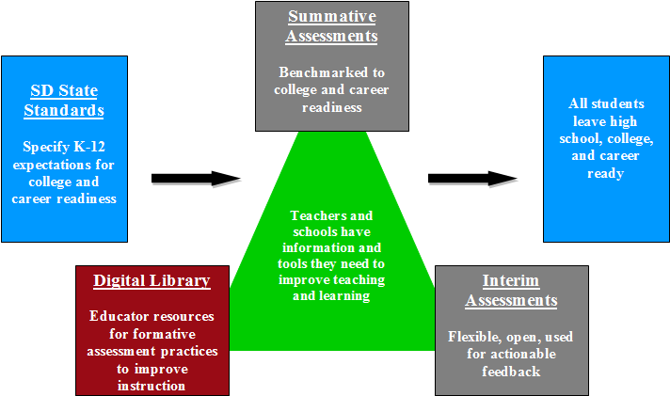
WHAT?: Smarter Balanced
*Summative
*Instructional: Interim and Formative

Slide 6
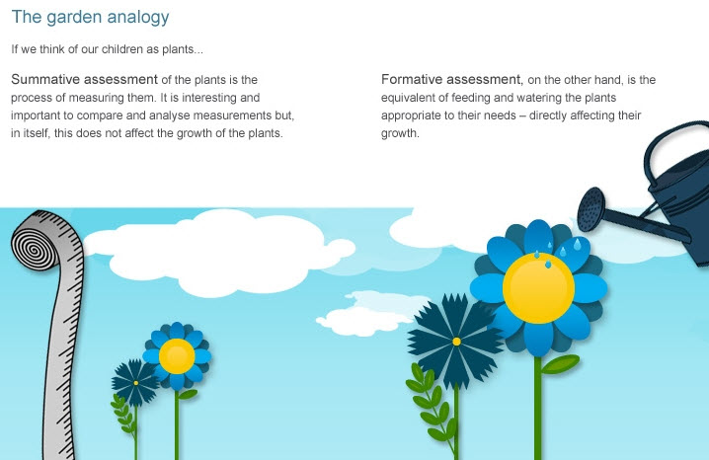
Summative vs. Formative
The Garden Analogy
If we think of our students as plants…
Summative assessment of the plants is the process of measuring them. It is interesting and important to compare and analyze measurements but in itself this does not affect the growth of the plants.
Formative assessment, on the other hand, is the equivalent of feeding and watering the plants appropriate to their needs – directly affecting their growth.

Slide 7
WHERE?: Smarter Balanced
Let’s make sure every one has an account and can log on
https://www.sd.portal.airast.org
Does anyone need an account?

Slide 8
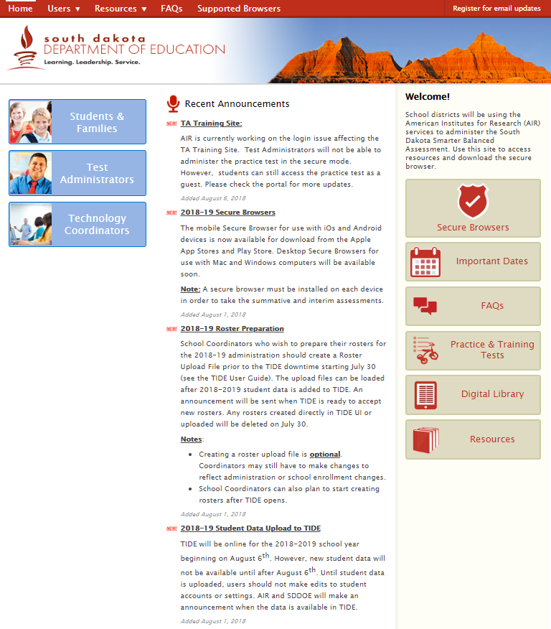
WHERE?: Assessment Portal
Assessment Portal
Entrance Points & Browser
Resources
Systems

Slide 9
WHERE?: Entrance Points
What do you need?
Checking in for updates?
Share the information with parents?
District/School/Classroom related?
Technology questions?
Need to download testing browsers?

Slide 10
WHERE?: Resources
Many places to find the same information
Important Dates
Maybe your question has been asked before?
General resources
Manuals
Tutorials
Additional Resources

Slide 11
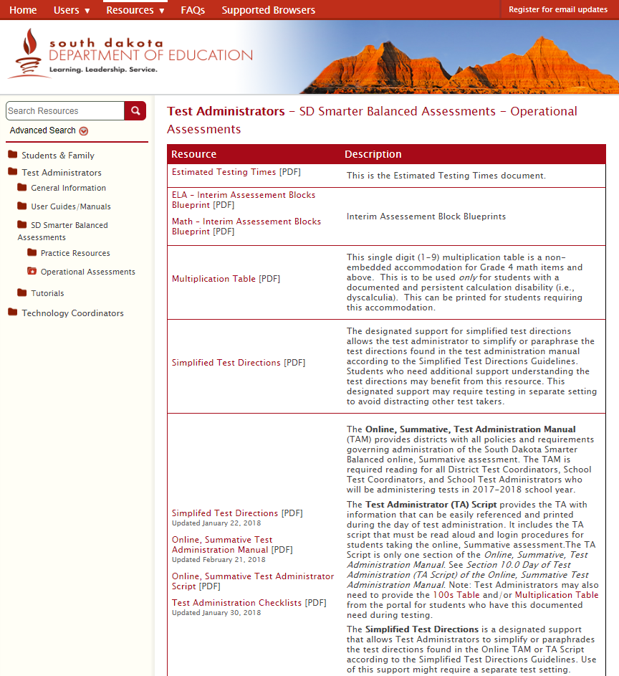
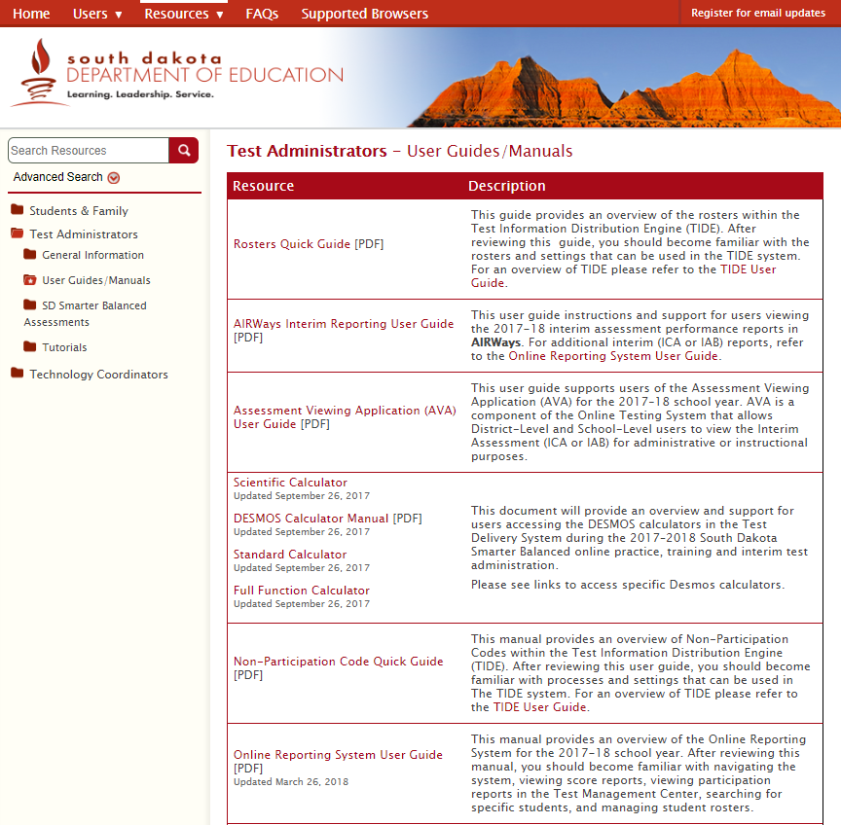
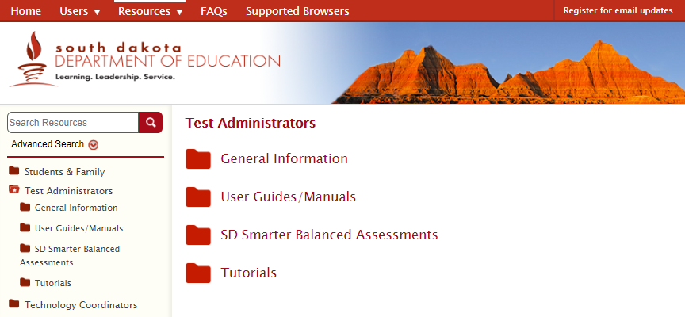
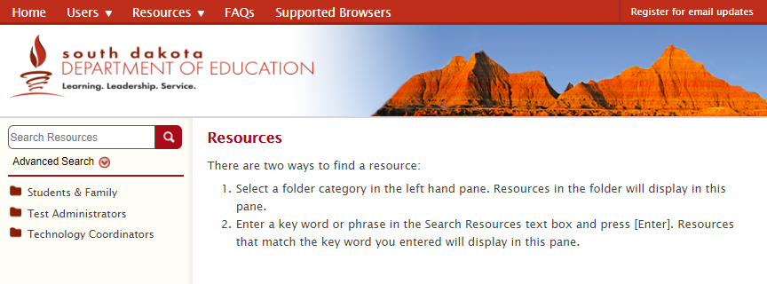
WHERE?: Resources
Let’s take a look
Select Resources
Select Test Administrators
What are you looking for?
Guide and Manuals
Select User Guides and Manuals
Multiplication Sheet, UAAG, Translations, TAM
Select SD Smarter Balanced Assessments

Slide 12
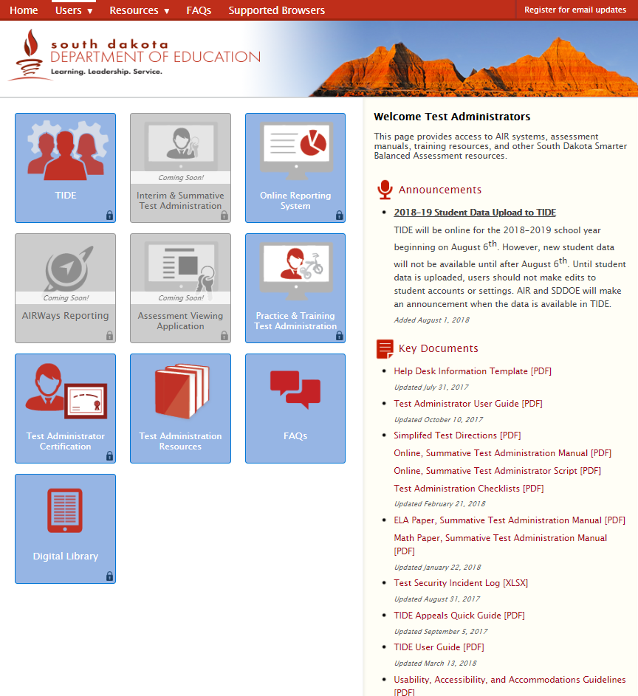
WHERE?: Systems
Portal Main Page
Select Test Administrators
TA Landing Page
Notice Key Documents
What systems are you interested in?
Interim and Summative Test Administration
Reports
Summative Data: Online Reporting System
Interim Data: AIRWays Reporting
Training
Test Administrator Certification

Slide 13
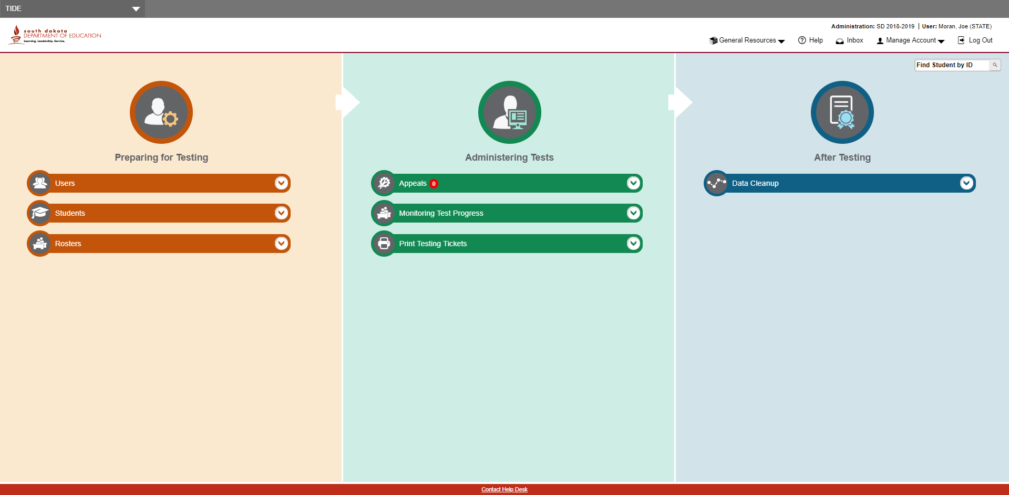
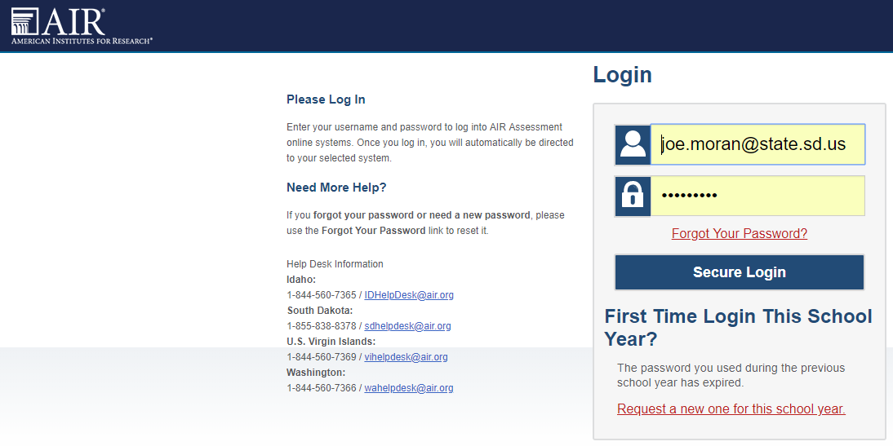
TIDE: Overview
TIDE: Test Information Distribution Engine
*An essential system for the responsibilities of the District Assessment Coordinator
TA Landing Page
Select TIDE
Enter Log On Information
NOTE: Reset PASSWORD upon first entrance every year.
Key Functions
System Choices
Management
Help Desk
System Sections

Slide 14
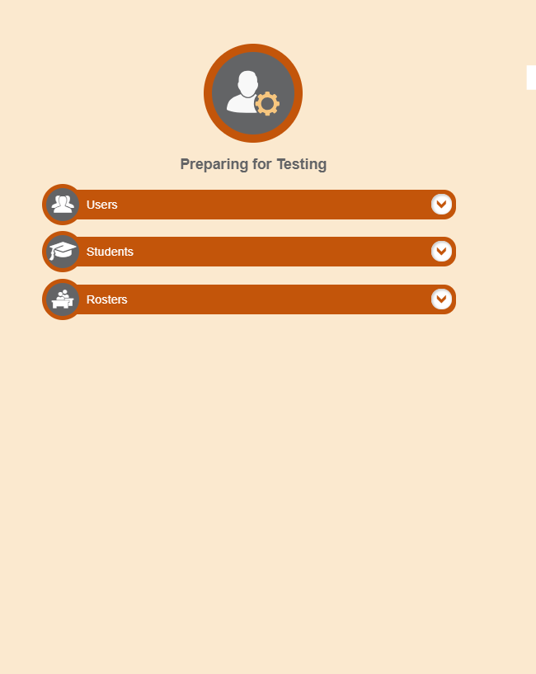
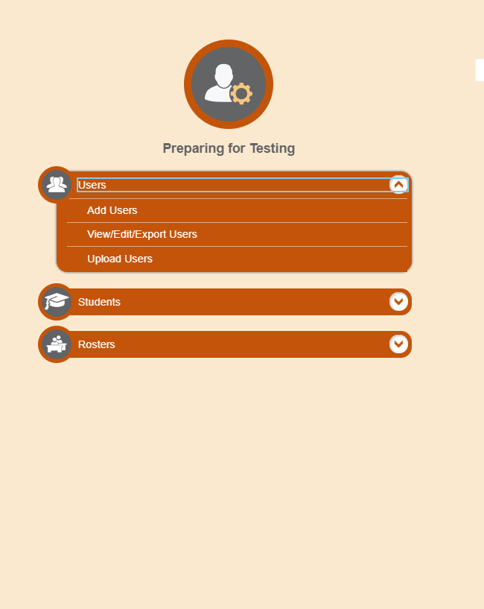
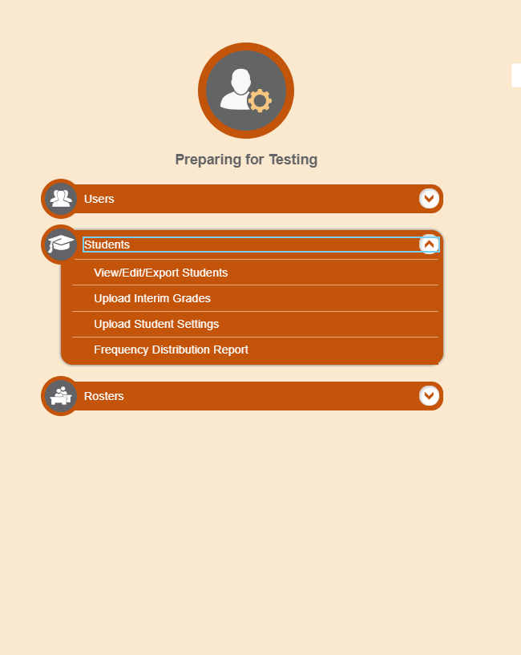
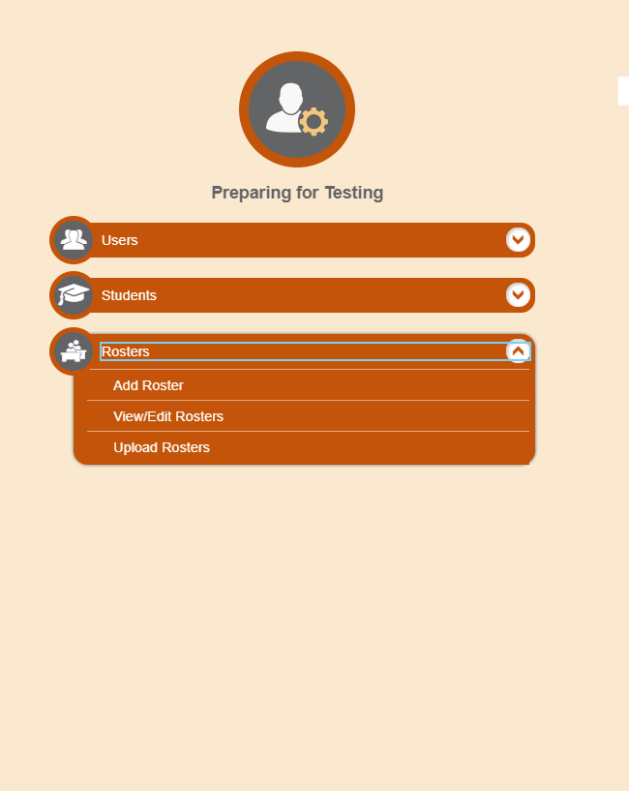
TIDE: Preparing
TIDE Landing Page: Preparing for Testing
Users: Staff Accounts
Students: Student Account Profiles
Discussion of how student accounts load into TIDE
Rosters: Mechanism for the organizational needs of the District or School

Slide 15
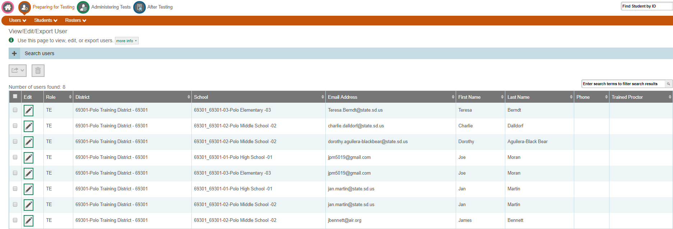
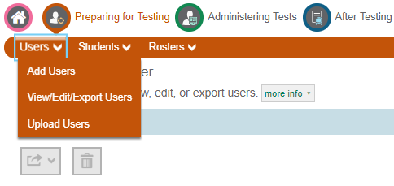
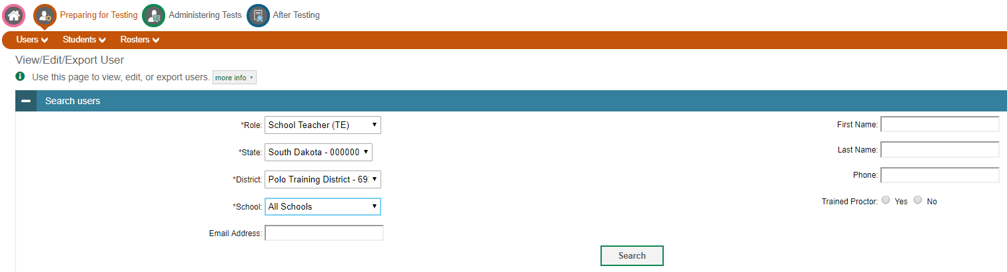
TIDE: Users
TIDE Landing Page: Preparing for Testing
Select View/Edit/Export Users
Filter for desired search
TE: Teachers
Select Search
View results
Delete User accounts
Select Check Box
Select Trash Bin
Add Users
Select Users
Select ADD Users

Slide 16
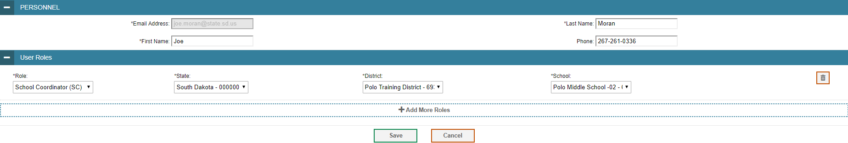
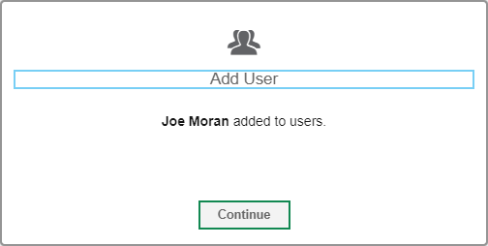
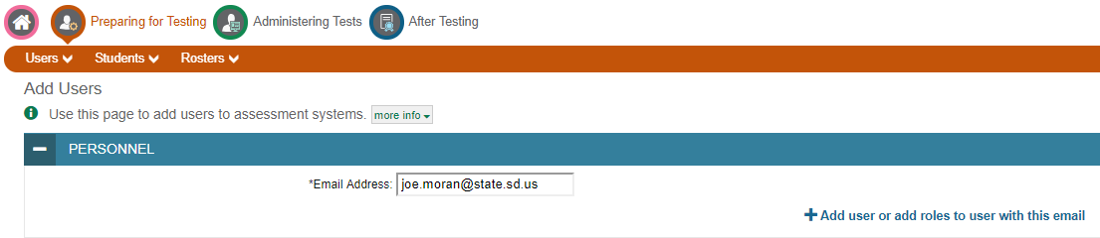
TIDE: Users
ADD Users Landing Page
Input users school issued email address
Select Add user or Add role
Input user information
Create user roles
NOTE: There are VERY FEW reasons why a user would need multiple roles.
Let’s discuss
Select Save
Assure Confirmation

Slide 17
TIDE: Rosters
Activity
Gather with 4 other educators
Determine who will be the District Assessment Coordinator (Coordinator)
Remaining three will act as teachers
Coordinator decides on a specific way to sort the deck of cards and distributes amongst all four participants
Coordinator recollects the cards and places the deck in front of the person to the left, who becomes the new Coordinator
New Coordinator sorts the deck differently and distributes amongst all four participants
Repeat steps 2-4 until everyone has had a chance to sort the deck differently.
Group discussion of ROSTERS

Slide 18
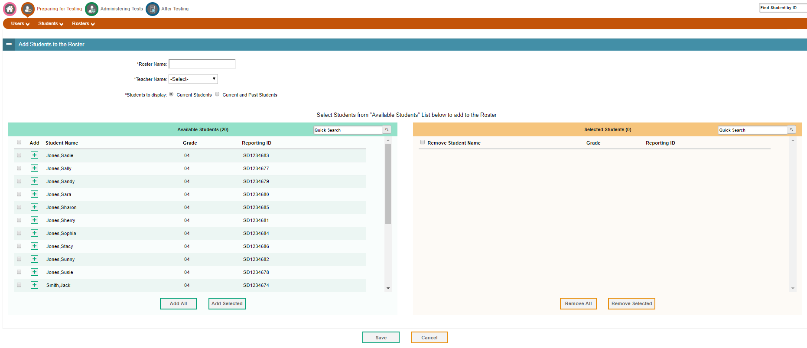
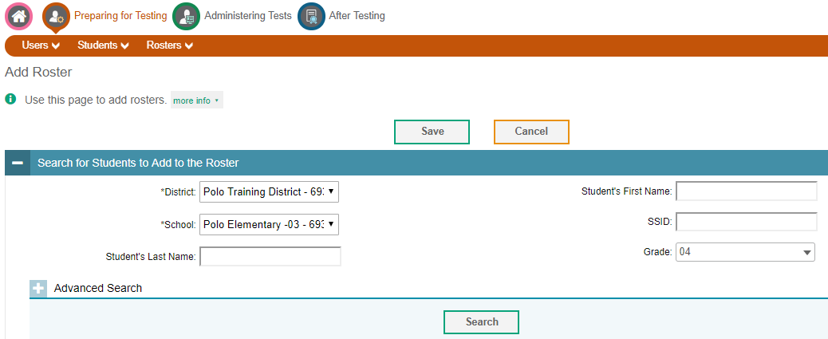
TIDE: Rosters
Creating Rosters
Select ADD Roster in TIDE
Filter appropriately
Click Search
Use system to create rosters as desired
Roster Name
Teacher
Student Selection

Slide 19
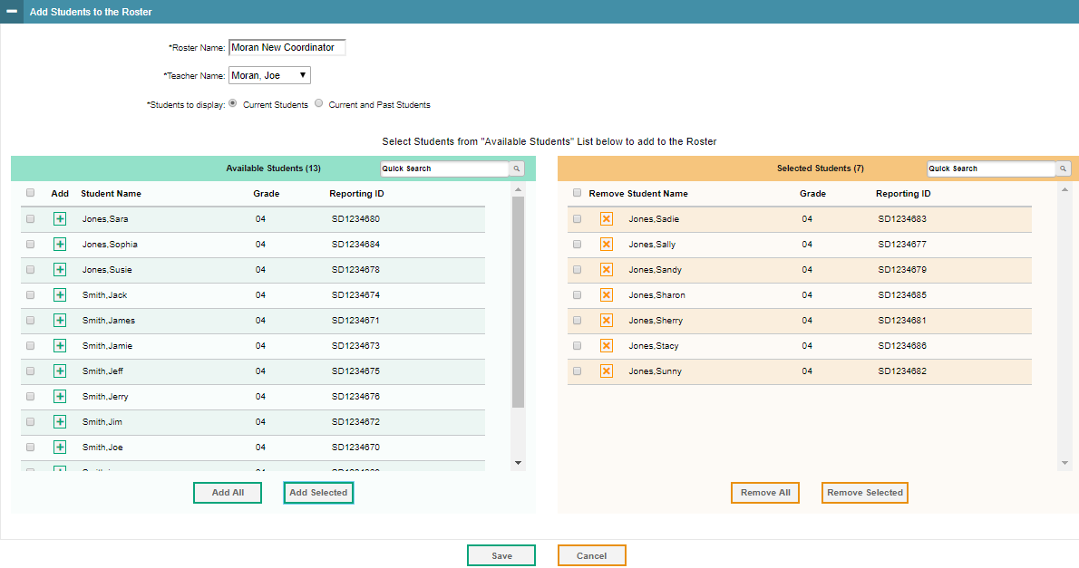
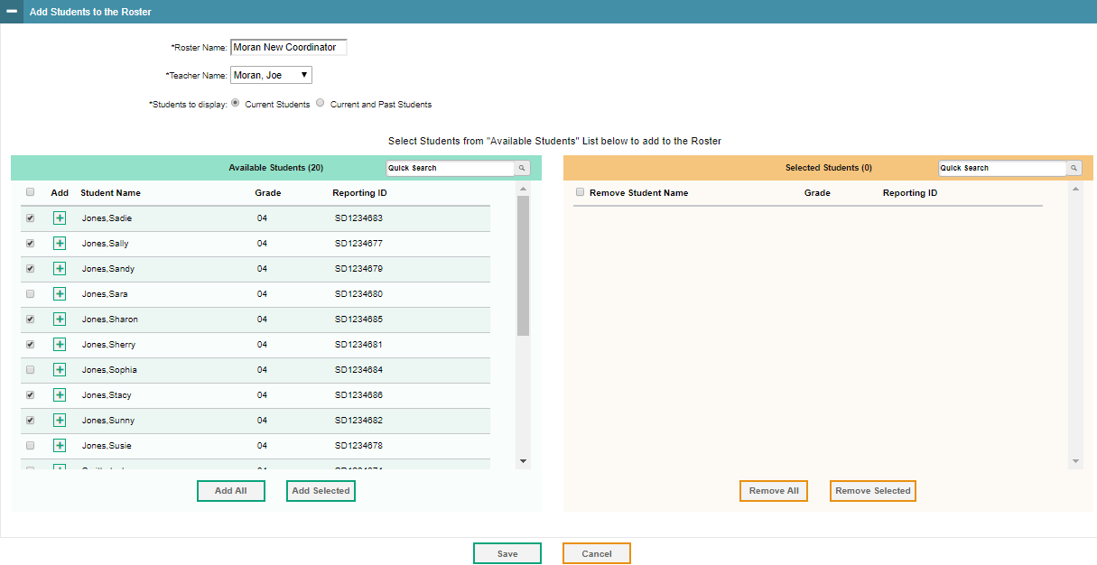
TIDE: Rosters
Creating Rosters
Select appropriate students
Add All or Add Selected
Once completed select appropriate ADD button
Confirm Roster
Correct students included?
Correct students excluded?
Missing students?
Save Roster

Slide 20
WHEN?: Generic Timeline
The Summative Assessment: Before
Timeline/Responsibilities
August:
Assure Infinite Campus data is being accurately uploaded into TIDE (Work with district Infinite Campus contact)
Create new users and clean up old users
Roster students
Explore previous results in ORS

Slide 21
WHEN?: Generic Timeline
The Summative Assessment: Before
Timeline/Responsibilities
September:
Install secure testing browsers {Work with district Technology Coordinator (TC)}
Distribute information on interim assessments to administrators, coaches, and teachers
Assist teachers with administration and navigating results of interim assessments

Slide 22
WHEN?: Generic Timeline
The Summative Assessment: Before
Timeline/Responsibilities
September – February:
Continue to work with district leads in assuring accurate student demographics, rosters, users, and student supports and accommodations
Work with administration to create an efficient district assessment schedule
Work with TC in assuring computers and technology are prepared and properly functioning
Alert teachers: Interim Comprehensive Assessments go offline February 28th

Slide 23
WHEN?: Generic Timeline
The Summative Assessment: During
Timeline/Responsibilities
March Mentality: Success is a team effort
Summative Assessment window opens March 6th
Prepare district for the spring summative assessment
In-Service Presentation/Staff Meeting
Assessment schedule
Policies/Procedures
Distribute TAMs (Manuals)
Assure all test administrators are completing training certifications
Be prepared to assist with technical and logistical situations
Collaboration with SDDOE contacts and technical assistance HelpDesk

Slide 24
WHEN?: Generic Timeline
The Summative Assessment: During
Timeline/Responsibilities
March - May:
Monitor and track the completion of all necessary assessments
Continue to assist in any technical or logistical situations
Continual communication with test administrators to submit and monitor APPEALS
Special circumstances that arise during testing that require documentation supported decisions
Contact with SDDOE on APPEALS should be made within 24 business hours of incident
Appeals close a day or two before the last day of the test window

Slide 25
WHEN?: Generic Timeline
The Summative Assessment: After
Timeline/Responsibilities
May - June:
Submit Medical Exemption forms and documentation by May 10th, 2018
Distribute student results to parents ASAP (Typically by the end of the school year)
Data Cleanup
Data Validation

Slide 26
WHAT?: The Instructional Side
SDDOE provides districts with two SBAC resources to support the development of instructional practices within classroom:
Interim Assessments
Digital Library

Slide 27
WHAT?: Interim Assessments
Assessments for global measuring of early, midyear, or periodic progress toward summative assessment targets
Content Standard aligned (Math and ELA)
Same assessment portal and system as the summative assessment
Same assessment platform
Same tools, designated supports and accommodations

Slide 28
WHAT?: Interim Assessments
Why use them?
ICA: Interim Comprehensive Assessments
Similar Math & ELA blueprints as summative
Useful for district/school wide assessment in Math and ELA
Determine district/school trends/needs
IAB: Interim Assessment Blocks
Separate SBAC Target aligned Math & ELA blueprints
Useful for classroom teachers at a finer grain in determining the student/instructional needs per target
*For full summary of all Interim Assessments see Fact Sheet handout

Slide 29
WHAT?: Digital Library
What is it?
A collection of educator vetted professional learning and instructional resources aligned to SD content standards and summative assessment targets
Created, vetted, and constantly improved by educators from across the nation including our own SD educators
How do you get access?
https://sbdigitallibrary.org/: Sign up here!
SDDOE Digital Library: Tips and support documents

Slide 30
WHAT?: Digital Library
Why use it?
Assessment – Supplemental Resources – Instruction alignment!
Vetted resources minimize the time needed to search and find useful resources
Forums allow you to communicate with educators from across the country about specific lessons or general practices
User profile functions allow you to create saved lists of resources and store favorites
Opportunities for networking and professional development available to educators looking to become involved in the creation of the Digital Library
Contact Joe Moran for more information @ Joe.Moran@state.sd.us

Slide 31
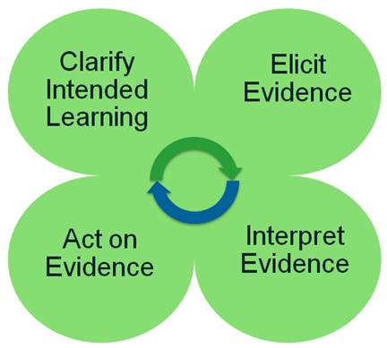
Connecting the System
Basics
Interims can provide districts/classrooms with a target focus
Digital Library can provide supplementary resources to assist educators in improving classroom instruction and student learning
Formative Assessment Process
The process is a continual cycle!
Allows for a connected and aligned usage of the
assessment system
Playlists
Students are assessed using IABs
Student reports show student performance levels
Playlists provide resources from the Digital Library that have been specifically selected to assist in success achievement of the students at those exact performance levels

Slide 32
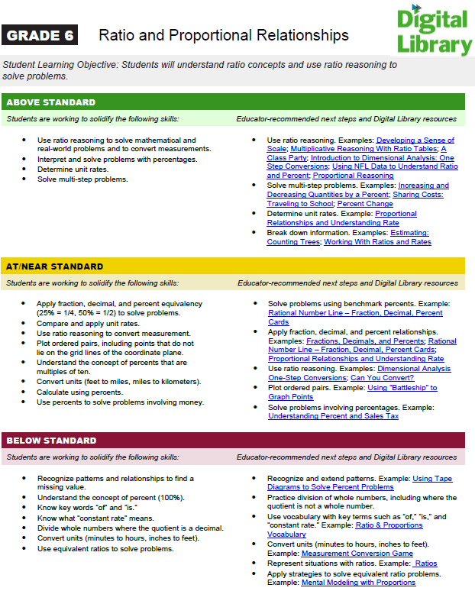
Connecting the System

Slide 33
Connecting the System
SBAC Summative Target Blueprint to SD Content Standards Crosswalk
*Use link and then expand the “What’s the Point?” folder. Labeled “SD Content Standard Crosswalk Blueprint”
Grade by grade single page printout for every summative assessment target assessed and the corresponding SD Content Standards and DOK level
Helps to associate SBAC targets to our specific state standards
Helps educators dive into the item specifications for improved item writing and classroom formative assessment
Questions about this document? Contact Joe Moran @ Joe.Moran@state.sd.us!

