Slide 1
Online Assessment Supports Accommodations 101
Beth Schiltz, Special Education Office
New Assessment Directors Workshop
August 2018

Slide 2
Topics for Today
Purpose
SD’s Smarter Balanced UAAG Guide
SD Science Assessment Accommodations
Resources

Slide 3
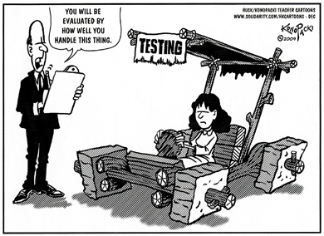

Slide 4
Why do assessment directors and/or tech coordinators need to know about this? Why now and not in the spring?
May be your responsibility to enable supports and accommodations through TIDE
Interim assessments
State assessment
May need to download additional supports/hardware/software
Know difference between supports and accommodations
May need to know who can and should receive supports and/or accommodations
May need to know when an accommodation is inappropriate
Inappropriate accommodations may invalidate an assessment

Slide 5
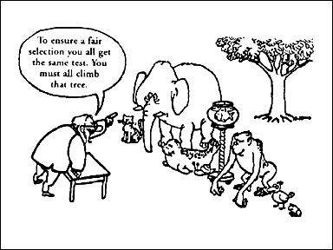

Slide 6
SD’s UAAG (Usability, Accessibility and Accommodations Guidelines)

Slide 7
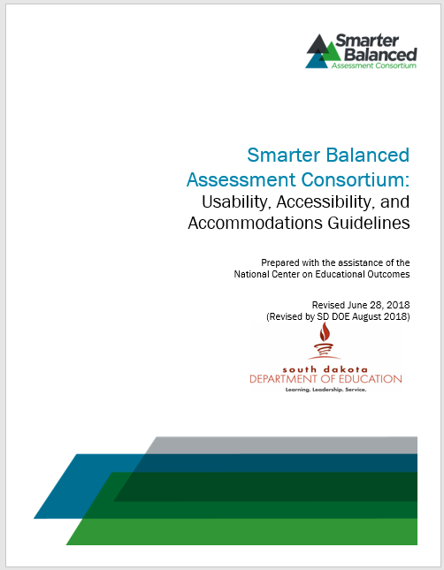
Usability, Accessibility, and Accommodations
South Dakota's version of Smarter Balanced: Usability, Accessibility and Accommodations guidance (UAAG) document
Guidelines apply to all students
Three levels of support
Not just for Special Education staff, but for all staff including classroom teachers
http://doe.sd.gov/octe/SMARTERbalanced.aspx
Scroll down to the Designated Supports and Accommodations table towards bottom of page

Slide 8
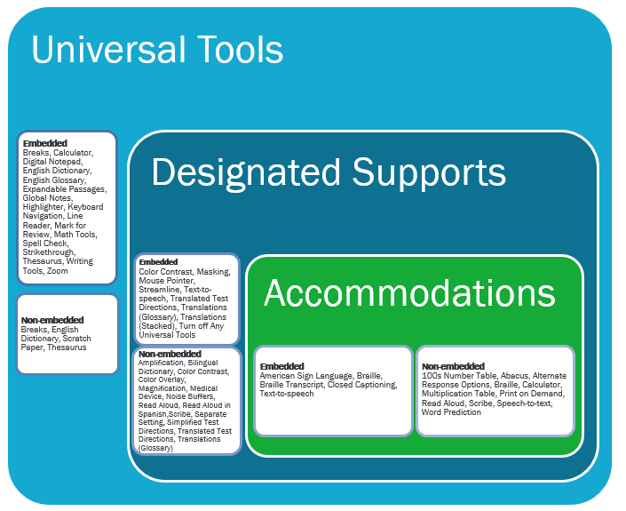
SD's SBAC UAAG
Three levels of support both embedded and non-embedded
Level 1 – Universal Tools
For ALL students
Level 2 – Designated Supports
For SOME students
Level 3 – Documented Accommodations
For a FEW students
Taken from the Smarter Balanced Assessment Consortium: Usability, Accessibility, and Accommodations Guidelines document
Notes:
The SBAC tools, supports, and accommodations come in three levels with both embedded (within the test delivery system – on the computer) and non-embedded tools (outside of the system).
The three levels are:
Level 1 – Universal tools
Level 2 – Designated Supports
Level 3 – Documented Accommodations.
This graphic shows a representation of what is available for students.

Slide 9
Level 1 – Universal Tools For ALL students
All Students

Slide 10
Level 1 – Universal Tools
Provided for all students
Provided digitally or separately
Based on student preference and selection
Can be turned off if tool is viewed as a distraction
Should be using these tools in other digital environments so students are familiar with them

Slide 11
Universal Tools Provided for ALL students
Embedded Tools
Breaks
Calculator (grades 6-8 & 11)
Digital Notepad
English Dictionary (for ELA performance task full write)
English Glossary
Expandable Passages
Global Notes (for ELA performance tasks
Highlighter
Keyboard Navigation
Line Reader
Mark for Review
Math Tools
Spell Check (for ELA items)
Strikethrough
Thesaurus (for ELA performance task full writes)
Writing Tools
Zoom (can be set at a larger font in TIDE)
Notes:
Let’s dig into those tools – they can be found starting on page 6 of your document.
Breaks – of more than 20 minutes will prevent the student from going back to a previous item. If students take breaks they may need more time to complete the test. If a student starts an assessment, takes a break and returns to the assessment, what the student has completed will be saved, however some of the information from the other tools may be lost. They also will not be able to go back to previous test questions.
Calculator – is embedded on-screen for those items requiring a calculator (Calculators will not be available for grades 3-5) as this would violate the constructs of the test) – Jan Martin has sent out a document that show what the different embedded calculators will look like.
Digital Notepad – for students to takes notes – notes taken are available until the end of the segment. Notes will disappear after 20 minute break.
English Dictionary – digitally available for the second portion of the performance tasks which consists of a full write
English Glossary – grade and content appropriate for some of the questions which do not violate the constructs of the item. This is an embedded glossary that will pop-up similar to what appears in Microsoft Word or other word processing programs.
Expandable passages – passages is expanded to take up a larger portion of the screen (different that zoom)
Global notes – Notes that students type in the global notes will move from segment to segment in the performance task portion of the assessment
Highlighter – students are able to highlight parts of passages. The highlights will disappear when the students move to a new segment.
Keyboard Navigation – just that – students can use the keyboard to move through the assessment using the appropriate keys such as the tab, etc.. (if they know which keys do what and are comfortable and have used these keys before)
Mark for Review – allows the student to move to the next questions and come back to the marked questions. These will disappear when moving to a new segment – the computer also provide a message indicating the student is moving to a new segment and do they want to check their marked item before moving on. These will only be available in the current session and will disappear once the student leaves or takes a break – the student will not be able to go back and check their answer.
Math tools – such as the embedded ruler or protractor for measuring when required. These will only appear when they are needed.
Spell check (for ELA items) – this is an icon on the embedded tool bar that students can use to check their spelling for those items in which spelling is not being assessed. This tool does not provide the correct spelling of a word, but just indicates that a word is misspelled.
Strikethrough – allows the student to cross out answer options they know are not appropriate for that question. Similar to using a pencil to cross out inappropriate answers
Writing Tools – a tool bar with the writing tool icons such as bold, italics, etc…
Zoom – makes the words and graphics in the window bigger. The student will have to use the scroll bars to be able to see all the information. This tool will zoom between 1.5 to 3 times larger. If the students do this, they have to do it for every questions. The default size is 14 point. This tool can be set prior to the student taking the assessment or can be used during the assessment in the TIDE (test distribution information engine). If the zoom is used, students may need more time to complete the test.
Non-embedded tools – those provided outside the digital (computer) setting
Breaks – given at predetermined interval or after completing a section. Using this tool may result in the student needing more time to take the assessment
English Dictionary – for the ELA performance task full writes which is the second portion of the test. This tool doesn’t change the construct of the item and may result in students needing extra time.
Scratch paper – for note taking, computations. All scratch paper must be collected and destroyed after each testing session. Only plain or lined paper. Graph paper can be used starting at 6th grade.
Thesaurus – for ELA performance task full writes – a thesaurus which contain synonyms. Students may need extra time when using this tool.

Slide 12
Universal Tools Provided for ALL students
Non-Embedded Tools
Breaks
English Dictionary (for ELA performance task full writes)
Scratch Paper
Thesaurus (for ELA performance task full writes)
Notes:
Let’s dig into those tools – they can be found starting on page 6 of your document.
Breaks – of more than 20 minutes will prevent the student from going back to a previous item. If students take breaks they may need more time to complete the test. If a student starts an assessment, takes a break and returns to the assessment, what the student has completed will be saved, however some of the information from the other tools may be lost. They also will not be able to go back to previous test questions.
Calculator – is embedded on-screen for those items requiring a calculator (Calculators will not be available for grades 3-5) as this would violate the constructs of the test) – Jan Martin has sent out a document that show what the different embedded calculators will look like.
Digital Notepad – for students to takes notes – notes taken are available until the end of the segment. Notes will disappear after 20 minute break.
English Dictionary – digitally available for the second portion of the performance tasks which consists of a full write
English Glossary – grade and content appropriate for some of the questions which do not violate the constructs of the item. This is an embedded glossary that will pop-up similar to what appears in Microsoft Word or other word processing programs.
Expandable passages – passages is expanded to take up a larger portion of the screen (different that zoom)
Global notes – Notes that students type in the global notes will move from segment to segment in the performance task portion of the assessment
Highlighter – students are able to highlight parts of passages. The highlights will disappear when the students move to a new segment.
Keyboard Navigation – just that – students can use the keyboard to move through the assessment using the appropriate keys such as the tab, etc.. (if they know which keys do what and are comfortable and have used these keys before)
Mark for Review – allows the student to move to the next questions and come back to the marked questions. These will disappear when moving to a new segment – the computer also provide a message indicating the student is moving to a new segment and do they want to check their marked item before moving on. These will only be available in the current session and will disappear once the student leaves or takes a break – the student will not be able to go back and check their answer.
Math tools – such as the embedded ruler or protractor for measuring when required. These will only appear when they are needed.
Spell check (for ELA items) – this is an icon on the embedded tool bar that students can use to check their spelling for those items in which spelling is not being assessed. This tool does not provide the correct spelling of a word, but just indicates that a word is misspelled.
Strikethrough – allows the student to cross out answer options they know are not appropriate for that question. Similar to using a pencil to cross out inappropriate answers
Writing Tools – a tool bar with the writing tool icons such as bold, italics, etc…
Zoom – makes the words and graphics in the window bigger. The student will have to use the scroll bars to be able to see all the information. This tool will zoom between 1.5 to 3 times larger. If the students do this, they have to do it for every questions. The default size is 14 point. This tool can be set prior to the student taking the assessment or can be used during the assessment in the TIDE (test distribution information engine). If the zoom is used, students may need more time to complete the test.
Non-embedded tools – those provided outside the digital (computer) setting
Breaks – given at predetermined interval or after completing a section. Using this tool may result in the student needing more time to take the assessment
English Dictionary – for the ELA performance task full writes which is the second portion of the test. This tool doesn’t change the construct of the item and may result in students needing extra time.
Scratch paper – for note taking, computations. All scratch paper must be collected and destroyed after each testing session. Only plain or lined paper. Graph paper can be used starting at 6th grade.
Thesaurus – for ELA performance task full writes – a thesaurus which contain synonyms. Students may need extra time when using this tool.

Slide 13
Level 2 – Designated Supports For SOME students
Some Students

Slide 14

Level 2 – Designated Supports
For any student for which a need has been indicated
by an educator or
a team of educators with parent/guardian and/or student
A process used to identify needs
Currently being used for instruction and/or other assessment
Identified prior to the assessment
Activated prior to testing in the TIDE (Test Information Distribution Engine)

Slide 15
Designated Supports Provided for SOME Students
Embedded Supports
Color Contrast
Masking
Mouse Pointer (size & color)
Streamline
Text-to-speech (Grades 3-8, &11 for all Math and ELA items) (May need to download Julie Voice pack for PC Computers)
Translated test directions
Translations (glossaries for math items)
Translations (stacked for math items)
Turn off universal tools

Slide 16
Designated Supports Provided for SOME Students
Non-Embedded Supports
Amplification (permissive mode must be enabled)
Bilingual dictionary (for ELA performance task full writes)
Color contrasts
Color overlays
Magnification (permissive mode may need to be enabled)
Medical Device
Noise Buffers
Read aloud (Grades 3-8, & 11 for all math and ELA items – not reading passages)
Scribe (for ELA non-writing items and math items)
Separate setting
Simplified Test Directions
Translated Test Directions (PDF of directions translated in the language read by an adult)
Translations (glossaries for math items)

Slide 17
Level 3 – Documented Accommodations For FEW students

Slide 18
Level 3 – Documented Accommodations
Documented need for the support such as an IEP or a 504 plan
Decisions made by a team
Information must be entered in the TIDE so they can be activated
Exception may be a student who has a physical injury such as a broken hand or arm and can’t use the computer
May use the speech-to-text and/or
Scribe
If they have experience using these supports

Slide 19
Accommodations
Must be needed for instruction first
Then decide if appropriate for assessment
Not all accommodations used for instruction are appropriate for assessments

Slide 20
Documented Accommodations For FEW students
Embedded Accommodations
American Sign Language (for ELA listening items and math items)
Braille
Braille Transcript (ELA listening passages)
Closed Captioning (for ELA listening passages)
Text-to-speech (for ELA reading passages)

Slide 21
Documented Accommodations For FEW students
Non-embedded Accommodations
100s Number Table (grade 4 and up)
Abacus
Alternate response options (may need to enable permissive mode)
Braille (paper/pencil assessment)
Calculator (Braille & Talking for calculator items only, grades 6-8, & 11)
Multiplication Table (grade 4 and above for math items – single digit 1-9)
Print on demand (contact DOE)
Read aloud (for ELA passages)
Scribe (for writing items)
Speech to text (need a voice recognition software and must enable permissive mode)
Word Prediction (must have word prediction software and must enable permissive mode)

Slide 22
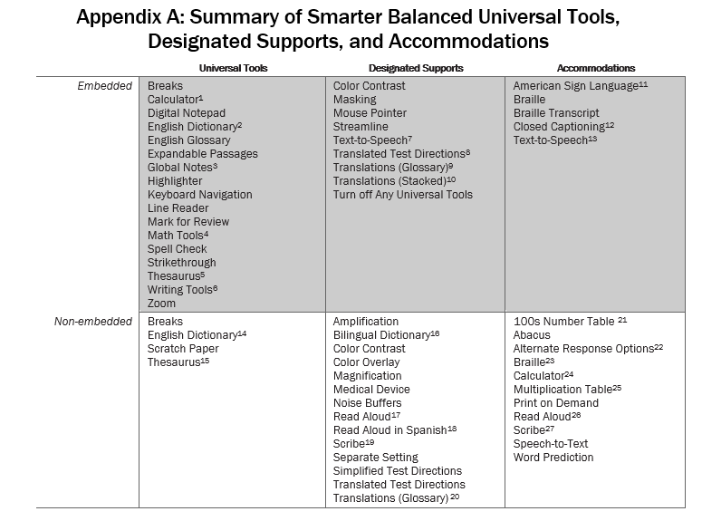

Slide 23
Permissive Mode
Needed for Non-Embedded Supports and/or Accommodations that need to interact with the computer
Amplification
Magnification
Noise Buffers
Alternate Response Options
Speech-to-Text
Word Prediction

Slide 24
Text-to-Speech/Read Aloud One of the other – not both
Designated Support
ELA – items
ELA PT – all
Math – all
Only for those who need it
Not for all kids in classroom
May hinder not help
Accommodations
ELA – passages
Should be very few in the state
Print disability
Documented on IEP
Receiving intensive instruction and interventions in fundamental reading
Requires specialized formats for reading

Slide 25
Resources

Slide 26
Documents
Reading Passages
Gr 3-5
Gr 6-11
Print on Demand
Special Considerations
http://doe.sd.gov/Assessment/

Slide 27
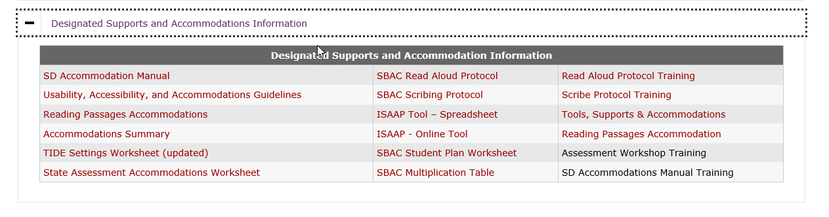
More Documents
SD Usability, Accessibility, and Accommodations Guidelines document
TIDE Settings Worksheet
Accommodations Summary
Read Aloud Protocol
Scribe Protocol
http://doe.sd.gov/Assessment/SMARTERbalanced.aspx

Slide 28
Things to Consider

Slide 29
What is your district plan for enabling Supports and Accommodations?
Who is responsible for enabling Supports and Accommodations in TIDE?
If it’s you, who do you need to talk to about these?
How do you get the information?
Who makes supports decisions? What about the accommodations?

Slide 30
Tasks that May be Required
Downloading Julie Voice Pack (for the text-to-speech – computer does the reading - feature for PC machines)
Speech-to-text (student reads into computer that does the typing) – need to have a stand alone voice recognition program
Magnification devices – for vision impaired students and hearing impaired students
Enable the permissive mode

Slide 31
Test Your Knowledge

Slide 32
Scenario 1
Student is:
On an IEP
Needs the reading passages aloud
Is this an appropriate request?
What do you do or what is your next step?

Slide 33
Scenario 2
Teacher requests:
Hand held calculator
For a 6th grade student
Is this an appropriate request?
What do you do or what is your next step?

Slide 34
Scenario 3
8th grade student
Teacher request numbers chart and the multiplication table
Is this an appropriate request?
What do you do or what is your next step?

Slide 35
Scenario 4
Teacher requests:
Text to speech for the items
For her whole classroom
Is this an appropriate request?
What do you do or what is your next step?

Slide 36
Scenario 5
Student
On a 504 plan
Needs Speech to Text
Is this an appropriate request?
What do you do or what is your next step?

Slide 37
South Dakota Science Assessment

Slide 38
Tools and Accommodations
Still working with vendor to clean up the accommodation language
Want it to mirror the SBAC accommodation language as much as possible
There will be text-to-speech ☺

Slide 39
Next Steps
Share Usability, Accessibility, and Accommodations Guidelines (UAAG) document
All staff, not just sped staff
Develop or review district plan for enabling the supports and accommodations in TIDE
Who will do this
How will you collected the needed information
Have conversations for students who make need extra supports (the following may help with these conversations) (tools available)
Do you need to download programs (such as Julie Voice Pack, a voice recognition program)?
Do you need to test these to make sure they work in the testing environment before the assessment?
Help staff incorporating technology within instructional environment and test the system to ensure ease of use
Interim assessments through SBAC portal
use the SBAC practice and training tests
Assessment Portal

Slide 40

Questions

Slide 41
Contact Information
Beth Schiltz
South Dakota Department of Education
Office of Special Education
605-773-4257
Beth.Schiltz@state.sd.us

