Slide 1
Alternate Assessment
MSAA ELA (Read and Writing)
MSAA: Math
SDSA-Alt (Science)

Slide 2
Purpose of the MSAA and SDSA- Alt
Ensure that all students are able to participate in an assessment that is a measure of what they know and can do in relation to the grade-level State Content Standards.
Ensure students with significant cognitive disabilities achieve increasingly higher academic outcomes and leave high school prepared for post-secondary options.
Meet requirements of the Every Student Succeeds Act (ESSA) and the Individuals with Disabilities Education Act (IDEA), which require the participation of all students in assessments designed to measure student knowledge and ability on grade-level content standards.
Notes:
The MSAA began as a federally funded grant called the National Center and State Collaborative (NCSC) 10 states now continue this work as the MSAA.
[] The purposes of the MSAA are to:
[] Ensure that all students are able to participate in an assessment that is a measure of what they know and can do in relation to the State content standards
[] Ensure students with significant cognitive disabilities achieve increasingly higher academic outcomes and leave high school prepared for post-secondary options.

Slide 3

Who are your Alternate Assessment Eligible Students?
Notes:
Who are the alternate assessment students?

Slide 4



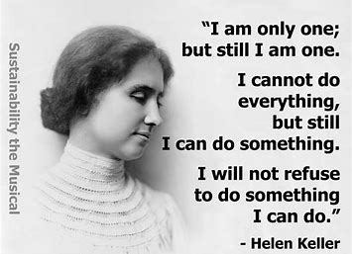
Presume Competence
Notes:
Would presume competence for these individuals may have limited their success?

Slide 5
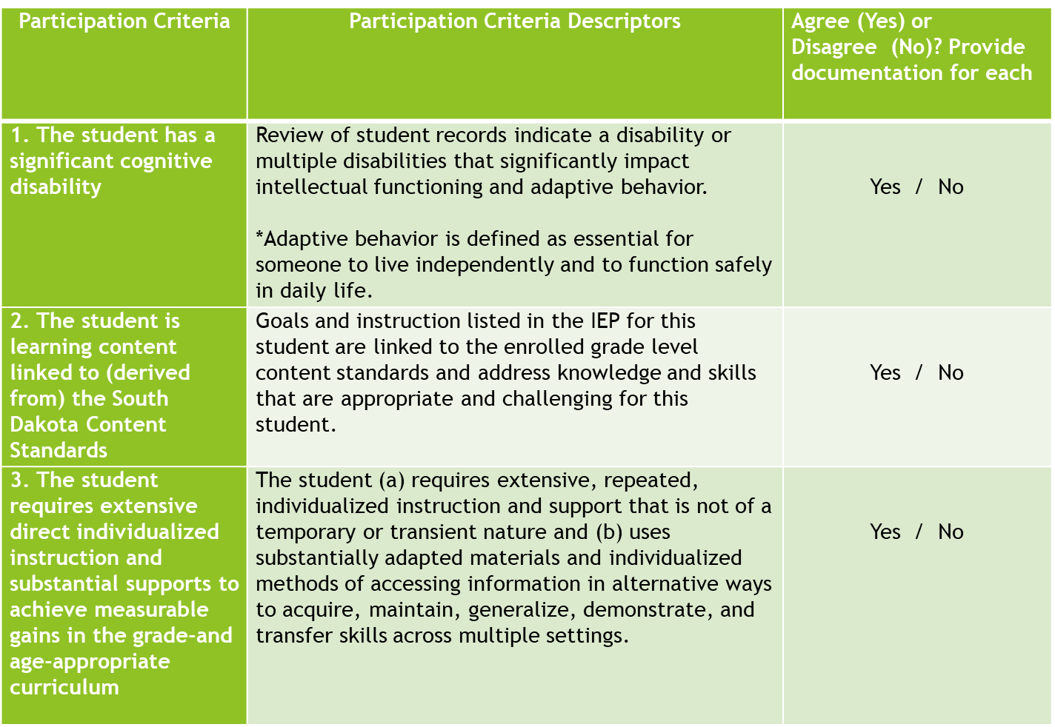
Alternate Assessment Criteria
Significant not just cognitive
Core Content Connectors
Notes:
When looking at the first criteria, focus on the word “Significant” cognitive disability. If you have a student, who meets a cognitive disability (2 standard deviation below), it does not mean they automatically meet this criteria.
This criteria means that the student has annual goals are linked to the Core Content Connectors (CCC) in ELA, Math and Science. If you have student who is in general classroom setting and doing content work with modifications, then student would not be working in the Core Content Connectors.
What data supports that the student needs extensive supports? Hand over hand, every day reminders to complete same task over long period of time, etc…
These students need extensive supports throughout their life: If student can do several tasks with minimal supports and/or independently, then team needs to really consider if alternate assessment is appropriate. Examples could be: make it from point a to b independently in a variety of settings, go to the store and purchase items on own, could hold a job or live independently with some supports, they probably don’t meet the need for alternate assessment.

Slide 6

It is not based on…
A disability category or label
Expected poor performance on the general education assessment
Administrator decision
Need for accommodations (e.g., assistive technology/AAC) to participate in assessment process)
Anticipated disruptive behavior
Impact of student scores on accountability system
Low reading level/achievement level
Poor attendance or extended absences
Native language/social/cultural or economic difference
Academic and other services student receives
Educational environment or instructional setting
Percent of time receiving special education services
English Learner (EL) status
Anticipated emotional duress
Notes:
If a student has a cognitive disability, Downs Syndrome, Multiple, Autism, etc does not mean they meet the criteria for this assessment
What is the difference between criteria and this list? (Picture ) Criteria are facts and these are opinion or belief – Group

Slide 7
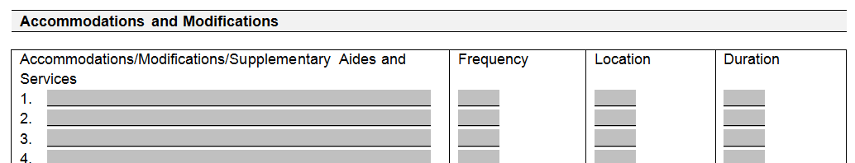
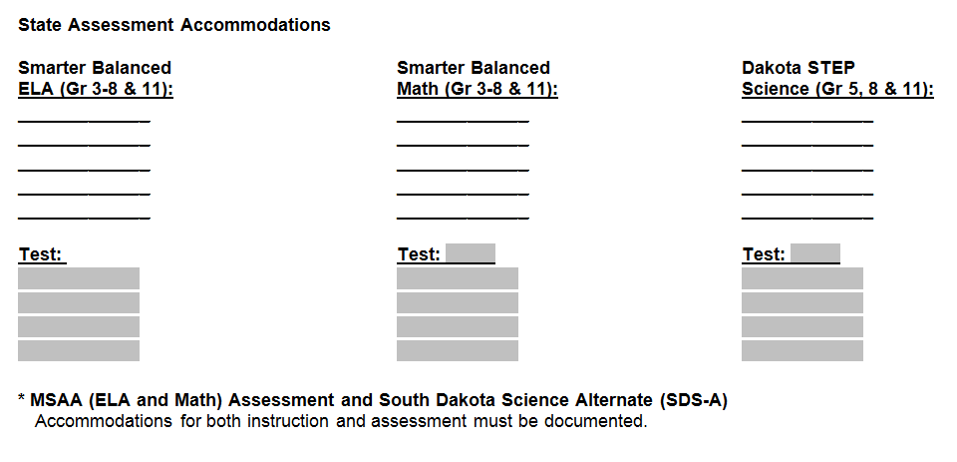
MSAA Accommodations
Assistive Technology
Paper Version
Scribe
Sign Language
Large Print
Braille
Must be written into the IEP on the Instructional And Statewide Section

Slide 8
Reports TC will Access

Slide 9
MSAA Reports
TC will download reports
September 25 to October 19, 2018
https://www.msaaassessment.org
When available, notification on TC list serv
Contact: Melissa Flor
(TC = Testing Coordinator)

Slide 10
MSAA Reports
District Summary (PDF and CSV file)
School Summary (PDF and CSV file)
Individual Student Report (ISR)
  Required to be sent to families
Must also download
  MSAA 2018 Guide for Score Report (Sept 25)
  DOE website under Alternate Assessment
Notes:
MSAA guide for Score report provides information on:
What the different reports mean?
Important teacher section:
Performance level descriptors used
Writing rubrics used

Slide 11
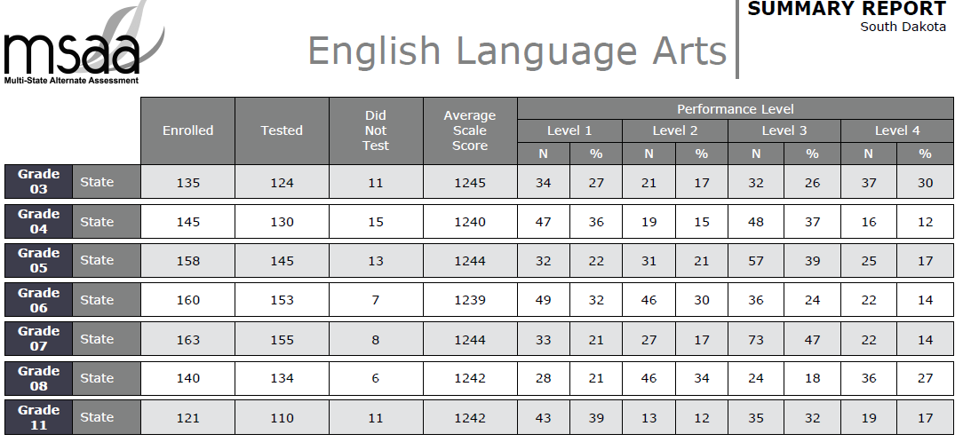
2017 State MSAA ELA
* Includes BIE

Slide 12
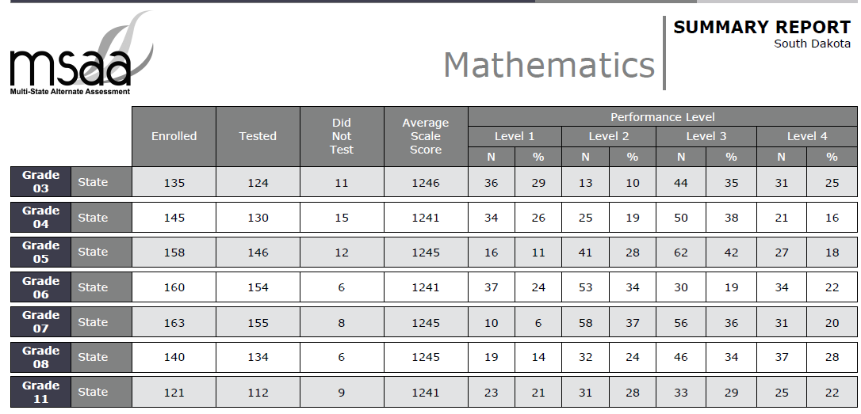
2017 State MSAA Math
* Includes BIE

Slide 13
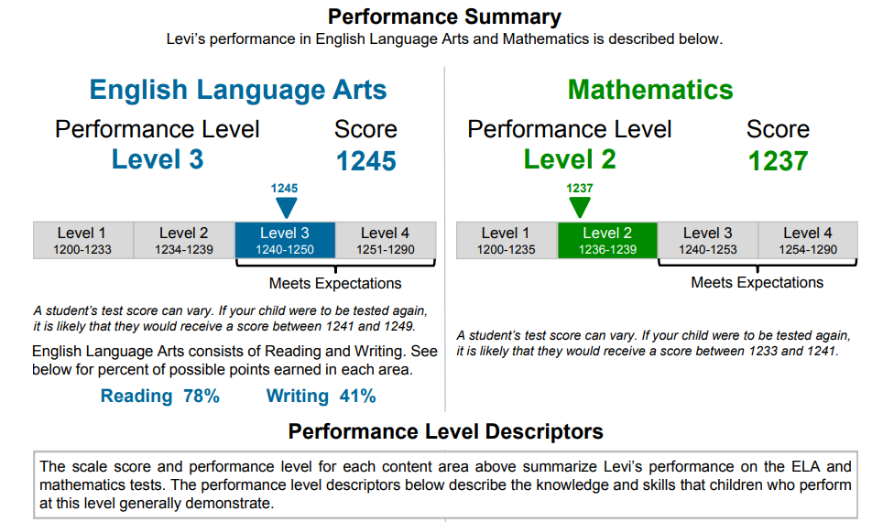
Individual Student Reports
2017: ELA score = reading and writing

Slide 14
Alternate Assessment Website
http://doe.sd.gov/assessment/alternate.aspx
  2018 Guide for Score Report
    Explains different reports
    Performance Level Descriptors (PLD)
      Grade
      ELA and Math
      Writing Rubric
  Available when download the reports
Share with teachers

Slide 15
Preparation for MSAA Administration

Slide 16
Timeline/Dates
Testing Window
  March 18 to May 3, 2019
Testing Coordinator access approximately to MSAAmeasuredprogress.org
  March 11, 2019

Slide 17
Process Prior to Administration
Review system modules
Add test administrators
Create classrooms
Students added or deleted
Is it updated in campus?
Contact DOE
DOE will request designated MSAA District TC
Access to MSAA system
Notes:
Request designated MSAA District TC – Last two weeks in February
Access to MSAA approximately March 11
Review appropriate modules – System and how to enter TA and class (if applicable ESR)

Slide 18
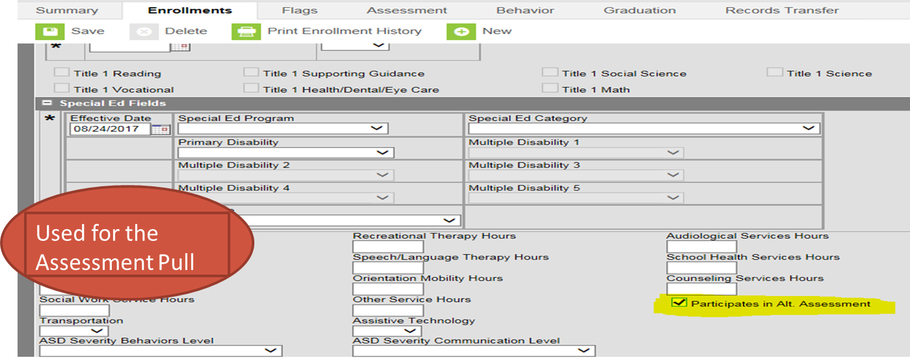
If yes, student will take the alternate assessment,
Staff notify the campus person
Campus person will go to the enrollment tab
Check the box “Participate in the Alt Assessment”

Slide 19
TC Roles During
Review training modules
Security Agreements TC and TA
Alternate Assessment website
Notify TA of required modules
Ensure TA following testing procedures
If applicable, Early Stopping Rule
Notes:
TC will have training modules on system and Early Stopping Rule
TC will need to ensure
Sign security agreement by TC and TA
Alternate Assessment website
Notify TA of required modules to pass
Ensure that TA are following all testing protocols

Slide 20
Early Stopping Rule (ESR)
(if applicable)
Unobservable independent response
TA tries to access the 1st 4 questions
TA tries multiple times
TA comes to TC with data
TC can select ESR
Testing Administrator (TA)
Notes:
ESR is very limited.

Slide 21
South Dakota Science Assessment - Alternate
SDSA-ALT

Slide 22
Overview
Embedded in regular SDSA system
Components SDSA-ALT:
Rubric
Evidence submission
Teachers must be using new Science Core Content Connectors
  Training Oct 2 and 4 (DOE Events Calendar)

Slide 23

Resources

Slide 24
Alternate Assessment Website
http://doe.sd.gov/assessment/alternate.aspx
Example of Information:
  Sample Items – Best Practice Videos (TEACHERS)
  MSAA Test Security Agreement Link
  2018 Guide for Score Report
  Alternate Assessment List Serv
    TC and TA - IMPORTANT
  Alternate Assessment Criteria
Testing Coordinator and Administrators

Slide 25
Instructional Support for Student with Significant Cognitive Disabilities
http://doe.sd.gov/sped/instructionalSCD.aspx
  ELA, Math, and Science Core Content Connectors
  Alternate Assessment Criteria
  Augmentative Communication
Testing Administrators/ Teacher

Slide 26
Contact
Melissa Flor
  605-773-6119
  Melissa.Flor@state.sd.us

