Slide 1
South Dakota Science Assessment South Dakota Science Assessment-Alt
New Assessment Coordinator Workshop
August 30, 2018

Slide 2
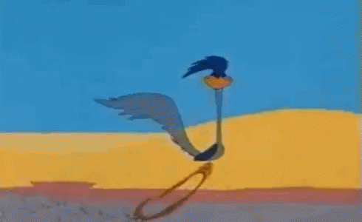
South Dakota Science Assessment

Slide 3
South Dakota Science Assessment
Background Information
Assessment based on standards adopted in 2015
Focuses on Disciplinary Core Ideas
Only grades 5, 8, and 11 are assessed
Standards assessed across grade spans
Grade 5: grades 3-5 standards
Grade 8: grades 6-8 standards
Grade 11: high school standards

Slide 4
South Dakota Science Assessment
Science Assessment page:
http://doe.sd.gov/Assessment/science.aspx
Test Design Plan and Blueprints
Achievement Level Descriptors
General statements of what students should know
Performance Level Descriptors
Reflect performance on assessment

Slide 5
South Dakota Science Assessment
Assessment Design
Each grade-level test has 60 operational items and 10 field test items across 3 strands
Strands are Physical, Life, and Earth Space Science
New items written to fill any gaps
Items evenly mixed as much as possible in 3 sessions

Slide 6
South Dakota Science Assessment
Curriculum/Classroom Resources
Full Standards found here:
http://doe.sd.gov/contentstandards/documents/sdSciStnd.pdf
Disciplinary Core Ideas (Appendix A):
http://doe.sd.gov/contentstandards/documents/ApxA-DCIP.pdf
NSTA Resources
Curriculum: http://ngss.nsta.org/Curriculum-Planning.aspx
Classroom Resources:
http://ngss.nsta.org/Classroom-Resources.aspx

Slide 7
South Dakota Science Assessment
District Test Coordinators
Whoever is listed as Assessment Coordinator in DOE database
Responsible for creating all other accounts in district
One DTC account per district
District Level User account has most of the same permissions

Slide 8
South Dakota Science Assessment
Students loaded from a one-time pull from Infinite Campus in January
If information is incorrect in Campus, it will be incorrect in SDSA/SDSA-Alt
Make sure it is correct before testing
Accommodations need to be set before testing, too
Should be used regularly, not just for summative assessments

Slide 9
South Dakota Science Assessment-Alternate

Slide 10
South Dakota Science Assessment-Alt
South Dakota Science Assessment-Alternate
Portfolio based
Students rated on Core Content Connectors
http://doe.sd.gov/sped/instructionalSCD.aspx
Rater 1 is the student’s certified teacher
Rater 2 is anyone else familiar with the student
Must have 1 piece of evidence for each strand
3 pieces total
Physical, Life, Earth and Space Sciences
Loaded into system by Rater 1

Slide 11
South Dakota Science and Science-Alt
Any Questions?
Chris Booth
christina.booth@state.sd.us
605-773-6516
Melissa Flor
Melissa.flor@state.sd.us
605-773-6119

