Slide 1
New Assessment Coordinator Workshop: English Learners
August 30, 2018

Slide 2
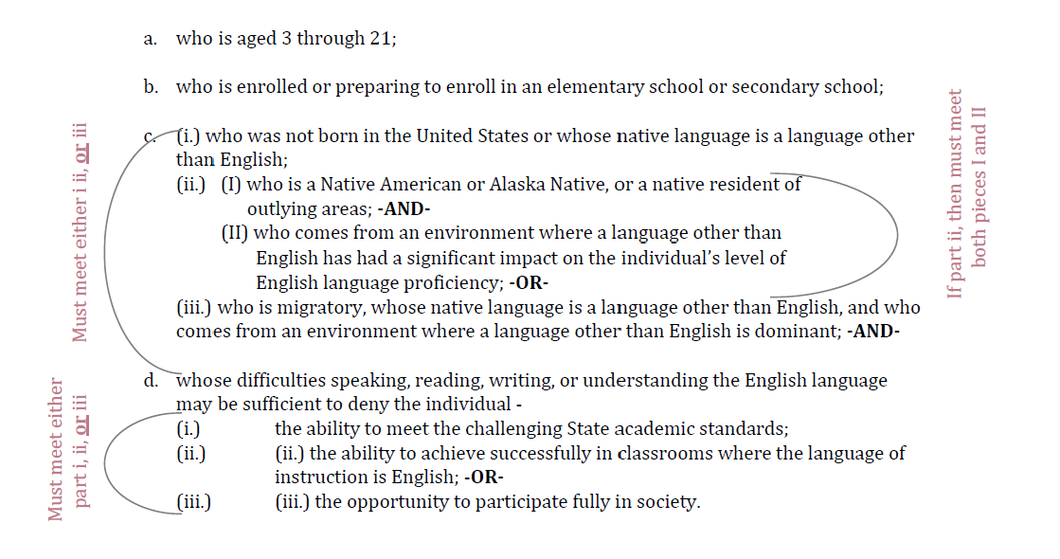
Who are English Learners?

Slide 3

Identification Process Timeline
The identification process MUST take place…
30 days from the beginning of the school year (ESEA Section 1112 (A))
Or 2 weeks after enrollment if student arrives after the beginning of the year

Slide 4
Identification Process
Screening
Parent Notification Letter
Infinite Campus
Home Language Survey
At the beginning of the school year 30 days from enrollment to complete process
Two weeks to complete process throughout school year

Slide 5
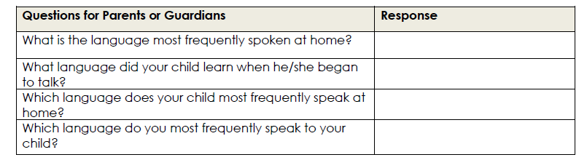
Identification
Questionnaire given to parents and guardians
Helps schools and LEAs identify which students are potential ELs and who will require assessment of their English language proficiency
Given to ALL students
Notes:
If any single response indicate a language other than English, school districts are then required to collect information to determine if the student is an EL.

Slide 6

Possible Considerations
Before screening student couple things to consider…
Does the student have available records that may be used to help determine whether the student demonstrated the “ability to successfully achieve in classrooms where there language of instruction is English.”
Examine student cumulative folder to determine whether the student was previously identified and receiving EL services
Did they come from another WIDA state and have screener results?

Slide 7
Screening
Once students are identified as potential ELs via the HLS…
Students must be assessed with a valid and reliable assessment to determine if they are indeed ELs
SD utilizes the WIDA English Language Proficiency Assessments

Slide 8

What is WIDA?
World-Class Instructional Design and Assessment
A consortium of states dedicated to the design and implementation of high standards and equitable educational opportunities for English Learners
South Dakota is 1 of 39 states that are members of the WIDA consortium
Notes:
WIDA provides us with a variety of assessments, standards, and professional development

Slide 9
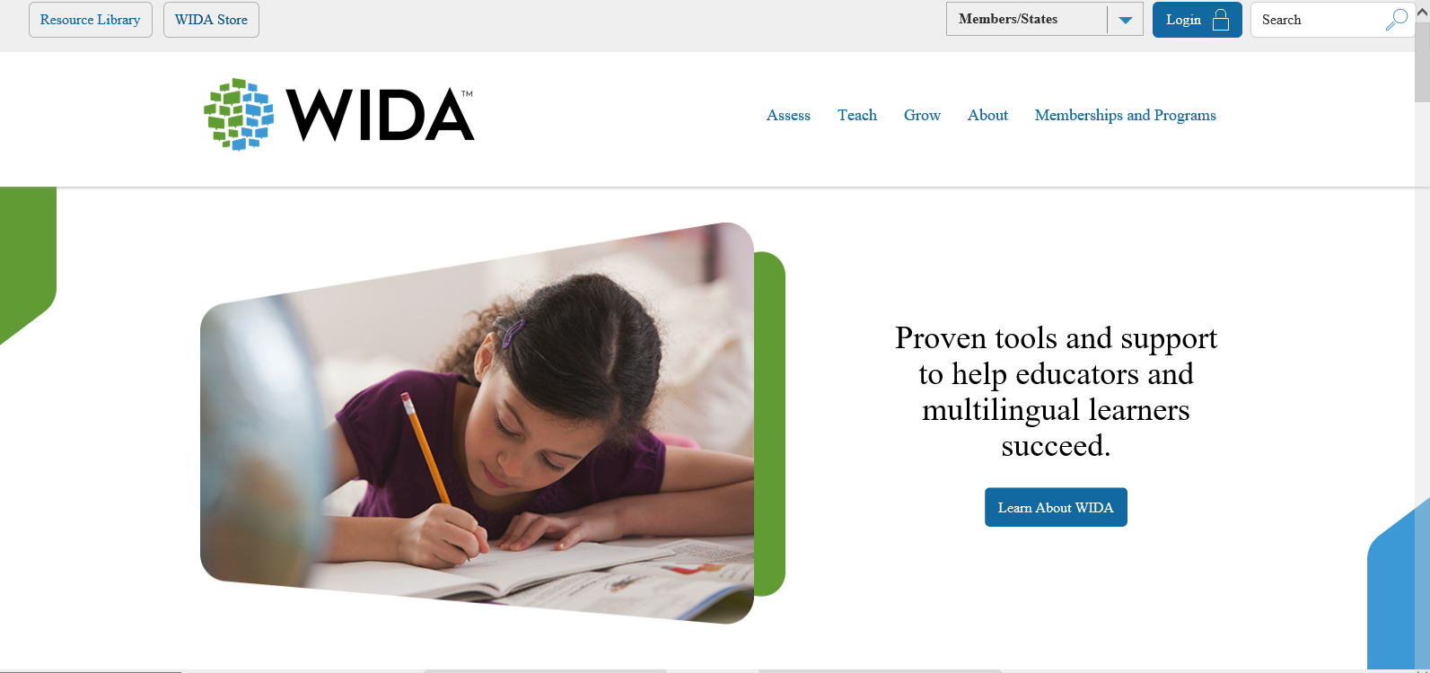
WIDA Website
KG W-APT & Screener Test Docs & Webinar
Training Course
Preparation Resources
Educator Resources
Summative Assessment
ELD Standards
Can-Do Descriptors
Sample Items
Manuals
Recorded webinars

Slide 10
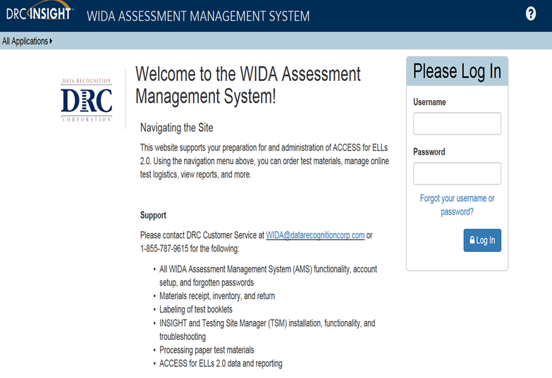
WIDA AMS
Set up Test Administrator and Technology Coordinator accounts
Designate permissions for users
Select needed accommodations
View Reports
View & Print test tickets
Create test sessions
Use system to view technology preparation materials
Such as user guides & technology web-based modules
Download testing software from the system

Slide 11
Who can administer the EL Assessments?
A certified educator must administer the EL assessments…

Slide 12
Kindergarten W-APT

Slide 13
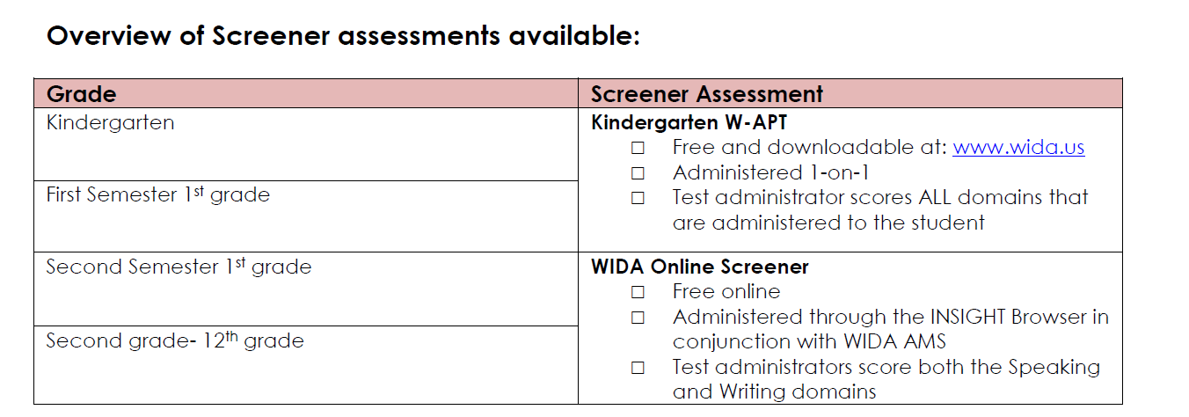
WIDA Identification Assessments
Notes:
What is the purpose: to identify the academic English language proficiency level of students who may be candidates for ELL services.
To determine the academic English language proficiency level of students new to a school or to the U.S. school system in order to determine appropriate instructional services

Slide 14
Kindergarten W-APT
Grades KG – first semester first grade
If student is first semester KG you only administer the Speaking and Listening domains
No quiz required
More information can be found here:
Notes:
This assessment is not for Pre-K students. The earliest you should give this assessment is May prior to entering KG.
Because literacy is so developmental for students at this age, it is not recommended that the diagnostic literacy test (Reading and Writing components of the W-APT) be administered until students have had some literacy instruction, or the second semester of Kindergarten at the earliest.

Slide 15

How to Access the Kindergarten W-APT
Free and downloadable from
My Account & Secure Portal on www.wida.us
Contact your District Testing Coordinator, or State Education Agency for accessibility

Slide 16
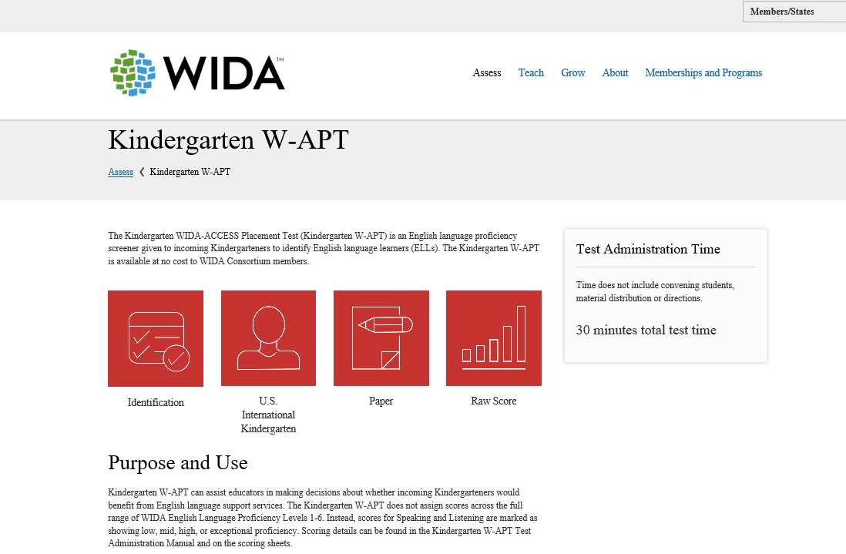
Resources for KG W-APT

Slide 17
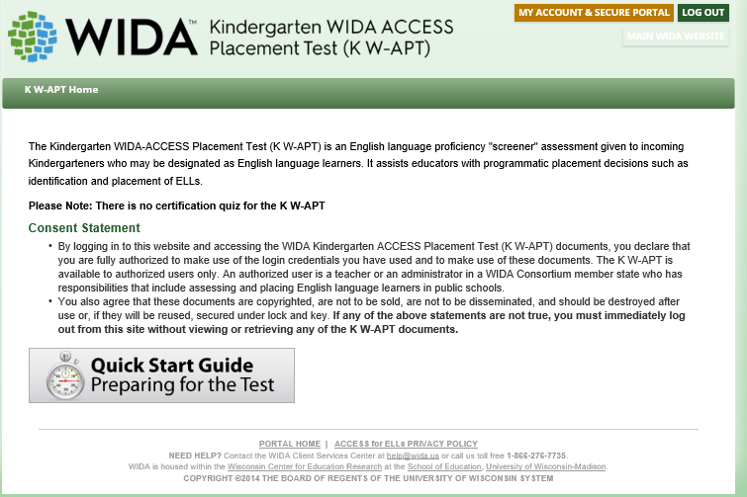
Resources for KG W-APT
Everything you need to help you administer the KG W-APT can be found here

Slide 18
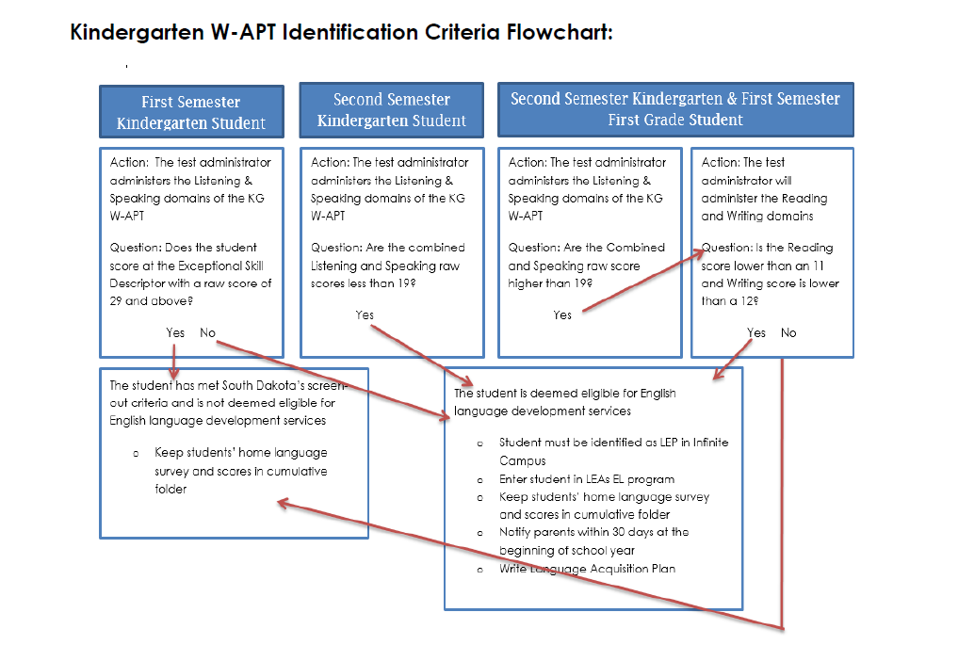
KG W-APT Entrance Criteria

Slide 19
WIDA Screener online

Slide 20

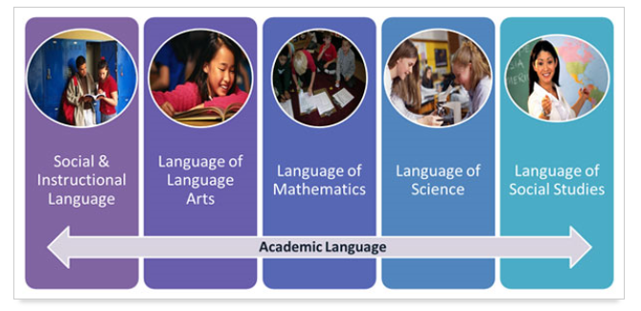

WIDA Screener Online Grades 1-12

Slide 21
WIDA Screener Online Grades 1-12
Grades second semester first grade -12th grade
Test administrator must complete all training requirements to give the WIDA Screener online
Test administrator scores Speaking and Writing domains of WIDA screener
Tech requirements are the same as the ACCESS for ELLs assessment

Slide 22
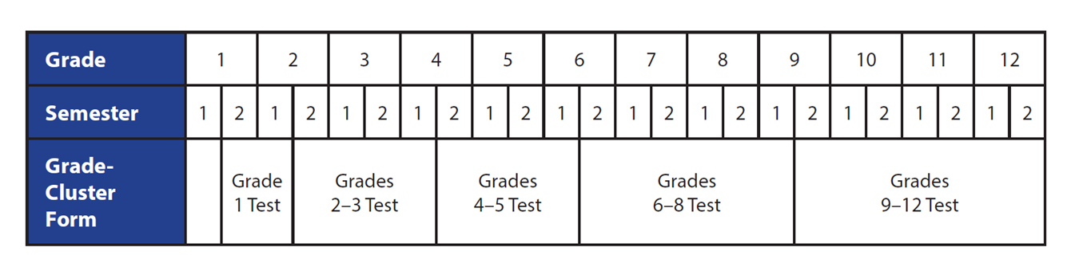
Off-Grade Clustering
For students in the first semester of the first year in a grade-level cluster, WIDA recommends the option of administering the lower grade cluster form

Slide 23

Technology Requirements
Technology requirements are the same as for ACCESS for ELLs:
- WIDA AMS
- TSM (Testing Site Manager)
- Secure INSIGHT Browser
What is different?
- student files & test sessions are created locally
- Using WIDA AMS to locally score Speaking and Writing

Slide 24
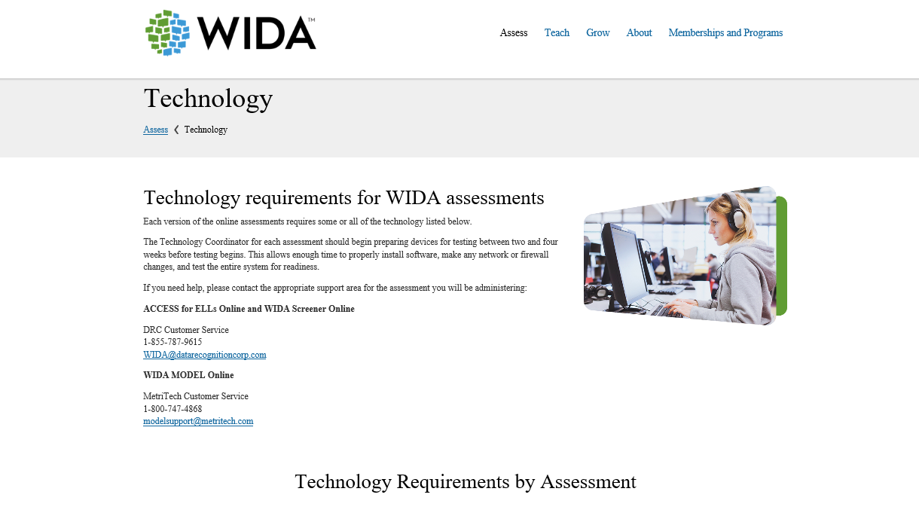
Technology Resources

Slide 25
Technology Coordinator
Will need an account for WIDA AMS
All downloads and resources are found in WIDA AMS
Technology Coordinators do not need a WIDA website account

Slide 26

Training Materials for TAs
Online Screener training course
Online Test Administrator Manual
WIDA AMS User Guide
4 modules:
- Launching the screener
- Administering screener
- Screener scoring
- Accessing score reports

Slide 27
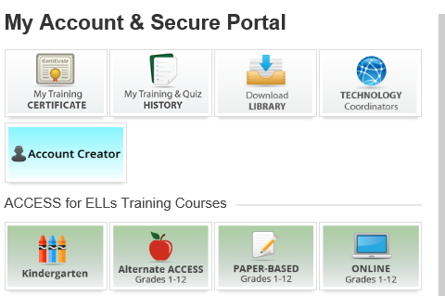
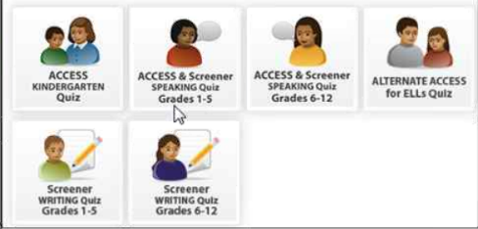
WIDA Screener Training Requirements
Quizzes must be passed with an 80% or higher to become certified to give the WIDA Online Screener

Slide 28
Administering Online Screener
One test ticket for the entire test
TA scripts are available on training course for local download and printing
TA prints Writing Test Booklets (Grades 1-3) and distribute based on Tier assignment during test
Student must open and click through the Writing domain even if they are taking the test on paper
Tier assignment shown on student screen

Slide 29
WIDA Screener Entrance Criteria
Grades 1-12 WIDA Screener:
-Students with a composite score lower than 5.0 qualify for EL services.

Slide 30

WIDA Screener Webinar
September 11, 2018 2-3 pm Central Time
Call information can be found here: http://doe.sd.gov/assessment/documents/WIDA-Schedule.pdf

Slide 31
Annual Parent Notification Letter
Must be sent annually to ALL families of identified English learners
Required under Title I and Title III
Must notify parents of 8 components
Sample letter available on SD DOE Title III page
Notes:
new families of identified English learners and families of students who continue in the program.
Give examples of the components

Slide 32
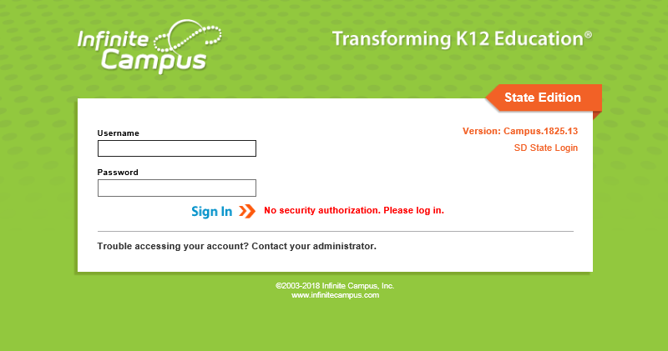
Infinite Campus
IMPORTANT data elements in Infinite Campus!
EL Designation
First Year in Country

Slide 33
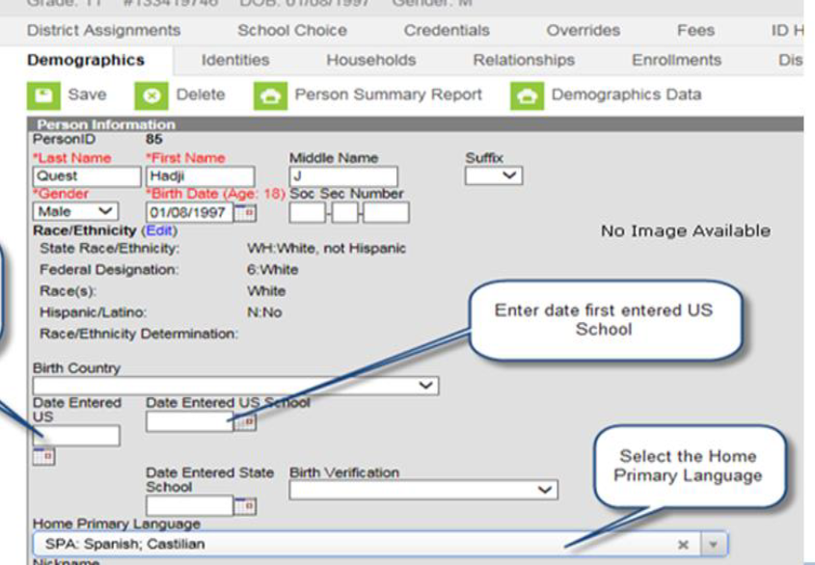
Creating an EL Record
Infinite Campus Path: Census-People-Demographics
Before creating EL record, please identify Home Primary Language

Slide 34
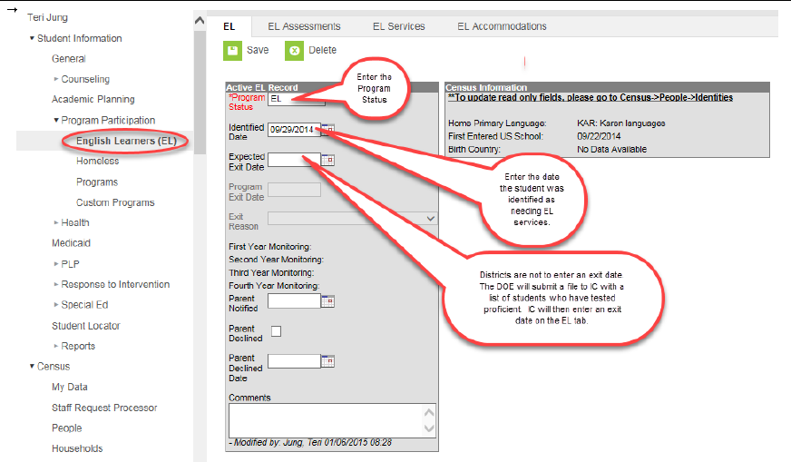
Creating EL Record
Infinite Campus Path: Student Information-Program Participation-EL
Please indicate the student Screener score here
Notes:
Explain the different sections

Slide 35
First Year in Country Criteria
Must be an identified EL student, who has attended schools in the United States (not including Puerto Rico) for less than 12 months
Must take ACCESS 2.0 if enrolled during testing window to get the first year exemption from the ELA portion of SD Summative Content Assessment (Smarter Balanced)
If student arrives after ACCESS 2.0 the school needs to administer the WIDA Screener
If this criteria is met, student is excused from ONE administration of ELA SD Summative Content Assessment
Student participates in Math & Science, but results only count for participation in the first year. Scores are not included in accountability

Slide 36
First Year in Country
The first year in country will be considered if a student is EL and first entered the United States between May 2 of the previous spring (Spring of 2018) and May 1 (Spring 2019) of the current year
Schools must indicate ALL 3 options:
Date Entered U.S
Date Entered U.S school
First Year in Country box

Slide 37
Creating a First Year in Country Record
Infinite Campus Path: Census-People-Demographics

Slide 38
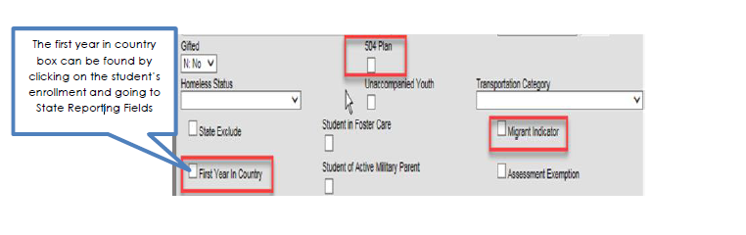
Creating a First Year in Country Record
Infinite Campus Path: Student Enrollment Record- State Reporting Fields

Slide 39


Resources
Identification & Screening Manual
English Learner Data Elements in Infinite Campus
http://doe.sd.gov/title/documents/Mini-Manual.pdf
http://doe.sd.gov/title/documents/IC-ELData.pdf

Slide 40
WIDA summative Assessments

Slide 41
WIDA Summative Assessments
Secure large-scale English language proficiency assessment
Administered to identified English learners in grades K-12

Slide 42

Kindergarten ACCESS
Paper
Individually administered
Includes manipulatives
ALL components scored by Test Administrator during test administration
KG ACCESS

Slide 43

Alternate ACCESS
Paper-based
Participating students must have a Significant Cognitive Disability
Taking an Alternate State Content Assessment documented in an IEP (alternate curriculum)
Participation Criteria
Alternate ACCESS for ELLs

Slide 44
ACCESS for ELLs
Grades 1-12
Online
Can be administered in a group setting
Staged Adaptive
ACCESS for ELLs

Slide 45
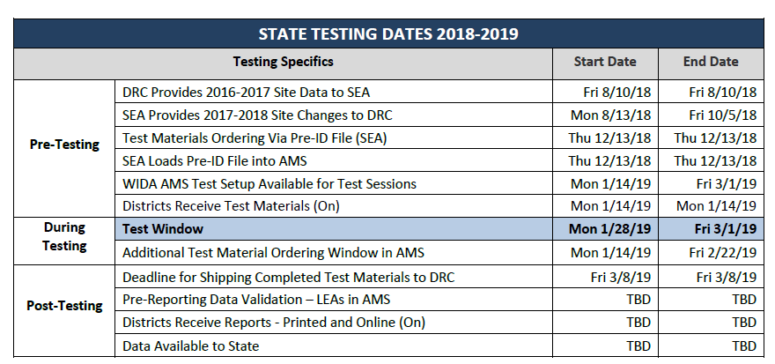
ACCESS 2.0 Schedule

Slide 46



Training Course
Each assessment has a separate training component
May be completed in one-sitting, or in as many sessions as necessary
One-two weeks prior to first administration of test

Slide 47
Training Summary
SD DOE highly recommends that all training is completed on an annual basis…

Slide 48

ACCESS 2.0 Roadshow
November 26, 2018 – Pierre
November 29, 2018- Sioux Falls
December 4, 2018 – Aberdeen
December 11, 2018- Rapid City
To register for the class, go to http://southdakota.gosignmeup.com

Slide 49
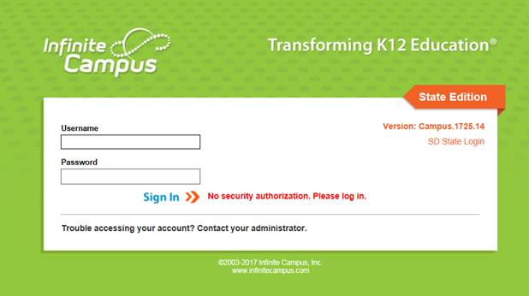
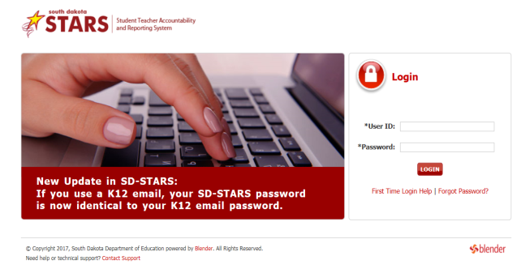
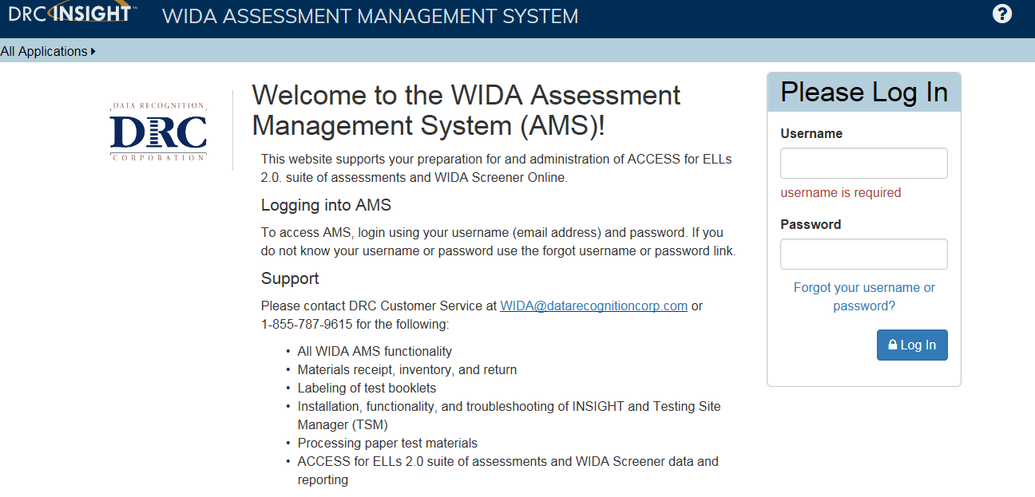
Reports and Data
Where to find it…
Infinite Campus
Assessment Tab – EL Tab
SD Stars
Reports Tab – Assessment Reports -
ACCESS Test Takers
WIDA AMS
All Application – Report Delivery –
On-Demand Reports

Slide 50
Reports and Data
Responsibilities for distributing and maintaining
File in student cumulative file
Share with student, their parents, and appropriate educational staff
District wide usage and monitoring of data to support and alter EL programs

Slide 51
WIDA & DRC webinars
Free weekly webinars
Covers a range of pre, during, and post-testing topics
Organized to cover content relevant to particular roles
Webinar Schedule & Call Information

Slide 52

Questions?

Slide 53
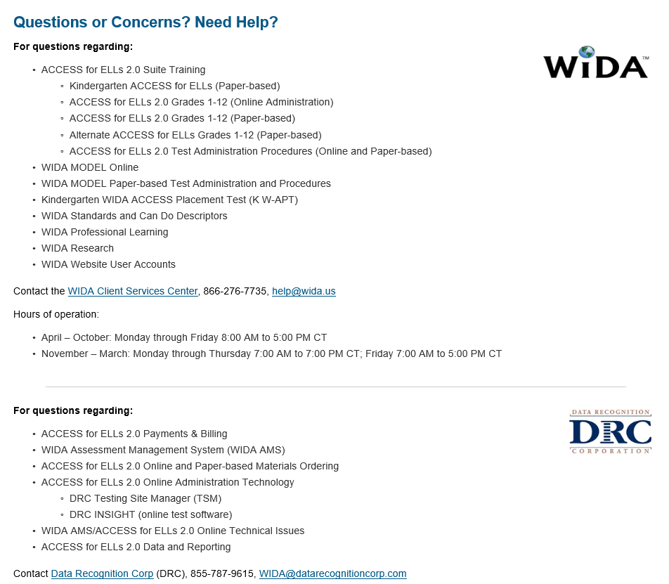
Who to Contact?

Slide 54

Yutzil Becker
Yutzil.Becker@state.sd.us
605.773.4698
Joe Moran
Joe.Moran@state.sd.us
605.773.3247

Slide 55


