Slide 1


Rob Ingalls Department of Education Child and Adult Nutrition Services
Claim Submission Instructions for iCAN
Notes:
Good day,
The following presentation will include instructions on how to submit claims in iCAN for the Fresh Fruit and Vegetable Program.

Slide 2
Budgeting
The school needs to be fiscally responsible for managing this grant
Establish a monthly budget to assist you in tracking funds and ensure timely expenditures of program funds
Weekly amount
Not spending the money is a disservice to your students
Notes:
Establish a method to ensure that whomever is responsible for ordering product is aware of the amount of allocation remaining. Remember to spend your funds responsibly.
Consider using the budget tracker form, or determine a weekly average of your allocation period.

Slide 3
60/90 Day Claiming
Claim Month | 60 Day Due Date
July | September 29
August | October 30
September | November 29
October | December 30
November | January 29
December | March 1
January | April 1
February | April 29
March | May 30
April | June 29
May | July 30
June | August 29
Federal regulations require claims be reviewed and approved within 60 calendar days from the last day of the claim month.
Notes:
Claiming for the FFVP follows the same 60/90 day rule as other programs like NSLP and SBP.

Slide 4
FFVP Claiming– pg. 25-27
Submit through iCAN
Claims must be submitted by the 10th of the month following the claim month and must follow the FNS 60/90 day claim guidance
August/September claim is the only claim that can be combined.
Notes:
FFVP claims for reimbursement are to be submitted through the iCAN system. If you are a previous participant, the same information previously provided will be included. Best practice would be to keep a copy of the iCAN FFVP claim instructions for the first few months until you feel comfortable. The FFVP Coordinator should have received the instructions. We will look more closely at the claim form and process momentarily.

Slide 5
Claims for Reimbursement
Costs are allocated to individual schools
Separate claim for reimbursement per school
F/V, labor, supplies, equipment must be school specific
Notes:
As a reminder, costs are allocated to individual sites. A separate claim for reimbursement must be submitted for each site. This would include fruit and vegetable purchases per site, labor per site (if claimed), small supplies, and equipment.

Slide 6

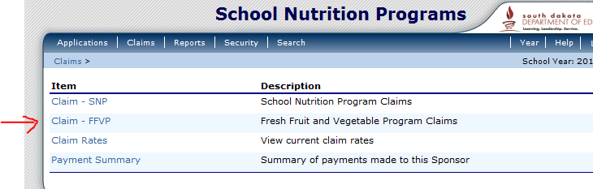
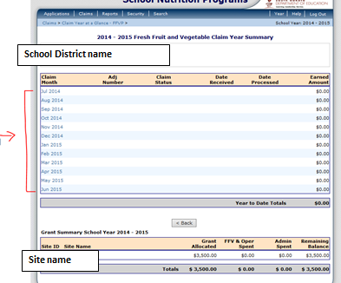
1.
2.
3.
Notes:
After logging in to iCAN, you will select the claims button on the top, as we can see in figure 1.
Then, select Claim – FFVP, if the option is available, as seen in figure 2. If you cannot see the FFVP section of the claims, you do not have security rights for FFVP. Please fill out a new user request, asking for FFVP claim rights, and submit to the CANS office. If you have any questions, please contact the CANS office.
After that, select the month that you are submitting a claim for, as seen in figure 3.

Slide 7
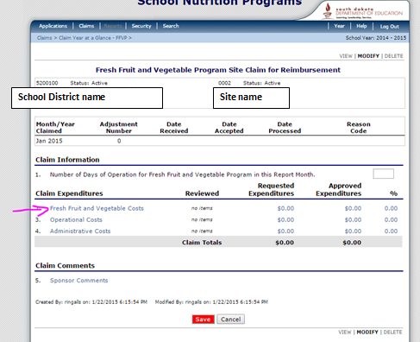
Claim Worksheet – Cover Page
Notes:
Next, you must click Add Original Claim.
After clicking on Add Original Claim, and clicking Add for the specific site, you can provide information for the specific parts of the claim. Click on Fresh Fruit and Vegetable Costs first.

Slide 8
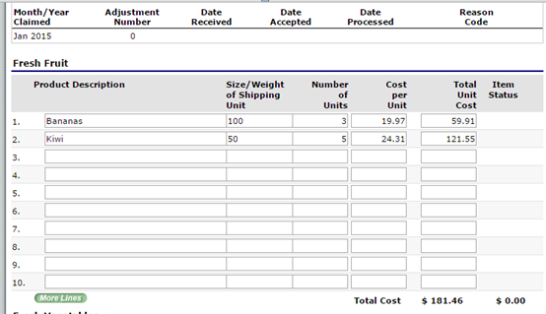
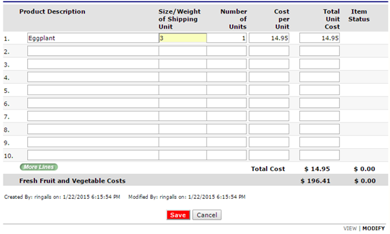
Claim – Fruit and Vegetable
Notes:
After clicking on Fresh Fruit and Vegetable Costs, enter the product description, size/weight/count of product, number of units, and cost per unit. The Total Unit Cost will automatically calculate.
The size/weight of shipping unit should be entered as the count, or number of products in one unit.
Here, we can see the school is claiming 3 units of bananas, each at 19.97, which comes to a total of 59.91. According to the size, each unit has 100 bananas.
Click Save when you are finished with listing your fruits and vegetables.

Slide 9
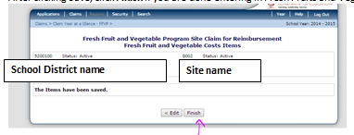
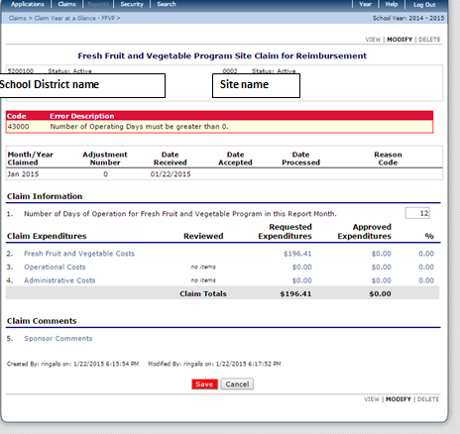
Claim – Other expenditures
Notes:
After clicking Save, click Finish on the Fruit and Vegetable section. You will then be returned to the Claim Expenditure section. Here, you can click on Operational costs or administrative costs, if you have other expenditures to claim. Follow the previous steps if there are additional items to claim. We will touch on Operational Costs in the next slide.
Remember that Administrative Costs, such as labor associated with menu planning, purchasing, and financial reporting cannot exceed 10% of the total award. You are not required to claim administrative costs.
Additionally, equipment purchases are to be considered as administrative costs – and sites must receive pre-approval prior to making the purchase.

Slide 10
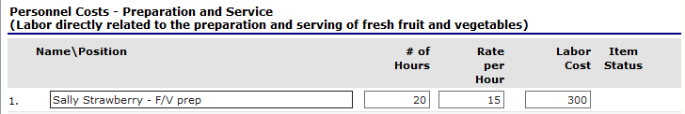
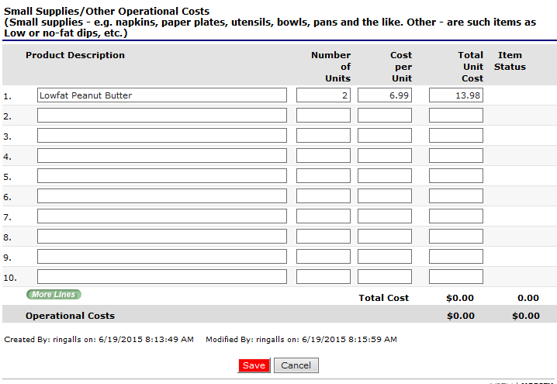
Claim – Other expenditures
Notes:
When claiming personnel costs in the Operational Costs section, provide the employee’s name, and a brief statement on work completed. Include number of hours claimed from the month for FFVP, and the hourly rate. Labor cost will be automatically calculated. As a reminder, you do not need to claim labor. In our example, we can see that Sally Strawberry worked 20 hours of FFVP over the month, at a rate of 15 dollars per hour, which calculates $300 of FFVP labor over the month.
For Small supplies, provide a product description, and number of units with the cost per unit. The total unit cost will automatically calculate. Here in our example, we can see that 2 units of Lowfat Peanut Butter were claimed at a cost of 6.99 per unit.
Once you are finished with this section, click Save.

Slide 11
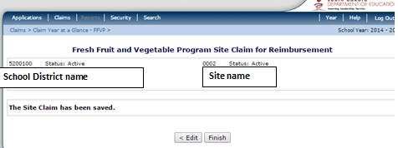
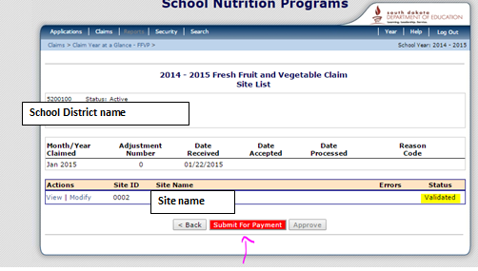
Claim – Submitting for Payment
Notes:
After clicking Save, click Finish if you are ready to submit. Remember to include number of operational days for the claim month.
Next, you will see a red button that says ‘Submit for Payment’. When you are ready to submit, click this button.
After submitting for payment, your claim status will indicate ‘Pending Approval’.

Slide 12
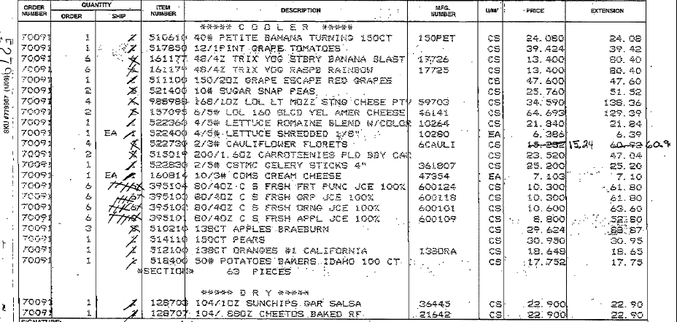
Sample Invoice
Notes:
Keep invoices on file at your school. You do not need to submit the invoices to the CANS office.
Some schools order all FFVP products within the same invoice as other food for other programs. This is fine. It would be best practice to have a copy of the invoice, and highlight the FFVP items.

Slide 13
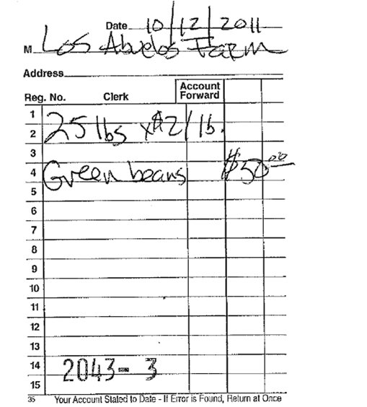
Sample Invoice
Notes:
Other schools are able to have the FFVP items broken out from the main invoices. This seems to work well for many schools.

Slide 14
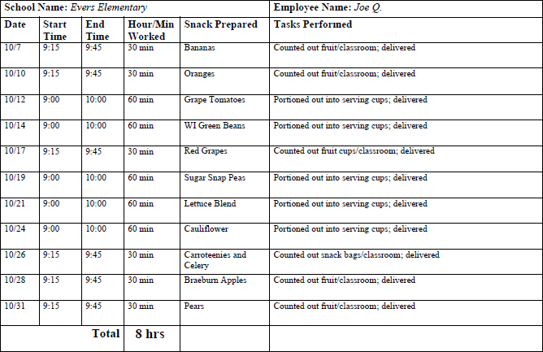
Sample Time Card – Labor
Notes:
If you are claiming labor with FFVP money, remember to develop a method of tracking the labor designated as FFVP to be claimed.

Slide 15
Filing a Second Claim
Schools must complete a new claim each month using the same process each month
No data will carry over
If revisions need to be made to any already submitted claim, submit the revised claim and the difference will be reimbursed if approved.
Notes:
Schools must complete a new claim each month using the same process each month
No data will carry over
If revisions need to be made to any already submitted claim, submit the revised claim and the difference will be reimbursed if approved.
You can complete a revised claim on iCAN, if needed. If difficulty with filing a second claim occurs, please contact myself or Dawn.

Slide 16
One-Time Exception
If something comes up where a claim is not submitted by the Final Deadline for the claim, a one-time exception can be filed.
School districts can only submit a one-time exception form once every three years.
If your school has submitted a one-time exception within the last 3 years, your claim will not be reimbursed if submitted after the Final Deadline of the claim.
Notes:
And lastly, the One time Exception.
If something comes up where a claim is not submitted by the deadline, a one-time exception can be filed.
School districts can only submit a one-time exception form once every three years.
If your school has submitted a one-time exception within the last 3 years, your claim will not be reimbursed if submitted after the deadline.
If one-time exception use is needed, please contact myself or Dawn Boyle, as submitting a claim outside of the due date window will trigger an error.

Slide 17



Thank you!
Please feel free to contact Rob Ingalls, FFVP Coordinator
605-773-2977
rob.ingalls@state.sd.us
Notes:
Thank you for observing the FFVP Claim Submission Instructions for iCAN. Additionally, we have posted instruction on FFVP claim submission on the iCAN webpage. Please feel free to take a look, as the printed instructions have been helpful to others.
Please feel free to contact me with any questions.
Thank you.

Slide 18

FFVP Claim Training
This training credits for 30 minutes of training in
Key Area 3 - Administration
3330 – Budgets
3310 – Meal Counting, Claiming, Managing Funds
Your Name:
Date of Training:

