Slide 1

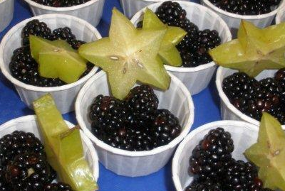
Rob Ingalls
Department of Education
Child and Adult Nutrition Services
Program Requirements
and Information
Notes:
Good day,
The following presentation will include Program Requirements and Information on the Fresh Fruit and Vegetable Program.

Slide 2

Today’s Agenda
Program Basics
  Goals, History, How it works
  Operating Costs, Admin Costs
  Allowable/Not allowable Costs
  Getting Started
  Food Safety
  Financial Planning
Menu Planning
  Purchasing Requirements
  Special Dietary Needs
Notes:
We will be discussing program basics such as history, goals, and how to effectively run the program. Additionally, we will touch on operating and administrative costs, as well as allowable and unallowable costs. We will also talk about Menu planning for the fresh fruit and vegetable program.
If you think of questions throughout the presentation, please write them down, and feel free to contact me.

Slide 3

FFVP Handbook
USDA program guidance
Found at: http://doe.sd.gov/cans/documents/FFVPhandb.pdf
Please read through handbook for all basic requirements
Notes:
If you have not yet done so already, please save a copy of the FFVP handbook. It can be found off of our CANS-FFVP page. If you have trouble locating the handbook, please contact me.
Some of the information in the presentation can also be found in the handbook, and will be referenced accordingly. You will notice the reference on slides, indicating page numbers. These page numbers are in relation to corresponding pages from the FFVP handbook.

Slide 4
Program Goals- pg. 1
Create healthier school environments by providing healthier food choices
Expand the variety of fruits and vegetable (f/v) children experience
Increase children’s f/v consumption
Make a difference in children’s diets to impact their present and future health
Notes:
First, we will talk about program goals.
The goal of the Fresh Fruit and Vegetable Program is to promote healthy food choices and expand children’s exposure to fresh fruits and vegetables, to encourage an increase in fruit and vegetable consumption.
School sites with a higher free/reduced eligibility is the primary focus of the program.

Slide 5
FFVP History- pg. 2
2004 – South Dakota Indian Tribal Organization, Pine Ridge included
  FFVP became permanent through Richard B. Russell National School Lunch Act
2006 – additional $6 million in funding
2008 – FFVP offered nationwide
  Farm Bill directed FNS to conduct an evaluation of the FFVP
Notes:
South Dakota was granted inclusion to the Fresh Fruit and Vegetable Program in 2004. Previously, the FFVP was primarily a test program. The FFVP became a permanent program the same year. As of 2008, the Farm Bill became the primary source of funding for the FFVP.

Slide 6

Funding for FFVP
Funding provided through Farm Bill
Issued in accordance with Fiscal Year (Oct thru Sept)
State Agencies responsible for holding back funding for start of following school year, holding back State Admin funding
CANS issues funding to schools already split up into two dollar amounts – each from a different Federal Fiscal Year to correspond with the School Year

Slide 7
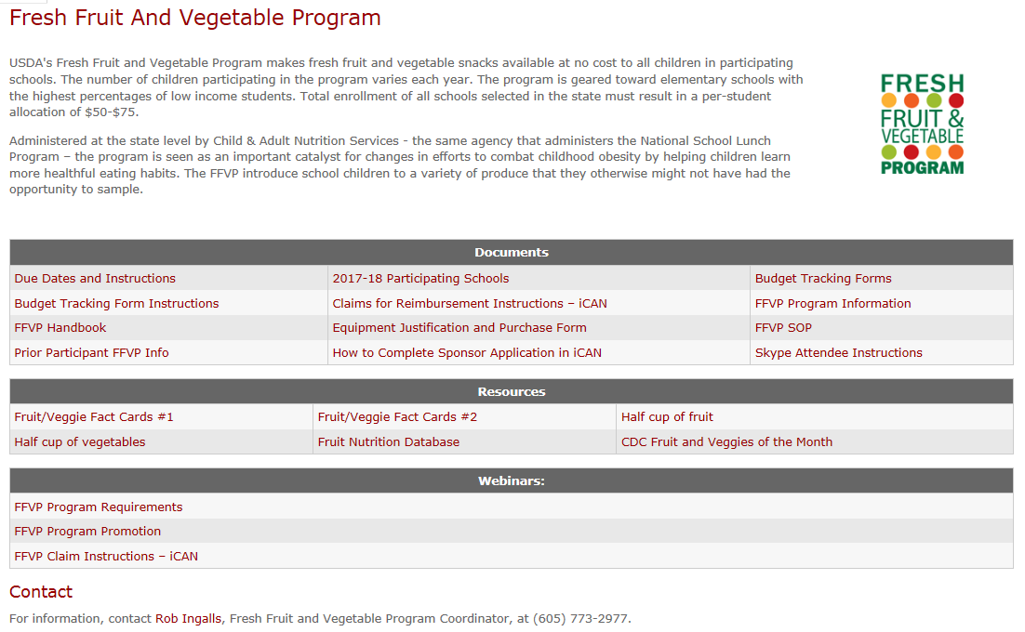
FFVP Website
Notes:
Here we can see a snapshot of the Fresh Fruit and Vegetable webpage.
The FFVP webpage provides links for a list of participating schools, budget tracking forms, the FFVP handbook, equipment justification forms, and also resources for the program.

Slide 8
How it works-
FFVP Handbook pg. 7-9
Elementary schools receive funds based on an allocation of $50-$75 per student
Funds are used to provide fresh f/v for all enrolled children
School submit claims to be reimbursed for costs of program
Fresh f/v are served at least 2 times per week during school hours
Notes:
Funding amounts are determined on a per-student allocation. The per-student allocation amounts were determined for schools based on frequency of service. The enrollment provided during the application process helped determine the budget per site. We used the free/reduced eligibility from October’s school lunch claim to help make approvals for the program, in accordance with program requirements.
More information can be found in the FFVP handbook, on page 7.

Slide 9

Grant Award
Award is allocated to school in two parts
  1st allocation
    Allocation period of 7/1 to 9/30
      State FFVP Coordinator notifies the FFVP Program Contact by email
    Items to complete:
      FFVP Quiz
Notes:
The grant award is split into two parts.
The 1st allocation runs from July 1 through September 30.
Allocation letters have already been sent to the FFVP coordinator and/or authorized representative.
There are a few items which are needed for FFVP participation:
The FFVP Quiz must be completed – this is a brief quiz, identifying basic areas to consider when running the program.
In prior years, schools had to complete:
The Attestation/addendum must be signed by the authorized representative or Superintendent. This should be taken care of automatically within iCAN now. I will reach out to the schools if additional action or information is needed.
The FFVP Sponsor Application must be completed in iCAN. This was completed at the time of application.

Slide 10

Grant Award
  2nd Allocation
    10/1 to end of the school year
      An average amount to spend per month is typically provided by the State FFVP Coordinator in email communication of the site selection
      2nd Allocation divided by number of months
Notes:
The 2nd allocation runs from October 1 through the end of the school year. This is the bulk of your award.
The 2nd allocation cannot be used for summer snacks.
An average amount to spend per month was provided in the July 30 email to the FFVP Coordinator.

Slide 11

Who can receive the fresh fruits and vegetables? pg. 10-11
All elementary school children who normally attend the school
Head Start or early childhood students enrolled at the school
Teachers and administrators who are role modeling f/v consumption in the classroom
Notes:
In regard to who can participate in the Fresh Fruit and Vegetable Program:
Elementary school is defined by how you report to the Dept. of Education (some schools have elementary schools K-8, PK-5, K-6, etc.)
This is to be consistent with the State of South Dakota Education Directory
Teachers choosing to participate with their students are strongly encouraged to include a nutrition education component to enhance modeling of healthy eating.
No additional FFVP funds will be provided; schools must stay within their per student allocation.
Please also note that this policy does not allow teacher or administrator fruit baskets, which were incorrectly purchased by some schools for promotional purposes when FFVP was initially implemented. Free fruits and vegetables are intended for all children enrolled in participating schools and cannot be used as gifts or rewards. You cannot withhold fruits and vegetables as a form of discipline.

Slide 12

Who cannot participate?
Middle School, Junior High and High School students
School staff not in direct contact with students during f/v snack time
Community members
Parents or grandparents
Notes:
In regard to who cannot receive the fruits and vegetables:
MS, JH, and HS students cannot receive the program
Additionally, school staff not in direct contact with the FFVP during snack time can also not participate in the program
And Community members cannot participate in this program, unless volunteering in the classroom providing the program

Slide 13
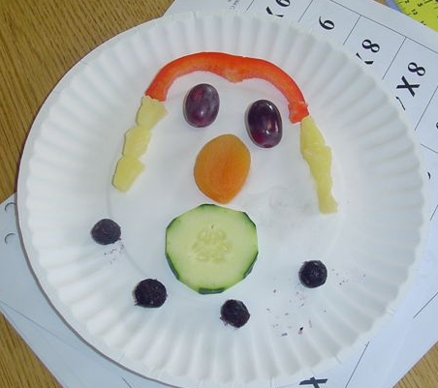
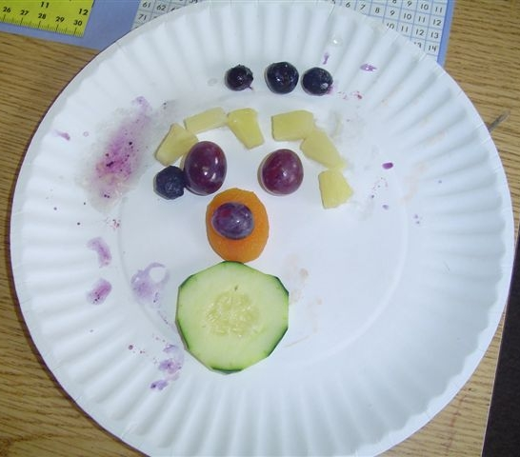
When to serve the f/v pg. 12-13
Must be served during the school day
Must be served separate of NSLP, SBP
You decide on the time of day and days of the week to best fit your school
Notes:
Must be served during the school day
Must be served separate of NSLP, SBP
You decide on the time of day and days of the week to best fit your school
When will your school serve the FFVP?

Slide 14
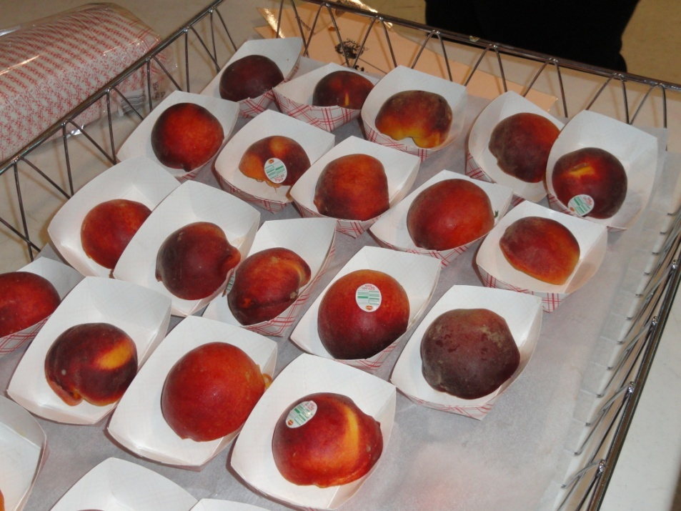
Snack Frequency
FFVP snack must be served a minimum of 2 days per week
Schools are encouraged to offer the program as many days of the week as their budget allows
Notes:
FFVP snack must be served a minimum of 2 days per week
Schools are encouraged to offer the program as many days of the week as their budget allows
Consider serving multiple times per day toward the end of the year if you have an excess amount of funds.

Slide 15
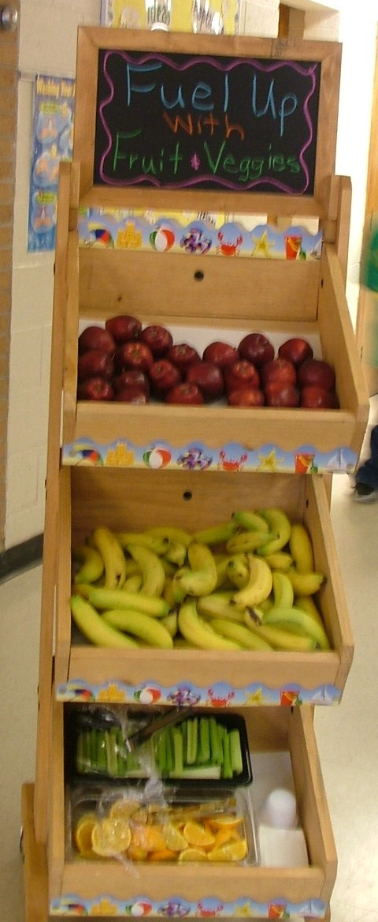
Where to serve the f/v? pg. 12-13
Classroom
Cafeteria
  Separate from NSLP and SBP
Hallways
  Kiosks
Nurse’s office
Library
School office
Notes:
The program can be provided in many different locations. Here are just a few.
Please remember that the FFVP must be provided separate, outside of the NSLP and SBP meal services.

Slide 16

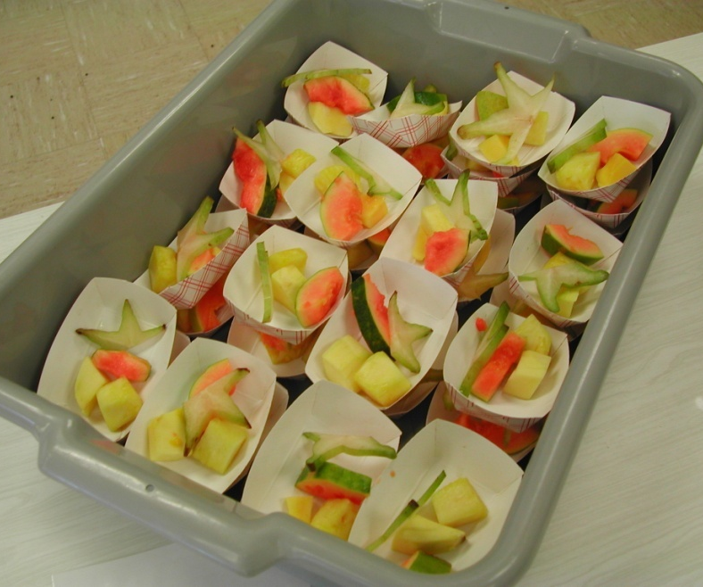
How to serve the f/v? pg. 12-13
No accompaniments
In the classroom
  Use of trays, rolling carts, bins
  Children/teachers pick up
  Food service staff delivers to classrooms or refrigerators near/in classrooms
Cafeteria/Central Location
  Platters
  Trays
  Free vending machines
Notes:
Some schools like to use trays, rolling carts, and bins and have students or teachers pick them up and deliver to the classroom. This is all appropriate. Others like to have students come down to the cafeteria. The decision is yours.
As a reminder, schools may not provide an accompaniment with the service of fresh fruits and vegetables. For example, a school could not provide a milk break in conjunction with the FFVP. Even if the school pays for the milk itself, the milk cannot be provided at the same time of the FFVP service.
The thought behind this is to maintain the focus on the fresh fruits and vegetables provided.
For more information on how to serve the program, see page 12 of the FFVP handbook.

Slide 17
What Can I Spend My Award On?
FFVP Funds
Operating Costs
Administrative Costs*
Food/Other
Labor
Equipment
Labor
  *Limited to 10% of award
Notes:
You can spend your FFVP award on operating costs and administrative costs.
Food, and small supplies fall under operating costs.
Labor, depending on the type, could fall under an operating cost or an administrative cost.
All equipment is considered administrative, and must be pre-approved.
Admin costs must be limited to no more than 10% of the total award, if you choose to do so.
We will break this down in greater detail on the coming slides.

Slide 18
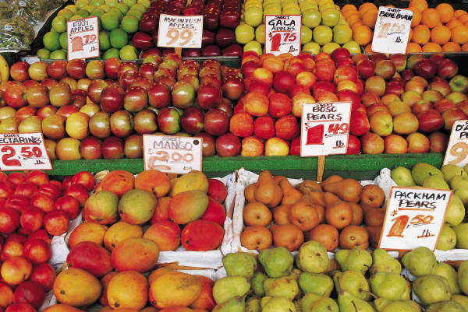
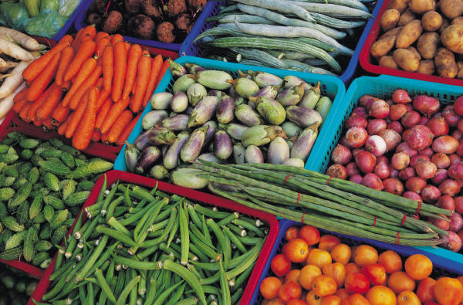
Operating Costs – Food/Other pg. 23
Fresh Fruits and Vegetables
  Fresh vegetable may be cooked and served once per week with education lesson
Non-Fruit or Vegetable Foods
  Low-fat or fat-free dip (vegetables only)
    Ingredients to make own dip
    Must make sure less than 30% of the calories are coming from fat
    Serving size must be 1-2 Tbsp. only
Notes:
In regard to operating costs:
Fruits and Vegetables are considered as operating costs, and will be claimed accordingly.
Additionally, fresh vegetables may be cooked and served one per week, as long as there is an education lesson connected.
Non-fruit or Vegetable foods can also be claimed, and would be considered as operating costs.
Low fat dips would fall into this category. Please limit the serving size of your dip to no more than 2 tbsp, and dip can only be provided for vegetables.
We will continue with operating costs on the coming slides.

Slide 19
Financial Planning Equipment/Supplies– pg. 22
Determine how you will serve the snack and what supplies you need
  Baskets/bins for classrooms
  Baggies, cups, forks
  Napkins
  Cleaning supplies
    wipes
Assess equipment needs
  Equipment justification form needed for any equipment purchase
Notes:
Non-food small supplies may also be claimed as an operating cost.
Small equipment items like knives, cutting boards, and bins can be claimed, in addition to paper supplies.
Provide the necessary information on the claim corresponding with the month that the item was invoiced.

Slide 20
Financial Planning – Labor
Identify employee who will be working with FFVP
Determine if labor will be claimed
  Labor costs should be kept to a minimum (as a bench mark, operational costs should not exceed 25% of your total award)
      Food production
      Snack service
      Clean-up
  ***FFVP labor must be documented***
Notes:
Labor can also be claimed as operating cost, but only as it relates to the food production, snack service, clean-up, and related tasks.
Labor should make up a small portion of the claim, as the majority of funds should be dedicated to purchase of fresh fruits and vegetables.
The claim form will ask for specifics on labor – such as hourly wage, number of hours worked on the program, etc.
It is important to document your labor at a local level, regarding the type of work being done and the amount of time worked.

Slide 21
Allowable Fruits and Vegetables pg. 14-16
Allowable
Not Allowed
Whole, fresh f/v
  Apples, bananas, oranges, strawberries, etc.
  Carrots, sweet potatoes, cherry tomatoes, broccoli, etc.
  Fresh broccoli/cauliflower florets; bagged greens
Pre-packaged f/v cups/bags
  Ascorbic acid may be used as a preservative
Fruit and vegetable trays
Canned or frozen f/v
Vacuum packed f/v cups
Dried fruit (raisins)
F/V cups/buckets with artificial flavorings and/or preservatives
Store-made fresh salsa
Juice
Smoothies
Edible flowers
Notes:
Next, we will touch on allowable and not allowable foods.
Whole, fresh fruits and vegetables are allowable
Prepackaged fresh fruits and vegetables are allowable – ascorbic acid may be used as a preservative
Fruit and Vegetable trays are also be allowed
For items not allowed –
Canned, frozen, vacuum-packed fruits and vegetables are not allowable.
Fruits and vegetables with artificial or added flavorings are not allowable
Store-made fresh salsa is not allowed - salsa if made in the classroom as a nutrition education project is allowable—just cannot be store bought
Juice and smoothies are not allowable
Grapples (apples with artificial grape flavorings) are not allowable

Slide 22
Non-Fruit and Vegetable Food pg. 15
Allowable
Not Allowed
Dips for vegetables
  1-2 Tbsp. serving size
  Low-fat yogurt-based or other low-fat or non-fat dips
  Low-fat means that less than 30% of the calories can come from fat
  Non-fruit or vegetable ingredients to make your own dips or salsa
    Low-fat or non-fat
Dips for fruits
  This includes caramel for apples
Notes:
To continue with the allowables and unallowables –
Dip is allowable, but only if it is low fat or non fat, and can only be used for vegetables.
Carmel for apples is not allowable.
In order for peanut butter to be considered “low-fat”, only less than 30% of the calories can come from fat. Schools have to assure that the low-fat peanut butter met this requirement in order to serve it as a dip.
Additionally, please restrict dips to be served in no greater than 2 Tbsp amounts.

Slide 23
Administrative Costs pg. 23-24
Admin Costs restricted to 10% of total award
Labor
  Menu planning
  Purchasing
  Financial reporting
Equipment
  Must be used exclusively for FFVP or cost must be prorated
  Pre-approval required prior to purchase
Notes:
Next, lets touch on administrative costs.
Administrative costs must be restricted to no greater than 10% of the total award.
Labor associated with administrative costs would include menu planning, purchasing, financial reporting, and other bookwork.
Additionally, equipment purchases are to be considered as administrative costs – and sites must receive pre-approval prior to making the purchase.

Slide 24
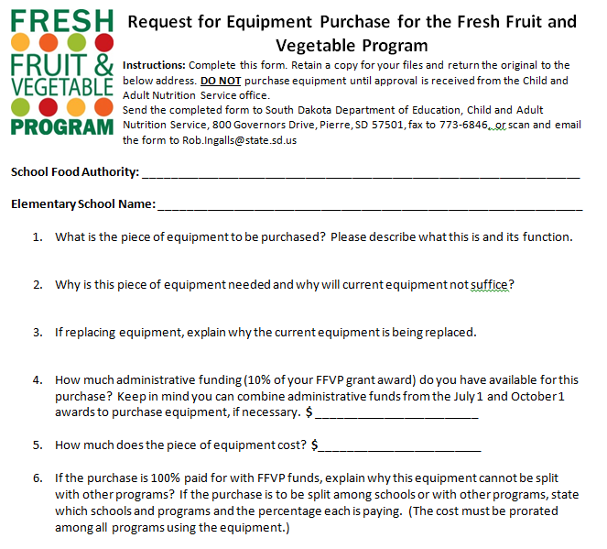
Equipment Justification Form
Notes:
For large purchases like slicers, refrigerators, shelving, or other machinery, an equipment justification form must be filled out prior to the purchase of the equipment. Equipment purchased with FFVP dollars can only be used for the FFVP. Otherwise, the purchase of the equipment must be prorated over other programs. The form can be found on the CANS/FFVP webpage.
In addition to the form, you would need to provide a quote, or some other product description with the cost listed (like a snippet from a magazine or webpage). Once approved by CANS, you can make the purchase, and will claim the equipment purchase on the monthly claim corresponding with the month from the invoice of the product purchase, and provide a copy of the invoice to CANS.
This would be something to only consider later in the year, after you get your budget determined and are comfortable with your program needs.

Slide 25
Getting Started
Determine your budget
  Labor
  Equipment/supplies
  Food cost
Determine snack schedule
  How many days snack will be served (min. of 2 days per week)
  Write menus
Develop spec documents if needed
Notes:
Before we get started, it is important to know your budget.
A suggestion would be to take the allocation amount and divide by the total number of service weeks in the allocation period.
We will discuss this on the coming slide.

Slide 26
Financial Planning
Determine estimated number of services per the allocation period (Ex: 10 services from beginning of school year thru Sept 30)
  Divide the allocation amount based on number of planned services
Determine a dollar amount to spend per service
  Use this average amount per service as a target
    Suggest identifying a weekly average goal
*Average cost includes any expenditures needed for labor, equipment, supplies
Notes:
I would suggest using a weekly average. One way to budget is to determine available funds per week.
For example, the 1st allocation period runs from July 1 through September 30. If there are six weeks of school during the 1st allocation period, take the 1st allocation amount divided by six to determine how much money can be spent per week.
From here, you can get hypothetical costs of fruits and vegetables, which in turn can help determine how many days per week you can provide the program. If you are just starting out, it would be suggested to start with the minimum of two day
If two days per week cannot be served due to adjusted schedules, weather delays, etc., don’t fret. You would like to plan for a minimum of two days per week, though.

Slide 27

Budgeting
The school needs to be fiscally responsible for managing this grant
  Establish a monthly budget to assist you in tracking funds and ensure timely expenditures of program funds
  Weekly amount
  Not spending the money is a disservice to your students
Notes:
Establish a method to ensure that whomever is responsible for ordering product is aware of the amount of allocation remaining. Remember to spend your funds responsibly.

Slide 28
60/90 Day Claiming
Federal regulations require claims be reviewed and approved within 60 calendar days from the last day of the claim month.
Claim Month | 60 Day Deadline
July | September 29
August | October 30
September | November 29
October | December 30
November | January 29
December | March 1
January | April 1
February | April 29
March | May 30
April | June 29
May | July 30
June | August 29
Notes:
The Due date is the 10th of the following month. If claims are not in by the 10th of the following month, they may not be approved and paid until the following month.
Claiming for the FFVP follows the same 60/90 day rule as other programs like NSLP and SBP.

Slide 29

FFVP Claiming– pg. 25-27
Submit through iCAN
Claims must be submitted by the 10th of the month following the claim month and must follow the FNS 60/90 day claim guidance
August/September claim is the only claim that can be combined.
Notes:
FFVP claims for reimbursement are to be submitted through the iCAN system. If you are a previous participant, the same information previously provided will be included. Best practice would be to keep a copy of the iCAN FFVP claim instructions for the first few months until you feel comfortable.
For more information regarding claim submission, please observe the FFVP Claim Submission presentation, or review claim instructions previously sent to the district, and also posted on the CANS-FFVP webpage.

Slide 30

Menu Planning
Notes:
Next, we are going to touch on menu planning.

Slide 31
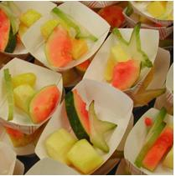
Menu Planning
Must include fruit and vegetables
Introduce students to a wide variety
Try different varieties of common fruit
  Honey Crisp, Red Delicious, and Granny Smith apples
  Bartlett, Bosc, and Anjou pears
Think exotic – try kumquats, star fruit, and pomegranates
Notes:
When menu planning the FFVP, you must plan both fruits and vegetables. You may need to try different strategies with vegetables, by starting with a fruit/vegetable mix, or a smaller amount of vegetables.
Consider increasing the frequency of serving the program, or trying more expensive items. Sometimes it can be tough for us to be willing to spend funds, but please try to spend as much of the FFVP allocation as you can.
Any unspent funds will be returned to the USDA. Funds cannot be carried over from one allocation to another.

Slide 32
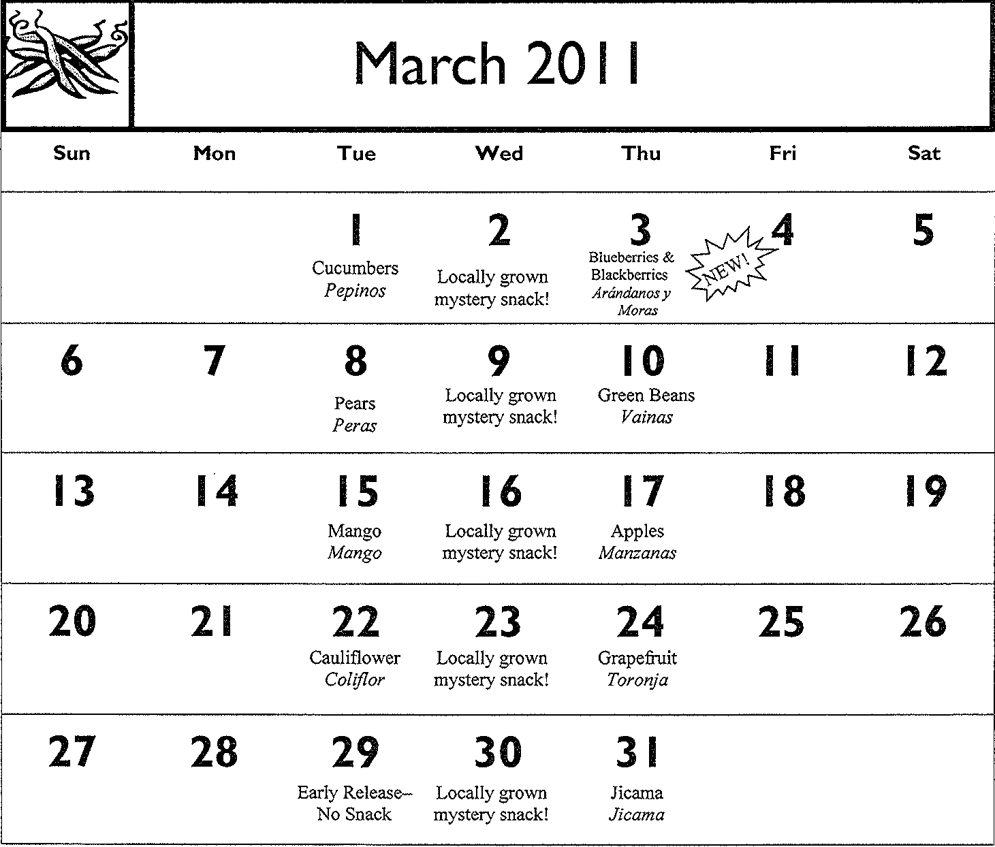

Sample Menu
Notes:
Although not required, some schools post and use menus with the FFVP. This can be beneficial for personnel in charge of prep, as well as classroom teachers for preparation of cross curricular lesson plans, and even for students from an expectation standpoint.
You are not required to create a menu or use production records, however, these tactics may be helpful from a local operational standpoint.

Slide 33
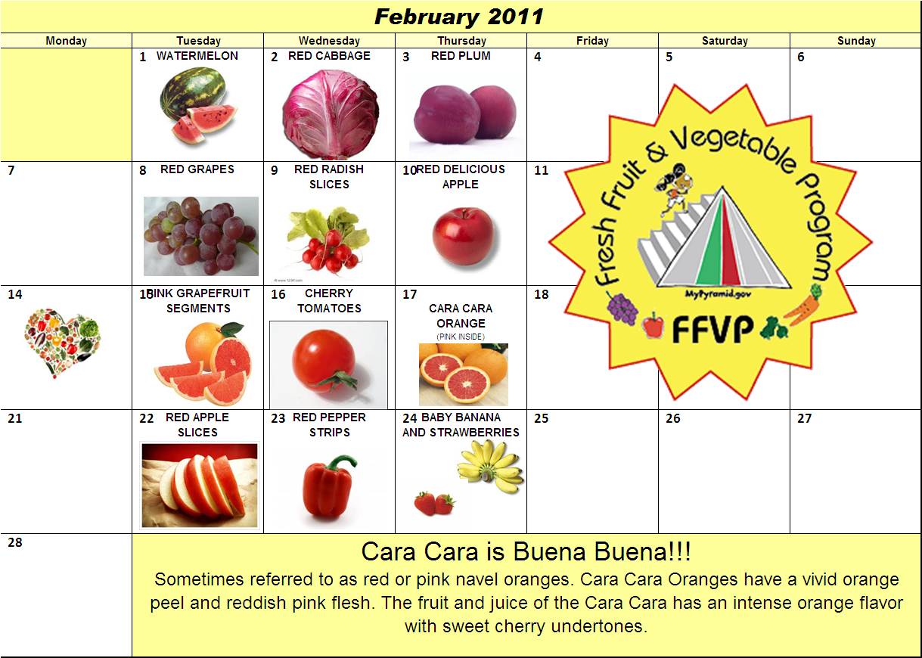
Sample Menu
April
Notes:
Another sample menu.
You are not required to create a menu or use production records, however, these tactics may be helpful from a local operational standpoint.

Slide 34
Menu Planning
Seasonal foods – try to choose foods in-season to lower cost
  Apples, broccoli, cucumbers in the fall
  Pears and citrus fruits in winter
  Asparagus, lettuce, and berries in late spring
Exotic fruits will likely cost more
Pair higher priced foods with lower cost foods to maintain an average price per snack
Notes:
You may want to consider to use in-season vegetables in order to stretch funding. Visit with local growers or distributors to determine how to get the best bang for your buck. That said, as previously discussed, be aware of your budget, and the amount you have available. Consider adjusting products based on the current state of your remaining allocation.
If you do not know your allocation amount, open up communication with the person submitting claims for reimbursement.

Slide 35
Menu Planning
Different portions for grades
Start small
  New program = new foods
  Start with small servings of ¼ cup or less
Increase with time
    New favorites may develop
    Increase servings to ½ cup if liked by students
Don’t give up!
  Vegetables must be served even if children “like fruit better”
    Strive to offer vegetables as many times as fruit!
  Continue to serve small portions of foods not well received
  10-16 times to try a food item to build healthy habits
Notes:
IF you are just starting out:
Consider Different portions for grades
Start small
Start with small servings of ¼ cup or less
Increase with time
New favorites may develop
You may be able to potentially increase servings to ½ cup if liked by students
Don’t give up!
Vegetables must be served even if children “like fruit better”
Strive to offer vegetables as many times as fruit!
Continue to serve small portions of foods not well received
10-16 times to try a food item to build healthy habits

Slide 36

Menu Planning
Spend your money!!
  Any FFVP funds not used get sent back to USDA
OKAY to start more conservatively
Don’t be afraid of expensive items
Notes:
Try to budget effectively. Any funds not used are sent back to USDA. With this said, it is definitely acceptable and understandable to start the program a bit more conservatively. Once you feel more comfortable, don’t be afraid of trying items that are a bit more expensive or rare.
Most schools start with a conservative amount on rare fruits or vegetables to avoid the potential for waste.

Slide 37
Special Dietary Needs
Texture modifications – soft, cut, pureed, etc.
  Physician’s statement is not required
  Recommended obtain statement with directions for texture modification
Food Substitutions – child cannot tolerate food in altered format
  Physician’s statement is required and should include: child’s disability, explanation of restrictions, food or foods to be omitted from diet
  Request list of food choices that can be used as a substitute
Notes:
Modifications may need to be made for special dietary needs, and that is OK. Feel free to contact me for specific issues if you are unsure how to handle the service of an item.
Consider special dietary needs of children in order to allow all elementary site students to participate.

Slide 38

FOOD SAFETY in the FFVP pg. 31-32
Notes:
Next we will touch on Food Safety as it relates to the Fresh Fruit and Vegetable Program.

Slide 39
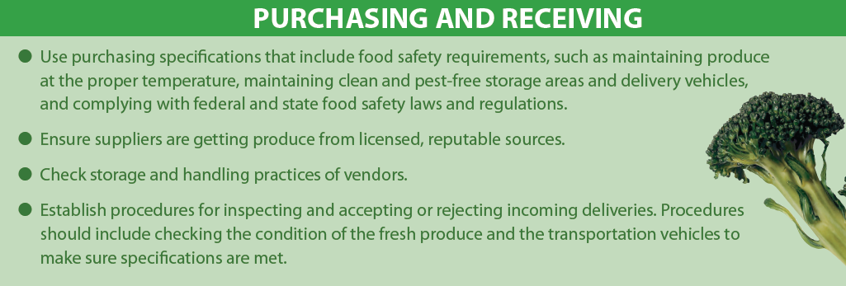
Handling Fresh Produce in Schools
Notes:
To prevent foodborne illness, fresh produce needs to be handled with care at each step from farm to table.
Consider food safety processes used during food service preparation.

Slide 40
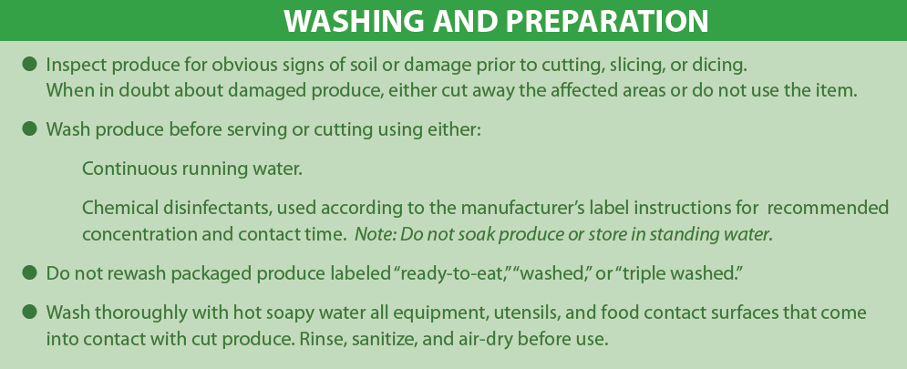
Handling Fresh Produce in Schools
Notes:
Wash fruits and vegetables under flowing water. Do not allow fruits and vegetables to ‘soak’ in water, as the location of the stem can work as an absorbant.

Slide 41
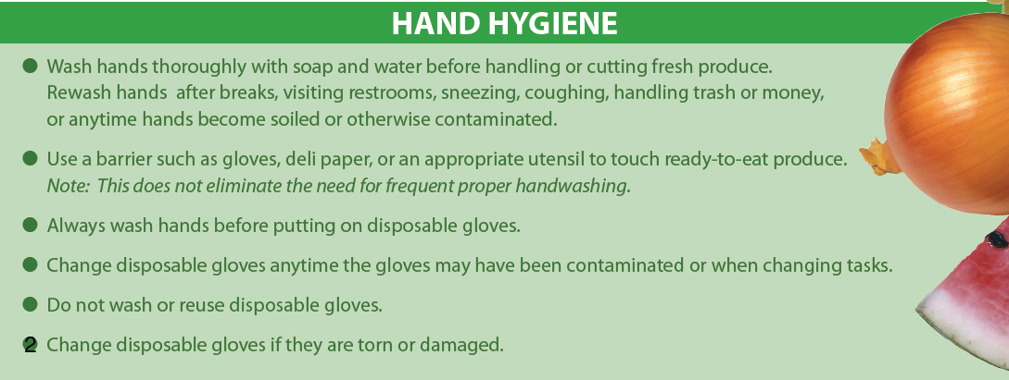
Handling Fresh Produce in Schools
Notes:
Remember to follow good hygiene practices, and wash your hands.

Slide 42
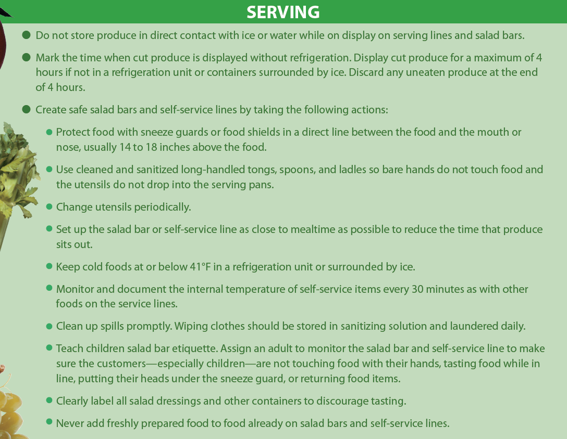
Handling Fresh Produce in Schools
Notes:
Consider common serving practices, and translate these practices for use during the FFVP, depending on the setup.
Avoid temperature danger zones, store product in refrigeration after cut, clearly label products in storage.

Slide 43
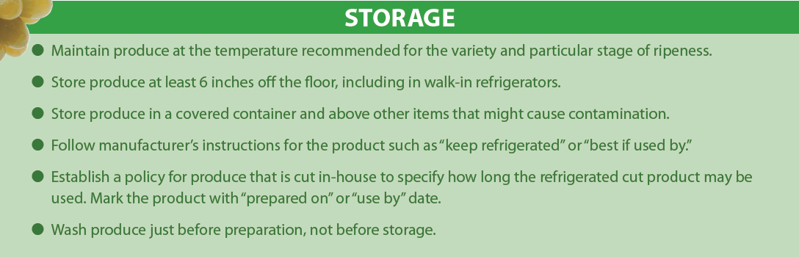
Handling Fresh Produce in Schools
Notes:
Keep fruits and vegetables at least six inches off the floor, and do not store under raw foods, or areas with potential for cross contamination

Slide 44

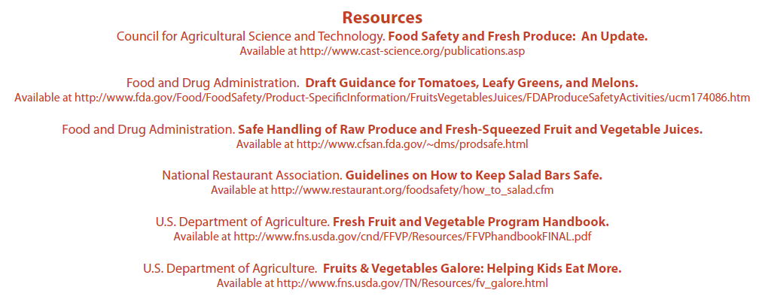
Handling Fresh Produce in Schools
Notes:
Remember that food service employees need a refresher course on the food safety plan every school year.

Slide 45
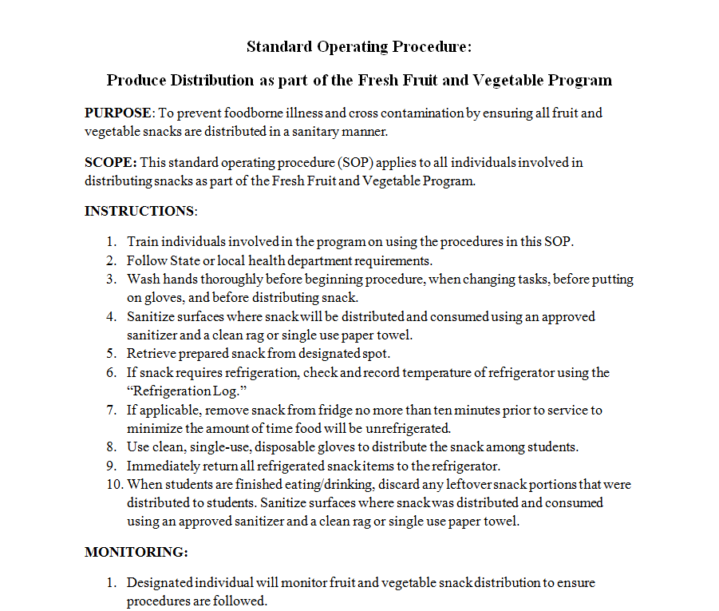
Standard Operating Procedures (SOPs)
Notes:
As with school lunch, FFVP should also follow a standard operating procedure. If you keep a SOP in your food safety plan regarding the handling and washing of fruits and vegetables you are covered. If you would like to add the FFVP SOP to the food safety plan, it is available on the CANS-FFVP website. You can also contact me with any questions.

Slide 46
Purchasing in the FFVP pg. 17-19
Notes:
Next, we are going to touch on purchasing.
FFVP Schools must follow proper procurement procedures.

Slide 47
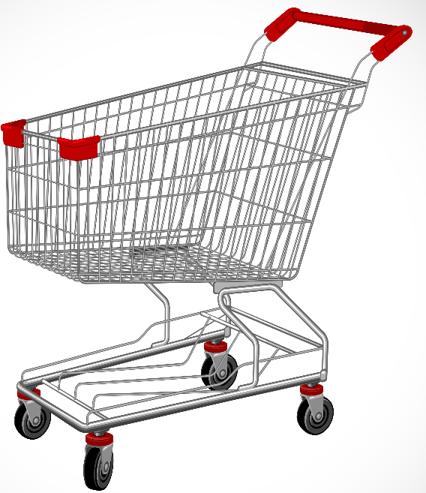
Purchasing
Produce must always be graded and inspected according to existing local, State and Federal guidelines
Notes:
Finding suitable vendors or suppliers that provide a reliable supply of produce has been a challenge for a number of schools. Many schools purchase fruits and vegetable from food wholesalers or brokers. The vendors deliver shipments of fresh produce directly to the schools.

Slide 48
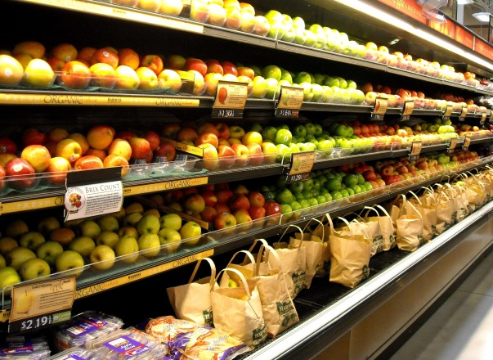
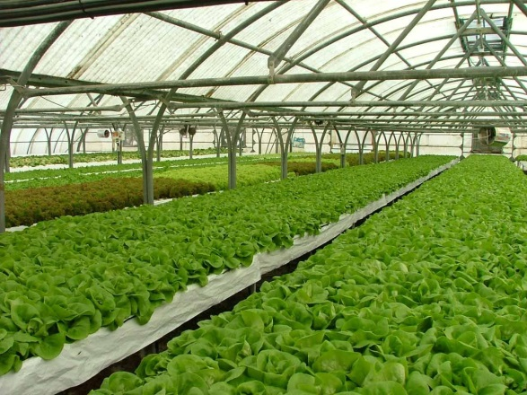
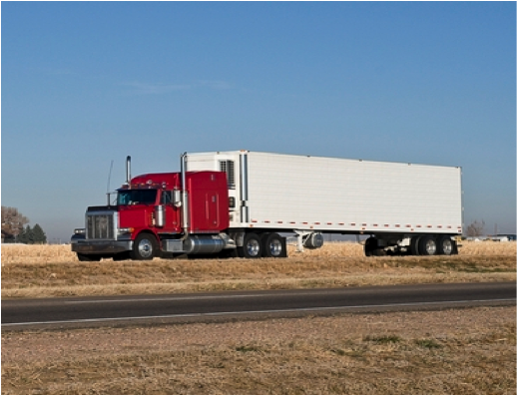
Schools may…
Buy produce from your local grocery stores and farmers’ markets, or contact conventional and organic growers, and commercial distributors
Notes:
Schools may…
Buy produce from your local grocery stores and farmers’ markets, or contact conventional and organic growers, and distributors
Local grocery stores and other retailers are not only good suppliers of fruits and vegetables, but also might be valued partners for free nutrition education and promotional activities.
Support farm-to-school projects by purchasing fresh fruits and vegetables from growers and farmers in your community

Slide 49

Schools may NOT…
Use commodity dollars for FFVP usage. (DON’T DO THIS)
Notes:
You cannot use entitlement dollars for FFVP, and then claim for reimbursement – this is ‘double-dipping’

Slide 50

Purchasing
Buy American
  USDA requires schools to purchase products of “domestic origin” when purchasing products with federal funds.
  Schools may not purchase the cheaper product if it is produced in a foreign country, unless there is a ‘substantial’ price difference
  Schools must purchase products from America unless it is an item that is not available in America, for example, bananas.
Notes:
When you are purchasing fresh produce, including produce from local vendors, proper procurement procedures must be followed.
Buy American whenever possible.

Slide 51
Purchasing Flowchart
Determine Product to Purchase
(May need written specifications)
Prime Vendor
Grocery Store, Convenience store, other vendors
Local Growers (farmers, orchards, farmers markets)
Purchase Products
Notes:
Consider various avenues of where to purchase produce from, in order to follow procurement requirements.
Request quotes from local grocers and suppliers. Keep the communication on file, and select the option that is the best for your school.

Slide 52
Purchasing
Specifications may include
  Food item
  Size of that food item
  Whole or pre-cut
  Amount to be purchased
  Delivery schedule/pick-up, cost of delivery
Notes:
Produce specifications may be needed to ensure quality produce. Also make sure to not create specifications that are too specific. Ask what various grocers can provide, and let them know what you are looking for.

Slide 53
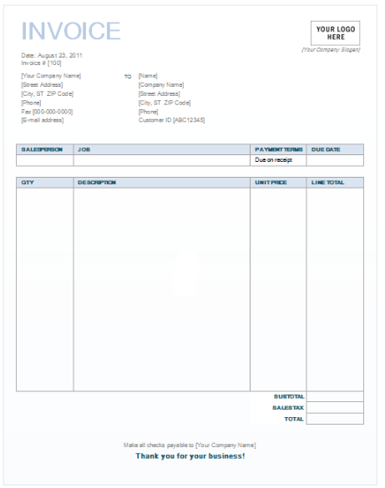
Invoices
Ask the vendor to invoice the f/v purchased for this program on a separate invoice so you can easily complete the claim for reimbursement
Notes:
Keep your invoices! Keep the invoices on file, and organize by month. These invoices will be looked at on an administrative review.
- If not separated, this is OK, but keep a copy of the invoices specifically for tracking of FFVP; I would suggest highlighting the items on the invoice copies which were used for FFVP – this will make things easier for submitting claims, and for a future review.

Slide 54
Leftovers– pg. 18
If you cannot easily use the leftovers in the FFVP, you may be able to use them in your school meal programs—but only to avoid waste.
Plan to use the f/v purchased with FFVP funds as part of the FFVP.
Notes:
If you cannot easily use the leftovers in the FFVP, you may be able to use them in your school meal programs—but only to avoid waste. This should not be a regularity. Plan to use the f/v purchased with FFVP funds as part of the FFVP, and adjust your forecasting of purchases based on prior popularity of a product.

Slide 55

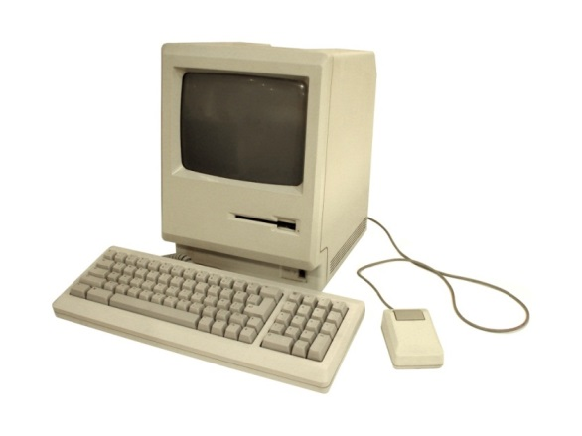

Thank you!
Please feel free to contact Rob Ingalls, FFVP Coordinator
  605-773-2977
  rob.ingalls@state.sd.us
Notes:
Thank you for observing the FFVP Program Requirements and Information presentation.
Please feel free to contact me with any questions.

Slide 56

FFVP Requirements Training
This training credits for 60 minutes of training in
Key Areas 2 & 3
Operations and Administration
3200 – Program Management; 3220 – Standardized Operating Procedures
2400 – Purchasing/Procurement; 2640 – Food Safety Culture
Your Name:
Date of Training:

