Slide 1
Standards for Mathematical Practice Review Meeting
April 12, 2017

Slide 2
Objectives for Today
Finalize the 8 Standards for Mathematical Practice

Slide 3
Norms for Today
Speak with the possibility of being heard and listen with the possibility of being changed.
Be present, and be your best self.
Everyone has something to learn. Everyone has expertise to offer.
We need each other.
You have the right to ask for help, and the duty to assist.
Be willing to experience discomfort.
Expect and accept non-closure.​

Slide 4
Participant Role….
Actively participate and offer ideas during discussion
Ensure that every voice is heard
Use provided resources to inform decisions made about standard revisions

Slide 5
Share:
Name and where you are from
How you feel about being here today
Expectations for today

Slide 6
South Dakota Content Standards
Define what a student should know or be able to accomplish by the end of a specific time period or grade level or completion of a course
Build on skills learned in previous years; each standard is not a new event, but an extension of previous learning.
Represent the knowledge and skills needed to successfully transition to postsecondary education and the workplace
Allow local districts, schools, and teachers to develop and implement curriculum, content and methodology
Serve as the basis for state assessment

Slide 7
Timeline
June & July 2016
Initial Review
August 2016 – April 2017
Educator Feedback Period
June 2017
Final Review
Sept. 2017 – May 2018
Public Hearings

Slide 8
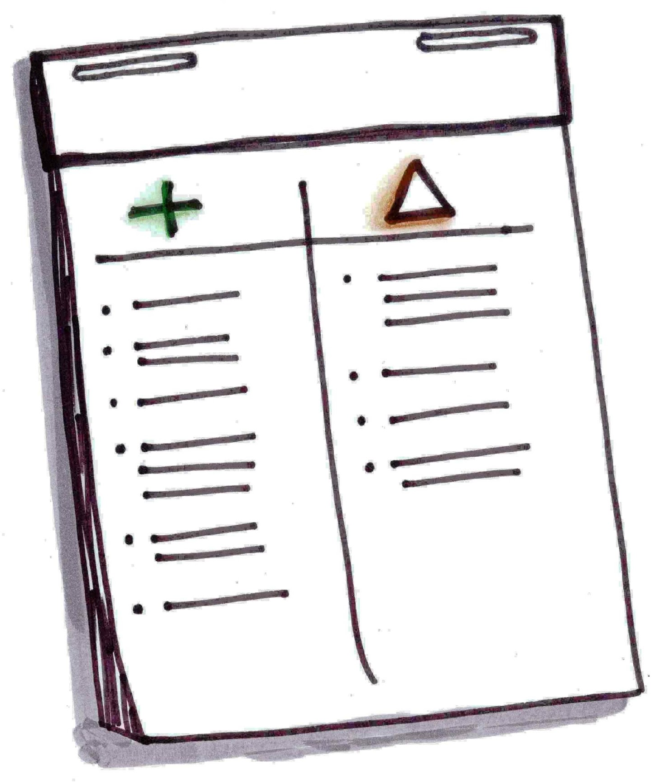
Big Picture
Pluses
(Want to Preserve)
Delta’s
(Want to Improve)

Slide 9

Consensus has been achieved when every person involved in the decision can say, “I believe this is the best decision we can arrive at for the organization at this time, and I will support its implementation.”

Slide 10
Documentation Rules
Strike through words the team wants eliminated
Use red and bold font for additions to the standards
Identify if the standards will stay the same or has a proposed change
Identify the type of change
Removed, Re-written, broken-up, combined, moved to a different grade level
Identify the Quality Standards Rule # that was used to justify improvements
Summarize reason for proposed change

Slide 11
Questions to Discuss
Is the edit necessary?
Does the proposed wording of the revised standard meet the qualities standards guidance?
Do the proposed edits maintain connections within and across grades? If not, what other standards are impacted?

Slide 12
Initial SMP Review
Take a few minutes of silence to individually read the standards that are in front of you.
Summarize the meaning or intent of that standard in the column beside the standard.

Slide 13
Initial SMP Review
Take a few minutes of silence to individually read the standards that are in front of you.
Summarize the meaning or intent of that standard in the column beside the standard.
Compare our own personal summaries to the explanatory text.
What did we notice?
Review previous feedback from Table Leads

Slide 14
Overall SMP Review
Take a few minutes of silence to individually read the full text of the Standards for Mathematical Practice.
Use the Features of Quality Standards to review the standard and justify and explain any changes.
Sort – Changes vs. No Changes
Share thoughts, come to a consensus, and document proposed changes.

Slide 15
End of Day Reflection and Feedback -
What went well today? What progress do you feel good about?
What suggestion do you have to improve and refine the process?
What else would you like us to know? What questions do you have?

