Slide 1
Standards Feedback Review Meeting
June 6, 2016

Slide 2
Objectives for Today
Analyze educator feedback and use it to make any needed additional revisions to the South Dakota Math Standards.
Use the Elements of Quality Standards to revise the mathematics standards for South Dakota
Employ effective strategies to communicate and work with a team

Slide 3
Norms for Today
Speak with the possibility of being heard and listen with the possibility of being changed.
Be present, and be your best self.
Everyone has something to learn. Everyone has expertise to offer.
We need each other.
You have the right to ask for help, and the duty to assist.
Be willing to experience discomfort.
Expect and accept non-closure.​

Slide 4
Housekeeping

Slide 5
“A way of seeing is also at the same time, a way of not seeing.” ~Elliot Eisner
Notes:
Discuss examples - are they useful, are they limiting, are they illuminating

Slide 6
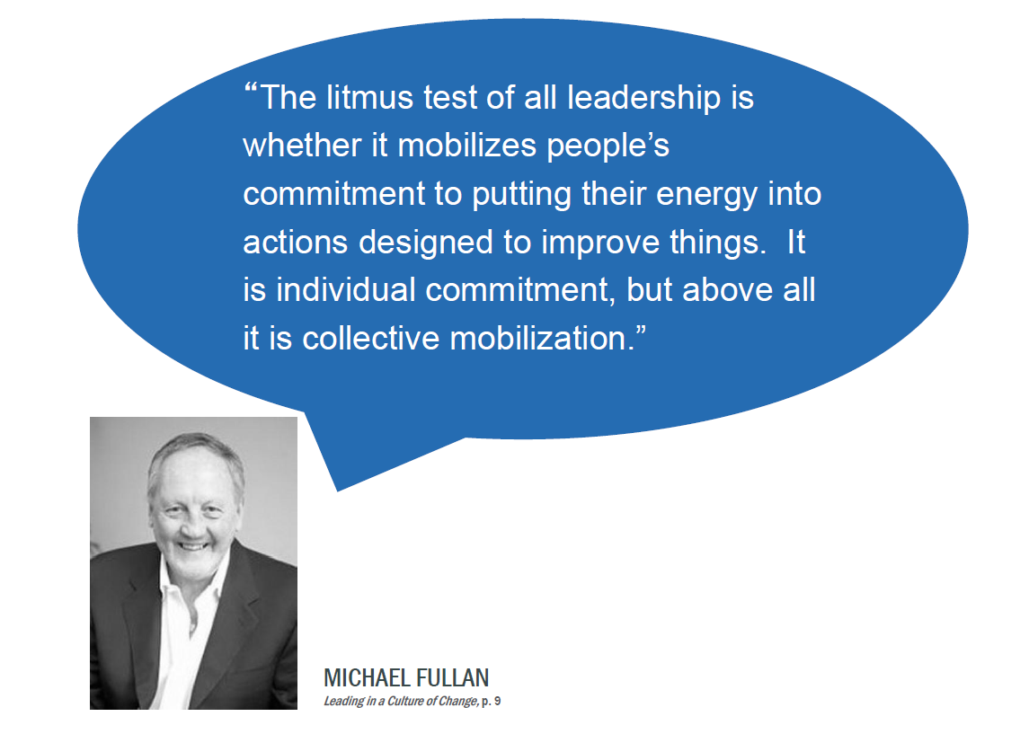

Slide 7
Today’s Plan
Refresh – Getting in the Same Space
Review where we are in the process
Review grade level standards
Review change summary
Review Quality Standards Checklist
Tour of the Feedback Spreadsheets
Review Educator Feedback
Discuss – Patterns
What did you notice? What was received well? What was not received well? Why?
Notes:
Quality Checklist that is in your folder and the document that will help to guide you through the standards review process.
Each standard should be compared to this checklist to help guide the discussions, revisions, proposals, or acceptance of a standards
FYI—Table Leads helped to create this document with clear language/focus for the work.

Slide 8
Today’s Plan
Updates/Discussion (if time allows)
Formatting
Overall Introduction
Parent Resource – Prep/Be informed for the Public Hearings
Advocating for the Standards - Opportunities

Slide 9
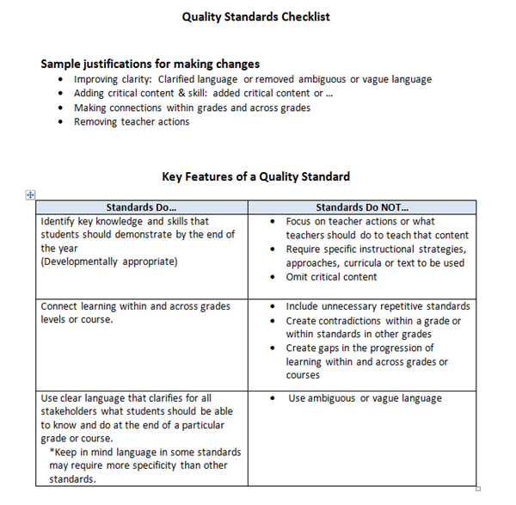
Features of a Quality Standard

Slide 10
End of Day Reflection and Feedback -
What went well today? What progress do you feel good about?
What suggestion do you have to improve and refine the process?
What else would you like us to know? What questions do you have?

Slide 11
Overview of Review Process
Use the guidelines for quality standards and other state standards and resources to discuss SD standards one at a time.
Capture recommendations on Google Excel
Review a section or set of the standards at a time
As a large group review the section or set standards for vertical alignment
Repeat the process

Slide 12
Grade Level Review
Take a few minutes of silence to individually read the standards that are in the category to be reviewed.
Mark or note standards that you would like to discuss at your table.
Use the resources and Features of Quality Standards to review the South Dakota standard and justify and explain any changes.
Share thoughts, come to a consensus, and document proposed changes.

Slide 13
Documentation Rules
Strike through words the team wants eliminated
Use red and bold font for additions to the standards
Identify if the standards will stay the same or has a proposed change
Identify the type of change
Removed, Re-written, broken-up, combined, moved to a different grade level
Identify the Quality Standards Rule # that was used to justify improvements
Summarize reason for proposed change
Open the vertical alignment excel document and make the formatting changes to the appropriate standard.

Slide 14
Questions to Discuss
Is the edit necessary?
Does the proposed wording of the revised standard meet the qualities standards guidance?
Do the proposed edits maintain connections within and across grades? If not, what other standards are impacted?

Slide 15
Vertical Alignment Reminders
Reflect a logical, consistent order
Key terminology should be consistent or show a progression
The rigor (depth of knowledge) across the standards should show a progression

Slide 16
Vertical Alignment Process
Grade Level Review:
Grade level teams will review standard changes in the two grades above and below their own grade. First, review silently.
Grade Level Discussion:
Grade level teams will discuss questions or concerns and table leader will document the team’s questions or concerns by putting a comment on the “Comments” Google document.
Be sure to think about the purpose of the comment by using the Quality Standards Checklist.

Slide 17
Vertical Alignment Process
Please consider the following when commenting:
Have you looked at the reasoning on the grade level standards document?
Does it meet one of the justifications or criteria on the Quality Standards Checklist?
Does it move the work forward?
Does it make a specific suggestion for improvement?
How does this change impact your grade level?
How does the change impact the intent or rigor of the standard?

Slide 18
Vertical Alignment Process
Grade Level Review of Comments, Questions & Recommendations
Make changes as needed. Note any questions to bring to the whole group.
Whole Group Discussion:
Table Leads discuss changes and concerns, starting with Kindergarten and moving through the grades. If there are concerns, table leads can discuss reasoning, whole group will be allowed to ask clarifying questions. Consensus cards will be used to come to a decision.
Final Decisions
After final decisions are made, table leaders will make edits on both the grade level and vertical documents.

