Slide 1

ELA Unpacked Standards
Toolkit
Created Summer 2019
By the ELA Team Members:
Kelsey Buchholz
Sally Crowser
Nicole Finnesand
Carla McMurray-Kozak
Anne Moege
Holly Mosterd
Samantha Walder
DOE/Teresa Berndt
”
Notes:
A shout-out to the ELA team members who collaborated to ensure that the activities, questions, timeframes, and resources would allow districts options for flexibility in both time and options.
The visual on this slide was created by the ELA Team Members as a way to ensure that all the work in SD education is seen in a connected way. Educators often feel like it is “another thing” added to their plate, so the goal of the visual was to show how the standards/unpacked standards documents are at the center of student learning and overall objectives.
Unpacked standards connect to the current work happening in classrooms across the state. Standards and the unpacked documents can assist with student learning objectives (SLO) work, evaluation components for teacher, self, students, state wide assessments, and the lesson planning and accreditation work that those plans provide in evidence of standards being taught to depth and rigor required.
This visual will be repeated throughout this PPT to keep viewers connecting the work versus seeing all of it in isolation.

Slide 2

P.M. Session
Notes:
Musical Mingle Activity:
Mingle around while the music plays when the music stops form triads- try to connect with people you may not know outside of your department.
Question 1: If you won the lotto, what is one selfish thing you would do for yourself? What is one charity you would give to?
20 seconds to think- and a structure to share out. (tallest person goes first)
SHARE out 3-5 minutes
Question 2: What is a quality in colleagues/teachers/leaders you appreciate, and you wish you had more of in yourself?
20 seconds to think… reverse order
SHARE OUT 3-5 minutes
Switch triads-
Question 1: What excites you most about the new school year?
Question 2: If there is one quality/value about public education or your school/district specifically you could change with a wand, what would it be and why?
20 seconds to think (person with the longest hair)
(switch order)
Other Options you could use for this activity:
Who goes first within the group: Determine who has the most siblings? The one with the least goes first.
Questions from the other day:
What was the best ever bargain hunting/shopping item you ever scored?
If you could have one room designed specifically for you, what would its features look like or include?

Slide 3
Norms for the Day
Speak with the possibility of being heard and listen with the possibility of being changed.
Stay engaged and responsive - sustained, voluntary, focused attention.
Expect and accept non-closure.
Be willing to experience discomfort.
Everyone here has expertise to offer.
Everyone here has something to learn.
Pay attention to what peers need (speak loudly enough, include everyone, monitor your airtime, encourage others, ask good questions).
Notes:
Guidelines for what norms for the day could look like, but these can be adapted for the audience.

Slide 4

Teaching to the Content Standards
Notes:
☺ Little Humor to start the session.
How many educators (teachers, admin.) feel with new initiatives and standards work.

Slide 5

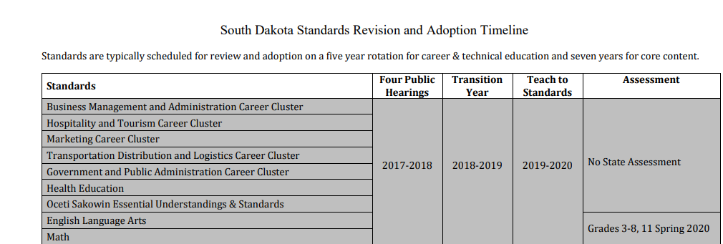
Standards Revision Process
Notes:
Summer 2016—a workgroup of educators, stake-holders, and community members came together over several days. The workgroup:
used research-based criteria. The work group wanted to maintain the rigor in the standards while improving the clarity of the language used within the standards. A ELA Standards Revision Summary document can be found at https://doe.sd.gov/ContentStandards/documents/ELA-summary.pdf
Summer 2017—the workgroup met again to consider feedback from teachers, administrators, and higher education teachers.
March 2018—The revised standards were approved by the South Dakota Board of Education after four public hearings.
Summer 2018—a workgroup of educators came together over several days to unpack the adopted mathematics standards, and create documents for teachers.
Summer of 2019: ELA teacher leaders were selected to attend summer trainings in Chamberlain and Tea to help districts develop and understanding of the unpacked documents and to provide a toolkit of resources to take back to districts to use and build capacity. Administrators were offered a session in Sioux Falls to provide them the same background and toolkit resources to use in district meetings and inservice sessions.
Reminder: The mathematics standards will be fully implemented the 2019-2020 school year and assessed in Spring, 2020.

Slide 6
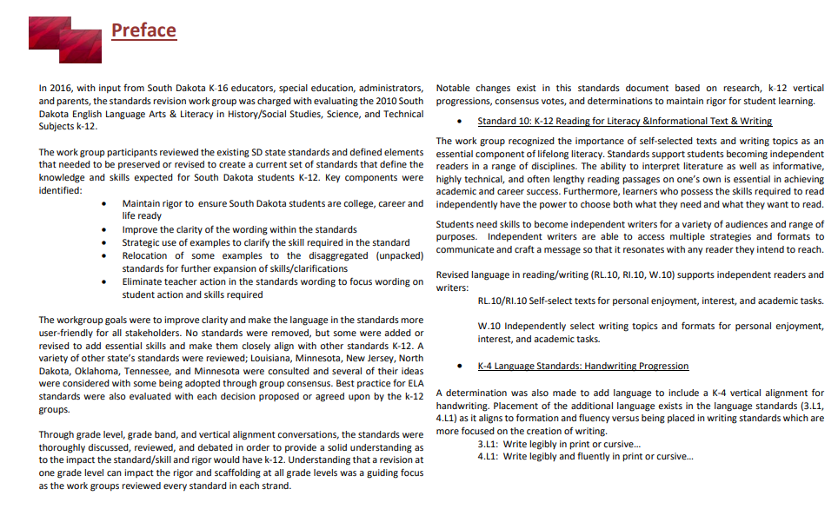
The Why…
Notes:
Potential Activity for adopted ELA Standards:
Have teachers read and annotate the introduction to the ELA standards, and then share with partner, small or large group their takeaways for the content standards changes and overall justifications for the changes made by the ELA work group. Either of the following documents could be used:
Preface page 3
Introduction pages 7-9
- I didn’t know if you had an introduction to the unpacked documents. Is there a write up that states why you unpacked at the cluster level, or the process that was used?

Slide 7

Notable Change 1: K-12 Reading for Information/Reading for Literacy/Writing—Standard 10
“Self-selected texts and topics”-- an essential component of lifelong literacy
Notable Change 2: K-4 Language Standards address handwriting progressions
k-4 vertical handwriting language and progression added to Language Standards
Notable Change 3: 6-12 Standards for Literacy in other content areas (Science, History, Technical Subjects)
Additional language proposed to improve rigor of expected skills
http://doe.sd.gov/ContentStandards/ELA-review.aspx
Notes:
The slide briefly overviews a few key notable changes.
The ELA Standards Revision Summary document provides additional information on the changes at each level K-12 and in the 6-12 Literacy Standards in history/social studies, science, and technical subjects.

Slide 8
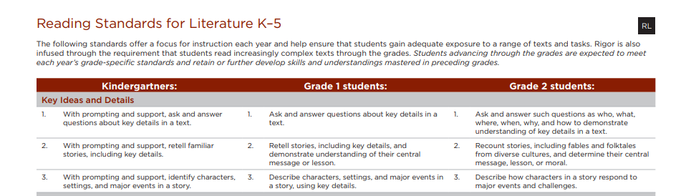
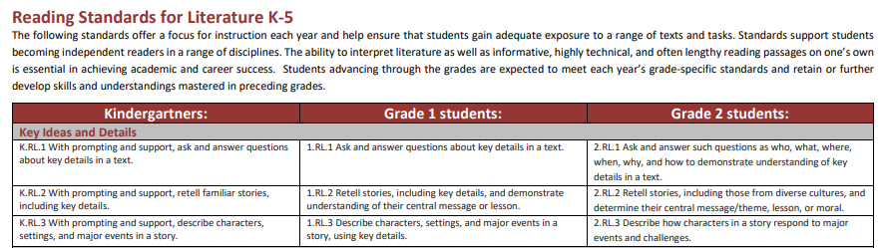
Old vs. New
Notes:
Example of the format changes
Educators shared that the top version was somewhat confusing and required much more reading of the the headlines to help determine the standard and standards numbers.
The bottom/new version is the identification for the ELA standards starting in 2019. These are the identifying codes that should be used on lesson plans so that when evidence is submitted to DOE for accreditation it provides additional evidence that the district is reviewing and implementing the newly adopted standards and coding. Ex: K.RL.1

Slide 9
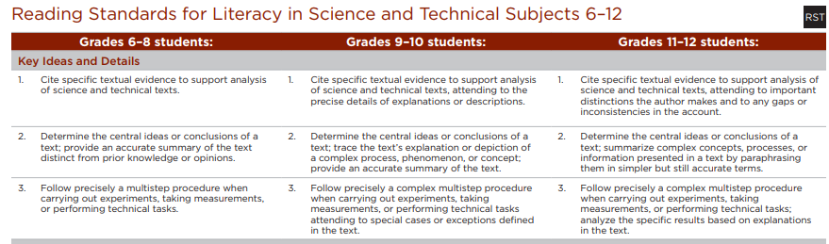
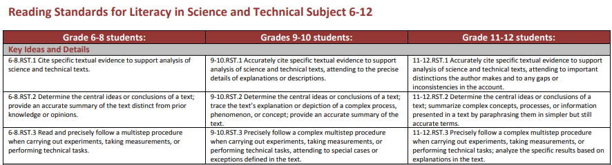
Old vs. New
Notes:
Standards for Literacy in Social Studies, History, Science and Technical Subjects.
The bottom/new version is the identification for the 6-12 Literacy Standards in other content areas. These are the identifying codes that should be used on lesson plans so that when evidence is submitted to DOE for accreditation it provides additional evidence that the district is reviewing and implementing the newly adopted standards and coding. Ex: 6-8.RST.1 (reading for science/technical subjects)

Slide 10
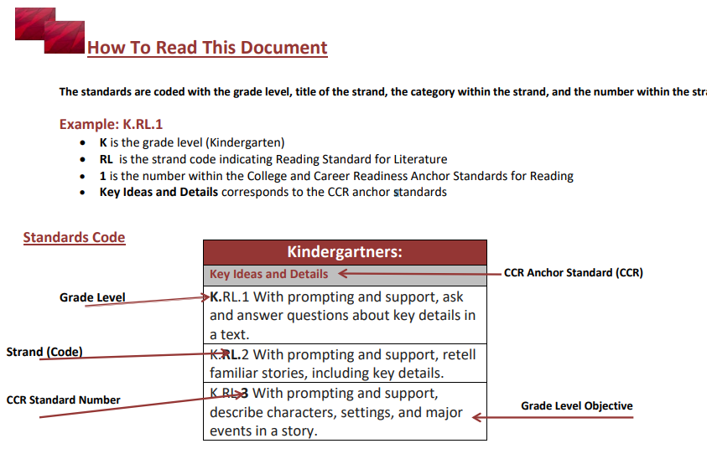
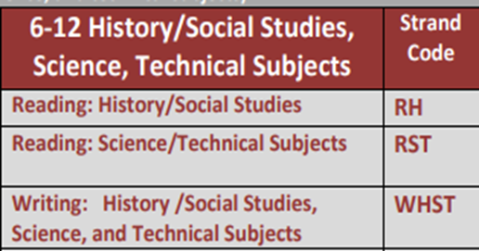
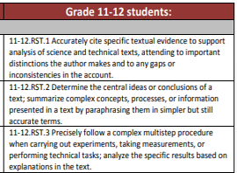
New Format
Notes:
This information can be found on page 12 and 13 in the complete K-12 ELA standards document found at this link.
https://doe.sd.gov/contentstandards/documents/ELA-Standards.pdf

Slide 11

Notes:
This visual represents how the unpacked standards connect to many of the other pieces that educators/districts incorporate into their ongoing objectives.
SLO/Lesson Planning/Accreditation/Evaluations-Daniels/State-wide assessments---all of these pieces require the skills in the standards/unpacked documents to be considered, implemented or evaluated.

Slide 12
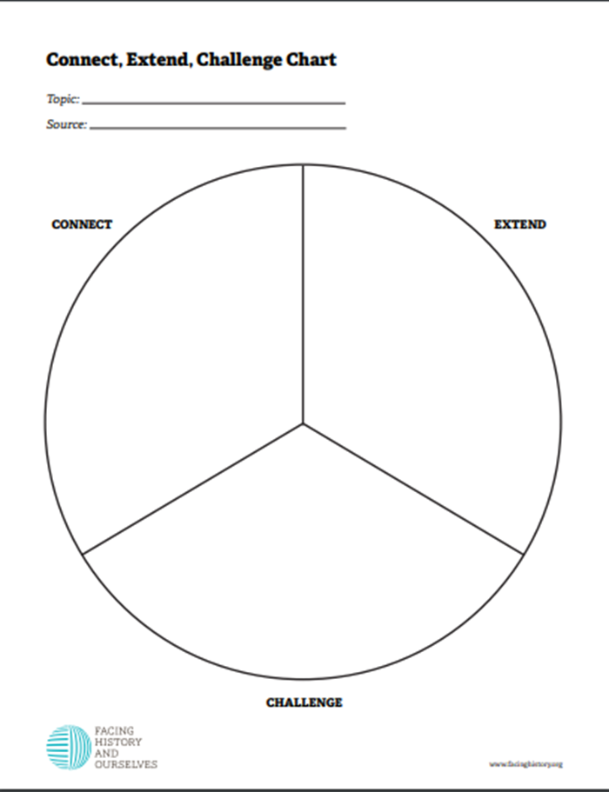
Connect, Extend, Challenge
Notes:
The following documents can be found on the ELA Resource page: https://doe.sd.gov/contentstandards/ELA-resources.aspx
In the Articles/Activities Section on that page, the following links/download information can be found:
Participants will read/annotate the article: The Grecian Urn Article
Participants will use the Connect, Extend, Challenge chart to document their ideas
Allow time for a elbow partner or small group discussion to share thoughts.
If time allows, this could be come a table/or large group share out activity.

Slide 13


Poster Activity
Select a Poster
Discuss with others any of the following?
Why did you select this particular poster?
What questions does this poster raise for you in connection to either the standards work or your classroom instruction?
How would you use this poster in a professional development training of your own?
Notes:
Directions:
Located in the Unpacked Guidance Document are the Poster Formats that could be printed, placed around the room taped to the wall, or projected up on the screen.
Option1: Have audience view all of the poster options and have them write on a post-it-note some brief line on why they selected that particular poster OR what question that poster brings to mind. The goal is to have them write BEFORE they move. *Questions are on the slides that can help guide what to place on the sticky notes.
Next, participants are asked to stand in front of the poster that they selected.
Each person at that poster will then share what they had on the sticky note with the group.
After sharing, they should place the sticky note on/beside the poster. This allows a visual to determine if all are finished with their sharing/discussion.
Allow time for each one to share and to discuss ideas after the sharing.
Option 2: If there is a particular poster that connects to district goals, selecting just one or two posters and using the sticky notes to share ideas within small groups in the audience would be another option.
_____________________________________
Option 3: This could be used as an icebreaker activity instead of the previous one described on Slide #2

Slide 14

Notes:
Following will be options for a 15 minutes time frame. This could be at a staff meeting, department level meeting, or grade level meeting.
Slide 15: Scavenger Hunt
Slides 16, 17, 18, 19: Extension Activity to review the ELA Tables of Information
Slides 20, 21, 22, 23, 24, 25: Strike-Through Documents

Slide 15


15 Minutes: Option 1
Notes:
The Scavenger Hunt Document can be found on the ELA Resources Page: https://doe.sd.gov/contentstandards/ELA-resources.aspx
In the 15 Minute Activity Options there is a link for this document.
If an answer key is needed, email for that document---- please email Teresa.Berndt@state.sd.us

Slide 16
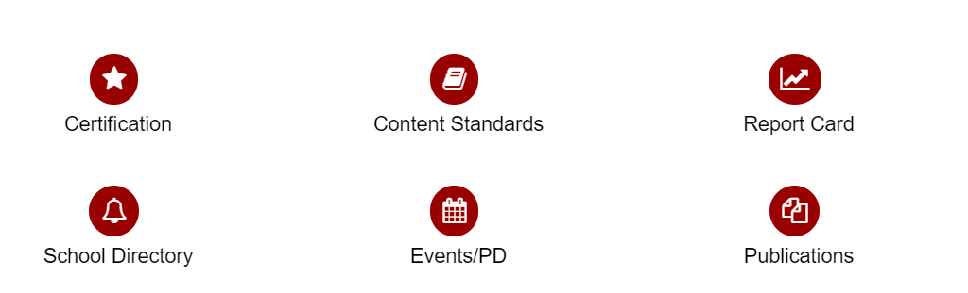
SD DOE Content Standards
https://doe.sd.gov/
Notes:
PPT Slides 16, 17, 18, 19: Extension Activity to review the ELA Tables of Information
Unpacked Guidance Document: Appendix A~ 15 Minute Extension/Option 1 provides directions and information to guide this extension activity and the table information found on the ELA page.
The new DOE website landing page. https://doe.sd.gov/

Slide 17

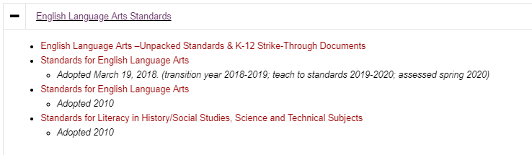

ELA Content Standards
ELA Unpacked Standards & K-12 Strike-Through Documents
Notes:
PPT Slides 16, 17, 18, 19: Extension Activity to review the ELA Tables of Information
Unpacked Guidance Document: Appendix A~ 15 Minute Extension/Option 1 provides directions and information to guide this extension activity and the table information found on the ELA page.
To gain access to the table above /ELA Unpacked Standards & K-12 Strike Through Documents
https://doe.sd.gov/ContentStandards/ELA.aspx

Slide 18
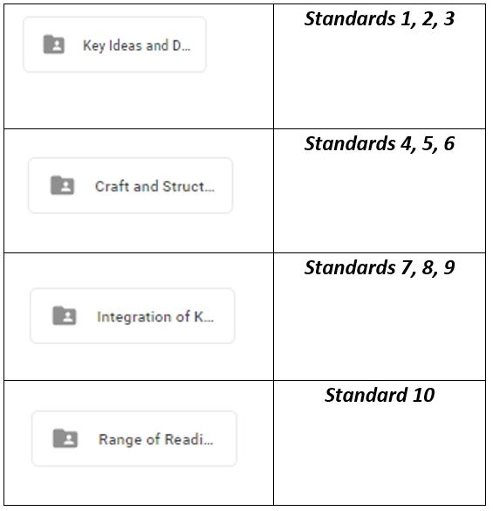
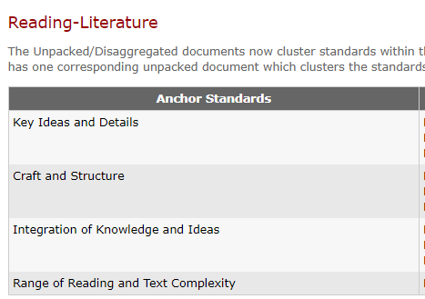
ELA Content Standards
Anchor Standards
Clusters
Notes:
PPT Slides 16, 17, 18, 19: Extension Activity to review the ELA Tables of Information
Unpacked Guidance Document: Appendix A~ 15 Minute Extension/Option 1 provides directions and information to guide this extension activity and the table information found on the ELA page.
ELA Unpacked Standards and Achievement Level Descriptors.
The Unpacked Standards documents are now clustered into the four areas indicated visually below. Unpacked documents will have clusters of standards as this is the way they are intended to be taught. Previously, the unpacked ELA standards had a separate document for each standard in every strand which did not allow educators, students, or parents to view them as a cluster of skills taught collectively.

Slide 19
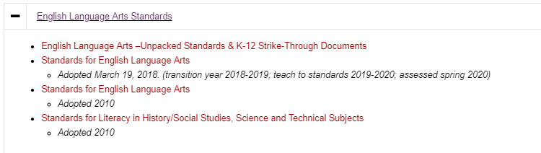
Strike-Through Documents
Notes:
PPT Slides 16, 17, 18, 19: Extension Activity to review the ELA Tables of Information
Unpacked Guidance Document: Appendix A~ 15 Minute Extension/Option 1 provides directions and information to guide this extension activity and the table information found on the ELA page.
The purpose of these documents is to show the changes from the 2010 standards to those adopted in 2018.
Both ELA and Math Strike-Through documents can be found from the Content Standards
Slide 20 will provide a digger dive into the Strike-Through Documents and provide Option 2 for a 15 minute activity.

Slide 20
15 Minutes: Option 2
Strike-Through Documents
Notes:
In the Unpacked Toolkit Guidance document, Appendix B (Strike Through Documents/options 2 in 15 minute time frame) can provide you an activity to process through this topic.
Appendix B document is also on the ELA Resource Page: https://doe.sd.gov/contentstandards/ELA-resources.aspx
On that page, see the 15 Minute Activity Options to download the Strike-Through Document
Power Point Slides 20, 21, 22, 23, 24, 25, 26 cover aspects of the unpacked documents that can be used in conjunction with Appendix B.

Slide 21
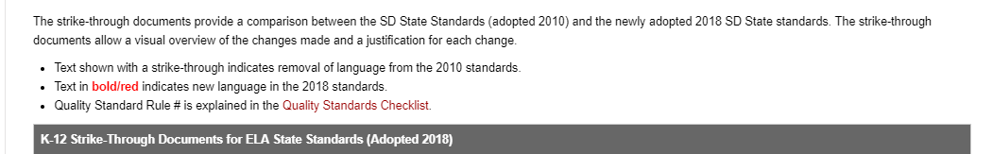
ELA Websites
https://doe.sd.gov/contentstandards/ELA.aspx
Notes:
https://doe.sd.gov/contentstandards/ELA.aspx

Slide 22
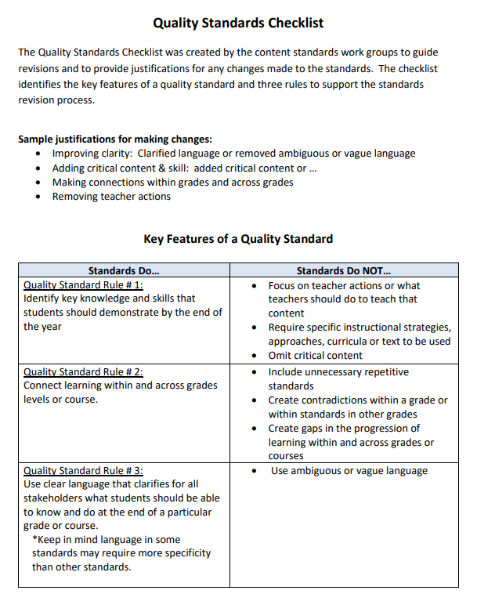
Features of a Quality Standard
This document can be viewed or downloaded by visiting:
Quality Standards Checklist
Notes:
The Quality Standard Checklist can be found in the K12 Strike Through table on this page: https://doe.sd.gov/contentstandards/ELA.aspx
Quality Checklist can be downloaded https://doe.sd.gov/contentstandards/documents/QStandardsChecklist.pdf
Each standard should be compared to this checklist to help guide the discussions, revisions, proposals, or acceptance of a standards
FYI—ELA Standards Work group Table Leads helped to create this document with clear language/focus for the work.

Slide 23
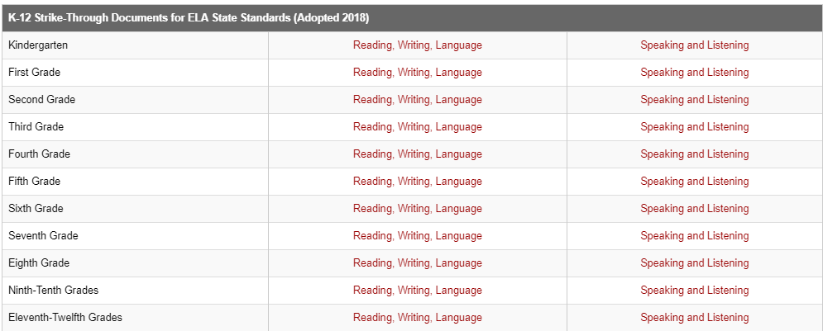
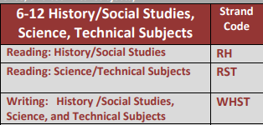
ELA Strike-Through Docs
*Note: 6-12 Literacy Standards in History/Social Studies, Science, and Technical Subjects
are located at the end section of the strike-through documents.
Notes:
The purpose of these documents is to show the changes from the 2010 standards to those adopted in 2018.
ELA Strike-Through documents can be found from the Content Standards https://doe.sd.gov/ContentStandards/ELA.aspx
*Note: 6-12 Literacy Standards in History/Social Studies, Science, and Technical Subjects
are located at the end section of the strike-through documents.
*Codes are different in the standards for History/Soc Studies, Science/Technical Subjects

Slide 24
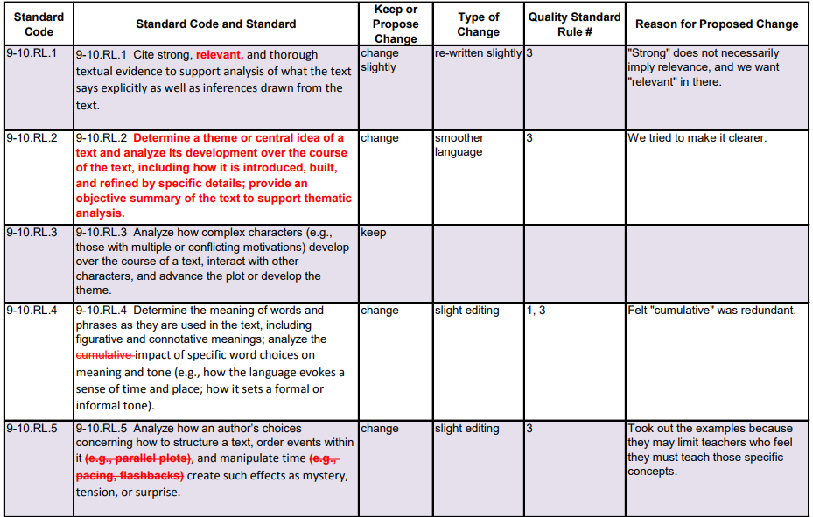
Grade 9-10 RL Strikethrough
Notes:
How would this document benefit educators/districts as they review the current standards to the newly adopted ones?
Why is this a beneficial tool for educators? For district K-12 progresson conversations?
Note: This example is for K-12 ELA standards. Ex: 9-10.RL.5
Again, these are the new ELA State Standards codes that should be used on lesson plans and evidence submitted for accreditation.

Slide 25
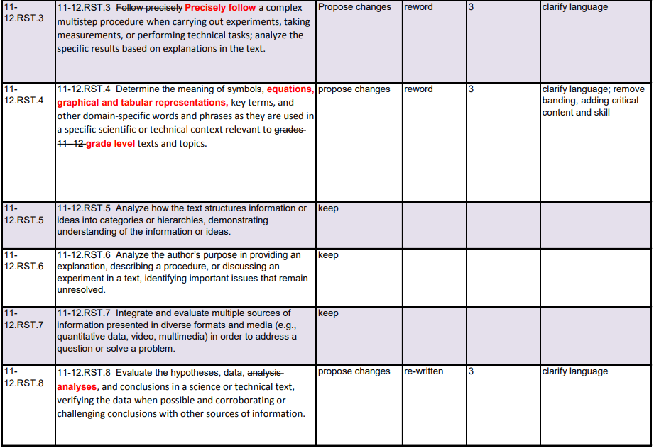
Grade 11-12 RST Strikethrough
Notes:
How would this document benefit educators/districts as they review the current standards to the newly adopted ones?
Why is this a beneficial tool for educators?
NOTE: This example is for 6-12 literacy standards for reading in science and technical subjects. Ex: 11-12. RST.8
Again, these are the new ELA State Standards codes that should be used on lesson plans and evidence submitted for accreditation.

Slide 26



15 Minutes Overview: Option 3
Essential ???
Learning Progressions
BIG Idea Statements
Relevance
Student Friendly
Language
Key Vocabulary
Rigor
&
Cognitive Complexity
Achievement Level Descriptors (ALD)
Resources
Notes:
Vector Infographics.com *source*
15minute Overview of the Unpacked Standards Document.
Go to one of the unpacked standards.
Depending on the audience, you may want to direct teachers to all go to the same unpacked document OR you may direct each teacher to their grade level.
Use the 15 minute handout in the Unpacked Toolkit Guidance document to provide a brief background of each of the sections within the unpacked document. (If time allows, there are also questions to help guide discussions.
Do a turn/talk or small group discussion based on some of the following:
What did they see that was new compared to the last unpacked documents?
What section did they find the most useful to assist them as a teacher in their lesson planning?
What section would they use that they might not have in the past?
IF time allows, you can select questions from the handout for the group to discuss.
Slides 27/28 assist with reflection options/discussions.

Slide 27

Reflection Question
What have you discovered that you can use to add to/revise lessons you teach to more explicitly build instruction based on the skills found in the standards/unpacked documents?
Notes:
This Reflective Questions could be used as:
a reflective journal entry
an exit slip at the end of the day
a sticky note with one of their ideas to be shared and placed on a designated “parking lot”/bulletin board/chart paper
See PPT Slide 28 for a sharing out verbally

Slide 28
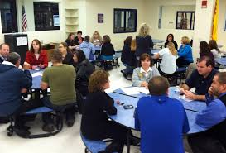
Talk Amongst Yourselves
Notes:
Follow up to PPT Slide # 26/27 Question: After looking at the unpacked standards documents, think and discuss: What have you discovered that you can use to add to/revise lessons you teach to more explicitly build instruction based on the skills found in the standards/unpacked documents?
Slide 28/Talk Amongst Yourselves
Reflective Questions could be used as:
A share out with partner, or team before they end this section (or 15 minute meeting)
Participants could share at their table and then designate 2 people to move to the next table to share out their ideas. A way to allow more people to share with others vs. just their team.

Slide 29


Slide 30

Notes:
30 Minute Options:
Below are only suggested options to help guide a 30 minute time frame. The pairings of the options are based on connections within the unpacked document, or to activities that would allow exploration of the unpacked document/standards at a deeper level.
Note that questions may repeat from previous time frames OR questions might have been added to extend the conversation on the various sections of the unpacked document.
PowerPoint slides are provided to assist with a visual for the questions/sections.
See Appendix D for the guiding questions and reflections
Option 1: Overview of Unpacked Standards (Appendix C) & Strike-through documents (See Appendix B in 15 minute options)
Option 2: Essential Questions/Big Ideas
Option 3: Student Friendly Language/Relevance
Option 4: Learning Progression
Option 5: Rigor and Cognitive Complexity (Know, Understand, Do)

Slide 31
30 Minutes: Unpack the Sections
Essential ???
BIG
Idea Statements
Rigor
&
Cognitive Complexity
Learning Progressions
Relevance
Student Friendly Language
Notes:
Use the Toolkit to view the questions/activities/options you can utilize to fill a 30 minute PD/inservice/dept meeting time frame.
30 Minute Options:
Appendix D~Puzzle Piecing The Unpacked Sections Together
Looking at the Unpacked Standards in 30 mins
Below are only suggested options to help guide a 30 minute time frame. The pairings of the options are based on connections within the unpacked document, or to activities that would allow exploration of the unpacked document/standards at a deeper level.
Note that questions may repeat from previous time frames OR questions might have been added to extend the conversation on the various sections of the unpacked document.
PowerPoint slides are provided to assist with a visual for the questions/sections.
Slide 30, 33, 34 introduce the sections of Unpacked documents
See Appendix D for the guiding questions and reflections in the Unpacked Toolkit Guidance Document OR use the Power Point slides indicated below. Unpacked Section Visuals and Exact Questions that could be used are provided on these PPT slides.
Option 1: Overview of Unpacked Standards (Appendix C) & Strike-through documents (See Appendix B in 15 minute options)
Option 2: Essential Questions/Big Ideas ( PPT 44, 45)
Option 3: Student Friendly Language/Relevance (PPT 50, 51)
Option 4: Learning Progression (PPT 48, 49)
Option 5: Rigor and Cognitive Complexity (Know, Understand, Do) (PPT 52, 53, 54) Webb Levels can assist in creating questions/assessments/lesson plans that incorporate the depth and rigor expected by the standards and skills learned.

Slide 32
Reflection Question
What have you discovered that you can use to add to/revise lessons you teach to more explicitly build instruction based on the skills found in the standards/unpacked documents?
Notes:
This Reflective Questions could be used as:
a reflective journal entry
an exit slip at the end of the day
a sticky note with one of their ideas to be shared and placed on a designated “parking lot”/bulletin board/chart paper
See PPT Slide 32 for a sharing out verbally

Slide 33
Talk Amongst Yourselves
Notes:
Talk Amongst Yourselves (use in connection with PPT slides 30, 31)
Reflective Questions could be used as:
A share out with partner, or team before they end this section (or 15 minute meeting)
Participants could share at their table and then designate 2 people to move to the next table to share out their ideas. A way to allow more people to share with others vs. just their team.

Slide 34

Notes:
Overview of 60 minute Options
Appendix E~Puzzle Piecing The Unpacked Sections (60 minutes)
60 Minute Options:
Below are only suggested options to help guide a 60 minute time frame. The pairings of the options are based on connections within the unpacked document, or to activities that would allow exploration of the unpacked document/standards at a deeper level.
Note that questions may repeat from previous time frames OR questions might have been added to extend the conversation on the various sections of the unpacked document.
PowerPoint slides are provided to assist with a visual for the questions/sections.
See Appendix E for the guidelines, questions, activities/reflections
Option 1: Overview of Unpacked Standards (Appendix C) & Strike-through documents (See Appendix B in 15 minute options)
*Use this option only if K-12 has not reviewed these documents.
*Use the poster activity/icebreaker or article activities that are additional options to be used in this time frame.
Option 2: Essential Questions/Big Ideas (PPT 44, 45)
Option 3: Student Friendly Language/Relevance (PPT, 50-51; 57-58)
Option 4: Key Vocabulary and Resources (PPT 55, 56, 59)
Option 5: Learning Progression (extension activity) (PPT 48, 49----see Guidance document for additional questions appendix E)
Option 6: Rigor and Cognitive Complexity (Know, Understand, Do)& Webb Levels (52, 53, 54)

Slide 35
60 Minutes: Options
Essential ???
Learning Progressions
BIG Idea Statements
Relevance
Student Friendly
Language
Key Vocabulary
Rigor
&
Cognitive Complexity
Resources
Notes:
60 Minute Options:
Appendix E~Puzzle Piecing The Unpacked Sections (60 minutes)
Below are only suggested options to help guide a 60 minute time frame. The pairings of the options are based on connections within the unpacked document, or to activities that would allow exploration of the unpacked document/standards at a deeper level.
Note that questions may repeat from previous time frames OR questions might have been added to extend the conversation on the various sections of the unpacked document.
PowerPoint slides are provided to assist with a visual for the questions/sections.
See Appendix E for the guidelines, questions, activities/reflections
Option 1: Overview of Unpacked Standards (Appendix C) & Strike-through documents (See Appendix B in 15 minute options)
*Use this option only if K-12 has not reviewed these documents.
Option 2: Essential Questions/Big Ideas (PPT 44, 45; 46-47)
Option 3: Student Friendly Language/Relevance (PPT 50-51; 57-58)
Option 4: Key Vocabulary and Resources (PPT 55-56; 59)
Option 5: Learning Progression (extension activity in guidance document Appendix E) (PPT 48-49)
Option 6: Rigor and Cognitive Complexity (Know, Understand, Do)& Webb Levels (PPT 52-54)

Slide 36
Reflection Question
What have you discovered that you can use to add to/revise lessons you teach to more explicitly build instruction based on the skills found in the standards/unpacked documents?
Notes:
This Reflective Questions could be used as:
a reflective journal entry
an exit slip at the end of the day
a sticky note with one of their ideas to be shared and placed on a designated “parking lot”/bulletin board/chart paper
See PPT Slide 37 for a sharing out verbally

Slide 37
Talk Amongst Yourselves
Notes:
Talk Amongst Yourselves (use in connection with PPT slides 35, 36)
Reflective Questions could be used as:
A share out with partner, or team before they end this section (or 15 minute meeting)
Participants could share at their table and then designate 2 people to move to the next table to share out their ideas. A way to allow more people to share with others vs. just their team.

Slide 38
2-3 Hour Options
15 Minute Topics
Essential ???
30 Minute Topics
Learning Progressions
BIG Idea Statements
Relevance
Student Friendly
Language
60 Minute Topics
Key Vocabulary
Rigor
&
Cognitive Complexity
Achievement Level
Descriptors (ALD)
Resources
Notes:
Overview of 2-3 Hour Options
Appendix F~Puzzle Piecing The Unpacked Sections (2-3 hours)
2-3 Hour Options:
Below are only suggested options to help guide a 2-3 hour time frame. All of the sections found within the unpacked documents are included in this option.
Note that questions may repeat from previous time frames OR questions might have been added to extend the conversation on the various sections of the unpacked document.
Extension activities will be found in both the 1 hour and 2-3 hour documents. Review and select the pieces that best support your district’s timeframe and purpose for the inservice/PD.
PowerPoint slides are provided to assist with a visual for the questions/sections.
See Appendix F
for the guidelines, questions, activities/reflections
All of the Sections listed in the Unpacked Documents appear in the 2 to 3 hour timeframe.
Standards
Essential Questions/Big Ideas
Learning Progressions (extension activities)
Rigor and Cognitive Complexity (Know, Understand, Do) (article activity)
Student Friendly Language
Key Vocabulary
Relevance
Resources
Achievement Level Descriptors (ALD) (questions)

Slide 39
Reflection Question
What have you discovered that you can use to add to/revise lessons you teach to more explicitly build instruction based on the skills found in the standards/unpacked documents?
Notes:
This Reflective Questions could be used as:
a reflective journal entry
an exit slip at the end of the day
a sticky note with one of their ideas to be shared and placed on a designated “parking lot”/bulletin board/chart paper
See PPT Slide 38 for a sharing out verbally

Slide 40
Talk Amongst Yourselves
Notes:
Talk Amongst Yourselves (use in connection with PPT slides 38, 39)
Reflective Questions could be used as:
A share out with partner, or team before they end this section (or 15 minute meeting)
Participants could share at their table and then designate 2 people to move to the next table to share out their ideas. A way to allow more people to share with others vs. just their team.

Slide 41
Unpacked Documents
K-12 English Language Arts Standards
Notes:
The following slides correspond to information in the Unpacked Toolkit Guidance/Appendixes Document.
NOTE: Remember that information is placed in the Note sections of each slide to provide information that can be used in the presentations and that connect back to the Guidance Appendixes.
These slides are in the order of the unpacked standards documents. Again, the goal of these resources is to make it usable for each district’s needs. You can rearrange the slides to fit your time frame or topics.
Slides 41-63 cover the Unpacked Documents for K-12 English Language Arts Standards
Slides provide Questions for each section of the unpacked documents that can be used for small/large group discussions
Slides 64-73 cover the 6-12 Literacy Standards in Social Studies/History, Science, and Technical Subjects
*Slides with the questions from the K-12 slides can be used with these slides

Slide 42
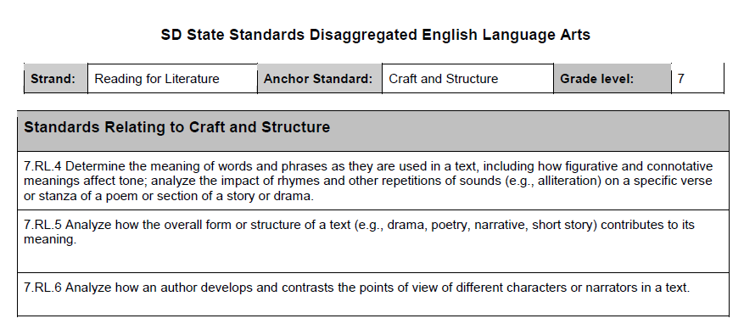
Unpacking the Standards
Notes:
Notice that the standards are not shown in isolation….standards seem overwhelming to teachers with SOOO many; however, many are clustered together when taught, so the templates reflect this forward thinking in how to teach/attack the many standards skills.
Questions to pose: Standards: The standards are clustered three at a time.
What purpose does this serve?
What are the benefits of presenting them this way?
Does this structure change your perception of the standards? If so, how?
Anchor Standards fall into four categories:
Key Ideas & Details
Craft & Structure
Integration of knowledge
Range of reading and level of text complexity

Slide 43

Standards/Anchor Standards
Standards:
Standards
Relating to Anchor Standards:
Key Ideas/Details
Craft & Structure
Integration of knowledge
Range of reading/text complexity
The standards are clustered three at a time.
What purpose does this serve?
What are the benefits of presenting them this way?
Does this structure change your perception of the standards? If so, how?
Notes:
Appendix C/15 Minute Puzzle Piecing the Unpacked Sections
In 15 minutes these are the main sections to focus on: Essential Questions, Student Friendly Language, Relevance.
The next slides will focus on each topic and provide guiding questions to use to start and/or guide discussions for your participants in small groups is suggested initially with a large group follow-up time.
Use Slide 42 to assist with a visual for this section/discussion time.

Slide 44
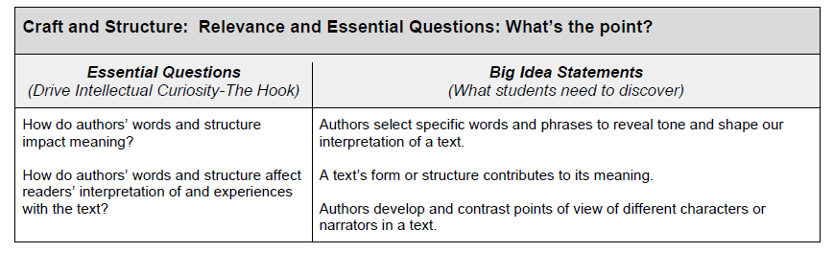
Essential ??s/Big Ideas
Notes:
Table talk with your partner your thoughts about this addition to the unpacked template.
Share how you would use these pieces in your classroom with students, with parents, within lesson planning itself.

Slide 45

Essential Questions
Essential Questions: These questions drive curiosity, hook students, stimulate discussion, provoke inquiry, and increase engagement. Answering these questions will require a
prolonged response.
Where would you use these in your class? Lesson planning? Student discussion?
How can they be used to drive planning, instruction, or student inquiry/engagement?
Notes:
Appendix C/15 Minute Puzzle Piecing the Unpacked Sections
In 15 minutes these are the main sections to focus on: Essential Questions, Student Friendly Language, Relevance.
The next slides will focus on each topic and provide guiding questions to use to start and/or guide discussions for your participants in small groups is suggested initially with a large group follow-up time.
Use Slide 26 to assist with a visual for this section/discussion time.

Slide 46

Big Idea Statement
Big Idea Statements: These statements demonstrate what students need to discover. Many of these statements are main concepts essential to mastering the standards
Where could you use these in your class? Lesson planning?
How can you use these with students? (Consider writing learning objectives or targets, SLOs, etc.)
How do the big idea statements relate to the essential questions?
Notes:
Appendix C/15 Minute Puzzle Piecing the Unpacked Sections
In 15 minutes these are the main sections to focus on: Essential Questions, Student Friendly Language, Relevance.
The next slides will focus on each topic and provide guiding questions to use to start and/or guide discussions for your participants in small groups is suggested initially with a large group follow-up time.
Use Slide 26 to assist with a visual for this section/discussion time.

Slide 47
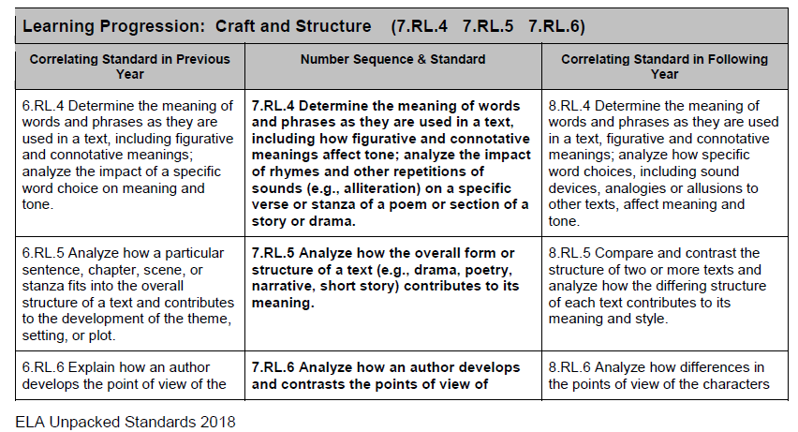
Learning Progressions
Notes:
In the Unpacked Toolkit Guidance Document there are two appendix options that could help with this particular section:
Option 1: Appendix C/15 Minute Puzzle Piecing the Unpacked Sections
In 15 minutes these are the main sections to focus on: Essential Questions, Student Friendly Language, Relevance.
The next slides will focus on each topic and provide guiding questions to use to start and/or guide discussions for your participants in small groups is suggested initially with a large group follow-up time.
Use Slide 26 to assist with a visual for this section/discussion time.
Option 2: Appendix E~Puzzle Piecing The Unpacked Sections (60 minutes)
Diving Deeper into Learning Progressions
Take time to review a shared learning progression as a whole group, making note participants will have time to develop a better understanding of their own grade level at a later point.
Please highlight within this progression the following information:
Previous: (grade before, or previous learning)3rd grade Reading informational text Key Ideas and Details standards that connect to the corresponding 4th grade standards.
Current: The 4th grade Key Ideas and Details Standards.
Future: (within the grade or in subsequent years) 5th grade Reading informational text Key Ideas and Details standards that connect to the corresponding 4th grade standards.
Teachers should make the connection of how their current grade level standards connect to those grade levels below and above, and how the standards build.
Notes on the Learning Progression Visuals on this slide:
Center/bold is the standard being taught; others show the progression
Vertical progressions/grade-band conversations were essential in both the writing and unpacking of the standards. This helps students/parents/teachers see the progression of skills and to where students should be growing or moving towards.
For those doing multi-age classrooms, or personalized learning, these progressions allow movement in lesson planning/students understanding of skills expected, taught, learned for them to progress to next level.

Slide 48

Learning Progression
Learning Progression: The unpacked standard contains the corresponding standard for the grade below and the grade above.
How can you connect the learning in your classroom/grade level to previous or future learning?
How does understanding the standards progressions create a deeper understanding of our own grade-level standards?
Notes:
Learning Progression:The unpacked standard contains the corresponding standard for the grade below and the grade above.
Go look 1 grade level below and 1 grade level above
How can you connect the learning in your classroom/grade level to previous or future learning?
If time allows, consider looking TWO grade levels below and TWO grade levels above.
How does understanding the standards progressions create a deeper understanding of our own grade-level standards?
Option 2: Appendix E~Puzzle Piecing The Unpacked Sections (60 minutes)
Diving Deeper into Learning Progressions

Slide 49
Learning Progression-Extended
Learning Progression:
After grade bands have met and discussed the learning progressions, use these extension questions to engage small or large group discussions How could you see you/your dept/your district using these discussion questions during this year of building capacity?
How does understanding the standards progressions create a deeper understanding of our own grade-level standards?
What professional development will be needed to support staff understanding and implementation of the standards?
Do the district’s current curriculum and resources support effective instruction using the proposed standards? If not, where are the gaps?
How do we plan on addressing any noticeable gaps?
Notes:
Learning Progression:The unpacked standard contains the corresponding standard for the grade below and the grade above.
Go look 1 grade level below and 1 grade level above
How can you connect the learning in your classroom/grade level to previous or future learning?
If time allows, consider looking TWO grade levels below and TWO grade levels above.
How does understanding the standards progressions create a deeper understanding of our own grade-level standards?
Option 2: Appendix E~Puzzle Piecing The Unpacked Sections (60 minutes)
Diving Deeper into Learning Progressions

Slide 50
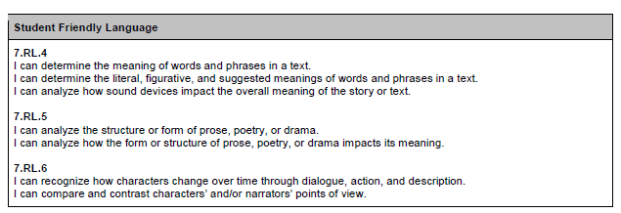
Student Friendly---I statements
Notes:
Student------ I can statements to clearly identify what students should be doing within each standard/cluster
Student Friendly Language:
Have teachers locate this section, making note that this language is intended to provide teachers with examples they can adjust to meet the needs of their own lessons when teaching the appropriate cluster of standards.

Slide 51

Student Friendly Language
Student Friendly Language: This language is intended to provide teachers with examples they can adjust to meet the needs of their own lessons when teaching this cluster of standards.
Where would you use this language in your classroom?
Where could you use this in communication with parents/community members or stakeholders?
How could this language be used in your professional requirements? (i.e. SLOs, evaluations, lesson planning, other communication)
Notes:
Puzzle Piecing the Unpacked Sections
The questions on this slide come from Appendix E~Puzzle Piecing The Unpacked Sections (60 minutes)

Slide 52
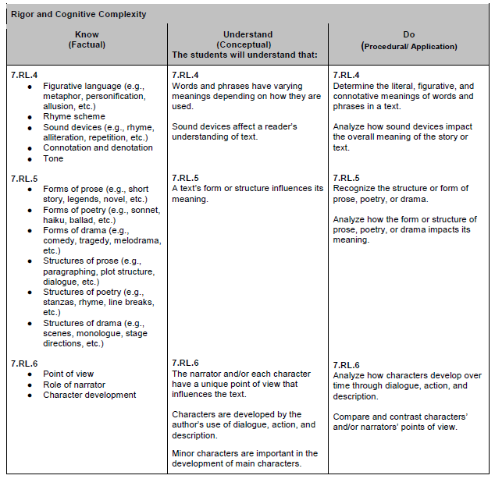
Know
Understand
Do
Notes:
Separated by bullets for each standards to show each one individually and within the cluster
Know---Understand---Do provides assistance in what is to be taught/learned/assessed for mastery of skills
This visual Is important to lesson planning and the skills to include within the plans. It connects to the slides that come later in this PPT.

Slide 53

Rigor & Cognitive Complexity
Rigor and Cognitive Complexity
(Know, Understand, Do): This section includes factual information students need to know for this standard, concepts students need to understand as a result of the standard, and procedures/applications/actions students can perform to master the standard.
Discuss the difference between “know”, “understand”, and “do.”
What is the balance between the “know”, “understand”, and “do” sections?
Where would you use these in your class? In lesson planning?
What does rigor mean?
How does each section of “know, understand, and do” support rigor?
Notes:
Unpacked Toolkit Guidance: Appendix F~Puzzle Piecing The Unpacked Sections (2-3 hours)
Rigor and Cognitive Complexity (Know, Understand, Do): This section includes factual information students need to know for this standard, concepts students need to understand as a result of the standard, and procedures/applications/actions students can perform to master the standard.
Discuss the difference between “know”, “understand”, and “do.”
What is the balance between the “know”, “understand”, and “do” sections?
Where would you use these in your class? In lesson planning?
What does rigor mean?
How does each section of “know, understand, and do” support rigor?
Look at the Webb Level Slide # 54 or on the ELA Resources page:
How does the Webb Leveling relate to the “Know, Understand, Do”
What level is your instruction?
What level are your students?
Where do you do most of your instruction?
How can we move the balance of our instruction to more levels 3 and 4?

Slide 54
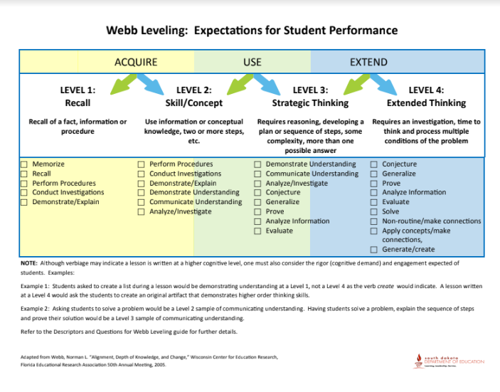
Notes:
Webb Level Link on DOE Webpage can be accessed to save printing.
Look at the Webb Level document on the ELA Resource Page: (https://doe.sd.gov/contentstandards/ELA-resources.aspx)
How does the Webb Leveling relate to the “Know, Understand, Do”
What level is your instruction?
What level are your students?
Where do you do most of your instruction?
How can we move the balance of our instruction to more levels 3 and 4?

Slide 55
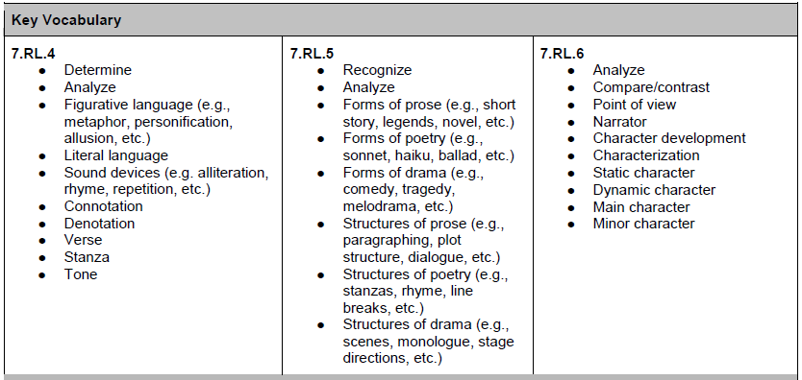
Key Vocabulary
Notes:
Academic vocabulary is important for student learning and consistency from grade to grade in that vocabulary.
On assessments, students are perplexed if academic language used is different from what they have heard in a classroom.
Discussion by teachers have revolved around a consistent understanding of how some figurative language is used/defined from classroom to classroom.

Slide 56

Key Vocabulary
Key Vocabulary: Key vocabulary is academic language both teachers and students should be using during the instruction and learning of the cluster of standards. Key vocabulary is explicit and implicit in teaching this standard. Some of this vocabulary will need student mastery and other vocabulary words need only introduction.
How do you teach vocabulary?
Where do you embed academic vocabulary into lessons?
How do you keep consistent academic vocabulary and language between standards, curriculum, grade levels, and student-friendly language?
Notes:
Option 1: Appendix C/15 Minute Puzzle Piecing the Unpacked Sections
In 15 minutes these are the main sections to focus on: Essential Questions, Student Friendly Language, Relevance.
The next slides will focus on each topic and provide guiding questions to use to start and/or guide discussions for your participants in small groups is suggested initially with a large group follow-up time.
Use Slides 30/31 to assist with guiding questions for small/large group discussions and visual.

Slide 57
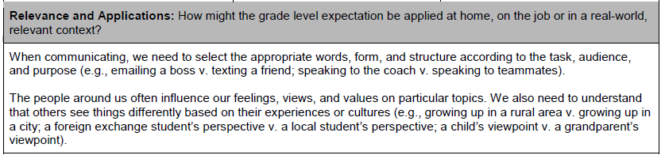
Relevance & Application
Notes:
How might “We” use these skills in the real world?
Notice voice has shifted from I can/student friendly to we/real world application for all needing this skill.
Activity: How might teachers and/or students create their own relevance statements?

Slide 58

Relevance
Relevance: This section shows how the skills in the standards might be applied at home, on the job, or in a real-world, relevant context.
Where could you use this language in your classroom? How can you use this during lessons with students?
How could this piece help create student engagement? How could this increase student learning?
Notice that this piece uses “We” language, which is a difference from the student friendly language which uses “I can.” Why is this significant? Why shift to include teachers in the relevance section?
Are there other examples to provide to students to assist in real-world connections?
Notes:
Guidance Document: Appendix F~Puzzle Piecing The Unpacked Sections (2-3 hours)
Questions for the Relevance can be found throughout the time frames.

Slide 59
Resources
ELA Resources
Unpacked Standards Toolkit Resources
Toolkit | Unpacked Toolkit Power Point
15 Minute Activity Options | Scavenger Hunt Strike-Through Documents
Articles/Activities | Is Your Lesson a Grecian Urn? How to Plan Effective Lessons Connect, Extend, Challenge, Chart Chalk Talk Activity
Unpacked Example Documents | Grade 7 Reading for Information 7.RL.7 7.RL.8 7.RL.9 Grade 11-12 Literacy Standards in Science/Technical Subjects
Lesson Planning | Page Lesson Plan Cheat Sheet Webb Level Chart Charlotte Danielson’s Framework for Teaching Smart Card
Exit Slip Reflection | Wonder-Wish-What’s Next-WooHoo!
Accreditation Supports | Q & A for Curriculum Alignment Accreditation Requirements
Notes:
ELA Resources: https://doe.sd.gov/contentstandards/ELA-resources.aspx
Currently this section hosts the Unpacked Standards Toolkit and Guidance/Appendix document to assist districts with the standards/unpacked standards work. Over the course of the year, updates will be made to this page. Information will be sent out in the ELA Listserv-Thursday’s Tidbits to inform teachers of new additions to the page.
If teachers want to sign up for the ELA Listserv, an easy subscription link can be shared: https://www.k12.sd.us/MailingList/DOELanguageArts

Slide 60
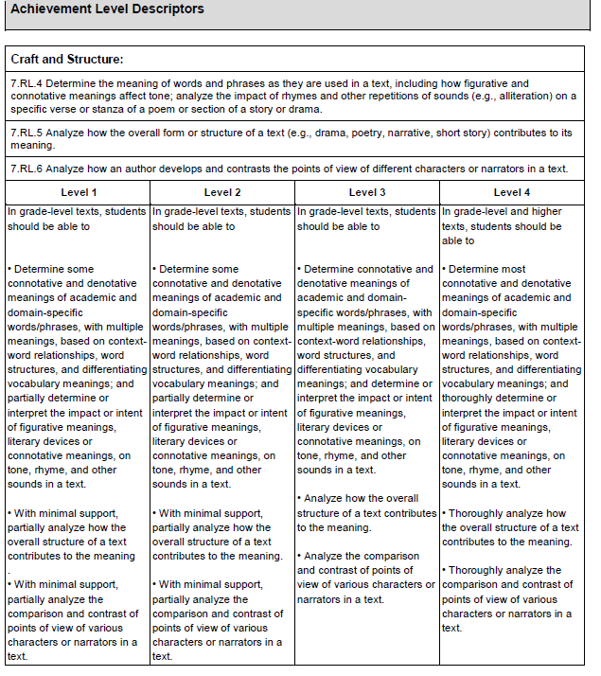
Achievement Level
Descriptors
(ALD)
Clusters
Level Differentiation
Skills for Assessing
Notes:
Achievement Level Descriptors: Their purpose is to properly assess students at the cluster level, give students opportunities to learn at this level, and give a good indication of how students will perform on standardized assessments within this cluster.
This is a new addition to the unpacked documents that previously were used in ELA.
The wording focuses on just the standards indicated on each unpacked document.
To help develop an understanding of the scaffolding of skills, read Level 3 first, and then go to level 1 and then 2. This helps educators, students, and parents to understand the progression of learning that takes place to move from one level to the next. The level 4 shows the highest level of learning in the skills for the standards.

Slide 61

Achievement Level Descriptors
Achievement Level Descriptors: Their purpose is to properly assess students at the cluster level, give students opportunities to learn at this level, and give a good indication of how students will perform on standardized assessments within this cluster.
Where could you use this language in your class? In assessment? In a rubric?
How do you use the ALDs to identify the levels of your students?
How could you use this language with students? Parents? Administrators? Instructional coaches/curriculum directors?
How can you differentiate for students at their individual levels?
At what level is your instruction? How do you know?
How can we support students to move them to the higher achievement levels?
Notes:
Appendix F~Puzzle Piecing The Unpacked Sections (2-3 hours)
Extension Activity/Questions for this slide on Achievement Level Descriptors
After looking at the unpacked standards documents, think and discuss:
What are the gaps between what you are teaching and what you should be teaching?
How can we enhance student learning by more closely aligning lessons with the standards?
What have you learned/found that you can use to add to/revise what you already do to more explicitly build instruction based on the standards?
Think and Discuss: What have you discovered that you can use to add to/revise lessons you teach to more explicitly build instruction based on the skills found in the standards/unpacked documents?

Slide 62
Reflection Question
What have you discovered that you can use to add to/revise lessons you teach to more explicitly build instruction based on the skills found in the standards/unpacked documents?
Notes:
This Reflective Questions could be used as:
a reflective journal entry
an exit slip at the end of the day
a sticky note with one of their ideas to be shared and placed on a designated “parking lot”/bulletin board/chart paper
See PPT Slide 61 for a sharing out verbally

Slide 63
Talk Amongst Yourselves
Notes:
Follow up to PPT Slide # 60/61Question: After looking at the unpacked standards documents, think and discuss: What have you discovered that you can use to add to/revise lessons you teach to more explicitly build instruction based on the skills found in the standards/unpacked documents?
Slide 63/Talk Amongst Yourselves
Reflective Questions could be used as:
A share out with partner, or team before they end this section (or 15 minute meeting)
Participants could share at their table and then designate 2 people to move to the next table to share out their ideas. A way to allow more people to share with others vs. just their team.

Slide 64
Unpacked Documents
6-12 Literacy in History/Social Studies, Science, and Technical Subjects
Notes:
Unpacked Documents for 6-12 Literacy in History/Social Studies, Science, and Technical Subjects
PPT Slides 64-73
These slides can be used to review the same components found in the K-12 ELA slides.
The same Questions/Appendixes from the guidance document can be used for these slides.
Areas to note for these content areas is that the language found in these standards may have some reading/writing also found in the ELA, but a group of content educators also reviewed the standards and unpacked documents to ensure that language/vocabulary from these contents would be present in the unpacked work.
Also note that these unpacked documents have the new 11-12.RST.1 numbering that should be used on lesson plans/syllabus information.

Slide 65
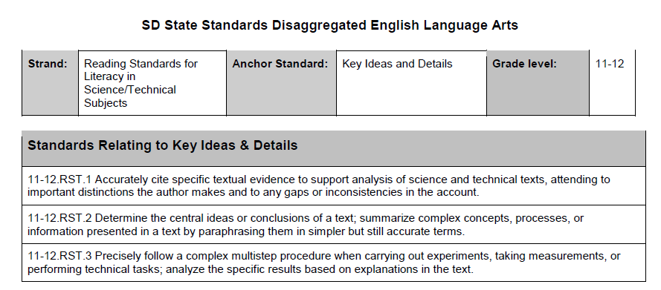
Unpacking the Standards
Notes:
Notice that the standards are not shown in isolation….standards seem overwhelming to teachers with SOOO many; however, many are clustered together when taught, so the templates reflect this forward thinking in how to teach/attack the many standards skills.
Key Ideas & Details
Craft & Structure
Integration of knowledge
Range of reading and level of text complexity

Slide 66
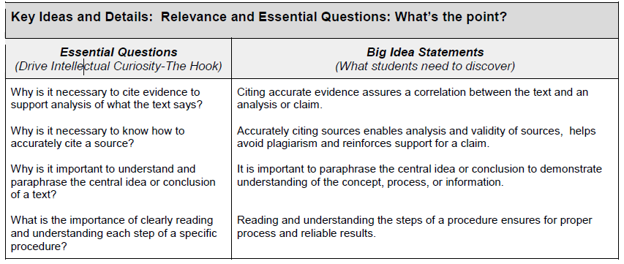
Essential ??s/Big Ideas
Notes:
Table talk with your partner your thoughts about this addition to the unpacked template.
Share how you would use these pieces in your classroom with students, with parents, within lesson planning itself.

Slide 67
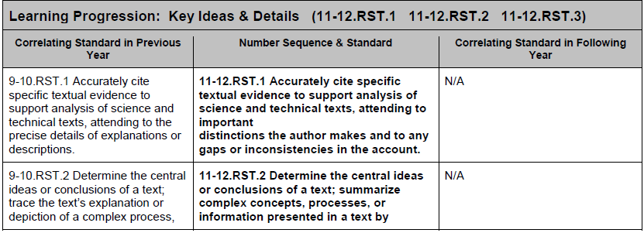
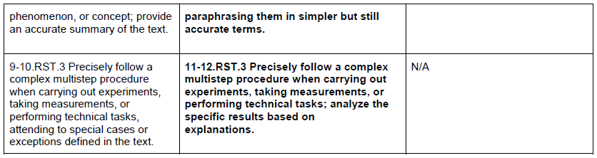
Learning Progressions
Notes:
Center/bold is the standard being taught; others show the progression
Vertical progressions/grade-band conversations were essential in both the writing and unpacking of the standards. This helps students/parents/teachers see the progression of skills and to where students should be growing or moving towards.
For those doing multi-age classrooms, or personalized learning, these progressions allow movement in lesson planning/students understanding of skills expected, taught, learned for them to progress to next level.

Slide 68
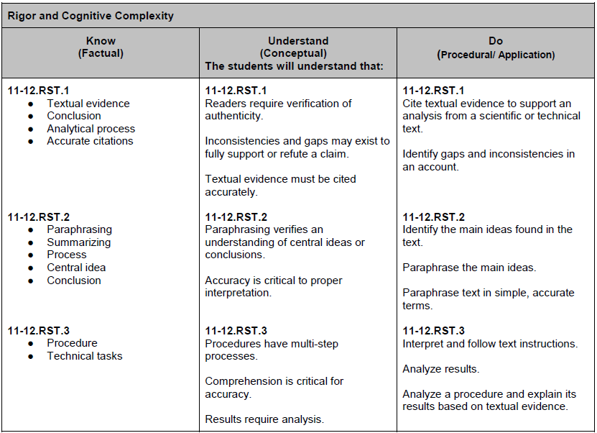
Know
Understand
Do
Notes:
Separated by standards to show each one individually and within the cluster
Know---Understand---Do provides assistance in what is to be taught/learned/assessed for mastery of skills

Slide 69
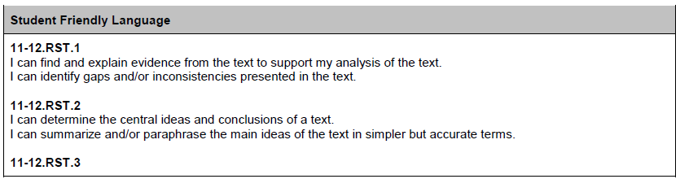
Student Friendly---I statements
Notes:
Student------ I can statements to clearly identify what students should be doing within each standard/cluster

Slide 70
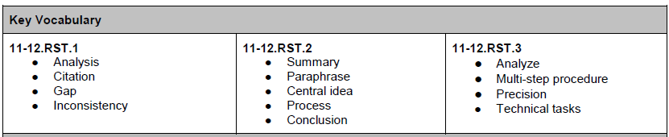
Key Vocabulary

Slide 71
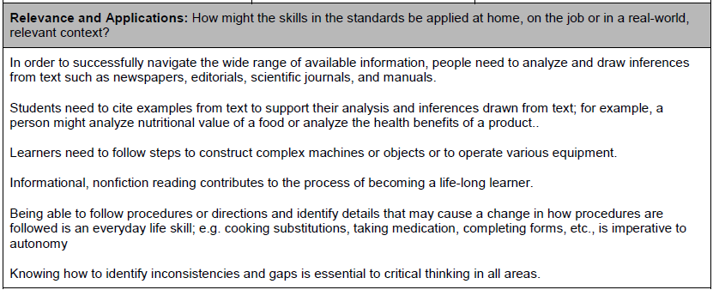
Relevance & Application
Notes:
How might “We” use these skills in the real world?
Notice voice has shifted from I can/student friendly to we/real world application for all needing this skill

Slide 72
Resources
ELA Resources
Unpacked Standards Toolkit Resources
Toolkit | Unpacked Toolkit Power Point
15 Minute Activity Options | Scavenger Hunt Strike-Through Documents
Articles/Activities | Is Your Lesson a Grecian Urn? How to Plan Effective Lessons Connect, Extend, Challenge, Chart Chalk Talk Activity
Unpacked Example Documents | Grade 7 Reading for Information 7.RL.7 7.RL.8 7.RL.9 Grade 11-12 Literacy Standards in Science/Technical Subjects
Lesson Planning | Page Lesson Plan Cheat Sheet Webb Level Chart Charlotte Danielson’s Framework for Teaching Smart Card
Exit Slip Reflection | Wonder-Wish-What’s Next-WooHoo!
Accreditation Supports | Q & A for Curriculum Alignment Accreditation Requirements
Notes:
Resources: This section is being vetted by the DOE currently, but there will be ample resources provided. Check back to the DOE website for updates.

Slide 73
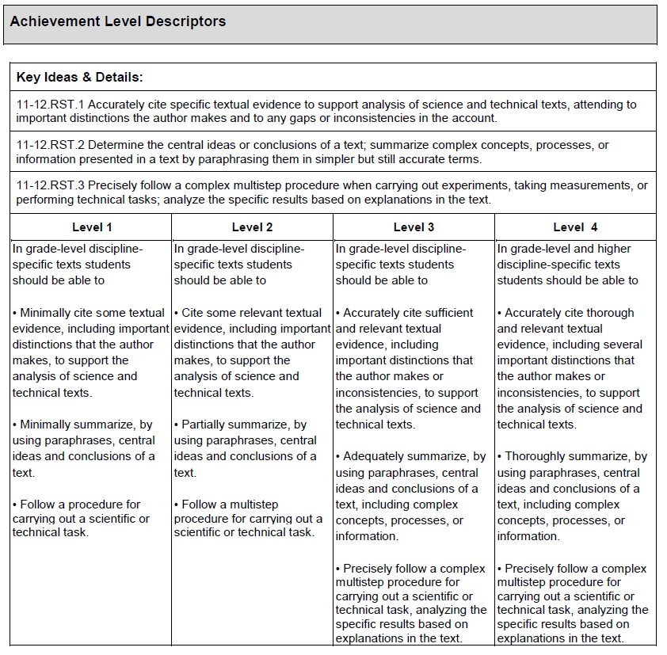
Achievement Level
Descriptors
(ALD)
Clusters
Level Differentiation
Skills for Assessing

Slide 74
Notes:
Accreditation Connections: (It’s NOT one more thing----it connects ALL initiatives throughout an educator’s year)
Slides 75-78 Review the questions used for the Teaching Standards/evidence part of the accreditation review process districts complete.
These are optional slides that can help to guide conversations as districts discuss both accreditation evidence, and also, how lesson plans are created to ensure that all students are learning skills required at each grade level.
Slides 79-88 provide some examples of lesson plans submitted for review and in the NOTES section of each slide are some questions to ponder and use in discussions. The goal is to provide some slides to assist district in hosting conversations about how to use the unpacked standards to help ensure skills are being taught to the depth and rigor required. Some districts are having conversations about the template they use, what they select to be included, and reviewing the unpacked documents for some guidance.
Accrediation conversations can review the slides for discussions that connect to both the evidence needed and the understanding to answer question 1 & 2 in the review process.

Slide 75
Questions to Ponder
TEACHING TO THE CONTENT STANDARDS
DIRECTIONS TO MEET CURRICULUM ALIGNMENT REQUIREMENTS FOR ACCREDITATION
Essential Question #1:
Narrative: Describe the process(es) used to ensure all standards are included in the taught curriculum for all students.
Referenced evidence must include: standards (concepts/skills) and timeline.
Possible Evidence: blueprint, scope and sequence, curriculum plan/map, units of instruction
Notes:
Question # 1 focuses on the “What” as in what is being taught and the timeline that “What” is being implemented. The slide provides possible evidence.
Utilize the 2 Accreditation Questions to help Administrators/Teachers contemplate why the standards/unpacked documents play a role in their work with the review process, teacher evaluation/walk-thrus (Danielson Framework).
A district goal could include discussions to assist in understanding the connections and importance for PD time to discuss, share, cross-over conversations between contents to understand the value of skills taught across K-12.
.

Slide 76
Questions to Ponder
TEACHING TO THE CONTENT STANDARDS
DIRECTIONS TO MEET CURRICULUM ALIGNMENT REQUIREMENTS FOR ACCREDITATION
Essential Question #2:
Narrative: What steps has the school taken to ensure the taught curriculum addresses the standards to the required depth and intention?
Examples could include, but are not limited to: system of common formative assessment, looked for during teacher evaluation observations, PLC groups focused on evaluating student work in relation to standards, evaluation of unit assessments, etc.
Referenced evidence must include: how the content standards are taught/performance expectations.
Possible Evidence:
a. In depth unit of instruction
b. In-depth lesson plans (only if narrative includes an explanation of district/school expectations or policy for aligning standards to DOK for all teachers)
c. Results of a curriculum review process for depth of knowledge.
Notes:
Question # 2: This is asking for the “HOW” the standards/skills are being taught in the classroom. The evidence provided does not just list the “what” but provides insight into “how” the skills are taught to students, “how” engagement is occurring, and how skills are assessed to ensure learning is occurring.
Evidence requirements: (4 pieces of evidence per district)
Upload evidence from three of the four core content areas (English language arts, math, science, social studies) and at least one non-core content area.
Evidence should represent grade-bands K-5, 6-8, and 9-12. Label which grade band (e.g. k-5, 6-8, 9-12) each piece of evidence is from, again, each grade-band should be represented at least once. Only four pieces of evidence per district are required.
Examples of evidence include, but are not limited to: blueprint, units of instruction, scope and sequence, or curriculum plan/map, in-depth lesson plans. Keep in mind that some pieces of evidence may not address both questions.

Slide 77
Guidance Questions
Guiding Questions
What are the STRENGTHS?
What are the WEAKNESSES?
What else would you like to know?
If you were the accreditation team, what guidance would you offer?
Describe the process(es) used to ensure ALL STANDARDS are included in the taught curriculum for all students.
What steps has the school taken to ensure the taught curriculum addresses the standards to the REQUIRED DEPTH AND INTENTION?
What story does the documentation support or tell?
Notes:
What would convince you if you were reviewing lesson plans or an accreditation piece of evidence?
____________________________
What examples can help them contemplate lesson plans and what depth/rigor looks like?
What do lesson plans look like from district to district?
What are the most essential pieces needed?
How do unpacked documents help to guide the plans for depth/rigor? Engagement? Learning of skills?

Slide 78
What are the Quick Look FOrs?
Is documentation aligned to the current content standards?
Is the documentation a story of what actually happens during instruction? For everyone?
Is this a copy of something a curriculum company created?
Notes:
What would convince you?
____________________________
What examples can help them contemplate lesson plans and what depth/rigor looks like?
What do lesson plans look like from district to district?
What are the most essential pieces needed?
How do unpacked help to guide the plans for depth/rigor? Engagement? Learning of skills?

Slide 79
Example Slides
For conversation on either lesson plans or what evidence looks like for accreditation reviews, Slides 80-88 can be used to provide some examples and questions to help guide discussions.

Slide 80
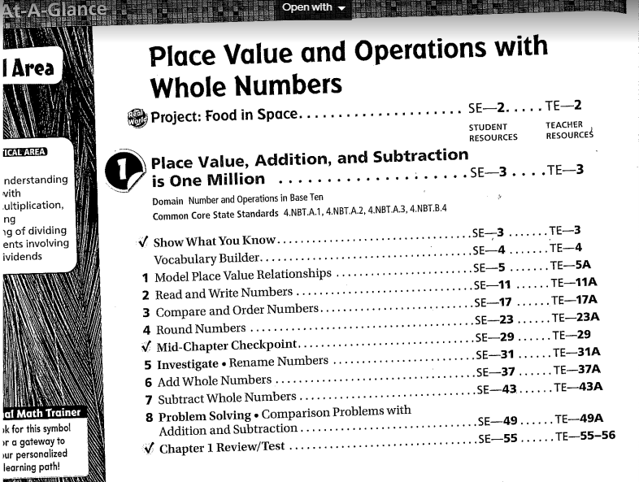
Does it answer question 1 or 2?
Guiding Questions
What story does the documentation support or tell?
Notes:
What do you see?
What do you Not see?
Does this answer question 1 or 2?
Discuss as a group what is a strength?
What is a weakness in the evidence/example shown?
____How can the evidence be expanded to answer both to ensure standards K-12 and depth /rigor?
________________________
What examples can help them contemplate lesson plans and what depth/rigor looks like?
What do lesson plans look like from district to district?
What are the most essential pieces needed?
How do unpacked help to guide the plans for depth/rigor? Engagement? Learning of skills?

Slide 81
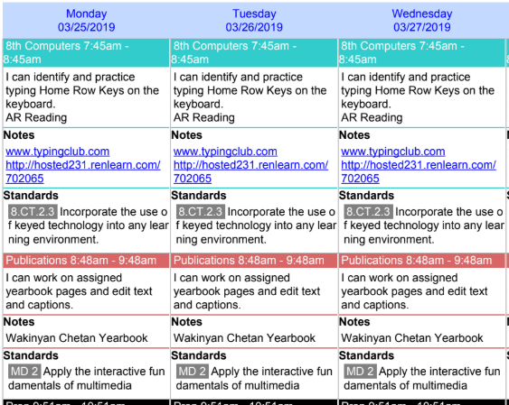
Guiding Questions
What story does the documentation support or tell?
Notes:
What do you see?
What do you Not see?
Does this answer question 1 or 2?
Discuss as a group what is a strength?
What is a weakness in the evidence/example shown?
____How can the evidence be expanded to answer both to ensure standards K-12 and depth /rigor?
________________________
What examples can help them contemplate lesson plans and what depth/rigor looks like?
What do lesson plans look like from district to district?
What are the most essential pieces needed?
How do unpacked help to guide the plans for depth/rigor? Engagement? Learning of skills?

Slide 82
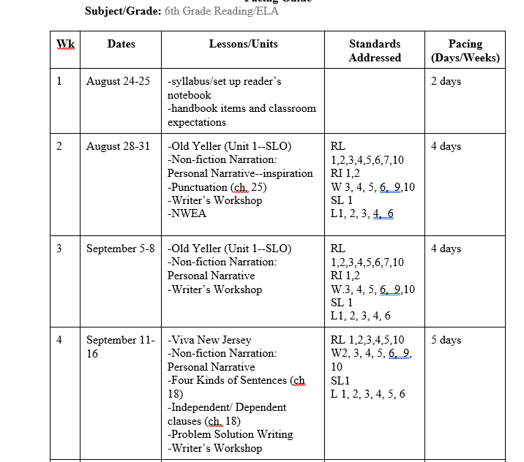
Guiding Questions
What story does the documentation support or tell?
Notes:
What do you see?
What do you Not see?
Does this answer question 1 or 2?
Discuss as a group what is a strength?
What is a weakness in the evidence/example shown?
____How can the evidence be expanded to answer both to ensure standards K-12 and depth /rigor?
________________________
What examples can help them contemplate lesson plans and what depth/rigor looks like?
What do lesson plans look like from district to district?
What are the most essential pieces needed?
How do unpacked help to guide the plans for depth/rigor? Engagement? Learning of skills?

Slide 83
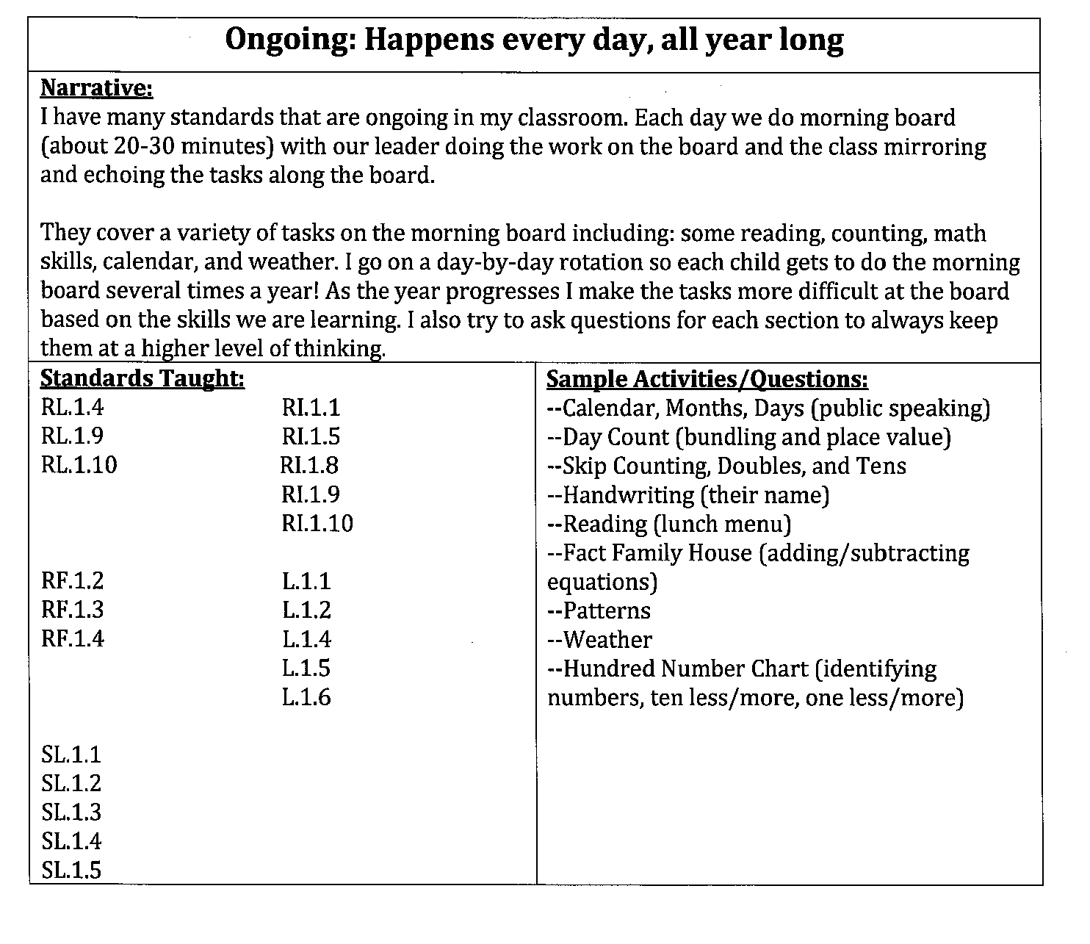
Guiding Questions:
What story does the documentation support or tell?
Notes:
What do you see?
What do you Not see?
Does this answer question 1 or 2?
Discuss as a group what is a strength?
What is a weakness in the evidence/example shown?
____How can the evidence be expanded to answer both to ensure standards K-12 and depth /rigor?
________________________
What examples can help them contemplate lesson plans and what depth/rigor looks like?
What do lesson plans look like from district to district?
What are the most essential pieces needed?
How do unpacked help to guide the plans for depth/rigor? Engagement? Learning of skills?

Slide 84
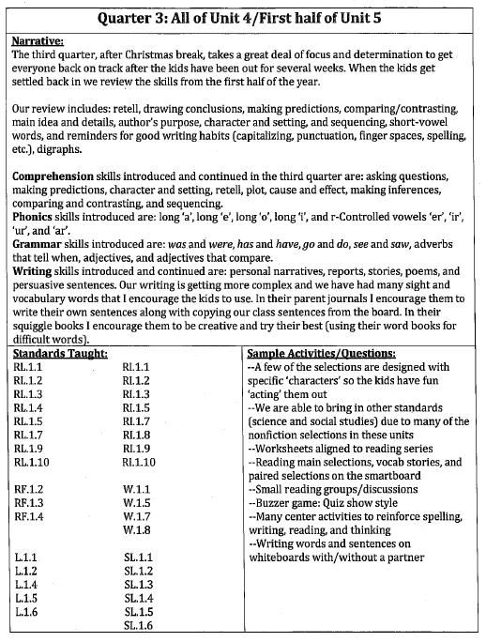
Guiding Questions:
What story does the documentation support or tell?
Notes:
What do you see?
What do you Not see?
Does this answer question 1 or 2?
Discuss as a group what is a strength?
What is a weakness in the evidence/example shown?
____How can the evidence be expanded to answer both to ensure standards K-12 and depth /rigor?
________________________
What examples can help them contemplate lesson plans and what depth/rigor looks like?
What do lesson plans look like from district to district?
What are the most essential pieces needed?
How do unpacked help to guide the plans for depth/rigor? Engagement? Learning of skills?
__________________________________

Slide 85
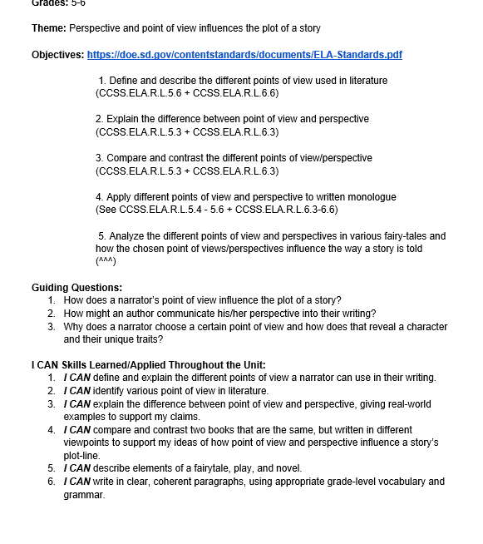
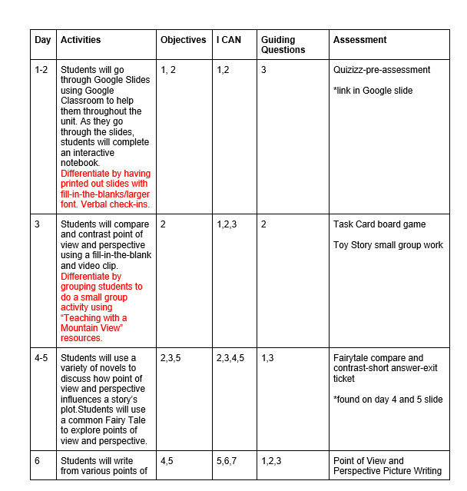
Notes:
What do you see?
What do you Not see?
Does this answer question 1 or 2?
Discuss as a group what is a strength?
What is a weakness in the evidence/example shown?
____How can the evidence be expanded to answer both to ensure standards K-12 and depth /rigor?
________________________
What examples can help them contemplate lesson plans and what depth/rigor looks like?
What do lesson plans look like from district to district?
What are the most essential pieces needed?
How do unpacked help to guide the plans for depth/rigor? Engagement? Learning of skills?

Slide 86
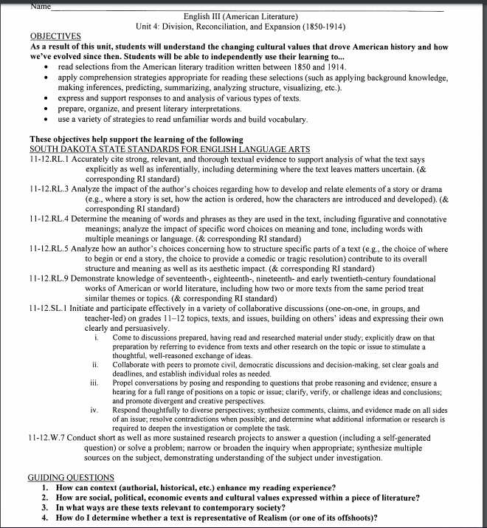
Guiding Questions:
What story does the documentation support or tell?
Example 1 of 3
Notes:
What do you see?
What do you Not see?
Does this answer question 1 or 2?
Discuss as a group what is a strength?
What is a weakness in the evidence/example shown?
____How can the evidence be expanded to answer both to ensure standards K-12 and depth /rigor?
________________________
What examples can help them contemplate lesson plans and what depth/rigor looks like?
What do lesson plans look like from district to district?
What are the most essential pieces needed?
How do unpacked help to guide the plans for depth/rigor? Engagement? Learning of skills?

Slide 87
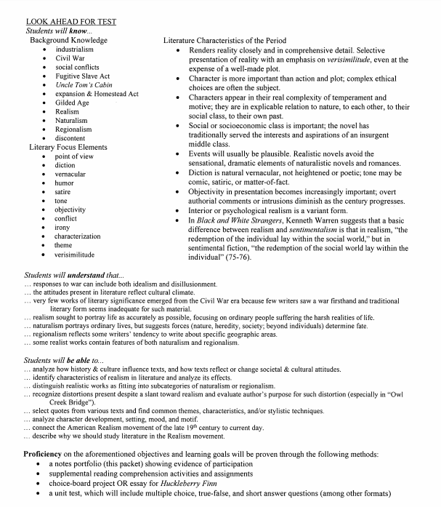
Guiding Questions:
What story does the documentation support or tell?
Example 2 of 3
Notes:
What do you see?
What do you Not see?
Does this answer question 1 or 2?
Discuss as a group what is a strength?
What is a weakness in the evidence/example shown?
____How can the evidence be expanded to answer both to ensure standards K-12 and depth /rigor?
________________________
What examples can help them contemplate lesson plans and what depth/rigor looks like?
What do lesson plans look like from district to district?
What are the most essential pieces needed?
How do unpacked help to guide the plans for depth/rigor? Engagement? Learning of skills?

Slide 88
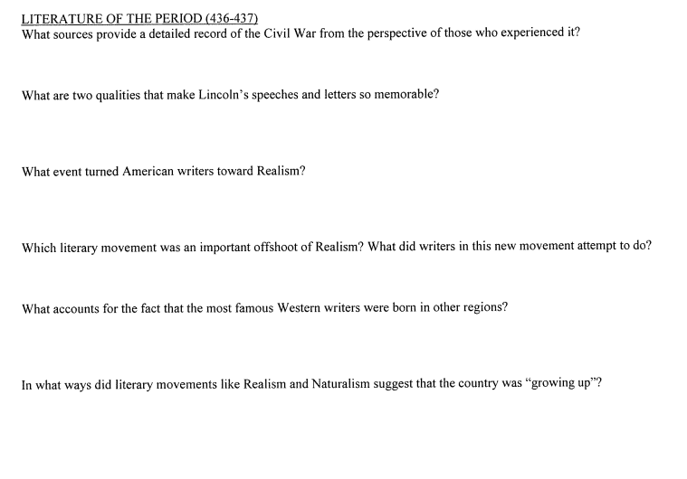
Guiding Questions:
What story does the documentation support or tell?
Example 3of 3
Notes:
What do you see?
What do you Not see?
Does this answer question 1 or 2?
Discuss as a group what is a strength?
What is a weakness in the evidence/example shown?
____How can the evidence be expanded to answer both to ensure standards K-12 and depth /rigor?
________________________
What examples can help them contemplate lesson plans and what depth/rigor looks like?
What do lesson plans look like from district to district?
What are the most essential pieces needed?
How do unpacked help to guide the plans for depth/rigor? Engagement? Learning of skills?

Slide 89

Lesson
Notes:
Slides 89-96 focus on lesson planning ideas and resources to help guide teachers in using both the unpacked standards/ELA standards and some guidelines on what to include in lessons to ensure that depth and rigor is occurring.

Slide 90


Article Activity: Chalk Talk
Notes:
This link will provide diretions on how to do a Chalk Talk Activity:
Https://www.scholastic.com/teachers/blog-posts/genia-connell/chalk-talks-engage-all-students/
Do this with the How to Plan Effective Lessons (ASCD Education Update article)
That article can be located on the ELA Resource page: https://doe.sd.gov/contentstandards/ELA-resources.aspx
*Group size might dictate what can be done with this activity.
Option1: As shown in picture, small groups at the table create the chalk talk---could share with 1 other table to see differences/similartieis in ideas.
Option 2: Smaller sized group, do a carousel walk.
Each person reads the articles/annotates/questions/aha/connections indicated
Each person assigned a group number (Ex. 30 people 5 groups of 6)
Chart paper with article attached & assigned a number (1-5)
Participants take their article and go to the assigned chart. Participants WITHOUT TALKING will add 1-2 annotations from their sheet onto the chart paper article.
After 1-2 minutes (you decide based on activity/writing by groups), the group will move collectively to the next chart paper group.
Participants will read the annotations from the previous group and WILL ADD their own annotations to the article. WHILE NOT TALKING!!

Slide 91
Lesson Plan Components
What is a lesson plan?
A roadmap of what will be taught
How it will be taught
How it might be modified for particular students in response to feedback
How you and your students will know they have mastered the content
The Simplified Lesson Planning Formula/Jackson (pg 9)
Notes:
Jill Jackson is a national consultant who has worked with South Dakota on several projects.
DOE is NOT promoting her book or requiring any district to purchase it. This is just a resource that could be reviewed IF your district is struggling with lesson planning strategies for new teachers or looking to revise lesson planning overall.

Slide 92
Lesson Plan vs Lesson Prepping
Lesson Planning: the detailed roadmap of WHAT you will teach (content, curriculum, standards, etc.)
Lesson Prepping: the detailed roadmap of HOW it will be delivered to the students (engagement techniques written, verbal, and physical responses, small group/whole group, etc.)
The Simplified Lesson Planning Formula/Jackson (pg 9)
Notes:
Both need to be incorporated into lesson planning AND lesson prepping. If only the WHAT is listed on a lesson plan, there needs to be time to purposefully create the HOW it will be delivered to students.
SMALL/LARGE GROUPO Questions:
What is the way that most teachers approach lesson planning?
How much time was spent in teacher preparation programs to assist you as a teacher with lesson planning strategies?
Have you used unpacked standards previously when planning/prepping lessons?
What is one item you’ve seen in the unpacked documents you know you could use to build your lesson plans with depth and rigor?
How much time is devoted to planning for lessons in your classes?
Is the same amount of time devoted to purposeful prepping of those ideas?

Slide 93

Notes:
Lesson planning is 140 hours
Lesson PREPPING is 450 hours---the HOW am I going to do it takes longer than the roadmap of what.
Using unpacked standards components help to be guides as to the “What” and the “How” needed for student learning of skills found within the standards.
ASCD infographic

Slide 94

One Page Lesson Plan
Notes:
1 Page Lesson Plan Cheat Sheet is on the ELA Resource Page and can be downloaded
https://doe.sd.gov/contentstandards/ELA-resources.aspx
Notice bold wording comes directly from the Unpacked standards sections. Other wording is pulled from Danielson Domains, one-page strategies, and state initiatives (SLO).
In the Full day training Agenda:
Participants will use multiple tools in their lesson planning “reboot” time. This 1 page along with the articles/unpacked documents will allow them time to revisit their lessons.
Participants will work on their lesson plans to embed pieces that are missing in planning/prepping, rigor, unpacked components etc. At the end of the allotted time, allow participants to talk with a partner(s) to share out items they revisited in their current lesson.
Allow a table or large group on “aha” moments, concerns with planning, etc.
If possible, allow participants to share with a couple of partners in smaller groups before moving into large groups. Less threatening to those who might be uncomfortable sharing in a large setting initially.

Slide 95
Reflection Question
What have you discovered that you can use to add to/revise lessons you teach to more explicitly build instruction based on the skills found in the standards/unpacked documents?
Notes:
After time with the lesson planning slides and activities, allow teachers time to reflect and process the key pieces that they will take back with them to their classrooms. Reflection is vital for real processing to occur.

Slide 96
Talk Amongst Yourselves
Notes:
/Talk Amongst Yourselves
Reflective Questions could be used as:
A share out with partner, or team before they end this section (or 15 minute meeting)
Participants could share at their table and then designate 2 people to move to the next table to share out their ideas. A way to allow more people to share with others vs. just their team.

Slide 97


EXIT SLIP
Notes:
Participants can complete this as an exit slip to help guide them and to allow feedback to trainer on session/next steps.
ELA Resource Page this WWWW document can be downloaded
https://doe.sd.gov/contentstandards/ELA-resources.aspx

Slide 98

Contact Information
Teresa Berndt, DOE Reading Specialist
Teresa.Berndt@state.sd.us
605.295.0335

