Slide 1



SOUTH DAKOTA PRINCIPAL EFFECTIVENESS MODEL PROCESS OVERVIEW
PE
WEBINAR I
10/29/2015

Slide 2
TIMELINE REVIEW
SY 2014-15 and SY 2015-16: Learning years with full implementation beginning in SY 2016-17.
SY 2015-16 Implementation Options:
Full implementation of the state-recommended principal evaluation system OR
Implementation of an alternative system aligned to the state model (crosswalk) OR
Planning, training, and capacity building for full implementation in SY 2016-2017.

Slide 3
IMPLEMENTATION TIMELINE
June 30, 2015: Deadline for submission of Gap Analysis and Planning Guide
June 15-19: Regional trainings for Gap Analysis and Planning Guide completion and Component Selection
October-June: Monthly webinars providing a more in-depth look at components of the PE Model.
SY: 2016-2017: Full Implementation
October 2017: Submission of district-level aggregate Principal Effectiveness data from SY 2016-17 via PRF
Notes:
Explain October 2017 Submission of district-level aggregate PE data (This always seems to be a concern).

Slide 4
COMPARISON OF MINIMUM REQUIREMENTS TO SD PRINCIPAL EFFECTIVENESS MODEL
Notes:
Basic differences are noted in red in left column and also highlighted in yellow.

Slide 5
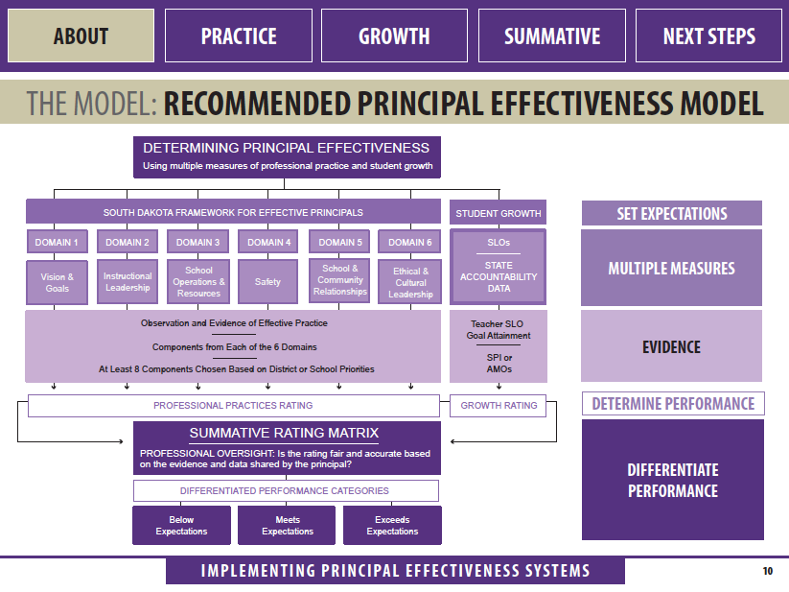
Notes:
Reminder: The PE Recommended Model suggest selecting 8 components-one from each of the six domains.
The Minimum Requirement only requires the selection of 6 components-one from each of the six domains.

Slide 6
RECOMMENDED PROCESS TIMELINE
Principals and evaluators are trained and oriented to the evaluation system.
The two steps are ideally completed no later than the first month of the school year.
Considering the time constraints on principals in the first month of school, districts might consider completing the training and orientation pre the start of the school year.
PHASE ONE:
PREPARE
Notes:
Participation in the following should all be considered part of the training process and could be used as evidence/artifacts. For example Domain 2: Component 2 specifically addresses the principal participating in his/her own professional development.
November 2014 PE training.
June 2015 PE training.
2015-2016 PE Webinar Series
Break Out Sessions offered at SD Elementary and Secondary Principals’ Conferences
Break Out Sessions offered at SD Turn Around Conference
Break Out Sessions at Systems Change Conference
Individual work at the district level, etc.

Slide 7
RECOMMENDED PROCESS TIMELINE
Principals conduct a self-assessment.
Assessment should be used to inform discussion at a goal setting conference with the superintendent or evaluator.
Goal setting should be completed no later than mid-October.
The mid-October date should allow for opportunities to meet with leadership teams and study all available data.
Goal setting and self-assessment document samples are available at http://doe.sd.gov/secretary/PE.aspx
PHASE TWO:
PLAN
Notes:
Sample Goal Setting documents are available on the DOE website under Principal Effectiveness.

Slide 8
RECOMMENDED PROCESS TIMELINE
The principal implements the plan set forth in the goal setting conference and should begin collecting evidence.
Formative reviews/collaborations of professional practice, including pre- and post-review conferences, are conducted throughout the evidence collection period.
Artifacts that demonstrate performance on non-observable components of professional practice are collected and principals gather quantitative data that demonstrates performance relative to school growth.
Evaluators also collect evidence/artifacts through formative reviews and collaborations.
Evidence collection concludes when all applicable evidence is submitted to the evaluator.
It is recommended that the principal and evaluator schedule either quarterly or mid-cycle meetings to evaluate progress and make any changes necessary to the plan.
Depending upon the principal and the professional practice components being evaluated, evaluation of components could be completed in an ongoing manner.
PHASE THREE:
PERFORM
Notes:
Sample Goal Setting documents are available on the DOE website under Principal Effectiveness.

Slide 9
RECOMMENDED PROCESS TIMELINE
The Progress phase brings the annual evaluation cycle to a close.
The principal prepares and finalizes the collection of artifacts and school growth data to present to the evaluator.
The evaluator in turn, reviews all evidence to determine Professional Practice and School Growth Ratings, which are used to create a Summative Principal Effectiveness Rating.
Again, depending upon the agreement between principal and evaluator, completion of evaluations for individual domain components and review of artifacts could occur on a quarterly or mid-cycle basis.
Evaluator and principal should meet to review the Summative Evaluation and start discussion of goals for the upcoming school year.
PHASE FOUR:
PROGRESS
Notes:
The process might be more meaningful ,timely, and manageable if evaluators completed individual domain/component evaluations throughout the course of the year. For example, Domain 4: School, Student, and Staff Safety is timely for the fall quarter or semester when administrators and staff are focused on establishing processes and procedures for the entire year. The evaluator could complete this part of the process by end of Quarter 1 and do a final summative review at the end of the year.
Domain 5: School and Community Relationships would also be timely for Semester 1.

Slide 10
RECOMMENDED PROCESS TIMELINE
I
PREPARE
2
PLAN
3
PERFORM
4
PROGRESS
Completed no later than mid October.
Completion determined by district policy.
Completed in an on going manner. (throughout the year)
Completed pre start of school.
Notes:
Evaluators can determine when the cycle starts. For example, many may want their principals to start the self-assessment process in the summer so that planning can begin at a summer or early fall meeting. Others may want to set goals and a plan in the spring, so they may want to begin the self-evaluation in the late winter. Superintendents/evaluators may also choose to complete portions of the evaluation on a quarterly or semester basis.

Slide 11
AMO/SPI Goal Development Considerations
To what degree do you participate or become involved in the fall data retreat?
If your school does not have a fall data retreat, how do you work with your leadership team or staff to look at data in order to establish student achievement goals?
What student growth goal (PE) might you develop that reflects and is aligned with what you have learned about your school at the data retreat or other team meetings focused on school data?
How do the goals your teachers have established through the SLO process align with your building goals (SIP; Title; Leap/Focus, SBAC)? Are you aligning your PE goal to the building goals to create a focused and seamless effort?
In addition to looking at SBAC data, what other local assessments or data might you consider when writing the PE student growth goal.
Notes:
The goal does not have to be what the state recommends for yearly growth.

Slide 12
AMO/SPI Goal Development Considerations
If you have other local assessments, do any of them drill down more deeply to standards related data? For example, if SBAC results show math as an area needing improvement, do you have a local assessment that provides more information about what specifically should be your focus, i.e. problem solving, computation, fluency, etc.?
Considering question number 6, will you develop a broad goal or a more specific goal? Either will be acceptable as long as the goals are in line with your data.
When looking at SBAC data and other assessment data together, are you considering trends?
Will your PE student growth goal be based upon some factor of AMO or some other factor included in the broader SPI calculation?
High School Completion
Attendance
Career readiness
Student Achievement OR Academic Growth
Notes:
The goal does not have to be what the state recommends for yearly growth.

Slide 13
AMO/SPI Goal Development Sample Goals
Sample Claims Level PE Goals
_percentage of all students at Grade __ will achieve at/near standard or above standard in comprehending a range of increasingly complex literary and informational texts.
__percentage of all students at Grades __, __, __will achieve at/ near standard or above standard in explaining and applying mathematical concepts and interpreting and carrying out mathematical procedures with precision and fluency.
__percentage of students in the Gap Group at Grade_ will move from below standard to at/near standard when explaining and applying mathematical concepts and interpreting and carrying out mathematical procedures with precision and fluency.
Notes:
These are just a few examples of the many potential goals that could be written after carefully studying multiple sources of data. The sample goals in the slides could be changed in multiple ways to fit the needs of your school.

Slide 14
AMO/SPI Goal Development Sample Goals
Sample Student Achievement Goal
__will meet the established AMO target in ELA by increasing the percentage of students scoring at a Level 3 or 4 from ______ % to ______%, with a six-year goal of ______%
will meet the established AMO target in Math by decreasing the percentage of students scoring at a Level 1 or 2 by _____ %.
Sample Attendance Goal
Attendance will increase by __percent among the non Gap Group and by __percent among the Gap Group.
Sample Other District Assessment Goal
70 % percent of Grades 3-4 students will meet the RIT projected growth score on the MAP (Measure of Academic Progress) in reading.
Notes:
The Sample Student Achievement Goals are written based upon what the State DOE recommends for yearly growth over a six year period. But, again, please be reminded, you do not have to use the State recommended growth measure.

Slide 15
AMO/SPI Goal Development Sample Goals
Sample ACT Goal
_percentage of all students taking the ACT will score a 20 or better on the math portion of the ACT.
Sample Graduation Goals
_percentage of students will achieve high school completion OR cohort graduation.
_percentage of students in the Gap Group will achieve high school completion or cohort graduation.
Sample NCRC Goal
_percentage of students taking the NCRC will score at the Bronze level or higher.
Notes:
The goal does not have to be what the state recommends for yearly growth.

Slide 16
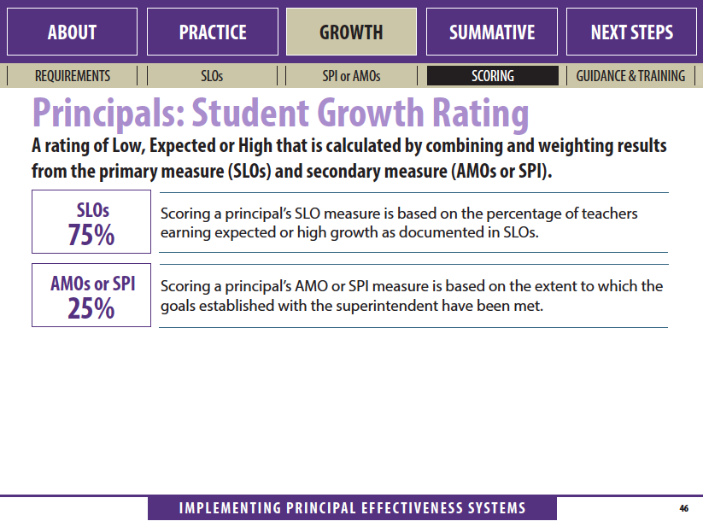

Slide 17
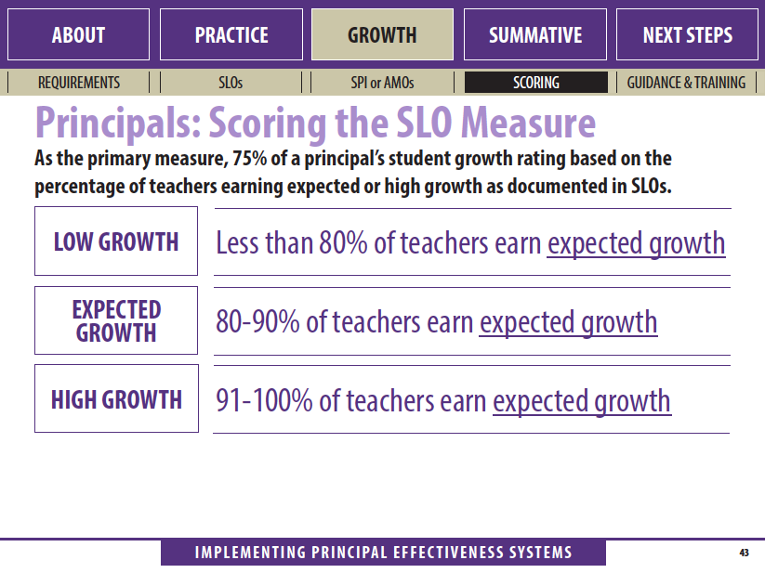
Critical Questions
The vertical and horizontal understanding of the rubric becomes the context for the critical questions.
Sample Question 1: What do you think the following descriptor means?
Sample Question 2: How did you or you and your team select the primary strategies within your school improvement plan?
Sample Question 3: Do you have any processes in place for program/curriculum purchases? If so what are they?
Sample Question 4: What kind of goal do you think we might write to address this descriptor?
Descriptor:
The strategies contained in the plan cite specific research that shows high effect sizes and influence on student achievement.

Slide 18
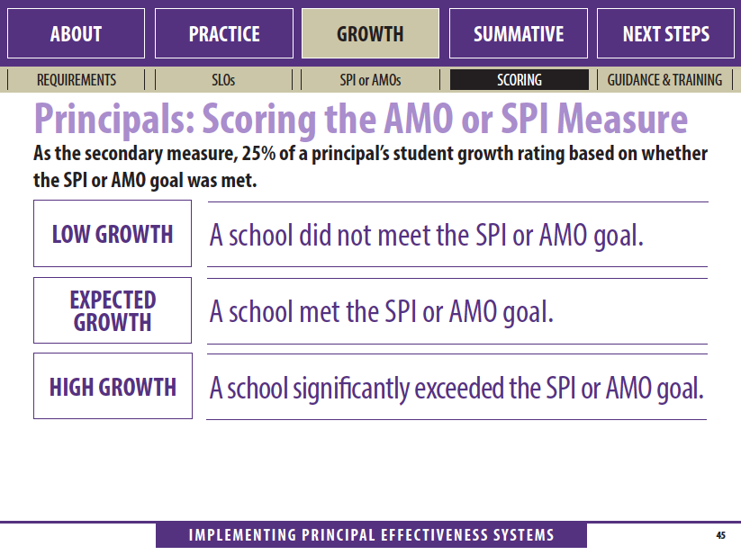

Slide 19
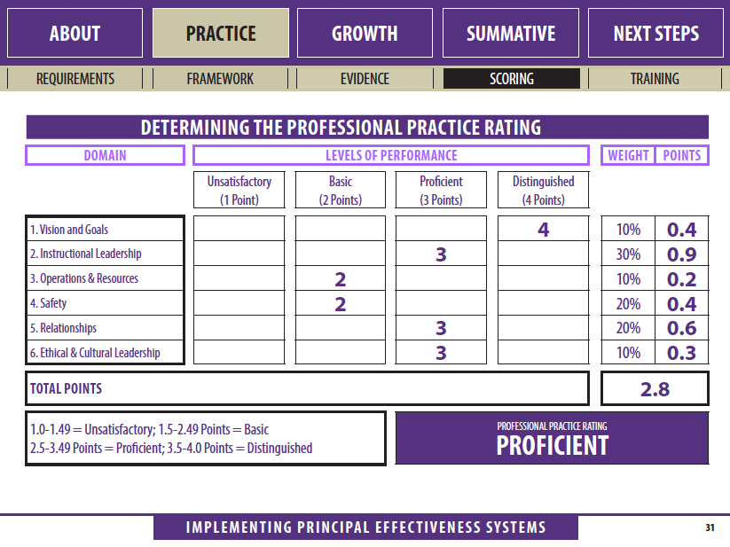
Notes:
Reminder: Domains are weighted and you have a choice as to how your district weights the domains.

Slide 20
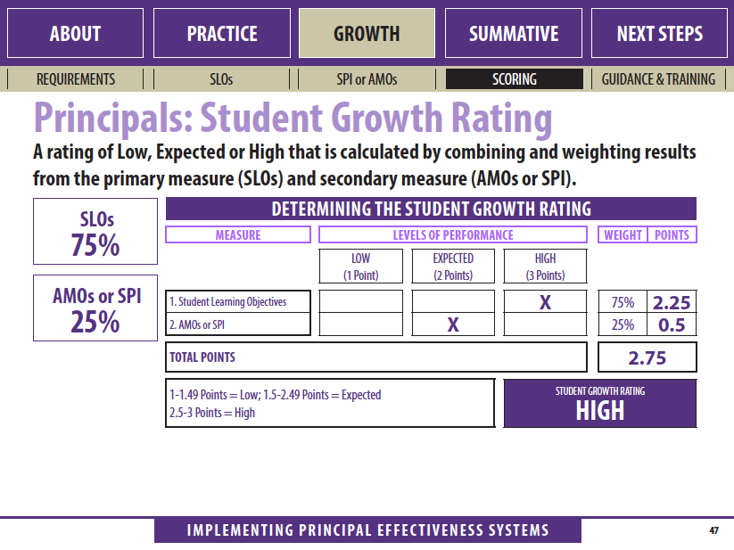

Slide 21
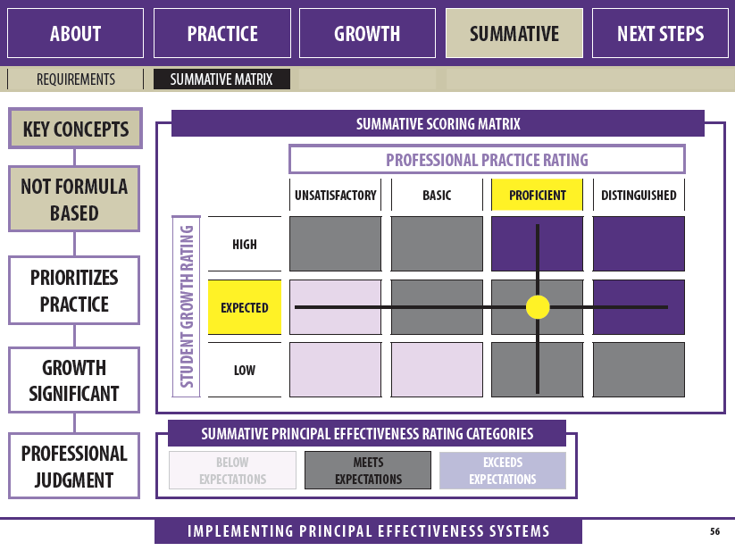

Slide 22
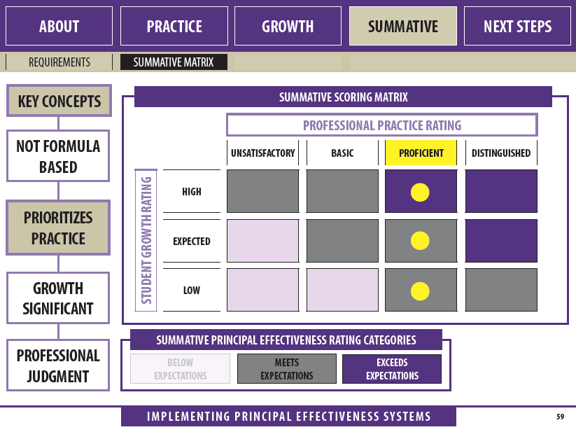

Slide 23
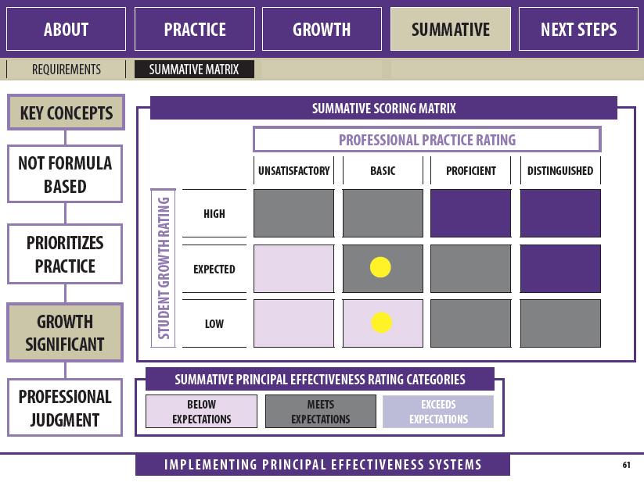

Slide 24

PRINCIPAL EFFECTIVENESS TOOLS
http://doe.sd.gov/secretary/PE.aspx

