Slide 1
SOUTH DAKOTA PRINCIPAL EFFECTIVENESS MODEL
Improving Instruction
and
Student Learning
PART ONE: OVERVIEW
Principal Effectiveness Handbook p. 2
Notes:
South Dakota’s work to develop a meaningful Principal Effectiveness System is united by a common aspiration: to improve instruction and student learning. The development of the South Dakota Principal Effectiveness Model has been influenced by the contributions of a diverse group of educators, professional organizations, state officials and other education stakeholders.
We recommend that participants access the South Dakota Principal Effectiveness Handbook and have the document on hand while they are going through the modules. Corresponding page numbers from the Principal Effectiveness Handbook are provided in the bottom left hand corner of each slide.

Slide 2
LEARNING TARGETS
PARTICIPANTS WILL
Develop an understanding of how the South Dakota Principal Effectiveness Model is designed to advance good leadership practices through ongoing reflective and collaborative practice.
Develop an understanding of the evaluation criteria within the Principal Effectiveness Framework and the key flexibility factors.
Principal Effectiveness Handbook p. 3
Notes:
A decade of research has conclusively identified the importance of both teacher quality and school leadership as the key levers for improved student achievement. While teacher quality is the single biggest factor influencing student achievement, strong principals/assistant principals are critical to teacher development and retention. Research about both teacher and principal effectiveness provided the basis for developing a model principal/assistant principal evaluation system for South Dakota.

Slide 3
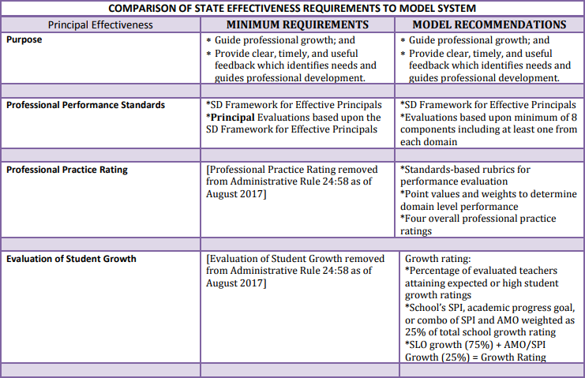
Minimum Requirements vs. Model Recommendations
Notes:
State administrative rule outlines the minimal requirements for implementation of Principal Effectiveness. The South Dakota Commission on Teaching and Learning designed a recommended model that goes above the minimum requirements. The training in this module explains the recommended model. However, for those districts choosing to implement their own evaluation model, the chart on this and the next slide compare the minimum requirements to the model recommendations.

Slide 4
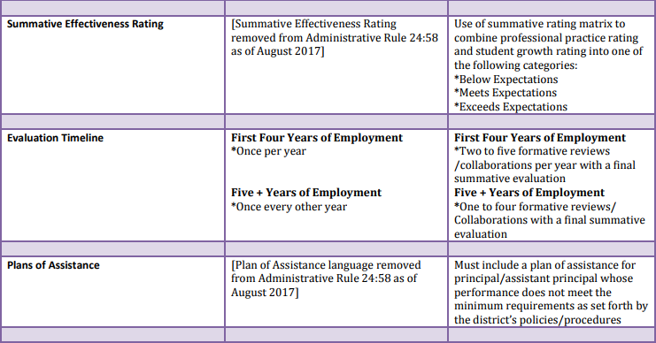
Minimum Requirements vs. Model Recommendations
Notes:
State administrative rule outlines the minimal requirements for implementation of Principal Effectiveness. The South Dakota Commission on Teaching and Learning designed a recommended model that goes above the minimum requirements. The training in this module explains the recommended model. However, for those districts choosing to implement their own evaluation model, the chart on this and the next slide compare the minimum requirements to the model recommendations.

Slide 5
RECOMMENDED PRINCIPAL EFFECTIVENESS MODEL
SOUTH DAKOTA FRAMEWORK FOR EFFECTIVE PRINCIPALS
STUDENT GROWTH
DOMAIN 1
DOMAIN 2
DOMAIN 3
DOMAIN 4
DOMAIN 5
DOMAIN 6
SLOs
Vision & Goals
Instructional Leadership
School Operations & Resources
School, Student & Staff Safety
School and Community Relationships
Ethical & Cultural Leadership
State Accountability Data (AMO, SPI as one measure where available)
District Assessments
Percentage of teachers meeting SLOs
Evaluator–approved
measures
School review and evidence of effective practice
Components from each of the six domains
PROFESSIONAL PRACTICES RATING
GROWTH RATING
SUMMATIVE RATING MATRIX
PROFESSIONAL OVERSIGHT: Is the rating fair and accurate based on the evidence and data shared by the principal?
DIFFERENTIATED PERFORMANCE CATEGORIES
Below Expectations
Meets Expectations
Above Expectations
Principal Effectiveness Handbook pp. 9-10
Notes:
The Commission on Teaching and Learning has developed a recommended method of determining Principal Effectiveness for public school districts.
Using the recommended model, evaluators should separately determine a Professional Practice Rating using the South Dakota Framework for Effective Principals and a School Growth Rating using Student Learning Objectives and goals based upon state assessment data. The two separate ratings can be combined by using the Summative Rating Matrix, a tool that provides educators the opportunity to exercise professional judgment prior to classifying principal/assistant principal performance into one of the three performance categories: Below Expectations; Meets Expectations; and Above Expectations.

Slide 6
SOUTH DAKOTA PRINCIPAL
EFFECTIVENESS MODEL
Improving Instruction
and
Student Learning
PART TWO: DOMAINS AND COMPONENTS
Principal Effectiveness Handbook pp. 11-12; Appendix G
Notes:
The Principal Evaluation Workgroup developed a framework to include six domains and 22 performance components.

Slide 7
INTRODUCTION
PRINCIPAL EFFECTIVENESS DOMAINS
VISION AND GOALS
INSTRUCTIONAL LEADERSHIP
SCHOOL OPERATIONS AND RESOURCES
SCHOOL STUDENT, AND STAFF SAFETY
SCHOOL AND COMMUNITY RELATIONSHIPS
ETHICAL AND CULTURAL LEADERSHIP
Principal Effectiveness Handbook pp. 11-12; pp. 73-102
Notes:
The six domains include Vision and Goals; Instructional Leadership; School Operations and Resources; School, Student, and Staff Safety; School and Community Relationships; and, Ethical and Cultural Leadership. The next six slides include the components within and a summary of each domain.

Slide 8
DOMAIN ONE
VISION AND GOALS
Shared Vision for School and Student Success
1.1
Reviewing and Monitoring for School and Student Success
1.2
Principal Effectiveness Handbook p.3; pp. 73-75
Notes:
Domain One has two components and can be summarized with two questions: Why do we exist? And, if we are able to answer that first question, then have we asked ourselves: What must our school become to accomplish our purpose? To that end, effective principals/assistant principals develop and implement goals, objectives, and strategies to achieve a shared vision for school and student success. They also review and monitor the school’s vision, mission, goals, and school improvement plans to ensure high expectations for student learning and continuous school improvement.

Slide 9
DOMAIN TWO
INSTRUCTIONAL LEADERSHIP
Effective Use of Data to Support Instruction
2.1
Involvement in Curriculum, Instruction, and Assessment
2.2
Distributed Leadership
2.3
Monitoring and Evaluating Standards and Content
2.4
Continuous Improvement
2.5
Principal Effectiveness Handbook p. 11; pp. 76-82
Notes:
Setting the vision, mission, and goals are just the beginning of the whole leadership process. True instructional leadership requires deeper involvement in the core business of schooling, which is teaching and learning. Principals/assistant principals as instructional leaders are required to ensure students receive the most effective instruction from their teachers to learn and apply the knowledge and skills articulated in the approved curriculum – one informed by state content standards and district learning priorities. An effective instructional leader possesses knowledge and uses skills to make a positive impact on curriculum design, instructional practice, and assessment development and use

Slide 10
DOMAIN THREE
SCHOOL OPERATIONS AND RESOURCES
Operational Procedures
3.1
Shared Leadership
3.2
High Quality Teachers
3.3
Challenges and Opportunities
3.4
Principal Effectiveness Handbook p. 12; pp. 83-87
Notes:
In order to maximize teaching and student learning, effective principals/assistant principals must be able to manage school operations efficiently by understanding the budgeting process, by identifying and procuring outside funding, and by obtaining the most effective teachers and staff. Effective principals/assistant principals provide staff members with leadership opportunities, support change initiatives that are geared toward eliminating learning gaps, and create an environment that is nurturing to both students and adults.

Slide 11
DOMAIN FOUR
SCHOOL, STUDENT, AND STAFF SAFETY
Safe Environment
4.1
Clear and Consistent Expectations
4.2
Student Behavior Management
4.3
Conflict Resolution
4.4
Principal Effectiveness Handbook p. 12; pp.88-92
Notes:
According to Maslow’s Hierarchy of Needs, humans are unable to achieve self-actualization until both their physiological and safety needs have been met. To that end, principals/assistant principals create and maintain a safe, nurturing school culture and environment that supports the physical, emotional, and cognitive needs of students, teachers, and other staff in the building.

Slide 12
DOMAIN FIVE
SCHOOL AND COMMUNITY RELATIONSHIPS
Culture of Family/Community Collaboration and Involvement
5.1
Two Way Communication with Internal and External Audiences
5.2
Culture of Dignity, Fairness, and Respect
5.3
Active Involvement with Community
5.4
Principal Effectiveness Handbook p.12; pp.93-98
Notes:
Educational research has taught us that involving family and the community in the education of their students has an impact on student achievement, retention rates, staff morale, and improved use of resources. To that end, effective principals/assistant principals create a culture of collaboration between the school, families, and communities by creating an inviting environment that helps parents and community members feel welcome and comfortable in the school and by ensuring that parent and community member contributions are acknowledged and valued. They also establish partnerships to engage parents/guardians and community members in establishing and supporting school goals and programs. Effective principals/assistant principals also establish and maintain two-way communications among teachers, families, and community members using a variety of methods to ensure that all internal and external stakeholders have access to information about the school. Finally, effective principals/assistant principals are visible ambassadors and advocates for the school by maintaining active involvement in parent-teacher organizations, community organizations, as well as state and national organizations.

Slide 13
DOMAIN SIX
ETHICAL AND CULTURAL LEADERSHIP
Sensitivity to Diversity and Cultural Differences
6.1
Modeling Values, Beliefs, and Attitudes
6.2
South Dakota Code of Ethics
6.3
Principal Effectiveness Handbook p.12; pp.99-102
Notes:
According to (Davis and Donald, 1997) cultural proficiency is a system requiring the integration and transformation of knowledge about individuals and groups of people into specific standards, policies, practices, values, and attitudes used in appropriate cultural settings to increase the effectiveness and quality of services, thereby producing better outcomes. Effective leaders should try to incorporate cultural leadership into all aspects of their work and interactions with stakeholders. Undergirding the framework for the Principal Effectiveness model is the expectation that principals/assistant principals are models of ethical behavior and follow the South Dakota Code of Ethics for Professional Administrators at all times.

Slide 14
SOUTH DAKOTA PRINCIPAL EFFECTIVENESS MODEL
Improving Instruction
and
Student Learning
PART THREE: EVALUATING PROFESSIONAL PRACTICE
Principal Effectiveness Handbook pp. 13-24
Notes:
Part Three will guide you through the steps for determining the Professional Practice Rating.
Just a reminder, producing a Professional Practice Rating is no longer required.

Slide 15
EVALUATING PROFESSIONAL PRACTICE
THROUGH
FORMATIVE REVIEWS/COLLABORATIONS
YEARS ONE-FOUR
(RECOMMENDED PER YEAR)
Two to five formative reviews/collaborations of professional practice
YEAR FIVE AND BEYOND
(RECOMMENDED PER YEAR)
Between one and four formative reviews/collaborations of professional practice
At least one review of a staff meeting
Reviews throughout school year
Reviews throughout school year
Principal Effectiveness Handbook pp. 17-18
Notes:
Professional practice is evaluated over the course of an entire school year through ongoing reviews of a principal’s performance. The evaluation considers the principal’s/assistant principal’s duties and responsibilities as outlined in the job description, effectiveness as a building manager, and overall competence as an instructional leader for students and teachers in the school. The overall evaluation results in a list of the principal’s/assistant principal’s strengths and weaknesses with supporting reasons for both and is used to set concrete goals and trajectories for professional development in the upcoming school year. A minimum of two and as many as five formative reviews/collaborations are conducted during the first four years of a principal’s/assistant principal’s tenure at a school, and at least once every other year thereafter. Each review will be conducted on-site and should cover enough time to observe a principal/assistant principal in multiple facets of the work. These reviews will include structured conversations before and after the review takes place. These conversations are scheduled in advance of the review and include at least one objective (related to the selected component(s) for evaluation) and include a review of the principal’s/assistant principal’s interactions and activities during a typical workday. This can include workdays in which the principal/assistant principal is contracted to work, but students are not present. At least one formative review conducted includes the observation of a leadership team meeting.
Using the recommended model, an evaluator can expect to spend three to six hours per evaluation from the beginning of the process to the end.

Slide 16
EVALUATING PROFESSIONAL PRACTICE
THROUGH
ARTIFACTS
SAMPLE ARTIFACTS
School improvement plan
Master schedule
Anecdotal notes from informal visits
Formative reviews
Data notebooks and retreats
School budget
Principal Effectiveness Handbook pp. 18-19
Notes:
Artifacts are documents, materials, processes, strategies, and other information that demonstrate performance relative to a standard of professional practice and that support a principal’s/assistant principal’s work. Artifacts are generally written records of a principal’s/assistant principal’s work (e.g., the school improvement plan, the master schedule, coaching records, teacher evaluation reports, etc.). In many cases, these artifacts will stem from a principal’s day-to-day work. Principals will not be required to create separate documentation specifically to support the evaluation process. Administrators may access a more comprehensive artifact list on Page 19 of the Principal Effectiveness Handbook.

Slide 17
EVALUATING PROFESSIONAL PRACTICE
THROUGH
OBSERVABLE EVIDENCE
SAMPLE OBSERVABLE EVIDENCE
Staff meetings
Principal leadership in a crisis
Student behavior in classrooms, hallways, events, etc.
Principal leadership in community
Notes:
Observable Evidence are those events that an evaluator should seek out during the course of the school year and the evaluation process. While principals/assistant principals have a responsibility to provide artifacts that support performance relative to the standards of professional practice, the evaluators also have a responsibility to provide observable evidence that supports performance relative to the standards of professional practice.

Slide 18
Rubrics
Domain 1
Rating
Domain 2
Rating
Domain 3
Rating
Domain 4
Rating
Domain 5
Rating
Domain 6
Rating
Weighting
Weighting
Weighting
Weighting
Weighting
Weighting
Component-Level Score (after weighting)
PROFESSIONAL PRACTICES RATING
Four performance categories based on average weighted component level score
UNSATISFACTORY
BASIC
PROFICIENT
DISTINGUISHED
Principal Effectiveness Handbook p. 14; Appendix G
Notes:
The evaluation of Professional Practice is determined through the use of the Performance rubrics surrounding each of the six domains and their 22 components and supported by evidence gathered by both the evaluator and the principal. Once component-level performance is determined, the evaluator uses a three-step process to assign an overall Professional Practice Rating.
The Professional Practice Rating represents overall performance across all evaluated domains and is categorized into one of four levels of performance: (4) Distinguished, (3) Proficient, (2) Basic, or (1) Unsatisfactory. A principal’s overall Professional Practice Rating represents an aggregate of performance on all evaluation domains. The Principal Evaluation Workgroup recommends weighting domains to more heavily prioritize those aspects of a principal’s duties focused on instructional leadership.

Slide 19
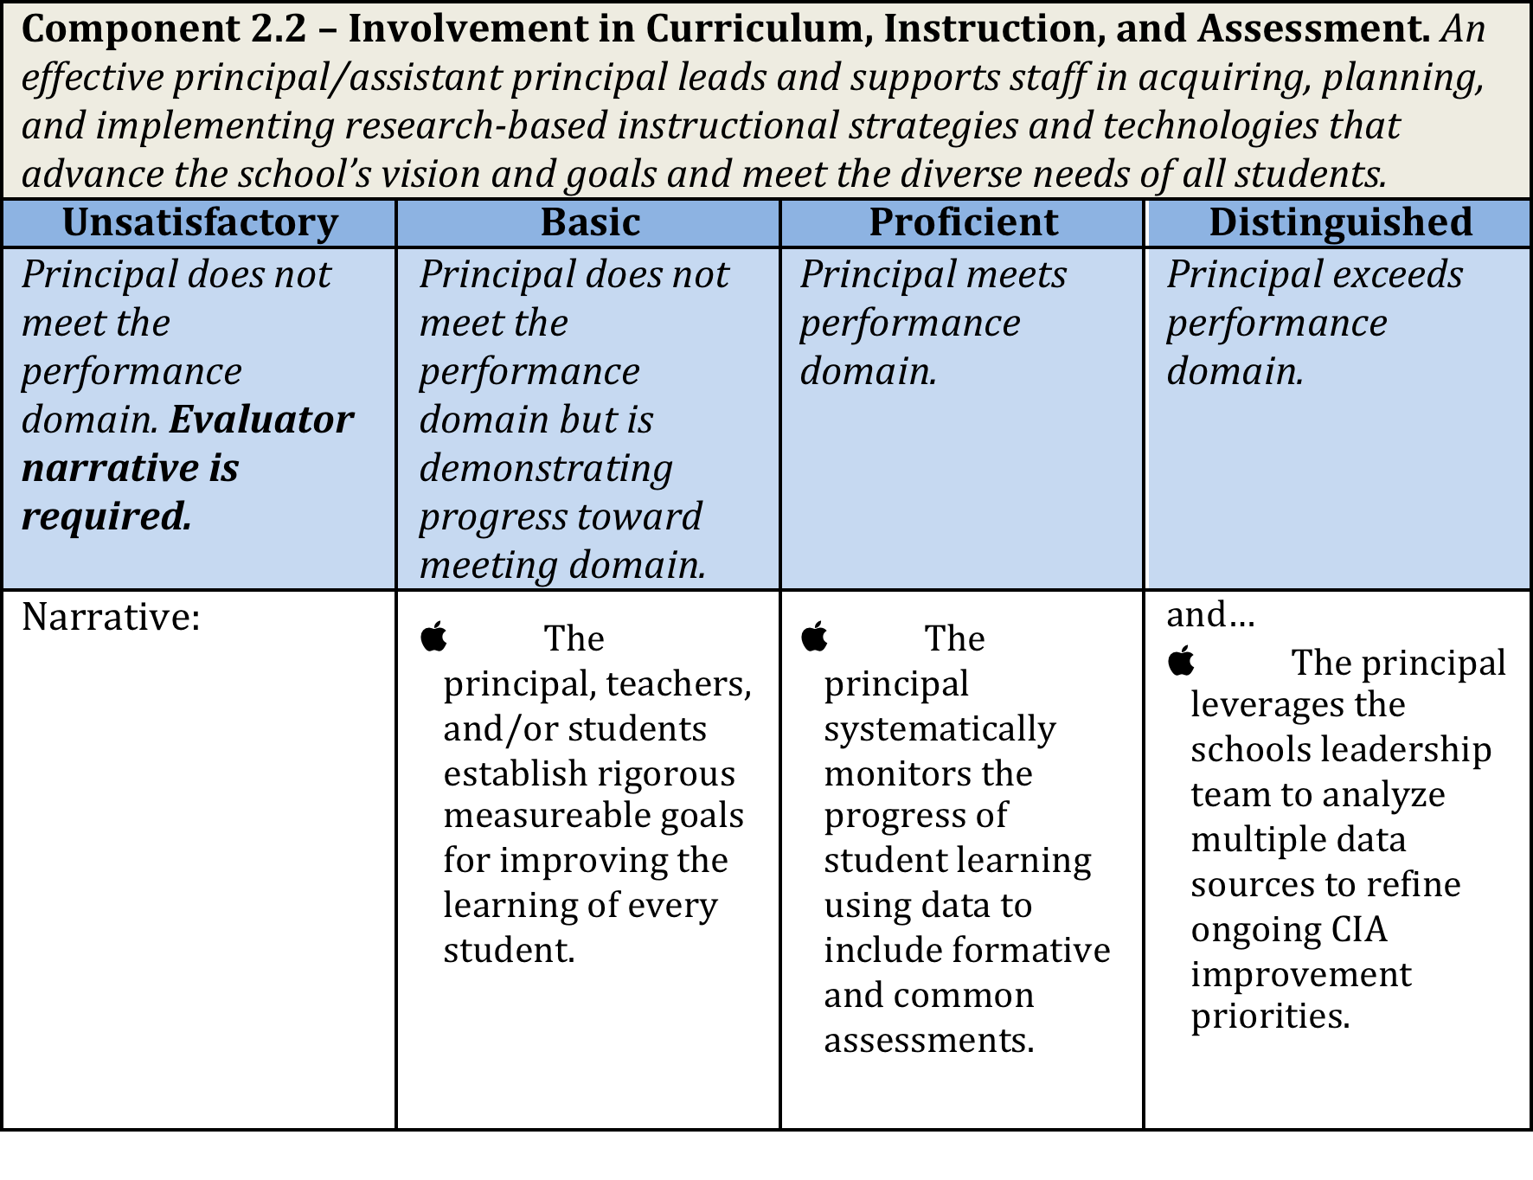
USING STANDARDS-BASED RUBRICS
Component
Rating
Descriptor
Principal Effectiveness Handbook p. 15-16; Appendix G pp. 73-102
Notes:
A collection of standards-based rubrics provides detailed definitions of all domains and performance components of professional practice outlined by the South Dakota Framework for Effective Principals. Each rubric describes the behaviors and actions present at each level of performance. Rubrics and their descriptors are known in advance and help focus principals on learning, understanding, and demonstrating the skills and knowledge expected in each of the domains.
Evaluators should use rubrics when observing and evaluating principals. These rubrics are considered a tool to foster constructive feedback and dialogue between the principal and evaluator about expectations and how to improve practice.
Rubric Construction:
Each rubric includes descriptors that describe performance as a continuum across four levels: (4) Distinguished, (3) Proficient, (2) Basic, and (1) Unsatisfactory. to determine a level of performance for each component evaluated.

Slide 20
READING AND SCORING THE RUBRIC
Principal Effectiveness Handbook p. 16
Notes:
For a principal/assistant to receive a rating on a rubric, he/she must have the majority of the boxes checked in that categorical rating and the majority of the boxes checked in the previous categorical ratings. In this example, the principal/assistant principal would earn a proficient rating as the majority of boxes are checked in both the Basic and Proficient categorical ratings.
Further study of the rubrics reveals that skills also develop horizontally. For example, in the Basic column, the highlighted text shows that the principal/assistant principal is involved in the implementation of a research-based instructional model. In the Proficient column, the highlighted text shows the principal/assistant principal going one step further through monitoring and evaluating the fidelity of implementing research-based instructional strategies through clearly defined protocols for collecting, analyzing, and reporting data.

Slide 21
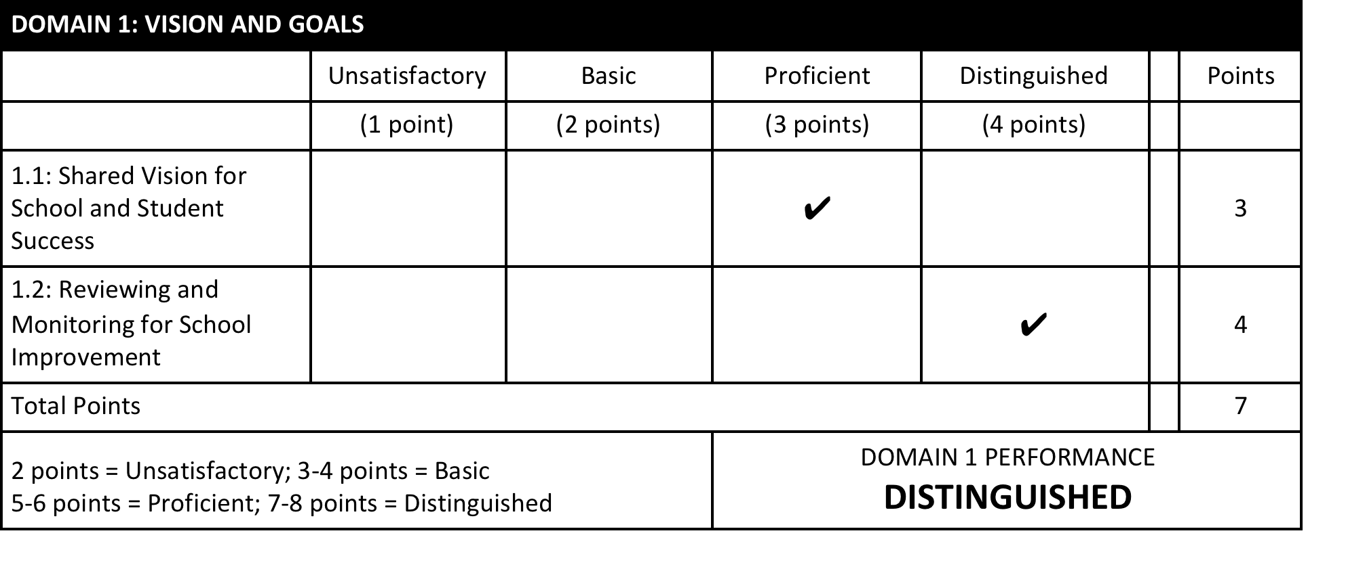
SCORING COMPONENT LEVEL PERFORMANCE
AND
DETERMINING DOMAIN LEVEL PERFORMANCE RATINGS
Principal Effectiveness Handbook pp. 20-24; http://doe.sd.gov/secretary/PE.aspx
Notes:
After using standards-based rubrics to determine principal/assistant principal performance for each component evaluated, the evaluator determines an overall Professional Practice Rating. The Commission on Teaching and Learning recommends a three-step process to score, calculate, and determine a principal’s/assistant principal’s summative performance relative to the South Dakota Framework for Effective Principals.
Step 1: Score Component-Level Performance
Point values are assigned to performance for each component evaluated: a distinguished rating is assigned four points; a proficient rating is assigned three points; a basic rating is assigned two points; and an unsatisfactory rating is assigned one point.
Step 2: Determine Domain-Level Performance Ratings
This example illustrates the process of scoring professional practice performance and determining the domain-level rating. Evaluators use the standards-based rubrics to determine the rating. This example is based on an evaluation of all 22 components. Public school districts choosing to evaluate on fewer than all 22 components should make modifications to this process to accommodate accurate scoring of domain-level performance. The South Dakota Department of Education has developed a Principal Evaluation Rating Spreadsheet that allows an evaluator to make modifications to this process. The link will access the Department of Education and Principal Effectiveness website.

Slide 22
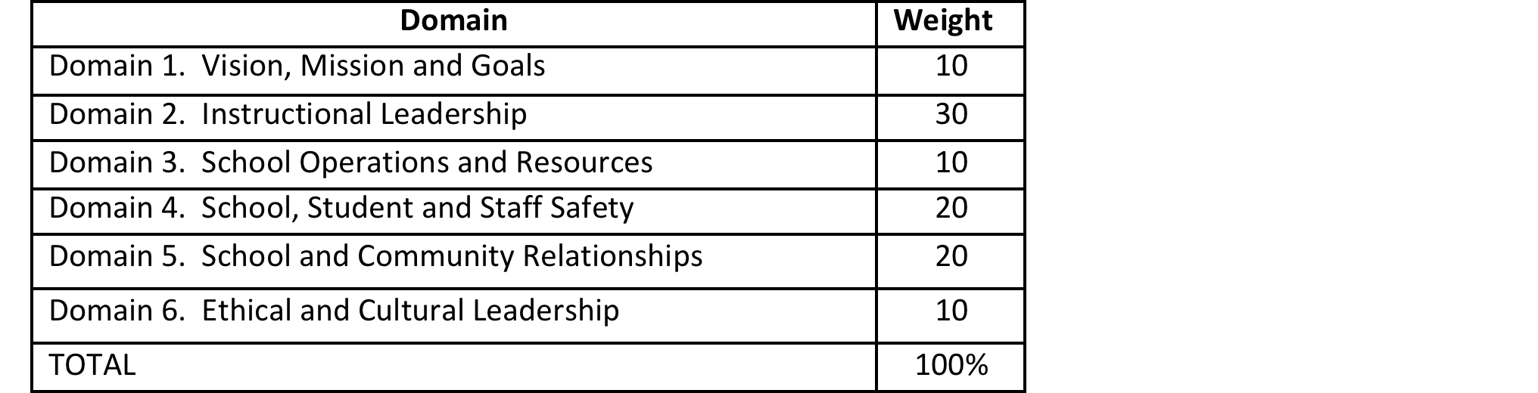
APPLYING WEIGHTS TO DOMAIN RATINGS
Principal Effectiveness Handbook p. 23
Notes:
The average component-level score is used to assign a Professional Practice Rating of Unsatisfactory, Basic, Proficient, or Distinguished. Per the recommended method, the domain scores are weighted as presented in the above figure to calculate a final Professional Practice Rating. However, per Administrative Rule, districts may adjust the Domain weights according to the needs and the priorities of the district.

Slide 23
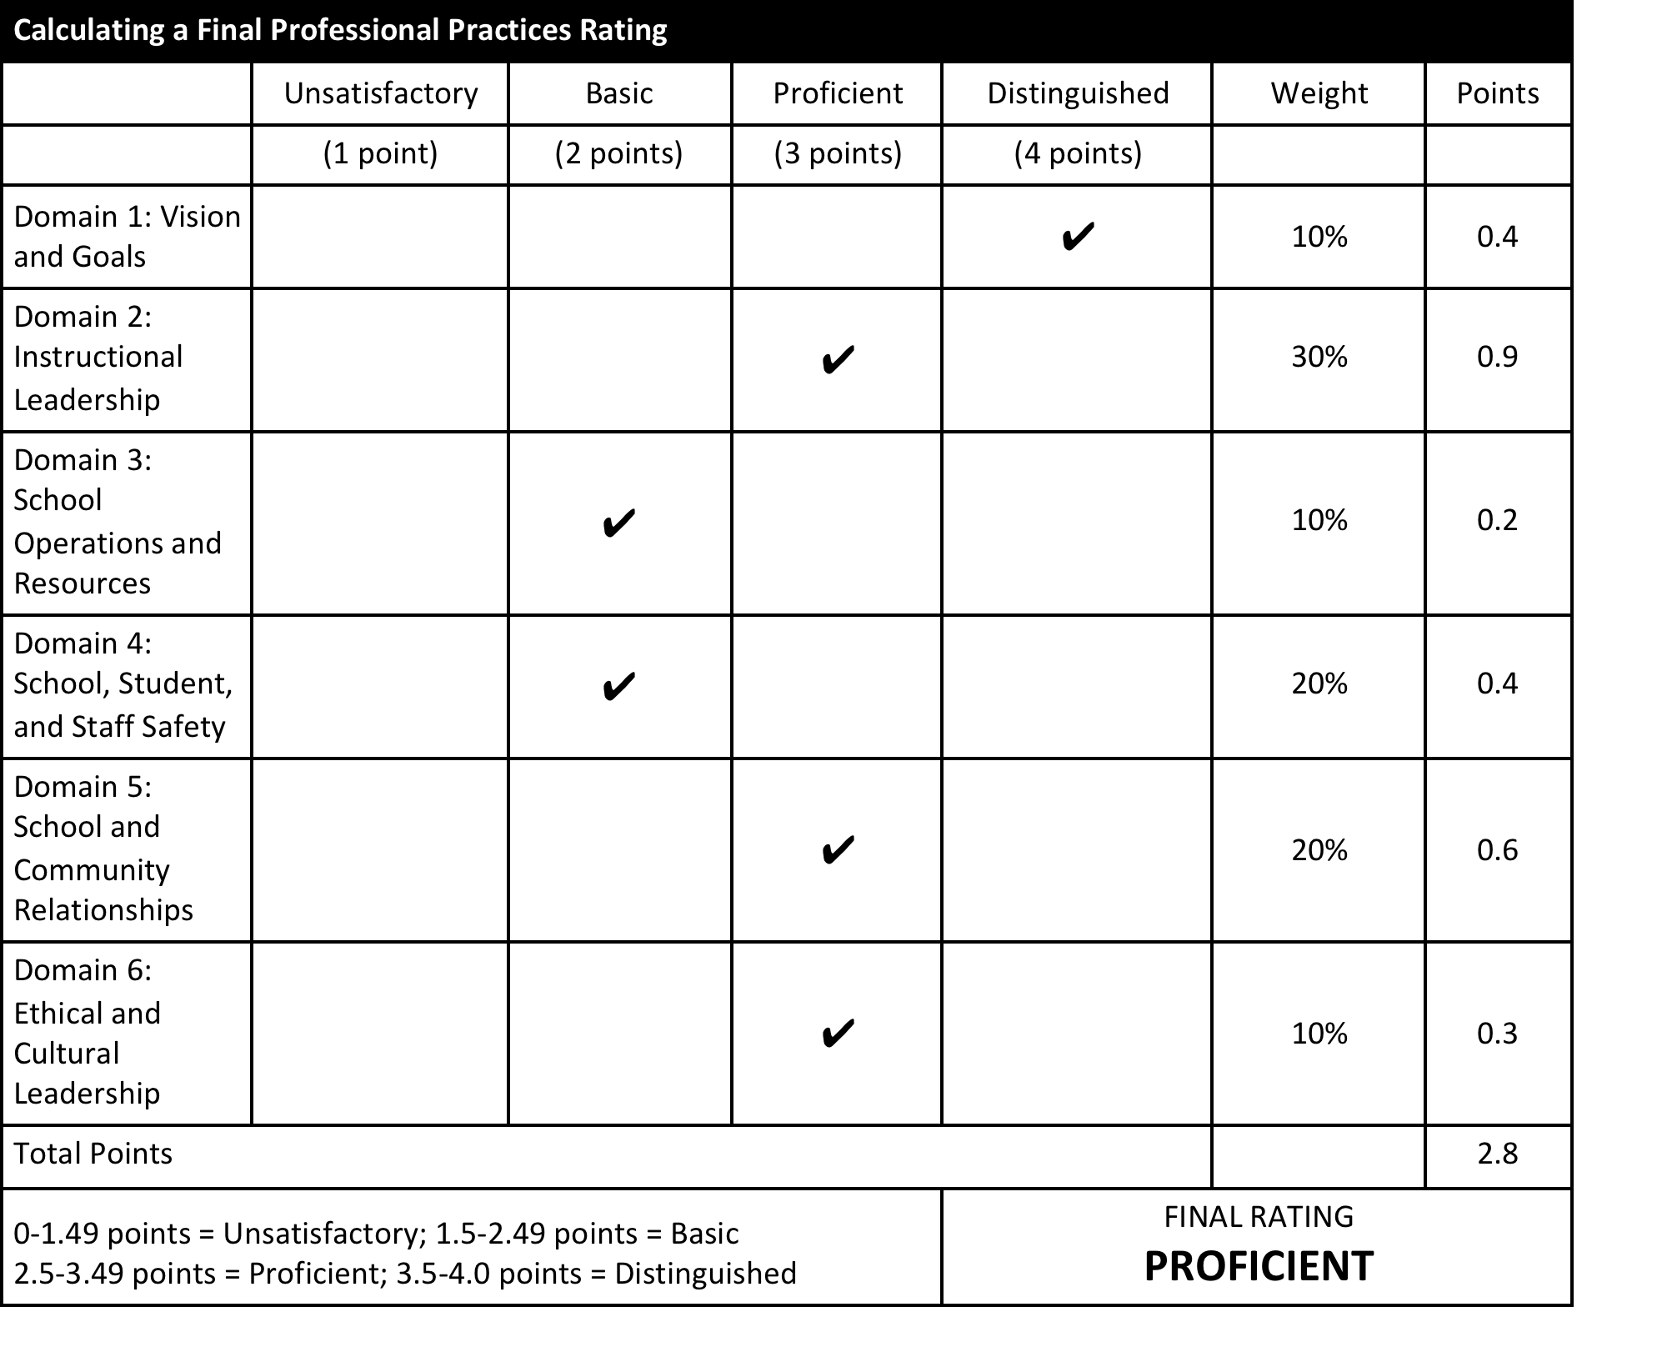
ASSIGNING AN OVERALL PROFESSIONAL PRACTICE RATING
Download the Principal Evaluation Rating Spreadsheet from the SD DOE website
Notes:
The above figure illustrates how to calculate the Overall Professional Practice Rating using the recommended weights addressed in the previous slide. A link has been inserted to the South Dakota DOE where the Principal Evaluation Rating Spreadsheet can be accessed. The formulas are built into the spreadsheet and allow for domain weights to be adjusted to meet the needs of the district. For convenience the rubrics have been built into the spreadsheet.

Slide 24
SOUTH DAKOTA PRINCIPAL EFFECTIVENESS MODEL
Improving Instruction
and
Student Learning
PART FOUR: SCHOOL GROWTH
Principal Effectiveness Handbook pp. 25-27
Notes:
Improving student achievement is at the core of the educational process. In addition to assessing principal’s/assistant principal’s performance on the South Dakota Framework, the Commission on Teaching and Learning subgroup recommends that a significant factor of the principal’s/assistant principal’s performance be based on results of student achievement and school growth measures.
Just a reminder, including School Growth in the Principal Evaluation is no longer required. It is only a recommendation.

Slide 25
EVALUATION OF SCHOOL GROWTH
A rating of Low, Expected, or High is calculated by combining and weighting results from the primary measure (SLOs) and the secondary measure (AMOs or SPI).
SLO’s and/or Other District Decided Measure 75% | Scoring a principal’s SLO measure is based on the percentage of teachers earning expected or high growth as documented in SLOs.
AMOs or SPI 25% | Scoring a principal’s AMO or SPI measure is based on the extent to which the goals established with the superintendent have been met. http://doe.sd.gov/accountability/spi.aspx https://doe.sd.gov/accountability/amo.aspx
Principal Effectiveness Handbook pp. 25-27
Notes:
Two different student growth measures are factored when evaluating student growth:
A Student Learning Objective (SLO) is a teacher-driven goal or set of goals that establishes expectations for student growth over a period of time. The specific, measurable goals must be based on baseline data and represent the most important learning that needs to occur during the instructional period. SLOs are aligned to applicable state or national standards and should also reflect school or district priorities. The development of SLOs provides teachers and principals a flexible framework to establish ambitious, yet achievable student growth goals.
SPI: South Dakota’s accountability system centers around a 100-point index, called the School Performance Index, or SPI. The SPI consists of key indicators of performance. A numeric value is assigned to each of the indicators. These values are added to create a total SPI score out of 100 points. Each public school in the state receives a SPI score, with limited exceptions due to school size and/or mission. A more detailed explanation of AMO/SPI can be found at the South Dakota Department Of Education website via the above link.
AMO (Annual Measurable Objective): The SPI score provides a broad first lens through which to view school performance. The model also applies a second lens. South Dakota’s overarching goal for Student Achievement is to reduce by half the percentage of students (all subgroups) who are not proficient within six years. Proficiency is measured by performance on the annual statewide assessment. Targets, based on this six-year goal, are set for each subgroup at each school, in equal increments, to give that school a unique trajectory that recognizes where the school’s subgroups started in terms of student proficiency and to support continuous improvement. Targets are set separately for English language arts and math. The 2014-15 school year serves as the base year for setting the six-year goal and annual targets. A more detailed explanation can be found at the SD DOE website via the link above.
It is recommended that AMO and/or SPI measures comprise a minimum of 25% of the principals final School Growth Rating. The SLO and other district decided applicable growth measures account for the remaining 75% of the final School Growth Rating.

Slide 26
RECOMMENDED GROWTH MEASURE STUDENT LEARNING OBJECTIVES (SLOs)
PERFORMANCE CATEGORY | DESCRIPTION
Low Growth | Less than 80% of teachers attained expected student growth on SLOs.
Expected Growth | 80% to 90% of teachers attained expected student growth on SLOs.
High Growth | 91% to 100% of teachers attained expected growth on SLOs.
Principal Effectiveness Handbook pp. 25-27
Notes:
Paralleling the evaluation of the teacher, a principal’s School Growth Rating is assigned a growth score based on the success his or her teachers had in meeting their SLOs. Once SLOs have been established and student growth has been measured between two points in time, a principal’s School Growth Rating is assigned based on the extent to which his or her teachers have attained their goals.

Slide 27
RECOMMENDED GROWTH MEASURE SPI AND AMO
PERFORMANCE CATEGORY | DESCRIPTION
Low Growth | A school did not meet either AMO or SPI target.
Expected Growth | A school met either one or both of AMO or SPI targets.
High Growth | A school met and significantly exceeded the AMO or SPI targets.
Principal Effectiveness Handbook pp. 25-27
Notes:
The AMOs and SPI utilize state assessments and are used to paint a picture of student performance and growth at the school level; therefore, it is recommended that they account for at least 25% of a principal’s School Growth Rating. This measure requires the principal, in cooperation with district superintendents or their designees, to set school-level growth goals based on the SPI, AMOs, and/or progress narrowing the achievement gap.

Slide 28
CALCULATING A FINAL SCHOOL GROWTH RATING
Download the Principal Evaluation Rating Spreadsheet from the SD DOE website
 | Low | Expected | High | Weight | Points
 | (1 points) | (2 points) | (3 points)
SLO Growth Score |  |  | ✔ | 75% | 2.25
AMO and/or SPI Growth Score |  | ✔ |  | 25% | .5
Other District Measures |  |  |  | *decided at district level
Total Points |  |  |  | Weights should total 100% | 2.75
1-1.49 = Low 1.5-2.49 = Expected 2.5-3.0 = High |  |  |  | FINAL RATING HIGH
Principal Effectiveness Handbook pp. 27
Notes:
The above figure illustrates how to calculate the Final School Growth Rating using the recommended weights. Once again, a link has been inserted to the South Dakota DOE where the Principal Evaluation Rating Spreadsheet can be accessed. The formulas are built into the spreadsheet and allow for growth weights to be adjusted to meet the needs of the district. However, AMO/SPI Growth measure cannot be weighted any less than 25% of the overall Student Growth Rating. The AMO/SPI measure could be weighted more than 25% but not less.

Slide 29
CONSIDERATIONS
To what degree do you participate or become involved in the fall data retreat?
If your school does not have a fall data retreat, how do you work with your leadership team or staff to look at data in order to establish student achievement goals?
What student growth goal (Principal Effectiveness) might you develop that reflects and is aligned with what you have learned about your school at the data retreat or other team meetings focused on school data?
How do the goals your teachers have established through the Student Learning Objectives process align with your building goals (School Improvement Plan, Title, LEAP/Focus, Smarter Balanced Assessment Consortium data)? Are you aligning your Principal Effectiveness goal to the building goals to create a focused and seamless effort?
In addition to looking at Smarter Balanced Assessment Consortium data, what other local assessments or data might you consider when writing the Principal Effectiveness student growth goal?
Notes:
As the superintendent/evaluatee works with the principal to determine appropriate student growth goals, both should consider the nine questions in this and the next slide. The questions are reflective in nature and focus on the level of principal involvement in data collection, data analysis, and aligned goal setting.

Slide 30
CONSIDERATIONS
If you have other local assessments, do any of them drill down more deeply to standards related data? For example, if SBAC results show math as an area needing improvement, do you have a local assessment that provides more information about what specifically should be your focus, i.e. problem solving, computation, fluency, etc.?
Considering question number 6, will you develop a broad goal or a more specific goal? Either will be acceptable as long as the goals are in line with your data.
When looking at SBAC data and other assessment data together, are you considering trends?
Will your Principal Effectiveness student growth goal be based upon some factor of AMO or some other factor included in the broader SPI calculation?
High School Completion
Attendance
Career Readiness
Student Achievement OR Academic Growth

Slide 31
SAMPLE SPI GOAL
Sample Claims Level PE Goals
_percentage of all students at grade __ will achieve at/near standard or above standard in comprehending a range of increasingly complex literary and informational texts.
__percentage of all students at grades __, __, __will achieve at/near standard or above standard in explaining and applying mathematical concepts and interpreting and carrying out mathematical procedures with precision and fluency.
__percentage of students in the Gap Group at grade_ will move from below standard to at/near standard when explaining and applying mathematical concepts and interpreting and carrying out mathematical procedures with precision and fluency.
http://doe.sd.gov/Assessment/documents/SBACguide.pdf
Notes:
This and the next two slides include a series of sample School Growth Goals. This first set of goals is derived from the Claims Level of the Smarter Balanced Assessment Consortium data. The claims level provides a picture of student performance on groups of test questions that measure similar skills. The link will connect to the SD Department of Education Interpretive Guide for the SBAC for a more detailed explanation of the Claims Level.

Slide 32
SAMPLE GOALS
Sample Student Achievement Goal
__will meet the established AMO target in ELA by increasing the percentage of students scoring at a Level 3 or 4 from ______ % to ______%, with a six-year goal of ______%.
__will meet the established AMO target in math by decreasing the % of students scoring at a Level 1 or 2 by _____ %.
Sample Attendance Goal
Attendance will increase by __ % among the non Gap Group and by __% among the Gap Group.
Sample Other District Assessment Goal
70 % of grades 3-4 students will meet the RIT projected growth score on the MAP (Measure of Academic Progress) in reading.
Notes:
These Sample Student Achievement Goals are written based upon what the State DOE recommends for yearly growth over a six-year period.

Slide 33
SAMPLE GOALS
Sample ACT Goal
_% of all students taking the ACT will score a 20 or better on the math portion of the ACT.
Sample Graduation Goals
_% of students will achieve high school completion OR cohort graduation.
_% of students in the Gap Group will achieve high school completion or cohort graduation.
Sample NCRC Goal
_% of students taking the National Career Readiness Certificate will score at the Bronze level or higher.
http://doe.sd.gov/Accountability/NCRC.aspx
Notes:
This last set of goals is based upon ACT results, graduation rates and NCRC results. The NCRC is the ACT National Career Readiness Certificate. The above link to the SD DOE provides a more detailed explanation of the National Career Readiness Certificate and the role NCRC, ACT, and graduation rate play in the SPI determination.

Slide 34
SOUTH DAKOTA PRINCIPAL EFFECTIVENESS MODEL
Improving Instruction
and
Student Learning
PART FIVE: SUMMATIVE DETERMINATION
Principal Effectiveness Handbook pp. 28-29
Notes:
Determining the Summative Principal Effectiveness rating demonstrates the connection between professional practice and school growth. Once evaluations of professional practice and school growth have occurred, the separate ratings can be combined into a Summative Principal Effectiveness Rating that categorizes overall principal performance.
Just a reminder, determining a Summative Principal Effectiveness Rating is no longer required.

Slide 35

SUMMATIVE SCORING MATRIX
PROFESSIONAL PRACTICE RATING
UNSATISFACTORY
BASIC
PROFICIENT
DISTINGUISHED
HIGH
STUDENT GROWTH
EXPECTED
LOW
Notes:
To combine the Professional Practice Rating and School Growth Rating to form the Summative Principal Effectiveness Rating, the Commission on Teaching and Learning recommends the use of a Summative Rating Matrix that differentiates Principal Effectiveness into one of the three required performance categories. The Matrix is informed first (columns) by a principal’s professional practice performance measured against the South Dakota Framework for Effective Principals, and, second (rows) by a principal’s school growth performance as measured by AMO’s, SPI, and SLOs.
Given the body of research and empirical evidence supporting the rigorous professional domains outlined in the South Dakota Framework for Effective Principals, the Summative Rating Matrix prioritizes professional practices evaluations as the measure most likely to promote advancements in instructional practices and improved student learning.
The physical construction of the recommended Summative Rating Matrix reflects the emphasis placed on professional practice evaluations. By design, the fact that there are four Professional Practice Rating categories – compared to three possible School Growth Rating categories – assigns greater weight to evaluations of professional practice. A closer examination of all 12 areas of intersection further reinforces the priority placed on professional practice evaluations. For example, a principal earning a Professional Practice Rating of Proficient or Distinguished is, by default, assigned a Summative Principal Effectiveness Rating of at least Meets Expectations.
This slide illustrates three different combinations of Student Growth and Professional Practice. In all three examples the principal has earned a Professional Practice rating of Proficient but Student Growth ratings of High, Expected, or Low. The first combination results in a Summative Rating of Exceeds Expectations. The second combination results in a Summative Rating of Meets Expectations; and, the third combination results in a Summative Rating of Meets Expectations.

Slide 36
SUMMATIVE SCORING MATRIX
PROFESSIONAL PRACTICE RATING
UNSATISFACTORY
BASIC
PROFICIENT
DISTINGUISHED
HIGH
STUDENT GROWTH
EXPECTED
LOW
Notes:
Exercising Professional Judgment to Adjust Principal Effectiveness Ratings
The recommended Summative Rating Matrix embeds opportunities for professional judgment to play a role in the assignment of a Summative Principal Effectiveness Rating. In the four areas in which one rating is very high and another rating is very low (denoted by the arrow symbols in the above chart), individual ratings are reviewed to ensure that rating is fair and accurate based on all evidence collected. The principal and evaluator may agree that additional evidence may be required and Summative Principal Effectiveness Ratings can be adjusted if it is determined that the Summative Principal Effectiveness Rating misrepresents principal performance.

Slide 37
SOUTH DAKOTA PRINCIPAL EFFECTIVENESS MODEL
Improving Instruction
and
Student Learning
PART SIX: RECOMMENDED EVALUATION CYCLE
Principal Effectiveness Handbook pp. 30-34
Notes:
The annual process engages principals and their evaluators in thoughtful, deliberate discussions designed to improve instruction and student learning.
The process begins with a self-assessment and concludes with summative evaluation and rating of impact on student learning. It is also a continuous improvement process in which evidence from the summative evaluation and rating of impact on school growth become important sources of information for the principal’s self-assessment and the school’s subsequent goal setting.

Slide 38
PHASE ONE: PREPARE
STEP ONE: TRAINING | Principals and evaluators are trained on the South Dakota Framework for Effective Principals and how the domains are used as the basis for professional practice evaluation. Evaluators are trained on how to conduct observations that support the professional practice portions of the evaluations. Teachers and principals are trained on how to develop SLO’s and how student growth factors into the evaluation.
STEP TWO: ORIENTATION | All staff impacted by the evaluation system collectively review the evaluation system to ensure all staff have sufficient knowledge to actively participate in the evaluation process.
Principal Effectiveness Handbook p. 31
Notes:
Phase 1: Prepare
In the Prepare phase of the evaluation cycle, principals and evaluators are trained and oriented to the evaluation system. The steps in the Prepare Phase are crucial to ensuring comprehension of evaluation procedures and shared understanding of expectations. The two steps are ideally completed within the first month of the school year. During the Prepare phase, after year one, principals/assistant principals will take some of this time to attend to professional development activities that are part of the growth plan generated at the end of the prior evaluation cycle. Online training through webinars and modules such as this one are available through the South Dakota Department of Education website.

Slide 39
PHASE TWO: PLAN
STEP THREE: SELF-ASSESSMENT | Principal assesses his/her professional practice and analyzes the learning, growth, and achievement results of his/her school. Principal prepares both professional practice and school growth goals for the year.
STEP FOUR: GOAL-SETTING CONFERENCE | Principal meets with evaluator to review self-assessment and jointly analyze school growth and professional practice goals. Principal and evaluator agree on goals for both professional practice and school growth. Principal and evaluator discuss the evidence necessary to support the professional practice and school growth goals. Goals are approved.
Principal Effectiveness Handbook pp. 31-32
Notes:
In the Plan Phase the principal conducts a self-assessment using the performance standards and accompanying rubrics within the effectiveness Framework, data about student learning, past progress on school goals (when available), the prior year’s evaluation and rating (when available), and other relevant evidence. Based on that assessment, the principal identifies goals to propose to the superintendent/evaluator. Goals can focus on professional practice, student learning, and school improvement.

Slide 40
PHASE THREE: PERFORM
STEP FIVE: EVIDENCE COLLECTION | Formative reviews and collaborations occur to collect evidence of professional practice. Evidence from multiple sources is compiled to support non-observable components of professional practice. Quantitative data demonstrating progress on SLO’s are collected. Evidence is documented and principals are provided structured feedback on performance throughout the evidence collection period.
Principal Effectiveness Handbook p. 32
Notes:
The Perform phase, the lengthiest of the four phases, involves the collection of evidence that supports both professional practice and school growth. The principal implements the plan set forth in the goal setting conference and begins collecting evidence. Formative reviews/collaborations of professional practice, including pre- and post-review conferences, are conducted throughout the evidence collection period. Artifacts that demonstrate performance on non-observable components of professional practice are collected and principals gather quantitative data that demonstrates performance relative to school growth. Evidence collection concludes when all applicable evidence is submitted to the evaluator. It is recommended that the principal and evaluator schedule either quarterly or mid-cycle meetings to evaluate progress and make any changes necessary to the plan. Depending upon the principal and the professional practice components being evaluated, evaluation of components could be completed in an ongoing manner. The Perform phase should then continue as the evaluation process is completed.

Slide 41
PHASE FOUR: PROGRESS
STEP SIX: EVALUATION | Using all document evidence collected, evaluator completes a summative evaluation including measures of both professional practice and school growth. Evaluator considers previously established professional practice and school growth in assigning ratings to each performance measure. Evaluator calculates primary Summative Principal Effectiveness Rating.
STEP SEVEN: SUMMATIVE CONFERENCE | Evaluator and principal meet to discuss the Summative Principal Effectiveness Rating. Comprehensive feedback is provided on full range of evidence collected to support the evaluation. Summative Principal Effectiveness Rating finalized.
STEP EIGHT: IMPROVEMENT PLANNING | Principal reflects on feedback from the summative conference to determine the focus of professional practice growth plan. If a plan of assistance is necessary, the evaluator works with the principal to prioritize areas of improvement and identifies professional development. Professional growth plan is approved and put into action
Principal Effectiveness Handbook p. 33
Notes:
Phase 4: Progress
The Progress phase brings the annual evaluation cycle to a close. In this phase, the principal prepares the End-of Cycle Progress Report and finalizes collection of artifacts to present to the evaluator. The evaluator in turn, reviews all evidence to determine Professional Practice and School Growth Ratings, which are used to create a preliminary Summative Principal Effectiveness Rating. Again, depending upon the principal and the professional practice components selected for evaluation, completion of components of the evaluation could occur on a quarterly or mid-cycle basis.
Results of the evaluation are provided in advance of any face-to-face meeting, allowing the principal an opportunity to prepare any evidence to support adjustments to the Summative Principal Effectiveness Rating. The summative conference provides an opportunity for in-depth discussion regarding the principal’s performance prior to the assignment of a final Summative Principal Effectiveness Rating. The Progress phase concludes with principal self-reflection and the adoption of plans to improve performance.
In this phase the principal/assistant principal prepares and finalizes collection of artifacts to present to the evaluator. The evaluator, in turn, reviews all evidence to determine Professional Practice and School Growth ratings, which are used to create a preliminary Summative Principal Effectiveness Rating. Results of the evaluation are provided in advance of any face-to-face meeting, allowing the principal an opportunity to prepare any evidence to support adjustments to the Summative Principal Effectiveness Rating. The summative conference provides an opportunity for in-depth discussion regarding the principal’s performance prior to the assignment of a final Summative Principal Effectiveness Rating. The Progress phase concludes with principal self-reflection and the adoption of plans to improve performance.

Slide 42
RECOMMENDED PROCESS TIMELINE
I
PREPARE
2
PLAN
3
PERFORM
4
PROGRESS
Completed no later than mid October
Completed in an on-going manner (throughout the year)
Completion determined by district policy
Completed prior to the start of school year
2
PLAN
Notes:
Evaluators can determine when the cycle starts. For example, many may want their principals to start the self-assessment process in the summer so that planning can begin at a summer or early fall meeting. Others may want to set goals and a plan in the spring, so they may want to begin the self-evaluation in the late winter. Superintendents/evaluators may also choose to complete portions of the evaluation on a quarterly or semester basis. In order to meet individual district needs, proceses, and procedures, districts have flexibility within the recommended timeline.

Slide 43
SOUTH DAKOTA PRINCIPAL EFFECTIVENESS MODEL
Improving Instruction
and
Student Learning
PART SEVEN:
COMPARISON OF STATE REQUIREMENTS TO RECOMMENDED MODEL
Principal Effectiveness Handbook pp. 30-34
Notes:
The annual process engages principals and their evaluators in thoughtful, deliberate discussions designed to improve instruction and student learning.
The process begins with a self-assessment and concludes with summative evaluation and rating of impact on student learning. It is also a continuous improvement process in which evidence from the summative evaluation and rating of impact on school growth become important sources of information for the principal’s self-assessment and the school’s subsequent goal setting.

Slide 44


PRINCIPAL EFFECTIVENESS TOOLS
http://doe.sd.gov/secretary/PE.aspx
Notes:
Multiple tools and resources can be accessed via this link to the Teacher/Principal Effectiveness website.

