Slide 1

Teacher Effectiveness and EL Teachers
Notes:
Welcome to the module covering Teacher Effectiveness and the English Learner (EL) Teacher. The purpose of this module is to assist EL teachers and their administrators in understanding the Teacher Effectiveness framework, including the four domains and the SLO process, from the perspective of an EL teacher.

Slide 2
Content Overview
Review of Teacher Effectiveness System for ALL teachers
Guiding Principles from EL Law
SLO Process Guide
Notes:
During this online module, we will analyze similarities and potential differences for EL teachers found within the South Dakota Teacher Effectiveness System. With the help of this module you will be able to identify how the Teacher Effectiveness System can help support EL teachers in measuring student outcomes, while focusing on continuous improvement in your instructional practices.
We will start with a brief review of the Teacher Effectiveness System for all teachers, touching on differences an EL teacher may find within the South Dakota Framework for Teaching. Next, we will look at guiding principles found within EL-related law that may affect the information included in your SLO. We will conclude the module by examining similarities and differences that may be found in completing the SLO process guide.
It is recommended that you complete the Teacher Effectiveness Module before completing this module. This will provide you a foundational understanding of the entire Teacher Effectiveness System, and will help you to better understand the contents of this module.

Slide 3
Acronyms
EL – English Learner
LAP – Language Acquisition Plan
ACCESS – Annual assessment taken by ELLs to measure English proficiency.
W-APT/WIDA Screener – Language proficiency screening/placement assessment.
WIDA – Consortium dedicated to high standards and equitable opportunities for ELs.
Notes:
In the field of education, we come across many different acronyms. Here are some common acronyms used within the field of EL.
(CLICK) EL stands for English Language Learner. This term is often used to describe students whose primary language is something other than English.
(CLICK) LAP stands for Language Acquisition Plan, the individualized plan developed for English Language learners.
(CLICK) ACCESS is an annual assessment taken by ELLs to measure English proficiency. The test is typically administered in February and early March.
(CLICK) WIDA Screener is a language proficiency screening/placement assessment given to students whose families identified the child’s primary language as something other than English on the Home Language Survey. Assessment results help to determine a student’s eligibility for EL services. The W-APT is the screener for kindergarten students.
(CLICK) and WIDA is a consortium dedicated to high standards and equitable opportunities for ELs. South Dakota is a member of the WIDA consortium, which provides access to EL tools and resources.
Understanding these acronyms will help you in following the content of this module.

Slide 4
Teacher Effectiveness System Review
Notes:
Let’s begin with a brief overview of the Teacher Effectiveness System

Slide 5
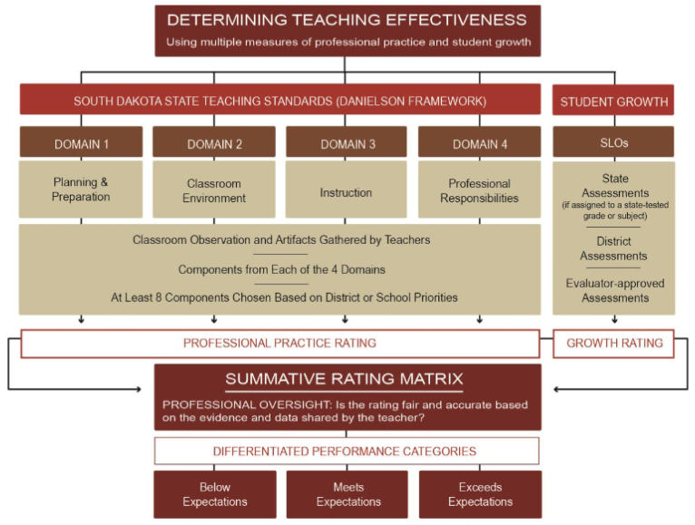
Notes:
Here you see the components included in the Teacher Effectiveness System. Remember, the Teacher Effectiveness System is made up of two components (CLICK), the SD Framework for Teaching (CLICK), and SLOs for student growth. Data from both components are collected and may be combined in the Summative Rating Matrix (CLICK) to determine a teacher’s performance category.
No matter what you teach, these components remain in effect. Later on, we will take a look at some specific elements within each piece that may be different for EL teachers.

Slide 6
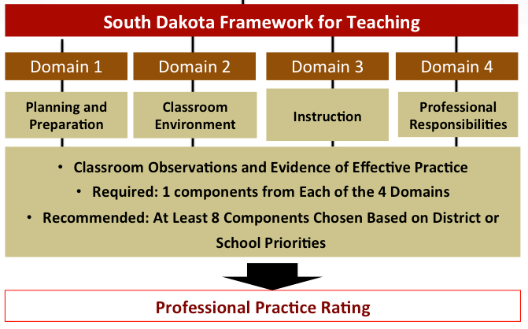
Summative Scoring Matrix
Notes:
Let’s take a closer look at the South Dakota Framework for Teaching.
The South Dakota Framework for Teaching is comprised of four domains. Each domain includes components related to effective teaching practices. Within the South Dakota Framework for Teaching, districts decide which components to focus on. At a minimum, districts must choose 4 components, with one from each domain. One difference you may notice in the evaluation process is in the assignment of your evaluator. Districts may choose to have EL teachers evaluated by one or more principals, depending on the grade levels included in the teacher’s caseload. For more information on who your evaluator may be, contact your school principal or superintendent.
Regardless of your teaching assignment, all teachers in a district will follow the same evaluation process identified by your district leadership and receive a Professional Practice rating from the same Summative Scoring Matrix (CLICK) seen here.

Slide 7
Before You Begin
EL teachers as well as evaluators are encouraged to meet and discuss:
Specialized practices, modifications, and adaptations used to instruct ELs.
Present academic and language proficiency levels of ELs in the class.
Roles of general classroom teacher and EL teacher in co-teaching or push-in support situations.
Any other potential differences in the district identified domain components.
Notes:
Because an EL classroom can look very different from a general education classroom, it can be challenging to understand how the components from each domain in the SD Framework for Teaching can be applied in such a unique setting. Teachers and their evaluators are encouraged to meet prior to the first evaluation to create a shared understanding of the instructional setting and strategies used by the teacher.
The teacher and evaluator may want to discuss:
Specialized practices, modifications, and adaptations the teacher uses to instruct ELs;
Present academic and language proficiency levels of the ELs in the class;
The roles of the general classroom teacher and the EL teacher in co-teaching or push-in support situations;
And any other potential differences that may arise when reviewing the district-identified components from the 4 domains.
Having a common understanding of the instructional strategies and learning environment prior to the teacher effectiveness process can help to alleviate some misunderstandings or misconceptions.

Slide 8
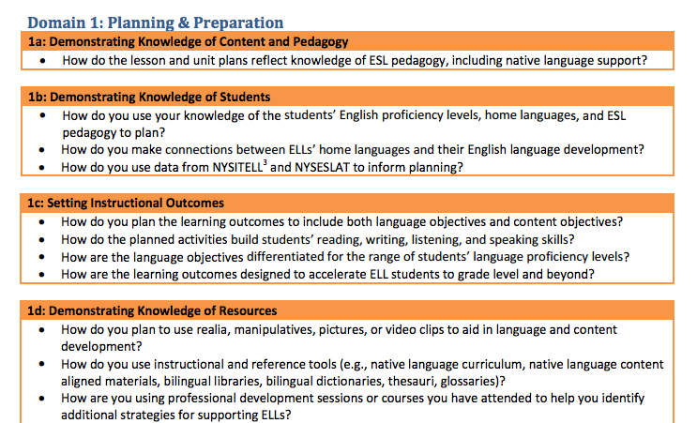
EL-Specific Domain Guidance
from: Specific Considerations for Teachers of English Language Learners (pg. 3)
Notes:
One helpful resource is the document “Specific Considerations for Teachers of English Language Learners” created by the New York Department of Education. This document contains guiding questions to help EL teachers and their evaluators to understand how the components from each domain in the SD Framework for Teaching can be applied in such a unique setting. The link to this document can be found at the end of this module.

Slide 9
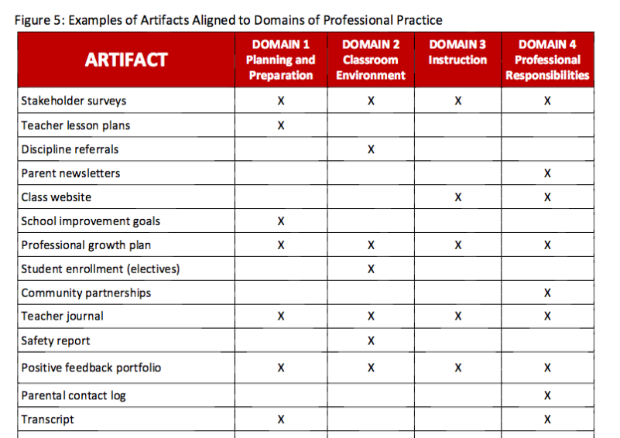
Collecting Artifacts
from: SD Teacher Effectiveness Handbook (pg. 19)
Notes:
Throughout the school year, teachers can collect artifacts that demonstrate performance relative to district-identified components from each domain. Artifacts can include any documents, photographs, reports, or other information related to a teacher’s instruction, preparation, or professional growth.
On page 19 of the Teacher Effectiveness Handbook, you will find some broad examples of artifacts that can be collected for each of the 4 Domains of Professional Practice. If you are looking for general ideas on what artifacts to collect, this is a good starting point. You can find the Teacher Effectiveness handbook on the South Dakota DOE website.

Slide 10
EL Teacher Artifact Ideas
Domain 1 (Planning and Preparation) Transcript from EL-related coursework Documentation of using student assessment results to create goals Home Language Survey results | Domain 2 (Classroom Environment) Individualized intervention plan Documentation of planning/prep with paraprofessionals
Domain 3 (Instruction) EL Progress Monitoring Parent Notifications Parent Progress Reports | Domain 4 (Professional Responsibilities) Results from annual parent surveys Documentation of membership/participation in WIDA or other EL organizations Agenda from EL-related trainings
Notes:
While the general examples from the Teacher Effectiveness Handbook may give you a general place to start, some of the artifacts you collect as an EL teacher may be a little different, and will reflect tasks, activities, and documentation unique to your teaching assignment.
Here are some examples that may be collected by an EL teacher.
Take a moment to review the examples in this table. Note any that would be beneficial in your teaching situation. Can you think of any other examples for each domain?
(short pause)

Slide 11
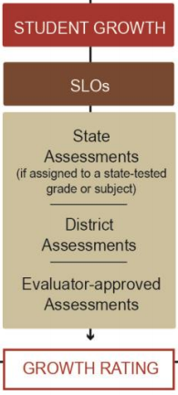
Notes:
Now, let’s take a look at the second component of the Teacher Effectiveness System (CLICK) – SLOs and student growth.

Slide 12
Who Completes An SLO?
Provides instruction to any grade, kindergarten through grade twelve, or ungraded class or who teaches in an environment other than a classroom setting;
Maintains daily student records;
Has completed an approved teacher education program at an accredited institution or completed an alternative certification program;
Has been issued a South Dakota certificate; and
Is not serving as a principal, assistant principal, superintendent, or assistant superintendent.
Notes:
Any person working in a school district who meets all the criteria of a teacher listed here, is required to write an SLO. For this process, a teacher is defined as someone who:
(CLICK) Provides instruction to any grade, kindergarten through grade twelve, or ungraded class or who teaches in an environment other than a classroom setting;
(CLICK) Maintains daily student records;
(CLICK) Has completed an approved teacher education program at an accredited institution or completed an alternative certification program;
(CLICK) Has been issued a South Dakota certificate;
(CLICK) and Is not serving as a principal, assistant principal, superintendent, or assistant superintendent.
Most EL teachers will meet the criteria, and will write an SLO.

Slide 13
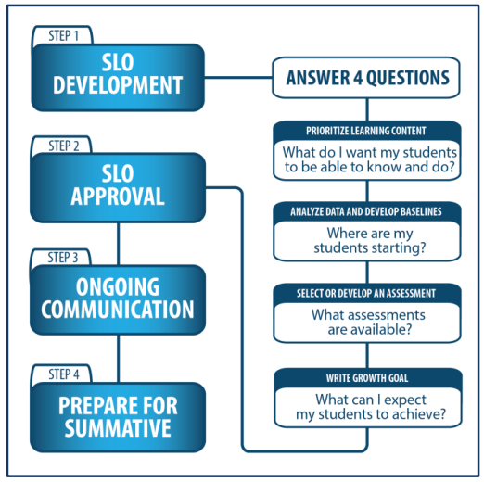
SLO Process
Low Growth: Growth goal is less than 65% attained.
Expected Growth: Growth goal is 65%-85% attained.
High Growth: Growth goal is 86% to 100% attained.
Notes:
As part of the SD Framework for Teaching, all teachers will develop at least one SLO to evaluate student growth each school year. All teachers will follow the same steps in SLO development, and will use the same four guiding questions. Growth is also calculated in the same way, using the same percentages for each level of growth.

Slide 14
EL Law and Guiding Principles
Notes:
Before you begin considering how to write your SLO, it’s important to keep in mind that federal and state regulations for ELLs place an emphasis on ensuring all students have access to and participate in the general education curriculum. Let’s take a look at some principles that can guide your SLO development.

Slide 15
EL Law/ Guiding Principles
SLOs should support the participation of ELs in programs to attain English proficiency.
SLOs should be developed in a way that holds all teachers accountable for the academic growth of ELs, regardless of immigration status or English proficiency.
Lau vs. Nichols; Bilingual Education Act; Equal Education Opportunity Act
Notes:
First, SLOs should support the participation of English Learners in programs to attain English proficiency. Second, SLOs should be developed in a way that holds all teachers accountable for the academic growth of English Learners, regardless of a student’s immigration status or English proficiency.
The next several slides will review considerations for writing SLOs within the parameters of these guiding principles.
(CLICK) The specific law referred to in this section is underlined at the bottom of the screen.

Slide 16
EL Law/ Guiding Principles
SLOs should not be based on the attainment of objectives within a student’s LAP (Language Acquisition Plan).
SLOs: | LAPs:
Focus - teacher’s ability to impact student growth | Focus - supporting individual student in achieving English proficiency
Includes one or more students | Individualized for one student
Includes teacher’s baseline data, growth targets, and measurement of progress | Includes academic history, assessment results, instructional plan, and assessment accommodations.
Notes:
The first consideration is that SLOs should not be based on the attainment of objectives included in a students LAP, or Language Acquisition Plan. It is important to remember that each document serves a different purpose. LAPs are individualized plans designed to improve English proficiency for the student. The focus of the SLO is a teacher’s ability to impact student growth. Including LAP objectives within the SLO may unintentionally move that focus. Take a moment to review some other differences between the two documents outlined in this table.
*short pause*
While LAPs and SLOs should be kept as different documents, information found within the LAP can be a good source of information and documentation that may be helpful in identifying priority learning content. EL teachers may find it helpful to review areas of need for the students they serve in order to identify a target group for the SLO. Also, EL teachers can leverage work already performed within the context of the instruction outlined in the LAP to gather data for SLOs. This may include reviewing results from specialized assessments to determine priority learning content or utilizing progress monitoring information in documenting student growth.

Slide 17
EL Law/ Guiding Principles
SLOs should focus on academic standards.
Instructed with same college and career readiness standards as peers.
English Language Development (ELD) standards can, and should, be included.
May differ in established learning targets and types of services and supports provided.
Notes:
The second consideration is that SLOs should focus on academic standards. Students with limited English proficiency, when appropriate, should be instructed and assessed using the same college and career readiness standards as their general education peers. When filling out the SLO process guide, appropriate ELD, or English Language Development, standards for the target group can, and should, be included.
However, SLOs written to encompass EL populations may differ in their established learning targets AND the types of services and supports provided to students to access the curriculum used in the regular classroom.

Slide 18
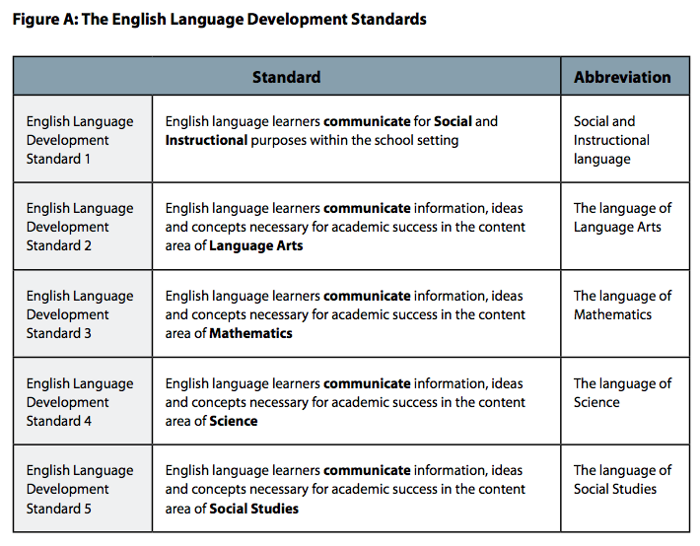
ELD STANDARDS
http://doe.sd.gov/oats/documents/WIDAstand.pdf
Notes:
The ELD standards were developed by the WIDA consortium. For a copy of the ELD standards book, visit the South Dakota Department of Education link on your screen.

Slide 19


EL Law/ Guiding Principles
In co-teaching situations, teachers are encouraged to collaborate to create SLOs.
Shared SLO
Both teachers share the:
diverse population
baseline data
growth goals
Notes:
The third consideration: In co-teaching situations, teachers are encouraged to collaborate to create SLOs. If more than one teacher is providing education and support to a student, or group of students, those teachers are responsible for the educational outcome of that student or group. This may be a good opportunity for those teachers to work together to create a shared SLO.
(CLICK) For example - Mrs. Smith is a third grade general education teacher. Mr. Jones, an EL teacher, provides push-in support for three ELs during Mrs. Smith’s reading instruction every day. If Mrs. Smith and Mr. Jones are writing SLOs on reading, they may want to create a shared SLO.
(CLICK) Because both teachers are responsible for the educational outcome of the students in this group, it would be beneficial for them to collaborate in writing an SLO that accounts for the diverse population, baseline data, and growth goals included in the group.

Slide 20
EL Law/ Guiding Principles
SLOs that include EL students should reflect the diverse program types in which the students in your district participate.
Your SLO should include students for whom you provide instruction.
Dual Language Two-way Immersion Transition Bilingual Developmental Bilingual Heritage Language Sheltered English Instruction | Structured English Immersion Specially-designed Academic Instruction Delivered in English Content-based EL Pull-out EL Other
Notes:
The final consideration we will take a look at is that SLOs that include EL students should reflect the diverse program types that students in your district participate in. During the creation of the LAP, each student’s team reviewed options within the range of language instruction programs, and identified the best placement for him/her. Your SLO can include students in any of those language instruction programs. However, when identifying your target group of students for your SLO, it is important to think about the students whose instruction you are responsible for. If your SLO includes students that you don’t provide instruction for, your SLO will not be a true measure of your impact on student growth.
Another important thing to keep in mind is that your SLO does not have to include every student on your caseload. Later in the module, we will look at ways to identify the student or students you will include in your SLO.
For more information on language instruction programs, contact the EL Coordinator at the South Dakota Department of Education.

Slide 21
SLO Process guide – What’s different for EL educators
Notes:
The final piece in this module will take a look at the SLO process guide, and review some potential differences you may find.

Slide 22
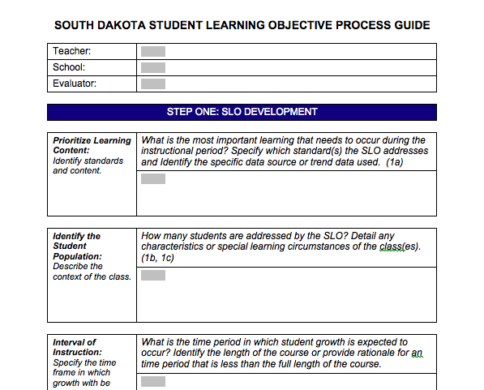
SLO Process Guide
Notes:
The SLO Process guide is a document that guides teachers in completing their SLOs. Regardless of what you teach, all teachers will follow the SLO process set by their district. This may include completing the steps in an online program, filling out a digital or paper copy of the process guide, or utilizing another district-identified format. During this section, we will look at the similarities and differences that may arise in each component included in the process guide.

Slide 23
Before You Begin
Review summative data to identify an area of need:
English Language Proficiency assessment
State Content Assessments
Other skill-based assessments
Other district assessments
Identify your target group of students
May be one or more students
Similar LAP objectives
Similar skill needs
Group shared with classroom teacher
Students may or may not be in the same grade or classroom
Notes:
Before you begin filling out the process guide, you’ll want to do the following:
First, look at summative student data to identify an overall area of need. Sources of data may include results from the English Language Proficiency assessment, State ELA, math, and science content assessments, and other skill-based assessments completed as part of a student evaluation. This information will help you zero in on a specific content area or set of skills that appear as an area of need for your students. You may notice more than one area of need, but for the purpose of your SLO, you will choose just one.
Once you have identified your priority content area, take a look at the students on your caseload for whom you provide instruction. This will vary widely by teacher and teaching assignment, but should include students that receive instruction from you. This can include one or more students, but does NOT have to include every student on your caseload.
Is there a group of students who share similar objectives in their Language Acquisition Plan? Do you have students who are working on similar skills? These groupings work well for a target group for your SLO. Do you provide push-in, or inclusion, support to several students in a general education classroom? This would be a good opportunity for a shared SLO.
Growth may be more difficult to reach with a small group of students, so you may also want to consider students who have common needs and objectives, but are instructed in different groups, grade-levels, or are instructed at different times of the day. You can include these students as one target group for your SLO.

Slide 24
Prioritizing Learning Content
Prioritize Learning Content: Identify standards and content. | What is the most important learning that needs to occur during the instructional period? Specify which standard(s) the SLO addresses and Identify the specific data source or trend data used. (1a)
 | SOUTH DAKOTA STANDARDS FOR YOUR STUDENTS’ GRADE LEVEL(s) ELD STANDARD(s) DATA SOURCES USED
Notes:
Once you’ve reviewed summative data to identify an area of need, and reviewed student data to select your target group of students, you are ready to begin the first step of the process guide.
In this step, you will identify your priority learning content. Within the area of need you identified, what is the most important learning that needs to occur? List the state standards, along with any identified ELD standards that best pinpoint which skill (or skills) to address. If you have a multi-grade group, you will want to identify standards within the various grade levels. You will also name the data sources you used to identify this priority learning content.

Slide 25
Identify Student Population
Identify the Student Population: Describe the context of the class. | How many students are addressed by the SLO? Detail any characteristics or special learning circumstances of the class(es). (1b, 1c)
 | SHARED – WHOLE CLASS INDIVIDUAL – STUDENTS IN YOUR TARGET GROUP Socio-economic status English proficiency level Language Instruction Program Educational/cultural background Title/SPED participation
Notes:
The next step in the Process Guide is to identify your student population. In this box, you will list the students in your target group that will be addressed by your SLO.
If you are writing a shared SLO with another teacher, you will list all of the students in that shared group. If you are writing an individual SLO, you will list all of the students in your target group.
This is also the place for you to identify any specific learning characteristics of your students that may impact the SLO goal. Specific learning characteristics include any information that may impact your students’ learning. This information can be for individual students and the whole group. You may want to include information such as socio-economic status, English proficiency level, participation in language instruction programs, educational or cultural background, and participation in Title or Special Education.

Slide 26
Interval of Instruction
Interval of Instruction: Specify the time frame in which growth will | What is the time period in which student growth is expected to occur? Identify the length of the course or provide rationale for a time period that is less than the full length of the course.
 | SCHOOL YEAR SEMESTER
Notes:
Step 3 of the process guide is to document your interval of instruction, or the time frame in which you will measure student growth. For most teachers, this will be a semester or school year. SLOs are intended to encompass the larger academic standards within a course or content area. It is important that the duration of the SLO spans the full length of time students are with their teacher for instruction. If you are unsure of the time frame you should select, contact your district evaluator.

Slide 27
Analyze Data & Develop Baseline
Analyze Data and Develop Baseline: Detail student understanding of the content at the beginning of the instructional period. | Where are my students starting? Summarize student baseline performance and attach additional data if necessary. (1b, 1f, 3d)
 | WHERE ARE YOUR STUDENTS STARTING Example: Student A – 4/10 Student B – 3/10 Student C – 3/10 Student D – 2/10 Student E – 2/10 Student F – 0/10
Notes:
In the next step, you will document where the students in your target group are at the beginning of your SLO timeline. In the first box of the process guide, you identified your priority learning content and the related standards. Next, you will identify and administer a pre-assessment that will measure where your students are starting.
Your pre-assessment may be similar to that of a general education teacher, depending on the priority learning content you selected. You can also use results from EL-specific assessments, such as ACCESS and W-APT.
If writing a shared SLO with a classroom teacher, you will document the results for the entire class in this box.
It is common, and expected, for your students to receive low scores on this pre-assessment. Low scores demonstrate that the priority content you have chosen is, indeed, an area of need for your target group.
If you are collecting and/or analyzing data using a separate document, such as an Excel spreadsheet, you can attach a copy of that to your process guide. Be sure to note that in the box so that your evaluator knows where to find your baseline data.

Slide 28
Select or Develop an Assessment
Select or Develop an Assessment: Describe how the goal attainment will be measured. | What specific assessment or instrument will be used to measure goal attainment? Describe the source of the assessment and the connection to identified content and standards. (1c, 1d, 1f, and 3d)
 | WHAT IS/ARE YOUR DATA SOURCE(S) Examples: ACCESS W-APT Portfolio of student work Performance Tasks Commercial Assessments Teacher-created assessments
Notes:
In this step of the SLO Process Guide, document the assessment you will use to measure growth during your SLO time frame. In most cases, teachers choose to use the same (or similar) assessment identified as the pre-assessment tool. Some examples of assessment include the W-APT assessment, portfolios of student work, or performance tasks evaluated with a rubric. Teachers may choose to use a commercial assessment, or create their own.
No matter the approach, assessments should be high quality and provide an accurate and reliable measure of student performance.

Slide 29
Growth Goal
Growth Goal: Establish expectations for student growth. | What can I expect my students to achieve? Establish rigorous expectations for student performance. (1b 1c)
 | SMART goals are: Specific – state content-based learning focus Measurable – includes assessment and increment for measurement (ex: minutes, points, percent) Appropriate – includes growth for ALL students (NOT “80% of my students will…”) Realistic/Rigorous – attainable, but stretches students to grow Time-bound – includes your time-frame
Notes:
This step of the SLO Process Guide is where you will identify the growth goal for your students. Analyzing data from the pre-assessment results will help you set solid goals for the students in your target group. When writing your growth goal, you want to keep the acronym “SMART” in mind, and include the following elements:
Your goal should be:
Specific. It should state your content-based learning focus.
(CLICK) Measurable. It should include the name of the assessment you are using to evaluate it, along with the measurement method, such as an increase in minutes, points, or percentage.
(CLICK) Appropriate. Your goal should be written to account for growth for all the students in your target group. Goals that are written with statements like “80% of my students will…” only account for growth of 80% of your students.
(CLICK) Realistic and Rigorous. Based on what you know about your students, and the baseline data from their pre-assessments, the goals you set should be reachable, but stretch the outer limits of what is attainable.
(CLICK) And Time-bound, or include the time frame you identified in your Interval of Instruction.
Now that we’ve taken a look at the components of a well-written goal, let’s review some options and examples of different growth goals.

Slide 30
Growth Goal – Mastery
Growth Goal: Establish expectations for student growth. | What can I expect my students to achieve? Establish rigorous expectations for student performance. (1b 1c)
 | Mastery – based on all students in the target group achieving mastery of identified skill(s). By the end of the 2015-2016 school year, all students will correctly compare 5 sets of objects using comparative terms (such as shorter, longest, etc…).
Notes:
One option in developing a growth goal is a mastery goal. In a class mastery goal, the focus is on all students in your target group achieving mastery of the identified skill or skills.
Here is an example of a lower-elementary class mastery growth goal in the area of math: “By the end of the 2015-2016 school year, all students will correctly compare 5 sets of objects using comparative terms, such as shorter and longest.”
This format works well when you want all students in your group to achieve the same level of mastery on your identified skill or concept. On the other hand, if mastery is not the focus for your identified skills or concepts, or if you feel mastery is not an attainable goal for one or more students in your target group, a class mastery goal may not be the best fit.

Slide 31
Growth Goal – Differentiated
Growth Goal: Establish expectations for student growth. | What can I expect my students to achieve? Establish rigorous expectations for student performance. (1b 1c)
 | Differentiated– establishes tiered expectations for students or groups. By the end of the 2015-2016 school year, students who fluently read 50 or fewer words per minute on the XYZ assessment will increase to 75 or more words per minute. Students who fluently read 51 or more words per minute will increase to 100 or more words per minute.
Notes:
Another option for your growth goal is a differentiated growth goal. Within a differentiated goal, a teacher can create different levels, or tiers, of expected growth based on the target group’s pre-assessment scores.
Here we have an example of a differentiated growth goal for the area of reading fluency. You can see the area in orange is the first tier of the goal – students who fluently read 50 or fewer words per minute on the XYZ assessment. The goal for that group is to increase to 75 words per minute. The second tier, or group, is in purple – students who fluently read 51 or more words per minute. The goal for that group is to increase to 100 or more words per minute.
Differentiated goals recognize that students within a group often begin with different levels of understanding of the priority content, and allows teachers to set appropriate goals for individuals and/or subgroups within their target group. There is no set number of tiers or groups you should have within your goal, or number of students per tier. Depending on the size of your target group, you may have one student in a tier. Reviewing your student pre-assessment scores will help you identify the number of tiers. To determine where to set the goal for each tier, take a look at your student information, along with your standards and assessment information. This will help you identify realistic and rigorous goals for each tier.

Slide 32
Growth Goal – Shared Performance
Growth Goal: Establish expectations for student growth. | What can I expect my students to achieve? Establish rigorous expectations for student performance. (1b 1c)
 | Shared Performance – allows for shared responsibility and accountability in situations where 2+ teachers share instruction for students. By the end of the school year, all students in 7th grade English will show an improvement in the ability to write a persuasive essay, moving up 1 rubric score on the teacher-created writing rubric.
Notes:
The third option for writing growth goals is a shared performance goal. Within this goal format, teachers writing a shared goal work together to determine an appropriate goal for the entire shared group. This kind of goal is sometimes used in a general education setting, where teachers in a common grade level or content-area create a goal that will be applied in each of their respective classrooms, with all teachers sharing accountability for all students included in the SLO. This goal format also works well in the event that a classroom teacher and EL teacher share instructional responsibility for students in a classroom.
Let’s take a look at the example goal, which is written for a middle school English classroom. “By the end of the school year, all students in 7th grade English will show an improvement in the ability to write a persuasive essay, moving up 1 rubric score on the teacher-created writing rubric.”
It is important to note that a shared performance goal can have elements of a mastery goal or differentiated goal embedded within it. The goal for each student here is to move up one rubric score. This allows for realistic and rigorous growth for each student, regardless of their individual starting points.

Slide 33
Goal Reflection
What was the growth goal for your most recent SLO?
Did you include all of the SMART components?
Did your goal allow for growth for all students in your target group?
What might you change when writing your next SLO growth goal?
Notes:
Take some time to reflect on the goal you wrote for your most recent SLO.
What was the growth goal for your most recent SLO?
Did you include all of the SMART components?
Did your goal allow for growth for all students in your target group?
What might you change when writing your next SLO growth goal?
Take a moment to jot down some notes on what you might change when writing your next SLO growth goal.

Slide 34
Provide Rationale
Provide Rationale: Describe how your SLO benefits student learning. | How do the content, baseline data, assessment and growth goal support student progress and growth? Describe why you chose to develop this SLO. (1a, 1f)
 | Why did you choose this goal? Importance of content Relationship to standards (State or ELD) Summative data identified this area as a need Baseline data shows weakness in skill(s) How will goal completion benefit your students?
Notes:
After you’ve written your growth goal, the next step is to provide rationale on how your SLO benefits student learning. In this box, you will explain how the content, standards, baseline data, assessment, and growth goal support student growth.
You may want to note the importance of the content you chose, how the goal is related to your identified standards (state standards and/or ELD standards), and the data (both from the summative assessment and the pre-assessment) that identify this content area and skillset as a need for your target group of students.

Slide 35
Learning Strategies
Learning Strategies: Describe your plan to meet student needs? | How will you help students attain the goal? Provide any specific actions that will lead to goal attainment. (1b, 1e, 1f, 4a)
 | INSTRUCTIONAL STRATEGIES Pacing, Wait Time Review, Repetition Scaffolding, Visual Aids SERVICES AND SUPPORTS ACCOMMODATIONS
Notes:
The final step before submitting your SLO for evaluator approval is to describe the instructional strategies you plan to implement in order to help the students in your target group meet their goal (or goals).
Some examples of strategies you may include are adjustments to pacing or wait time, more frequent review, or providing scaffolding or visual aids. Can you think of other strategies you might include?
You can also list any services and supports your students receive that are related to the priority learning content. You will also want to include information on student accommodations and/or modifications, as those are applicable to the SLO.

Slide 36
Content Review
The Teacher Effectiveness System applies to all teachers.
Reviewing EL-specific instructional settings and strategies with your evaluator before the TE Process begins will create a shared understanding.
The “Specific Considerations for Teachers of English Language Learners” document can be helpful in identifying how the Teacher Effectiveness components can relate to EL teachers.
LAPs are not SLOs, but can inform the content included in your SLO.
Consider a differentiated or shared goal, depending on your target group.
Notes:
To recap, here are some key points we explored within this module.
(CLICK) The Teacher Effectiveness System applies to all teachers.
(CLICK) Reviewing EL-specific instructional settings and strategies with your evaluator before the Teacher Effectiveness Process begins will create a shared understanding.
(CLICK) The “Specific Considerations for Teachers of English Language Learners” document can be helpful in identifying how the Teacher Effectiveness components can relate to EL teachers.
(CLICK) LAPs are not SLOs, but can inform the content included in your SLO.
(CLICK) Consider a differentiated or shared goal, depending on your target group.

Slide 37
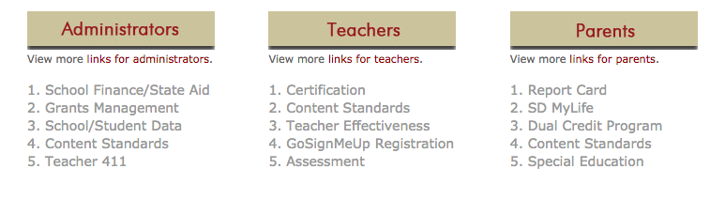

http://doe.sd.gov
http://on.nyc.gov/1St2Zcc
Notes:
For more information on the topics covered in this module, visit these resources.
For more information on teacher effectiveness, and links to both the Teacher Effectiveness Handbook and SLO Handbook, visit doe.sd.gov, and click “Teacher Effectiveness” under the “Teacher” links.
(CLICK) To access the “Specific Considerations for Teachers of English Language Learners” document, visit the website listed here.
(CLICK) For more information about WIDA and the EL resources included, visit www.wida.us. If you don’t have log-in information, contact your district EL Coordinator or the South Dakota Department of Education.

Slide 38


www.wida.us
https://www.wida.us/standards/eld.aspx
Notes:
For more information on the topics covered in this module, visit these resources.
For more information on teacher effectiveness, and links to both the Teacher Effectiveness Handbook and SLO Handbook, visit doe.sd.gov, and click “Teacher Effectiveness” under the “Teacher” links.
(CLICK) To access the “Specific Considerations for Teachers of English Language Learners” document, visit the website listed here.
(CLICK) For more information about WIDA and the EL resources included, visit www.wida.us. If you don’t have log-in information, contact your district EL Coordinator or the South Dakota Department of Education.

