Slide 1

Teacher Effectiveness System
Implementation Support for
Schools in Improvement
Online modules

Slide 2
Module 1:
Teacher Effectiveness System Overview
History
Model System Recommendations
Minimum Requirements
Timeline
Notes:
The purpose of this module is to assist participants in developing an awareness of the SD Teacher Effectiveness System. Topics included in this short overview:
*The history of Teacher Effectiveness
*System requirements and recommendations
*What is included in the Teacher Effectiveness Model

Slide 3
Determining Teacher Effectiveness
Using multiple measures of professional practice and student learning
South Dakota Framework for Teaching
Student Growth
Domain 1
Domain 2
Domain 3
Domain 4
Teacher Effectivenesss
Teacher Effectivenesss
Planning and Preparation
Classroom Environment
Instruction
Professional Responsibilities
District Assessments
Evaluator-Approved Assessments
Classroom Observations and Evidence of Effective Practice
Components from Each of the 4 Domains
At Least 8 Components Chosen Based on District or School Priorities
Professional Practice Rating
Growth Rating
Summative Rating Matrix
Professional Oversight: Is the rating fair and accurate based on the evidence
and data shared by the teacher
Differentiated Performance Categories
Below Expectations
Meets Expectations
Exceeds Expectations
Notes:
The South Dakota Teacher Effectiveness Model is a collection of recommended practices that serves as guidance toward successful implementation of high quality teacher evaluation systems. Practices outlined in the model are not required. Public school districts have the freedom to implement evaluation systems that differ from the model, provided a locally-developed system complies with all minimum state requirements. South Dakota’s Teacher Effectiveness Model establishes clear performance expectations, identifies multiple performance measures, includes recommendations for evidence collection and provides guidance to meaningfully determine and differentiate teaching performance.
Using the recommended model, public school districts will separately determine a Professional Practice Rating and a Student Growth Rating. The two separate ratings are combined by using the Summative Rating Matrix, a tool that provides educators the opportunity to exercise professional judgment prior to classifying teacher performance into one of the three performance categories.
This model of combining the two ratings does not rely on a uniform formula to calculate a Summative Teacher Effectiveness Rating. Instead, the model prioritizes evaluations based on the South Dakota Framework for Teaching, while incorporating the evaluation of student growth as one significant factor in the rating system.

Slide 4
The Aspiration:
Improve Instruction and Student Learning
PURPOSE: Evaluation and professional growth systems
Encourage meaningful, in-depth dialogue focused on improving instruction
Provide regular, timely, useful feedback that guides professional growth
Support a culture in which data drives instructional decisions
Establish clear expectations for teacher performance
Use multiple measures to meaningfully determine and differentiate teacher performance
Provide a fair, flexible, research-based model that informs personnel decisions
Notes:
The new Teacher Effectiveness System should result in the following outcomes if implemented with fidelity:
• Improved student success through the implementation of research-based educational practices.
• Improved student success through teachers’ professional growth and accountability.
• A record of facts and assessments for personnel decisions to ensure every public school in South
Dakota has effective teachers.
Continuous improvement is at the core of the annual appraisal cycle, with professional growth and accountability embedded in the use of rubrics. Student and school data, as well as other sources of evidence, will lead to a teacher’s professional growth plan. Data collected through the teacher evaluation process can help guide discussions about professional growth, especially as it relates to teachers early in their careers. Assignment to performance levels will help teachers know what skills they need to develop to move to the next performance level.

Slide 5
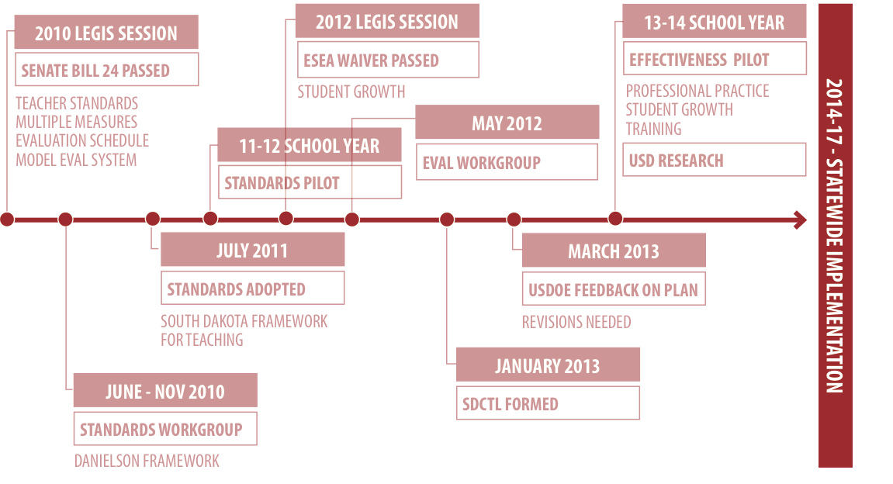
History of Teacher Effectiveness in SD
Notes:
Work on developing a teacher evaluation model began in response to legislation passed in 2010 requiring teacher evaluations in SD school districts. Prior to the passing of that legislation, there was no requirement that teachers be evaluated. This led to the creation of a standards work group charged with identifying a research-based set of professional teaching standards upon which to build our teacher evaluation system. The work group recommended the Danielson Framework, which was adopted as our SD professional teaching standards. That work group then became known as the SD Commission on Teaching and Learning. The CTL brought together education stakeholders from k-12 and higher education, SDDOE, USDOE, and SDEA. The CTL worked to develop a Teacher Effectiveness System that would meet the requirements of the ESEA waiver and hold true to the needs of administrators, teachers, and students in our schools. The TE System has been piloted for multiple years in districts across SD and is now in full implementation.

Slide 6
Definition of a Teacher
An individual who:
Provides instruction to any grade, K-12, or ungraded class or who teaches in an environment other than a classroom setting;
Maintains daily student records;
Has completed an approved teacher education program or completed an alternate certification program;
Has been issued a South Dakota certificate; and
Is not serving as a principal, assistant principal, superintendent, or assistant superintendent.
Notes:
The Teacher Effectiveness System was developed specifically for teachers. This slide gives the federal definition of a teacher used in the SD Teacher Effectiveness System. Individuals who meet the above definitions will be evaluated using the model. As has been common in many school districts all along, under this model, teachers would not be evaluated with the same tool that might be used to evaluate other school staff, such as business managers, paraprofessionals, custodians, etc.

Slide 7
Teacher Effectiveness System
Professional Practice Rating: based on performance relative to the South Dakota Framework for Teaching (Danielson Model)
Student Growth Rating: Based on the development and attainment of Student Learning Objectives
Summative Rating (optional): Three categories – Below, Meets or Exceeds Expectations; based on multiple measure, student growth a “significant factor”
Results and Outcomes: Useful performance feedback that guides professional growth and improvement plans for those not meeting district expectations
Evaluation Cycle: Probationary teachers summatively evaluated every year, non-probationary teachers at least every other year.
Notes:
State codified law and administrative rule outline the minimum requirements for implementation of Teacher Effectiveness (SDCL 13-42-33, SDCL 13-42-34, SDCL 13-42-70, ARSD 24:57).
All South Dakota public school districts must use multiple valid measures to evaluate Teacher Effectiveness. The teacher evaluation process must rely on qualitative and quantitative measures and be based on measures of both professional practice and student growth.
Local teacher evaluation systems must assess teaching performance relative to the South Dakota Framework for Teaching based on the Danielson Framework for Teaching.
The South Dakota Framework for Teaching includes 22 individual teaching components clustered into four domains. All local effectiveness systems must include professional performance evaluations based on a minimum of four teaching components, including one from each domain (ARSD 24:57).
Student Learning Objectives as a Measure of Teacher Impact on Student Growth
Impact on student growth will be assessed through the Student Learning Objectives (SLOs) process. Public school districts may apply to use an alternate method of student growth, provided the measure meets minimum state requirements (ARSD 24:57).
SUMMATIVE TEACHER EFFECTIVENESS RATING
Local teacher evaluation systems may include a process to combine the Professional Practice Rating and Student Growth Rating into a Summative Teacher Effectiveness Rating (ARSD 24:57).
Performance Differentiated Into Three Categories
Summative teaching performance is assigned one of three overall performance ratings: Below Expectations, Meets Expectations, or Exceeds Expectations (ARSD 24:57). The Summative Teacher Effectiveness Rating includes an evaluation of student growth that serves as one significant factor and an evaluation of professional practices as the other significant factor.
SUMMATIVE EVALUATION CYCLE
All South Dakota public school districts must regularly provide teachers with a summative evaluation, but the frequency varies based on the amount of time a teacher has been employed with the district.
Probationary Teachers
Teachers in years one to three of employment, commonly referred to as probationary teachers, must be provided with a summative evaluation every school year (SDCL 13-42-34).
Non-Probationary Teachers
Teachers in or beyond their fourth year of employment, commonly referred to as continuing contract teachers, must be evaluated at least once every two school years (SDCL 13-42-34).

Slide 8

Comparison
Minimum Requirements & Model Recommendations
Notes:
Our next few slides will compare the minimum requirements & the model recommendations of the teacher effectiveness model. Districts and attendance centers within districts have autonomy to develop and implement the model that will best meet the needs of their staff and students and support increased student achievement. A full text document outlining the minimum requirements and model recommendations can be found in the TE handbook on the DOE website.

Slide 9
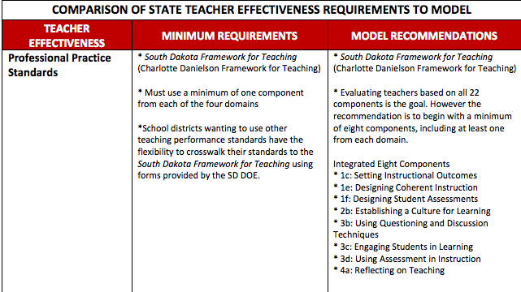
Comparison of Minimum Requirements to
Model Recommendations
from: SD Teacher Effectiveness Handbook (pg. 7)
Notes:
The recommended model suggests selecting 8 of 22 Danielson components. The Integrated 8 shown on this slide represents 8 components that overlap among lists generated as CTL recommendations and to best fit State Math and ELA standards and SLOs. General Component selection guidance will be addressed in an upcoming module and more information can be found in the TE handbook on the DOE website. In addition, a specific module of guiding component selection for schools in improvement is also included in this training package.

Slide 10
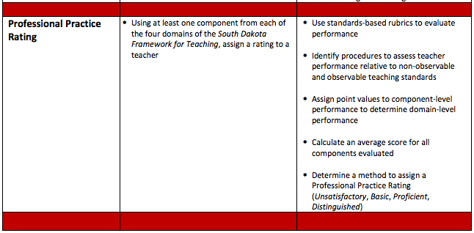
Comparison of Minimum Requirements to
Model Recommendations
from: SD Teacher Effectiveness Handbook (pg. 7)
Notes:
While it is a requirement that all teachers earn a professional practice rating, the model recommends using a standards based rubric. Each of the 22 Danielson components has an accompanying rubric with descriptions of each performance level as well as examples and critical attributes of both the component and its performance levels. These rubrics can be found on the DOE website and districts choosing to use Frontline will find the rubrics embedded into both the formal and informal observations as well as the walkthrough feature, if desired.

Slide 11
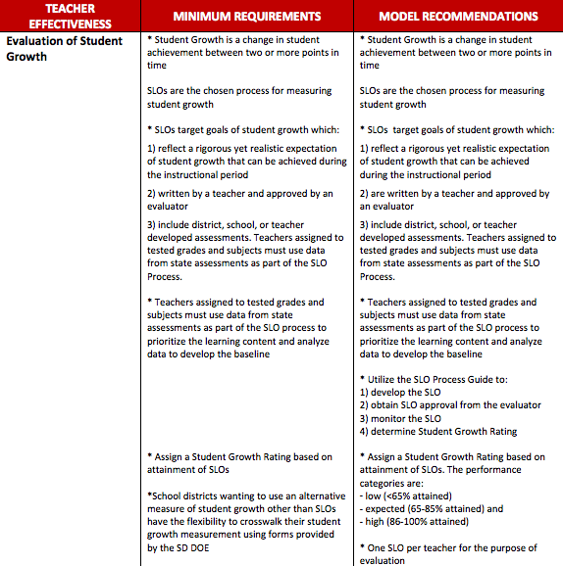
Comparison of Minimum Requirements to
Model Recommendations
from: SD Teacher Effectiveness Handbook (pg. 7)
Notes:
Both the model recommendation and the minimum requirements include a measure of student growth. Most often Student Learning Objectives are used to determine the student growth rating.

Slide 12
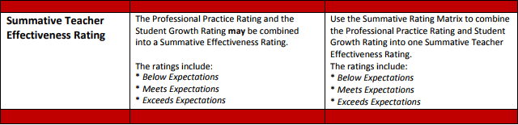
Comparison of Minimum Requirements to
Model Recommendations
from: SD Teacher Effectiveness Handbook (pg. 7)
Notes:
The model recommendation culminates in teachers earning a summative teacher effectiveness rating that is determined by combining a teacher’s earned professional practice rating with his/her student growth rating. The summative teacher effectiveness rating will always be differentiated into three categories: below expectations, meets expectations, and exceeds expectations.
Districts are not required to combine the Professional Practice Rating and the Student Growth Rating into a Summative Teacher Effectiveness Rating, though.

Slide 13
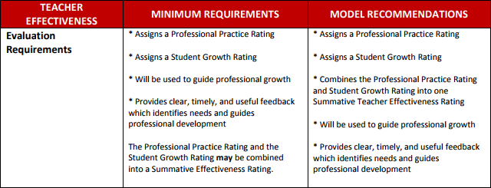
Comparison of Minimum Requirements to
Model Recommendations
from: SD Teacher Effectiveness Handbook (pg. 7)
Notes:
While districts or attendance centers within districts may select different professional practice components or even different numbers of components and various methods for generating a student growth rating, both of those components make up the evaluation requirements.
The only difference between the minimum requirements and the model recommendations is that districts are no longer required to combine the Professional Practice Rating and the School Growth Rating into a Summative Effectiveness Rating.

Slide 14
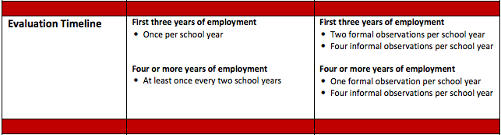
Comparison of Minimum Requirements to
Model Recommendations
from: SD Teacher Effectiveness Handbook (pg. 7)
Notes:
The evaluation timeline refers to the general frequency with which a teacher may be evaluated. Districts should refer to their current policies and negotiated agreements to ensure their frequency of evaluation meets the minimum requirements. Districts may evaluate more frequently as desired for both tenured and non tenured staff.

Slide 15
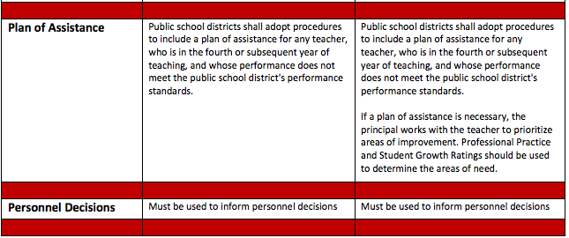
Comparison of Minimum Requirements to
Model Recommendations
from: SD Teacher Effectiveness Handbook (pg. 7)
Notes:
Each district will adopt their own procedures for using the results of the teacher evaluation model to place teachers on plans of assistance or to use the data collected to recommend teachers for continued employment.

Slide 16
Determining Teacher Effectiveness
Using multiple measures of professional practice and student learning
South Dakota Framework for Teaching
Student Growth
Domain 1
Domain 2
Domain 3
Domain 4
Teacher Effectivenesss
Teacher Effectivenesss
Planning and Preparation
Classroom Environment
Instruction
Professional Responsibilities
District Assessments
Evaluator-Approved Assessments
Classroom Observations and Evidence of Effective Practice
Components from Each of the 4 Domains
At Least 8 Components Chosen Based on District or School Priorities
Professional Practice Rating
Growth Rating
Summative Rating Matrix
Professional Oversight: Is the rating fair and accurate based on the evidence
and data shared by the teacher
Differentiated Performance Categories
Below Expectations
Meets Expectations
Exceeds Expectations
Notes:
This concludes the Teacher Effectiveness System Overview. The next module in this series focuses on Professional Practice: SD Framework for Teaching

Slide 17
Module 2:
Teacher Effectiveness System
Professional Practices General Overview
SD Framework for Teaching
Evidence & Artifacts
Scoring
Notes:
Module 2 in the teacher effectiveness system series will focus on Professional Practices. Improving teaching performance begins with a clear definition of effective teaching. The South Dakota Framework for Teaching based on the Danielson Framework offers a description of professional practices that, based on research and empirical evidence, have been shown to promote student learning. Evaluations of professional practice relative to the Framework contribute to the Summative Teacher Effectiveness Rating and serve as a basis for developing individual professional growth plans focused on improving instruction.
Also included in this module are methods of gathering evidence and artifacts as they pertain to the components and information on scoring the components.

Slide 18
Determining Teacher Effectiveness
Using multiple measures of professional practice and student learning
South Dakota Framework for Teaching
Student Growth
Domain 1
Domain 2
Domain 3
Domain 4
Teacher Effectivenesss
Teacher Effectivenesss
Planning and Preparation
Classroom Environment
Instruction
Professional Responsibilities
District Assessments
Evaluator-Approved Assessments
Classroom Observations and Evidence of Effective Practice
Components from Each of the 4 Domains
At Least 8 Components Chosen Based on District or School Priorities
Professional Practice Rating
Growth Rating
Summative Rating Matrix
Professional Oversight: Is the rating fair and accurate based on the evidence
and data shared by the teacher
Differentiated Performance Categories
Below Expectations
Meets Expectations
Exceeds Expectations
Notes:
As we review this graphic, you will see the left side highlights the SD Framework for Teaching and its flow into the professional practices rating.

Slide 19
Standards-based Performance Assessment
School districts chose whether to adopt the South Dakota Framework for Teaching (Danielson Model) or crosswalk to state teaching standards.
Minimum: 4 Performance Standards Including 1 from Each Domain
  Local school districts may select components relevant to school or district goals.
Assign a Professional Practice Rating
  Defined: The rating assigned to a teacher using at least one component from each domain.
Notes:
Again, The South Dakota Framework for Teaching is divided into four domains of teaching practice. Within the four domains are 22 components and 76 elements that identify the skills and knowledge associated with that domain. Minimum requirement is to select 4 of the 22 components, one from each domain and to assign a professional practice rating based on the proficiency demonstrated in the 4 selected components.

Slide 20
The South Dakota Framework for Teaching
A proven, comprehensive definition of effective teaching (Danielson Model)
State Model Recommendation: 8 components, including 1 from each domain
Domain 1 PLANNING AND PREPARATION | Domain 2 THE CLASSROOM ENVIRONMENT
1a: Demonstrating Knowledge of Content and Pedagogy 1b: Demonstrating Knowledge of Students 1c: Setting Instructional Outcomes 1d: Demonstrating Knowledge of Resources 1e: Designing Coherent Instruction 1f: Designing Student Assessments | 2a: Creating an Environment of Respect and Rapport 2b: Establishing a Culture for Learning 2c: Managing Classroom Procedures 2d: Managing Student Behavior 2e: Organizing Physical Space
Domain 4 PROFESSIONAL RESPONSIBILITIES | Domain 3 INSTRUCTION
4a: Reflecting on Teaching 4b: Maintaining Accurate Records 4c: Communicating with Families 4d: Participating in a Professional Community 4e: Growing and Developing Professionally 4f: Showing Professionalism | 3a: Communicating with Students 3b: Using Questioning and Discussion Techniques 3c: Engaging Students in Learning 3d: Using Assessment in Instruction 3e: Demonstrating Flexibility and Responsiveness
Notes:
A complete listing of the 4 domains and 22 components appears here. Please note that the minimum requirement for component selection is 4, but the CTL recommends using 8 components.
The CTL recognizes and appreciates the holistic view of teaching represented by the research-based South Dakota Framework for Teaching. Teacher evaluations based on the full Framework should result in high levels of professional feedback and dialogue, setting the stage for all teachers to continually improve their instruction. For South Dakota public school districts where consideration of the full Framework is not immediately feasible, the Commission recommends basing Professional Practice Ratings on a minimum of eight components, including at least one component from each of the four domains.

Slide 21
The South Dakota Framework for Teaching
Domain 1 PLANNING AND PREPARATION | Domain 2 THE CLASSROOM ENVIRONMENT
1a: Demonstrating Knowledge of Content and Pedagogy 1b: Demonstrating Knowledge of Students 1c: Setting Instructional Outcomes 1d: Demonstrating Knowledge of Resources 1e: Designing Coherent Instruction 1f: Designing Student Assessments | 2a: Creating an Environment of Respect and Rapport 2b: Establishing a Culture for Learning 2c: Managing Classroom Procedures 2d: Managing Student Behavior 2e: Organizing Physical Space
Domain 4 PROFESSIONAL RESPONSIBILITIES | Domain 3 INSTRUCTION
4a: Reflecting on Teaching 4b: Maintaining Accurate Records 4c: Communicating with Families 4d: Participating in a Professional Community 4e: Growing and Developing Professionally 4f: Showing Professionalism | 3a: Communicating with Students 3b: Using Questioning and Discussion Techniques 3c: Engaging Students in Learning 3d: Using Assessment in Instruction 3e: Demonstrating Flexibility and Responsiveness
NOT OBSERVABLE | OBSERVABLE
Notes:
Teaching is a complex act that requires the execution of many skills simultaneously. While classroom environment and the act of instructing are obvious acts of teaching, planning and preparation and professional responsibilities that occur outside the classroom are equally important. Because not everything a teacher does happens during instruction, the SD Framework for Teaching Domains are identified as observable, domains 2 -3, and unobservable domains 1 and 4. Let’s review how evidence and artifacts may be collected for both observable and unobservable domains.

Slide 22
Evidence Sources: Artifacts & Observations
Evidence gathered through classroom observation and by the collection of artifacts
Domain 1 PLANNING AND PREPARATION | Domain 2 THE CLASSROOM ENVIRONMENT
Domain 4 PROFESSIONAL RESPONSIBILITIES | Domain 3 INSTRUCTION
ARTIFACTS | OBSERVATIONS
Notes:
Once the desired components for all domains have been selected, evaluators will gather evidence on the observable domains 2-3 through classroom observations, formal and informal evaluations and walkthroughs. Teachers and administrators will identify a set of agreed upon teacher-submitted artifacts for the selected components in domains 1 and 4. Further guidance on component and artifact selection will be highlighted in Module 3 of this series. Additional resources can be found on the DOE website.

Slide 23
Evidence Sources
Formal Observations
Informal Observations/Walkthroughs
Teacher Artifacts
Notes:
EVALUATING PRACTICE USING EVIDENCE PROVIDED BY CLASSROOM OBSERVATION
Evaluations of professional practice relative to Domain 2 (Classroom Environment) and Domain 3 (Instruction) of the South Dakota Framework for Teaching are supported primarily by evidence collected through classroom observation.
Formal Observations
A formal observation is at least 15 minutes in length, is conducted by the teacher’s evaluator, and includes structured conversations before and after the observation. A pre-observation conference provides the evaluator and teacher time to discuss the upcoming formal observation, including any lesson plans, assessments, or differentiation strategies that will be used. A post-observation conference is an opportunity for feedback, reflection, and analysis, giving the evaluator and teacher time to engage in a professional dialogue.
Informal Observations
An informal observation, commonly referred to as a drop-in, is an observation that is at least five minutes in length and results in feedback to the teacher. Informal observations may or may not be announced.
EVALUATING PRACTICE USING EVIDENCE PROVIDED BY ARTIFACTS
Professional practice evaluations also require the consideration of evidence that cannot be collected through classroom observation. Components that are not observable are supported by the collection of artifacts. Artifacts are documents, materials, processes, strategies, and other information that demonstrate performance relative to a component of professional teaching practice. It is up to the teacher and his or her evaluator to determine how artifacts will be collected. To ensure expectations are established and artifact collection is focused, evaluators and teachers should discuss which artifacts support the evaluation. In many cases, artifacts stem from a teacher’s day-to-day work, and teachers do not need to create documentation specifically to support the evaluation process.

Slide 24
Rubric-based Evaluation
All supporting evidence is evaluated against clear, common rubrics.
Domain 1 PLANNING AND PREPARATION |  | Domain 2 THE CLASSROOM ENVIRONMENT
Domain 4 PROFESSIONAL RESPONSIBILITIES |  | Domain 3 INSTRUCTION
PERFORMANCE RUBRICS Describes performance on each component along a continuum of performance
UNSATISFACTORY | BASIC | PROFICIENT | DISTINGUISHED
Notes:
USING STANDARDS-BASED RUBRICS TO EVALUATE TEACHING PERFORMANCE
A collection of standards-based performance rubrics aligned to the South Dakota Framework for Teaching support transparent, accurate, and consistent assessments of teaching performance. Each rubric contains performance indicators and critical attributes that differentiate performance across a four-tiered continuum of performance: Unsatisfactory, Basic, Proficient, and Distinguished.
PROFESSIONAL PRACTICE RATING DESCRIPTIONS
Each of the four final Professional Practice Ratings – Unsatisfactory, Basic, Proficient and Distinguished – is defined in general terms to illustrate the continuum of possible performance relative to the rigorous professional teaching components outlined in the South Dakota Framework for Teaching.
▪ Unsatisfactory: A teacher performing at the Unsatisfactory level does not appear to understand the underlying concepts represented by the Framework. Performance at this level requires significant intervention and coaching to improve the teacher’s performance.
▪ Basic: A teacher performing at the Basic level appears to understand the Framework conceptually but struggles to implement the standards into professional practice. Performance at this level is generally considered minimally competent for teachers early in their careers and improvement is expected to occur with experience.
▪ Proficient: A teacher performing at the Proficient level clearly understands the concepts represented by the Framework and implements them well. Teachers performing at this level are qualified in the craft of teaching and work to continually improve practice.
▪ Distinguished: A teacher performing at the Distinguished level is a master teacher and makes a contribution to the field, both inside and outside the classroom. While all teachers strive to attain Distinguished-level performance, this level is considered difficult to attain consistently.

Slide 25
The Professional Practice Rating
Determined by calculating average component-level performance
Assign point values to component-level performance
  Distinguished = 4; Proficient = 3; Basic = 2; Unsatisfactory = 1
Calculate an average score for all components evaluated
  Total points divided by number of components evaluated; all components equally weighted
Assign the overall professional practice rating
  The average component-level score translates into one of four professional practice ratings:
    1.00 to 1.49 = Unsatisfactory
    1.50 to 2.49 = Basic
    2.50 – 3.49 = Proficient
    3.50-4.00 = Distinguished
Notes:
DETERMINING THE OVERALL PROFESSIONAL PRACTICE RATING
After using standards-based rubrics to determine teaching performance for each component evaluated, the evaluator uses a three-step process to determine a Professional Practice Rating of Unsatisfactory, Basic, Proficient, or Distinguished.
Step 1: Determine Component-Level Performance
Numerical values are assigned to teaching performance for each component evaluated: A Distinguished rating is assigned 4 points; a Proficient rating is assigned 3 points; a Basic rating is assigned 2 points; and an Unsatisfactory rating is assigned 1 point.
Step 2: Calculate an Average Score for all Components Evaluated
An average score across all components is calculated by dividing the total of all points earned by the number of components evaluated. The average will range from 1 to 4, and is rounded to the nearest hundredth of a point. All components are given equal weight.
Step 3: Determine the Overall Professional Practice Rating
The average component-level score is used to assign a Professional Practice Rating of Unsatisfactory, Basic, Proficient, or Distinguished. The chart below presents the score ranges aligned to the four performance categories.

Slide 26
Determining Teacher Effectiveness
Using multiple measures of professional practice and student learning
South Dakota Framework for Teaching
Student Growth
Domain 1
Domain 2
Domain 3
Domain 4
Teacher Effectivenesss
Teacher Effectivenesss
Planning and Preparation
Classroom Environment
Instruction
Professional Responsibilities
District Assessments
Evaluator-Approved Assessments
Classroom Observations and Evidence of Effective Practice
Components from Each of the 4 Domains
At Least 8 Components Chosen Based on District or School Priorities
Professional Practice Rating
Growth Rating
Summative Rating Matrix
Professional Oversight: Is the rating fair and accurate based on the evidence
and data shared by the teacher
Differentiated Performance Categories
Below Expectations
Meets Expectations
Exceeds Expectations
Notes:
To review, Professional Practices ratings are based on the proficiency demonstrated in the selected Danielson component. The minimum requirement is to select 4 components, one from each domain. Proficiency is determined by evidence collected through classroom observations and teacher-submitted artifacts, which are then scored using the standards-based rubrics. The next short module will provide suggestions for component and artifact selection.

Slide 28
Module 3 :
Teacher Effectiveness System
Component & Artifact
Selection Guidance for Schools in Improvement
Notes:
Module 3 in the TE System will briefly share recommendations for both component and accompanying artifact selection. It is imperative to note that districts are encouraged to select components and artifacts which best represent local goals and priorities. The following information is meant to be used as a recommendation only.

Slide 29
The South Dakota Framework for Teaching
Domain 1 PLANNING AND PREPARATION | Domain 2 THE CLASSROOM ENVIRONMENT
1a: Demonstrating Knowledge of Content and Pedagogy 1b: Demonstrating Knowledge of Students 1c: Setting Instructional Outcomes 1d: Demonstrating Knowledge of Resources 1e: Designing Coherent Instruction 1f: Designing Student Assessments | 2a: Creating an Environment of Respect and Rapport 2b: Establishing a Culture for Learning 2c: Managing Classroom Procedures 2d: Managing Student Behavior 2e: Organizing Physical Space
Domain 4 PROFESSIONAL RESPONSIBILITIES | Domain 3 INSTRUCTION
4a: Reflecting on Teaching 4b: Maintaining Accurate Records 4c: Communicating with Families 4d: Participating in a Professional Community 4e: Growing and Developing Professionally 4f: Showing Professionalism | 3a: Communicating with Students 3b: Using Questioning and Discussion Techniques 3c: Engaging Students in Learning 3d: Using Assessment in Instruction 3e: Demonstrating Flexibility and Responsiveness
NOT OBSERVABLE | OBSERVABLE
Notes:
Teaching is a complex act that requires the execution of many skills simultaneously. While classroom environment and the act of instructing are obvious acts of teaching, planning and preparation and professional responsibilities that occur outside the classroom are equally important. Because not everything a teacher does happens during instruction, the SD Framework for Teaching Domains are identified as observable, domains 2 and 3, and unobservable domains 1 and 4. We will now review some recommendations for component selection and how evidence and artifacts may be collected for both observable and unobservable domains.

Slide 30
Comparison of Minimum Requirements to
Model Recommendations
from: SD Teacher Effectiveness Handbook (pg. 7)
Notes:
You may remember from previous slides that the model system recommends selecting 8 of 22 Danielson components. The minimum requirement is to select 4 professional practice components that will be the basis of teacher evaluations. It is recommended that district level and/or school level personnel carefully review data sources and the rubrics that accompany each one of the components to best select the components that will have the greatest impact on student success. The Danielson rubrics can be found on the DOE website. The Integrated 8 components shown on this slide represents 8 components that overlap among lists generated as CTL recommendations and to best fit State Math and ELA standards and SLOs. General Component selection guidance is addressed in training modules on the General Overview of the Teacher Effectiveness System and more information can be found in the TE handbook on the DOE website. This module will focus on specific guidance on component selection for schools in improvement.

Slide 31
Identifying Factors that Contribute to Improvement School Status
High Schools
Elementary/
Middle Schools
Student Achievement
Attendance
Academic Growth
(added in 2015-16)
Student Achievement
Graduation Rate
Career & College Readiness
Why are we here?
Notes:
The first step in component selection for schools in improvement is to complete a comprehensive data analysis to determine areas for growth. Simply put, what factors led to the status of being placed in school improvement? Most likely, it will be one or more of the above factors identified for elementary, middle, and/or high schools which causes schools to be placed in improvement. Once the factors determining school improvement status have been identified and areas of strength and weakness have been determined, the next step will be to align those factors to Danielson components.

Slide 32
Identifying Factors that Contribute to Improvement School Status
Comprehensive Support and Improvement Schools
Targeted Support and Improvement Schools
Any Title I school performing in the bottom 5% of the SPI
Any public high school with a graduation rate less than 67%
Any Title I school identified as Targeted Support not exiting within 4 years
Any school with a subgroup or its Gap group performing no better on any indicator than the best performance by a Comprehensive Support school over three years
Any school with a subgroup performing disproportionately below the performance of the all student group at a school for three consecutive years.
Notes:
Some additional factors that contribute to school improvement status are specific to Title I schools as listed above. Please note that any high school with a graduation rate of 60% or less for 2 consecutive years, regardless of Title I status can be placed on Improvement status.

Slide 33

Identifying Factors that Contribute to Improvement School Status
https://doestars.sd.gov
Notes:
SD-STARS (South Dakota Student Teacher Accountability and Reporting System) is the statewide longitudinal data system. This online data system is available to all SD school district personnel. SD-STARS houses multiple data sources in one place to facilitate systematic data analysis and identifying factors that could contribute to improvement school status. SD-STARS also houses each district and school’s accountability data, including School Performance Index, AMOs, and other district statistical data in one convenient location.

Slide 34
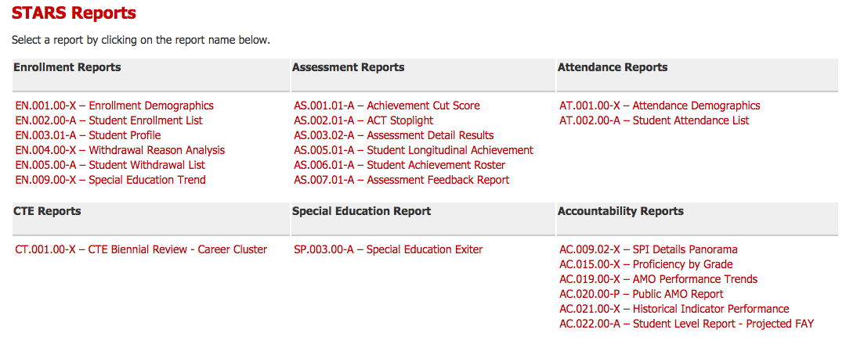
Identifying Factors that Contribute to Improvement School Status
Notes:
Thinking back to the general factors that contribute to improvement status, which include attendance, student achievement, graduation rate, and career and college readiness, you can see that SD-STARS (South Dakota Student Teacher Accountability and Reporting System) houses multiple reports that contain valuable information about factors that contribute to school improvement status. More information about SD-STARS is available on the DOE website

Slide 35
Identifying Factors that Contribute to Improvement School Status
Local Data Sources
Curriculum
Assessment
Instruction
Programs &
Structures
Professional Practices
Family & Community
Notes:
Districts and schools should also carefully examine local data sources as they pertain to curriculum, assessments, instructions, school programs and structures, family and community involvement, and professional practices such as teacher and principal evaluation in order to develop a clear picture of factors that contribute to school improvement status.

Slide 36
The South Dakota Framework for Teaching
Domain 1 PLANNING AND PREPARATION | Domain 2 THE CLASSROOM ENVIRONMENT
1a: Demonstrating Knowledge of Content and Pedagogy 1b: Demonstrating Knowledge of Students 1c: Setting Instructional Outcomes 1d: Demonstrating Knowledge of Resources 1e: Designing Coherent Instruction 1f: Designing Student Assessments | 2a: Creating an Environment of Respect and Rapport 2b: Establishing a Culture for Learning 2c: Managing Classroom Procedures 2d: Managing Student Behavior 2e: Organizing Physical Space
Domain 4 PROFESSIONAL RESPONSIBILITIES | Domain 3 INSTRUCTION
4a: Reflecting on Teaching 4b: Maintaining Accurate Records 4c: Communicating with Families 4d: Participating in a Professional Community 4e: Growing and Developing Professionally 4f: Showing Professionalism | 3a: Communicating with Students 3b: Using Questioning and Discussion Techniques 3c: Engaging Students in Learning 3d: Using Assessment in Instruction 3e: Demonstrating Flexibility and Responsiveness
NOT OBSERVABLE | OBSERVABLE
Teacher Controlled
Notes:
Let’s take another look at the Danielson components and think back to general factors that contribute to school improvement status: student achievement, attendance, graduation rate, and career and college readiness. As we begin to align Danielson components to factors that contribute to school improvement status, you will begin to notice that there are many overlaps between each area. Additionally, as each school district and attendance center is completely unique, a comprehensive data analysis will assist in aligning components based on factors that contribute to school improvement status and the justification of each component selected. Bottom line, the selected components must be meaningful to the staff and students at each school. With that in mind, the following suggestions are meant to serve as a guide through the component selection process. Finally, it is crucial to point out that all of the above components are teacher and/or school controlled. Many factors related to students are outside teacher control, but teachers and the districts for whom they work DO control the 22 components listed on the screen. Every teacher can make a choice to create an environment of respect and rapport or not; to be reflective in his/her practice or not; to use assessment data to drive instruction or not.

Slide 37
Component Selection Guidance for Schools in Improvement
Student Achievement-Curriculum
Domain 1 PLANNING AND PREPARATION | Domain 2 THE CLASSROOM ENVIRONMENT
1a: Demonstrating Knowledge of Content and Pedagogy 1b: Demonstrating Knowledge of Students 1c: Setting Instructional Outcomes 1d: Demonstrating Knowledge of Resources 1e: Designing Coherent Instruction 1f: Designing Student Assessments | 2a: Creating an Environment of Respect and Rapport 2b: Establishing a Culture for Learning 2c: Managing Classroom Procedures 2d: Managing Student Behavior 2e: Organizing Physical Space
Domain 4 PROFESSIONAL RESPONSIBILITIES | Domain 3 INSTRUCTION
4a: Reflecting on Teaching 4b: Maintaining Accurate Records 4c: Communicating with Families 4d: Participating in a Professional Community 4e: Growing and Developing Professionally 4f: Showing Professionalism | 3a: Communicating with Students 3b: Using Questioning and Discussion Techniques 3c: Engaging Students in Learning 3d: Using Assessment in Instruction 3e: Demonstrating Flexibility and Responsiveness
Notes:
This graphic shows all 22 Danielson components, divided into their 4 domains. We will now focus on components that might logically align to student achievement. There are valid arguments that would show that ALL 22 components would contribute to student achievement. For our component selection guidance today, we will narrow the scope and select components that might best align with student achievement as it pertains to curriculum, instruction, and assessment rather than other factors that contribute to school improvement. After identifying the selected components, the next slides will provide further information about the components selected.

Slide 38
Component Selection Guidance
Student Achievement-Curriculum
Domain 1: Planning & Preparation
1a: Demonstrating Knowledge of Content & Pedagogy
  Knowledge of content, structure of discipline, prerequisite relationships, content-related pedagogy
1c: Setting Instructional Outcomes
  Sequence, clarity, alignment, balance
1d: Demonstrating Knowledge of Resources
  Resources to extend content knowledge and pedagogy for classroom and student use
Notes:
The components in domain one that might align with curriculum as it pertains to student achievement are 1a, 1c, and 1d. It is important to consider the teachers at the school and confirm that they are experts in their content and are able to identify content related resources to use as they align their content in a way that is sequential and leads to student mastery.

Slide 39
Component Selection Guidance
Student Achievement-Curriculum
Domain 4: Professional Responsibilities
4e: Growing and Developing Professionally
  Enhancement of content knowledge and pedagogical skill
  Receptive to feedback from colleagues
  Service to the profession
Notes:
Teachers who demonstrate commitment to growing and developing professionally continue to seek knowledge, training, resources, and other content-area teachers for collaboration. Teachers committed to the professional work to develop a deeper understanding of their content and curriculum. Are your teachers participating in professional development opportunities, content related work groups like standards revision or local or statewide professional organizations? Are your teachers collaborating with content-related peers?

Slide 40
Component Selection Guidance for Schools in Improvement
Student Achievement-Instruction
Domain 1 PLANNING AND PREPARATION | Domain 2 THE CLASSROOM ENVIRONMENT
1a: Demonstrating Knowledge of Content and Pedagogy 1b: Demonstrating Knowledge of Students 1c: Setting Instructional Outcomes 1d: Demonstrating Knowledge of Resources 1e: Designing Coherent Instruction 1f: Designing Student Assessments | 2a: Creating an Environment of Respect and Rapport 2b: Establishing a Culture for Learning 2c: Managing Classroom Procedures 2d: Managing Student Behavior 2e: Organizing Physical Space
Domain 4 PROFESSIONAL RESPONSIBILITIES | Domain 3 INSTRUCTION
4a: Reflecting on Teaching 4b: Maintaining Accurate Records 4c: Communicating with Families 4d: Participating in a Professional Community 4e: Growing and Developing Professionally 4f: Showing Professionalism | 3a: Communicating with Students 3b: Using Questioning and Discussion Techniques 3c: Engaging Students in Learning 3d: Using Assessment in Instruction 3e: Demonstrating Flexibility and Responsiveness
Notes:
With an entire domain devoted to instruction, it is obvious that all the components are included in a discussion about how instruction drives student achievement. You will also notice that component 4a is highlighted.

Slide 41
Component Selection Guidance
Student Achievement-Instruction
Domain 3: Instruction
3a: Communicating with Students
  Expectations, directions, explanations of content, proper oral and written language and pedagogy
3b: Questioning & Discussion Techniques
  Quality of questions, variety of discussion techniques, student participation
3c: Engaging Students in Learning
  Activities, assignments, grouping, instructional materials, structure and pacing
Notes:
The components in domain three that might align with instruction as it pertains to student achievement are 3a, 3b, and 3c. Regardless of grade levels or content areas, high quality instruction is characterized by effective use of instructional techniques designed to engage students in active learning and differentiate to meet student needs.

Slide 42
Component Selection Guidance
Student Achievement-Instruction
Domain 3: Instruction
Domain 4: Professional Responsibilities
3d: Using Assessment in Instruction
  Assessment criteria, monitoring of student learning, feedback to students, student self-assessment
3e: Demonstrating Flexibility and Responsiveness
  Lesson adjustment, response to students, persistence
4a: Reflecting on Teaching
  Accuracy, use in future teaching
Notes:
Using assessment in instruction can fall in both the instruction and assessment categories. Are your teachers constantly taking the pulse of their students to check for understanding? Are they providing clear criteria of what is expected and providing feedback to students so the students can continue to grow academically? Are your teachers analyzing assessment data to make adjustments along the way and reflecting on what did or did not work in the classroom and making changes based on that information?

Slide 43
Component Selection Guidance for Schools in Improvement
Student Achievement-Assessment
Domain 1 PLANNING AND PREPARATION | Domain 2 THE CLASSROOM ENVIRONMENT
1a: Demonstrating Knowledge of Content and Pedagogy 1b: Demonstrating Knowledge of Students 1c: Setting Instructional Outcomes 1d: Demonstrating Knowledge of Resources 1e: Designing Coherent Instruction 1f: Designing Student Assessments | 2a: Creating an Environment of Respect and Rapport 2b: Establishing a Culture for Learning 2c: Managing Classroom Procedures 2d: Managing Student Behavior 2e: Organizing Physical Space
Domain 4 PROFESSIONAL RESPONSIBILITIES | Domain 3 INSTRUCTION
4a: Reflecting on Teaching 4b: Maintaining Accurate Records 4c: Communicating with Families 4d: Participating in a Professional Community 4e: Growing and Developing Professionally 4f: Showing Professionalism | 3a: Communicating with Students 3b: Using Questioning and Discussion Techniques 3c: Engaging Students in Learning 3d: Using Assessment in Instruction 3e: Demonstrating Flexibility and Responsiveness
Notes:
3d Using assessment in instruction can fit in both the instructional category as discussed on the previous slide, or in the planning category.

Slide 44
Component Selection Guidance
Student Achievement-Assessment
Domain 1: Planning
1f: Designing Student Assessments
  Congruence with instructional outcomes, uses criteria and standards, uses formative assessments, uses assessments to plan lessons that align to assessment criteria
Notes:
Designing assessments is a very complex skills. Assessments must align to standards, Webb levels, and mastery criteria expectations, Formative assessments should be brief enough to serve as a check for understanding. Summative assessments should be broad enough to indicate the mastery of a complete course or content area. Are your teachers accurately assessing what they are teaching? DO their assessments provide them with adequate data to make instructional decisions?

Slide 45
Component Selection Guidance for Schools in Improvement
Student Achievement-Attendance & Graduation Rate
Domain 1 PLANNING AND PREPARATION | Domain 2 THE CLASSROOM ENVIRONMENT
1a: Demonstrating Knowledge of Content and Pedagogy 1b: Demonstrating Knowledge of Students 1c: Setting Instructional Outcomes 1d: Demonstrating Knowledge of Resources 1e: Designing Coherent Instruction 1f: Designing Student Assessments | 2a: Creating an Environment of Respect and Rapport 2b: Establishing a Culture for Learning 2c: Managing Classroom Procedures 2d: Managing Student Behavior 2e: Organizing Physical Space
Domain 4 PROFESSIONAL RESPONSIBILITIES | Domain 3 INSTRUCTION
4a: Reflecting on Teaching 4b: Maintaining Accurate Records 4c: Communicating with Families 4d: Participating in a Professional Community 4e: Growing and Developing Professionally 4f: Showing Professionalism | 3a: Communicating with Students 3b: Using Questioning and Discussion Techniques 3c: Engaging Students in Learning 3d: Using Assessment in Instruction 3e: Demonstrating Flexibility and Responsiveness
Notes:
For our purposes, we will consider attendance and graduation rate together. Graduation rate could be aligned to curriculum, instruction, and assessment in situations where students have consistent attendance, but are not able to pass courses in order to meet state graduation requirements. Courses taught by teachers who are not skilled in their content areas and best practices in instruction can lead to student failure, apathy, poor attendance, loss of credit, and eventual drop out. it is likely that a school is identified for improvement status for graduation rate due to drop out percentages. The goal is for students to graduate with their age level cohort peers and graduate in 4 years. High schools with a low graduation rate will need to carefully analyze data to best determine what are the actual causes. it is likely that a school is identified for improvement status for graduation rate due to drop out percentages. The goal is for students to graduate with their age level cohort peers and graduate in 4 years. There are many factors outside the control of teachers and schools at play in poor attendance and low graduate rates.

Slide 46
Component Selection Guidance
Student Achievement-Attendance & Graduation Rate
Domain 1: Planning
Domain 4: Professional Responsibilities
1b: Demonstrating knowledge of students
  Knowledge of child and adolescent development
  Knowledge of the learning process
  Knowledge of students’ skills, knowledge, and language proficiency
  Knowledge of students’ interests and cultural heritage
  Knowledge of students’ special needs
4c: Communicating with Families
  Information about the instructional program
  Information about individual students
  Engagement of families in the instructional program
Notes:
Demonstrating knowledge of students is obviously key in high quality instruction, but it is also vital to developing relationships with students. Students who feel there are adults at school who care for them are more likely to have better attendance. Do your teachers make an effort to learn about their students’ interests and culture? Do your teachers gather enough knowledge about their students to provide instruction that is differentiated to best meet students’ needs? School and family partnerships are vital to student success. Families who feel included in their child’s education will often be more supportive of the educational program and strive to help their child reach her highest potential. Do your teachers reach out to families to share information about the instructional program and each child’s progress? Do your teacher reach out to families in a positive manner to share good news on a regular basis?

Slide 47
Component Selection Guidance
Student Achievement-Attendance & Graduation Rate
Domain 2: Classroom Environment
2a: Creating an Environment of Respect and Rapport
  Teacher interaction with students, student interaction with other students
2b: Establishing a Culture for Learning
  Importance of content, expectations for learning and achievement, student pride in work
2c: Managing Classroom Procedures
  Management of groups, transitions, materials, non-instructional duties, volunteers and paraprofessionals
Notes:
A well-managed classroom where students feel comfortable and confident in taking chances with their learning can facilitate student attendance. Do your teachers engage in respectful behavior with their students and expect students to behave respectfully with each other? Do your teachers communicate the importance of what they are teaching and stress high expectations for all students? Are the classrooms well-organized with little loss of instruction time during transitions or interruptions?

Slide 48
Component Selection Guidance
Student Achievement-Attendance & Graduation Rate
Domain 2: Classroom Environment continued
2d: Managing Student Behavior
  Expectations, monitoring of student behavior, response to student misbehavior
2e: Organizing Physical Space
  Safety and accessibility, arrangement of furniture and use of physical resources
Notes:
Managing student behavior and physical space can assist with creating a safe space for students. Do teachers clearly state expectations of student behavior and respond consistently and without sarcasm or favoritism in instances of student misbehavior? Does school staff maintain a clean and orderly facility? Are furniture and physical resources arranged and/or stored safely?

Slide 49
Component Selection Guidance for Schools in Improvement
Student Achievement-Career & College Readiness
Domain 1 PLANNING AND PREPARATION | Domain 2 THE CLASSROOM ENVIRONMENT
1a: Demonstrating Knowledge of Content and Pedagogy 1b: Demonstrating Knowledge of Students 1c: Setting Instructional Outcomes 1d: Demonstrating Knowledge of Resources 1e: Designing Coherent Instruction 1f: Designing Student Assessments | 2a: Creating an Environment of Respect and Rapport 2b: Establishing a Culture for Learning 2c: Managing Classroom Procedures 2d: Managing Student Behavior 2e: Organizing Physical Space
Domain 4 PROFESSIONAL RESPONSIBILITIES | Domain 3 INSTRUCTION
4a: Reflecting on Teaching 4b: Maintaining Accurate Records 4c: Communicating with Families 4d: Participating in a Professional Community 4e: Growing and Developing Professionally 4f: Showing Professionalism | 3a: Communicating with Students 3b: Using Questioning and Discussion Techniques 3c: Engaging Students in Learning 3d: Using Assessment in Instruction 3e: Demonstrating Flexibility and Responsiveness
Notes:
The components highlighted here as impacting career and college readiness will already be familiar, as they have been previously discussed during this module as part of curriculum and instruction. In order for students to be career and college ready, they need to engage in a rigorous curriculum and high quality instruction. Are the students in your school challenged with rigorous curriculum and coursework that will best prepare them to be career and college ready? Are protocols in place to assist students with creating a personal learning plan that maps out their high school schedules and coursework that will support their post-secondary plans? Do teachers set high expectations for all students?

Slide 50
Artifact Selection
Notes:
We will now transition from component selection guidance to artifact selection guidance.

Slide 51
The South Dakota Framework for Teaching
Domain 1 PLANNING AND PREPARATION | Domain 2 THE CLASSROOM ENVIRONMENT
1a: Demonstrating Knowledge of Content and Pedagogy 1b: Demonstrating Knowledge of Students 1c: Setting Instructional Outcomes 1d: Demonstrating Knowledge of Resources 1e: Designing Coherent Instruction 1f: Designing Student Assessments | 2a: Creating an Environment of Respect and Rapport 2b: Establishing a Culture for Learning 2c: Managing Classroom Procedures 2d: Managing Student Behavior 2e: Organizing Physical Space
Domain 4 PROFESSIONAL RESPONSIBILITIES | Domain 3 INSTRUCTION
4a: Reflecting on Teaching 4b: Maintaining Accurate Records 4c: Communicating with Families 4d: Participating in a Professional Community 4e: Growing and Developing Professionally 4f: Showing Professionalism | 3a: Communicating with Students 3b: Using Questioning and Discussion Techniques 3c: Engaging Students in Learning 3d: Using Assessment in Instruction 3e: Demonstrating Flexibility and Responsiveness
NOT OBSERVABLE | OBSERVABLE
Notes:
Remember that Domains 1 and4 are considered the unobservable domains. Therefore, artifacts must be used to demonstrate proficiency in the components selected from these 2 domains. EVALUATING PRACTICE USING EVIDENCE PROVIDED BY ARTIFACTS
Professional practice evaluations also require the consideration of evidence that cannot be collected through classroom observation. Components that are not observable are supported by the collection of artifacts. Artifacts are documents, materials, processes, strategies, and other information that demonstrate performance relative to a component of professional teaching practice. It is up to the teacher and his or her evaluator to determine how artifacts will be collected. To ensure expectations are established and artifact collection is focused, evaluators and teachers should discuss which artifacts support the evaluation. In many cases, artifacts stem from a teacher’s day-to-day work and teachers do not need to create documentation specifically to support the evaluation process.

Slide 52
Rubric-based Evaluation
All supporting evidence is evaluated against clear, common rubrics.
Domain 1 PLANNING AND PREPARATION |  | Domain 2 THE CLASSROOM ENVIRONMENT
Domain 4 PROFESSIONAL RESPONSIBILITIES |  | Domain 3 INSTRUCTION
PERFORMANCE RUBRICS Describes performance on each component along a continuum of performance
UNSATISFACTORY | BASIC | PROFICIENT | DISTINGUISHED
Notes:
Please also note that whether observable or unobservable, each of the 22 components have an accompanying standards-based rubric. It is recommended that evaluators and teachers review these rubrics prior to identifying agreed upon artifacts, as these artifacts will be scored using the rubrics. Just as there are varying levels of performance in instruction, there are varying performance levels to be demonstrated with artifacts.

Slide 53
Domain 1
1a: Knowledge of Content and Pedagogy 1b: Knowledge of Students 1c: Setting Instructional Outcomes 1d: Knowledge of Resources 1e: Designing Coherent Instruction 1f: Designing Student Assessments
Possible Artifacts
Lesson Plans Curriculum Maps SLO Process Guide Student Portfolios Teacher created instructional materials Pacing Guides Formative and Summative Assessments
Notes:
This is a short list of possible artifacts for the components of domain 1. A list of additional suggested artifacts may be found on the DOE website and in the TE handbook. The key is to review the component rubrics as well as the rubric descriptions and critical attributes provide additional ideas for possible artifacts. Choosing components and artifacts that support the work of teachers that is already in place strengthen the work of the component.
It is also important to note that parts of the SLO process guide have been aligned to the Danielson components as a means of emphasizing how professional practices and student growth complement each other and to highlight how the SLO process guide can be used as an artifact for multiple components.
SLOs as Artifacts
The SLO process reflects recommended practices aligned to the South Dakota Framework for Teaching. The SLO Process Guide and other SLO resources are powerful artifacts that can be used as evidence of teaching performance relative to non-observable state teaching standards (Domains 1 and 4). As guidance for districts working to create efficiencies in

Slide 54
Domain 4
4a. Reflecting on Teaching 4b. Maintaining Accurate Records 4c. Communicating with Families 4d. Participating in a Professional Community 4e. Growing and Developing Professionally 4f. Showing Professionalism
Possible Artifacts
Self-Assessments Self-Scoring evaluations Post-evaluation conference forms District employee related paperwork SLO Process Guide Website, newsletter, contact logs Committee and volunteer work Professional development Service to students
Notes:
NOTE: Script is the same as slide 31 – these two slides must be used together…
This is short list of possible artifacts for the components of domain 1. A list of additional suggested artifacts may be found on the DOE website and in the Teacher Effectiveness handbook. The key is to review the component rubrics as well, as the rubric descriptions and critical attributes provide additional ideas for possible artifacts.
Selecting components and artifacts that support the work that teachers are already doing strengthens the work of the component. It is also important to note that parts of the SLO process guide have been aligned to the Danielson components as a means of emphasizing how professional practices and student growth complement each other and to highlight how the SLO process guide can be used as an artifact for multiple components.
SLOs as Artifacts
The SLO process reflects recommended practices aligned to the South Dakota Framework for Teaching. The SLO Process Guide and other SLO resources are powerful artifacts that can be used as evidence of teaching performance relative to non-observable state teaching standards (Domains 1 and 4). As guidance for districts working to create efficiencies in artifact collection, the steps within the SLO Process Guide have been aligned to components of the South Dakota Framework for Teaching.

Slide 55
Module 3 :
Teacher Effectiveness System
Component & Artifact
Selection Guidance for Schools in Improvement
Notes:
Module 3 in the TE System will briefly share recommendations for both component and accompanying artifact selection. It is imperative to note that districts are encouraged to select components and artifacts which best represent local goals and priorities. The following information is meant to be used as a recommendation only.

Slide 57
Module 4 :
Teacher Effectiveness System
Aligning Student Learning Objectives to Improvement Efforts
Notes:
Module 4 will give guidance on aligning student learning objectives or SLOs as they are commonly referred to improvement efforts.
The complex task of connecting teaching performance to student academic outcomes is best handled closest to the student, which is why the SLO process asks teachers to identify and address the unique learning needs of all students. A Summative Teacher Effectiveness Rating is based in part on student growth, which is defined as a positive change in achievement between two or more points in time. SLOs contribute to the Summative Teacher Effectiveness Rating and provide another mechanism to generate feedback that guides professional growth.
More detailed information about SLOs can be found on the DOE website including modules specific to how to use the SLO process guide and how to develop different types of SLOs. Additional guidance on assessments is also on the website.

Slide 58
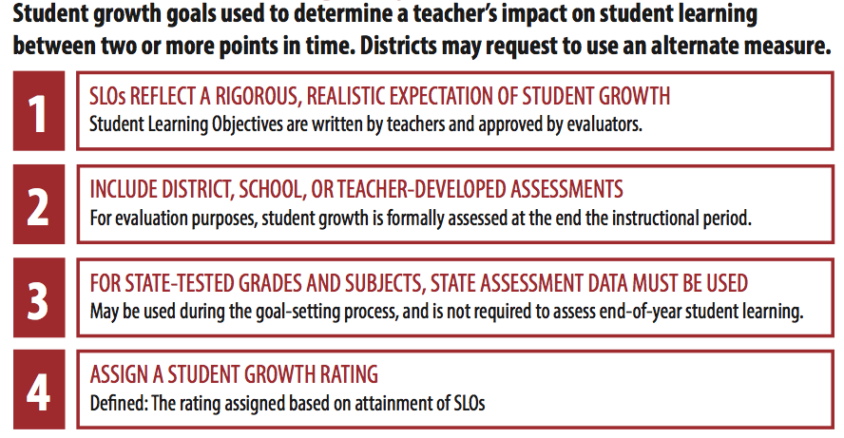
Student Learning Objectives (SLOs)
Notes:
A Student Learning Objective is a process by which a teacher establishes expectations for student growth during a specified period of time. Specific, measurable student growth goals are based on student learning needs and aligned to applicable content standards. At the end of the instructional period, the teacher’s Student Growth Rating is determined by the progress toward documented goals.

Slide 59
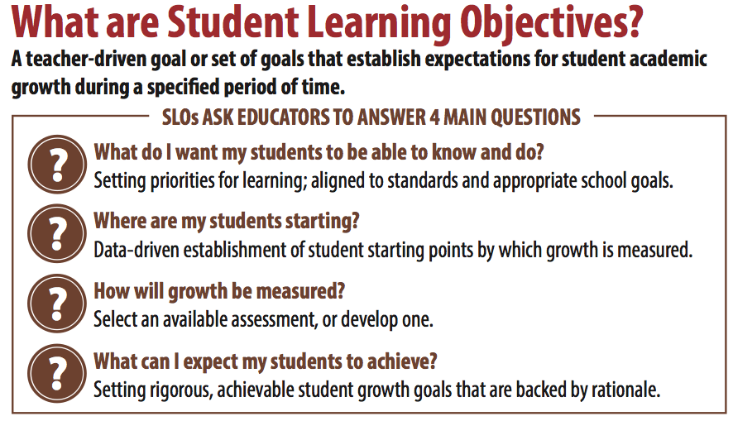
What are Student
Learning Objectives
Notes:
A Student Learning Objective is a process by which a teacher establishes expectations for student growth during a specified period of time. Specific, measurable student growth goals are based on student learning needs and aligned to applicable content standards. At the end of the instructional period, the teacher’s Student Growth Rating is determined by the progress toward documented goals.
The SLO process begins with the important task of attaching structure to student learning expectations. Through SLO development, teachers answer four key questions:
• What do I most want my students to know and be able to do?
Answering this question helps the teacher identify the core concepts and standards that will be addressed by the SLO.
• Where are my students starting?
Answering this question involves gathering and analyzing data to establish student baseline knowledge.
• What assessments are available?
Answering this question leads to the selection or development of an appropriate assessment to measure student growth and goal attainment.
• What can I expect my students to achieve?
Answering this question leads to the development of a student growth goal and a strong rationale statement supporting why the goal is appropriate for the instructional period.

Slide 60
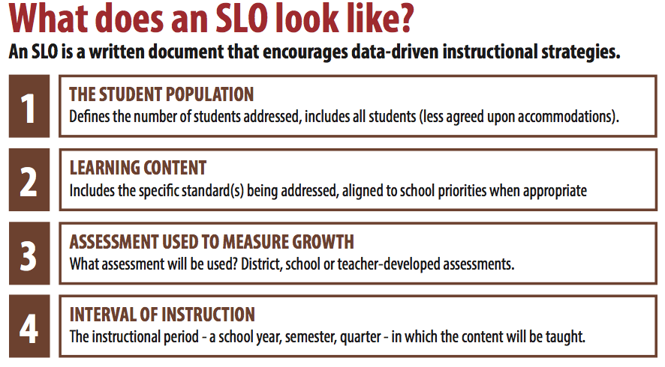
What Does an SLO look like?
Notes:
SLOs follow the SD SLO Process Guide. SLO Process Guide resources including a sample process guide, SLO and assessment quality checklists, and SLO handbook can be found on the DOE website.
Step 1 in the process is to develop the SLO by identifying the student population, the learning content and standards that will be achieved through the SLO, the assessment to be used to measure growth, and the interval of instruction-the agreed upon time between pre and post assessment.

Slide 61
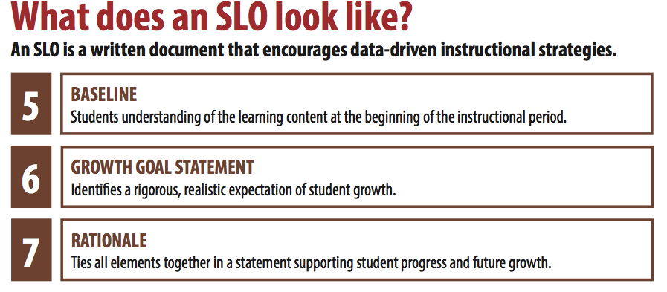
What does an SLO look like?
Notes:
The SLO development continues with a review of available data sources to establish students’ strengths and weaknesses regarding selected content at the beginning of the instructional period and administration of the selected SLO assessment in order to gather pre-assessment scores. Once pre-assessment scores have been analyzed, teachers can set a realistic and rigorous amount of growth to occur between the pre and post assessment time period. The rationale statement defines the purpose of the selection of the SLO content and standards and how the growth goals were developed.

Slide 62
Identifying Factors that Contribute to School Improvement Status
Elementary/Middle Schools
High Schools
Student Achievement
Attendance
Academic Growth
(added in 2015-16)
Student Achievement
Graduation Rate
Career & College Readiness
Why are we here?
Notes:
As in the previous module, the first step in aligning student learning objectives to improvement efforts is to complete a comprehensive data analysis to determine areas for growth. Simply put, what factors led to the status of being placed in school improvement? Because student learning objectives are specifically academic in nature, it makes sense to carefully review student achievement data.

Slide 63
Identifying Factors that Contribute to Improvement School Status
https://doestars.sd.gov
Notes:
SD-STARS (South Dakota Student Teacher Accountability and Reporting System) is the statewide longitudinal data system. This online data system is available to all SD school district personnel and houses multiple data sources in one place to facilitate systematic data analysis and identifying factors that could contribute to improvement school status. SD-STARS also houses each district and school’s accountability data, including School Performance Index, AMOs, and other district statistical data in one convenient location.

Slide 64
Identifying Factors that Contribute to Improvement School Status
Notes:
Thinking back to the general factors that contribute to improvement status, which include attendance, student achievement, graduation rate, and career and college readiness, you can see that SD-STARS (South Dakota Student Teacher Accountability and Reporting System) houses multiple reports that contain valuable information about factors that contribute to school improvement status. More information about SD-STARS is available on the DOE website.

Slide 65
Identifying Factors that Contribute to Improvement School Status
Local Data Sources
Curriculum
Assessment
Instruction
Programs &
Structures
Professional Practices
Family & Community
Notes:
Districts and schools should also carefully examine local data sources as they pertain to curriculum, assessments, instruction, school programs and structures, family and community involvement, and professional practices such as teacher and principal evaluation in order to develop a clear picture of factors that contribute to school improvement status. Consider statewide assessment data like State Math and ELA Assessments, WAP-T and ACCESS for EL students, and DSTEP for science, as well as local assessment data like benchmark assessments, commercially purchased assessments, semester tests, ACT scores, grades and/or GPA, etc.

Slide 66
Aligning SLOs to Improvement Efforts
trends
Are there any discernible trends in strengths and weaknesses?
Across grade levels? Content areas? Standards?
standards
What standards , claims, or targets encompass the areas of concern?
What curriculum and materials are usually used to teach these standards?
instruction
What instructional strategies are generally used to teach this content?
Does the instruction match the expectation of the standards and how they will be assessed?
Notes:
After carefully reviewing multiple data sources pertaining to student achievement, teachers and administrators can begin to make decisions about aligning SLOs to improvement efforts. Once the above questions are answered, teachers can begin to develop their SLOs to align to student needs. The next few slides will demonstrate a very simple process to review SBAC data as one piece of evidence to be used in aligning SLOs to improvement efforts.

Slide 67
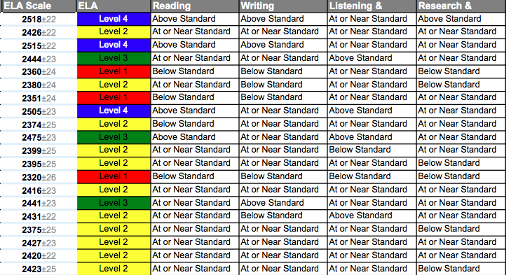
Aligning SLOs to Improvement Efforts
One Data Source: SBAC
Notes:
It is important for all school staff to review various sources of student achievement data. This slide is an example of an ELA SBAC assessment feedback report found in SD-STARS. As you can see, this report includes the scale score, the achievement levels 1, 2, 3, 4 that is also color-coded, and how each student scored in the 4 ELA claims of reading, writing, listening, and research. One possible step might be to analyze the performance of the students in each of the claims. Is there one claim where more students were below standard or at or near standard? Is there one claim where more students were above standard?

Slide 68
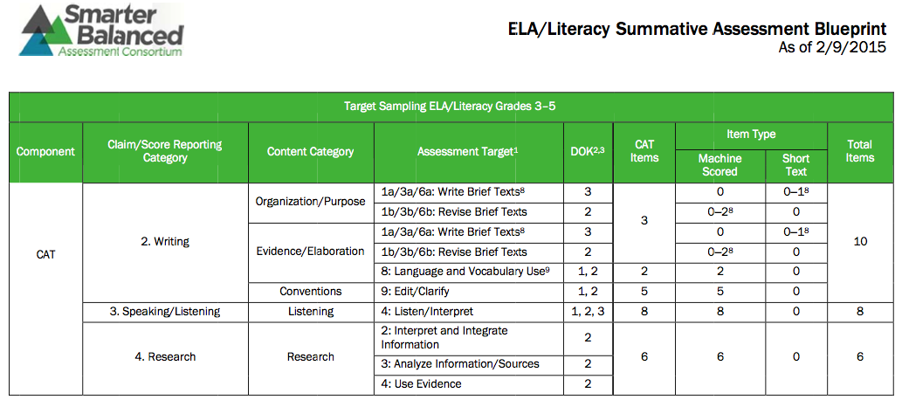
Aligning SLOs to Improvement Efforts
One Data Source: SBAC Blueprints
http://doe.sd.gov/octe/SMARTERbalanced.aspx
Notes:
Perhaps you have determined that there is one claim where students are consistently below grade level. In order to dig deeper into the claim and review what is assessed, the SBAC blueprints provide further information. The SBAC blueprints can be found on the DOE website under the assessment page. Blueprints are available for both ELA and math and for all grade levels tested. Each blueprint has a breakdown of each claim. This slide is showing the breakdown of the writing, speaking/listening, and research claims. We can see the learning targets assessed, the Depth of Knowledge or Webb level of each question, the number of questions, and how each question will be scored. Aligning the targets from the blueprint to the ELA standards will assist teachers in developing a standards-based SLO that aligns to efforts to increase student achievement.

Slide 69
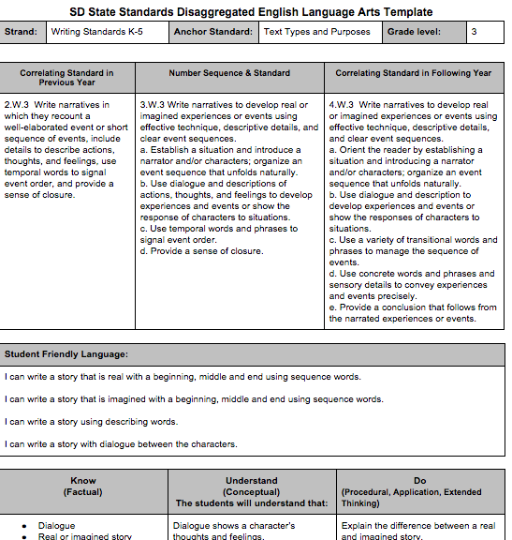
Aligning SLOs to Improvement Efforts
One Data Source:
SD Disaggregated Standards
Notes:
An additional resource in developing a standards based SLO are the SD Disaggregated standards for ELA and math. The disaggregated standards can be helpful in defining what is expected of the students, how to share it in student-friendly language, and what students will be expected to know, understand, and do for each standard. Also included is key vocabulary. Full text of the disaggregated standards can be found on at sdccteachers.k12.sd.us

Slide 70
Module 4 :
Teacher Effectiveness System
Aligning Student Learning Objectives to Improvement Efforts
Notes:
This concludes the Module 4 aligning student learning objectives or SLOs as they are commonly referred, to improvement efforts.
More detailed information about SLOs can be found on the DOE website including modules specific to how to use the SLO process guide and how to develop different types of SLOs. Additional guidance on assessments, SD-STARS, data analysis, and standards can also on the website.

Slide 72
Module 5 :
Teacher Effectiveness System
Summative Growth Rating
Notes:
The final module in the TE system series will demonstrate how the summative TE ratings can be derived from combining the Professional Practices Rating and Student Growth Rating using a unique matrix system. The overall Summative Teacher Effectiveness Rating differentiates Teacher Effectiveness into one of three performance categories: Below Expectations, Meets Expectations, or Exceeds Expectations.
Combining the two ratings into a Summative Teacher Effectiveness Rating is no longer required, though.

Slide 73
Summative Effectiveness Rating Scoring Matrix
(Optional)
 |  | PROFESSIONAL PRACTICE RATING
 |  | UNSATISFACTORY | BASIC | PROFICIENT | DISTINGUISHED
STUDENT GROWTH RATING | HIGH
 | EXPECTED
 | LOW
Notes:
USING A MATRIX MODEL TO DETERMINE SUMMATIVE TEACHER EFFECTIVENESS RATINGS
The recommended matrix model does not rely on uniform, prescriptive formulas to calculate a Summative Teacher Effectiveness Rating. Instead, the matrix guides the assignment of the Summative Teacher Effectiveness Rating while providing opportunities for professional judgment to be exercised.
Professional Practice and Student Growth Ratings are represented in the columns and rows of the matrix. The Summative Teacher Effectiveness Rating, determined by the intersection of the two individual ratings, translates into one of three required performance categories.
The physical construction of the recommended Summative Rating Matrix reflects the emphasis placed on professional practice evaluations. A closer examination of all 12 areas of intersection reinforces the priority placed on professional practice evaluations. For example, a teacher earning a Professional Practice Rating of Proficient or Distinguished is, by default, assigned a Summative Teacher Effectiveness Rating of at least Meets Expectations.

Slide 74
Summative Effectiveness Rating Scoring Matrix
(Optional)
 |  | PROFESSIONAL PRACTICE RATING
 |  | UNSATISFACTORY | BASIC | PROFICIENT | DISTINGUISHED
STUDENT GROWTH RATING | HIGH
 | EXPECTED
 | LOW
Notes:
This view highlights the student growth rating which is delineated by the rows running left to right. There are three categories of student growth: Low, Expected, and High. The student growth rating is based on the percentage of goal attainment as explained in previous modules.
Student Growth as One Significant Factor
The design of the recommended Summative Rating Matrix assigns significance to student growth measures while maintaining focus on evaluations relative to professional practices based on the South Dakota Framework for Teaching. Student growth remains a key piece of the system, as no educator receiving the lowest Student Growth Rating can receive the highest Summative Teacher Effectiveness Rating within the system.

Slide 75
Scoring Matrix
(Optional)
 |  | PROFESSIONAL PRACTICE RATING
 |  | UNSATISFACTORY | BASIC | PROFICIENT | DISTINGUISHED
STUDENT GROWTH RATING | HIGH
 | EXPECTED
 | LOW
SUMMATIVE TEACHER EFFECTIVENESS RATING CATEGORIES
BELOW EXPECTATIONS | MEETS EXPECTATIONS | EXCEEDS EXPECTATIONS
Notes:
Examining the placement of the colored square within the matrix and comparing that to the rating categories key below the graphic, we can see that a summative score that falls in the pink boxes is a below expectations rating, a score that falls in the gray boxes is a meets expectations rating, and a score that falls in the royal blue boxes is an exceeds expectations rating.
Please note that earning the lowest or highest score in either professional practices or student growth does not automatically indicate a low or high summative rating. Both parts play a role in the summative score.
The graphic shows a simple example of using the scoring matrix to identify a summative score. In this example, we see that the professional practices rating of proficient was earned, and the student growth rating of expected was achieved. We can simply intersect the two points to indicate this teacher earned a rating of meets expectations.

Slide 76
Teacher A
 |  | PROFESSIONAL PRACTICE RATING
 |  | UNSATISFACTORY | BASIC | PROFICIENT | DISTINGUISHED
STUDENT GROWTH RATING | HIGH
 | EXPECTED
 | LOW
SUMMATIVE TEACHER EFFECTIVENESS RATING CATEGORIES
BELOW EXPECTATIONS | MEETS EXPECTATIONS | EXCEEDS EXPECTATIONS
Notes:
For example….
Teacher A has been observed and demonstrated proficiency in professional practice ratings, and has artifacts/evidence that support a Proficient level of performance according to The SD Framework (Danielson).
SLO’s are set, monitored and “Expected” growth is achieved.
The two measures are applied to the matrix and where the two meet indicate “Meets Expectations” Rating for Teacher A.

Slide 77
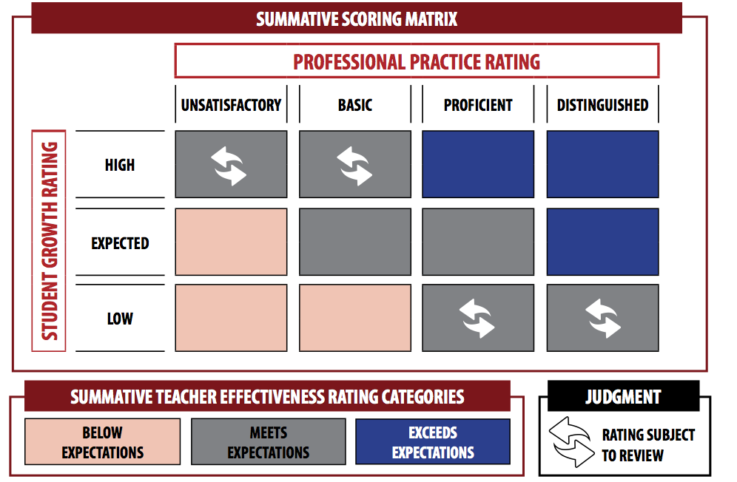
Scoring Matrix
Notes:
EXERCISING PROFESSIONAL JUDGMENT TO ADJUST TEACHER EFFECTIVENESS RATINGS
The Summative Rating Matrix embeds opportunities for professional judgment to play a role in the assignment of a Summative Teacher Effectiveness Rating. In the four areas in which one rating is very high and another rating is very low, individual ratings are reviewed to ensure the rating is fair and accurate based on all evidence collected. The teacher and evaluator may agree that additional evidence may be required, and Summative Teacher Effectiveness Ratings can be adjusted if it is determined that the outcome misrepresents teaching performance.
Supporting Professional Judgment with Evidence and Documentation
High quality implementation of the South Dakota Teacher Effectiveness System is intended to establish a firm connection between instructional practice and student academic outcomes. Exercising professional judgment should be rare; reserved only for situations in which the body of evidence clearly demonstrates that a Summative Teacher Effectiveness Rating is not truly reflective of teaching performance. When professional judgment is exercised, principals include evidence and rationale in narrative form along with the summative results. If a teacher ultimately disagrees with a principal’s use of professional judgment, teachers supply evidence and accompanying narrative to accompany the summative results.
Tracking the Use of Professional Judgment
High quality implementation of the South Dakota Teacher Effectiveness System requires public school districts to track the number of times professional judgment is exercised. The data may be used to document any needed revisions or changes to the district’s policies, practice, or procedures.

Slide 78
Teacher B
 |  | PROFESSIONAL PRACTICE RATING
 |  | UNSATISFACTORY | BASIC | PROFICIENT | DISTINGUISHED
STUDENT GROWTH RATING | HIGH
 | EXPECTED
 | LOW
Judgment
Rating Subject
To Review
SUMMATIVE TEACHER EFFECTIVENESS RATING CATEGORIES
BELOW EXPECTATIONS | MEETS EXPECTATIONS | EXCEEDS EXPECTATIONS
Judgment
Rating Subject
To Review
Notes:
Another example.
Teacher A has less than great observations, and has artifacts/evidence that support an Unsatisfactory level of performance according to The SD Framework (Danielson).
SLOs are set, monitored and “High” growth is achieved.
The two measures are applied to the matrix and this teacher too falls under “Meets Expectations” Rating for Teacher B
The rating falls under the two top/right cells, therefore it is a rating that is “subject to review” and open for a judgment call from the teacher’s administrator.

Slide 79
Teacher C
 |  | PROFESSIONAL PRACTICE RATING
 |  | UNSATISFACTORY | BASIC | PROFICIENT | DISTINGUISHED
STUDENT GROWTH RATING | HIGH
 | EXPECTED
 | LOW
Judgment
Rating Subject
To Review
SUMMATIVE TEACHER EFFECTIVENESS RATING CATEGORIES
BELOW EXPECTATIONS | MEETS EXPECTATIONS | EXCEEDS EXPECTATIONS
Judgment
Rating Subject
To Review
Notes:
Another example.
Teacher C has fantastic observations, and has artifacts/evidence that support a Distinguished level of performance according to The SD Framework (Danielson).
SLOs are set, monitored and “low” growth is achieved. (This may be a very low achieving group of students…or perhaps the “Distinguished” rating is a bit inflated?)
The two measures are applied to the matrix and this teacher also falls under “Meets Expectations” Rating for Teacher C.
The rating falls under the two bottom/right cells, therefore it is a rating that is “subject to review” and open for a judgment call from the administrator.
In the final analysis, if the Professional Practice Rating and the Student Growth Rating are two totally opposite ratings….the administrator may choose to make a judgment call on the teachers summative rating.

Slide 80
Determining Teacher Effectiveness
Using multiple measures of professional practice and student learning
South Dakota Framework for Teaching
Student Growth
Domain 1
Domain 2
Domain 3
Domain 4
Teacher Effectivenesss
Teacher Effectivenesss
Planning and Preparation
Classroom Environment
Instruction
Professional Responsibilities
District Assessments
Evaluator-Approved Assessments
Classroom Observations and Evidence of Effective Practice
Components from Each of the 4 Domains
At Least 8 Components Chosen Based on District or School Priorities
Professional Practice Rating
Growth Rating
Summative Rating Matrix
Professional Oversight: Is the rating fair and accurate based on the evidence
and data shared by the teacher
Differentiated Performance Categories
Below Expectations
Meets Expectations
Exceeds Expectations
Notes:
It is fitting to conclude our series of TE system modules with another view of this graphic, which depicts all parts of the system from professional practices and SLOs to ratings and summative differentiated performance categories. Additional TE resources can be found on the DOE website. Thank you!

