Slide 1

Teacher Effectiveness and Special Education
Notes:
The purpose of this module is to assist Special Education teachers and administrators in understanding the Teacher Effectiveness framework, including the four domains and the SLO process, from a Special Education perspective.

Slide 2
Content Overview
Review of Teacher Effectiveness System for ALL teachers
Special Education Law Considerations
SLO Process Guide
If possible, have a copy of your most recent SLO.
Notes:
Welcome to SLO Module _: SLOs for Special Educators!
During this online module, we will analyze similarities and potential differences found within the South Dakota Teacher Effectiveness system. With the help of this module you will be able to identify how the Teacher Effectiveness System can help support special education teachers in measuring student outcomes, while focusing on continuous improvement in your instructional practices.
We will start with a brief review of the Teacher Effectiveness System for all teachers, touching on differences a special education teacher may find within the South Dakota Framework for Teaching. Next, we will look at considerations within special education law that may affect the information included in your SLO. We will conclude our module by examining similarities and differences that may be found in completing the SLO process guide. If you have recently completed the SLO process guide, you may find it helpful to review and reflect on that as we go through this section of the module.
It is recommended that you complete (*name introductory module[s]*) before completing this module. This will provide you a foundational understanding of the entire Teacher Effectiveness System, and will help you to better understand the contents of this module.

Slide 3
Teacher Effectiveness System Review
Notes:
Let’s begin with a brief overview of the Teacher Effectiveness System

Slide 4
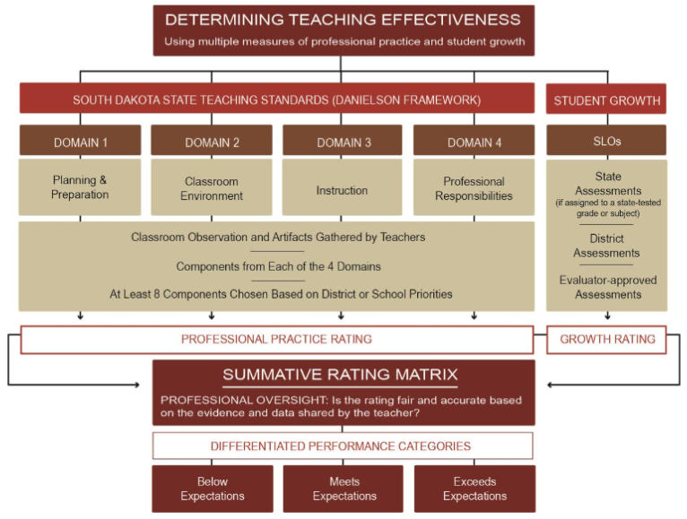
Notes:
Here you see the components included in the Teacher Effectiveness System. Remember, the Teacher Effectiveness System is made up of two components (CLICK), the SD Framework for Teaching (CLICK), and SLOs for student growth. Data from both components are collected and combined in the Summative Rating Matrix (CLICK) to determine a teacher’s performance category.
No matter what the needs are of the students you teach, these components remain in effect. Later on, we will take a look at some specific elements within each piece that may be different for Special Education teachers.

Slide 5
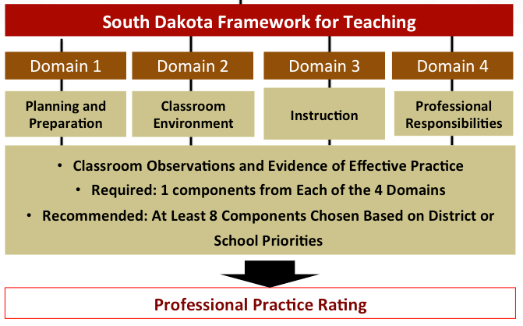
Summative Scoring Matrix
Notes:
Let’s take a closer look at the first component – the South Dakota Framework for Teaching.
The SD Framework for Teaching is comprised of four domains. Each domain includes components related to effective teaching practices. Within the SD Framework for Teaching, districts decide which components to focus on. At a minimum, districts must choose 4 components, with one from each domain. One difference you may notice in the evaluation process is in the assignment of your evaluator. Districts may choose to have special education teachers evaluated by the principal, special education director, or a combination of the two. For more information on who your evaluator may be, contact your school principal or special education director.
Regardless of your teaching assignment, all teachers in a district will follow the same evaluation process identified by your district leadership and receive a Professional Practice rating from the same Summative Scoring Matrix (CLICK) seen here.

Slide 6

Another Helpful Resource
https://www.danielsongroup.org/special-education/
Notes:
Because a special education classroom can look very different from a general education classroom, it can be challenging to understand how the components from each domain in the SD Framework for Teaching can be evaluated in the unique setting of a special education classroom.
To support the professional practice of those working with students with special needs, the Danielson Group has created “Special Ed Scenarios” – a document with extended examples of practice for each component across all four levels of performance.
You can find the “Special Ed Scenarios” document at the website danielsongroup.org.

Slide 7
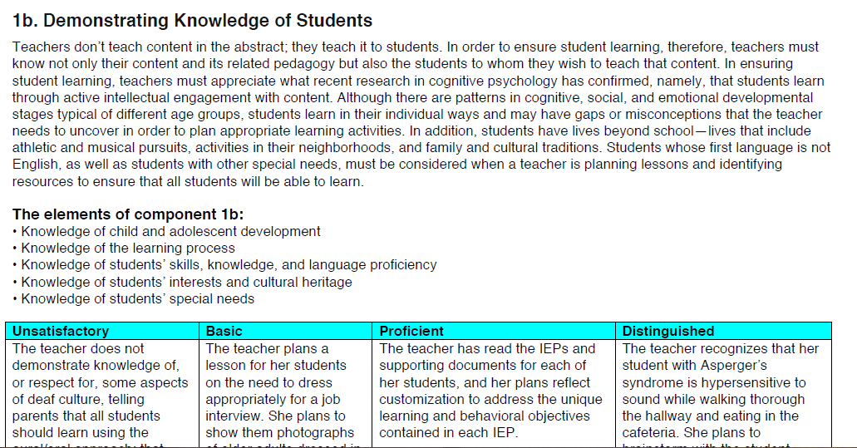
A Peek inside “Special Ed Scenarios”
Component description and elements remain the same
Levels of Performance are Special Ed - specific
Notes:
Let’s take a look at one page from the “Special Ed Scenarios” document. This page looks at Component 1B: Demonstrating Knowledge of Students
(CLICK) You will notice that the description of the component and the elements of the component are exactly the same as what you would find in the SD Framework for Teaching.
(CLICK) The main difference is found in the descriptions for each level of performance. Each description is specific to a special education environment.
Special education-specific examples are given for each level of performance for Domains 1 and 4. For Domains 2 and 3 (also known as the observable domains), the examples are expanded to include specific scenarios that align with several disability categories. It is important to remember that these examples DO NOT replace the rubric used for evaluation of each component, and may not reflect every possible teaching situation for every special education teacher.
Both special education teachers, and their evaluators, have found the “Special Ed Scenarios” document to be a helpful tool in reflecting on what effective teaching looks like with different students and within different educational environments.

Slide 8
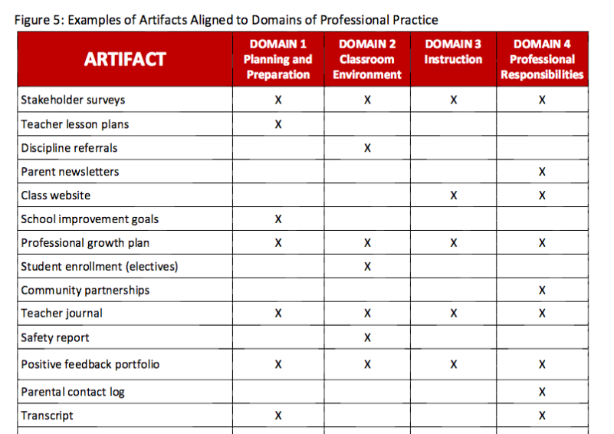
Collecting Artifacts
Notes:
Throughout the school year, teachers can collect artifacts that demonstrate performance relative to district-identified components from each domain. Artifacts can include any documents, photographs, reports, or other information related to a teacher’s instruction, preparation, or professional growth.
On page 19 of the Teacher Effectiveness Handbook, you will find some broad examples of artifacts that can be collected for each of the 4 Domains of Professional Practice. If you are looking for general ideas on what artifacts to collect, this is a good starting point. You can find the Teacher Effectiveness handbook on the South Dakota DOE website.

Slide 9
Special Education Artifact Ideas
Domain 1 (Planning and Preparation) Transcript from SPED-related coursework Documentation of using student assessment results to create goals | Domain 2 (Classroom Environment) Photograph of students’ visual schedule Individualized behavior plan Documentation of planning/prep with paraprofessionals
Domain 4 (Professional Responsibilities) Results from annual parent surveys (Indicator 8) Documentation of membership/participation in professional SPED organizations Agenda from SPED-related trainings | Domain 3 (Instruction) IEP Progress Monitoring Parent Prior Notices Parent Goal Progress Reports
Notes:
While the general examples from the Teacher Effectiveness Handbook may give you a general place to start, some of the artifacts you collect as a special education teacher may be a little different, and will reflect tasks, activities, and documentation unique to your teaching assignment.
Here are some examples that may be collected by a special education teacher.
Take a moment to review the examples in this table. Which of these examples would be beneficial in your teaching situation? Can you think of any other examples not included in this chart?
(short pause)

Slide 10
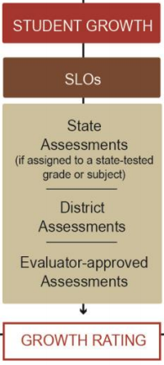
Notes:
Now, let’s take a look at the second component of the Teacher Effectiveness System (CLICK) – SLOs and student growth.

Slide 11
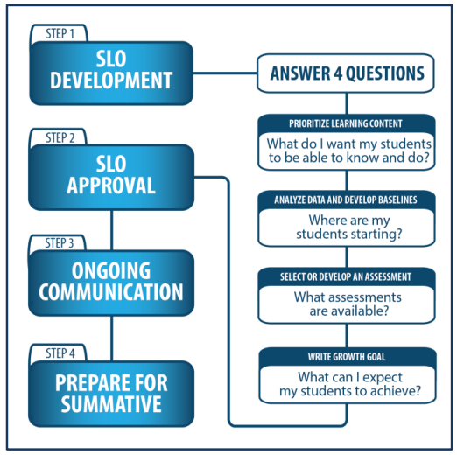
SLO Process
Low Growth: Growth goal is less than 65% attained.
Expected Growth: Growth goal is 65%-85% attained.
High Growth: Growth goal is 86% to 100% attained.
Notes:
As part of the SD Framework for Teaching, all teachers will develop at least one SLO to evaluate student growth each school year. All teachers will follow the same steps in SLO development, and will use the same four guiding questions. Growth is also calculated in the same way, using the same percentages for each level of growth.

Slide 12
Special Education Law and Guiding Principles
Notes:
Before you begin considering how to write your SLO, it’s important to keep in mind that federal and state regulations for special education place an emphasis on ensuring students with disabilities have access to and participate in the general education curriculum. Let’s take a look at some principles that can guide your SLO development.

Slide 13
SPED Law/ Guiding Principles
SLOs should support the participation of students with disabilities in the general education curriculum to the maximum extent possible.
SLOs should be developed in a way that holds all teachers accountable for the academic growth of students with disabilities.
ARSD 24:05:13:02 Free Appropriate Public Education
ARSD 24:05:27:01.03(2)(a)
Notes:
First, SLOs should support the participation of students with disabilities in the general education curriculum to the maximum extent possible. Second, SLOs should be developed in a way that holds all teachers accountable for the academic growth of students with disabilities.
The next several slides will review considerations for writing SLOs within the parameters of these guiding principles.
(CLICK) The specific law referred to in this section is underlined at the bottom of the screen.
***Note: (not spoken in the module)*****
ARSD 24:05:13:02 Free Appropriate Public Education - FAPE must be provided to any child found eligible for special education and related services
ARSD 24:05:27:01.03(2)(a) - Must meet the students needs so he/she is enabled to be involved and progress in the general education curriculum

Slide 14
SPED Law/ Guiding Principles
SLOs should not be based on the attainment of IEP goals.
SLOs: | IEPs:
Focus - teacher’s ability to impact student growth | Focus - supporting individual student in achieving goals
Includes one or more students | Individualized for one student
Includes teacher’s baseline data collected for all students, growth targets, and measurement of progress | Includes student’s present levels of performance, supports and accommodations
Notes:
The first consideration is that SLOs should not be based on the attainment of IEP goals. It is important to remember that each document serves a different purpose. IEPs are legal documents designed to ensure individualized services to students with disabilities based on their needs. The focus of the SLO is a teacher’s ability to impact student growth. Including IEP goals within the SLO may unintentionally move that focus. Some other differences between the two documents are outlined in this table.
*short pause*
While IEPs and SLOs have different purposes, the IEP can be a good source of information and documentation that may be helpful in identifying priority learning content. A special education teacher may find it helpful to review areas of need for the students they serve in order to identify a target group for his or her SLO. Also, special education teachers can leverage work already performed within the context of the specialized instruction outlined in the IEP to gather data for SLOs. This may include reviewing results from specialized assessments to determine priority learning content or utilizing progress monitoring information in documenting student growth.

Slide 15
SPED Law/ Guiding Principles
SLOs should not be based on the attainment of IEP goals.
SLOs are written for content area standards. Special education is not a content area.
SLOs: | IEPs:
Focus - teacher’s ability to impact student growth | Focus - supporting individual student in achieving goals
Includes one or more students | Individualized for one student
Notes:
The first consideration is that SLOs should not be based on the attainment of IEP goals. It is important to remember that each document serves a different purpose. IEPs are legal documents designed to ensure individualized services to students with disabilities based on their needs. The focus of the SLO is a teacher’s ability to impact student growth. Including IEP goals within the SLO may unintentionally move that focus. Some other differences between the two documents are outlined in this table.
*short pause*

Slide 16
The IEP Can Support and Inform the Teacher’s SLO
The IEP is a source of information to gather data for SLO
Results from specialized assessments
Progress monitoring information as documentation of student growth
Could help the teacher identify
Priority learning content
A target group
Notes:
While IEPs and SLOs have different purposes, the IEP can be a good source of information and documentation that may be helpful in identifying priority learning content. A special education teacher may find it helpful to review areas of need for the students they serve in order to identify a target group for his or her SLO. Also, special education teachers can leverage work already performed within the context of the specialized instruction outlined in the IEP to gather data for SLOs. This may include reviewing results from specialized assessments to determine priority learning content or utilizing progress monitoring information in documenting student growth.

Slide 17
SPED Law/ Guiding Principles
SLOs should focus on academic standards.
Students with disabilities, when appropriate, should be instructed and assessed using the same college and career readiness standards as their general education peers.
SLOs may differ in:
Established learning targets
Types of services and supports provided
Notes:
The second consideration is that SLOs should focus on academic standards. Students with disabilities, when appropriate, should be instructed and assessed using the same college and career readiness standards as their general education peers.
However, SLOs written to encompass special education populations may differ in their established learning targets AND the types of services and supports provided to students with disabilities to access the general education curriculum. For example, if you have a student who receives accommodations and/or modifications for a specific learning disability in reading, that student should receive the same accommodations and/or modifications when assessed and instructed for the SLO.

Slide 18
SPED Law/ Guiding Principles
SLOs should focus on academic standards.
For infrequent instances when functional skills are addressed in an SLO, the skill(s) addressed should be:
critical to learning academic content
essential for showing what students know and/or can do related to the academic content
instructed and assessed within the context of content-based activities
Notes:
There may be occasions in which an SLO needs to be written to address a functional skill, such as communication. This most often takes place with students who take an alternate assessment in place of the Smarter Balanced ELA and Math, and D-Step Science assessments in the spring.
In these infrequent instances, the the skill(s) addressed should be:
critical to learning academic content
essential for showing what students know and/or can do related to the academic content, and
instructed and assessed within the context of content-based activities
For more information on which students may best be addressed through functional skills within an SLO, contact your district’s special education director or your Region Representative at the DOE Office of Special Education.

Slide 19
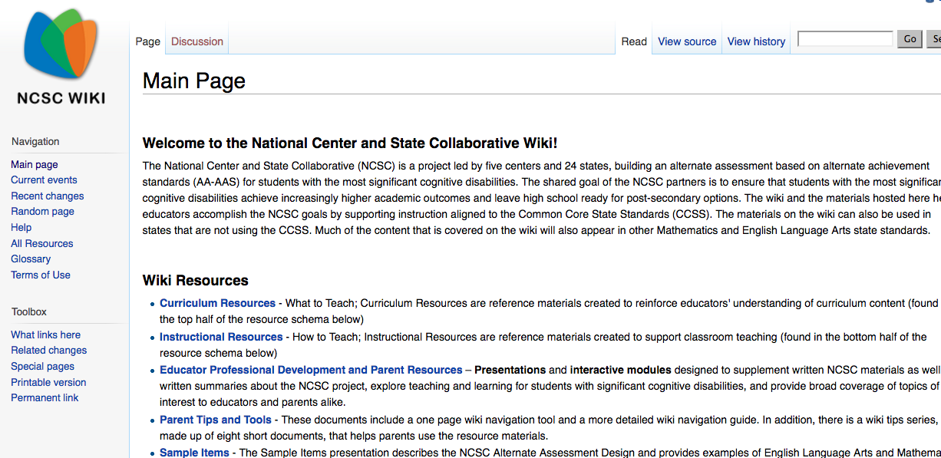
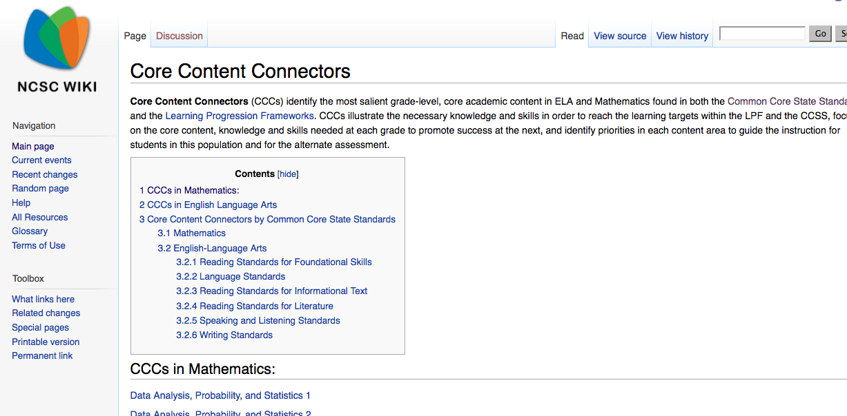
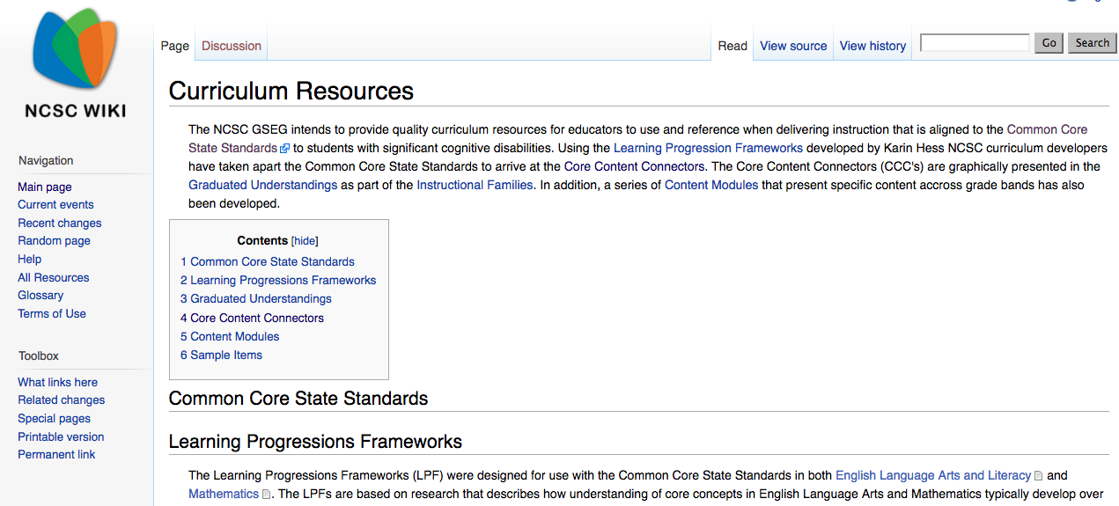
http://doe.sd.gov/oess/instructionalSCD.aspx
Core Content Connectors
Notes:
The National Center and State Collaborative (also known as NCSC) project, created a wiki site which is a great resource for identifying standards to include in your SLO when it includes students working well below grade level. The site includes lots of great information for special education teachers, but one piece that is valuable in SLO creation is the page on Core Content Connectors. Core Content Connectors are used with the most significant cognitive students but can help teachers identify skill targets to work on that are related to a student’s grade-level Common Core State Standards. For example, if your Geometry SLO includes a 5th grader who is performing well below 5th grade level, the Core Content Connectors can help you identify skills that student can work on that are related to the 5th grade Geometry standards within the Common Core State Standards.
To find the Core Content Connectors on the Students with Significant Cognitive Disabilities website, first click on NCSC wiki, then “Curriculum Resources”, then “Core Content Connectors.” (CLICK)
*short pause*
(CLICK) There are Core Content Connectors for Math and ELA. After the module, you may want to take some time to explore the NCSC Wiki Page, and the Core Content Connectors for students on your caseload who are performing well below grade level.
Although the NCSC project ended in the fall of 2016, all resources will were transitioned to MSAA (or Multi-State Alternative Assessment), and will continue to be available at this web link.
Science Core Content Connectors are also available on this site.

Slide 20


SPED Law/ Guiding Principles
In co-teaching situations, general education and special education teachers are encouraged to collaborate to create SLOs.
Shared SLO
Both teachers share the diverse:
Population
baseline data
growth goals
Notes:
The third consideration: In co-teaching situations, general education and special education teachers are encouraged to collaborate to create SLOs. If more than one teacher is providing education and support to a student, or group of students, those teachers are responsible for the educational outcome of that student or group.
(CLICK) For example - Mrs. Smith is a third grade general education teacher. Mr. Jones, a special education teacher, provides inclusion support for three students on IEPs during Mrs. Smith’s reading instruction every day. If Mrs. Smith and Mr. Jones are writing SLOs on reading, they may want to create a shared SLO.
(CLICK) Because both teachers are responsible for the educational outcome of the students in this group, it would be beneficial for them to collaborate in writing an SLO that accounts for the diverse population, baseline data, and growth goals included in the group.

Slide 21
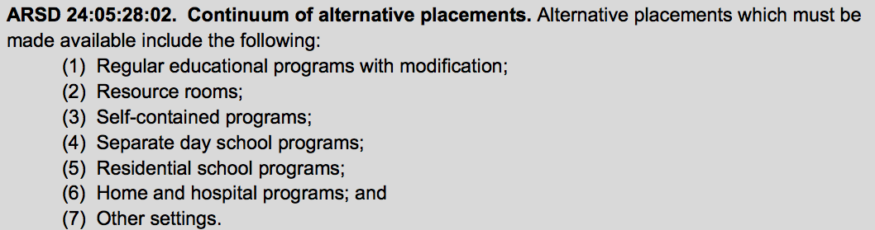
SPED Law/ Guiding Principles
SLOs for special education teachers must reflect the diverse education settings found in the continuum of special education services.
Notes:
The final consideration we will take a look at is that SLOs for special education teachers must reflect the diverse education settings found in the continuum of special education services. During the IEP process, each student’s team reviewed options within the continuum of alternative placements and identified the best placement for him/her. Inclusion of a student in your SLO should, in no way, affect his/her placement.

Slide 22
SPED Law/ Guiding Principles
SLOs for special education teachers must reflect the diverse education settings found in the continuum of special education services.
Your SLO
Your Instruction
Your Impact on Student Growth
Notes:
Your SLO can include students in any of the placement categories found on the continuum of services. When identifying your target group of students for your SLO, it is important to think about the students whose instruction you are responsible for. If your SLO includes students that you don’t provide instruction for, your SLO will not be a true measure of your impact on student growth.

Slide 23
SLO Process guide – What’s different for special educators
Notes:
The final piece in this module will take a look at the SLO process guide, and review some potential differences you may find.

Slide 24
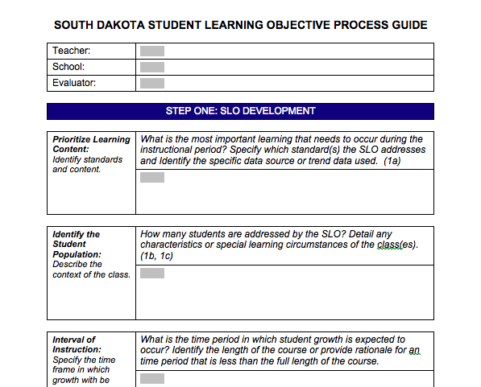
SLO Process Guide
Notes:
The SLO Process guide is a document that guides teachers in completing their SLOs. Regardless of what you teach, all teachers will follow the SLO process set by their district. This may include completing the steps in an online program, filling out a digital or paper copy of the process guide, or utilizing another district-identified format. During this section, we will look at the similarities and differences that may arise in each component included in the process guide.

Slide 25
Before You Begin
Review summative data to identify an area of need
South Dakota ELA/Math Content Assessment
South Dakota Science Assessment
Alternative Assessment
Functional Assessment
Identify your target group of students
May be one or more students
Similar IEP goals
Similar skill needs
Group shared with classroom teacher
Students may or may not be in the same grade / classroom
Notes:
Before you begin filling out the process guide, you’ll want to do the following:
First, look at summative student data to identify an overall area of need. You may notice more than one area of need, but for the purpose of your SLO, you will choose just one. Sources of data may include results from State ELA and Math assessments, South Dakota science assessments, Alternative Assessments, and functional or skill-based assessments completed as part of a student evaluation. This information will help you zero in on a specific content area or set of skills that appear as an area of need for your students.
Once you have identified your priority content area, take a look at the students on your caseload for whom you provide instruction, or co-teach. This will vary widely by teacher and teaching assignment, but should include one or more students that receive instruction from you.
Is there a group of students who share similar IEP goals? Do you have students who are working on similar skills? These groupings work well for a target group for your SLO. Do you provide inclusion support to several students in a general education classroom? This would be a good opportunity for a shared SLO.
Growth may be more difficult to reach with a small group of students, so you may also want to consider students who have common needs and goals, but are instructed in different groups or at different times of the day. You can include these students as one target group for your SLO.

Slide 26
Prioritizing Learning Content
Prioritize Learning Content: Identify standards and content. | What is the most important learning that needs to occur during the instructional period? Specify which standard(s) the SLO addresses and Identify the specific data source or trend data used. (1a)
 | SOUTH DAKOTA STANDARDS FOR YOUR STUDENTS’ GRADE LEVEL(s) CORE CONTENT CONNECTORS (if applicable) DATA SOURCES USED
Notes:
Once you’ve reviewed summative data to identify an area of need, and reviewed student data to select your target group of students, you are ready to begin the first step of the process guide.
In this step, you will identify your priority learning content. Within the area of need you identified, what is the most important learning that needs to occur? List the state standards (or core content connectors for students working below grade level) that you have chosen to pinpoint which skill (or skills) to address. If you have a multi-grade group, you will want to identify standards within the various grade levels. You will also name the data sources you used to identify this priority learning content.

Slide 27
Identify Student Population
Identify the Student Population: Describe the context of the class. | How many students are addressed by the SLO? Detail any characteristics or special learning circumstances of the class(es). (1b, 1c)
 | SHARED – WHOLE CLASS INDIVIDUAL – YOUR STUDENTS Accommodations/Modifications LRE placement Socio-economic status Gender Language proficiency
Notes:
The next step in the Process Guide is to identify your student population. In this box, you will list the students in your target group that will be addressed by your SLO.
If you are writing a shared SLO with another teacher, you will list all of the students in that shared group. If that group is a general education classroom, you and the classroom teacher will list all students in the class.
If you are writing an individual SLO, you will list all of the students in your target group.
This is also the place for you to identify any specific learning characteristics of your students that may impact the SLO goal. Specific learning characteristics include any information that may impact your students’ learning. This information can be for individual students and the whole group. You may want to include information such as accommodations, modifications, special education placement, socio-economic status, gender, language proficiency or other characteristics pertinent to your target group.

Slide 28
Interval of Instruction
Interval of Instruction: Specify the time frame in which growth will | What is the time period in which student growth is expected to occur? Identify the length of the course or provide rationale for a time period that is less than the full length of the course.
 | SCHOOL YEAR SEMESTER
Notes:
Step 3 of the process guide is to document your interval of instruction, or the time frame in which you will measure student growth. For most teachers, this will be a semester or school year. SLOs are intended to encompass the larger academic standards within a course or content area. It is important that the duration of the SLO spans the full length of time students are with their teacher for instruction. If you are unsure of the time frame you should select, contact your district evaluator.

Slide 29
Analyze Data & Develop Baseline
Analyze Data and Develop Baseline: Detail student understanding of the content at the beginning of the instructional period. | Where are my students starting? Summarize student baseline performance and attach additional data if necessary. (1b, 1f, 3d)
 | WHERE ARE YOUR STUDENTS STARTING Student A – 4/10 Student B – 3/10 Student C – 3/10 Student D – 2/10 Student E – 2/10 Student F – 0/10
Pre-Assessment Ideas
Skill-based
Rubric
Functional assesssment
Notes:
In the next step, you will document where the students in your target group are at the beginning of your SLO timeline. In the first box of the process guide, you identified your priority learning content and the related standards. Next, you will identify and administer a pre-assessment that will measure where your students are starting.
Some examples of a pre-assessment include a skill-based assessment, an evaluation of work using a rubric, or an assessment of a student’s functional skills. Your assessment may be administered different ways (such as paper/pencil, via observation or oral assessment, or with the use of a computer or other device), depending on the priority content, and the students in your target group.
If writing a shared SLO with a classroom teacher, you will document the results for the entire class in this box.
It is common, and expected, for your students to receive low scores on this pre-assessment. Low scores demonstrate that the priority content you have chosen is, indeed, an area of need for your target group.
If you are collecting and/or analyzing data using a separate document, such as an Excel spreadsheet, you can attach a copy of that to your process guide. Be sure to note that in this box so that your evaluator knows where to find that information.

Slide 30
Select or Develop an Assessment
Select or Develop an Assessment: Describe how the goal attainment will be measured. | What specific assessment or instrument will be used to measure goal attainment? Describe the source of the assessment and the connection to identified content and standards. (1c, 1d, 1f, and 3d)
 | WHAT IS/ARE YOUR DATA SOURCE(S) Skill-based Rubric Functional Assessment WHY THIS ASSESSMENT? Aligned to priority content and standards Correlation of pre- and post-assessments
Notes:
In this step of the SLO Process Guide, document the assessment you will use to measure growth during your SLO time frame. In most cases, teachers choose to use the same (or similar) assessment identified as the pre-assessment tool. In this step, you will also explain why you chose this assessment to measure your goal attainment. You may want to explain how this assessment is aligned with your priority learning content and standards. If using different pre-assessment and post-assessment tools or forms, you will want to explain how the results of the two assessments correlate to be an effective measure of student growth.
For more information on selecting an assessment for your SLO, see the South Dakota SLO Handbook.

Slide 31
Growth Goal
Growth Goal: Establish expectations for student growth. | What can I expect my students to achieve? Establish rigorous expectations for student performance. (1b 1c)
 | SMART goals are: Specific – state content-based learning focus Measurable – includes assessment and increment for measurement (ex: minutes, points, percent) Appropriate – includes growth for ALL students (not “80% of my group will…”) Realistic/Rigorous – attainable, but stretches students to grow Time-bound – includes your time-frame
Notes:
This step of the SLO Process Guide is where you will identify the growth goal for your students. Analyzing data from the pre-assessment results will help you set solid goals for the students in your target group. When writing your growth goal, you want to keep the acronym “SMART” in mind, and include the following elements:
Your goal should be:
Specific. It should state your content-based learning focus.
(CLICK) Measurable. It should include the name of the assessment you are using to evaluate it, along with the measurement method, such as an increase in minutes, points, or percentage.
(CLICK) Appropriate. Your goal should be written to account for growth for all the students in your target group. Goals that are written with statements like “80% of my students will…” only account for growth of 80% of your students.
(CLICK) Realistic and Rigorous. Based on what you know about your students, and the baseline data from their pre-assessments, the goals you set should be reachable, but stretch the outer limits of what is attainable.
(CLICK) And Time-bound, or include the time frame you identified in your Interval of Instruction.
Now that we’ve taken a look at the components of a well-written goal, let’s review some options and examples of different growth goals.

Slide 32
Growth Goal – Mastery
Growth Goal: Establish expectations for student growth. | What can I expect my students to achieve? Establish rigorous expectations for student performance. (1b 1c)
 | Mastery – based on all students in the target group achieving mastery of identified skill(s). By the end of the 2015-2016 school year, all students will correctly read 100% of the words from the Dolch word lists.
Notes:
One option in developing a growth goal is a mastery goal. In a class mastery goal, the focus is on all students in your target group achieving mastery of the identified skill or skills.
Here is an example of a class mastery growth goal in the area of reading: “By the end of the 2015-2016 school year, all students will correctly read 100% of the words from the Dolch word lists.”
This format works well when you want all students in your group to achieve the same level of mastery on your identified skill or concept. On the other hand, if mastery is not the focus for your identified skills or concepts, or if you feel mastery is not an attainable goal for one or more students in your target group, a class mastery goal may not be the best fit.

Slide 33
Growth Goal – Differentiated
Growth Goal: Establish expectations for student growth. | What can I expect my students to achieve? Establish rigorous expectations for student performance. (1b 1c)
 | Differentiated– establishes tiered expectations for students or groups. By the end of the 2015-2016 school year, students who solved 2 or fewer multi-step problems correctly on the XYZ assessment will increase to 5 correctly-solved problems. Students who solved 3 or more multi-step problems correctly will increase to 10 correctly-solved problems.
Notes:
Another option for your growth goal is a differentiated growth goal. Within a differentiated goal, a teacher can create different levels, or tiers, of expected growth based on the target group’s pre-assessment scores.
Here we have an example of a differentiated growth goal for the area of math. You can see the area in orange is the first tier of the goal – students who solved 2 or fewer multi-step problems. The goal for that group is to increase their number of problems solved to 5. The second tier, or group, is in purple – students who solved 3 or more problems. The goal for that group is to increase their number of problems solved to 10.
Differentiated goals recognize that students within a group often begin with different levels of understanding of the priority content, and allows teachers to set appropriate goals for individuals and/or subgroups within their target group. There is no set number of tiers or groups you should have within your goal. Reviewing your student pre-assessment scores will help you identify the number of tiers. To determine where to set the goal for each tier, take a look at your student information, along with your standards and assessment information. This will help you identify realistic and rigorous goals for each tier.

Slide 34
Growth Goal – Shared Performance
Growth Goal: Establish expectations for student growth. | What can I expect my students to achieve? Establish rigorous expectations for student performance. (1b 1c)
 | Shared Performance – allows for shared responsibility and accountability in situations where 2+ teachers share instruction for students. By the end of the school year, all students in Biology will show an improvement in the ability to follow the “Gather/Reason/Communicate” format for science investigations, moving up 1 rubric score.
Notes:
The third option for writing growth goals is a shared performance goal. Within this goal format, teachers writing a shared goal work together to determine an appropriate goal for the entire shared group. This kind of goal is sometimes used in a general education setting, where teachers in a common grade level or content-area create a goal that will be applied in each of their respective classrooms, with all teachers sharing accountability for all students included in the SLO. This goal format also works well in the special education setting where a classroom teacher and special education teacher share instructional responsibility for students in a classroom.
Let’s take a look at the example goal, which is written for a high school biology classroom. “By the end of the school year, all students in Biology will show an improvement in the ability to follow the “Gather/Reason/Communicate” format for science investigations, moving up 1 rubric score.”
It is important to note that a shared performance goal can have elements of a mastery goal or differentiated goal embedded within it. The goal for each student here is to move up one rubric score. This allows for realistic and rigorous growth for each student, regardless of their individual starting points. For example, if you have a student who scores a level 1 on the pre-assessment rubric, that student’s goal is to increase to a level 2. If you have a student who scores a level 3 on the pre-assessment rubric, that student’s goal is to increase to a level 4.

Slide 35
Goal Reflection
What was the growth goal for your most recent SLO?
Did you include all of the SMART components?
Did your goal allow for growth for all students in your target group?
What might you change when writing your next SLO growth goal?
Notes:
Take some time to reflect on the goal you wrote for your most recent SLO.
What was the growth goal for your most recent SLO?
Did you include all of the SMART components?
Did your goal allow for growth for all students in your target group?
Take a moment to jot down some notes on what you might change when writing your next SLO growth goal.

Slide 36
Provide Rationale
Provide Rationale: Describe how your SLO benefits student learning. | How do the content, baseline data, assessment and growth goal support student progress and growth? Describe why you chose to develop this SLO. (1a, 1f)
 | Why did you choose this goal? Importance of content Relationship to standards Summative data identified this area as a need Baseline data shows weakness in skill(s)
Notes:
After you’ve written your growth goal, the next step is to provide rationale on how your SLO benefits student learning. In this box, you will explain how the content, standards, baseline data, assessment, and growth goal support student growth.
You may want to note the importance of the content you chose, how the goal is related to your identified standards, and the data (both from the summative assessment and the pre-assessment) that identify this content area and skillset as a need for your target group of students.

Slide 37
Learning Strategies
Learning Strategies: Describe your plan to meet student needs? | How will you help students attain the goal? Provide any specific actions that will lead to goal attainment. (1b, 1e, 1f, 4a)
 | INSTRUCTIONAL STRATEGIES Pacing Repetition, Spiraling Frequency and/or intensity of supports SERVICES AND SUPPORTS ACCOMMODATIONS/MODIFICATIONS
Notes:
The final step before submitting your SLO for evaluator approval is to describe the instructional strategies you plan to implement in order to help the students in your target group meet their goal (or goals).
Some examples of strategies you may include are adjustments to pacing, repetition or spiraling to allow for frequent review, or changes to the frequency and/or intensity of support for students (especially when using a differentiated goal). Can you think of other strategies you might include?
You can also list any services and supports your students receive that are related to the priority learning content. You will also want to include information on student accommodations and/or modifications, as those are applicable to the SLO.

Slide 38
Content Review
The Teacher Effectiveness System applies to all teachers.
Your evaluator may/may not be the same as a general education teacher.
The Special Ed Scenarios document can be helpful in identifying how the Teacher Effectiveness components can relate to Special Education settings.
IEPs are not SLOs, but can inform the content included in your SLO.
Consider a differentiated or shared goal, depending on your target group.
Notes:
To recap, here are some key points we explored within this module.
The Teacher Effectiveness System applies to all teachers.
Your evaluator may/may not be the same as a general education teacher.
The Special Ed Scenarios document can be helpful in identifying how the Teacher Effectiveness components can relate to Special Education settings.
IEPs are not SLOs, but can inform the content included in your SLO.
Consider a differentiated or shared goal, depending on your target group.

Slide 39
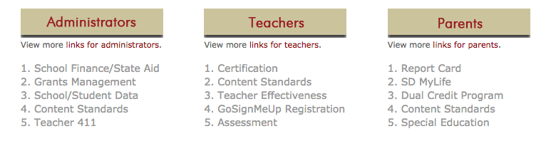

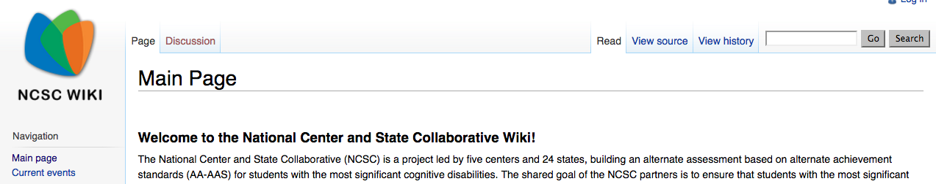
doe.sd.gov
danielsongroup.org
wiki.ncscpartners.org
Notes:
For more information on the topics covered in this module, visit these resources.
For more information on teacher effectiveness, and links to both the Teacher Effectiveness Handbook and SLO Handbook, visit doe.sd.gov, and click “Teacher Effectiveness” under the “Teacher” links.
(CLICK) To access the SPED Scenarios document, visit the Danielson Group website at www.danielsongroup.org, and under the “Resources” tab, click “Special Education.
(CLICK) For more information about Core Content Connectors, visit wiki.ncscpartners.org.

