Slide 1

Teacher Effectiveness System
Online modules

Slide 2
Module 1: Teacher Effectiveness System Overview
History
Minimum Requirements
Timeline
Notes:
The purpose of this module is to assist participants in developing an awareness of the SD Teacher Effectiveness System. Topics included in this short overview:
*The history of Teacher Effectiveness
*System requirements and recommendations
*What is included in the Teacher Effectiveness Model

Slide 3
Determining Teacher Effectiveness
Using multiple measures of professional practice and student learning
South Dakota Framework for Teaching
Student Growth
Domain 1
Domain 2
Domain 3
Domain 4
Teacher Effectiveness
Teacher Effectiveness
Planning and Preparation
Classroom Environment
Instruction
Professional Responsibilities
District Assessments
Evaluator-Approved Assessments
Classroom Observations and Evidence of Effective Practice
Components from Each of the 4 Domains
At Least 8 Components Chosen Based on District or School Priorities
Professional Practice Rating
Growth Rating
Summative Rating Matrix
Professional Oversight: Is the rating fair and accurate based on the evidence
and data shared by the teacher
Differentiated Performance Categories
Below Expectations
Meets Expectations
Exceeds Expectations
Notes:
Using the recommended model, public school districts will separately determine a Professional Practice Rating and a Student Growth Rating. The two separate ratings may be combined using the Summative Rating Matrix, a tool that provides educators the opportunity to exercise professional judgment prior to classifying teacher performance into one of the three performance categories.
This model of combining the two ratings does not rely on a uniform formula to calculate a Summative Teacher Effectiveness Rating. Instead, the model prioritizes evaluations based on the South Dakota Framework for Teaching, while incorporating the evaluation of student growth as one significant factor in the rating system.
The South Dakota Teacher Effectiveness Model is a collection of recommended practices that serves as guidance for successful implementation of high quality teacher evaluation systems. Practices outlined in the model are not required. Public school districts have the freedom to implement evaluation systems that differ from the model, provided a locally-developed system complies with all minimum state requirements. South Dakota’s Teacher Effectiveness Model establishes clear performance expectations, identifies multiple performance measures, includes recommendations for evidence collection and provides guidance to meaningfully determine and differentiate teaching performance.

Slide 4
The Aspiration: Improve Instruction and Student Learning
PURPOSE: Evaluation and professional growth systems
Encourage meaningful, in-depth dialogue focused on improving instruction
Provide regular, timely, useful feedback that guides professional growth
Support a culture in which data drives instructional decisions
Establish clear expectations for teacher performance
Use multiple measures to meaningfully determine and differentiate teacher performance
Provide a fair, flexible, research-based model that informs personnel decisions
Notes:
The Teacher Effectiveness System should result in the following outcomes if implemented with fidelity:
• Improved student success through the implementation of research-based educational practices.
• Improved student success through teachers’ professional growth and accountability.
• A record of facts and assessments for personnel decisions to ensure every public school in South
Dakota has effective teachers.
Continuous improvement is at the core of the annual appraisal cycle, with professional growth and accountability embedded in the use of rubrics. Student and school data, as well as other sources of evidence, will lead to a teacher’s professional growth plan. Data collected through the teacher evaluation process can help guide discussions about professional growth, especially as it relates to early career teachers. Assignment to performance levels will help teachers know what skills they need to develop to move to the next performance level.

Slide 5
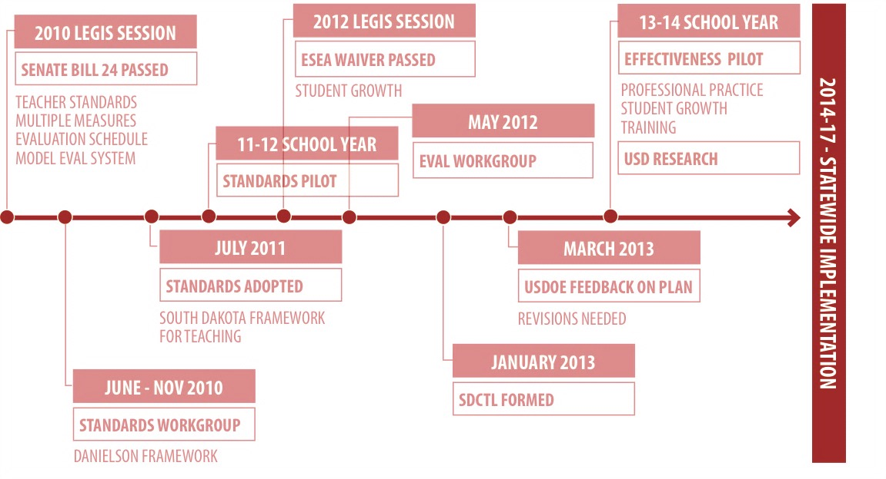
History of Teacher Effectiveness in SD
Notes:
Work on developing a teacher evaluation model began in response to legislation passed in 2010 requiring teacher evaluations in SD school districts. Prior to the passing of that legislation, there was no requirement that teachers be evaluated. This led to the creation of a standards work group charged with identifying a research-based set of professional teaching standards upon which to build our teacher evaluation system. The work group recommended the Danielson Framework, which was adopted as our SD professional teaching standards. That work group then became known as the SD Commission on Teaching and Learning. The CTL brought together education stakeholders from k-12 and higher education, SDDOE, USDOE, and SDEA. The CTL worked to develop a Teacher Effectiveness System that would meet the requirements of the ESEA waiver and hold true to the needs of administrators, teachers, and students in our schools. The TE System has been piloted for multiple years in districts across SD and is now in full implementation.

Slide 6
Definition of a teacher
An individual who:
Provides instruction to any grade, K-12, or ungraded class or who teaches in an environment other than a classroom setting;
Maintains daily student records;
Has completed an approved teacher education program or completed an alternate certification program;
Has been issued a South Dakota certificate; and
Is not serving as a principal, assistant principal, superintendent, or assistant superintendent.
Notes:
The Teacher Effectiveness System was developed specifically for teachers. This slide gives the federal definition of a teacher used in the SD Teacher Effectiveness System. Individuals who meet the above definitions will be evaluated using the model. As has been common in many school districts all along, under this model, teachers would not be evaluated with the same tool that might be used to evaluate other school staff, such as business managers, paraprofessionals, custodians, etc.

Slide 7
Teacher Effectiveness Minimum Requirements
Professional Practice Rating: based on performance relative to the South Dakota Framework for Teaching (Danielson Model)
Student Growth Rating: Based on the development and attainment of Student Learning Objectives
Summative Rating (optional): Three categories – Below, Meets or Exceeds Expectations; based on multiple measure, student growth a “significant factor”
Results and Outcomes: Useful performance feedback that guides professional growth and improvement plans for those not meeting district expectations
Evaluation Cycle: Probationary teachers summatively evaluated every year, non-probationary teachers at least every other year.
Notes:
State codified law and administrative rule outline the minimum requirements for implementation of Teacher Effectiveness (SDCL 13-42-33, SDCL 13-42-34, SDCL 13-42-70, ARSD 24:57).
All South Dakota public school districts must use multiple valid measures to evaluate Teacher Effectiveness. The teacher evaluation process must rely on qualitative and quantitative measures and be based on measures of both professional practice and student growth.
Local teacher evaluation systems must assess teaching performance relative to the South Dakota Framework for Teaching based on the Danielson Framework for Teaching.
The South Dakota Framework for Teaching includes 22 individual teaching components clustered into four domains. All local effectiveness systems must include professional performance evaluations based on a minimum of four teaching components, including one from each domain (ARSD 24:57).
Student Learning Objectives as a Measure of Teacher Impact on Student Growth
Impact on student growth will be assessed through the Student Learning Objectives (SLOs) process. Public school districts may apply to use an alternate method of student growth, provided the measure meets minimum state requirements (ARSD 24:57).
SUMMATIVE TEACHER EFFECTIVENESS RATING (OPTIONAL)
Local teacher evaluation systems may include a process to combine the Professional Practice Rating and Student Growth Rating into a Summative Teacher Effectiveness Rating (ARSD 24:57).
Performance Differentiated Into Three Categories
If combined, Summative teaching performance is assigned one of three overall performance ratings: Below Expectations, Meets Expectations, or Exceeds Expectations (ARSD 24:57). The Summative Teacher Effectiveness Rating includes an evaluation of student growth that serves as one significant factor and an evaluation of professional practices as the other significant factor.
SUMMATIVE EVALUATION CYCLE
All South Dakota public school districts must regularly provide teachers with a summative evaluation, but the frequency varies based on the amount of time a teacher has been employed with the district.
Probationary Teachers
Teachers in years one to three of employment, commonly referred to as probationary teachers, must be provided with a summative evaluation every school year (SDCL 13-42-34).
Non-Probationary Teachers
Teachers in or beyond their fourth year of employment, commonly referred to as continuing contract teachers, must be evaluated at least once every two school years (SDCL 13-42-34).

Slide 8
Implementation Timeline
IMPLEMENT | PLAN OPTION
 | School Year
 | 13-14 | 14-15 | 15-16 |  | 16-17
Pilot Year
Teacher Evaluations
District Reporting
Personnel Decisions
Notes:
South Dakota public school districts had two pathways to implementation. In the 2014-15 school year, districts had the option of either fully implementing the system or treating the year as a learning year. By the 2015-16 school year, all districts must be implementing a system that meets the state minimum requirements, and by the 2016-17 school year must be using the results of this system to inform personnel decisions.
Reporting
Summative Teacher Effectiveness Ratings will be reported annually to the SD DOE through the Personnel Record Form (PRF) process. It is important that all educators understand two key concepts related to state reporting:
• Individual teacher evaluation results are legally protected as personnel information and are not subject to South Dakota’s public records laws (SDCL 13-42-70).
• South Dakota’s ESEA waiver requires the SD DOE to report aggregate Teacher Effectiveness data.

Slide 9
Determining Teacher Effectiveness
Using multiple measures of professional practice and student learning
South Dakota Framework for Teaching
Student Growth
Domain 1
Domain 2
Domain 3
Domain 4
Teacher Effectiveness
Teacher Effectiveness
Planning and Preparation
Classroom Environment
Instruction
Professional Responsibilities
District Assessments
Evaluator-Approved Assessments
Classroom Observations and Evidence of Effective Practice
Components from Each of the 4 Domains
At Least 8 Components Chosen Based on District or School Priorities
Professional Practice Rating
Growth Rating
Summative Rating Matrix
Professional Oversight: Is the rating fair and accurate based on the evidence
and data shared by the teacher
Differentiated Performance Categories
Below Expectations
Meets Expectations
Exceeds Expectations
Notes:
This concludes the Teacher Effectiveness System Overview. The next module in this series focuses on Professional Practice: SD Framework for Teaching

Slide 11
Module 2: Teacher Effectiveness System Professional Practices
SD Framework for Teaching
Evidence & Artifacts
Scoring
Notes:
Module 2 in the teacher effectiveness system series will focus on Professional Practices. Improving teaching performance begins with a clear definition of effective teaching. The South Dakota Framework for Teaching based on the Danielson Framework offers a description of professional practices that, based on research and empirical evidence, have been shown to promote student learning. Evaluations of professional practice relative to the Framework contribute to the Summative Teacher Effectiveness Rating and serve as a basis for developing individual professional growth plans focused on improving instruction.
Also included in this module are methods of gathering evidence and artifacts as they pertain to the components and information on scoring the components.

Slide 12
Determining Teacher Effectiveness
Using multiple measures of professional practice and student learning
South Dakota Framework for Teaching
Student Growth
Domain 1
Domain 2
Domain 3
Domain 4
Teacher Effectiveness
Teacher Effectiveness
Planning and Preparation
Classroom Environment
Instruction
Professional Responsibilities
District Assessments
Evaluator-Approved Assessments
Classroom Observations and Evidence of Effective Practice
Components from Each of the 4 Domains
At Least 8 Components Chosen Based on District or School Priorities
Professional Practice Rating
Growth Rating
Summative Rating Matrix
Professional Oversight: Is the rating fair and accurate based on the evidence
and data shared by the teacher
Differentiated Performance Categories
Below Expectations
Meets Expectations
Exceeds Expectations
Notes:
As we review this graphic, you will see the left side highlights the SD Framework for Teaching and its flow into the professional practices rating.

Slide 13
Standards-based Performance Assessment
School districts chose whether to adopt the South Dakota Framework for Teaching (Danielson Model) or crosswalk to state teaching standards.
Minimum: 4 Performance Standards Including 1 from Each Domain
Local school districts may select components relevant to school or district goals.
Assign a Professional Practice Rating
Defined: The rating assigned to a teacher using at least one component from each domain.
Notes:
Again, The South Dakota Framework for Teaching is divided into four domains of teaching practice. Within the four domains are 22 components and 76 elements that identify the skills and knowledge associated with that domain. The minimum requirement is to select 4 of the 22 components, one from each domain and to assign a professional practice rating based on the proficiency demonstrated in the 4 selected components.

Slide 14
The South Dakota Framework for Teaching
A proven, comprehensive definition of effective teaching (Danielson Model) State Model Recommendation: 8 components, including 1 from each domain
Domain 1 PLANNING AND PREPARATION | Domain 2 THE CLASSROOM ENVIRONMENT
1a: Demonstrating Knowledge of Content and Pedagogy 1b: Demonstrating Knowledge of Students 1c: Setting Instructional Outcomes 1d: Demonstrating Knowledge of Resources 1e: Designing Coherent Instruction 1f: Designing Student Assessments | 2a: Creating an Environment of Respect and Rapport 2b: Establishing a Culture for Learning 2c: Managing Classroom Procedures 2d: Managing Student Behavior 2e: Organizing Physical Space
Domain 4 PROFESSIONAL RESPONSIBILITIES | Domain 3 INSTRUCTION
4a: Reflecting on Teaching 4b: Maintaining Accurate Records 4c: Communicating with Families 4d: Participating in a Professional Community 4e: Growing and Developing Professionally 4f: Showing Professionalism | 3a: Communicating with Students 3b: Using Questioning and Discussion Techniques 3c: Engaging Students in Learning 3d: Using Assessment in Instruction 3e: Demonstrating Flexibility and Responsiveness
Notes:
A complete listing of the 4 domains and 22 components appears here. Please note that the minimum requirement for component selection is 4 components to include one from each of the 4 domains, but the Commission on Teaching and Learning recommends using 8 components.
The CTL recognizes and appreciates the holistic view of teaching represented by the research-based South Dakota Framework for Teaching. Teacher evaluations based on the full Framework should result in high levels of professional feedback and dialogue, setting the stage for all teachers to continually improve their instruction. For South Dakota public school districts where consideration of the full Framework is not immediately feasible, the Commission recommends basing Professional Practice Ratings on a minimum of eight components, including at least one component from each of the four domains.

Slide 15
The South Dakota Framework for Teaching
Domain 1 PLANNING AND PREPARATION | Domain 2 THE CLASSROOM ENVIRONMENT
1a: Demonstrating Knowledge of Content and Pedagogy 1b: Demonstrating Knowledge of Students 1c: Setting Instructional Outcomes 1d: Demonstrating Knowledge of Resources 1e: Designing Coherent Instruction 1f: Designing Student Assessments | 2a: Creating an Environment of Respect and Rapport 2b: Establishing a Culture for Learning 2c: Managing Classroom Procedures 2d: Managing Student Behavior 2e: Organizing Physical Space
Domain 4 PROFESSIONAL RESPONSIBILITIES | Domain 3 INSTRUCTION
4a: Reflecting on Teaching 4b: Maintaining Accurate Records 4c: Communicating with Families 4d: Participating in a Professional Community 4e: Growing and Developing Professionally 4f: Showing Professionalism | 3a: Communicating with Students 3b: Using Questioning and Discussion Techniques 3c: Engaging Students in Learning 3d: Using Assessment in Instruction 3e: Demonstrating Flexibility and Responsiveness
NOT OBSERVABLE | OBSERVABLE
Notes:
Teaching is a complex act that requires the execution of many skills simultaneously. While the classroom environment and the act of instructing are obvious acts of teaching, planning and preparation and professional responsibilities that occur outside the classroom are equally important. Because not everything a teacher does happens during instruction, the SD Framework for Teaching Domains are classified as observable and not observable. The observable components are in Domains 2 and 3, while the non-observable components are in Domains 1 and 4. Let’s review how evidence and artifacts may be collected for both observable and unobservable domains.

Slide 16
Evidence Sources: Artifacts & Observations
Evidence gathered through classroom observation and by the collection of artifacts
Domain 1 PLANNING AND PREPARATION | Domain 2 THE CLASSROOM ENVIRONMENT
Domain 4 PROFESSIONAL RESPONSIBILITIES | Domain 3 INSTRUCTION
ARTIFACTS | OBSERVATIONS
Notes:
Once the desired components for all domains have been selected, evaluators will gather evidence on the observable domains 2-3 through classroom observations, formal and informal evaluations and walkthroughs. Teachers and administrators will identify a set of agreed upon teacher-submitted artifacts for the selected components in domains 1-4. Further guidance on component and artifact selection will be highlighted in Module 3 of this series. Additional resources can be found on the DOE website.

Slide 17
Evidence Sources: Artifacts & Observations
Evidence gathered through classroom observation and by the collection of artifacts
Formal Observation
Is announced
Lasts at least 15 minutes
Includes conversations before and after the observation (pre- and post-observation conferences
Informal Observation
May or may not be announced
Lasts at least 5 minutes
Results in some form of feedback to the teacher
Artifacts
Documents and other information that stem from the daily work of teaching that demonstrates performance relative to non-observable standards
Notes:
EVALUATING PRACTICE USING EVIDENCE PROVIDED BY CLASSROOM OBSERVATION
Evaluations of professional practice relative to Domain 2 (Classroom Environment) and Domain 3 (Instruction) of the South Dakota Framework for Teaching are supported primarily by evidence collected through classroom observation.
Formal Observations
A formal observation is at least 15 minutes in length, is conducted by the teacher’s evaluator, and includes structured conversations before and after the observation. A pre-observation conference provides the evaluator and teacher time to discuss the upcoming formal observation, including any lesson plans, assessments, or differentiation strategies that will be used. A post-observation conference is an opportunity for feedback, reflection, and analysis, giving the evaluator and teacher time to engage in a professional dialogue.
Informal Observations
An informal observation, commonly referred to as a walkthrough, is an observation that is at least five minutes in length and results in feedback to the teacher. Informal observations may or may not be announced.
EVALUATING PRACTICE USING EVIDENCE PROVIDED BY ARTIFACTS
Professional practice evaluations also require the consideration of evidence that cannot be collected through classroom observation. Components that are not observable are supported by the collection of artifacts. Artifacts are documents, materials, processes, strategies, and other information that demonstrate performance relative to a component of professional teaching practice. It is up to the teacher and his or her evaluator to determine how artifacts will be collected. To ensure expectations are established and artifact collection is focused, evaluators and teachers should discuss which artifacts support the evaluation. In many cases, artifacts stem from a teacher’s day-to-day work and teachers do not need to create documentation specifically to support the evaluation process.

Slide 18
Rubric-based Evaluation All supporting evidence is evaluated against clear, common rubrics.
Domain 1 PLANNING AND PREPARATION |  | Domain 2 THE CLASSROOM ENVIRONMENT
Domain 4 PROFESSIONAL RESPONSIBILITIES |  | Domain 3 INSTRUCTION
PERFORMANCE RUBRICS Describes performance on each component along a continuum of performance
UNSATISFACTORY | BASIC | PROFICIENT | DISTINGUISHED
Notes:
USING STANDARDS-BASED RUBRICS TO EVALUATE TEACHING PERFORMANCE
A collection of standards-based performance rubrics aligned to the South Dakota Framework for Teaching support transparent, accurate, and consistent assessments of teaching performance. Each rubric contains performance indicators and critical attributes that differentiate performance across a four-tiered continuum of performance: Unsatisfactory, Basic, Proficient, and Distinguished.
PROFESSIONAL PRACTICE RATING DESCRIPTIONS
Each of the four final Professional Practice Ratings – Unsatisfactory, Basic, Proficient and Distinguished – is defined in general terms to illustrate the continuum of possible performance relative to the rigorous professional teaching components outlined in the South Dakota Framework for Teaching.
▪ Unsatisfactory: A teacher performing at the Unsatisfactory level does not appear to understand the underlying concepts represented by the Framework. Performance at this level requires significant intervention and coaching to improve the teacher’s performance.
▪ Basic: A teacher performing at the Basic level appears to understand the Framework conceptually but struggles to implement the standards into professional practice. Performance at this level is generally considered minimally competent for teachers early in their careers and improvement is expected to occur with experience.
▪ Proficient: A teacher performing at the Proficient level clearly understands the concepts represented by the Framework and implements them well. Teachers performing at this level are qualified in the craft of teaching and work to continually improve practice.
▪ Distinguished: A teacher performing at the Distinguished level is a master teacher and makes a contribution to the field, both inside and outside the classroom. While all teachers strive to attain Distinguished-level performance, this level is considered difficult to attain consistently.

Slide 19
The Professional Practice Rating
Determined by calculating average component-level performance
Assign point values to component-level performance
Distinguished = 4; Proficient = 3; Basic = 2; Unsatisfactory = 1
Calculate an average score for all components evaluated
Total points divided by number of components evaluated; all components equally weighted
Assign the overall professional practice rating
The average component-level score translates into one of four professional practice ratings:
1.00to 1.49 = Unsatisfactory
1.50 to 2.49 = Basic
2.50 – 3.49 = Proficient
3.50-4.00 = Distinguished
Notes:
DETERMINING THE OVERALL PROFESSIONAL PRACTICE RATING
After using standards-based rubrics to determine teaching performance for each component evaluated, the evaluator uses a three-step process to determine a Professional Practice Rating of Unsatisfactory, Basic, Proficient, or Distinguished.
Step 1: Determine Component-Level Performance
Numerical values are assigned to teaching performance for each component evaluated: A Distinguished rating is assigned 4 points; a Proficient rating is assigned 3 points; a Basic rating is assigned 2 points; and an Unsatisfactory rating is assigned 1 point.
Step 2: Calculate an Average Score for All Components Evaluated
An average score across all components is calculated by dividing the total of all points earned by the number of components evaluated. The average will range from 1 to 4, and is rounded to the nearest hundredth of a point. All components are given equal weight.
Step 3: Determine the Overall Professional Practice Rating
The average component-level score is used to assign a Professional Practice Rating of Unsatisfactory, Basic, Proficient, or Distinguished. The chart below presents the score ranges aligned to the four performance categories.

Slide 20
Determining Teacher Effectiveness
Using multiple measures of professional practice and student learning
South Dakota Framework for Teaching
Student Growth
Domain 1
Domain 2
Domain 3
Domain 4
Teacher Effectiveness
Teacher Effectiveness
Planning and Preparation
Classroom Environment
Instruction
Professional Responsibilities
District Assessments
Evaluator-Approved Assessments
Classroom Observations and Evidence of Effective Practice
Components from Each of the 4 Domains
At Least 8 Components Chosen Based on District or School Priorities
Professional Practice Rating
Growth Rating
Summative Rating Matrix
Professional Oversight: Is the rating fair and accurate based on the evidence
and data shared by the teacher
Differentiated Performance Categories
Below Expectations
Meets Expectations
Exceeds Expectations
Notes:
To review, Professional Practices ratings are based on the proficiency demonstrated in the selected Danielson components. The minimum requirement is to select 4 components, one from each domain. Proficiency is determined by evidence collected through classroom observations and teacher-submitted artifacts, which are then scored using the standards-based rubrics. The next short module will provide suggestions for component and artifact selection.

Slide 22
Module 3 : Teacher Effectiveness System Component & Artifact Selection Guidance
Notes:
Module 3 in the Teacher Effectiveness System will briefly share recommendations for both component and accompanying artifact selection. It is imperative to note that districts are encouraged to select components and artifacts which best represent local goals and priorities. The following information is meant to be used as a recommendation only.

Slide 23
Component Selection Guidance (CTL) Schools seeking guidance can consider a collection of 8 components that are equally distributed across all four domains.
Domain 1 PLANNING AND PREPARATION | Domain 2 THE CLASSROOM ENVIRONMENT
1a: Demonstrating Knowledge of Content and Pedagogy 1b: Demonstrating Knowledge of Students 1c: Setting Instructional Outcomes 1d: Demonstrating Knowledge of Resources 1e: Designing Coherent Instruction 1f: Designing Student Assessments | 2a: Creating an Environment of Respect and Rapport 2b: Establishing a Culture for Learning 2c: Managing Classroom Procedures 2d: Managing Student Behavior 2e: Organizing Physical Space
Domain 4 PROFESSIONAL RESPONSIBILITIES | Domain 3 INSTRUCTION
4a: Reflecting on Teaching 4b: Maintaining Accurate Records 4c: Communicating with Families 4d: Participating in a Professional Community 4e: Growing and Developing Professionally 4f: Showing Professionalism | 3a: Communicating with Students 3b: Using Questioning and Discussion Techniques 3c: Engaging Students in Learning 3d: Using Assessment in Instruction 3e: Demonstrating Flexibility and Responsiveness
Notes:
As previously mentioned in Module 2 Professional Practices, the minimum number of components required is 4, with one from each domain. The Commission on Teaching and Learning recommends selecting 8 components and this graphic represents those recommended 8. They are equally distributed among the 4 domains and represent a holistic cross section of skills and abilities that are often included in various teacher evaluation tools.

Slide 24
Integrating ELA and Math State Standards
The framework recognizes the instructional implications of the State standards. Modifications made to 1c, 13, 1f, 2b, 3a, 3b, 3c, 3d
Domain 1 PLANNING AND PREPARATION | Domain 2 THE CLASSROOM ENVIRONMENT
1a: Demonstrating Knowledge of Content and Pedagogy 1b: Demonstrating Knowledge of Students 1c: Setting Instructional Outcomes 1d: Demonstrating Knowledge of Resources 1e: Designing Coherent Instruction 1f: Designing Student Assessments | 2a: Creating an Environment of Respect and Rapport 2b: Establishing a Culture for Learning 2c: Managing Classroom Procedures 2d: Managing Student Behavior 2e: Organizing Physical Space
Domain 4 PROFESSIONAL RESPONSIBILITIES | Domain 3 INSTRUCTION
4a: Reflecting on Teaching 4b: Maintaining Accurate Records 4c: Communicating with Families 4d: Participating in a Professional Community 4e: Growing and Developing Professionally 4f: Showing Professionalism | 3a: Communicating with Students 3b: Using Questioning and Discussion Techniques 3c: Engaging Students in Learning 3d: Using Assessment in Instruction 3e: Demonstrating Flexibility and Responsiveness
Notes:
As South Dakota adopted the State math and English-Language Arts standards, the Danielson Group recommended the above 8 components that align to the instructional implications of the State standards. Please note that this recommended set of 8 components DOES NOT include a component from Domain 4. Remember, the minimum requirements for SD schools is to select 4 components, one from each domain. Individuals choosing to select the above components will need to add an additional component from domain 4 to meet the minimum SD requirements.

Slide 25
Components Linked to SLOs
The knowledge and skills necessary to implement Student Learning Objectives as a measure of teacher effectiveness
Domain 1 PLANNING AND PREPARATION | Domain 2 THE CLASSROOM ENVIRONMENT
1a: Demonstrating Knowledge of Content and Pedagogy 1b: Demonstrating Knowledge of Students 1c: Setting Instructional Outcomes 1d: Demonstrating Knowledge of Resources 1e: Designing Coherent Instruction 1f: Designing Student Assessments | 2a: Creating an Environment of Respect and Rapport 2b: Establishing a Culture for Learning 2c: Managing Classroom Procedures 2d: Managing Student Behavior 2e: Organizing Physical Space
Domain 4 PROFESSIONAL RESPONSIBILITIES | Domain 3 INSTRUCTION
4a: Reflecting on Teaching 4b: Maintaining Accurate Records 4c: Communicating with Families 4d: Participating in a Professional Community 4e: Growing and Developing Professionally 4f: Showing Professionalism | 3a: Communicating with Students 3b: Using Questioning and Discussion Techniques 3c: Engaging Students in Learning 3d: Using Assessment in Instruction 3e: Demonstrating Flexibility and Responsiveness
Notes:
This set of 9 components is linked to the work teachers will conduct with their SLOs student learning objectives.

Slide 26
Artifact Selection
Notes:
We will now transition from component selection guidance to artifact selection guidance.

Slide 27
The South Dakota Framework for Teaching
Domain 1 PLANNING AND PREPARATION | Domain 2 THE CLASSROOM ENVIRONMENT
1a: Demonstrating Knowledge of Content and Pedagogy 1b: Demonstrating Knowledge of Students 1c: Setting Instructional Outcomes 1d: Demonstrating Knowledge of Resources 1e: Designing Coherent Instruction 1f: Designing Student Assessments | 2a: Creating an Environment of Respect and Rapport 2b: Establishing a Culture for Learning 2c: Managing Classroom Procedures 2d: Managing Student Behavior 2e: Organizing Physical Space
Domain 4 PROFESSIONAL RESPONSIBILITIES | Domain 3 INSTRUCTION
4a: Reflecting on Teaching 4b: Maintaining Accurate Records 4c: Communicating with Families 4d: Participating in a Professional Community 4e: Growing and Developing Professionally 4f: Showing Professionalism | 3a: Communicating with Students 3b: Using Questioning and Discussion Techniques 3c: Engaging Students in Learning 3d: Using Assessment in Instruction 3e: Demonstrating Flexibility and Responsiveness
NOT OBSERVABLE | OBSERVABLE
Notes:
Remember that Domains 1 and 4 are considered the unobservable domains. Therefore, artifacts must be used to demonstrate proficiency in the components selected from these 2 domains. EVALUATING PRACTICE USING EVIDENCE PROVIDED BY ARTIFACTS
Professional practice evaluations also require the consideration of evidence that cannot be collected through classroom observation. Components that are not observable are supported by the collection of artifacts. Artifacts are documents, materials, processes, strategies, and other information that demonstrate performance relative to a component of professional teaching practice. It is up to the teacher and his or her evaluator to determine how artifacts will be collected. To ensure expectations are established and artifact collection is focused, evaluators and teachers should discuss which artifacts support the evaluation. In many cases, artifacts stem from a teacher’s day-to-day work and teachers do not need to create documentation specifically to support the evaluation process.

Slide 28
Rubric-based Evaluation
All supporting evidence is evaluated against clear, common rubrics.
Domain 1 PLANNING AND PREPARATION |  | Domain 2 THE CLASSROOM ENVIRONMENT
Domain 4 PROFESSIONAL RESPONSIBILITIES |  | Domain 3 INSTRUCTION
PERFORMANCE RUBRICS Describes performance on each component along a continuum of performance
UNSATISFACTORY | BASIC | PROFICIENT | DISTINGUISHED
Notes:
Please also note that whether observable or unobservable, each of the 22 components have an accompanying standards-based rubric. It is recommended that evaluators and teachers review these rubrics prior to identifying agreed upon artifacts, as these artifacts will be scored using the rubrics. Just as there are varying levels of performance in instruction, there are varying performance levels to be demonstrated with artifacts.

Slide 29
Domain 1
1a: Knowledge of Content and Pedagogy 1b: Knowledge of Students 1c: Setting Instructional Outcomes 1d: Knowledge of Resources 1e: Designing Coherent Instruction 1f: Designing Student Assessments
Possible Artifacts
Lesson Plans Curriculum Maps SLO Process Guide Student Portfolios Teacher created instructional materials Pacing Guides Formative and Summative Assessments
Notes:
This is short list of possible artifacts for the components of domain 1. A list of additional suggested artifacts may be found on the DOE website and in the Teacher Effectiveness handbook. The key is to review the component rubrics as well, as the rubric descriptions and critical attributes provide additional ideas for possible artifacts.
Selecting components and artifacts that support the work that teachers are already doing strengthens the work of the component. It is also important to note that parts of the SLO process guide have been aligned to the Danielson components as a means of emphasizing how professional practices and student growth complement each other and to highlight how the SLO process guide can be used as an artifact for multiple components.
SLOs as Artifacts
The SLO process reflects recommended practices aligned to the South Dakota Framework for Teaching. The SLO Process Guide and other SLO resources are powerful artifacts that can be used as evidence of teaching performance relative to non-observable state teaching standards (Domains 1 and 4). As guidance for districts working to create efficiencies in artifact collection, the steps within the SLO Process Guide have been aligned to components of the South Dakota Framework for Teaching.

Slide 30
Domain 4
4a. Reflecting on Teaching 4b. Maintaining Accurate Records 4c. Communicating with Families 4d. Participating in a Professional Community 4e. Growing and Developing Professionally 4f. Showing Professionalism
Possible Artifacts
Self-Assessments Self-Scoring evaluations Post-evaluation conference forms District employee related paperwork SLO Process Guide Website, newsletter, contact logs Committee and volunteer work Professional development Service to students
Notes:
NOTE: Script is the same as slide 31 – these two slides must be used together…
This is short list of possible artifacts for the components of domain 1. A list of additional suggested artifacts may be found on the DOE website and in the Teacher Effectiveness handbook. The key is to review the component rubrics as well, as the rubric descriptions and critical attributes provide additional ideas for possible artifacts.
Selecting components and artifacts that support the work that teachers are already doing strengthens the work of the component. It is also important to note that parts of the SLO process guide have been aligned to the Danielson components as a means of emphasizing how professional practices and student growth complement each other and to highlight how the SLO process guide can be used as an artifact for multiple components.
SLOs as Artifacts
The SLO process reflects recommended practices aligned to the South Dakota Framework for Teaching. The SLO Process Guide and other SLO resources are powerful artifacts that can be used as evidence of teaching performance relative to non-observable state teaching standards (Domains 1 and 4). As guidance for districts working to create efficiencies in artifact collection, the steps within the SLO Process Guide have been aligned to components of the South Dakota Framework for Teaching.

Slide 31
Module 3 : Teacher Effectiveness System Component & Artifact Selection Guidance
Notes:
This concludes module 3 component and artifact selection guidance. The next module in the series will review Student Learning Objectives.

Slide 33
Module 4 : Teacher Effectiveness System Student Growth
Student Learning Objectives
Notes:
Module 4 will give a brief overview of Student Growth, commonly referred to as Student Learning Objectives, and its role in the Teacher Effectiveness System.
Evaluation of Student Growth
The complex task of connecting teaching performance to student academic outcomes is best handled closest to the student, which is why the SLO process asks teachers to identify and address the unique learning needs of all students. A Summative Teacher Effectiveness Rating is based in part on student growth, which is defined as a positive change in achievement between two or more points in time. SLOs contribute to the Summative Teacher Effectiveness Rating and provide another mechanism to generate feedback that guides professional growth.
More detailed information about SLOs can be found on the DOE website including modules specific to how to use the SLO process guide and how to develop different types of SLOs. Additional guidance on assessments is also on the website.

Slide 34
Student Learning Objectives (SLOs)
Student growth goals are used to determine a teacher’s impact on student learning between two or more points in time. Districts may request to use an alternate measure.
SLOs reflect a rigorous, realistic expectation of student growth
Student Learning Objectives are written by teacher and approved by evaluators.
Include district, school, or teacher-developed assessments
For evaluation purposes, student growth is formally assessed at the end of the instructional period
For state-tested grades and subjects, state assessment data must be used.
May be used during the goal-setting process, and is not required to assess end-of-year student testing
Assign a student growth rating
Defined: The rating assigned based on attainment of SLOs.
Notes:
A Student Learning Objective is a process by which a teacher establishes expectations for student growth during a specified period of time. Specific, measurable student growth goals are based on student learning needs and aligned to applicable content standards. At the end of the instructional period, the teacher’s Student Growth Rating is determined by the progress toward documented goals.

Slide 35
What are Student Learning Objectives?
A teacher-driven goal or set of goals that establish expectations for student academic growth during a specified period of time.
SLO’s ask educators to answer 4 main questions:
What do I want my students to be able to know and do?
Setting priorities for learning
Aligned to standards and appropriate school goals
Where are my students starting?
Data-driven establishment of student starting points by which growth is measured
How will growth be measured?
Select an available assessment or develop one.
What can I expect my students to achieve?
Setting rigorous, achievable student growth goals that are backed by rationale.
Notes:
The SLO process begins with the important task of attaching structure to student learning expectations. Through SLO development, teachers answer four key questions:
• What do I most want my students to know and be able to do? Answering this question helps the teacher identify the core concepts and standards that will be addressed by the SLO.
• Where are my students starting? Answering this question involves gathering and analyzing data to establish student baseline knowledge.
• What assessments are available? Answering this question leads to the selection or development of an appropriate assessment to measure student growth and goal attainment.
• What can I expect my students to achieve? Answering this question leads to the development of a student growth goal and a strong rationale statement supporting why the goal is appropriate for the instructional period.

Slide 36
Why Use SLOs as a Measure of Growth?
Four benefits associated with SLO implementation:
REFLECT BEST PRACTICE: SLO’s formalize teaching best practices – setting goals for students, sing data to drive instruction – while promoting reflection and professional dialogue
COLLABORATIVE: Teachers or teams of teacher take ownership in establishing SLOs and the process encourages support and ongoing communication with principals.
FLEXIBLE: All teachers participate in a common goal-setting process that empowers teacher to develop goals that are relevant and authentic.
FOCUSED: Teachers develop a single SLO based on the most important learning that needs to occur.
Notes:
There are four benefits to support the implementation of SLOs:
ONE: REINFORCING RECOMMENDED PRACTICES
Setting goals for students, assessing student progress, and using data to inform adjustments to instructional strategies demonstrate good teaching practices (What Works Clearing House, 2009). Many South Dakota teachers regularly use assessment data to inform instructional decisions, and implementing the SLO process formalizes those recommended practices while working to focus conversations around student results, which ultimately benefits teaching and student learning (Lachlan- Hache, Cushing, & Bivona, 2012).
USING THE S.M.A.R.T. GOAL SETTING PROCESS TO DEVELOP SLOs
SLO implementation encourages teachers to make direct connections between planning and instruction by asking educators to use the S.M.A.R.T. goal-setting framework to structure classroom-level goal setting. Using the S.M.A.R.T. goal-setting framework, educators are guided toward establishing SLOs that are (S)pecific, (M)easurable, (A)ppropriate, (R)igorous and realistic, and (T)ime-bound.
CONNECTION TO THE FRAMEWORK FOR TEACHING
When integrated with evaluations of professional practice relative to the South Dakota Framework for Teaching, SLOs provide yet another way to reinforce recommended practices. Public school districts in the early stages of SLO implementation may consider focusing evaluations of professional practice on the components that are most closely connected to the knowledge and skills necessary to establish and attain SLOs. In addition, SLO documentation can serve as an artifact to demonstrate performance relative to non-observable components of the Framework. Module 3 of the TE system highlights component and artifact selection guidance and offers suggestions of how to align SLOs with both artifacts and components.
TWO: A TEACHER-LED, COLLABORATIVE GOAL-SETTING PROCESS
Districts that have effectively implemented SLOs found that the process provided teachers with the opportunity to take ownership in establishing authentic and relevant growth goals. Implementing SLOs has also been shown to build a culture of collaboration (Lachlan-Hache, Cushing, & Bivona, 2012).
THREE: A FLEXIBLE FRAMEWORK BASED ON STUDENT NEEDS, GRADE LEVEL AND CONTENT AREA
Implementing SLOs empowers districts to create a uniform goal-setting process that provides teachers with flexibility to match the assessment and student growth goal to course content and unique student population. SLOs are not entirely dependent upon the availability of statewide assessments; an important benefit considering nearly 70 percent of teachers teach in grades and subjects in which state assessments are not available (U.S. Department of Education, 2013).
FOUR: FOCUSED ON THE MOST IMPORTANT LEARNING THAT NEEDS TO OCCUR
SLOs promote educator expertise by emphasizing teacher knowledge of curriculum, assessment, learning context, and student data. Through SLO development, teachers are asked to assess student needs and align instruction accordingly. While many teachers rely on similar goal-setting strategies to guide instruction for all content taught during the year, they are only asked to formalize the process for the most critical learning that needs to occur.

Slide 37
What does and SLO look like?
An SLO is a written document that encourages data-driven instructional strategies.
THE STUDENT POPULATION: Defines the number of students addressed, includes all students (less agreed –upon accommodations).
LEARNING CONTENT: Includes the specific standard(s) being addressed aligned to school priorities when appropriate.
ASSESSMENT USED TO MEASURE GROWTH: What assessment will be used? District, school or teacher-developed assessments.
INTERVAL OF INSTRUCTION: The instructional period – a school year, semester, quarter – in which the content will be taught.
Notes:
SLOs follow the SD SLO Process Guide. SLO Process Guide resources including a sample process guide, SLO and assessment quality checklists, and SLO handbook can be found on the DOE website.
The SLO is developed first by identifying the student population, the learning content and standards that will be achieved through the SLO. Also included in this stage is selection of the assessment to be used to measure growth, and the interval of instruction-the agreed upon time between pre and post assessment.

Slide 38
What does and SLO look like?
An SLO is a written document that encourages data-driven instructional strategies.
BASELINE: Students understanding of the learning content at the beginning of the instructional period
GROWTH GOAL STATEMENT: Identifies a rigorous, realistic expectation of student growth.
RATIONALE: Ties all elements together in a statement supporting student progress and future growth.
Notes:
The SLO development continues with a review of available data sources to establish students’ strengths and weaknesses regarding selected content at the beginning of the instructional period and administration of the selected SLO assessment in order to gather pre-assessment scores. Once pre-assessment scores have been analyzed, teacher can set a realistic and rigorous amount of growth to occur between the pre and post assessment time period. The rationale statement defines the purpose of the selection of the SLO content and standards and how the growth goals were developed.

Slide 39
Types of Growth Goals
High-quality SLOs include the most appropriate type of goal for a given teacher. Teachers and evaluators are empowered to select the most appropriate goal type.
DIFFERENTIATED GROWTH:
Establishes tiered expectations for student growth for groups of students.
A teacher defines what growth looks like for each group of students.
CLASS MASTERY:
Based on quality baseline data and an educator-determined definition of mastery.
Goal is structured based on percentage of students attaining mastery.
SHARED PERFORMANCE:
Teams of teachers agree to work collaboratively and share responsibility for student learning for a content area, grade level, or school.
Notes:
Although the other steps in SLO development remain the same regardless of grade level or content area, the actual development of the growth goal can vary by teacher. After reviewing various data sources to gain understanding of students’ current knowledge of the SLO content and standards and administration of the selected SLO assessment, the next step to is write the growth goal. Data gathered through both a review and careful analysis of pre-assessment performance can drive the type of growth goal selected. Teaching assignments and a school’s chosen instructional program might also influence the type of growth goal written.
DIFFERENTIATED GROWTH goals allow students to achieve at different levels within the same instructional period identified between pre and post assessment. (This is recommended in most cases because it includes 100% of the students)
CLASS MASTERY goals are written to include the entire group of students identified in the student population section of the SLO process guide.
SHARED PERFORMANCE goals are often used by teachers who share the same student populations, for example team-teaching or grade level teams who share students.

Slide 40
Teachers: Student Growth Rating
A teachers’ student growth rating is determined by the percentage of goal attainment and is classified into one of three performance categories.
LOW GROWTH: Less than 65% goal attainment
EXPECTED GROWTH: Between 65% and 85% goal attainment
HIGH GROWTH: Between 85% and 100 goal attainment.
Notes:
The following method is recommended to determine the Student Growth Rating…
A teacher’s Student Growth Rating quantifies the impact a teacher has on the learning of all of his/her students during the instructional period. Once SLOs have been established and student growth has been measured between two points in time, the teacher’s Student Growth Rating is assigned, based on SLO goal attainment. Performance relative to the student growth measure is classified into one of three performance categories: Low Growth, Expected Growth, or High Growth.
The key to calculating student growth rating is to remember that it is based on the percentage of the goal attained, not that the goal was attained or not. It is realistic to expect that students grow each year, and it is also realistic to expect students to grow at different rates and to keep that in mind when setting SLO goals. For more information about writing differentiated SLOs that address different rates of growth, refer to the SLO online modules and resources on the DOE website. As you review the chart, let’s focus on the Expected Growth performance category. A teacher does not earn an expected growth rating by setting his/her SLO goal at 65%- 85% or by his/her students scoring between a 65% and 85% on a test. A teacher earns Expected Growth if she/he reaches between 65%-85% of his/her original SLO goal developed after pre-assessing. Student growth rating is not an ‘all or nothing’ situation. It is not a case of meeting or not meeting the growth goal, but how much of the goal a teacher met.

Slide 41
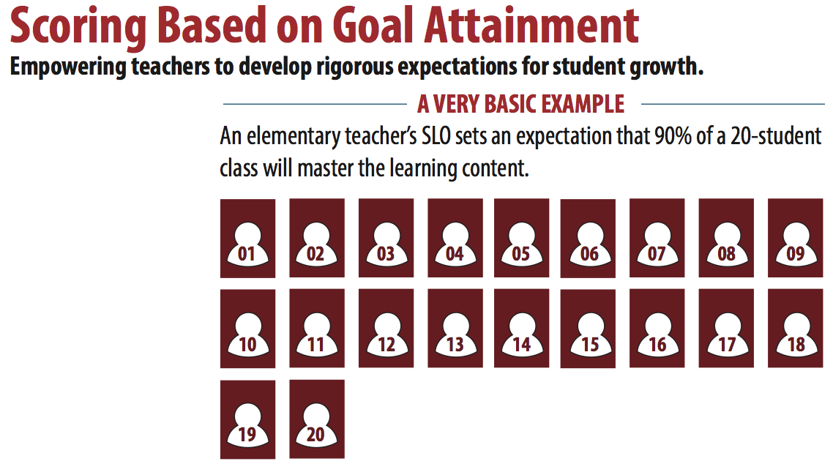
Notes:
This simple example demonstrates how to calculate a growth rating based on a class mastery SLO growth goal that 90% of a 20 student class will master the identified learning content.

Slide 42
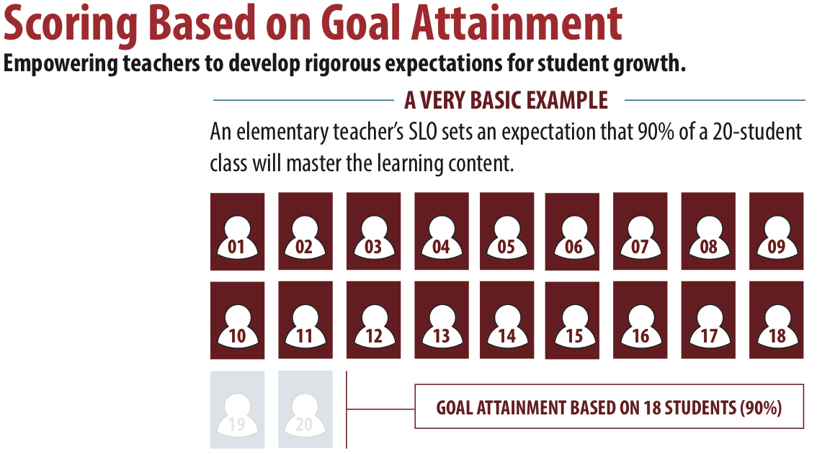
Notes:
The SLO growth goal is for 90% of a 20 student class will master the identified learning content. 90% of 20 students = 18 students. Therefore, the goal is for 18 of 20 students to master the learning content.

Slide 43
Teachers: Student Growth Rating
A teachers’ student growth rating is determined by the percentage of goal attainment and is classified into one of three performance categories.
LOW GROWTH: Less than 65% goal attainment
EXPECTED GROWTH: Between 65% and 85% goal attainment
HIGH GROWTH: Between 85% and 100 goal attainment.
Notes:
Let’s revisit the student growth rating categories as they relate to the example SLO of 90% of 20 students mastering the learning content. Remember that 90% of 20 students is 18 students. The goal is for 18 of 20 students to master the learning content. The growth rating will be based on how much of the goal was attained. In other words, how much of the 18 student goal was attained?

Slide 44
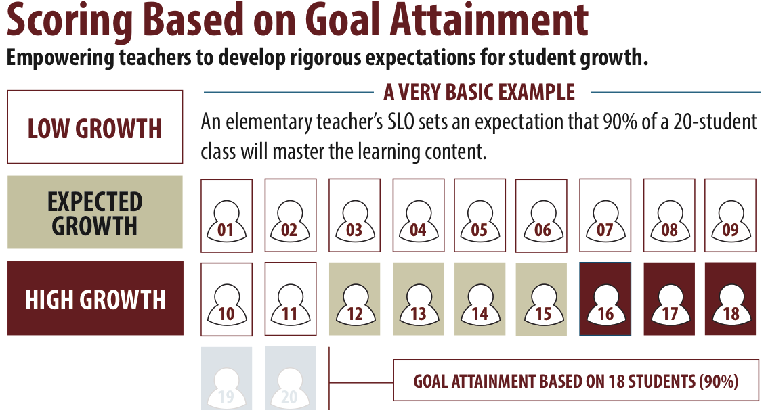
Notes:
Using our SLO growth categories, we are able to show how many students master the learning content in order to achieve Low, Expected, or High growth.
The SLO growth goal is for 90% of a 20 student class will master the identified learning content. 90% of 20 students = 18 students. Therefore, the goal is for 18 of 20 students to master the learning content.
If less that 65% of the SLO goal is attained, that is identified as low growth. Less than 65% of the 18 student goal would be if only 1 to 11 students mastered the content instead of the goal of 18 students.
If 65%-85% of the SLO goal is attained, that is identified as expected growth. 65%-85%of the 18 student goal would be 12-15 students mastering the content instead of the goal of 18 students.
If 86%-100%% of the SLO goal is attained, that is identified as high growth. 86%-100%of the 18 student goal would be 16-18 students mastering the content instead of the goal of 18 students.
As the example illustrated, student growth is not dependent on attaining the SLO goal at 100%. It is based on a percentage of the goal attained.
This concludes Module 4 in the Teacher Effectiveness System series: SLO overview.

Slide 46
Module 5 : Teacher Effectiveness System Summative Growth Rating
*Optional
Notes:
The final module in the Teacher Effectiveness System series will demonstrate how the summative Teacher Effectiveness ratings may be derived from combining the Professional Practices Rating and Student Growth Rating using a unique matrix system. The overall Summative Teacher Effectiveness Rating differentiates Teacher Effectiveness into one of three performance categories: Below Expectations, Meets Expectations, or Exceeds Expectations.
Just a reminder, combining the Professional Practice Rating and the Student Growth Rating into a Summative Teacher Effectiveness Rating is optional.

Slide 47
Summative Effectiveness Rating Scoring Matrix
 |  | PROFESSIONAL PRACTICE RATING
 |  | UNSATISFACTORY | BASIC | PROFICIENT | DISTINGUISHED
STUDENT GROWTH RATING | HIGH
 | EXPECTED
 | LOW
Notes:
USING A MATRIX MODEL TO DETERMINE SUMMATIVE TEACHER EFFECTIVENESS RATINGS
The recommended matrix model does not rely on uniform, prescriptive formulas to calculate a Summative Teacher Effectiveness Rating. Instead, the matrix guides the assignment of the Summative Teacher Effectiveness Rating while providing opportunities for professional judgment to be exercised.
Professional Practice and Student Growth Ratings are represented in the columns and rows of the matrix. The Summative Teacher Effectiveness Rating, determined by the intersection of the two individual ratings, translates into one of three required performance categories.
The physical construction of the recommended Summative Rating Matrix reflects the emphasis placed on professional practice evaluations. A closer examination of all 12 areas of intersection reinforces the priority placed on professional practice ratings. For example, a teacher earning a Professional Practice Rating of Proficient or Distinguished is, by default, assigned a Summative Teacher Effectiveness Rating of at least Meets Expectations.

Slide 48
Summative Effectiveness Rating Scoring Matrix
 |  | PROFESSIONAL PRACTICE RATING
 |  | UNSATISFACTORY | BASIC | PROFICIENT | DISTINGUISHED
STUDENT GROWTH RATING | HIGH
 | EXPECTED
 | LOW
Notes:
This view highlights the student growth rating which is delineated by the rows running left to right. There are three categories of student growth: Low, Expected, and High. The student growth rating is based on the percentage of goal attainment as explained in previous modules.
Student Growth as One Significant Factor
The design of the recommended Summative Rating Matrix assigns significance to student growth measures while maintaining focus on instruction and classroom environment relative to professional practices based on the South Dakota Framework for Teaching. Student growth remains a key piece of the system, as no educator receiving the lowest Student Growth Rating can receive the highest Summative Teacher Effectiveness Rating within the system.

Slide 49
Scoring Matrix
 |  | PROFESSIONAL PRACTICE RATING
 |  | UNSATISFACTORY | BASIC | PROFICIENT | DISTINGUISHED
STUDENT GROWTH RATING | HIGH
 | EXPECTED
 | LOW
SUMMATIVE TEACHER EFFECTIVENESS RATING CATEGORIES
BELOW EXPECTATIONS | MEETS EXPECTATIONS | EXCEEDS EXPECTATIONS
Notes:
Examining the placement of the colored squares within the matrix and comparing that to the rating categories key below the graphic, we can see that a summative score that falls in the pink boxes is a below expectations rating, a score that falls in the gray boxes is a meets expectations rating, and a score that falls in the royal blue boxes is an exceeds expectations rating.
Please note that earning the lowest or highest score in either professional practices or student growth does not automatically indicate a low or high summative rating. Both parts play a role in the summative score.
The graphic shows a simple example of using the scoring matrix to identify a summative score. In this example, we see that the professional practices rating of proficient was earned, and the student growth rating of expected was achieved. We can simply intersect the two points to indicate this teacher earned a rating of meets expectations.

Slide 50
Teacher A
 |  | PROFESSIONAL PRACTICE RATING
 |  | UNSATISFACTORY | BASIC | PROFICIENT | DISTINGUISHED
STUDENT GROWTH RATING | HIGH
 | EXPECTED
 | LOW
SUMMATIVE TEACHER EFFECTIVENESS RATING CATEGORIES
BELOW EXPECTATIONS | MEETS EXPECTATIONS | EXCEEDS EXPECTATIONS
Notes:
For example….
Teacher A has been observed and demonstrated proficiency in professional practice ratings, and has artifacts/evidence that support a Proficient level of performance according to The SD Framework (Danielson).
SLO’s are set, monitored and “Expected” growth is achieved.
The two measures are applied to the matrix and where the two meet indicate “Meets Expectations” Rating for Teacher A.

Slide 51
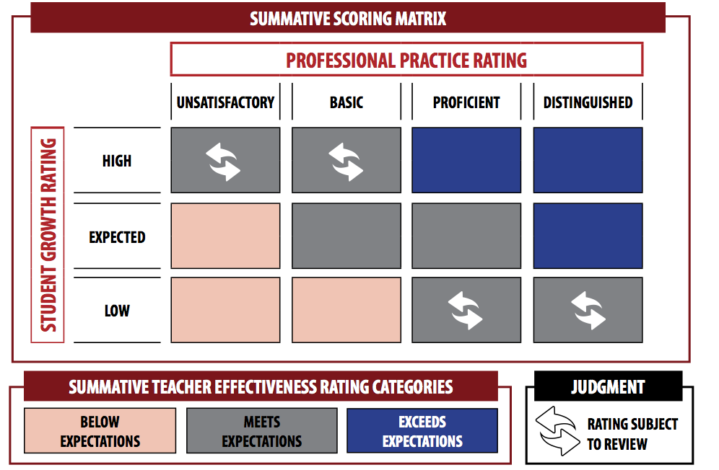
Scoring Matrix
Notes:
EXERCISING PROFESSIONAL JUDGMENT TO ADJUST TEACHER EFFECTIVENESS RATINGS
The Summative Rating Matrix embeds opportunities for professional judgment to play a role in the assignment of a Summative Teacher Effectiveness Rating. In the four areas in which one rating is very high and another rating is very low, individual ratings are reviewed to ensure the rating is fair and accurate based on all evidence collected. The teacher and evaluator may agree that additional evidence may be required, and Summative Teacher Effectiveness Ratings can be adjusted if it is determined that the outcome misrepresents teaching performance.
Supporting Professional Judgment with Evidence and Documentation
High quality implementation of the South Dakota Teacher Effectiveness System is intended to establish a firm connection between instructional practice and student academic outcomes. Exercising professional judgment should be rare; reserved only for situations in which the body of evidence clearly demonstrates that a Summative Teacher Effectiveness Rating is not truly reflective of teaching performance. When professional judgment is exercised, principals include evidence and rationale in narrative form along with the summative results. If a teacher ultimately disagrees with a principal’s use of professional judgment, teachers supply evidence and accompanying narrative to accompany the summative results.
Tracking the Use of Professional Judgment
High quality implementation of the South Dakota Teacher Effectiveness System requires public school districts to track the number of times professional judgment is exercised. The data may be used to document any needed revisions or changes to the district’s policies, practice, or procedures.

Slide 52
Teacher B
 |  | PROFESSIONAL PRACTICE RATING
 |  | UNSATISFACTORY | BASIC | PROFICIENT | DISTINGUISHED
STUDENT GROWTH RATING | HIGH
 | EXPECTED
 | LOW
Judgment
Rating Subject
To Review
SUMMATIVE TEACHER EFFECTIVENESS RATING CATEGORIES
BELOW EXPECTATIONS | MEETS EXPECTATIONS | EXCEEDS EXPECTATIONS
Judgment
Rating Subject
To Review
Notes:
Another example.
Teacher B has demonstrated less than proficient professional practices during classroom observations, and has artifacts/evidence that support an Unsatisfactory level of performance according to The SD Framework (Danielson).
SLO’s are set, monitored and “High” growth is achieved.
The two measures are applied to the matrix and this teacher too falls under “Meets Expectations” Rating for Teacher B
The rating falls under the two top/right cells, therefore it is a rating that is “subject to review” and open for a judgment call from the teachers administrator.

Slide 53
Teacher C
 |  | PROFESSIONAL PRACTICE RATING
 |  | UNSATISFACTORY | BASIC | PROFICIENT | DISTINGUISHED
STUDENT GROWTH RATING | HIGH
 | EXPECTED
 | LOW
Judgment
Rating Subject
To Review
SUMMATIVE TEACHER EFFECTIVENESS RATING CATEGORIES
BELOW EXPECTATIONS | MEETS EXPECTATIONS | EXCEEDS EXPECTATIONS
Judgment
Rating Subject
To Review
Notes:
Another example.
Teacher C has high quality observations, and has artifacts/evidence that support a Distinguished level of performance according to The SD Framework (Danielson).
SLO’s are set, monitored and “low” growth is achieved. (This may be a very low achieving group of students…or perhaps the “Distinguished” rating is a bit inflated?)
The two measures are applied to the matrix and this teacher also falls under “Meets Expectations” Rating for Teacher C.
The rating falls under the two bottom/right cells..therefore it is a rating that is “subject to review” and open for a judgment call from the administrator.
In the final analysis, if the Professional Practice Rating and the Student Growth Rating are two totally opposite ratings….the administrator may choose to make a judgment call on the teachers summative rating.

Slide 54
Determining Teacher Effectiveness
Using multiple measures of professional practice and student learning
South Dakota Framework for Teaching
Student Growth
Domain 1
Domain 2
Domain 3
Domain 4
Teacher Effectiveness
Teacher Effectiveness
Planning and Preparation
Classroom Environment
Instruction
Professional Responsibilities
District Assessments
Evaluator-Approved Assessments
Classroom Observations and Evidence of Effective Practice
Components from Each of the 4 Domains
At Least 8 Components Chosen Based on District or School Priorities
Professional Practice Rating
Growth Rating
Summative Rating Matrix
Professional Oversight: Is the rating fair and accurate based on the evidence
and data shared by the teacher
Differentiated Performance Categories
Below Expectations
Meets Expectations
Exceeds Expectations
Notes:
It is fitting to conclude our series of Teacher Effectiveness system modules with another view of this graphic, which depicts all parts of the system from professional practices and SLOs to ratings and summative differentiated performance categories. Additional Teacher Effectiveness resources can be found on the DOE website. Thank you!

