Slide 1
South Dakota State Personnel Development Grant (SPDG)
District Building Leadership Teams
West River—Rapid City/Hot Spring District
May 8, 2019
Notes:
Teresa/Brandi

Slide 2

Introductions
Review of Agenda and Purpose of Meeting
Woo Hoo!
Notes:
Teresa----Purpose of the meeting/agenda---located on table & the SPDG website
Introduce the Team We are from _____ and our Woo Hoo so far this year is___________.

Slide 3
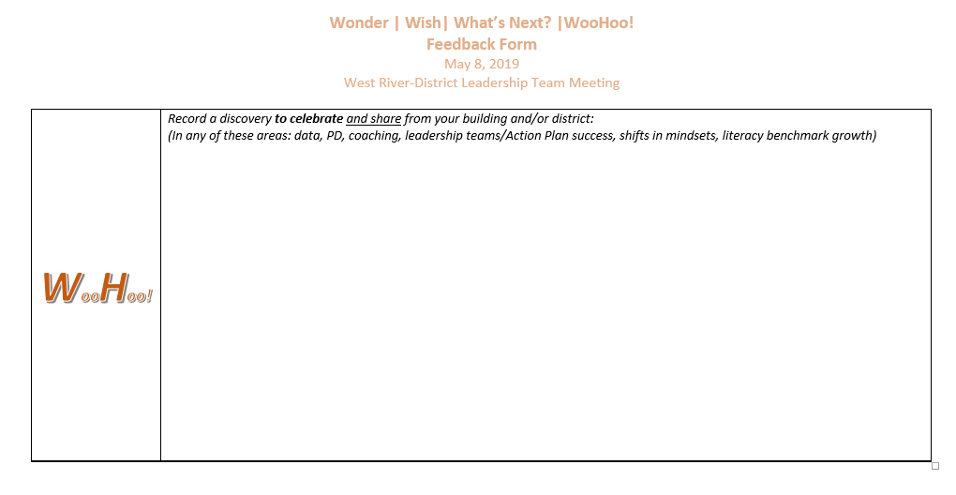
Celebrate!
Notes:
Brandi----your idea---so you can introduce the concept. I’ll do the Woo Hoo at the end of the day.
. WWWW sheets on table.
They NEED TO WRITE THESE DOWN---as we WILL collect them at the end of the day for future PR.
Tell them to keep thinking and adding any Woohoo from what they see in action plans or the data presented to them, planning for next year.

Slide 4

Notes:
Teresa
Brandi you can add on to anything you want to say ☺

Slide 5
Reviewing the SPDG
SPDG BIG PICTURE
Purpose
“The State Personnel Development program provides grants to help state educational agencies (SEAs) reform and improve their systems for personnel preparation and professional development of individuals providing early intervention, educational, and transition services to improve results for children with disabilities.”
-OSEP
Notes:
Brandi

Slide 6
SPDG Overarching Goals
Develop a system that:
Supports struggling readers (Specific Learning Disabilities) K-5
Utilizes data-driven decision making
Implements an evidence-based literacy model
Embeds coaching to ensure fidelity of implementation models
90% of budget must be spend on professional development
Provides a cohesive and collaborative system
Engages families
Develops sustainability plan after five year grant completion
Notes:
Brandi

Slide 7
School Commitments
School teams attend training to develop district implementation plans
2. All teachers grades K-5 participate
Special education (mandatory)
General education (mandatory)
Title (mandatory)
Para-professionals (optional)
3. Provide data to the Department of Education (SPDG Evaluation Plan)
4. Participate in up to two yearly meetings in Pierre
5. Conduct the R-TFI annually
6. Budget for continued support of instructional coaches
(1/2 salary, travel and benefits) after year three
7. Work with Parent Connection for family engagement strategies
8. Create Action Plans yearly and revise monthly
Notes:
Teresa---

Slide 8
SPDG Timeline
Year 1: 03/01/18 - 06/30/18
Year 2: 07/01/18 - 06/30/19
Year 3: 07/01/19 - 06/30/20
Year 4: 07/01/20 - 06/30/21
Year 5: 07/07/21 - 06/30/22
Notes:
Teresa

Slide 9
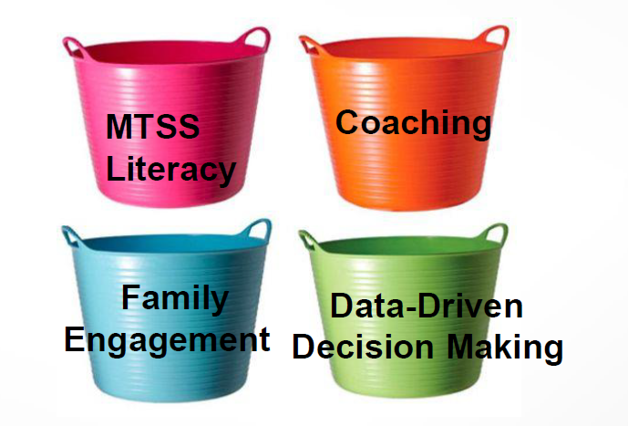
SD SPDG – Four “Buckets”
Notes:
Teresa

Slide 10

SPDG Website
https://doe.sd.gov/grants/SPDG.aspx
Notes:
Teresa
Show website
Access Action Plan revamped/agenda/power point—other documents’
Brandi---District Documents---Invoice. Budget Information------

Slide 11

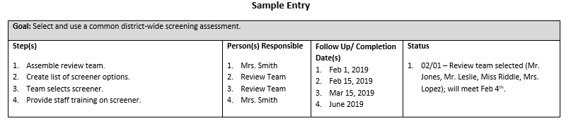
District Action Plans
Current Action Plans for 2018-2019
Action Plans for 2019-2020
DEADLINE to submit to state by June 13, 2019
EMAIL to Teresa.Berndt@state.sd.us
Notes:
Teresa
New Template due to State Leadership Team feedback in a format that is not consistent when reviewing.
Due to me by June 13th. On SPDG

Slide 12
Let’s talk about data!
Notes:
Susan
Pat/slide 16 ??

Slide 13
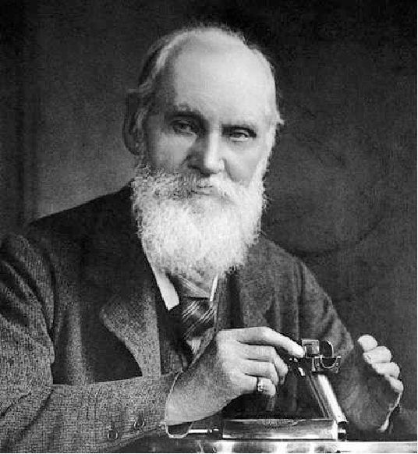
“If you cannot measure it, you cannot improve it.”
-- Lord Kelvin
Notes:
Susan

Slide 14
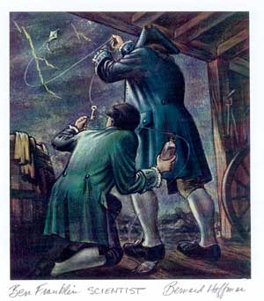
“When you are face-to-face with a difficulty, you are up against a discovery.”
-- Lord Kelvin
Notes:
susan

Slide 15
Why are data important?
Data use moves the culture from an intuition-driven, gut-feeling one to an objective, data-driven one.
Big Data/Data Analytics are here to stay – let’s use it!
Notes:
susan

Slide 16
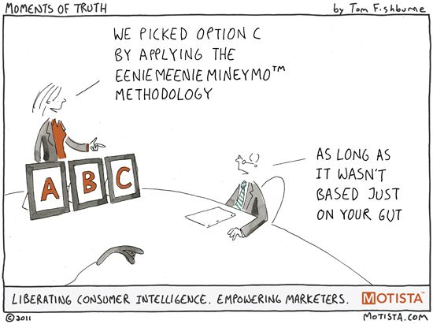
Notes:
susan

Slide 17
SD SPDG Data
OSEP Measures
Project Measures
State Test Data
Notes:
Susan

Slide 18
SD SPDG Data
OSEP requires every SPDG state to report out on three “Program Measures.”
1. Professional Development Components Rubric
2. Fidelity of Implementation – this is the one that is relevant to schools and districts!
3. Sustainability
Notes:
Susan

Slide 19
OSEP PROGRAM MEASURES
OSEP requires every SPDG state to report out on three “Program Measures.”
1. Professional Development Components Rubric
2. Fidelity of Implementation – this is the one that is relevant to schools and districts!
3. Sustainability
Notes:
Susan

Slide 20
OSEP PROGRAM MEASURES
Program Measure 2: Fidelity of Implementation
Are schools implementing the core features of the SPDG initiative with fidelity?
Fidelity information may be collected via self-assessment, but at least 20% of the participating schools must also be observed for fidelity by an external observer.
The SD SPDG uses the Reading-Tiered Fidelity Inventory (R-TFI) as its implementation measure.
Notes:
Susan

Slide 21
OSEP PROGRAM MEASURES
Program Measure 2: Fidelity of Implementation
In 2019-20, 50% of the participating schools will receive a score of 70% or higher on the appropriate fidelity of implementation checklist.
2017-18 Target: Baseline
2018-19 Target: Baseline
2019-20 Target: 50%
2020-21 Target: 70%
2021-22 Target: 70%
Notes:
Susan

Slide 22
PROJECT MEASURES
Each state also has state-specific, or “project” measures. SD SPDG project measures include:
Training participants’ self-reports of knowledge, skills, and behaviors
External observers’ ratings of participating teachers’ implementation of critical skills
Staff and family members’ ratings re family engagement
Staff members’ ratings of coaches
Student outcomes on benchmark and state tests
All of these are specified on the evaluation plan.
Notes:
Susan

Slide 23
2018-19 EVALUATION PLAN
See the SPDG Evaluation Plan Hand-Out
The evaluation plan is organized by the four buckets, plus student outcomes, plus the OSEP Measures.
Data from each of these buckets will be shared today.
The SPDG Manual of Evaluation Tools is posted here: https://doe.sd.gov/grants/documents/EVALUATION-Manual.pdf
Notes:
Susan

Slide 24
BENCHMARK DATA
Project Measure related to Benchmark Data
After three years of training:
15% of students with disabilities and 10% of students with specific learning disabilities in the SPDG schools will show an increase in their district-level benchmark reading scores over the spring 2018 baseline.
Notes:
Susan

Slide 25
STATE TEST DATA
Project Measure related to State Test Data
After three years of training:
Compared to the spring 2018 baseline, the state reading proficiency rates will increase by 7 percentage points for students with disabilities and by 3 percentage points for student with specific learning disabilities in the SPDG schools.
Notes:
Susan

Slide 26
STATE TEST DATA
Project Measure related to State Test Data
After three years of training:
Compared to the spring 2018 baseline, the percentage of students scoring at Level 1 will decrease by 15 percentage points over for students with disabilities and by 10 percentage points for students with specific learning disabilities.
Notes:
Susan

Slide 27
STATE TEST DATA
Spring 2018 Reading Proficiency
Baseline Data of the SPDG Schools
Notes:
Susan

Slide 28
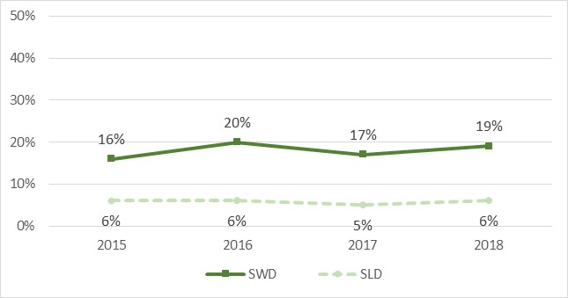
STATE TEST DATA
Spring 2018 Reading Proficiency
Baseline Data of the SPDG Schools
Notes:
Susan

Slide 29
STATE TEST DATA
Spring 2018 Percent Scoring at Level 1 Reading
Baseline Data of the SPDG Schools
Notes:
Susan

Slide 30
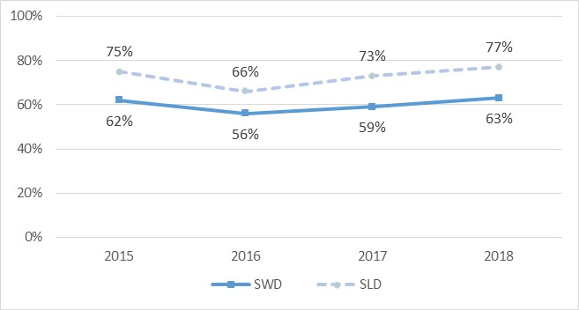
STATE TEST DATA
Spring 2018 Percent Scoring at Level 1 Reading
Baseline Data of the SPDG Schools
Notes:
Susan

Slide 31
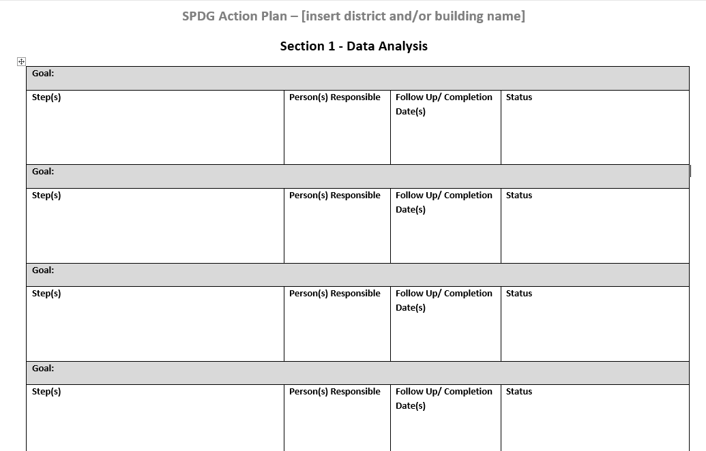
ACTION PLAN
SPDG---State Level Data District Level Building Level
Notes:
Reminder to Visit the Action Plan---Brandi

Slide 32

Questions?
W
Wonder
Wish
What’s Next
Woo Hoo!
Notes:
Teresa/Brandi help answer as needed

Slide 33

Review Data and Goals by “Bucket”
Notes:
Teresa

Slide 34

LITERACY – Year in Review
Literacy PD received/provided to district
Calendar of PD provided for coaches/goals to take back to teachers in year 1-2 Tier 1
Dashboard Report
Notes:
Teresa
Susan – data
Summer PD for Instructional Coaches
Explicit Instruction using Anita Archer’s Text
Digging Deeper into the CORE Sourcebook
Unpacked Standards & Lesson Planning Simplified
__________
Teresa
18 hours of PD reminder
*reference back to PD planning might involve thinking about how to purchases texts to support PD
New books for new teachers: Plan on how to build new teachers capacity in Literacy/Core
Foundational Reading Summer sessions. GSMUP (slide or handout on the Webpage)

Slide 35
PD Supports
What to Buy… | What NOT to buy…
Texts that support current PD in CORE/Reading Instruction (Ex: CORE Vocab text) | Assessment materials
Coach or teacher materials for literacy that connect to summer PD 2019: | Student driven materials
Explicit Instruction/Anita Archer | Curriculum Textbooks
Simplified Lesson Planning/Jill Jackson | Online reading programs
Additional CORE Sourcebook Texts for new staff, administrators, or coach | Online Subscriptions for literacy sites
Other items under consideration by a district would need to be submitted to the Co-Directors for APPROVAL PRIOR to purchase.
If not approved, the invoice can be denied for payment by SPDG funds.
Notes:
*reference back to PD planning might involve thinking about how to purchases texts to support PD
*Can/cannot buy: Assessment pieces, no curriculum, and no student materials, no online reading subscriptions or programs.
Can buy :
Explicit Instruction PD
what coaches are training you in that year. IF training in Exp Inst texts to support that work
Must have prior approval if not on this list or if you are uncertain that the invoice will be covered by SPDG funds.
New books for new teachers: Plan on how to build new teachers capacity in Literacy/Core
Foundational Reading Summer sessions. (slide or handout on the Webpage)

Slide 36
Fidelity of System Data
Reading-Tiered Fidelity Inventory (R-TFI)
Completed fall 2018 for baseline
Completed spring 2019, 2020, 2021, 2022
Provides feedback to leadership team
Shows growth
Helps with decision making
Approximately 2-3 hours to complete as a team with coach
Current RtI schools may already have already completed this process
Notes:
Pat----

Slide 37
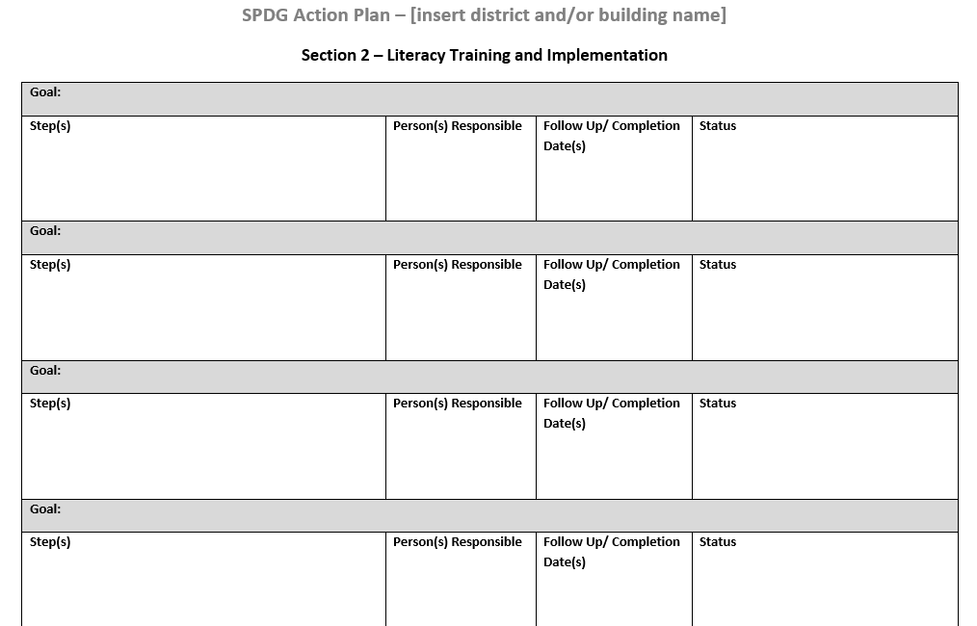
ACTION PLAN
SPDG---State Level Data District Level Building Level
Notes:
Brandi

Slide 38
Questions to Consider…
Did our PD Plan work this year? Why? If not, what are revisions needed to move the work forward next year in literacy and/or R-TFI ?
What does the data show are key areas to continue in Tier 1 instruction of the Big 5 foundational skills next year?
Did the PD calendar allow coaches to meet the 18 hours of PD required? What additions or revisions are needed?
How will we build the capacity of new teachers in our district for literacy and sourcebook training?
Are there additional PD topics on reading/strategies we could suggest for future webinars, PD, or district trainings?

Slide 39

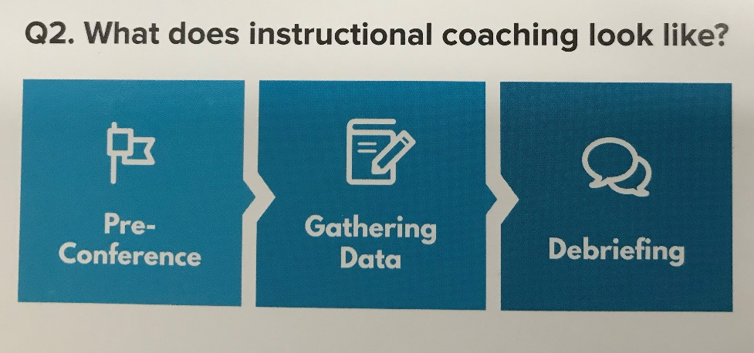
COACHING – Year in Review
Monthly coaching webinars
Graduate Credit/CEUs for coaches/teachers
Coaching cycle
Dashboard Report
Notes:
Brandi
Katie--# of Graduate credit for teachers/coaches 130 Grades were due by May 8th
Susan - data

Slide 40
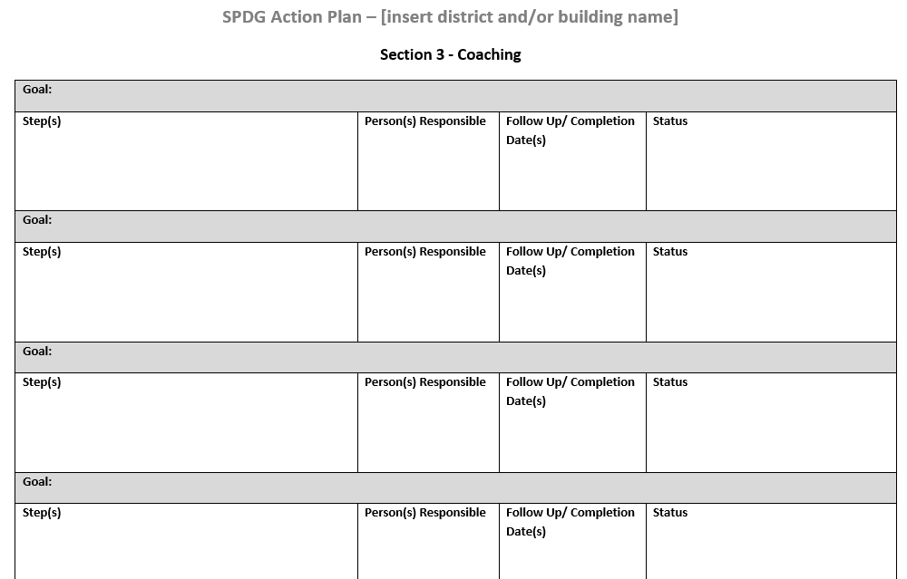
ACTION PLAN
SPDG---State Level Data District Level Building Level
Notes:
Brandi

Slide 41
Questions to Consider…
What is the role of an instructional literacy (SPDG) coach?
How will teachers be expected to work with the instructional literacy coach? How/who communicates this?
Does every teacher have access to work with the literacy SPDG coach?
What is the line of communication between literacy coach and administrator and/or district leadership team?

Slide 42
Questions?
W
Wonder
Wish
What’s Next
Woo Hoo!
Notes:
Norm
Teresa/Brandi help answer as needed

Slide 43

Notes:
Norm

Slide 44

Notes:
Norm

Slide 45

FAMILY ENGAGEMENT – Year in Review
District visits/supports
Family Friendly Walkthroughs
Family Literacy trainings and supports
Parent Literacy Toolkit
Dashboard Report
Notes:
Carla/Susan

Slide 46
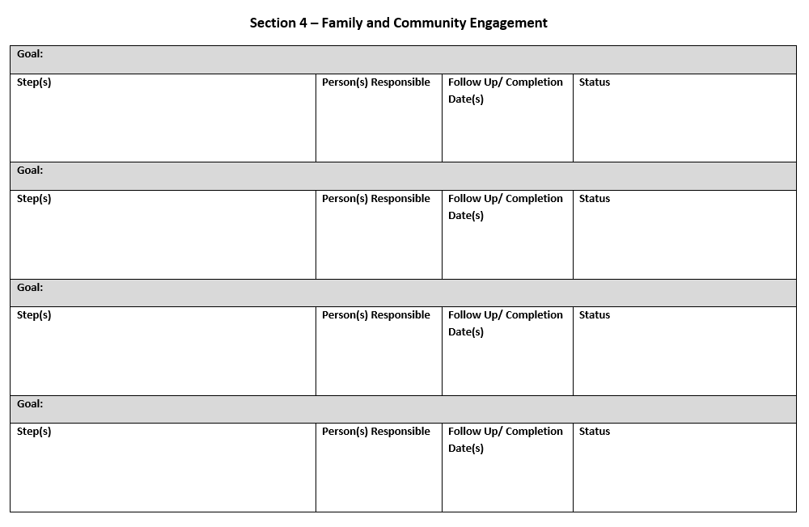
ACTION PLAN
SPDG---State Level Data District Level Building Level
Notes:
Teresa

Slide 47
Questions to Consider…
Did we provide specific information on literacy activities (Big 5) parents could do with their children? Are there ideas we want to continue? Are there new ideas to add for next year?
What worked best to distribute literacy information to parents? (Ex: literacy nights, newsletters, take-home activities, parent conferences)
What did we learn from the family friendly walk through surveys? What can we incorporate from the feedback?
Are we utilizing the Parent Connection resources efficiently? Can we do more to include their resources in district/parent communications?

Slide 48


DDDM – Year in Review
Districts completed “Year 1” processes in 2018-2019.
Work on finalizing “Year 2+” processes.
Dashboard Report
Notes:
Brandi
Coaches trained on that this summer/Aug

Slide 49

Driven by Data
Focus: Using data to make instructional decisions.
SPDG Data Workbook
Grade-level, student-level goal-setting
Identify skill gaps
Develop tiered intervention supports
Measure student progress, adjust as needed
Notes:
Brandi/Pat

Slide 50
Questions?
W
Wonder
Wish
What’s Next
Woo Hoo!
Notes:
Norm
Teresa/Brandi help answer as needed

Slide 51
Leadership & Sustainability
What is the vision for next year and beyond?
How do we sustain the four buckets?
What are your plans if leadership or coach changes?
What is your plan to continue funding your coach after year 5 of the grant?
Dashboard Report
Notes:
Brandi
After slide 43----Teresa Administrative Support Series

Slide 52
State Commitments Years 2-3 (07/01/18 - 06/30/20)
Salary for 9 coaches(salary, travel, benefits)
Up to $75,000 per coach per year
On-site support for coaches
Training materials
Travel costs for state level meetings
Substitute pay
Support for administrators to implement MTSS system
Notes:
Brandi

Slide 53
State Commitments Years 4-5 (07/01/20 - 06/30/22)
Salary for 9 coaches(salary, travel, benefits)
Up to $37,500 per coach per year
On-site support for coaches
Training materials
Travel costs for state level meetings
Substitute pay
Support for administrators to implement MTSS system
Notes:
Brandi

Slide 54
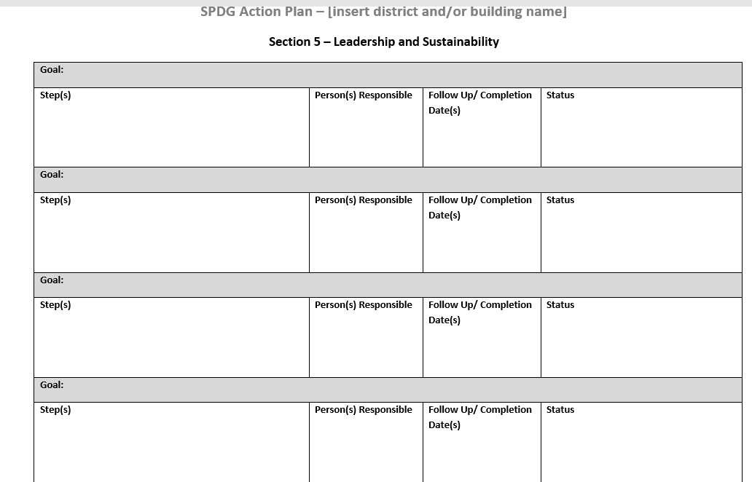
ACTION PLAN
SPDG---State Level Data District Level Building Level
Notes:
Teresa--reminder

Slide 55
Questions to Consider…
What planning is required for sustainability of this program overall?
Budget: This is one piece of the puzzle starting year 4 & 5, but what happens beyond year 5? How do those discussion start now in district teams and administrative levels?
Coaches: How will their roles continue in the district? Will they continue K-5 or will their roles expand to upper grades? Will they move to other schools in the district to duplicate SPDG elements/training?
PD: How do we maintain the literacy strategies and MTSS interventions to ensure fidelity of how they are taught? How do we train new teachers, coaches, administrators?
PD: What are topics to expand upon? How do we create a long-term plan of what is taught, when, and how many hours are needed for the scaffolding of those topics?
Leadership: How do our district leadership teams assist in long-term planning? How do we support administrators in the ongoing work?
Family Engagement: How will we include more parents on our teams and district literacy projects?

Slide 56
Questions?
W
Wonder
Wish
What’s Next
Woo Hoo!
Notes:
Norm
Teresa/Brandi help answer as needed

Slide 57


Notes:
Teresa----follow-up from a.m. woo hoo! Use WWWW sheet to capture comment. Share out

Slide 58

Notes:
Reminders on Action Plan to be submitted
SPDG website has reminders
Coaching Meeting on May 28th

