Slide 1
Finalizing End of the Year Data
in Infinite Campus
Spring 2019

Slide 2
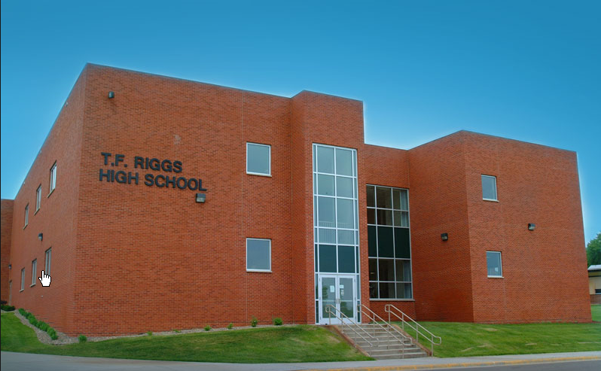
Verification of Educational Structure
At the beginning of March, the Educational Structure was finalized for the 2019-2020 school year.
Changes reported:
        New Schools
        Closed Schools
        School Name Changes
        Grade Span Changes

Slide 3
Educational Structure and Infinite Campus MUST match!
The Educational Structure grade span MUST match the grades that students are enrolled in, in Infinite Campus!
When they do not match, it causes issues with:
    SBAC Assessment – students will not show up correctly in the TIDE system
    Pre-ID files for SDSA/SDSA Alt, MSAA, and Access/Access Alt Tests
    Enrollments/Membership Counts
    State Aid
    Special Education
    Federal Reporting

Slide 4

Verification of Educational Directory
Each district will be contacted in August to update their directory information for the 2019-2020 school year.
The information that is entered here is displayed on our website and is also used to communicate with the administrators in your district.
  .
  School Board Contacts
  School Website
  Mailing/Physical addresses for Districts/Schools
  Contact information for school personnel

Slide 5
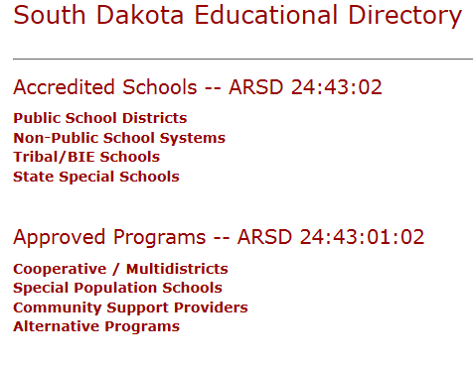
Verification of Educational Directory
If the correct contacts are not provided to DOE, you will miss out on important communications!
Please make sure the people who are doing the work are the people who are listed on our website.
http://www.doe.sd.gov/ofm/edudir.aspx
  .

Slide 6
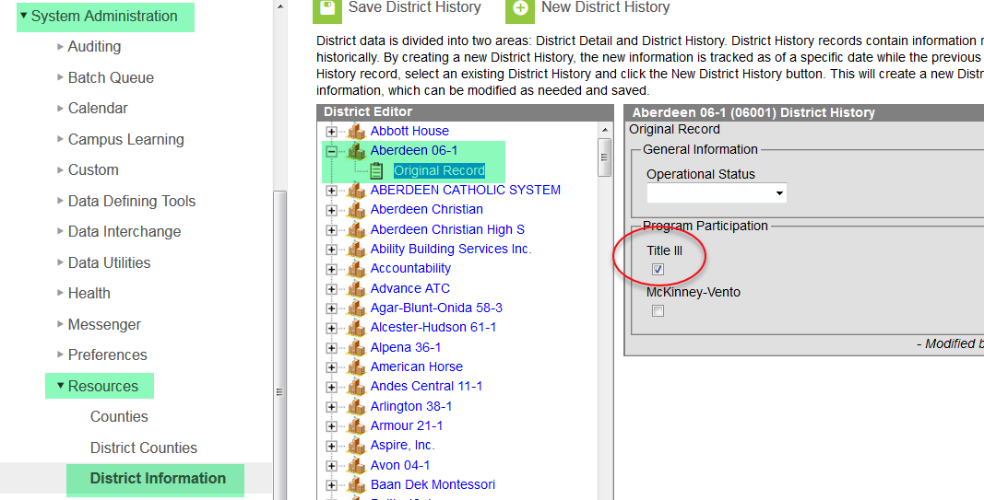
Title III Coding
If you are operating a Title III program in any of your schools the Title III Check Box in the District set up must be checked. Title III district means you receive your own Title III grant or you are part of a Title III consortium.

Slide 7
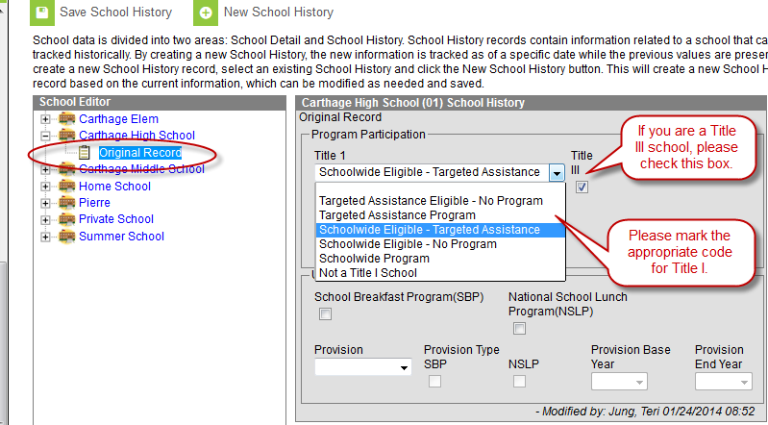
Title I Coding
System Administration>Resources>School
Notes:
Make sure that your Title I and Title II school are marked appropriately.

Slide 8
2019-2020 Calendars
Create a calendar for EVERY attendance center in your district, including:
  Home School
  Preschool
  Private Schools
  SPED/Out of District Placement
Notes:
When rolling your general ed. calendars, please make sure that you all calendars associated with your district.

Slide 9
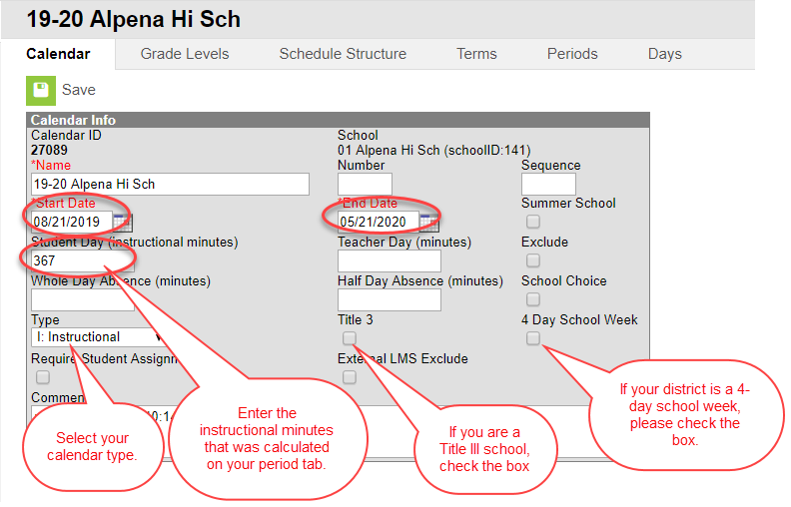
2019-2020 Calendar Requirements
Calendars are due in Infinite Campus by the last Friday in August, according to 24:17:03:08.
Start date of school year
End date of school year
Instructional minutes

Slide 10
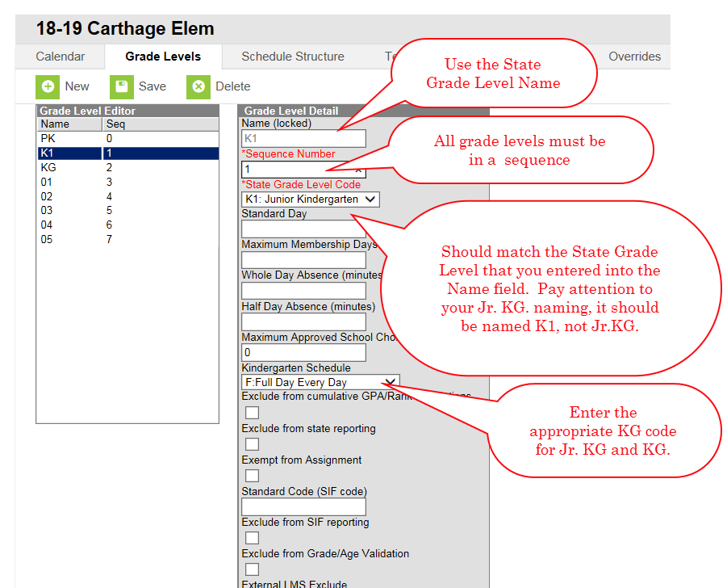
2019-20 Calendar Requirements
Grade Levels
Notes:
You can’t enter a student whose grade level is not within the grade span for that school. Example: if you grade span is 7th-8th, you are not allowed to enroll a 6th grade student into that school.

Slide 11
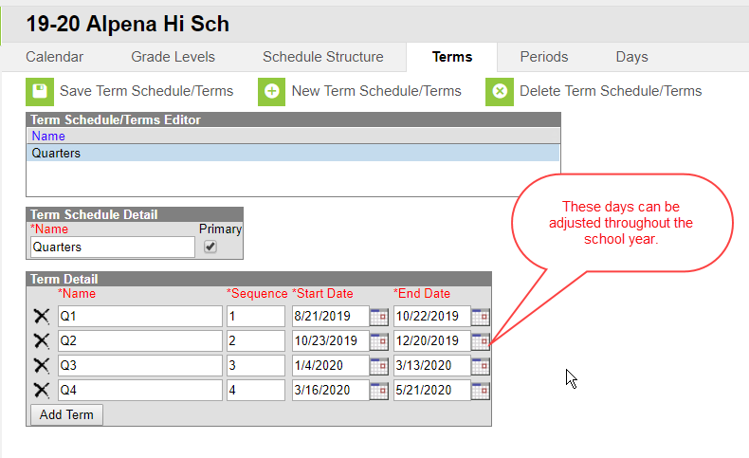
2019-2020 Calendar Requirements
Quarters/Semesters/Trimesters
Notes:
Set your term dates. Remember, you can always adjust them if you have snow days etc.

Slide 12
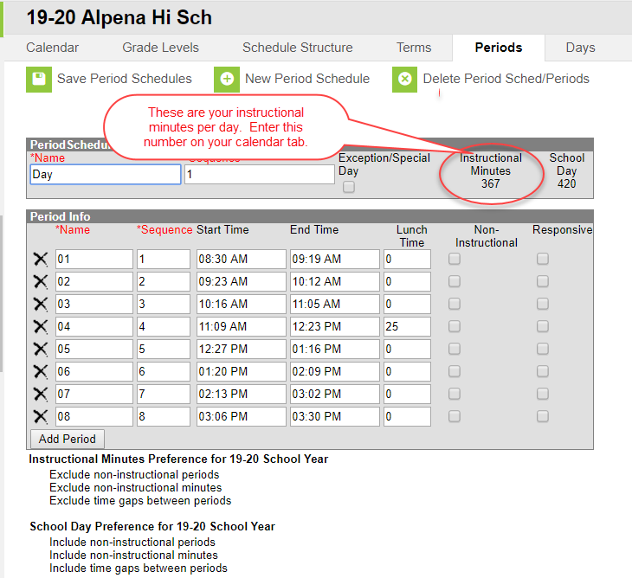
2019-2020 Calendar Requirements
Periods
Notes:
Once your period schedule is set up, it will automatically calculate your instructional minutes

Slide 13
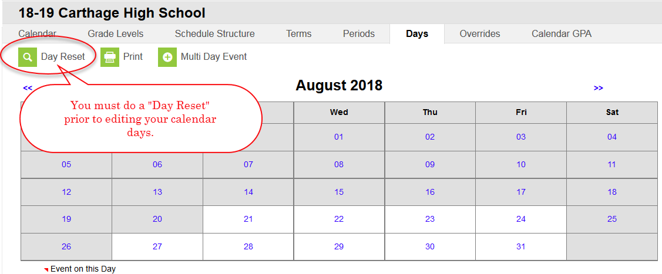
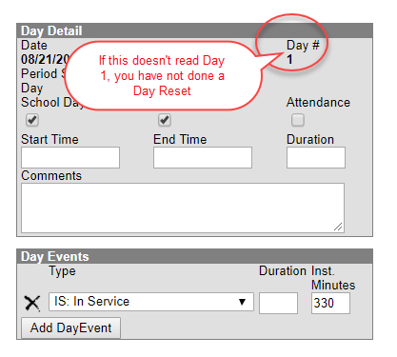
2018-2019Calendar Requirements
A Day Reset must be done on all calendars!
If a “Day Reset” is not done, your numbered calendar days will not start over for the new school year.
https://community.infinitecampus.com/knowledge-base/?tool=calendar.Calendar&version=1645

Slide 14
State Course Codes
Districts MUST make sure their local course are mapped to the appropriate State Course Codes in Infinite Campus. This information will be used for Accountability purposes (CCR Indicator, AP courses, and reporting of Accelerated Coursework on the Report Cards), and for prepopulating additional systems with course information such as the Perkins system.
http://doe.sd.gov/octe/commoncourse.aspx

Slide 15
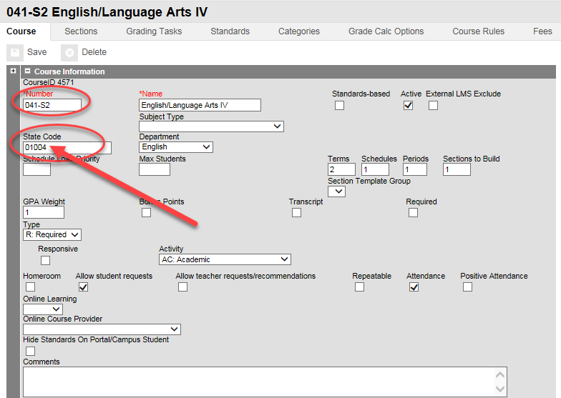
State Course Codes
88888 is to be used to identify regular high school courses not aligned to one of our state course codes.

Slide 16
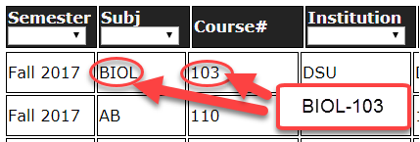
Entering A Dual Credit Course in IC
Essential to use the right coding.
The list of current Dual Credit Courses offered is on the SDMyLife website at: http://doe.sd.gov/octe/commoncourse.aspx
For all South Dakota BOR/TI Dual Credit Courses, the State Code is a “alpha code” such as BIOL-103 and WLD-114. (letters-dash-numbers) NO SPACES

Slide 17
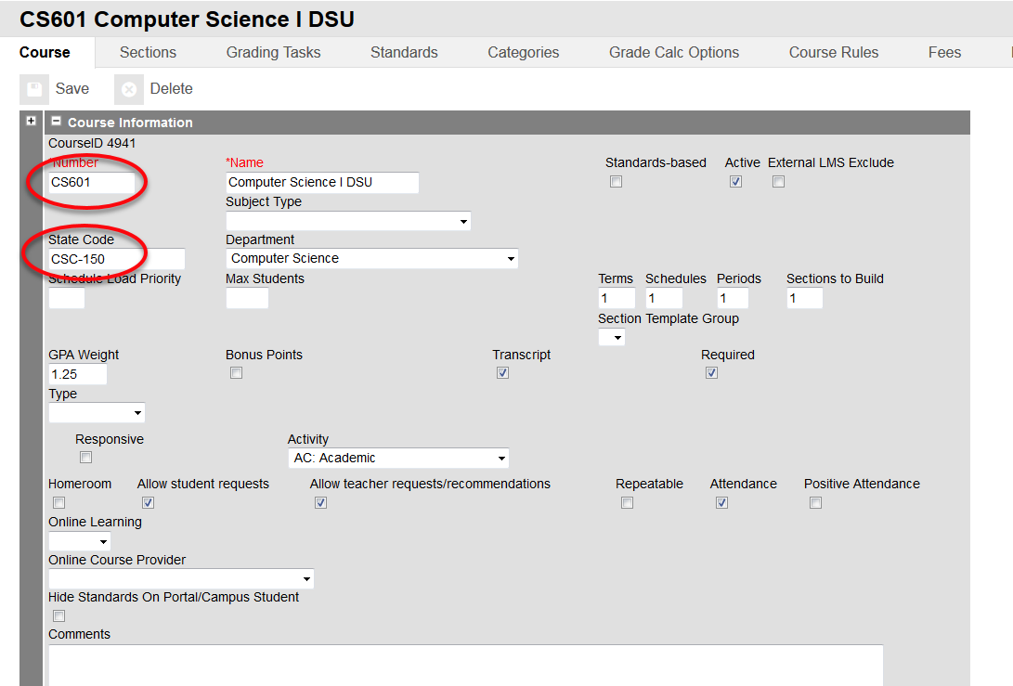
Entering A Dual Credit Course in IC
99999—To be used for Dual Credit Courses from a Private College or University such as (Mount Marty or DWU) or from an out of state College/University such as (University of MN). This is also to be used to signify a concurrent college credit course being taught by a teacher within your school district.

Slide 18
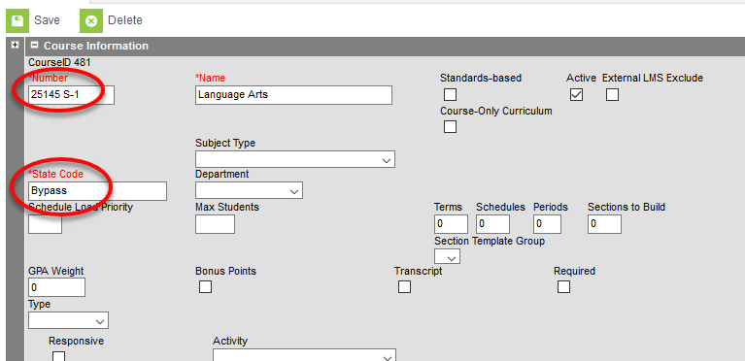
Elem/MS Course Codes
When editing an elementary or MS course, you will need to tie it to a state course code. The DOE has created the state code of “Bypass” to be used for all K-8 courses in Infinite Campus system.

Slide 19
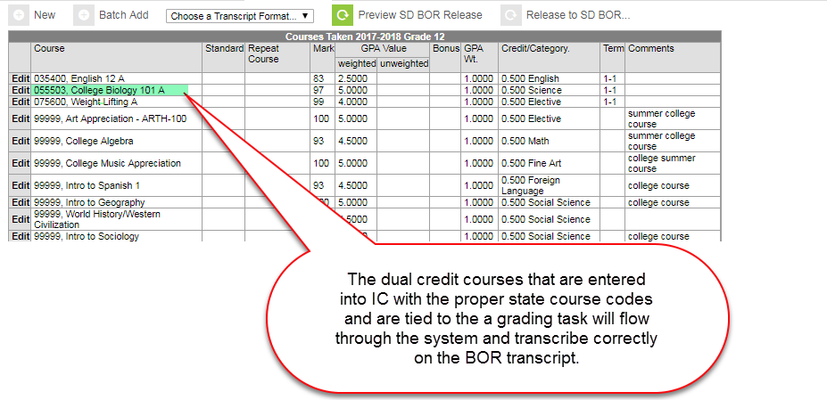
Dual Credits Entered into IC

Slide 20
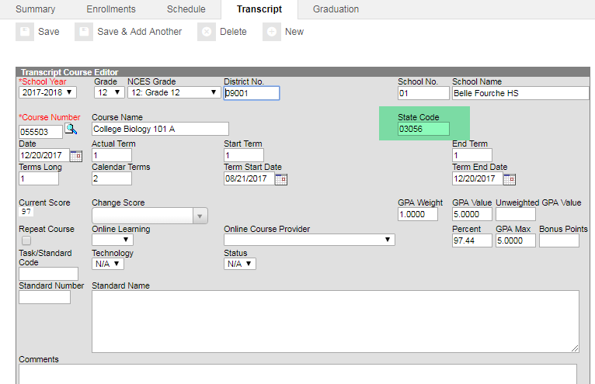
State Course Code Populated
When the dual credit course is entered into IC with the correct State Course Code and is tied to a grading task , it will flow through the system and will appear on the BOR transcript.

Slide 21
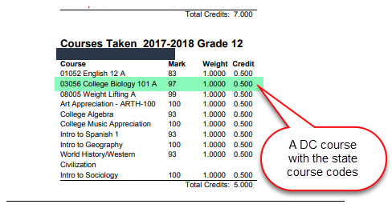
BOR Transcript

Slide 22
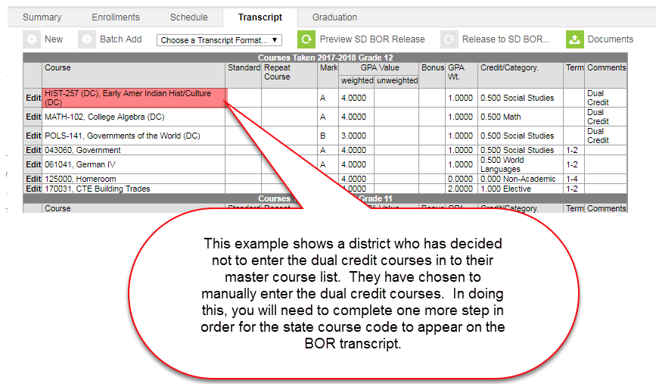
Manually Entering Duel Credit Courses

Slide 23
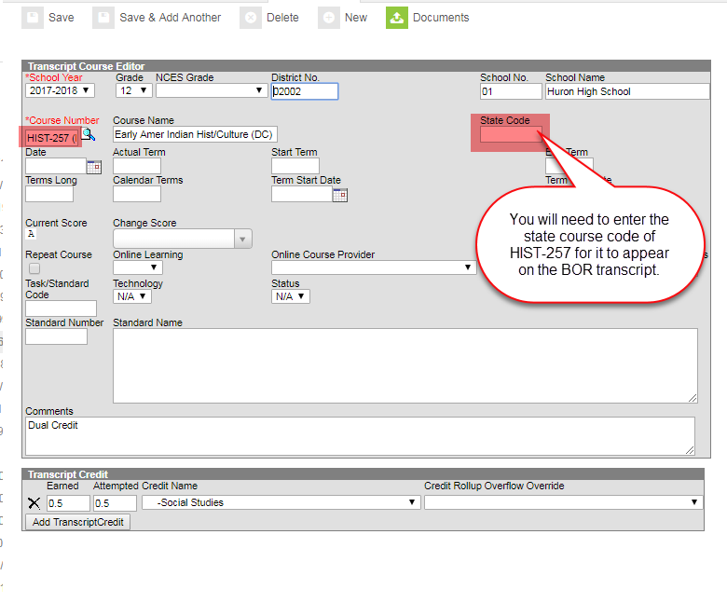
Editing the Transcript

Slide 24
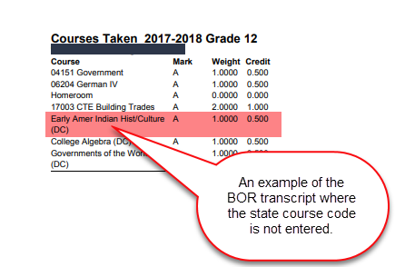
BOR Transcript w/o State Course Code

Slide 25
Industry Recognized Credentials
To meet the requirements of the South Dakota High School Graduation Advanced Career Endorsement a student must earn at least one industry-recognized credential. If the student is meeting the requirements of the endorsement through coursework in an approved CTE program (either in part or in full), the credential must be from the same cluster as the student’s coursework.
How should districts record industry-recognized credentials on the transcripts?
Districts must note students’ industry-recognized credentials on transcripts of students earn the Advanced Career Endorsement. Industry-recognized credentials should be recorded only after students have earned credentials.
We do encouraged districts to note industry-recognized credentials for all students on a transcript.
State Approved Industry Recognized Credentials
https://doe.sd.gov/gradrequirements/documents/Industry.pdf
Common Course Numbering for Industry Recognized Credentials
http://doe.sd.gov/octe/commoncourse.aspx

Slide 26
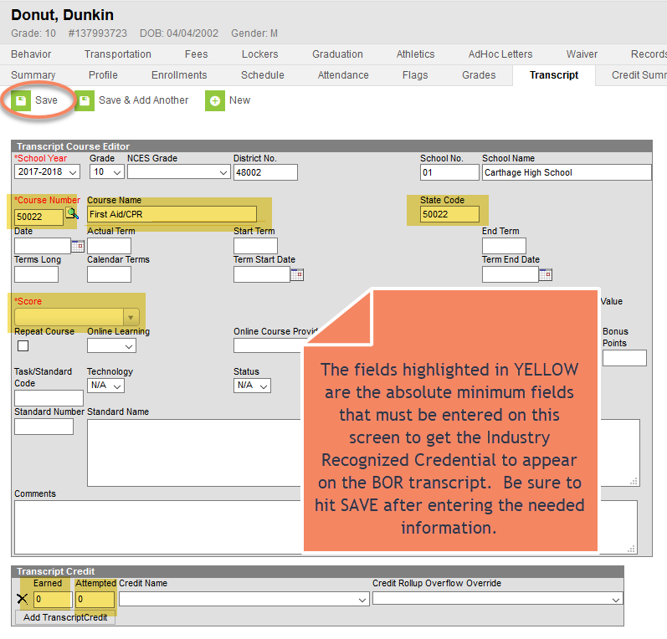
Industry Recognized Credentials
https://doe.sd.gov/octe/commoncourse.aspx

Slide 27
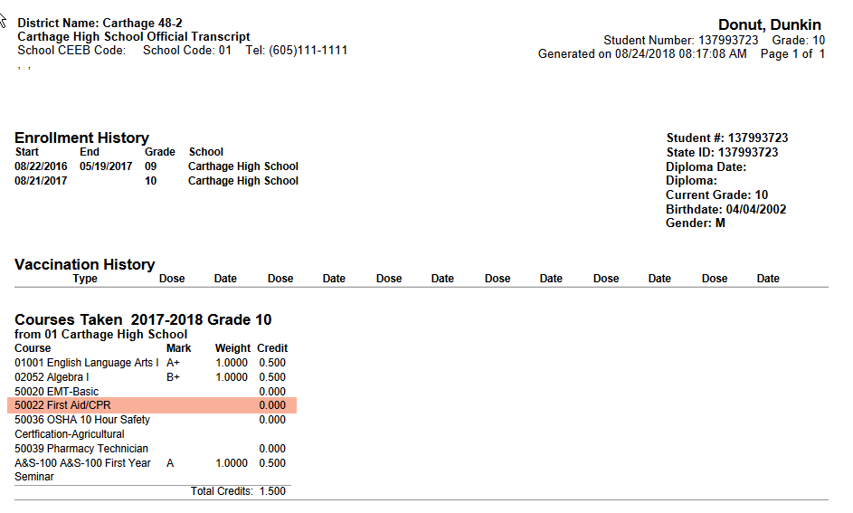
Industry Recognized Credentials
BOR Transcript

Slide 28
Finalizing 18-19 Data
For Accountability

Slide 29
Accountability - Calendars
Check all school calendars for accuracy.
Check that all snow days have been entered. SDCL 13-26-2
Make sure that the school days, instructional days and attendance boxes are checked appropriately.
If calendars are not accurate, it will impact your school’s attendance rate.
It can also impact your funding for State/County Apportionment.

Slide 30
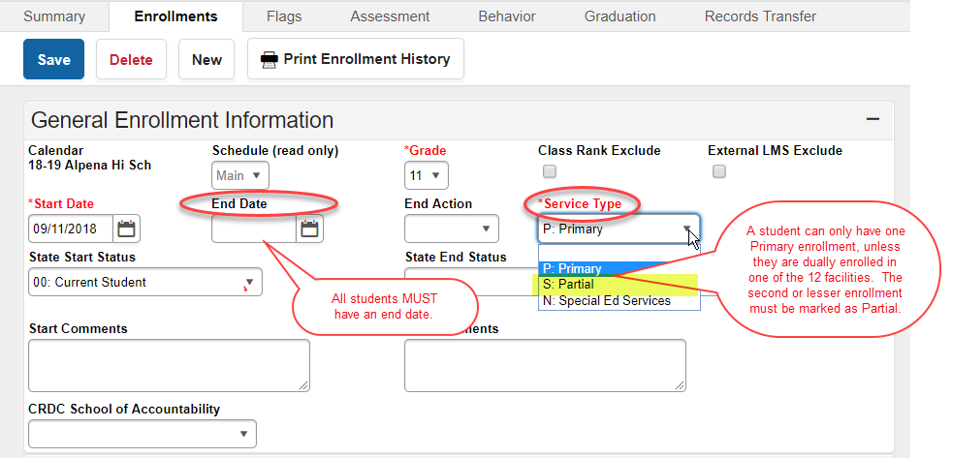
Accountability - Enrollments
Full Academic Year (FAY): October 1st – May 1st
Notes:
Make sure that all students have an end date. Please, double check the service types, as a student can only have 1 primary enrollment unless they have an enrollment in one of the 13 facilities.

Slide 31
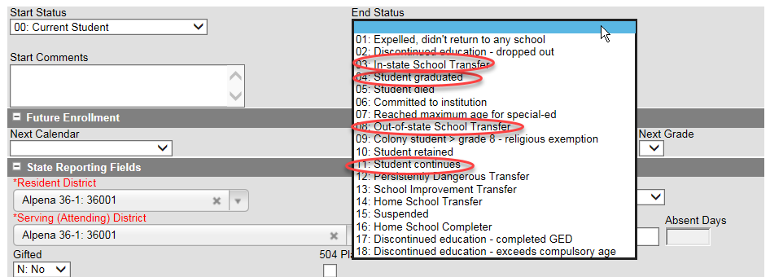
End Status
All students must have an end status.
End Status of 12: this is to be used only if a student transfers from a school that has been identified as a “Persistently Dangerous School”. This code is not to be used to indicate a “dangerous student”.
Notes:
Every student must have an end status. Circled are the most frequently used status.

Slide 32
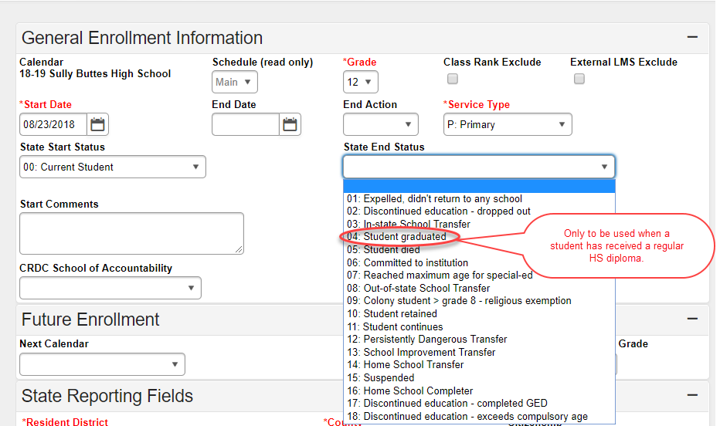
Graduates
All graduates who have received a regular HS diploma should have an end status of 04: Student graduated.
8th grade students are not considered graduates. PLEASE, do not mark them as graduates.
Notes:
All graduates must have the end status of 04: student graduated. Also, all senior end dates should be the last day of school, not the graduation date.

Slide 33
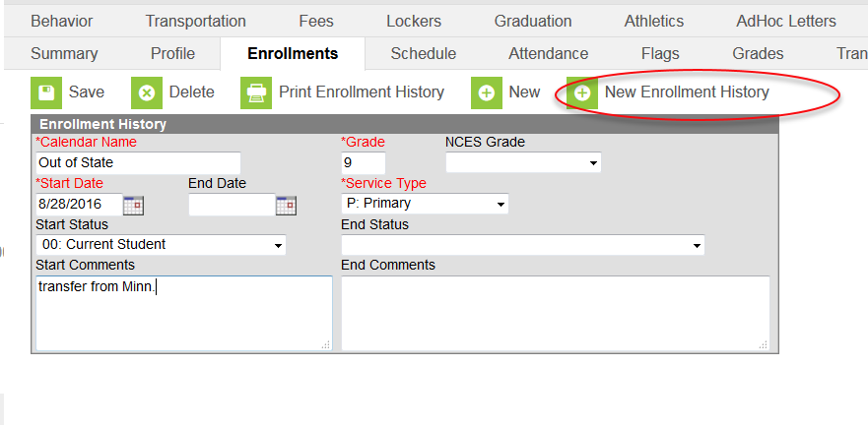
Date First Entered 9th Grade
The date is populated with the student’s first point of entry into the 9th grade.
If a student started 9th grade outside of your district, but was enrolled in a South Dakota district that has records-transfer capability, the date should populate when the records transfer process is complete.
If a student started 9th grade outside of the state, in a BIE school, in a private school, or in Brandon Valley, Rapid City or Yankton, you need to create a 9th grade Enrollment History.
Notes:
In figuring the 4-year co-hort, every student must have a 1st point of entry into 9th grade. You will need to enter the data in the fields that are red.

Slide 34
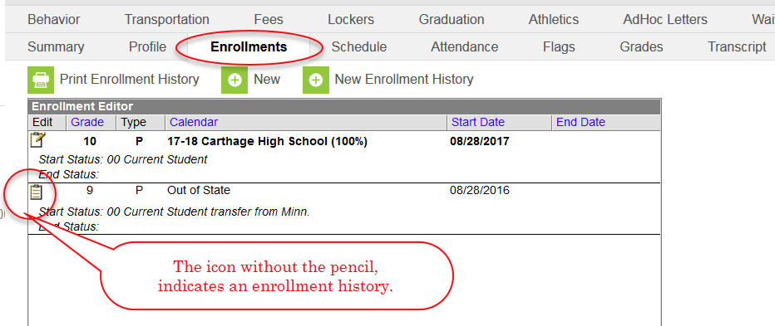
Enrollment History
Notes:
Once the enrollment history is created, you will notice that it will be listed on the student’s enrollment record. There is a difference in the icon with an enrollment history. It will have the clipboard with the pencil.

Slide 35
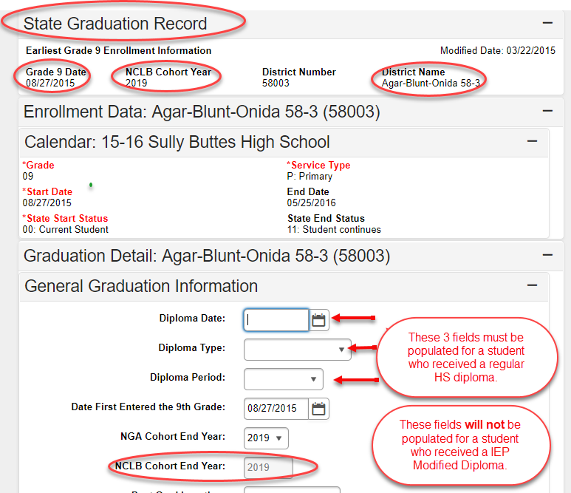
Graduation Data
Verify that all high school graduates have the Diploma Date, Diploma Type and Diploma Period updated on the GRADUATION tab in Infinite Campus. You can use the actual diploma date on this screen, or you can use the last day of school.
Verify that the NCLB Cohort End Year for all high school students has been checked to ensure that it is accurately reflecting the correct graduation cohort year on the GRADUATION tab in Infinite Campus.
Notes:
On this slide, you will also see what the state has for the co-hort year for each student.

Slide 36
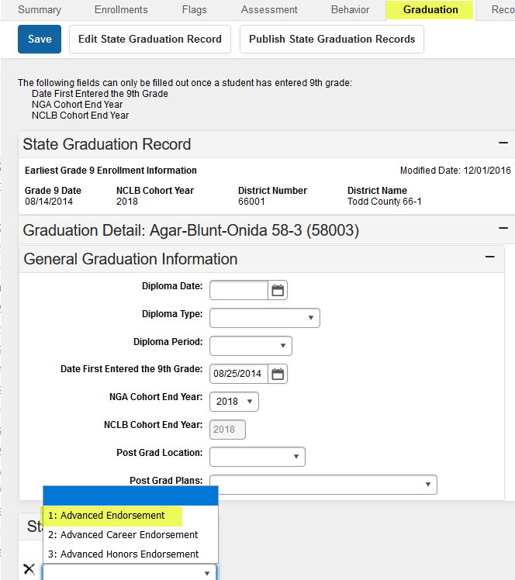
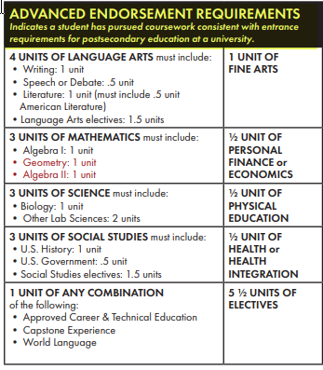
Advanced Endorsement
New Graduation Requirements = Soft Implementation 2018/19, 2019/20
Mandatory in 2020/21
Notes:
New section added to Infinite Campus with last update. State Seal Information (verbiage will be changed in future).

Slide 37
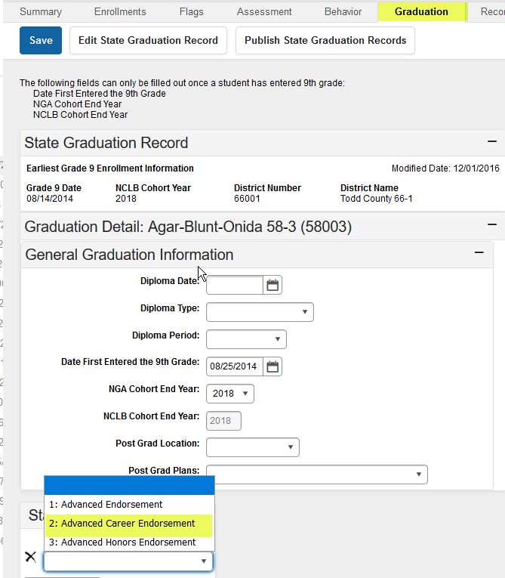
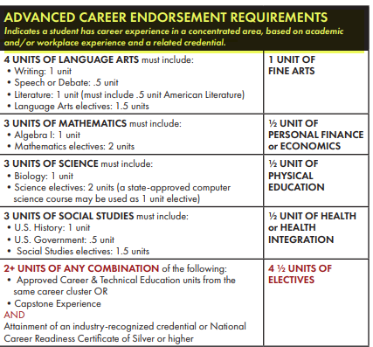
Advanced Career Endorsement
New Graduation Requirements = Soft Implementation 2018/19, 2019/20
Mandatory in 2020/21

Slide 38
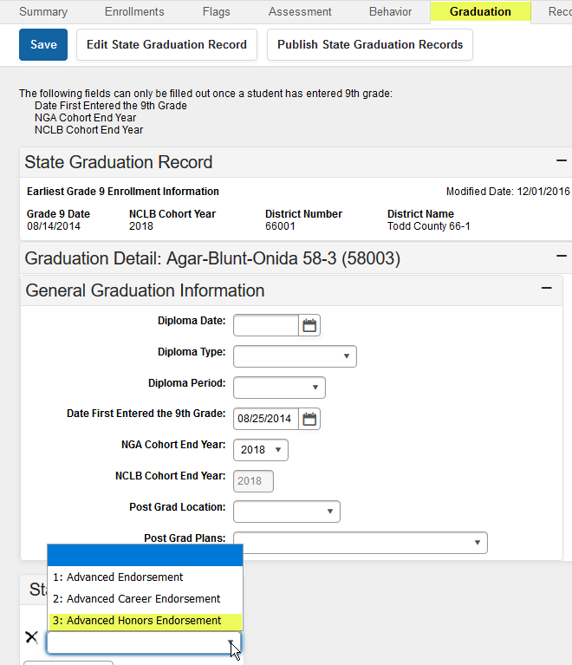
Advanced Honors Endorsement
New Graduation Requirements = Soft Implementation 2018/19, 2019/20
Mandatory in 2020/21

Slide 39
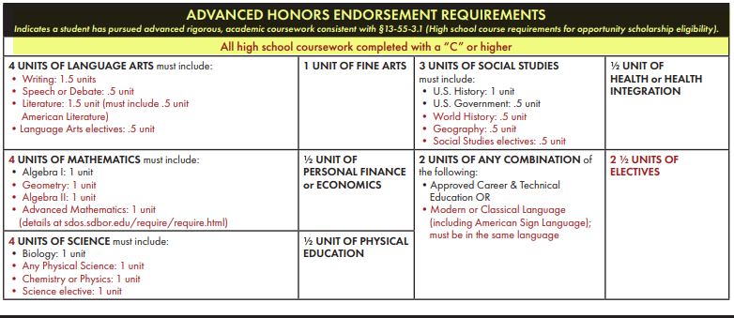
Advanced Honors Endorsement
New Graduation Requirements = Soft Implementation 2018/19, 2019/20
Mandatory in 2020/21

Slide 40
Accountability/Special Ed. Students
Can a student who has graduated with a signed regular diploma continue to receive special education services?
  No. Graduating with a signed regular HS diploma ends the student’s eligibility for Special Education.
Can a student who has received a signed IEP modified diploma continue to receive special education services?
Yes. An IEP modified diploma is not considered to be a regular SD diploma, as they did not meet the same requirements as their peers.
Can a student who has earned enough HS credits to meet the LEA graduation requirements still receive special education services until age 21?
  Yes. A student is eligible to receive special education services until the age of 21, unless they have received a signed HS diploma.
**When using the end batch tool with seniors, make sure that you ARE NOT coding students that will continue to receive special education services with an end status of: “student graduated”.

Slide 41
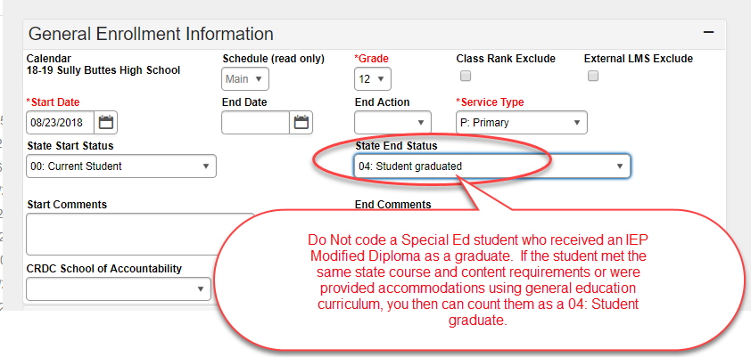
Special Education Graduates

Slide 42
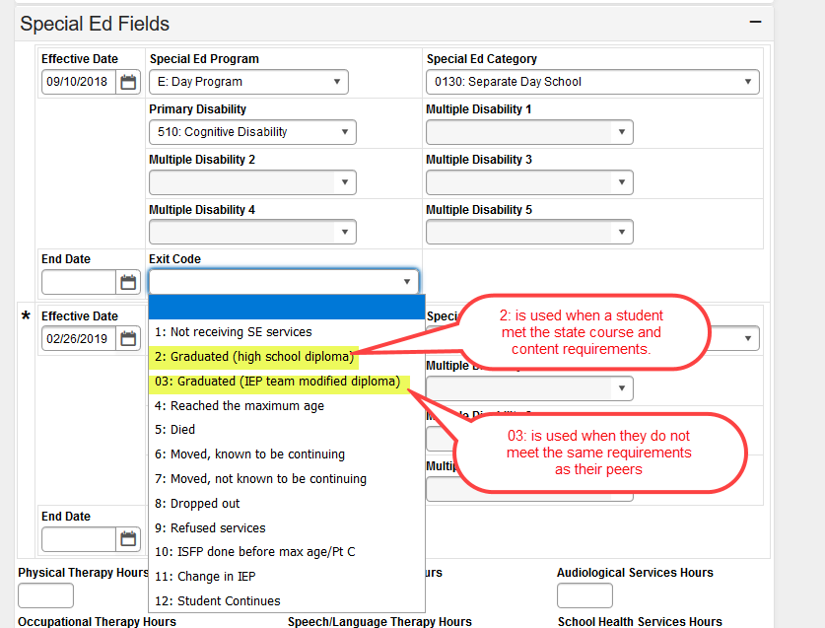
Special Education Graduate
Please note that the exit codes differ between the general education portion of the enrollment record and the Special Ed portion of the enrollment record.

Slide 43
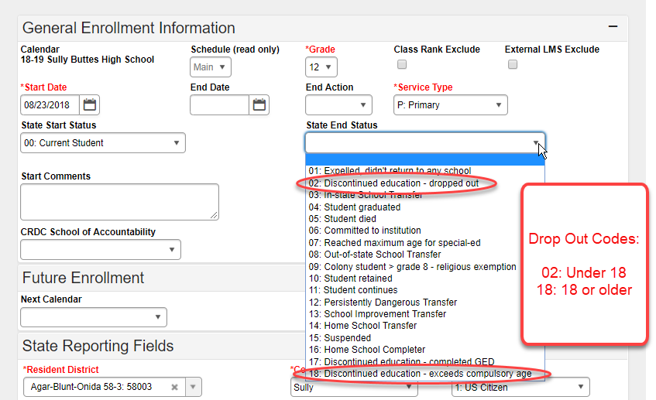
Discontinued Education/Dropout
A dropout is defined as a student that:
Was enrolled in a school at some point during the school year
Was not enrolled on the last day of school
Has not graduated from high school or completed a state approved program
Does not meet any of the following conditions:
  Transfers to another accredited school
  Has a temporary absence due to suspension or illness
  Is excused from a public attendance center (Home School)
  Death
REMINDER: If a student left to pursue their GED, they are considered a dropout until it has been completed.

Slide 44
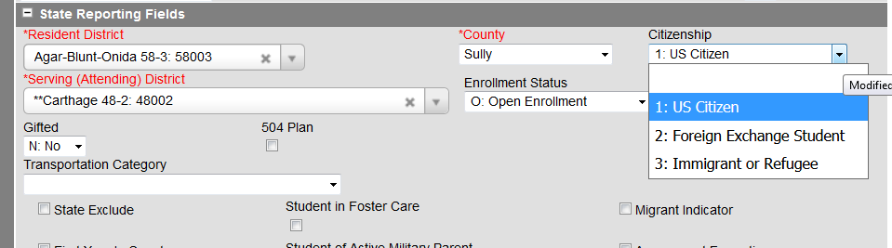
Citizenship
Verify that the Citizenship field is properly coded for your foreign exchange students and immigrants. Foreign Exchange students are not required to test and they are not included in the graduation/completer rate.

Slide 45
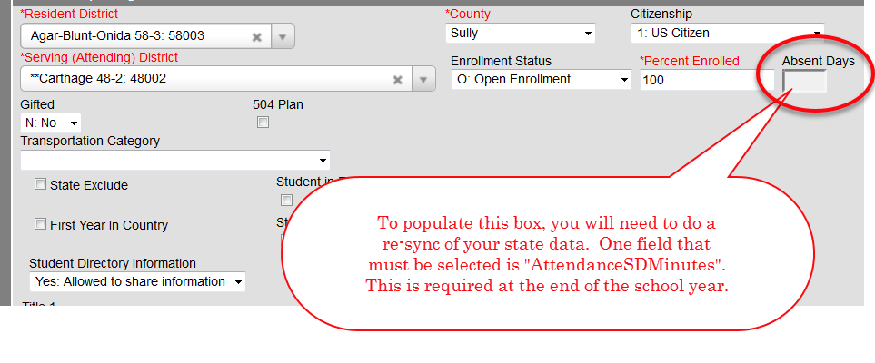
Absent Days
System Administration>Data Utilities>Re-sync State Data
Pathway to sync absent days:
Index>system Administration>Data Utilities>Resync state data> AttendanceSDMinute

Slide 46
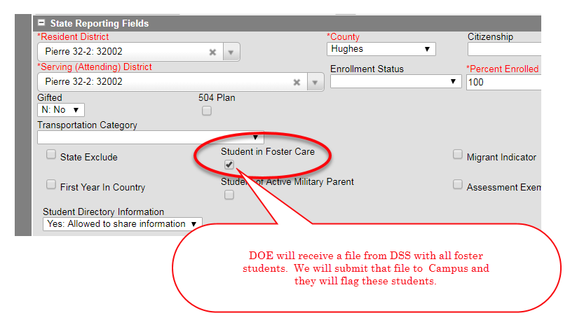
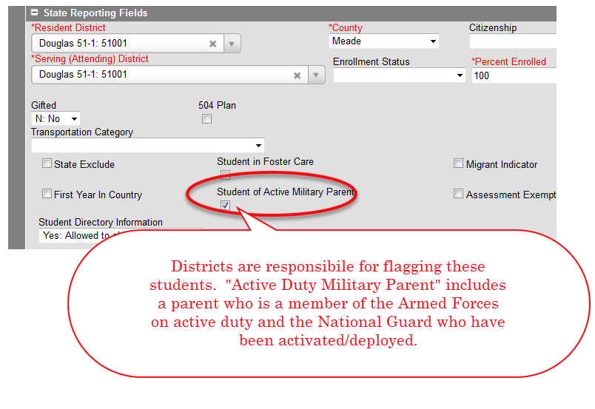
Foster/Military
*HB 1044 – HB 1044 directs that the children of active duty military who are transferred, or pending transfer, to a military institution in South Dakota meet the residency requirement for free school privileges in the district where the military parent/guardian resides or will reside. Students of active duty military can be enrolled prior to actually being served in the district. With this enrollment, the student will be enrolled at 0% until they are actually attending. You will then make a new enrollment at 100%.

Slide 47
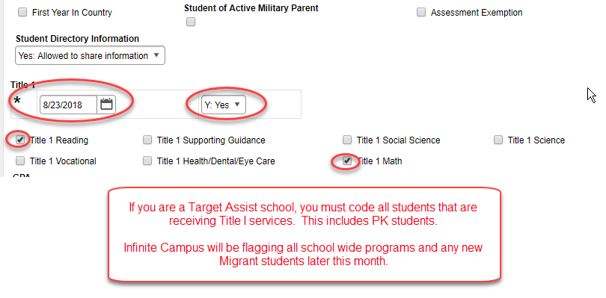
Title I – Target Assist

Slide 48
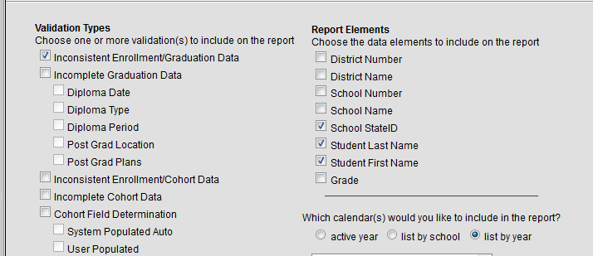
Accountability Validation
Student Information>Reports>Graduation Cohort Validations
This report lists graduation & cohort records that are not complete or do not match enrollment records.
Users can choose which validation types to include on the report. Examples: Inconsistent Enrollment/Graduation Dates, Inconsistent Enrollment/Graduation Cohorts, Incomplete Cohort Data.

Slide 49
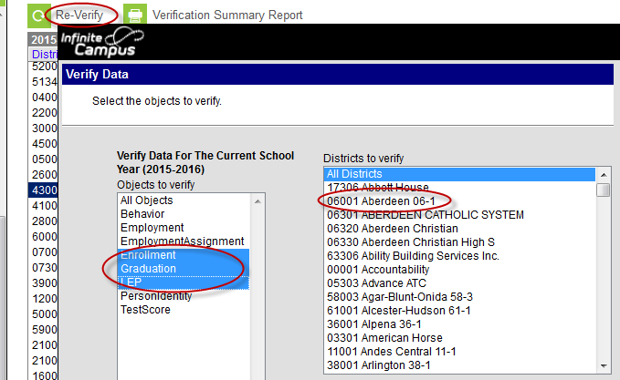
Accountability Verification
System Administration>Data Interchange>Verification
This summary tool provides information on data inconsistencies in:
  Enrollment Records
  Graduation Records
  EL Records
If you are noticing several enrollments missing at the state level, please generate a re-sync of your data.

Slide 50
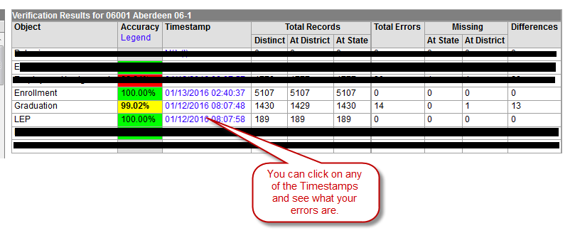
Accountability Verification

Slide 51
Accountability Ad Hoc Reports
Ad Hoc Reporting>Filter Designer> State Published
The State has designed several Ad Hoc reports to verify data.
Reports include:
  EL Students
  Citizenship
  FRAM
  Migrants
  Title I Target Assist
  Homeless
  Unaccompanied Youth
Race/Ethnicity
1st Year in Country
Student end dates/end status
Grad Tab Blank Cohort
Grad Data w/differences/state/dist.
Military
Foster Care
Notes:
These ad-hocs have been published down to the districts. They were created to help you verify your data at the end of the year.

Slide 52
New for 2019-2020
End Status on General Enrollment
Exit Codes for Sped Students
Code 19: Continues - Completed IEP team modified course requirements
Code 20: : Discontinued education - Completed IEP team modified course requirements
Code 21: Aged Out - Completed IEP team modified course requirements
Code 03: : Continues - Completed IEP team modified course requirements
Code 13: Discontinued education - Completed IEP team modified course requirements
Code 14: Aged Out - Completed IEP team modified course requirements
Code 15: Revocation of consent

Slide 53
Resources
DOE website
  http://doe.sd.gov
Student Data Collections Desk Guide
http://doe.sd.gov/ofm/documents/DataGd-18.pdf
Student Data Newsletters
http://doe.sd.gov/ofm/documents/F18-SIMnews.pdf
School Directory
http://doe.sd.gov/ofm/edudir.aspx

Slide 54
DOE Contacts
Data Management
  Judy.Merriman@state.sd.us
  Teri.Jung@state.sd.us
  Jennifer.RattlingLeaf@state.sd.us
  Clive.Bremser@state.sd.us
  Randy.Hanson@state.sd.us
  Angie Bren@state.sd.us
Assessment
  Roxanne.Weber@state.sd.us
  Accountability
  Shannon.Malone@state.sd.us
  Dorothy.Aguliera-BlackBear@state.sd.us
Title I
  Shannon.Malone@state.sd.us
LEP/ELL
  Yutzil.Becker@state.sd.us
Special Education
  Linda.Turner@state.sd.us

