Slide 1
September 2018
DOE – Data Management State Reporting User Groups

Slide 2
Review District & School
Contact Information
WAS DUE September 1st!
Find your school district on the DOE website at http://www.doe.sd.gov/ofm/edudir.aspx
Review the district information.
Review the school information for each school. (The schools in your district will be found on the right side of the district information page.)
Please make sure the person who actually does the work is the person that is listed as the contact.
If anything needs updated now, or throughout the school year, contact Jennifer at Jennifer.RattlingLeaf@state.sd.us.

Slide 3
Educational Structure
If your district is thinking of making changes to its Educational Structure for the 2019/2020 school year, these changes must be reported to the DOE during the Educational Structure Data Collection between February 1, 2019 through March 1, 2019.
  Opening new school
  Closing a school
  Grade Span changes

Slide 4
Calendars
All calendars were due the last Friday in August.
Make sure that your instructional minutes from the period tab are entered correctly on the calendar tab.
Verify that your terms and periods are entered correctly.
A Day Reset must be done before you edit any calendar days.
In-Service – You are allowed to count 5.5 hours (330 min.) as a school day and an instructional day.
Parent Teacher Conferences – allowed to count 11 hours (660 min.) as a school day and an instructional day.

Slide 5
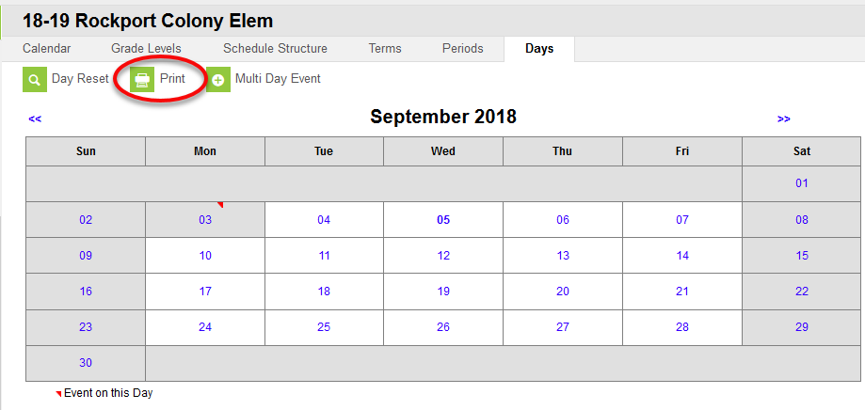
Required Minutes
Pre-School Student – minimum of 128 hours (7,608)
KG Student – minimum of 437.5 hours ( 26,250)
Grades 1-5 – 875 hours (52,500)
Grades 6-12 – 962.5 hours ( 57,570 minutes)
To check the total of instructional minutes for your schools, follow this path: System Adm>Calendar>Calendar>Days>Print

Slide 6
Student Enrollments
For accurate State Aid and Fall Enrollment Counts, districts must enter enrollment records for ALL students including Home School, Sped Out of District, Preschool and EC students.
Pre-School Student – per 24:17:01:07 – For the purpose of data collection, a preschool student is defined as a child who is at least three years of age on or before September 1st, is not enrolled in kindergarten, and is receiving educational services from a public school district for a minimum of 128 hours. A full-time preschool student is a student who is enrolled in a program that operates at least 448 hours per year. For purposes of this data collection, students enrolled in programs operated for a lesser time shall be reported on a prorated basis as a percentage of 448 hours. All public school districts operating a preschool program shall report student data for preschool students including attendance data. This definition is intended exclusively for data collection and should not be used for any other purpose.

Slide 7
Student Enrollments
EC Students -- are those not enrolled in Preschool or Kindergarten but who are only receiving Special Education services from your district. District must enter EC as a grade in the grade level field.
**NOTE** District are required to take attendance for all preschool (PK) students. Attendance is not required for student who are enrolled as EC.

Slide 8
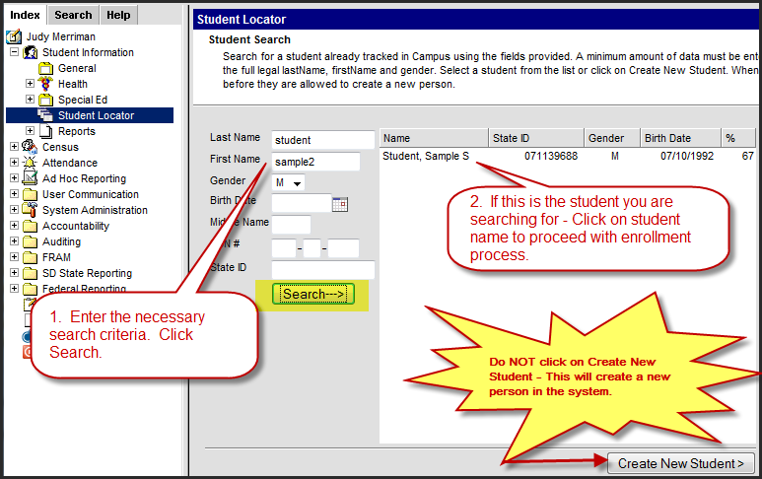
Enrolling a Student
Index>Student Information>Student Locator

Slide 9
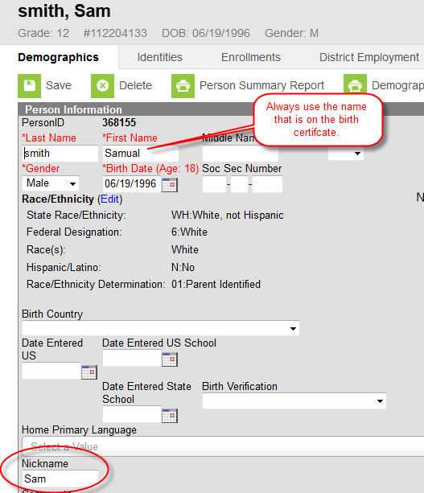
Student Names
When entering student names, do not use parentheses, commas or periods. If a student goes by a nickname, put it in the nickname field.
Jr and Sr should be entered in the Suffix box.
Do not “space” after the first or last name as that is a character in Campus.

Slide 10
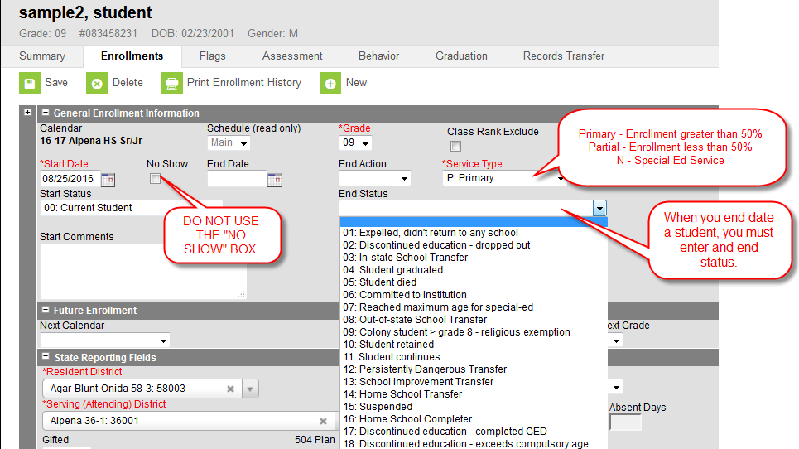
Enrollment Tab

Slide 11
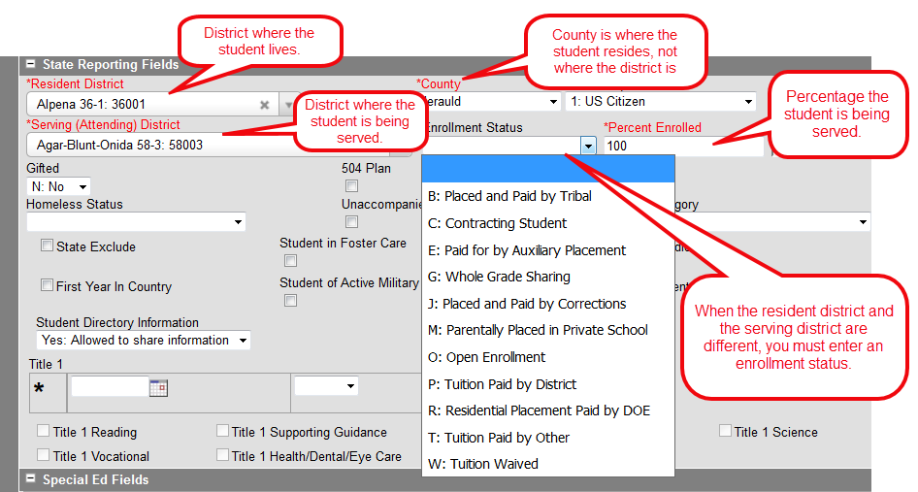
Enrollment Status

Slide 12
Enrollment Status
B: Placed and Paid by Tribal
  Used primary by BIE schools
  In few cases, public schools could use the code if the student is attending a residential treatment program operated by public school districts but paid for by the tribe.
C: Contracting Student
  Use if your district contracts students to an out-of-state educational program or if your district receives students from a contracting district.
E: Placed for by Auxiliary Placement
  Use when the student is placed by the Department of Social Services. Resident district for students with E code must be either Custody of the State (90090) or DSS Aux Placement (68302).
G: Whole Grade Sharing
  Refer to SDCL 13-15-31 (All school districts shall adopt the contract or agreement no later than February 1st of the school year proceeding the school year for which the agreement will take affect).
J: Placed and Paid by Corrections
  Use when the student is placed by the Department of Corrections. Resident district for students with J code must be either Custody of State (90090) or Department of Corrections (49321).

Slide 13
Enrollment Status
M: Parentally Placed in Private
  Use when the student is attending a private school.
O: Open Enrollment
Use when a student lives in one South Dakota school district but chooses to attend another South Dakota school district.
Use for “cross-border” enrollments with North Dakota and Minnesota.
If the student changes address during the school year that results in a change in their resident district, then the previous enrollment must be ended and a new enrollment entered with the updated resident district and the correct county of residency. In addition, Open Enrollment does not apply to students who are homeless and remain in the school of origin after moving to a different district.
PK students CANNOT be coded as Open Enrolled.
T: Tuition Paid by Other
  Use for students attending the School for the Deaf in Harrisburg & Brandon Valley
  Use for a South Dakota student enrolling in Iowa. (this pertains to Alcester-Hudson & Elk Point-Jefferson only)
  If the student’s tuition is being paid by an outside entity, such as a foundation or a program.

Slide 14
Enrollment Status
W: Tuition Waived
  This code is used for students attending the School for the Blind.
  PK students that are attending a PK program outside their resident district. Open enrollment is not allowed for PK students.
P: Tuition Paid by District
  Use when the resident district is paying for the student’s placement in another school district/facility.
  Use for an Iowa student enrolling in South Dakota.
R: Residential Placement Paid by DOE
Use for students placed in one of the below facilities for whom DOE is paying the tuition for their placement. This Enrollment code can only be used for non-IEP students.
  Plankinton – Aurora Plains Academy
  Huron – Our Home ASAP
  Mitchell – Abbott House
  Parkston – Our Home
  Spearfish – Spearfish Academy at Canyon Hills (Elementary and High School)
  Sioux Falls – Summit Oaks Residential

Slide 15
Overlapping Enrollments
Overlapping enrollments are permissible for up to 90 consecutive school days according to SD Adm. Rule 24:17:03:05 in one of the following 12 facilities.
Short Term Group Care Facilities
1. Keystone Treatment Center – Canton – 41001
2. Chief Gall Alternative – Adolescent Treatment Center – Aberdeen - 06901
3. Our Home Rediscovery – Huron – 02002
4. ARISE Shelter Care – Sioux Falls - 49005
5. Volunteers of American – Adolescent Treatment – Sioux Falls - 49005
JDC’s (Juvenile Detention Centers)
1. Aberdeen JDC – 06001
2. Huron JDC – 02002
3. Pierre JDC – 32002
4. Rapid City JDC – 51004
5. Sioux Falls JDC – 49005
6. Walworth County (Selby) JDC – 62005
7. Wanbli Wiconi Tipi (Todd County) JDC - 66001

Slide 16
Overlapping Enrollments
Resident District – They are allowed to keep an enrollment at 100% with the Service Type field marked as P: Primary. The resident district needs to track how long the student is placed at the Short Term Group Care or JDC facility and must drop the student on the 91st consecutive school day if the student is still at the facility. Remember, if you have an enrollment for a student while they are in one of the allowable facilities, you must count the student absent.
Attending District - will create an enrollment record showing their district as both the Resident and the Serving district for the period in which the student is attending the Short Term Group Care or JDC facility. The Percent Enrolled field should be marked as 100% and the Service Type field should be marked as P: Primary.
  This will allow for State Aid to be paid to both the Resident and the Attending District if the student is dually enrolled in both districts on the last Friday in September.

Slide 17
Cross Border Agreements
The SD DOE has an “Open Enrollment” agreement with North Dakota and Minnesota that allows students to choose cross border attendance .
MN or ND students enrolling in SD
Resident district 99086
Attending district 25003
Enrollment Status “O” open enrolled
% of day enrollment 100%
SD student enrolling in MN or ND
Resident district 25003
Attending district 99085 or 99086
Enrollment status “O” open enrolled
% of day enrollment 100%

Slide 18
Cross Border Continued
Agreement with Iowa is not an “Open Enrollment” type program. This agreement sets a standard and uniform amount of tuition to be paid for each student that may be placed out of district/state by their resident district.
IA student enrolling in SD
Resident district 99087
Attending district 61001
Enrollment Status “P”
tuition pd by district
% of day enrolled 100%
SD student enrolling in IA
(Alcester-Hudson & Elk Point –Jefferson only)
Resident district 61001
Attending district 99087
Enrollment status “T”
tuition pd by other
% of day enrollment 100%
SD student enrolling in IA
(All other students)
Resident district Student’s resident district
Attending district 99087
Enrollment status “P” tuition pd by district
% of day enrolled 100%

Slide 19
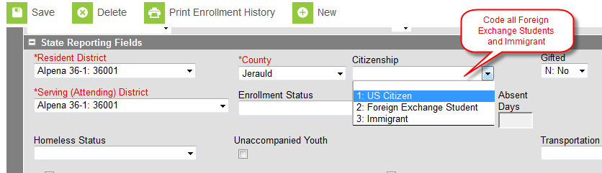
Citizenship
Immigrant Students– The term `immigrant children and youth’ means individuals who:
are age 3 through 21
were not born in any State; and
have not been attending one or more schools in any one or more States for more than three full academic years.
If the student is born outside the US, please populate the “Date Entered US” on the Demographics tab. Also, enter the date the student entered a US School and a State School.
If you have an Immigrant student who has been in the country for more than 3 years without gaining US citizenship, you will continue to mark these students as immigrants, but they will not be included in your Title III funding.
Contact Yutzil Becker at 773-4698

Slide 20
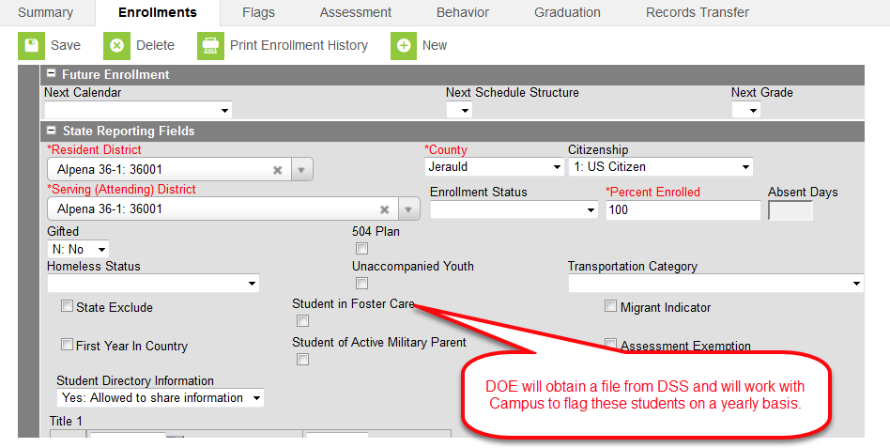
Student in Foster Care

Slide 21
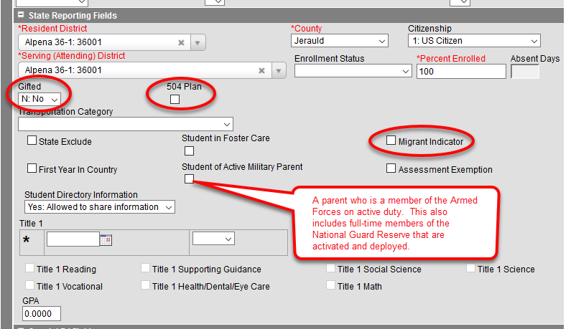
Active Military Parent

Slide 22
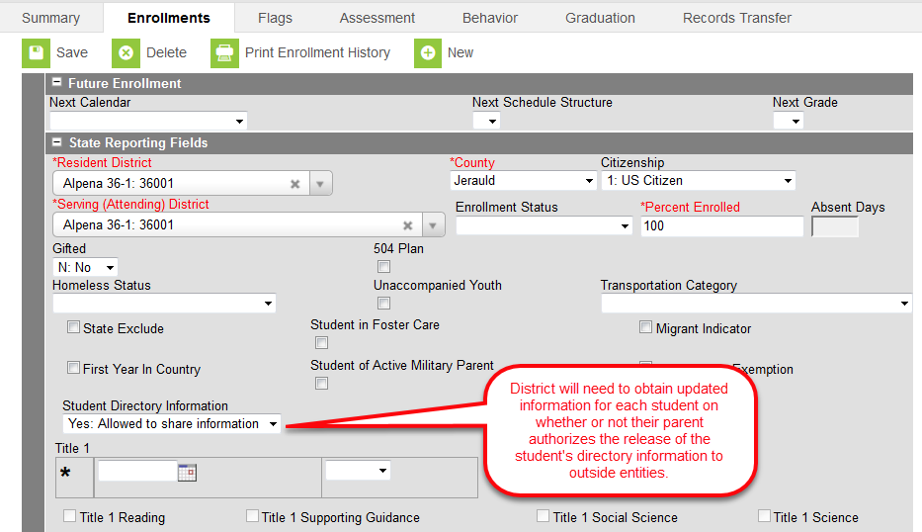
Student Directory Information

Slide 23
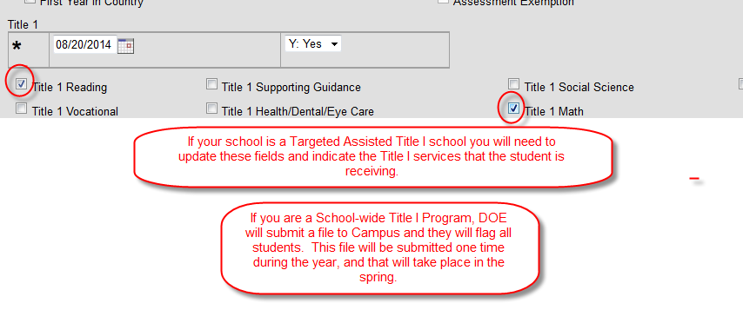
Title I
Title I - If your school is a School-Wide Title I program you do not need to update the Title I fields in Infinite Campus. The DOE will provide the list of School-Wide Title I programs to Infinite Campus and they will flag each student as receiving Title I services.
If your school is a Targeted Assisted Title I program, it is your responsibility to update the below fields on the Enrollment Tab for each of the students in your school who are receiving Title I services.

Slide 24
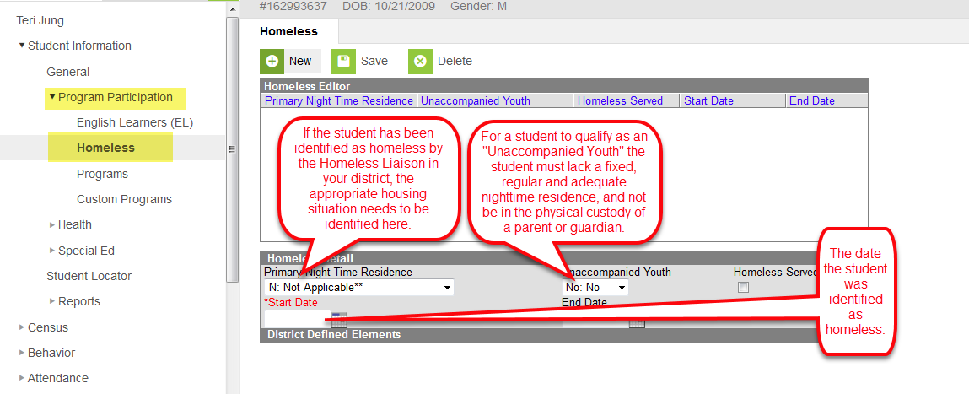
Homeless

Slide 25
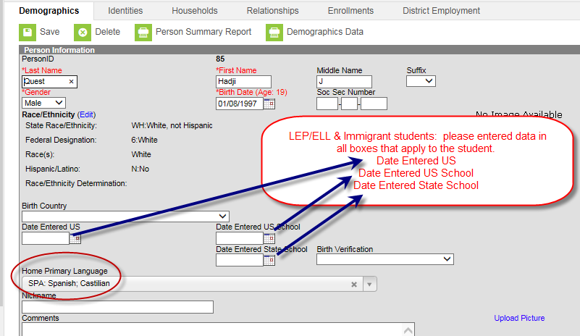
EL
Home Primary Language and Date Entered US School fields are populated on the student’s Demographics tab. This must be completed prior to entering EL information onf the EL tab.

Slide 26
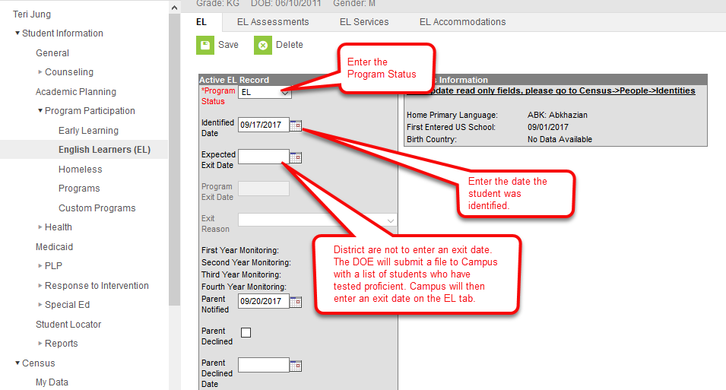
EL

Slide 27
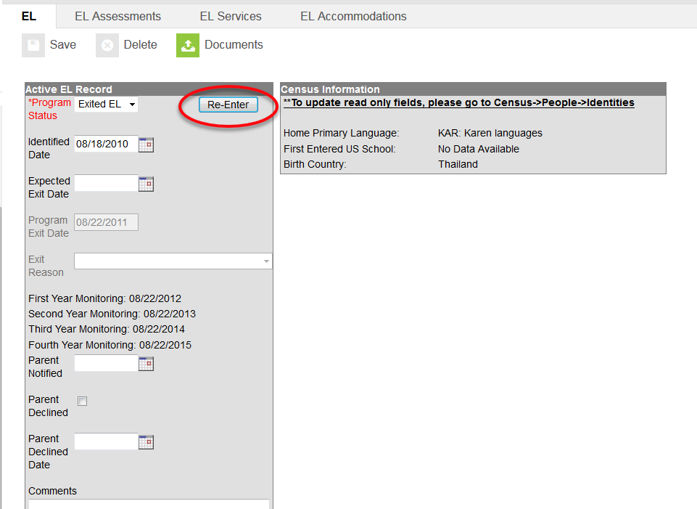
Re-Entry to EL
If a school district determines that a student is still struggling due to a language barrier, then the school may re-enter the student into the EL program.
The school must administer the screener test for those students that will re-enter.
* If a school district determines that a student is still struggling due to a language barrier, the school may re-enter the student into the EL program.
* The school must administer the screener test for those students prior to re-entering them.

Slide 28
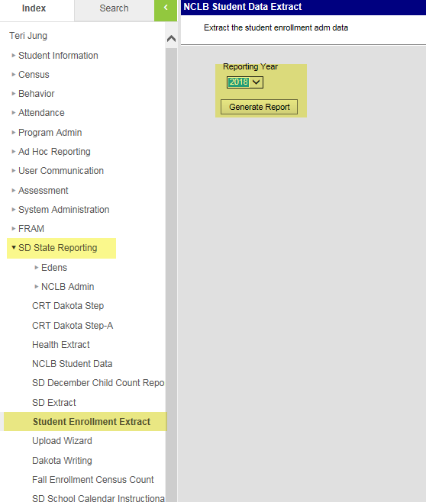
Student Extract Report
With this report, you can filter by school, grade, percent enrolled, resident & serving district.
This report will help you validate your enrollments, prior to the last Friday in September.

Slide 29
Requesting Records for a Transfer Student
Once a student is enrolled, a Records Transfer Request form will display. Enter any comments and click Submit Request. A notice will be sent to the student’s previous district.
Once the records are released to you, be sure that you use the Data Import Wizard for data that pertains to the student. This could include EL data, transcripts, assessment, etc.
One of the important reasons for using the Records Transfer is that once the records are released to the requesting district, the date the student first entered the 9th grade will populate on the Grad Tab.

Slide 30
Date First Entered 9th Grade
This is the first point of entry in to 9th grade.
If a student started 9th grade outside your district but in a district in SD that has records-transfer capability, the date should come over when the records transfer process is complete.
If a student started 9th grade outside the state, in a BIE school or a private school, you will need to create a 9th grade Enrollment History.

Slide 31
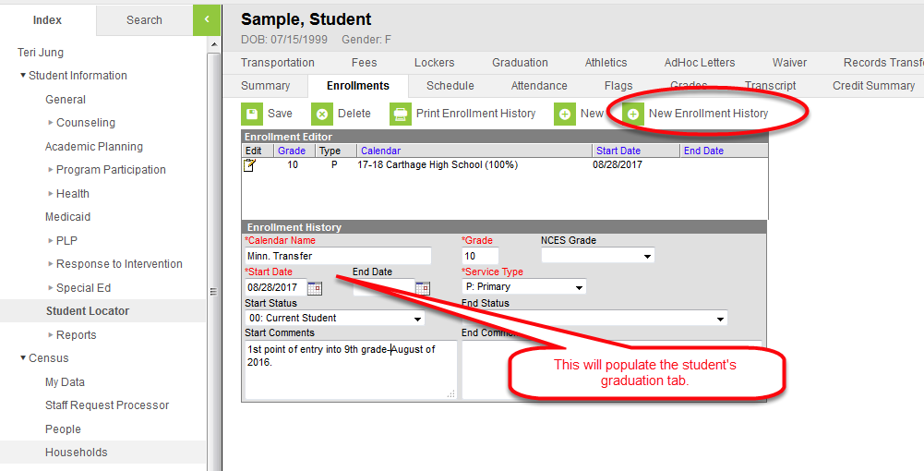
Creating an Enrollment History

Slide 32
State Aid Fall Enrollment
Students must be enrolled on Friday, September 28th (students exiting or failing to return to school by this date and students enrolling after this date will not be included),
Student’s enrollment for any percent of day will be included in this count (data is reported to the nearest hundredth decimal place),
Enrollment in home school is not included,
Students assigned out of district but for whom the district pays a tuition costs are included,
If you are a four day school week, the student must be enrolled on the Thursday prior to the last Friday in September,
Out of state students (except for open enrolled students from ND and MN) are excluded from this count,
Open enrolled students are included in the count for the district or school in which they are enrolled and served, and
Count is applicable to public school districts only

Slide 33
Fall Enrollment Census Count
Students must be enrolled on Friday, September 28th,
Enrollments in home school are excluded,
Students must be enrolled greater than 49% to be included,
Open enrolled students are counted in the school in which they are enrolled and served,
Out of state students enrolled in SD schools are included in this count,
Students are counted in the school in which they are enrolled,
This count is applicable to all schools in the state (public, private, BIE)

Slide 34
Black Hills and Dial On-Line
For enrollment/state-aid purposes, these students are treated like every other “traditional” student in the district. For school districts agreeing to participate in these alternative education programs, the district is agreeing to be accountable for these students in all capacities just like every other student in their district. This means the students must be enrolled as of the last Friday in September for the school district to receive State Aid for them. The school district is responsible for attendance, annual standardized testing, providing SPED services, etc. These students will be included in all Accountability determinations for the school and district that they are enrolled in.
For those districts accepting Open Enrolled students into this program, all normal open enrolled paperwork must be completed and on file.

Slide 35
On-Line Learning Con’t
1. Students participating in these on-line programs must have an enrollment record in Infinite Campus in the general education calendar (elementary, middle school, & high school) in the school that the student will be attached to. These students ARE NOT included in any Home School calendar. You will not be allowed to create a new calendar to house these students.
2. The student will be coded as 100% enrolled.
3. This will be considered the student’s Primary enrollment.
4. These students MUST be tested. You will need to work directly with the DOE Assessment Office, to ensure all testing requirements are met.
5. Attendance is required however, these students are to be entered with the absent/exempt attendance code. This needs to be set up in your attendance codes.

Slide 36
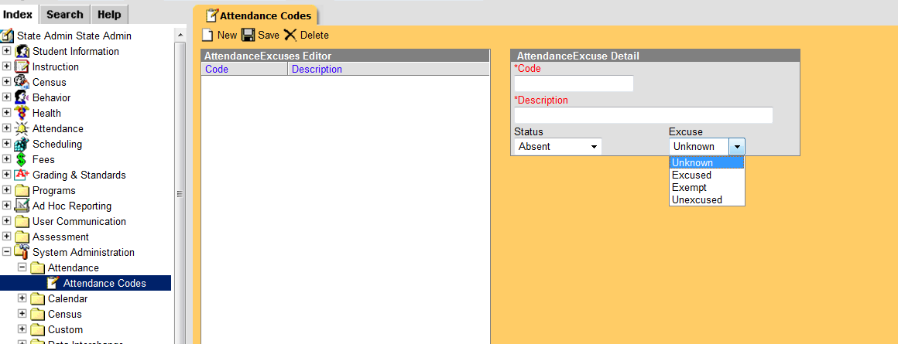
Absent Exempt

Slide 37
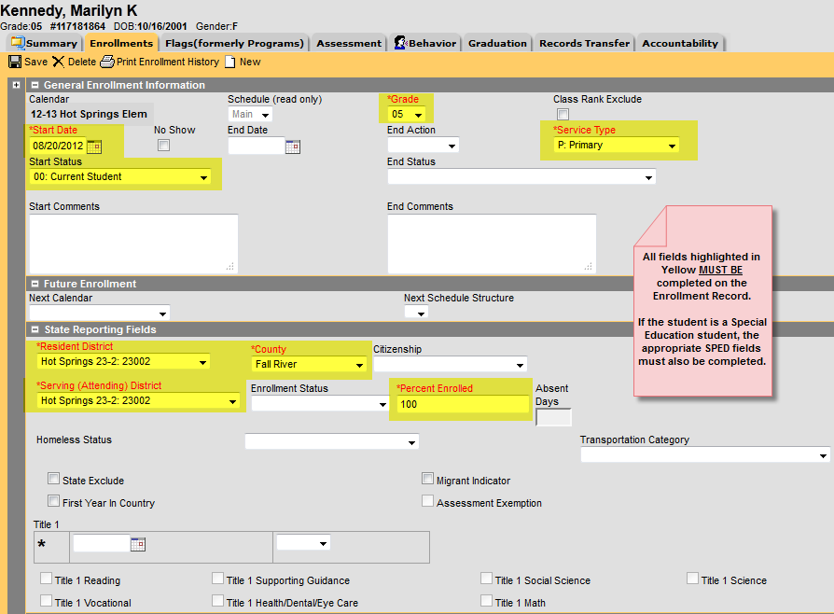
Enrollment Record of a student who is a resident within your school district and participating in Black Hills On-Line Learning or Dial

Slide 38
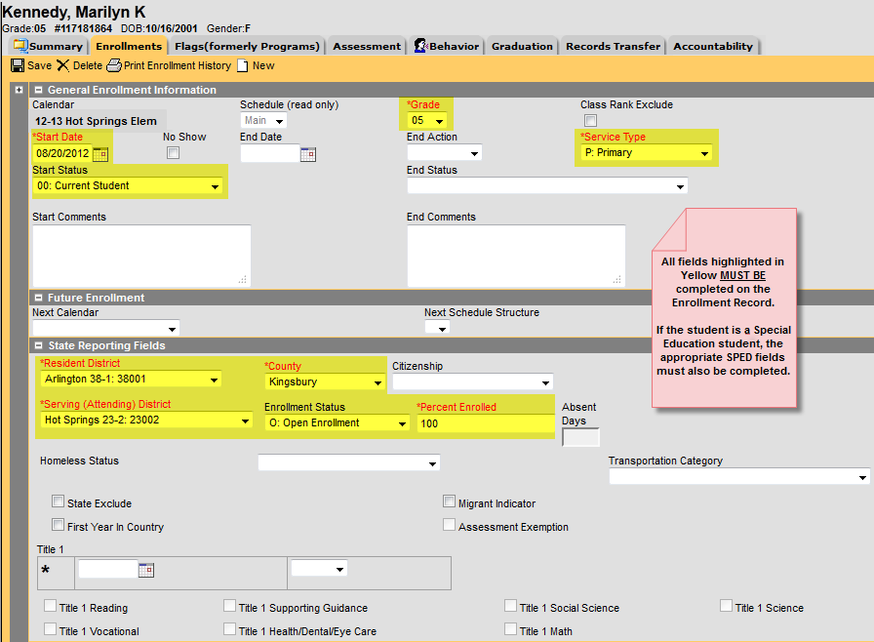
Enrollment Record of a student who is open enrolling into your school district to participate in Black Hills On-Line Learning or DIAL

Slide 39
Creating a Black Hills On-Line Learning or DIAL Flag
In order to track which students are participating in Black Hills On-Line Learning or DIAL, we have created a flag on the State Edition of Infinite Campus. We also need you to create the same flag on your District Edition of Campus. When creating this flag you must enter the name, code and description exactly as the state has entered it. In doing this, it will flag all students participating in the program. The path to follow in creating the flag is: Program Adm>Flags>New
Once you have saved your flag, you will then attach that flag to each student that is participating in the program. To attach the flag, you bring up each student and go to his or her Flags tab. Once you are on their Flags tab, click on new, enter the flag named BHOLL or DIAL and enter the start date (enrollment start date). Once that is completed, you will see the flag for the students located at the top of the screens.

Slide 40
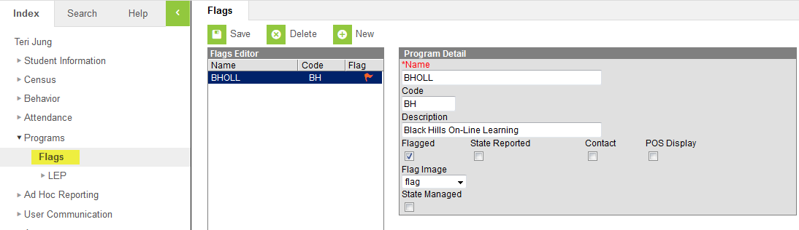
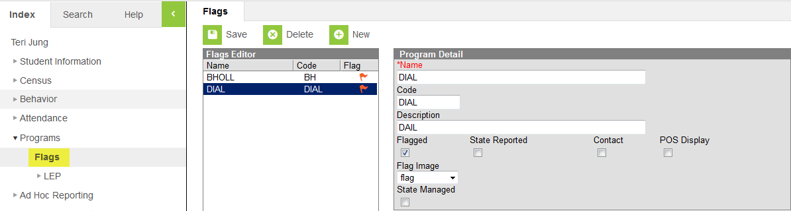
Flags

Slide 41
State Course Codes
Districts MUST make sure their local courses are mapped to the appropriate State Course Codes in Infinite Campus. This information will be used for Accountability purposes (CCR Indicator and reporting of Accelerated Coursework on the Report Cards), and for prepopulating additional systems with course information such as the Perkins system.
Master State Code list can be found at:
  http://doe.sd.gov/octe/commoncourse.aspx

Slide 42
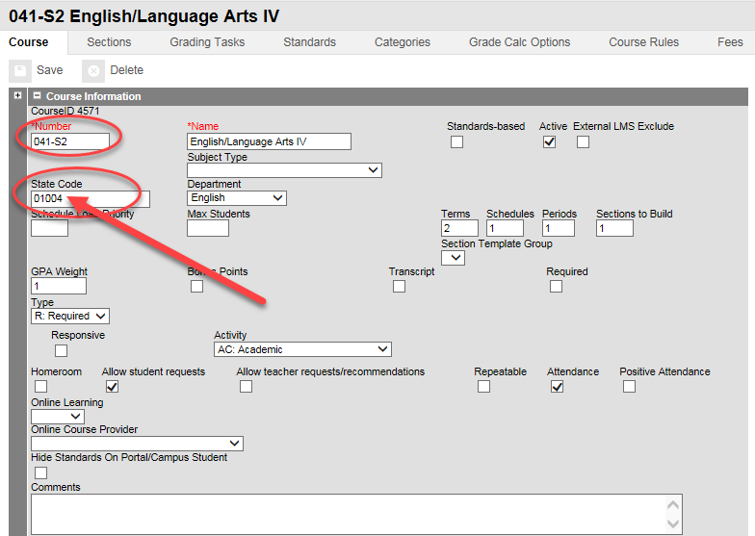
State Course Codes
88888 is to be used to identify regular high school courses not aligned to one of our state course codes.

Slide 43
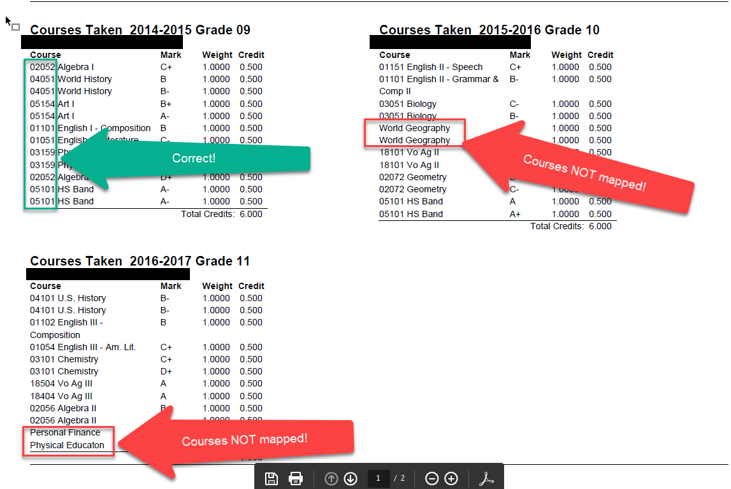
BOR Transcript with/without State Course Codes

Slide 44
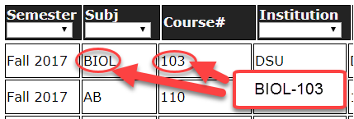
Entering a Dual Credit Course in IC
Essential to use the right coding.
The list of current Dual Credit Courses offered is on the DOE website at: http://doe.sd.gov/octe/commoncourse.aspx
For all South Dakota BOR/TI Dual Credit Courses, the State Code is a “alpha code” such as BIOL-103 and WLD-114. (letters-dash-numbers)

Slide 45
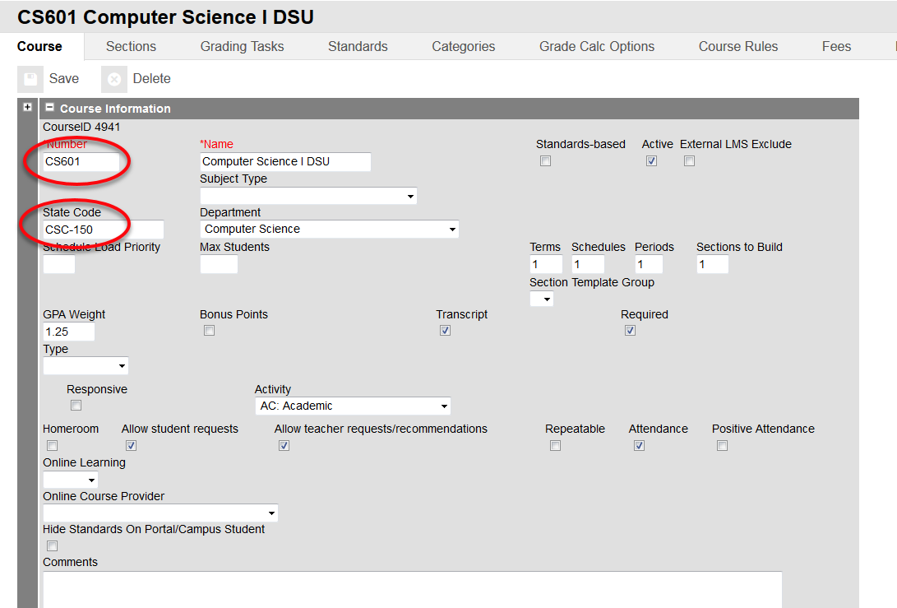
Entering a Dual Credit Course in IC
99999—To be used for Dual Credit Courses from a Private College or University such as (Mount Marty or DWU) or from an out of state College/University. This is also to be used to signify concurrent college credit course being taught by a teacher within your district.

Slide 46
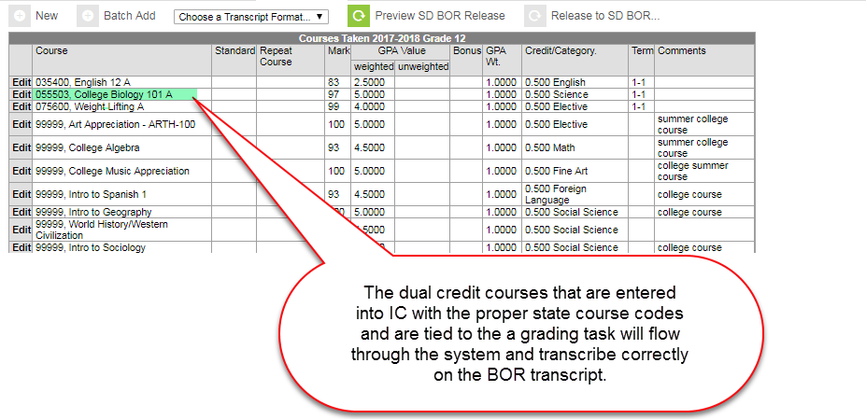
Dual Credits Entered into IC

Slide 47
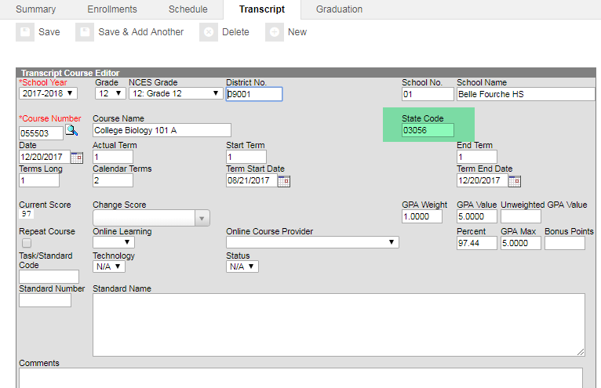
State Course Code Populated
When the dual credit course is entered into IC with the correct State Course Code and is tied to a grading task, it will flow through the system and will appear on the BOR transcript.

Slide 48
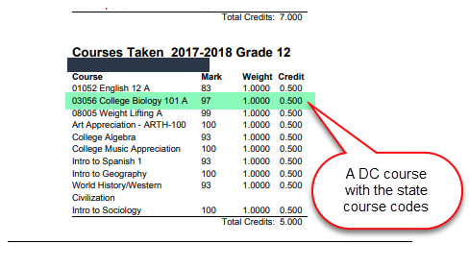
BOR Transcript

Slide 49
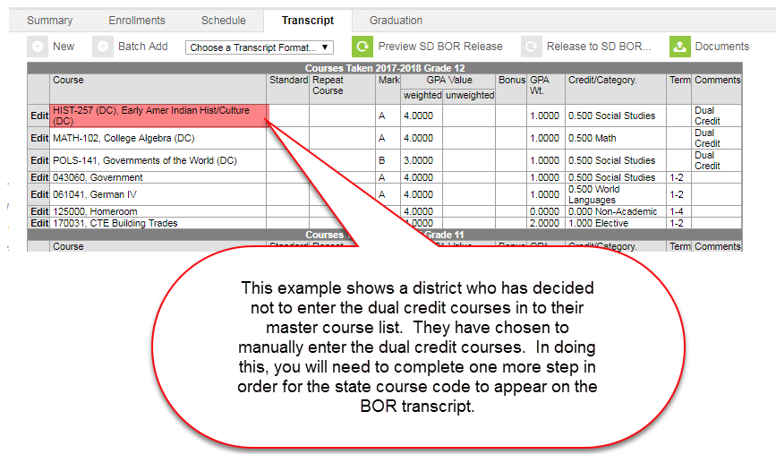
Manually Entering Dual Credit Courses

Slide 50
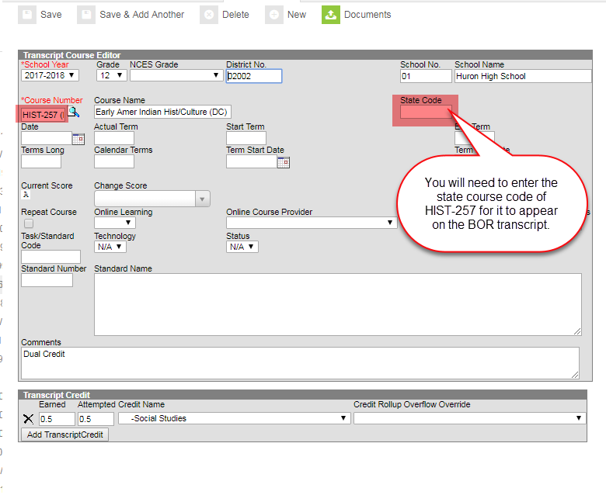
Editing the Transcript

Slide 51
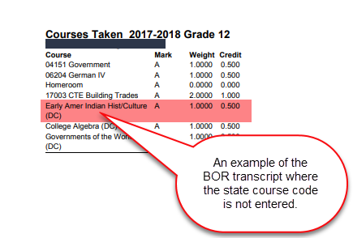
BOR Transcript w/o State Course Code

Slide 52
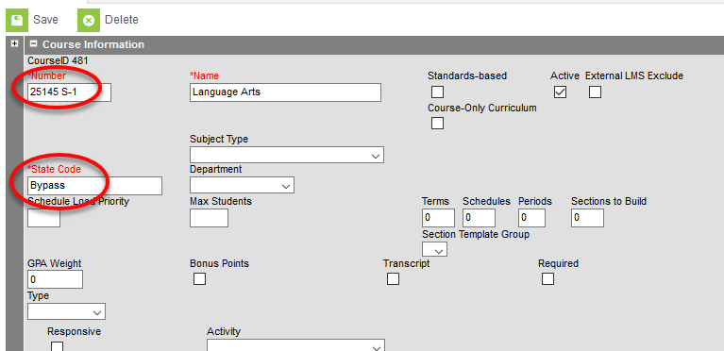
Elem/Middle School Course Codes
With the 1825.13 update, districts have not been able to create or edit elementary or middle school courses. To accommodate this, the DOE has created the state code of “Bypass” to be used for all K-8 courses in the Infinite Campus system.

Slide 53
State Codes/Dual Credit Contacts
Dual Credit course questions, please contact Amber Rost at amber.rost@state.sd.us or 605-220-6612.
Core Content course alignment, please contact Cheryl Reiter at cheryl.reiter@state.sd.us or 605-280-0990
Technical assistance with Campus, please contact Randy Hanson at randy.hanson@state.sd.us or 605-773-4727
Career & Tech Education course alignment, please contact Erin Larsen at erin.larsen@state.sd.us or 605-773-2533

Slide 54
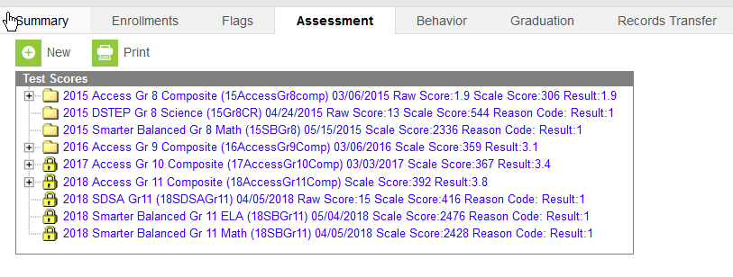
State Edition
Student Assessment Tab

Slide 55
Industry-Recognized Credential
Industry recognized credentials are a way for students to demonstrate mastery of knowledge and skills. They can increase job prospects and options for post-secondary education as well as marketability to employers.
To meet the requirements of the South Dakota High School Graduation Advanced Career Endorsement a student must earn at least one state approved industry-recognized credential. If the student is meeting the requirements of the endorsement through coursework in an approved CTE program (either in part or in full), the credential must be from the same cluster as the student’s coursework.
A list of state approved industry recognized credential is located at https://doe.sd.gov/gradrequirements/documents/Industry.pdf.
Districts must note a student’s industry-recognized credential on a transcript if the student earns the Advanced Career Endorsement.
Districts are encouraged to note industry-recognized credentials for all students on the BOR transcript.

Slide 56
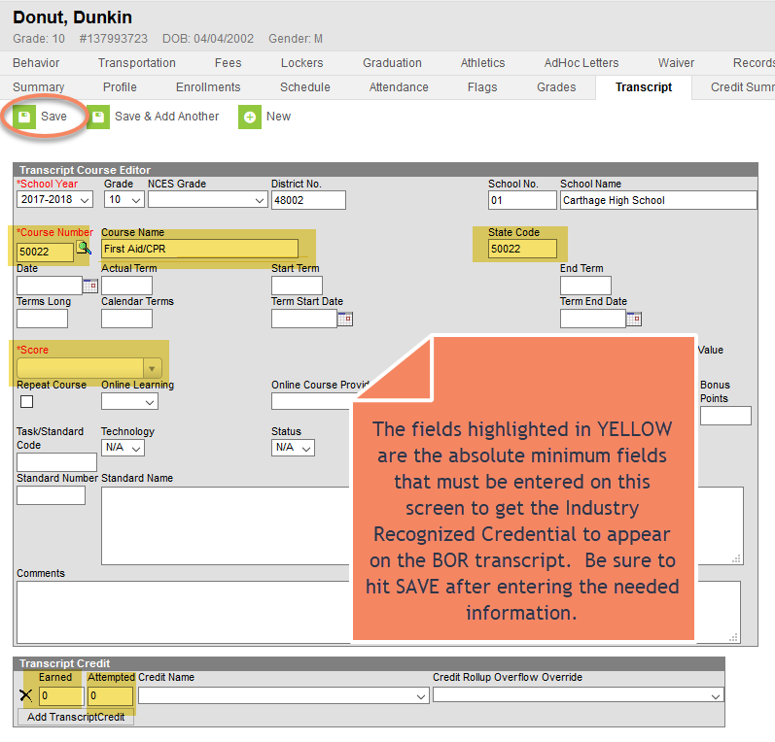
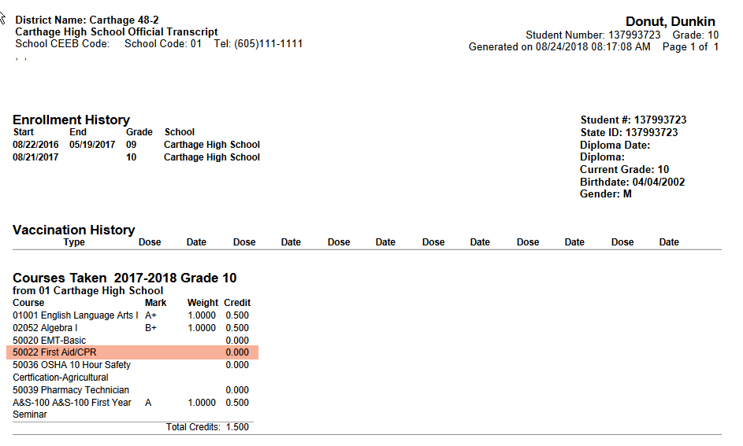
How to Enter Industry-Recognized Credentials into Infinite Campus

Slide 57
Special Education
Child Count

Slide 58

Child Count
Unduplicated count of all children with disabilities ages 3 – 21 receiving special education and related services according to an individualized education program (IEP) on December 1st of each year.

Slide 59
Child Count
Students with disabilities who are placed out of district.
Public School Districts will enter an enrollment record for students who are placed out of district. Those students will be enrolled in school number 97 and the name is “Sped/Out of District Placement”. The students will have a percent enrolled of 1%.
Making this change will allowed school districts to run the SD Child Count report out of Infinite Campus that will include all students for whom they are financially responsible for and who should be on the Child Count.
The “Out of District Placement” facility will still hold an enrollment record for the student and the student will be enrolled 100%. This will cause an overlap, but the department will exclude school number 97 when running the overlap reports.

Slide 60
Requirements for school 97
Must have a calendar for school 97
Must have grade levels entered
Must have a term set up. This term can be a year long term
Must have a period scheduled enter. This period can be set up as one period.
Must do a “Days Reset”, but you do not have to edit the days.

Slide 61
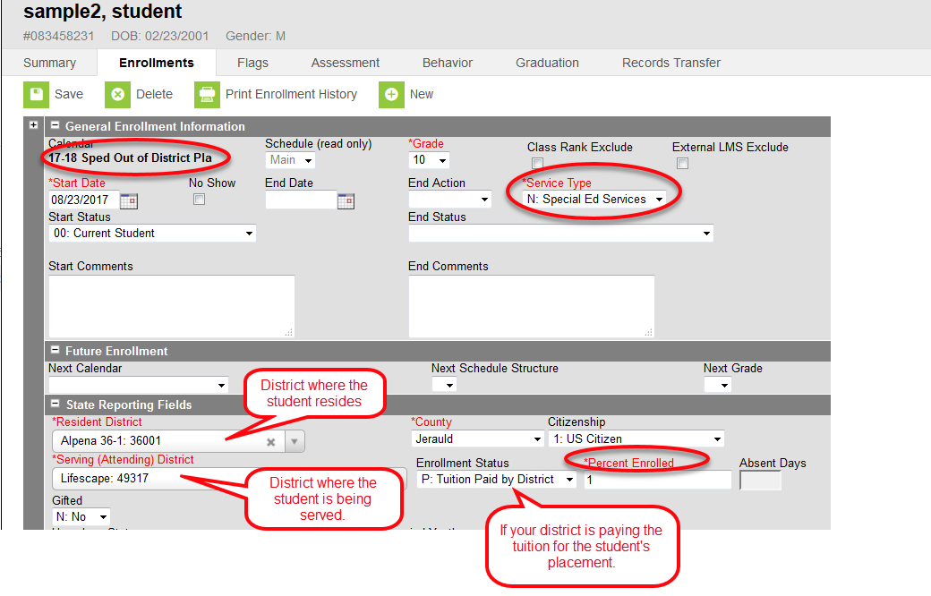
Sped Out of District

Slide 62
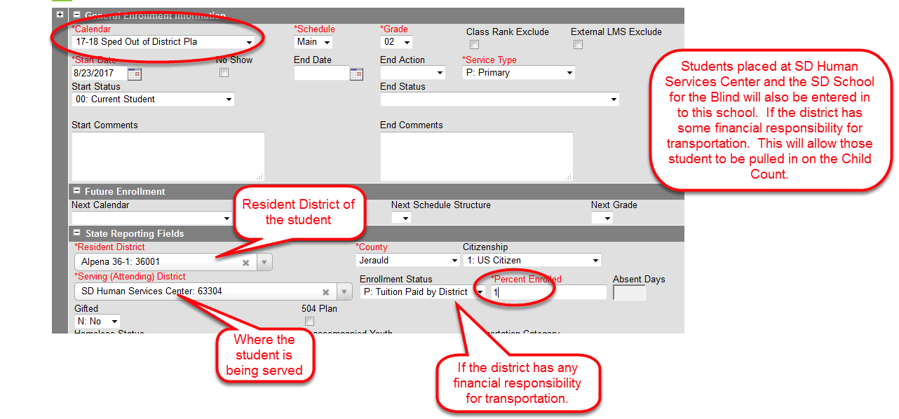
Enrollment in Sped/Out of District Placement

Slide 63
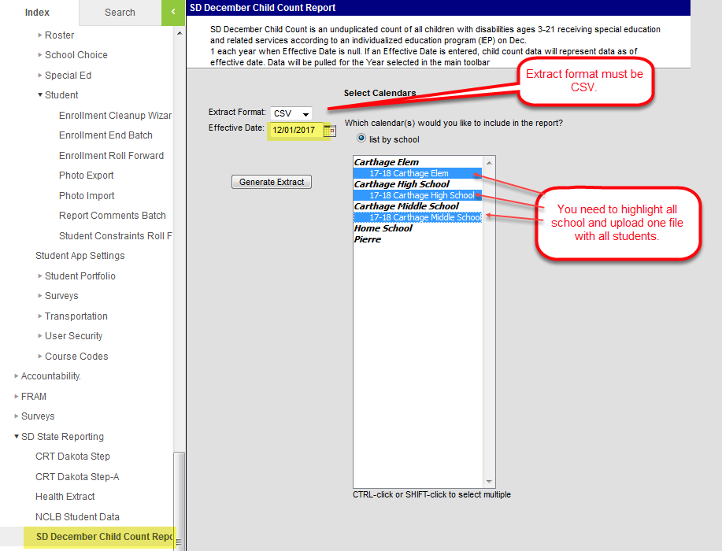
Child Count Report in Infinite Campus

Slide 64
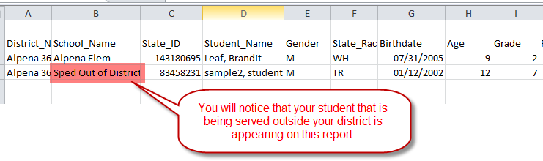
Child Count Report
Verify that all demographic information is correct on your report. If you have a student who is placed out of district, they should show up under the Sped Out of District School.

Slide 65
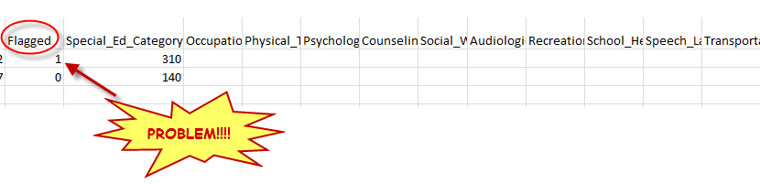
What is the “Flagged” Column?
If there is a “1” in this column on your report, that means there is a problem with the Special Ed Category in the next column on the Child Count report.

Slide 66
Things to check if a student doesn’t show up on your child count report
Make sure the student has an active special ed record on December 1st. Sometimes if there is a change in IEP, the old record gets ended but a new record does not get put in.
The special ed fields may not have rolled over from the previous year. You will need to re-enter the information into this year’s enrollment record.
Make sure that you student is entered in Infinite Campus and have an enrollment in the Sped Out of District Placement School.
Any student under the age of 3 or over the age of 21 will not be on the report.
    Birth date errors are common. If you need to change the birth date, you will need to go into the Identities tabs to make the change.

Slide 67
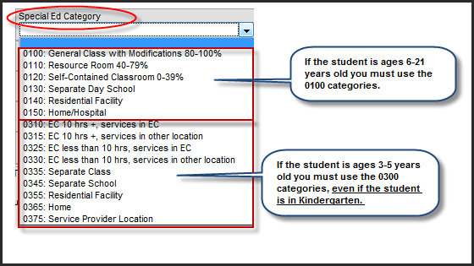
Child Count (con’t)

Slide 68
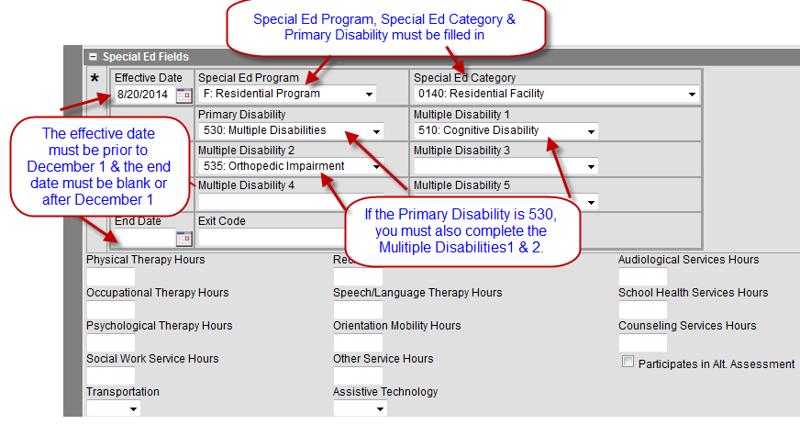
Child Count
The following Special Ed fields must be populated.

Slide 69
Resources
DOE website - http://doe.sd.gov
Student Data Collections Desk Guide –http://doe.sd.gov/ofm/documents/DataGd-16.pdf
Data Newsletters -
http://doe.sd.gov/ofm/documents/0416-SIMp.pdf
Infinite Campus’ Campus Community-
https://community.infinitecampus.com/news/
DDN Listserv-
https://www.k12.sd.us/MailingList/DDNCampus

Slide 70
Important Dates
September 28th – State Aid Fall Enrollment
October 15th – All enrollments final
October 31st – All free & reduced data must be entered
December 1st – Child Count

