Slide 1
“New to Infinite Campus” Training
Deb Fredrickson – Watertown
Martin Sieverding – Menno
Denise Cavigielli – Sioux Falls
Theresa Crawford – Brookings
August 6, 2019

Slide 2
Deb Fredrickson

Slide 3
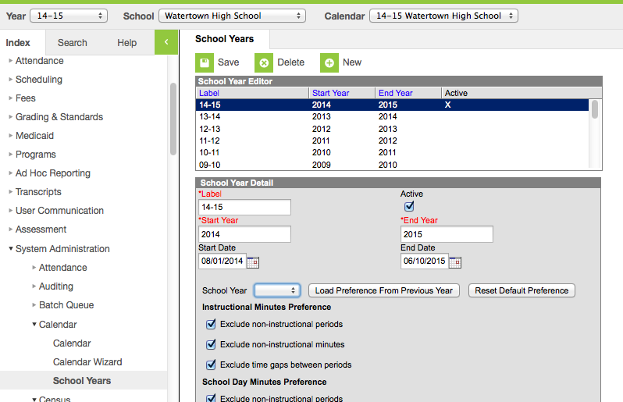
Step 1: Create School Year

Slide 4
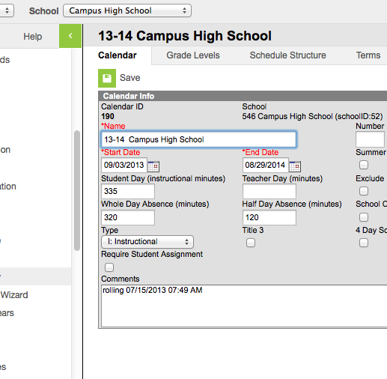
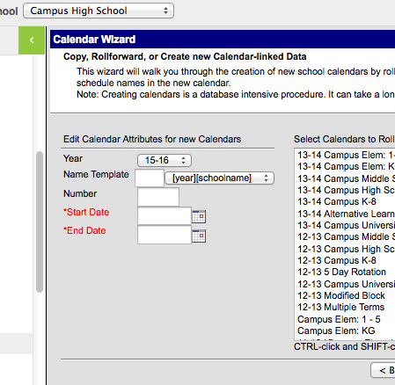
Step 2: Create New School Calendar
Check previous Calendar
Use to create new calendar

Slide 5
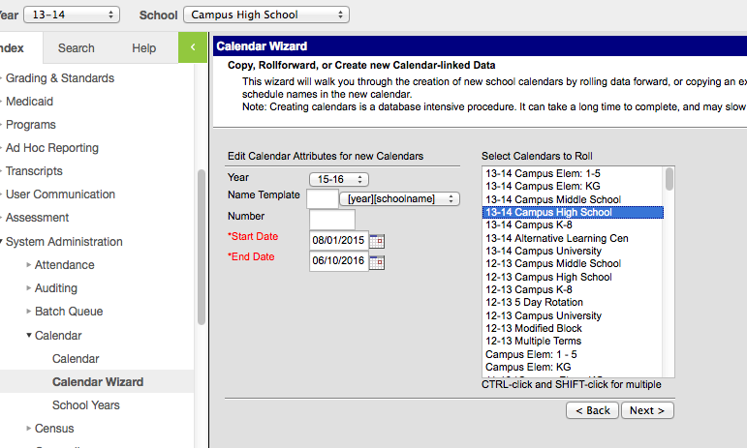
Use Wizard to Roll Calendar

Slide 6
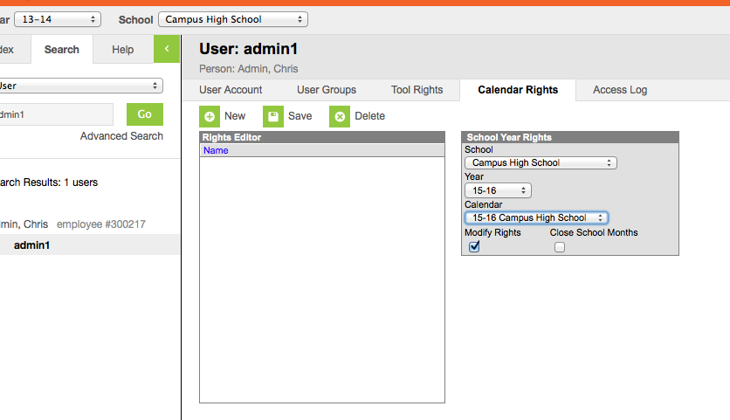
Give Yourself Rights!

Slide 7
Calendar Set-Up
Check each heading for content
Make sure all grade levels needed are present
Schedule Structure: Main (need something)
Set your terms (we call ours terms, some quarters, some trimesters) Need dates from administration for this.

Slide 8
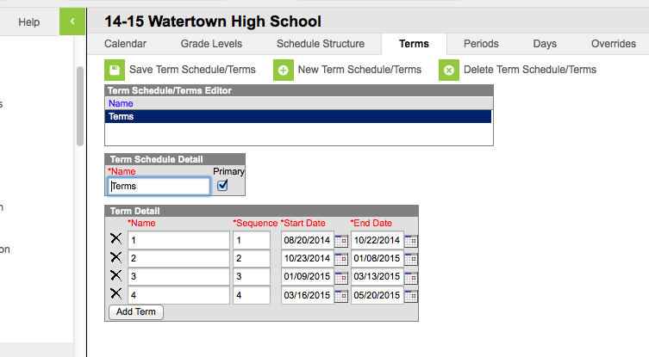
Terms in Calendar

Slide 9
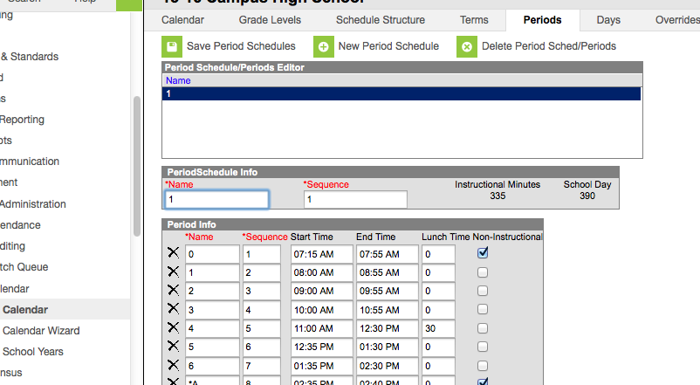
Periods in Calendar

Slide 10
Day Reset
Once you have terms and periods, you need to do a Day Reset
Do not be concerned about the warning—it needs to be done!
Here is where you should set the calendar to the actual start day, first day of school.

Slide 11
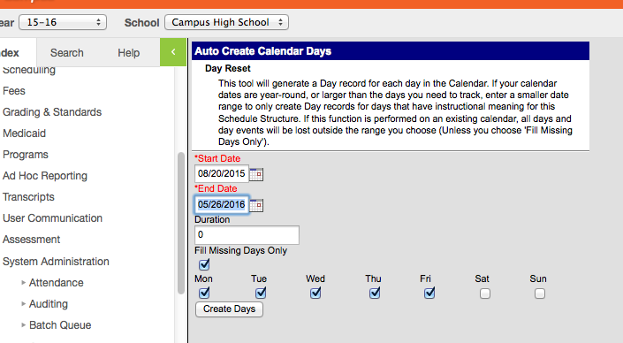
Day Reset

Slide 12
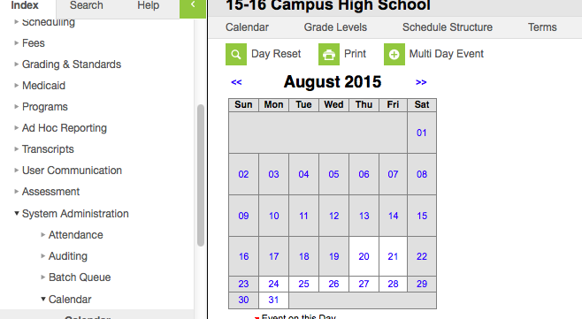
Calendar Days

Slide 13
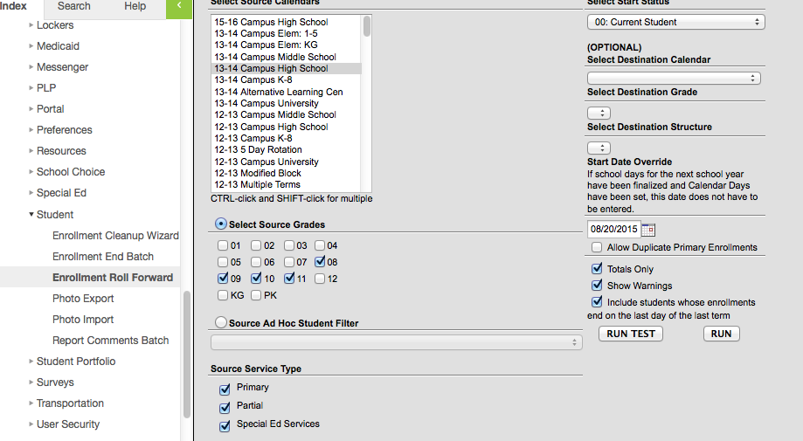
Enrollment Roll Forward

Slide 14
Enrollment Roll Forward
There is no limit to the number of times you can roll students
Make sure as students leave, you end their enrollments (do not delete)
After all enrollments are done (usually summer), clean up enrollments with enrollment cleanup wizard (system admin/student)

Slide 15
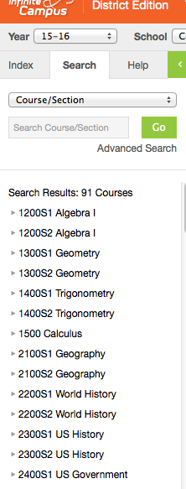
Course/Section Set Up
Make sure all courses needed are present
Do a search, course section in pull-down

Slide 16
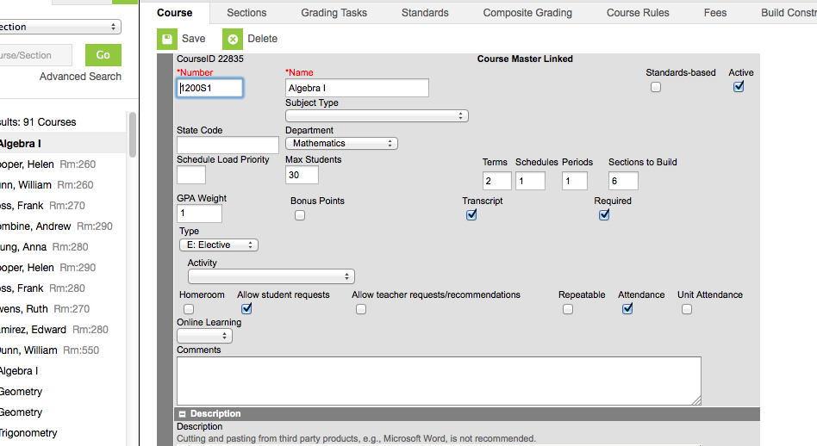
Course Settings

Slide 17
Course Settings
Set from left to right on the heading
Sections: check to see right number of sections, correct teacher
Grading tasks: Make sure these are set—teachers will be lost without them (be especially careful of changes or additions)
Grading tasks (choose default score group for teachers) This is one area I see a lot of errors in. Cannot mix grading scales in a course!

Slide 18
Course Set Up
Standards: depends on school
Can use built in standards
Can write your own (Watertown has as “I can statements”
Leave grading/posting open all term or just at end?
Lots of work to do on back side to get set up

Slide 19
Course Set Up Cont.
Composite Grading: Admin set or teacher?
Works either way, but help staff set up if their choice so they understand what they want Vs. what they say
Course rules are for scheduling—may or may not have them
Fees: if you use them, add them here

Slide 20
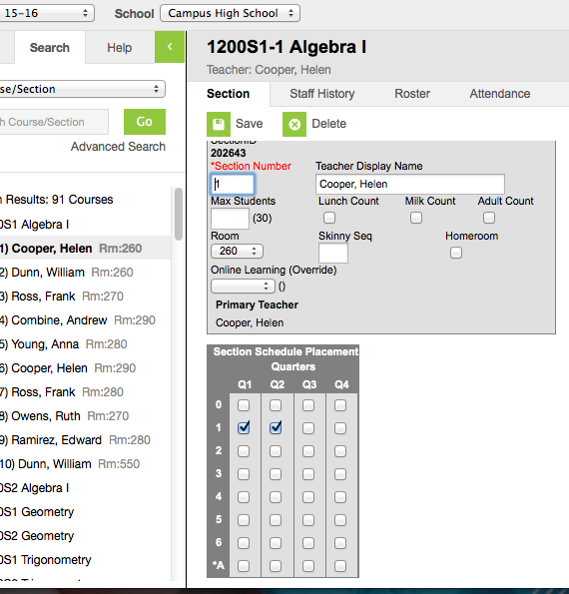
Section Set Up
Click on a section name

Slide 21
Section Set Up
Notice the setting—check marks for terms very important
Options: Lunch count, display name (will show in portal and on report cards), room number, skinny sequence, new—online over-ride, max number students

Slide 22
Section Set Up
Staff history—use for new instructor or to add more (inclusion, team teaching, student teachers, Multi-district, etc)
Grading by task and grading by student—can help staff here with posting if need be
Roster—shows who is in the course
Roster Set-up tab (use until school starts)
Roster Copy can be your best friend

Slide 23
User Groups
Why have user groups?
Giving calendar rights
Helpful in scheduling
This can save you TIME!
Use the groups to build Ad Hoc reports for staff
Always make yourself a copy and save it to your account
Edit and view rights
Membership summary

Slide 24
Groups
Never remove people from Campus
Only remove their rights
Are you a Campus Administrator?
Add yourself to the groups
Refresh your rights after each update

Slide 25
User Security
User Groups
User groups can be used to consistently assign rights across the district.
Under System Administration, User Security, User Groups, select Create a New User Group
On the Tool Rights tab, select the appropriate user tools
Calendar Rights
Calendar rights determine the schools and years a user or group of users can see. These should be assigned to a group that does not have tool rights
Assign the appropriate calendar year and school on the Calendar Rights tab. The modify checkbox determines read or inquiry only rights for the specified caledar.
User Accounts
User accounts can only be created after a person record has been created. Each user should be assigned to the appropriate tool groups and calendar groups.

Slide 26
Denise Cavigielli

Slide 27
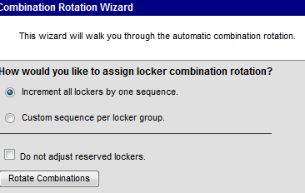
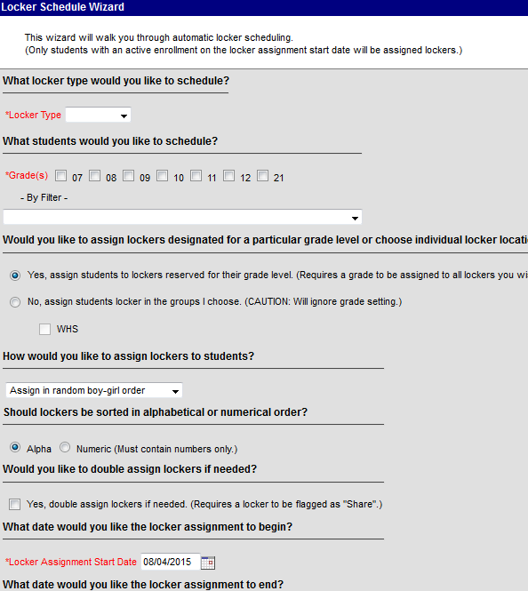
Locker Maintenance
Combination Rotation
Rotate the combination number sequence using the Combination Rotation Wizard located under System Administration->Lockers
Locker Batch End Wizard
Use the Locker Batch End Wizard located under System Administration->Lockers to end locker assignments for last year’s students. Note the Locker Effective Date should be a date when students would still be assigned to lockers (typically the last day of school).
Locker Schedule Wizard
Use the Locker Schedule Wizard located under System Administration->Lockers to assign students to lockers.

Slide 28
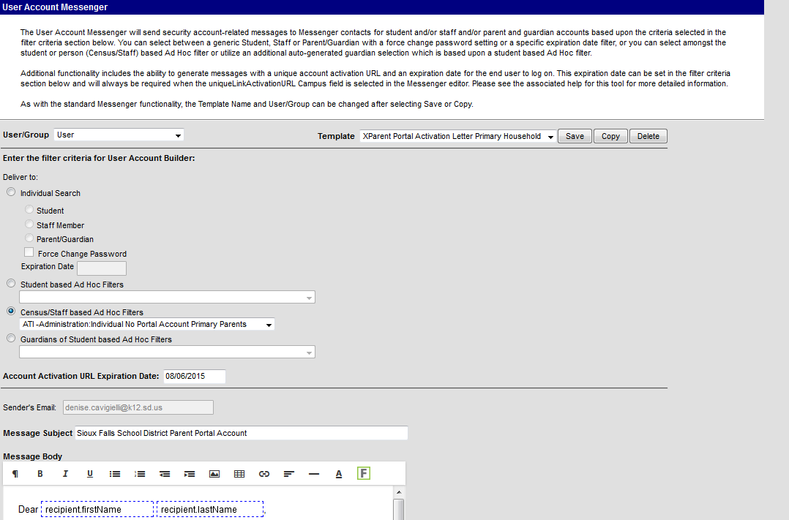
Parent Portal Accounts
Use the tools in the Batch and Import Wizards located under System Administration-> User Security to create parent/guardian accounts or create a message to send to parents to create their own account.

Slide 29
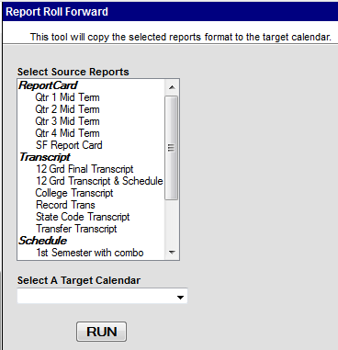
Preferences
Portal Preferences
Portal preferences allows districts to choose what features are available to parents in the portal view. Preference setup is located under System Administration, Portal, Preferences. The preferences are specific to each school.
Report Preferences
Report preferences allow districts to configure schedule, report card and transcript reports.
Reports can be rolled forward each year using the Report Roll Forward tool.
Resources
User the Resources tools to manage departments, rooms, standards and lockers, locks and locker locations.

Slide 30
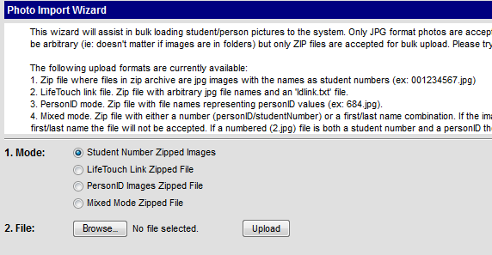
Preferences Cont.
Photo file export
Use the Photo Export option under System Administration->Student to create a student file for photography company use.
Photo Import
Use the Photo Import option to load student photos from photography companies into Infinite Campus.

Slide 31
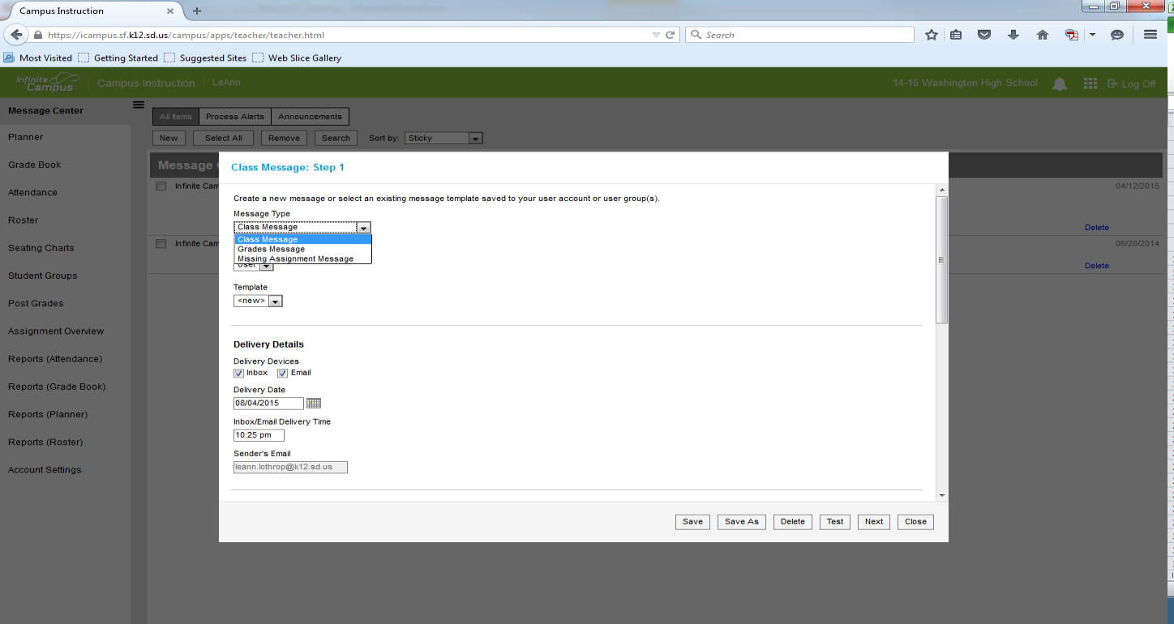

Campus Instruction Messenger
Teachers can use the Message Center to send class messages, missing assignment messages and failing grade messages to their class.
To create a message, select within the Message Center. Follow the prompts within to create a message to either parents/guardians or students.
NEW

Slide 32

Martin Sieverding

Slide 33
Census
Create Household
Use Census Wizard
People
Address/Contact Information
Relationships
Creating New Identity
Former Student as Staff or Parent
Staff Employment/Assignment Records

Slide 34
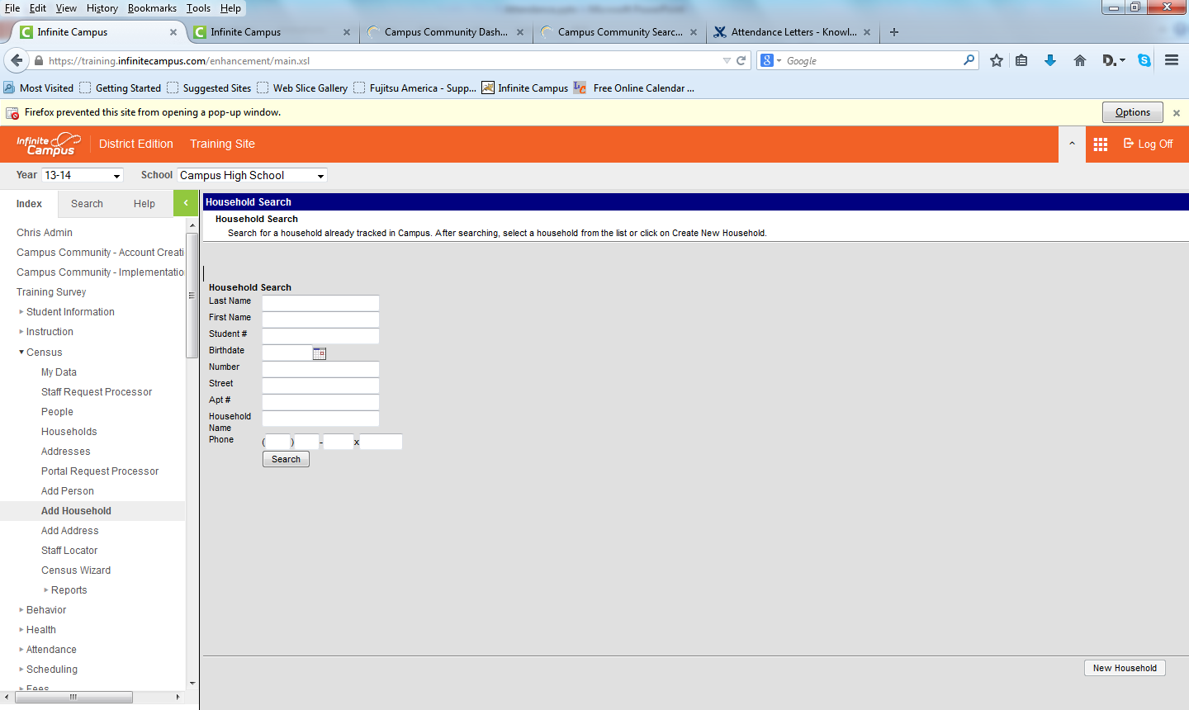
Create Household
Census>>Add Household
Always do a Household Search
Avoid creating a duplicate
Then click “New Household”

Slide 35
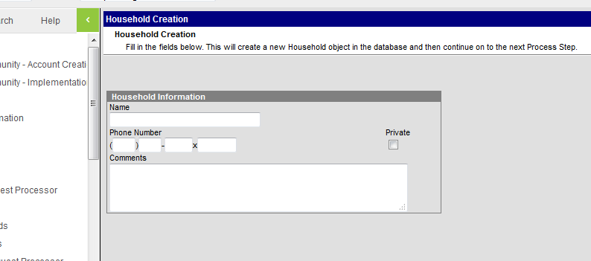
Create Household
Household name and Phone number
Naming Convention
Click Save

Slide 36
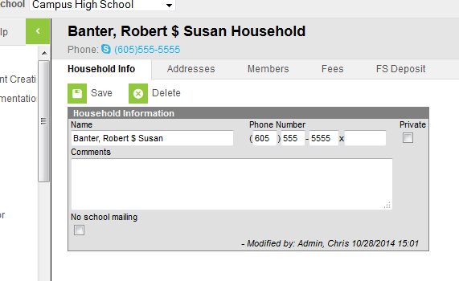
Create Household
Household created
No members
No addresses

Slide 37
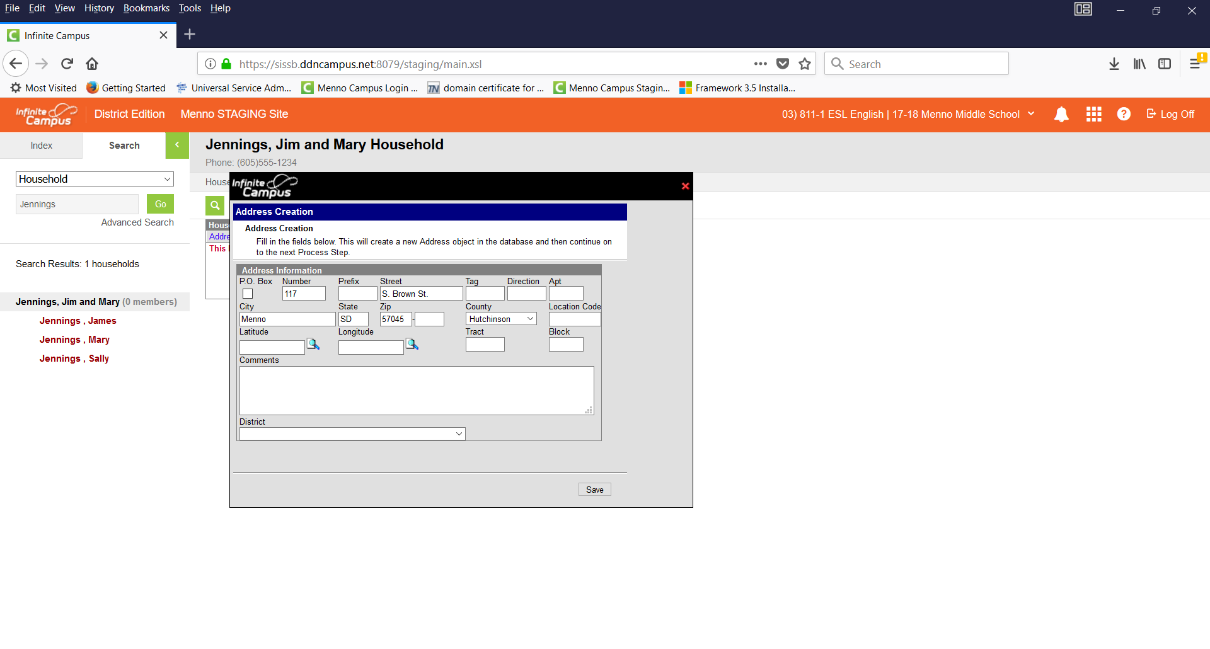
Add an Address to Household
Click on Address tab
Search for address – then Create New
Add pertinent information

Slide 38
Field | Definition
Post Office Box | Indicates the address is not a physical location but a mailing location.
Number | House Number of the address, or Box number if the address is a P.O. Box address. In the address 7750 South Barstow Street NE, My Town MN 55555, 7750 is the number. Only enter the number of the address.
Prefix | Direction of the street in the address. In the address 7750 South Barstow Street NE, MyTown MN 55555, South is the prefix.
Street | Name of the street. In the address 7750 South Barstow Street NE, My Town MN 55555, Barstow is the street name. Enter only the name of the street.
Tag | Label of the entered street - Avenue, Street, Blvd., etc. In the address 7750 South Barstow Street NE, My Town MN 55555, Street is the tag. Enter only the tag in this field.
Direction | Direction indicating the placement of the street within the city limits. In the address 7750 South Barstow Street NE, MyTown MN 55555, NE is the direction. Enter only the direction in this field.
Apt | Apartment number if this address is for an apartment building location. In the address 7750 South Barstow Street NE, Apt. 101 My Town MN 55555, 101 is the Apartment number.
City | Postal city for the address.
State | Two-digit state code for the address.
Zip Code | Postal zip code (plus 4 if available).
County | County in which the address is located.

Slide 39
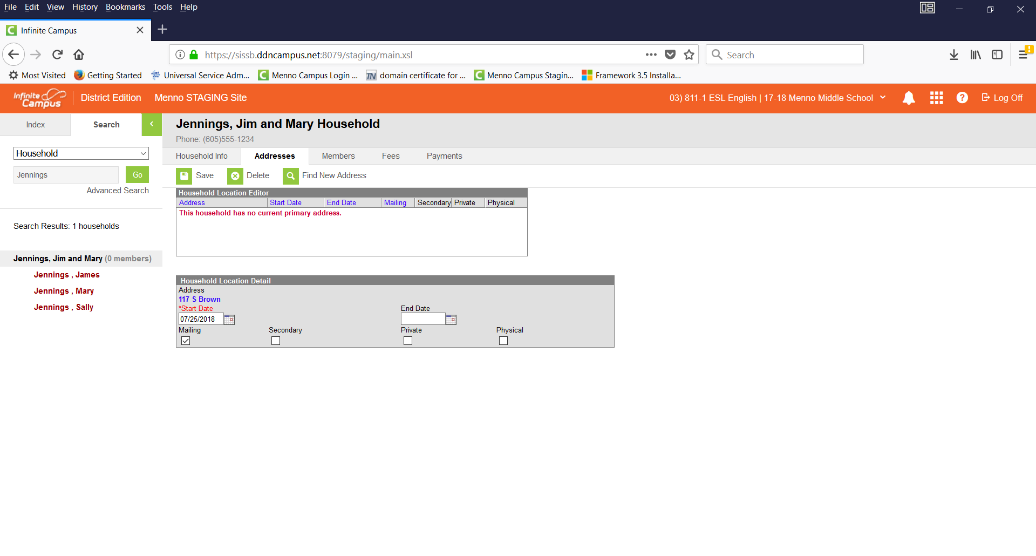
Add an Address to Household
Add a Start Date on the next screen and click Save

Slide 40
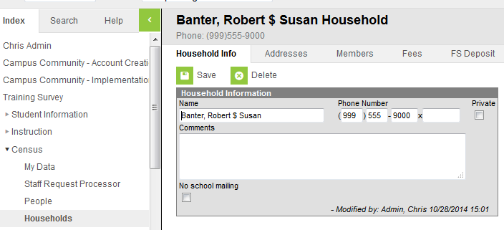
Add Members to Household
Click on Members tab

Slide 41
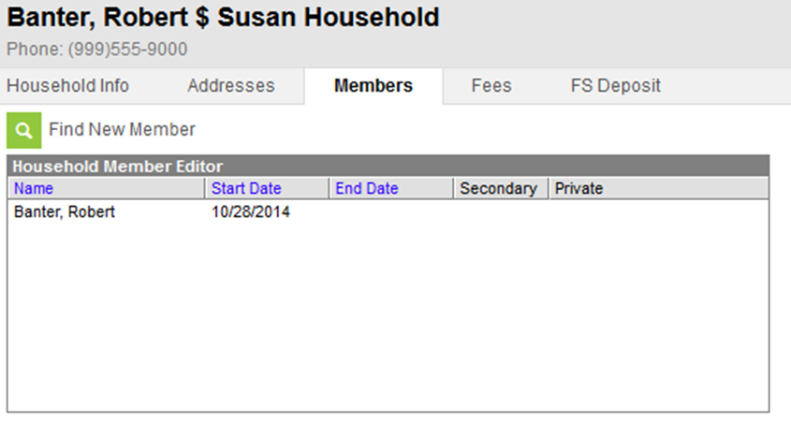
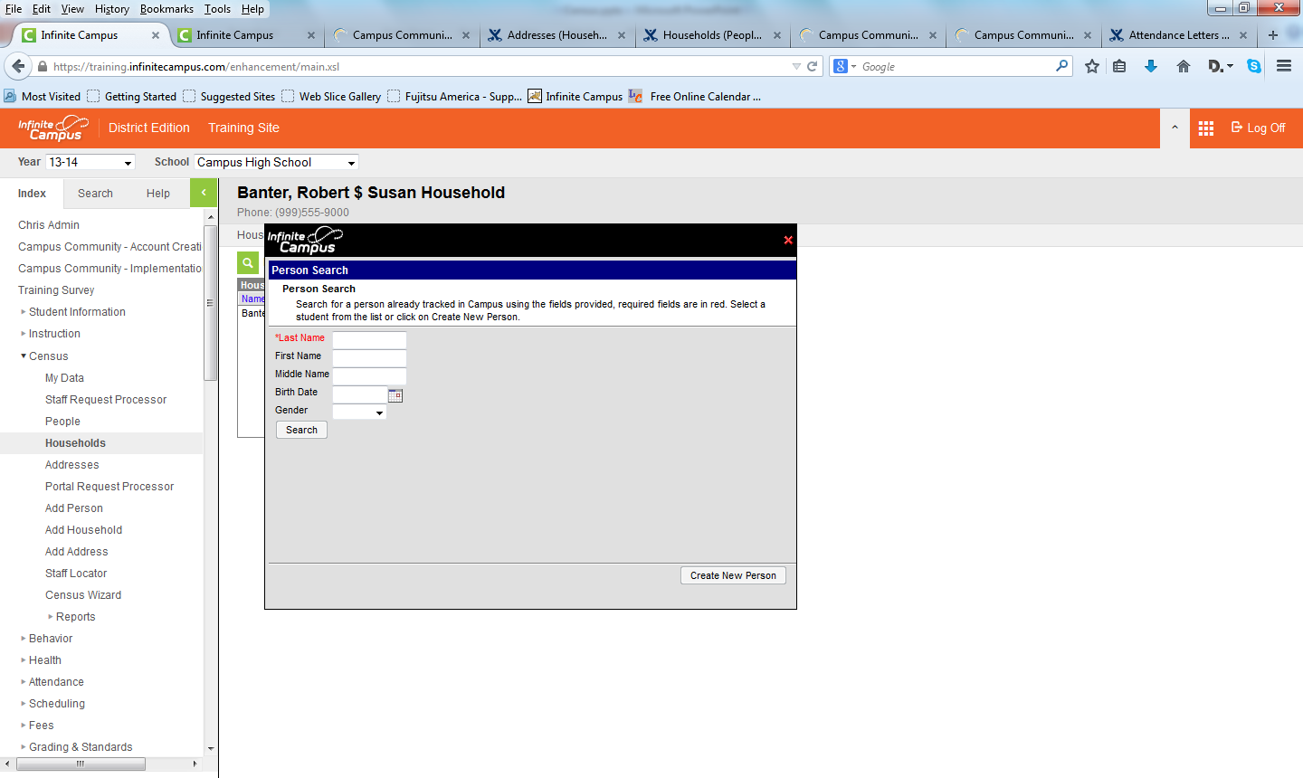
Add Members to Household
Click Members tab
Then click Find New Member
Note: Always search
before creating a
new person

Slide 42
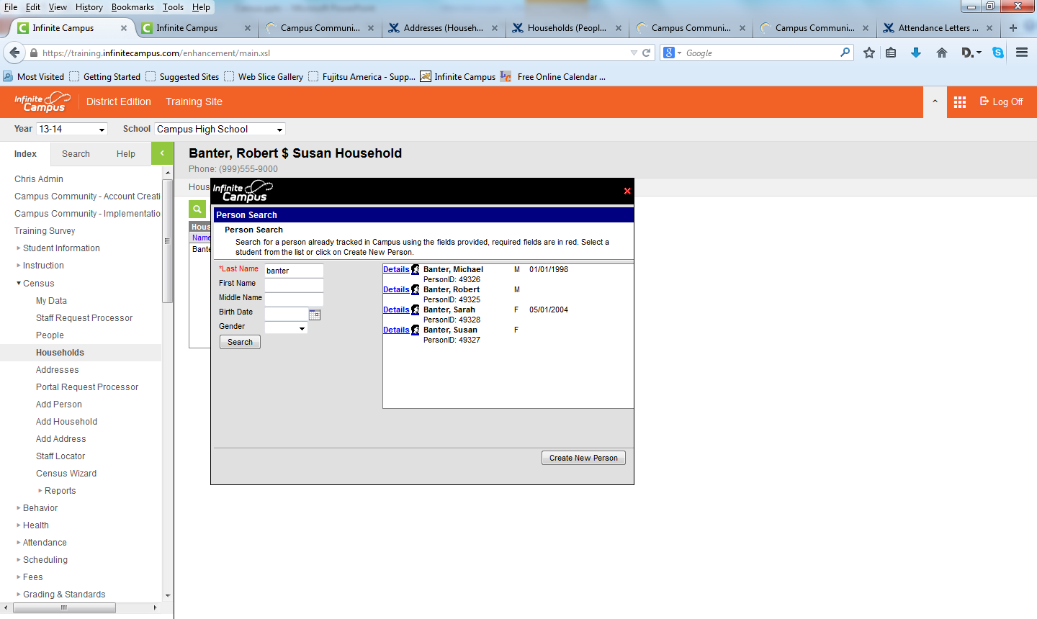
Add Members to Household
Do a search – only last name is required
Click on person to add or Create New Person

Slide 43
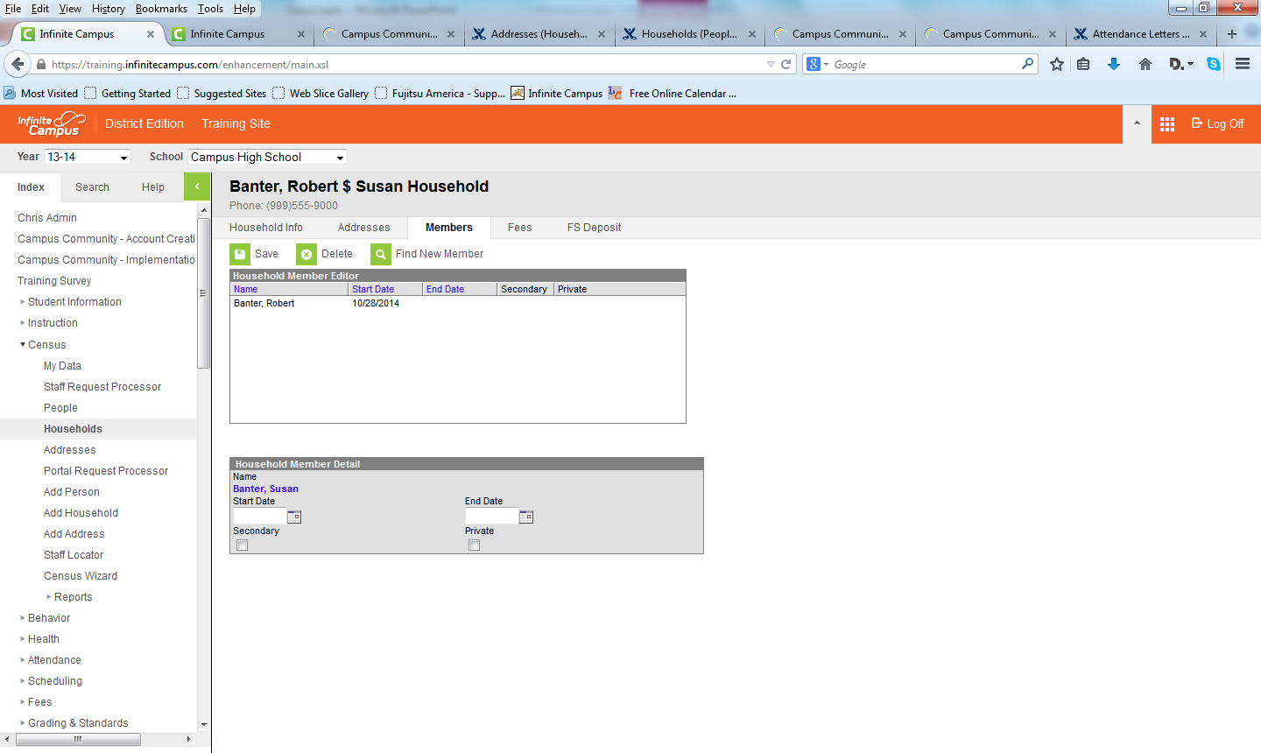
Add Members to Household
If adding existing person
Add start date and other information
Click Save

Slide 44
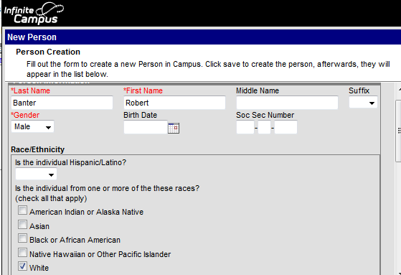
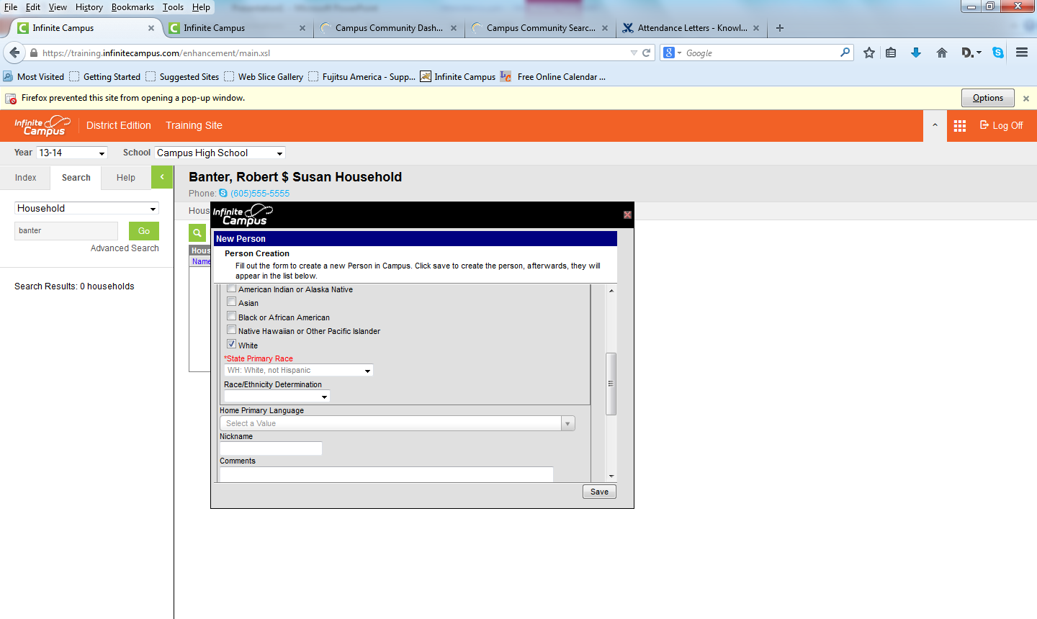
Add Members to Household
If Create New Person
Add required and other information
Click Save

Slide 45
Add Members to Household
Still must add start date
Click Save

Slide 46
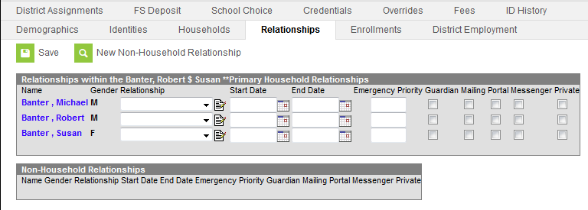
Add Members to Household
Need to set up relationships
Census>>Person do a search
Click on Relationship tab
Check boxes for communication

Slide 47
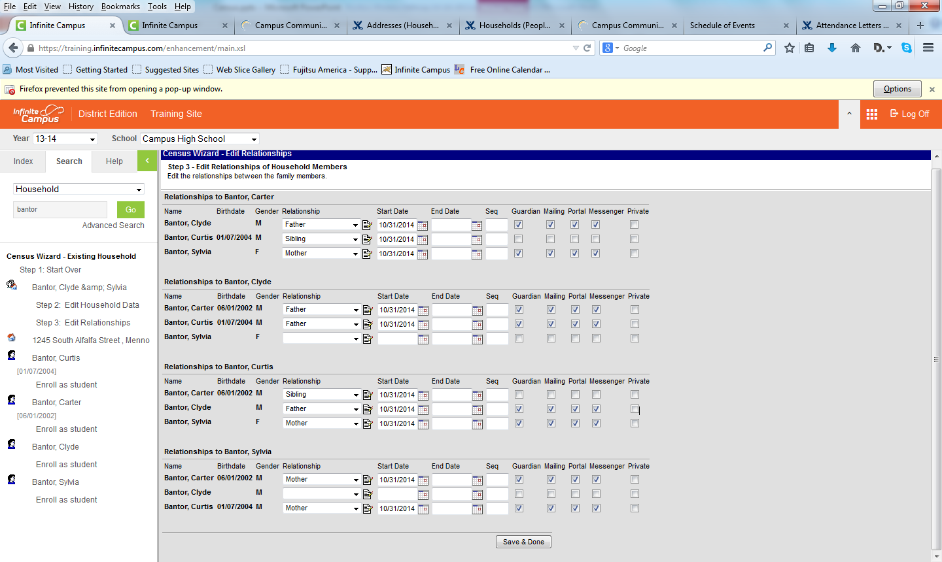
Relationship Shortcut
See step 3 in Census Wizard

Slide 48
Add Person to a Secondary Household
Census>>People do a search
Click on Households tab
Click New Household Membership
New Window – Search for household or Create New
Be sure to mark as Secondary or it will replace the Primary
Set Relationships

Slide 49
Census – adding individual items
The next section explains adding items to the Census prior to creating a Household. You can then use the Census Wizard to create the Household and add the Address and People to that Household

Slide 50
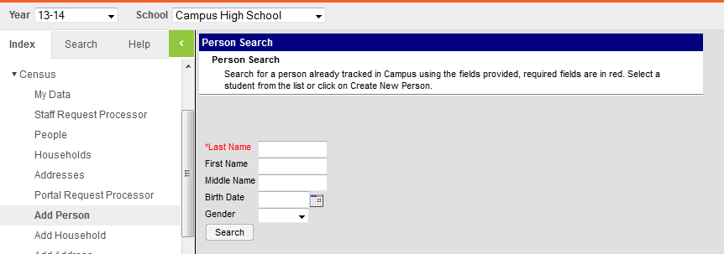
Add Person to Census
Census>>Add Person
Always search BEFORE you create new

Slide 51
Add Person to Census
Add required and other information
Click Save

Slide 52
Add Person to Census
Repeat as needed
For students and future students
Add Birthday during process
Does not connect with Household yet

Slide 53
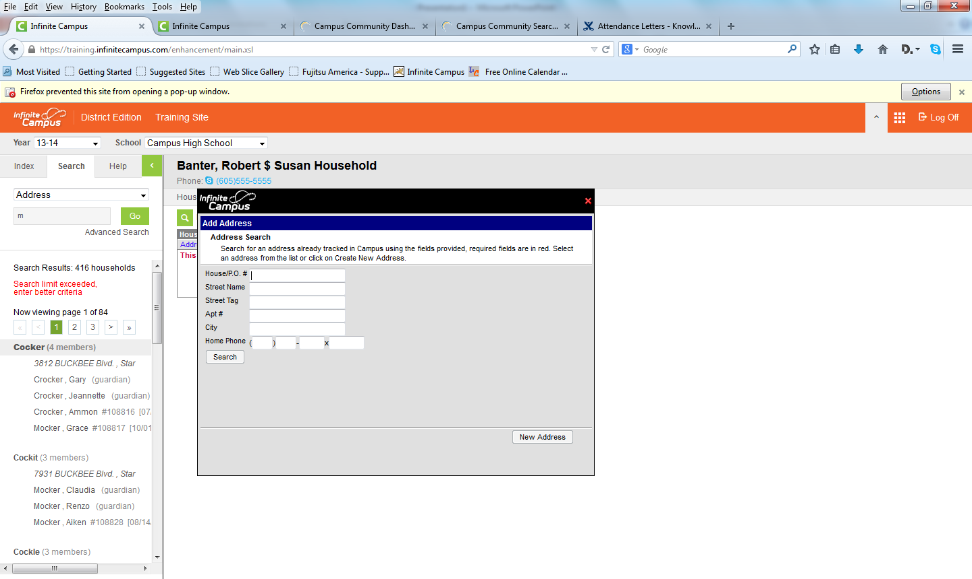
Add Address
Census>>Add Address
Notice: We do a
search first
If no results click
New Address

Slide 54
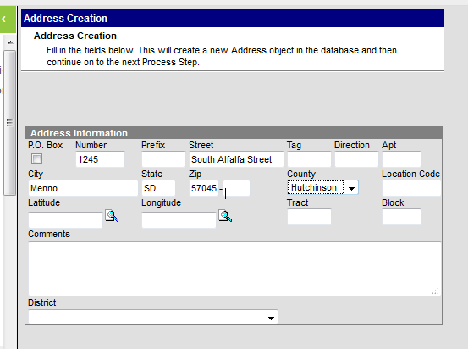
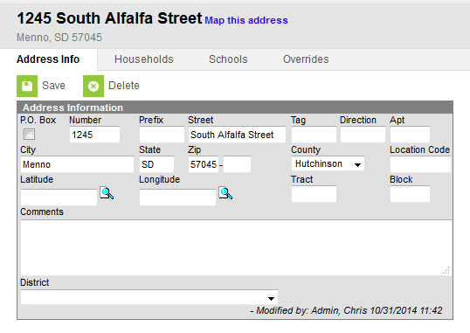
Add Address
Note: Check box if number is PO Box
Fill in information and click Save

Slide 55
Field | Definition
Post Office Box | Indicates the address is not a physical location but a mailing location.
Number | House Number of the address, or Box number if the address is a P.O. Box address. In the address 7750 South Barstow Street NE, My Town MN 55555, 7750 is the number. Only enter the number of the address.
Prefix | Direction of the street in the address. In the address 7750 South Barstow Street NE, MyTown MN 55555, South is the prefix.
Street | Name of the street. In the address 7750 South Barstow Street NE, My Town MN 55555, Barstow is the street name. Enter only the name of the street.
Tag | Label of the entered street - Avenue, Street, Blvd., etc. In the address 7750 South Barstow Street NE, My Town MN 55555, Street is the tag. Enter only the tag in this field.
Direction | Direction indicating the placement of the street within the city limits. In the address 7750 South Barstow Street NE, MyTown MN 55555, NE is the direction. Enter only the direction in this field.
Apt | Apartment number if this address is for an apartment building location. In the address 7750 South Barstow Street NE, Apt. 101 My Town MN 55555, 101 is the Apartment number.
City | Postal city for the address.
State | Two-digit state code for the address.
Zip Code | Postal zip code (plus 4 if available).
County | County in which the address is located.

Slide 56
Address Notes
Do not delete Addresses
End date instead to preserve historical data
Mark additional addresses as Secondary
If you do not, it will end date primary address
Necessary if household has 2 or more residences
Necessary if household has PO Box and street
Mark Private if address should not be given to 3rd party mailing lists

Slide 57
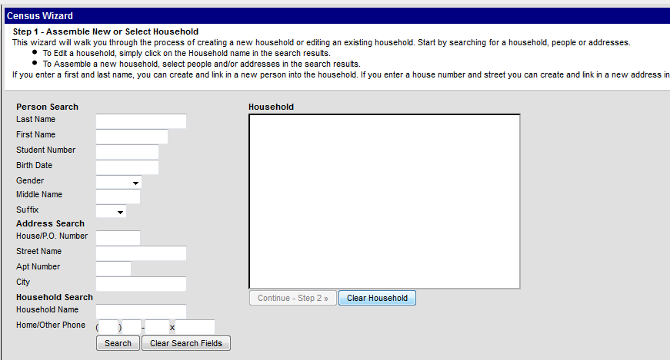
Census Wizard
Census>>Census Wizard

Slide 58
Census Wizard
This wizard will walk you through the process of creating a new household or editing an existing household. Start by searching for a household, people or addresses. To Edit a household, simply click on the Household name in the search results.
To Assemble a new household, select people and/or addresses in the search results.
If you enter a first and last name, you can create and link a new person into the household. If you enter a house number and street you can create and link a new address into the household.

Slide 59
Census Wizard
Search by Person, Address, or Household
To create new household you must add people to the census first
If unsure about household name, search that first

Slide 60
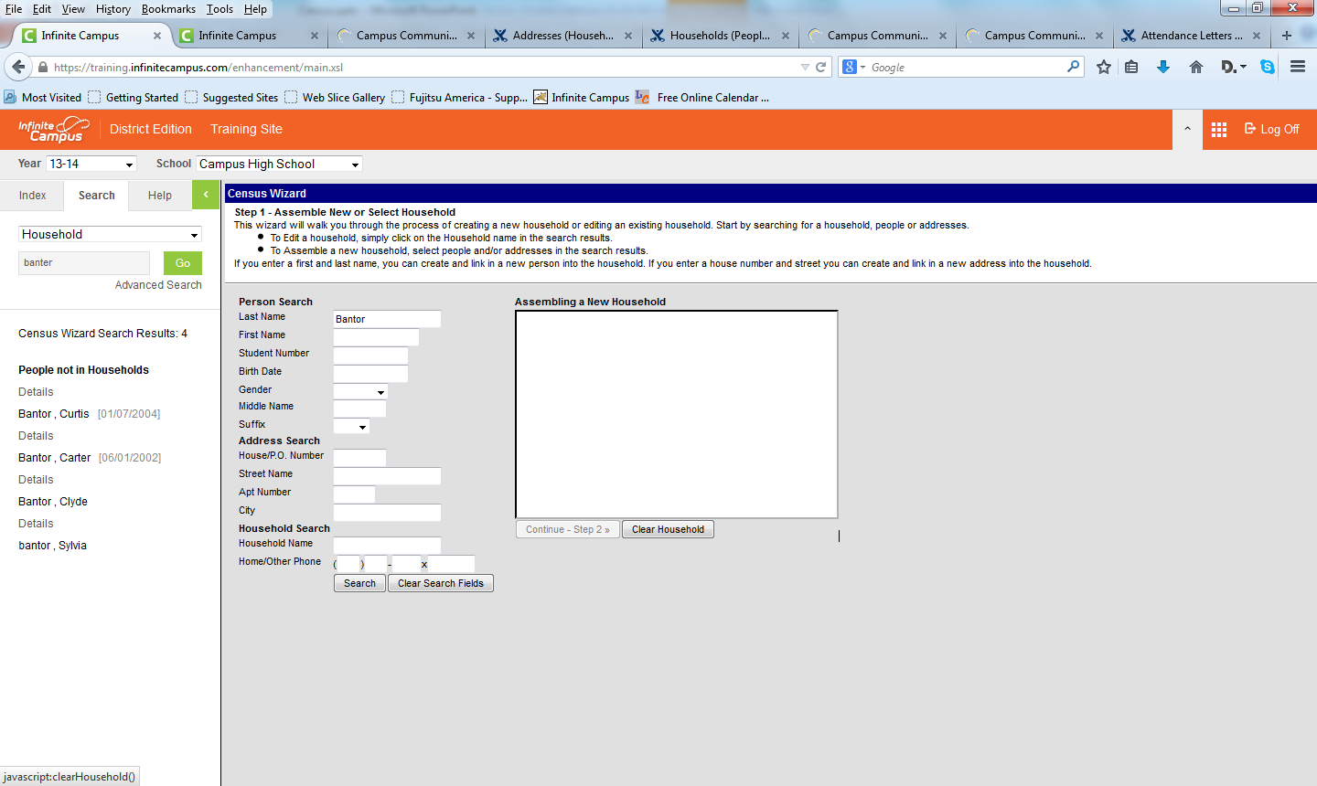
Census Wizard
Search for person
People listed on the left
Click any to include in new household

Slide 61
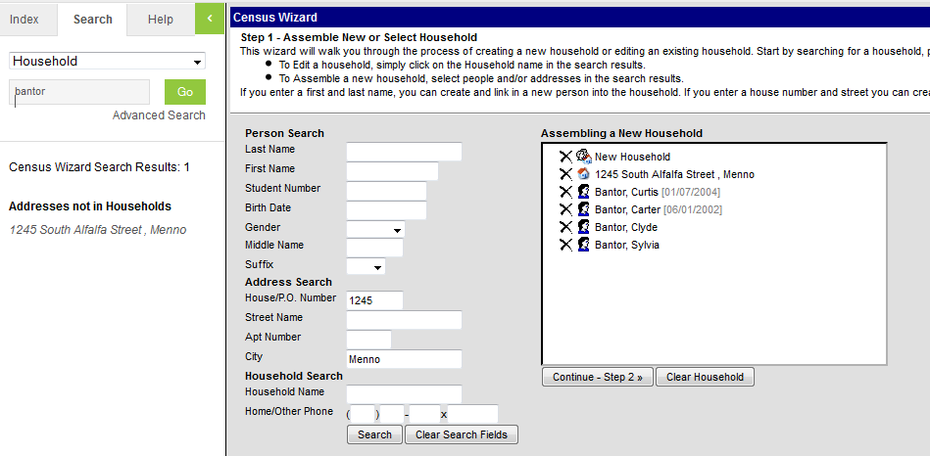
Census Wizard
Clear Name and Search for Address
Click to add to New Household
Click Continue – Step 2

Slide 62
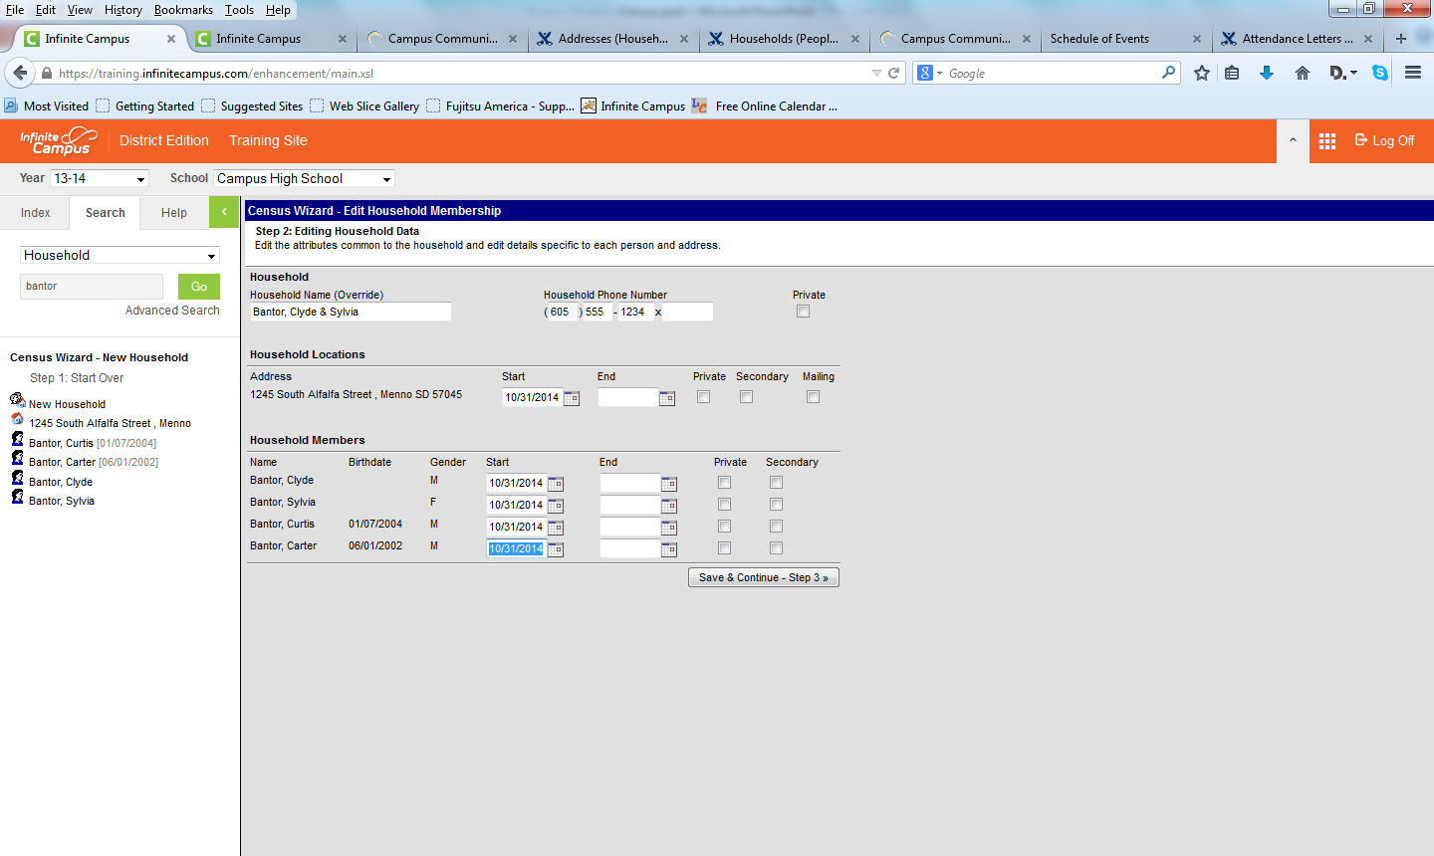
Census Wizard
Add Household Name/Phone Number
Add Start Date for Address and All Members
Mark Address for Private, Secondary, and Mailing as appropriate
Click Save & Continue – Step 3

Slide 63
Census Wizard
Set Relationships, Start Date, Guardian, Mailing, Portal, etc.
Note: Guardian,
Mailing, Portal,
and Messenger
are NOT Sibling
to Sibling
Click Save &
Done

Slide 64
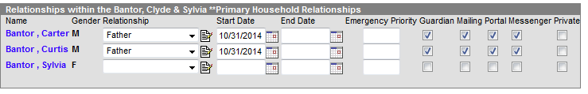
What about those boxes?
Guardian – authority to make decisions on behalf of the student
Mailing – receive addressed reports to his/her attention
Portal – access to portal information of person being viewed
Messenger – considered a messenger contact for person
Private – contact information will not be printed in reports

Slide 65
Non-Household Relationships
Census>>People do a search
Click Relationships tab
Click New Non-Household Relationship link
Search by last name or Create New
Set up Relationships, Start Date, check boxes
Examples Grandparents, Babysitter

Slide 66
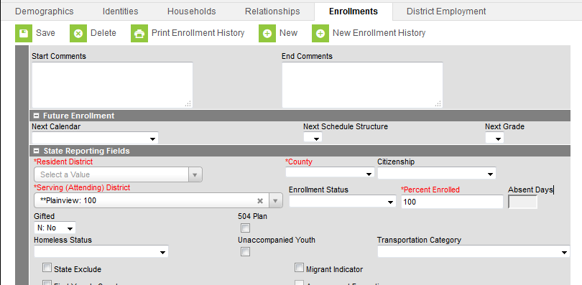
Foreign Exchange Student
Census>>Person or Student Information>>General
Enrollment tab
State Reporting Fields
Citizenship drop-down menu

Slide 67
New Identity
Never delete an identity unless it is completely wrong and NOTHING is attached to it
Census>>People Identities tab
Marriage, adoption (changed last name)

Slide 68
Former Student now Staff or Parent
Find the students state ID number and copy and paste that into the Comments Section on the Demographics tab. This way you will have it for your records.
Go to their census page and take out the Student number and save. If the State ID number is grayed out, you will need to submit a ticket to Support so they can updated on the backend.
Go to their enrollment record to see when their end date was for graduation and make that the end date as a member to their parents household.
Go to the relationships tab and uncheck all parent/guardian information to the former student and their guardians.
Delete any dr. or emg contact relationships from when the former parent was a student and no longer needed.
You can keep the history of the parent household and the relationship history of parents/grandparents/siblings.
If the former student has a new name I go to the Identities Tab and click on New and type in the new name and comment as to why.
Make a new household for this former student and their new child and setup like any other household.

Slide 69
Staff – Employment/Assignment
Census>>People
District Employment Tab – Start Date
District Assignment Tab – School, Start Date, and Title for each assignment (high school, middle school, elementary school

Slide 70
Campus Community
https://community.infinitecampus.com/knowledge-base/
To find information on any part of the Campus Tools section

Slide 71
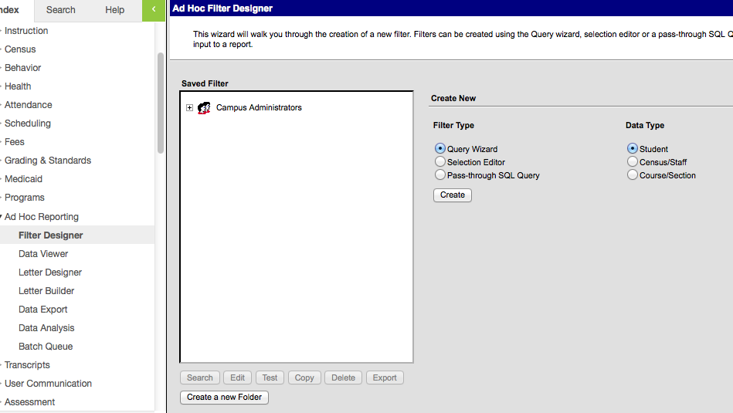
Simple Ad Hoc Reports
What is an Ad Hoc?

Slide 72
Ad Hoc (Simple)
Simple Query that allows you to pull information out of Campus
Robust or as simple as you need
Save to your account or save to groups
Understanding the data base
Easier said than done, patience and experimentation

Slide 73
Ad Hoc
Samples Watertown Uses:
nurses
Beginning year picture lists for vendors
Ethnicity
Lists for elementary admin assistants (school reach, perfect attendance, etc)
Student list for ICU Database
Attendance desk for school reach calls
ETC, too many to mention

Slide 74
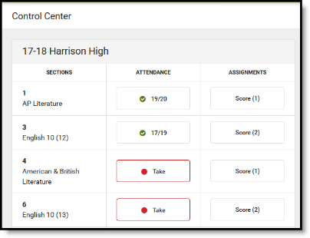
Campus Instruction Control Center
Use the Campus Instruction Control Center to quickly take attendance or score assignments for sections
Enter the order in which the category should appear in the Sequence field. (Optional) This number will determine the order in which the groups and assignments appear on reports.
Select the checkboxes to activate the following choices (Optional)
Exclude this category from calculation: This means the assignments in this group will not count for the overall grade. This may be an option if you want to enter student’s assignments or daily work but you do not want to calculate the assignments in the student’s overall grade.
Drop lowest score: This will automatically exclude the lowest score (by percentage). As you enter scores, the lowest score will be dropped. Important: If using this option, it must be checked at the beginning of the term; the calculation begins on the date the box is checked.
Select the Section(s) in which to place the category.
Click the Standards/Grading Tasks you wish to include.
Click Save.

Slide 75

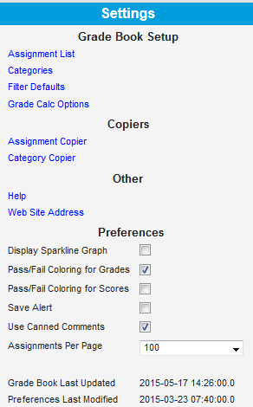
Grade Book
Creating Categories
Click on the Settings chevron (expansion arrows) directly to the right of the Control Center.
Click on Categories.
Click on the Add button.
Type a descriptive name for the new category in the Name field (example: Assessments).
Enter a weight for this group in the Weight field (optional). If you do not weight your groups, leave it at 0. No decimal or percentage is needed.
Enter the order in which the category should appear in the Sequence field. (Optional) This number will determine the order in which the groups and assignments appear on reports.
Select the checkboxes to activate the following choices (Optional)
Exclude this category from calculation: This means the assignments in this group will not count for the overall grade. This may be an option if you want to enter student’s assignments or daily work but you do not want to calculate the assignments in the student’s overall grade.
Drop lowest score: This will automatically exclude the lowest score (by percentage). As you enter scores, the lowest score will be dropped. Important: If using this option, it must be checked at the beginning of the term; the calculation begins on the date the box is checked.
Select the Section(s) in which to place the category.
Click Save.

Slide 76
Grade Book cont.
Setting Grade Calc Options
Grade Calc Options determine how the student’s in-progress grade or proficiency estimate is calculated. Calc options are different for grading tasks and standards.
Select Composite to set weights on each grading task to calculate the overall grade. For example, quarter 1 and quarter 2 each weighted at 50% to arrive at a semester grade. This should be used only for grading tasks, not standards.
Select Rollup to calculate a grade for a parent standard based on the scores for child standards. This option is used for standard based grading.
Select the Type of grade the student will receive. In-Progress Grade is typically used for grading tasks. Proficiency Estimate (Rubrics) is used for standard based grading.
If grade Type is In-Progress, select an appropriate Grading Scale. Then chose any optional setting.
Weight Categories – this weights the values entered for the category in the calculation.
Use Scores’s % Value – this calculates the grade based on the percentage of points earned rather than the raw point value.
Limit Assignments to Last - Limits all In Progress and Proficiency Estimate calculations to the most recent scores of a specified number of assignments.
Cumulative Grading Starting - Calculates In Progress and Proficiency Estimates across multiple terms in the school year, beginning with the selected term.

Slide 77
Grade Book cont.
Setting Grade Calc Options Cont.
If grade Type is Proficency Estimate, select an appropriate Method.
Power Law - The Power Law calculation approximates a student's proficiency by taking their scores and determining a trend line through a linear regression to the model y = m*x^b.
Highest Score - Highest Score reports the student's estimated proficiency as the highest score entered.
Mode - Mode reports the student's estimated proficiency as the most frequently occurring score amongst scores. Enter a value in “Limit Assignments to Last” to specify how many scores to calculate the mode from.
Most Recent - Most Recent reports the student’s estimated proficiency as the score from their most recently graded assignment.
Mean - Mean reports the student's estimated proficiency as the average score amongst scores. Calculations are based on the Mean % Value entered on the rubric.
Decaying Average - Decaying Average reports the student's estimated proficiency as the average score amongst scores by giving recent scores more weight than older scores. Calculations are based on the Mean % Value entered on the rubric.
Limit Assignments to Last - Limits all In Progress and Proficiency Estimate calculations to the most recent scores of a specified number of assignments.
Cumulative Grading Starting - Calculates In Progress and Proficiency Estimates across multiple terms in the school year, beginning with the selected term.
Chose any optional setting using the checkboxes to activate the following choices (Optional)
Limit Assignments to Last: This limits the grade calculation to the most recent x number of assignments.
Cumulative Grading Starting : Calculates the proficiency estimate across multiple terms in the school year, beginning with the selected term.

Slide 78
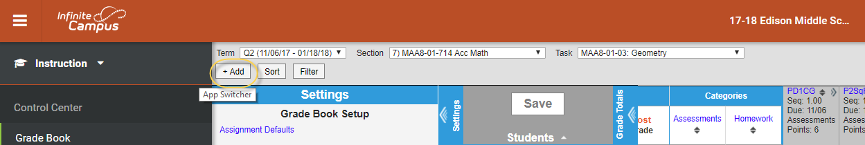
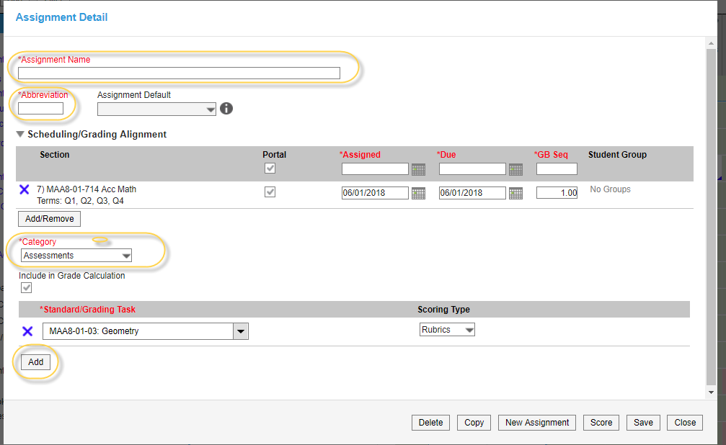
Creating Assignments
Click on the +Add button located in the top menu bar of Campus Instruction under Gradebook.
In the Assignment Name field, enter a descriptive name for the assignment (50 characters or less).

Slide 79
Creating Assignments cont.
In the Abbreviation field, type an abbreviation for the assignment (5 characters or less).
Under Section, chose the section this assignment should be associated with. Additional sections can be added using the Add/Remove button below the section listed.
Choose the appropriate category to align the assignment to under the Category drop-menu.
Choose the Standard/Grading Task that applies to this assignment. Additional tasks or standards can be added using the Add button below.

Slide 80
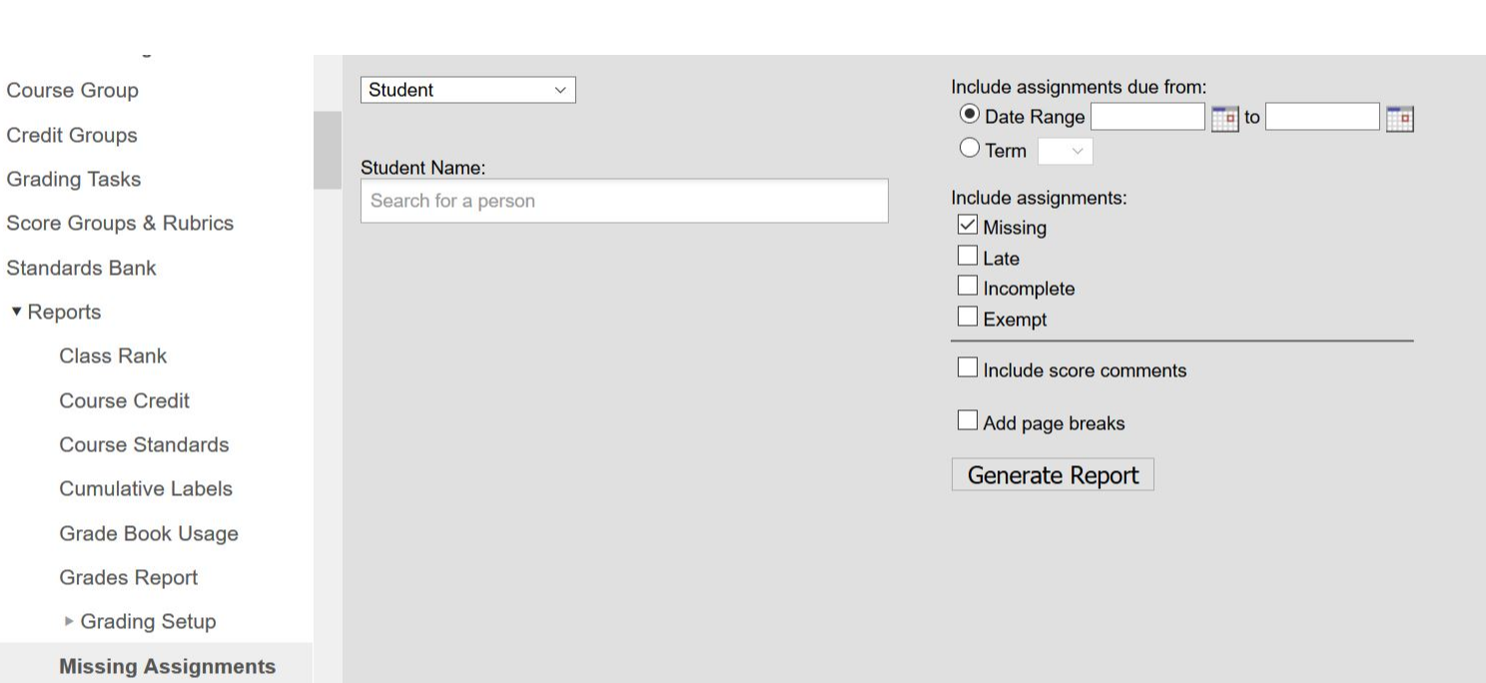
Missing Assignment

Slide 81
Scoring Assignments
Assignment scoring can be accessed through the Control Center, Gradebook or the Assignment Overview.
Enter scores for an assignment in the appropriate column, based on the scoring options selected for that assignment, such as points or rubrics. Use the Arrow, Tab and Enter keys to navigate among the score cells.
Flag Assignments
Assignments can be flagged as Turned In (T), Missing (M), Late (L), Incomplete (I), Cheated (Ch), Exempt (X) or Dropped (D).
Enter a comment to attach to the score in the Comment box (optional). Comments can be up to 255 characters in length. If you enter a comment on a score, a red indicator displays in the top right corner of the score grid. Hovering over the score displays the comment.
Fill Options: Use the fill options for an assignment to save time entering scores or proficiency levels. Click the Fill Scores/Comments link. This will open the Fill Scores/Comments window.
Indicate whether you want to fill Scores, Comments or both using the checkboxes. Enter the score and/or comment to add. Then select which students should be given the score and/or comment.
Click Fill to fill scores and/or comments.

Slide 82
Posting grades in Grade Book
Open the Grade Book and select the desired section (course) from the Section drop down box.
To post grades, review the In Progress portion of the Grade Totals. Click the orange Post button to open the post grades window.
The Post Grades window shows the source and destination of the grades you are posting. The current Term and Task appear in the from (source) section. If the to (destination) is different, select the destination Term and Task from the dropdown lists. You can only select a task as the destination if the grading window is open for the grading task or standard. The grading window does not need to be open for the source term and task to post grades. Change the destination term and task if you want to post the grades to another task, such as a Progress Report task that is used to report grades but doesn't have any assignments.
Click OK to copy grades from the In Progress columns to the Posted section, if the In Progress grade is a valid option in the score group. If you posted grades from one task another, the destination task opens.
Review the Posted grades and make modifications as desired, such as a grade that could round up to the next letter grade. Options in the grade dropdown list are based on the score group aligned to the grading task, rather than the grading scale which determined the In Progress grade.
Enter any comment in the Report Card Comments column or click the CC (canned comments) link to open the comments window. Canned Comments are only available if you enable them in Grade Book > Settings.
To give comments to all students or students who do not have any comments, click Fill, enter your comments as described above, select who should receive these comments (All or Empty) and click Fill.
Finally, Save the Grade Book to post grades.

Slide 83
Posting by task or student
Posting by Task
Open the Post Grades tool.
Select the Section and Term from the dropdown lists at the top to populate the Task and Student dropdown lists with available options.
When posting by task, select a Task from the dropdown list. If you see a Student dropdown list instead, click Post by Standard/Grading Task and then select a task. All students in the selected section are listed.
Enter a Percent (if you're grading a task) and select a Grade from the score group or rubric aligned to the task or standard.
Enter any Comments for the report card using the text box or by clicking Add to access the canned comments window.
Click Save when finished to post grades.
Posting by Student
Open the Post Grades tool and select the Section and Term from the dropdown lists at the top to populate the Task and Student dropdown lists with available options.
When posting by student, select a Student from the dropdown list. If you see a Task dropdown list instead, click Post by Student and then select a student. All standards and tasks assigned to that section appear.
Enter a Percent (if you're grading a task) and select a Grade from the score group or rubric aligned to the task or standard for each standard or task.
Enter any Comments for the report card using the text box or by clicking Add to access the canned comments window.
Click Save when finished to post grades.

Slide 84
Grading Window
Open the grading window
Under Grading & Standards, select Grading Window
Select the year and calendars you are opening
Select the grading task to be opened
Check the terms that are being opened
Click Update Active Masks
Close the grading window
Under Grading & Standards, select Grading Window
Select the year and calendars you are opening
Select the grading task to be opened
Do not check any terms
Click Update Active Masks

Slide 85
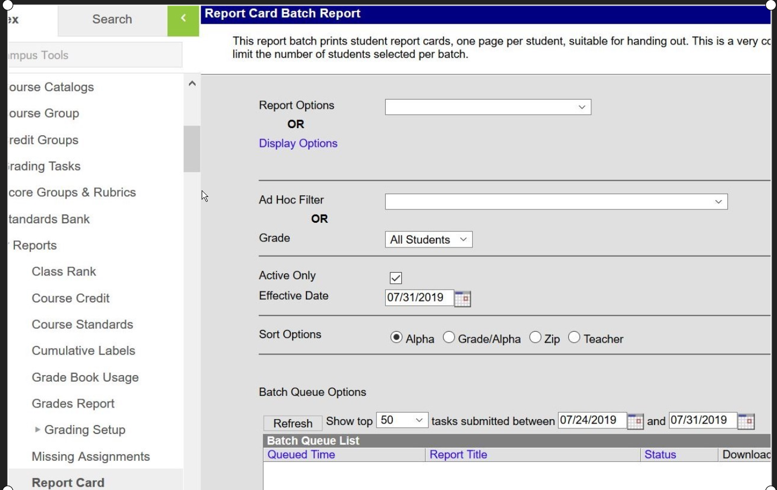
Report Cards

Slide 86

Grade Reports

Slide 87

Grade Book Usage

Slide 88

Transcript Batch

Slide 89


Standard Based Grading
Create a Score Group or Rubric
Create a scoring rubric under Grading & Standards->Score Groups & Rubrics
Next, add Standards to the Standards Bank under Grading & Standards->Standards Bank
When doing so, consider how you would like the standards grouped on the report card. Use groups to keep the standards for particular courses together. Select the appropriate scoring rubric for each group.

Slide 90



Standard Based Grading cont.
Add standards by placing them under the appropriate Standards Bank Location (Parent Group/Standard).
After the groups and standards have been added to Standards Bank, allow those standards to be used in the appropriate school under System Administration->Resources->Resources on the School Standards tab .

Slide 91


Standard Based Grading cont.
Now, add the standards to each course either directly under the course number in the school or through the course master record. Be sure to select the terms that each standard will apply to.
Lastly, open the standards for grading under Grading & Standards->Grading Window by selecting the Standards option, rather than Grading Tasks.

Slide 92

Tool Rights for Guest Access to Grade Book

Slide 93

Tool Rights

Slide 94

Tool Rights by Section

Slide 95

Guest Access to the Gradebook

Slide 96
Enrolling Students
First time enrollment
Using the Student Locator
Creating New Student
Enrollment Roll Forward
Enrollment End Batch
Enrollment Cleanup Wizard
New Enrollment History
Foreign Exchange Students

Slide 97

First Time Enrollments
Potential student is under a Household in the Census
Click on student name
Click on Enrollment tab
Click on New

Slide 98

Student Locator
Student Information>>Student Locator

Slide 99
Student Locator
Provide first and last name and gender
Avoid nicknames
If you know State ID use that.
Mouse-over each result to see last enrollment
Match birth dates
Be sure of identity – avoid duplications
If match use – if not Create New Student

Slide 100

Create New Student
Student Number – locally generated State ID – state assigned
At minimum include all information marked red

Slide 101

Create New Student
Include all necessary information
When complete click SAVE at the top

Slide 102
Enrollment Roll Forward
Do this during prep for new year
Create new calendars before you roll
Roll multiple Grades of students
Roll from one calendar to another
Middle School to High school
Can do multiple times
Repeat if new students enroll

Slide 103

Enrollment Roll Forward
System Administration>>Students>>Enrollment Roll Forward

Slide 104
A district should have rolled their calendars using the Calendar Wizard before using this tool. This tool is safe to run repeatedly. If a student has already been promoted into the next calendar, it will not roll them again. It is assumed that each student should be rolled only once. Where the student is rolled is determined on the logic described below. Run this in test mode to preview which students will roll and where.
1.) The new enrollment start date will be the first instructional day in the calendar unless a date is specified.
2.) Only students without an End Date on their enrollment in the source calendar/grade will roll into a new calendar/grade unless the option to roll students whose end dates match the last day of the last term is selected. With that option, if an enrollment end date matches the last day of the term in any term schedule, the student will roll. It is always best to roll your students before ending their enrollments. Dropped students will not roll.
3.) If the destination calendar has multiple schedule structures with the same grades, the destination will have to be selected manually.
4.) Any students that have Future Enrollment information in their enrollment will be rolled directly into the calendar and grade specified. Use this to retain or demote students. These students will be excluded from any of the following logic.
5.) Sequence numbers must be assigned to all grade levels in all calendars. A student will be promoted to the next number in the sequence: Grade 09 with a sequence of 9 will be promoted to Grade 10 with a sequence of 10. Grade Levels with sequence 0 will be ignored. Students are assumed promoted unless flagged as retained or demoted on their enrollment. The tool will increment the grade sequence and look for next year's calendar in the same school.
6.) If a student needs to be promoted to a new building and the student's address contains a School Boundary mapping, the new building will be selected from the mapping information.
7.) If the student does not meet any of the conditions above, they will not automatically roll forward without a destination calendar, structure, and grade selected. These include 0 sequenced grades, and building promotion where multiple schools provide the promotion grade. These students should be rolled independently of a district-wide roll.

Slide 105
Enrollment Roll Forward
I do a separate roll for students changing calendars.
Check and double check to make sure you are sending the correct students to the correct school
Be sure you do your final roll BEFORE you end date students!

Slide 106
Enrollment End Batch
Done at end of school year
After all other actions (grades, attendance)
Will NOT change already populated data
Process graduating students separately
End date for seniors is last day of school calendar NOT their last day
Diploma date can be last day or graduation day

Slide 107

Enrollment End Batch
System Administration>>Student>>Enrollment End Batch

Slide 108
Enrollment End Batch
All Students – End Date, End Status, End Action
Graduates – Diploma Date, Diploma Type, Diploma Period
Can change individual students under their Enrollment tab

Slide 109
Enrollment Cleanup Wizard
Will remove next year’s enrollments created with the Enrollment Roll Forward tool
If previous enrollment was ended prior to last day of school OR
If student fails to meet Student Assignment requirements for next year’s enrollment

Slide 110

Enrollment Cleanup Wizard
System Administration>>Student>>Enrollment Cleanup Wizard

Slide 111
New Enrollment History
Under Student Enrollment Tab
Manually insert enrollment records from other schools
Such as 9th Grade
Must have to trigger the NCLB Cohort End Year
Check with previous school for verification of date

Slide 112

New Enrollment History

Slide 113

New Enrollment History
Calendar Name = Previous School Name
Grade and Start Date, End Date if appropriate

Slide 114
Student Transfers
Initiating a student records transfer
The process Inbox
Student Records Transfer
Completing the process

Slide 115
Student Transfers
Student Information>>General>>Records Transfer Tab
Click “New State Transfer Request”
Information sent directly to previous school
Must be exact student match
Contact school as a courtesy
Everything you wanted to know about records transfers:
https://content.infinitecampus.com/sis/Campus.1917/documentation/student-records-transfer/

Slide 116


Process Inbox
Requesting District
Receiving District

Slide 117

Completing the Process
When District is ready to approve the release

Slide 118

Completing the Process
You may print documents or run the import wizards

Slide 119

Student Records Transfer
System Administration>>Data Utilities>>Student Records Transfer
Find all transfers in and out

Slide 120
Student Roster Setup
Schedule Wizard available for use
https://content.infinitecampus.com/sis/Campus.1917/documentation/schedule-wizard/
Roster
Roster Setup
Walk-In Scheduler
Moving students mid-year

Slide 121

Roster Copy
Scheduling>>Roster Copy
Copy from one year to another or one calendar to another

Slide 122

Roster Setup
Scheduling>>Courses>>Section>>Roster Setup
Add students and/or Copy Sections within a year or calendar

Slide 123

Roster Setup
Scheduling>>Courses>>Section>>Roster Batch Edit
Cannot add students
Can End Date, mark to Repeat or mark No Credit

Slide 124

Walk-In Scheduler
Student>>General>>Schedule Tab

Slide 125

Walk-In Scheduler
Click Walk-In Scheduler

Slide 126

Walk-In Scheduler
Click a class link
Add Start/End Date
Mark Repeat
Mark No Credit

Slide 127

Walk-in Scheduler

Slide 128

Walk-in Scheduler
Under Counseling
Mid-Term adjustments
Once completed use Messenger to send information to affected teachers

Slide 129
Moving Students Mid-Year - Process
DO NOT DELETE
Loss of data (grades, attendance, etc.)
Add student to new section using Roster Setup
Use Walk-In Scheduler to apply Start/End date
End previous on today’s date
Start new on tomorrow’s date
Newly enrolled appear Green for a time
Dropped appear Red

Slide 130
Attendance
Admin Setup
Daily Attendance – Teacher
Daily Attendance – Office
Finalizing Attendance
Attendance Letters
Attendance Messenger

Slide 131

Admin Setup
System Administration>>Attendance>>Attendance Codes
Add more attendance codes

Slide 132

Admin Setup
System Administration>>Attendance>>Excuse Code Copier
Copy attendance codes to multiple calendars

Slide 133

Admin Setup - Classes
Scheduling>>Courses>>Course Tab
Check box for Attendance

Slide 134

Side Note - Lunch
Scheduling>>Courses>> course section
Checkbox for Lunch and/or Milk count

Slide 135

Attendance - Teacher
Classroom Instruction>>Attendance

Slide 136
Attendance - Office
Steps
Check attendance via Daily Attendance
Print Call Sheet
Process student attendance
Save
https://content.infinitecampus.com/sis/E.1314/documentation/attendance/

Slide 137

Attendance - Office
Attendance>>Daily Attendance

Slide 138


Slide 139

Attendance - Office
Click any Attendance mark for a particular student
You can add Attendance Code, Present Minutes and Comments
Fill Down

Slide 140

Attendance - Office
Add Attendance prior to an event
Student Information>>General>>Attendance Tab

Slide 141

Attendance - Office
Attendance>>Attendance Wizard
Search for students, choose one or many
Enter attendance for day or period specific
Batch – for a specific period of time
Choose one and additional instructions appear at bottom

Slide 142

Attendance Letters
Attendance>>Attendance Letter Wizard
Walks through the process
Type – Period Marks or
Course Marks allow you to
eliminate course sections
Type – Whole/Half Day Absences,
Exact Day Absences, and Single Day
Count do not
Attendance Type – Attendance Code
(AE – Absent Excused, DR – Doctor
Attendance Type – StatusExcuse
differentiates Excused and Unexcused

Slide 143

Attendance Letter
Attendance Letter Wizard example
Can weight each type of status
To determine a total Qualification
Criteria for Letter

Slide 144

Attendance Letter
Attendance Letter Wizard –
Format Letter
Note the additional
information included
in the letter by default.
Note – The “Organized To”
so you can save for others
to use.

Slide 145
Attendance Letter
Printing letters
Attendance>>Attendance Letter
Choose letter template
Click Preview and Print
Shown a list of students affected
Print

Slide 146

Attendance Messenger
Attendance>>
Attendance Messenger
1. Choose Grade,
Status (Absent/Tardy,
Excuse (Excused/Unexcused,
and Minimum Periods
2. Apply Ad Hoc Filter
if appropriate
3. Add Date
4. Language Preference
5. Inbox and/or Email
6. Create message
7. Save template

Slide 147

Attendance Messenger
Set Deliver Date and Time
Preview/Send

Slide 148

Attendance Messenger Scheduler
Attendance>>Attendance Messenger Scheduler
Based on Template created in Attendance Messenger
Choose specific calendar affected (EL, MS, HS)
Run Daily, Weekly, Monthly,

Slide 149
Attendance Notes
When setting up a Letter or Messenger
Be sure your results match your intent
Do not set up automatic until you are sure
https://content.infinitecampus.com/sis/latest/study-guide/attendance
https://content.infinitecampus.com/sis/Campus.1841/documentation/attendance-letters/
https://content.infinitecampus.com/sis/Campus.1813/documentation/attendance-messenger/
https://content.infinitecampus.com/sis/E.1509/documentation/attendance-messenger-scheduler/

Slide 150


Updating behavior
Use the Behavior tab for a particular student to update an individual’s behavior records.
Click on the specific behavior incident to view the incident details.
Use the Incident ID link to update the detail.

Slide 151


Behavior
Behavior Management
Create a new behavior incident by starting
under Behavior Management
Complete all items relevant to the incident
Next, Add the Event and Participants using the Add Event/Participant button.

Slide 152


Behavior cont.
Add participants under the Participant Detail using the Search options.
Lastly, add the Resolutions for each participant. Resolutions can be added to multiple participants at the same time.

Slide 153
FRAM
Denise will explain how to properly code students on the FRAM tab for Free/Reduced Priced Lunch
Eligibility
Reports – Eligibility/Lunch Counts

Slide 154
Reminders
Verification of the Educational Directory will open August 7th and will close on September ^{3rd}. If you have questions, please contact Jennifer.RattlingLeaf@state.sd.us
Always use the student locator to enroll a student. If you are unsure of the student that you pulled up, please contact us and we can look into it.
Double check the birthdates on your PK and KG students to make sure that they are old enough to attend.
A student can only have one primary enrollment, unless they are attending one of the 12 facilities that a dual enrollment is allowed.
Student who do not return and you did not receive a request for transfer----you will need to code that student as a drop out for the 19-20 school year. You will have a start date and the an end date as the first day of school.
Districts are not allowed to add a grade level during the school year.
School calendar are due in by the last Friday of August. This includes all calendars that you have set up in your system, this includes home school too.
State Aid – is the last Friday in September.
FRAM – must be entered by the 31 of October

Slide 155
Fall User Groups
September 17th –Lake Area Tech.-Watertown
September 18th – Southeast Tech.-Sioux Falls
September 19th - MacKay Building DOE – Pierre
September 20th – University Center – Rapid City

Slide 156
Data Management Staff
Judy Merriman Teri Jung
Data Management, Administrator Management Analyst
Judy.Merriman@state.sd.us Teri.Jung@state.sd.us
773-4737 773-8197
Jennifer Rattling Leaf Clive Bremser
Policy/Data Analyst Management Analyst
Jennifer.Rattlingleaf@state.sd.us Clive.Bremserstate.sd.us
773-4703 773-2539
Randy Hanson Angie Bren
Management Analyst Ed Facts Coordinator
Randy.Hanson@state.sd.us Angie.Bren@state.sd.us
773-4727 773-2263

