Slide 1
Writing Positive and Effective Behavior Support Plans

Slide 2
Who are you?
Special education teachers
General education teachers
Administrators
Related service providers
School psychologists
Others

Slide 3
Thank you Diana Browning Wright !
Please visit www.pent.ca.gov
For more information on the Competing Behaviors Pathways

Slide 4

Goal For the Morning
help you to understand the process behind writing effective Behavior support plans

Slide 5

Our Cuing System
You will have time to talk in your groups
Time is short! We will need you to return your attention to us when the timer goes off.

Slide 6
You should have…
Two copies of Competing Behaviors Pathways
One copy of Behavior Plan
Sheet to write positive support ideas

Slide 7

The Behavior Plan Process

Slide 8
What We Can Give You Is..
A tool to help the team (including the student) work toward a more effective way to communicate
A process that involves teaching/redirecting/reinforcing
Information can be found at www.pent.ca.gov

Slide 9
The Facts:
Problem behavior continues to be the primary reason why individuals in our society are excluded from school, home, recreation, community, and work.
BUT
We know that behaviors are trying to communicate
a need or a want and shouldn’t be ignored.

Slide 10
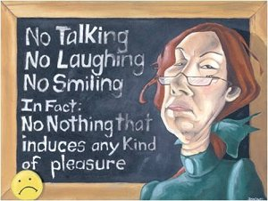

Traditional Discipline vs Positive Supports
Traditional Discipline:
Stop undesirable behavior by:
Punishment
Focuses on the student’s problem behavior
Positive Supports:
Stop undesirable behavior by:
Replacing with a new behavior or skill
Altering environments
Teaching appropriate skills
Reinforcing/recognizing appropriate behavior

Slide 11

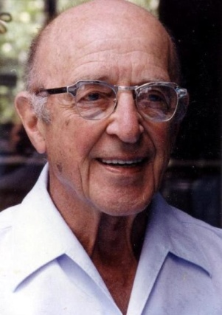
Bring Carl and Fred into your classroom
I like you just the way you are!
Unconditional Positive Regard
Unconditional Positive Regard

Slide 12
Some Tips on Behavior Impedes Learning on the IEP:

Slide 13
Students with Behavior Eligibility
OHI (ADHD), ED, Autism
Formal evaluations have been done
Should have information on Present Levels Page regarding behavior
Strengths and needs
Should have behavior addressed in goals
All should have behavior impedes learning checked
Can reference behavior plan
Can reference behavior goals

Slide 14
Students without Behavior Eligibility
Is the student’s behavior impeding learning?
Formal behavior evaluations not required for small or emerging behaviors.
Was there a behavior eval done?
Are there strengths and needs in the are of behavior?
Meant to be proactive
Safeguard to stop behaviors before a behavior plan is needed.

Slide 15
What should BIL section contain?
Not just what the student will do
Specify with the teacher/staff will do
Alterations in the environment
How the new behaviors be taught
Should be brief
Collaboratively developed
Not consequence based

Slide 16
REMEMBER!!
Behavior plans are not just for special education students!!

Slide 17
Basic Needs
Hunger
Thirst
Sleep
Bathroom
Air and Space

Slide 18

Examples of Behavior Supports

Slide 19
Before You Can Help a Kid Change…
You need to think about what success would look like for this student.
What are the steps he/she will need to take to get there
What is my role in this process?

Slide 20
Planned Discussion
Does the student KNOW you have a problem with their behavior?
Have you had a PLANNED discussion.
“I care about your success”
Not “YOU IN THE HALLWAY, NOW!”

Slide 21
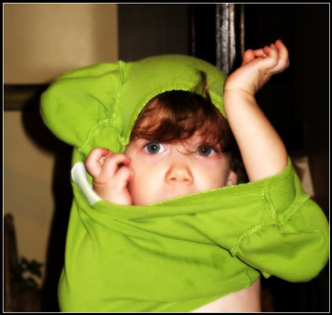
Consider This:
Kids not only need to learn a new behavior, they need to get rid of an old behavior too.

Slide 22
Before You Can Work on Changing a Behavior
You need to know the function of the behavior
You can make a behavior worse if you don’t know the function
Are they working to get something or get out of something?
The behavior is continuing because it’s working for them

Slide 23
Examples of Positive Supports: Taking a Break
When Sally comes into class and is noticeably agitated, the teacher will ask her if she would like to take a five minute break in the relaxation corner to write about what is bothering her. Upon returning to her desk the teacher will read Sally’s paper and set up a meeting to discuss it later. Sally will be verbally rewarded for returning to work.
Want the student to learn to know when they need a break
Taking a break will probably need to be taught!!

Slide 24
Examples of Positive Supports: Do Later File
When the student becomes frustrated have them put work away
Only give them so many at a time
Have them go through and circle the ones they would like to do on their own and put an X by the ones they would like help with

Slide 25
Examples of Positive Supports: Build Momentum
Start with what they know to get them working
Build confidence and momentum

Slide 26
Examples of Positive Supports: Cueing System
When Billy is becoming frustrated with the material because it is too difficult for him, Billy will use the cueing system to let staff know he is frustrated. Staff will adapt the number of items he is expected to learn or number of activities student will complete prior to assessment for mastery.
- Steps for teaching Billy how to use the cueing system
- Who will teach
- Reinforcement for using system correctly
- Plan for re-teaching if system is not used correctly

Slide 27
Examples of Positive Supports: Sandwich Method
A. Reinforce earlier behavior
B. State inappropriate behavior with a calm voice
(Just now your….)
C. Empathy statement
D. State appropriate behavior
E. Rational statement
- Require response
- Require performance
- Give ½ consequences
F. Reinforce compliance
**Turn and burn!!

Slide 28
Example of Positive Supports
2 X 10

Slide 29
Example of Positive Support: Schedules
Picture schedules
Written schedules in planners
Written schedule posted for all students

Slide 30
Examples of Positive Supports: Teaching Expectations, Can’t Do vs. Won’t Do
Take students to each area and teach what is expected in that area
If issues start to arise in certain areas, take class and teach again
Role play

Slide 31

“If a child doesn’t know how to read, we teach.”
“If a child doesn’t know how to swim, we teach.”
“If a child doesn’t know how to multiply, we teach.”
“If a child doesn’t know how to drive, we teach.”
“If a child doesn’t know how to behave, we… …teach? …punish?”
“Why can’t we finish the last sentence as automatically as we do the others?”
(Herner, 1998)
31
Notes:
31

Slide 32
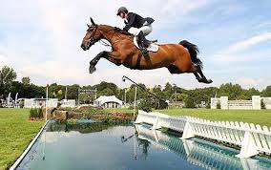
Examples of Positive Supports: Set Kids Up for Success
If you have a classroom system in place but the student has never experienced success with it, it will become meaningless and frustrating
Same is true with behavior support plan
Kids become programed to think they CAN’T

Slide 33

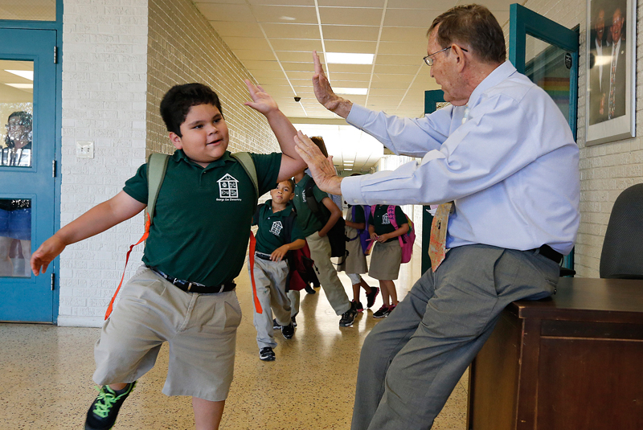
Examples of Positive Supports: Reinforcement/Recognize Systems
It’s not as much about the reinforcement as it is about the relationship
VS.

Slide 34
Examples of Positive Support: Focus on Behaviors You Want to Increase
Pay more attention to positive behaviors
When collecting data for some behaviors, collect it on the behaviors you want to see (on task, in seat, working quietly)

Slide 35
Examples of Positive Supports: Classroom Strategies
Get Students' Attention Before Giving Directions (Wait until all students are looking at you and ready to listen)
Class Participation: Keep Students Guessing
(ask questions, call on students randomly)
Use Proximity Control (circulate around the room or when needed, stand next to someone)

Slide 36
More Classroom Strategies
Instruct at a Brisk Pace (Minimize time spent things like collecting homework or on transitions)
Make the Activity Stimulating (Make instruction interesting & exciting)
Pay Attention to the On-Task Student (“Catch the child being good”)
Provide a Quiet Work Area (This is not a time out)

Slide 37
Questions on Supports?
Turn and Talk
Take five minutes and talk to a neighbor about strategies you use and ones you think will work with your students

Slide 38
BREAK

Slide 39
Behavior Support Plan Process

Slide 40

Think of it as a Doctor Visit
Look at the symptoms
Diagnose
Find the right level of care
If symptoms persist, may need to re-diagnose

Slide 41
Tools needed
1. Data Collection
2. Competing Behaviors Pathways
3. Behavior Support Plans

Slide 42
Where Do You Start? Data Collection
Gather information
Collect data on the problem behavior
Through observations
Through interviews
Past information
Look at what is happening before the behavior occurs (antecedent)
Look at what happens after the behavior occurs (reinforcing behavior)

Slide 43
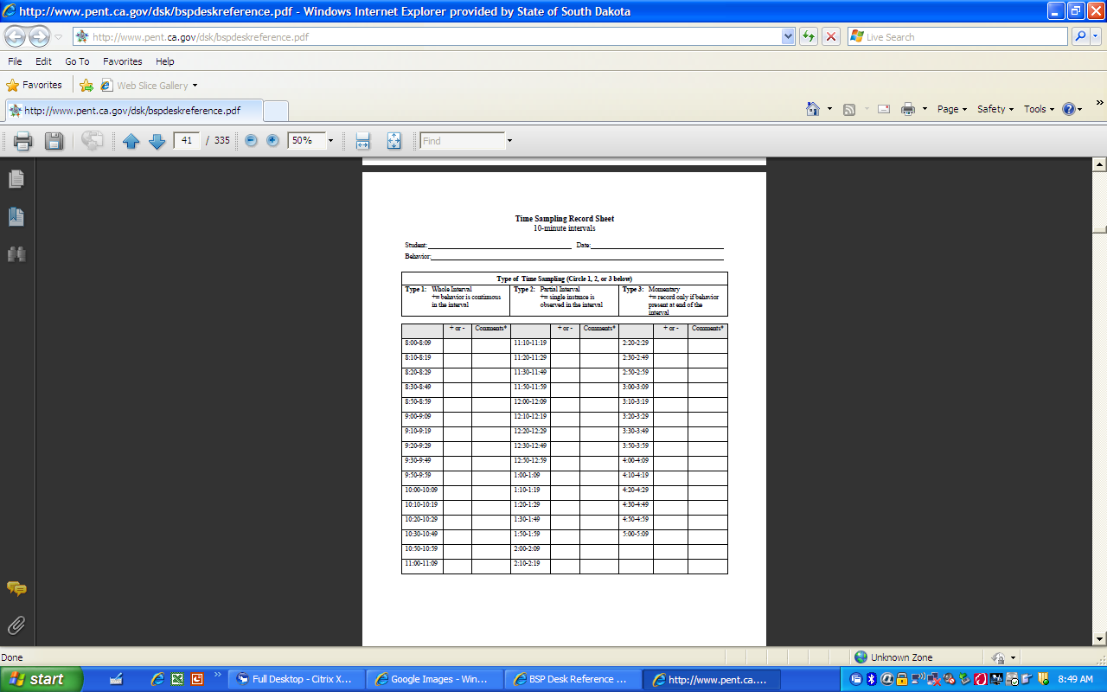

Slide 44
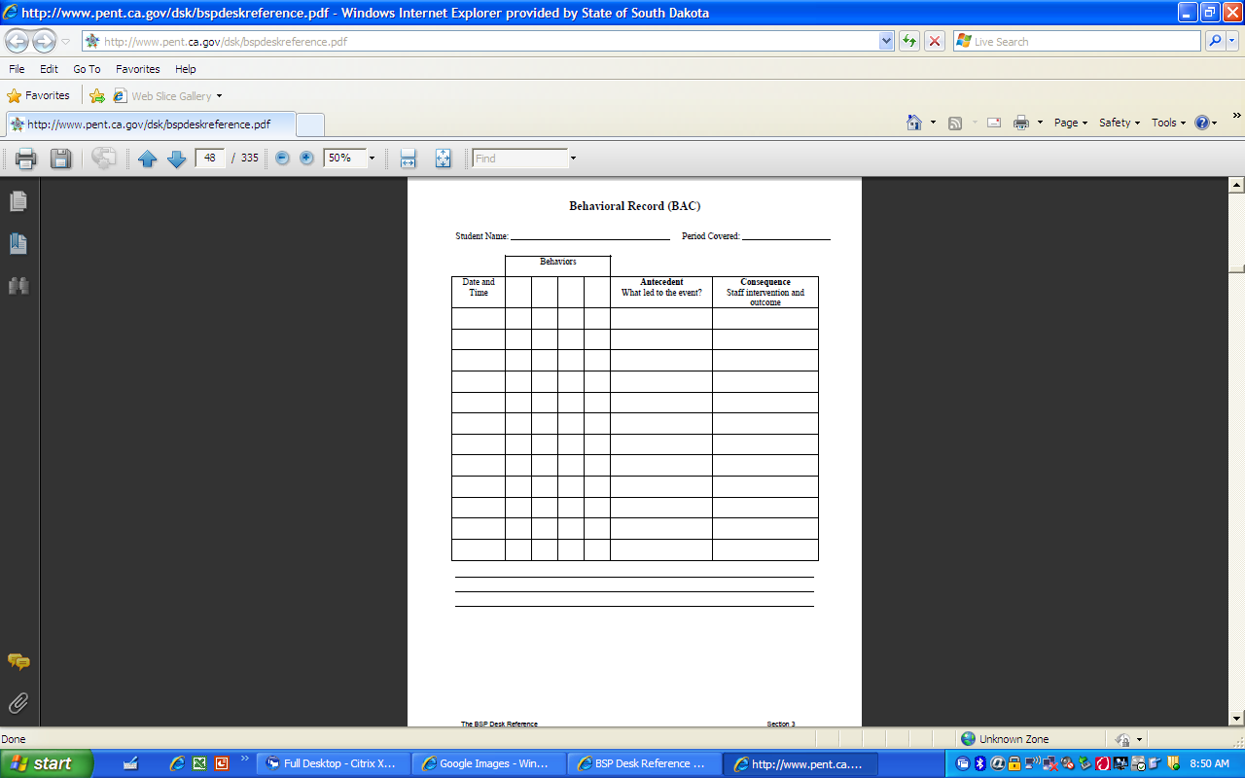

Slide 45
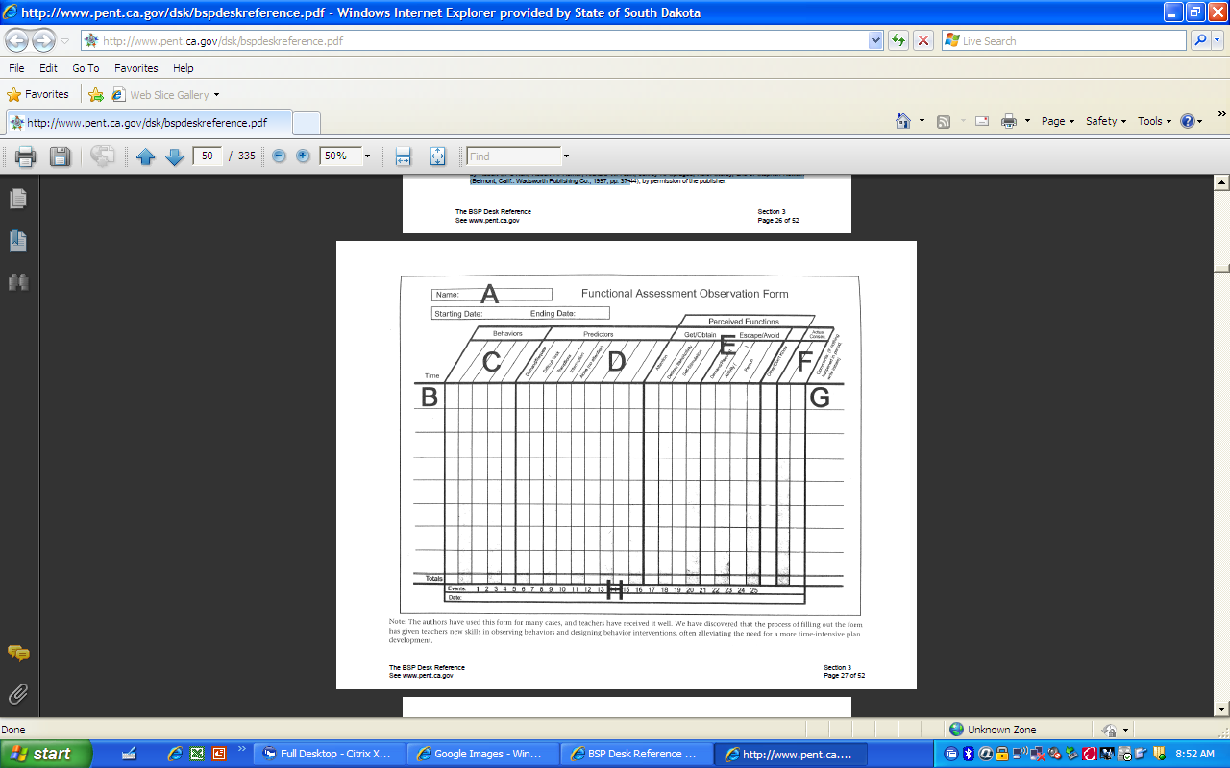

Slide 46
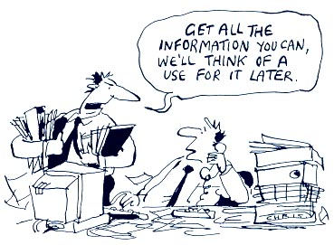

Slide 47
Once you have your data…
1. Competing Behaviors Pathways
2. Behavior Support Plan

Slide 48
Why use the Pathways chart?
1. Helps bring consensus to the group
2. Establishes buy-in for the Behavior Support Plan
3. Gives a great visual of the real issues and solutions

Slide 49
Competing Pathways
Upper: Get this—general positive behavior
Middle: Prevent this—reactive strategies to prevent problem behavior escalation
Lower: Accept this—FERB in lieu of problem behavior when general positive upper pathway fails
Notes:
49

Slide 50
Summary Statement
Order of Team Discussion
What everyone else in the
Classroom is doing
This is the picture of what is currently going
on with the student
What the team will accept when
The upper pathway is not able
To be reached
Advanced Behavior Management
Notes:
50

Slide 51
Reminder! Expectations for Rest of the Morning
Time is short, please stay on task!
When the timer goes off, please raise your hand, finish conversations, and be ready to move on to the next section

Slide 52
Meet Our Example Student Brian
Please read the next slide to yourself
On a piece of paper please write down
Main behavior
Antecedents
Consequences

Slide 53
Brian is a kindergartener with a special education eligibility diagnosis of speech/language disorder but with many features suggestive of autism. He is verbal, and uses 3-4 word sentences routinely to express needs and wants, but never to comment on something in the environment. Brian likes routines, and becomes very upset if the bus is late, or if the bus driver is not the expected one. On those days, when Brian’s bus routine has changed, staff members say they “know he will have problems.” Each school day Brian puts his coat away, and goes to circle time. After going to circle, on many days, Brian will run away, and kick and head butt if captured after running away, if the activity at circle time lasts more than five minutes. Brian is more likely to leave circle by running away, on days when the bus routine has changed from the typical bus routine.

Slide 54
The Competing Behaviors Pathway Process
We will look at the boxes one by one
Very important to fill the boxes out in the order the are numbered
We will look at the information that should go there
We will look at some examples
We will decide what should go there for Brian

Slide 55
Desired
Alternative
Typical
Consequence
Summary Statement
Order of Team Discussion
second
third
First
fifth
Setting Events
Must be
periodic,
Not continuous!
sixth
Triggering
Antecedents
Problem
Behavior
Maintaining
Consequences
fourth
seventh
Acceptable
Alternative
Advanced Behavior Management
Notes:
55

Slide 56
1. Define Problem Behavior
Description should be observable, e.g., what it looks like to a camera, and therefore measurable for progress monitoring.
What the behavior looks like, not how it makes you feel
If the team describes a category or label for the behavior, follow that with a description of exactly what the student is doing.

Slide 57
Examples for #1
Off task:
Poor organization
and planning:
Tantrums:
Outbursts/Rage/
Explosive Reactions
crawls on the floor; plays with objects in desk; attempts play with others
rushes to complete assignment without planning each phase; waits until the final work period to begin a long term assignment
student throws materials; student crawls under the desk and screams with high volume.

Slide 58
Desired
Alternative
Typical
Consequence
Summary Statement
Order of Team Discussion
second
third
Gets up and
Runs into the
Hallway during
Circle time
fifth
Setting Events
Must be
periodic,
Not continuous!
sixth
Triggering
Antecedents
1.Problem
Behavior
Maintaining
Consequences
fourth
seventh
Acceptable
Alternative
Advanced Behavior Management
Notes:
58

Slide 59
Desired
Alternative
Typical
Consequence
Summary Statement
Order of Team Discussion
Second
third
first
fifth
Setting Events
Must be
periodic,
Not continuous!
sixth
Triggering
Antecedents
Problem
Behavior
Maintaining
Consequences
fourth
seventh
Acceptable
Alternative
Advanced Behavior Management
Notes:
59

Slide 60
2. Desired Alternative Behavior
What is the child supposed to be doing at that time?
What are other students doing at that time?

Slide 61
Examples for #2
Sit at desk
Complete assignment during class time
Turn in neat completed homework on time
Use language that does not contain swear words while talking to peers and teachers
Keep hands and feet to self while in the lunch room

Slide 62
2. Desired
Alternative
Typical
Consequence
Summary Statement
Order of Team Discussion
Sit in circle time and listen to the lesson
third
First
fifth
Setting Events
Must be
periodic,
Not continuous!
sixth
Triggering
Antecedents
Problem
Behavior
Maintaining
Consequences
fourth
seventh
Acceptable
Alternative
Advanced Behavior Management
Notes:
62

Slide 63
Desired
Alternative
Typical
Consequence
Summary Statement
Order of Team Discussion
second
Third
first
fifth
Setting Events
Must be
periodic,
Not continuous!
sixth
Triggering
Antecedents
Problem
Behavior
Maintaining
Consequences
fourth
seventh
Acceptable
Alternative
Advanced Behavior Management
Notes:
63

Slide 64
#3 Typical Consequence for #2
What happens when the student or all the other students exhibit the desired behavior written in #2?

Slide 65
Examples for #3
Students are allowed access to the computer
Students learn the material
Students are able to move on to the next lesson in the book
Students are able to stay in the classroom and participate in class
Students are able to play on the playground
Students are able to sit where they want at lunch

Slide 66
Desired
Alternative
3. Typical
Consequence
Summary Statement
Order of Team Discussion
second
Learn the information the teacher is sharing verbal praise
first
fifth
Setting Events
Must be
periodic,
Not continuous!
sixth
Triggering
Antecedents
Problem
Behavior
Maintaining
Consequences
fourth
seventh
Acceptable
Alternative
Advanced Behavior Management
Notes:
66

Slide 67
Desired
Alternative
Typical
Consequence
Summary Statement
Order of Team Discussion
second
third
first
fifth
Setting Events
Must be
periodic,
Not continuous!
sixth
Triggering
Antecedents
Problem
Behavior
Maintaining
Consequences
Fourth
seventh
Acceptable
Alternative
Advanced Behavior Management
Notes:
67

Slide 68
#4 Triggering Antecedents
Situations in which the behavior is likely to occur: people, time, place, object, etc.

Slide 69
Examples for #4
Physical Setting
Social Setting
Instructional
Strategies
Scheduling
Factors
Sensory under or over stimulation: noise, crowding, temperature, etc.; missing or present materials, configurations of furniture;
Interaction patterns in or around the student, people present or absent; substitute teacher
Mismatch between learner accommodation needs and instructional components. An accommodation plan may be necessary to increase student success.
Specific times within the schedule; with or without sequencing and transition supports; absence of a visual schedule; unanticipated changes in routine.

Slide 70
Desired
Alternative
Typical
Consequence
Summary Statement
Order of Team Discussion
second
third
first
fifth
Setting Events
Must be
periodic,
Not continuous!
sixth
4. Triggering
Antecedents
Problem
Behavior
Maintaining
Consequences
Circle time lasts more than 5 minutes
seventh
Acceptable
Alternative
Advanced Behavior Management
Notes:
70

Slide 71
Desired
Alternative
Typical
Consequence
Summary Statement
Order of Team Discussion
second
third
first
Fifth
Setting Events
Must be
periodic,
Not continuous!
sixth
Triggering
Antecedents
Problem
Behavior
Maintaining
Consequences
fourth
seventh
Acceptable
Alternative
Advanced Behavior Management
Notes:
71

Slide 72
#5 Maintaining Consequences
What is happening after or during the behavior that makes it worth while for the student to keep doing it?
Also know as function of the behavior in terms of getting or rejecting (protest, escape, or avoid) something that will guide development of a functionally equivalent replacement behavior

Slide 73
Examples for #5
Getting Examples:
To gain adult attention
To gain sustained peer attention and positive comments (use instead of “power”)
To gain a desired item or activity
To get a choice in the pacing of activities (use instead of “control”)
Reject: (Escape/Protest/Avoid) Examples:
To escape or avoid a task student states is (a) too hard or (b) too long, or (c) not meaningful to the student or (d) to escape peer comments that the task is too easy
To avoid or protest a demand or request or reprimand
To escape an environment in which the student states negative comments from peers frequently occur
To escape or avoid specific people or activities

Slide 74
Desired
Alternative
Typical
Consequence
Summary Statement
Order of Team Discussion
second
third
first
Setting Events
Must be
periodic,
Not continuous!
sixth
Triggering
Antecedents
Problem
Behavior
5. Maintaining
Consequences
Does not
Have to
Participate
In circle time
fourth
seventh
Acceptable
Alternative
Advanced Behavior Management
Notes:
74

Slide 75
Desired
Alternative
Typical
Consequence
Summary Statement
Order of Team Discussion
second
third
first
fifth
Setting Events
Must be
periodic,
Not continuous!
Sixth
Triggering
Antecedents
Problem
Behavior
Maintaining
Consequences
fourth
seventh
Acceptable
Alternative
Advanced Behavior Management
Notes:
75

Slide 76
#6 Setting Events
Not something that happens all the time
Special events that may ADD TO the likelihood a behavior will occur

Slide 77
Examples #6
Child refused meds
Child broke up with girl/boyfriend
Child did not get enough sleep the night before

Slide 78
Brian likes routines, and becomes very upset if the bus is late, or if the bus driver is not the expected one. On those days, when Brian’s bus routine has changed, staff members say they “know he will have problems.” Each school day Brian puts his coat away, and goes to circle time. After going to circle, on many days, Brian will run away, and kick and head butt if captured after running away, if the activity at circle time lasts more than five minutes. Brian is more likely to leave circle by running away, on days when the bus routine has changed from the typical bus routine.

Slide 79
Desired
Alternative
Typical
Consequence
Summary Statement
Order of Team Discussion
second
third
first
fifth
Setting Events
Bus is late/not
The usual bus
driver
Sixth
Triggering
Antecedents
Problem
Behavior
Maintaining
Consequences
fourth
seventh
Acceptable
Alternative
Advanced Behavior Management
Notes:
79

Slide 80
Desired
Alternative
Typical
Consequence
Summary Statement
Order of Team Discussion
second
third
first
fifth
Setting Events
Must be
periodic,
Not continuous!
sixth
Triggering
Antecedents
Problem
Behavior
Maintaining
Consequences
fourth
Seventh
Acceptable
Alternative
Advanced Behavior Management
Notes:
80

Slide 81

#7 Functionally Equivalent Replacement Behavior (FERB)
FERB =What student should do instead of the problem behavior?
The FERB is a positive alternative that allows the student to obtain the same outcome that the problem behavior provided.
The FERB must be as easily performed as the problem behavior.

Slide 82
Examples for #7
(Swears at teacher: protesting a lack of attention) – FERB: Verbally state a desire for attention from the teacher.
(Fights: protesting not getting his way during a recess game) – FERB: Use protest language taught in verbal conflict resolution training.
(Screams: protesting an unexpected activity) – FERB: Use the printed schedule to protest and then negotiate about an upcoming unexpected activity.
(Runs from room-escaping hard work) – FERB: Go to time away/break center.
(Gains sustained positive peer attention from gang members for assaultive behavior) – FERB: Gain sustained positive peer attention from an alternative group for prosocial behavior.

Slide 83
Desired
Alternative
Typical
Consequence
Summary Statement
Order of Team Discussion
second
third
first
fifth
Setting Events
Must be
periodic,
Not continuous!
sixth
Triggering
Antecedents
Problem
Behavior
Maintaining
Consequences
fourth
7. Acceptable
Alternative (FERB)
Teacher will cue
Brian to go to
Designated spot in
The classroom.
Advanced Behavior Management
Notes:
83

Slide 84
Remember!!!!
Celebrate small successes
Brian may never do exactly what all the other students do

Slide 85
Form a team of 2-3
Take a minute and think of a student who needs a structured plan for shaping behavior.

Slide 86
Desired
Alternative
Typical
Consequence
Summary Statement
Order of Team Discussion
second
third
First
fifth
Setting Events
Must be
periodic,
Not continuous!
sixth
Triggering
Antecedents
Problem
Behavior
Maintaining
Consequences
fourth
seventh
Acceptable
Alternative
Advanced Behavior Management
Notes:
86

Slide 87
1. Define Problem Behavior
Description should be observable, e.g., what it looks like to a camera, and therefore measurable for progress monitoring.
What the behavior looks like, not how it makes you feel
If the team describes a category or label for the behavior, follow that with a description of exactly what the student is doing.

Slide 88
Desired
Alternative
Typical
Consequence
Summary Statement
Order of Team Discussion
Second
third
first
fifth
Setting Events
Must be
periodic,
Not continuous!
sixth
Triggering
Antecedents
Problem
Behavior
Maintaining
Consequences
fourth
seventh
Acceptable
Alternative
Advanced Behavior Management
Notes:
88

Slide 89
2. Desired Alternative Behavior
What is the child supposed to be doing at that time?
What are other students doing at that time?

Slide 90
Desired
Alternative
Typical
Consequence
Summary Statement
Order of Team Discussion
second
Third
first
fifth
Setting Events
Must be
periodic,
Not continuous!
sixth
Triggering
Antecedents
Problem
Behavior
Maintaining
Consequences
fourth
seventh
Acceptable
Alternative
Advanced Behavior Management
Notes:
90

Slide 91
#3 Typical Consequence for #2
What happens when the student or all the other students exhibit the desired behavior written in #2?

Slide 92
Desired
Alternative
Typical
Consequence
Summary Statement
Order of Team Discussion
second
third
first
fifth
Setting Events
Must be
periodic,
Not continuous!
sixth
Triggering
Antecedents
Problem
Behavior
Maintaining
Consequences
Fourth
seventh
Acceptable
Alternative
Advanced Behavior Management
Notes:
92

Slide 93
#4 Triggering Antecedents
Situations in which the behavior is likely to occur: people, time, place, object, etc.

Slide 94
Desired
Alternative
Typical
Consequence
Summary Statement
Order of Team Discussion
second
third
first
Fifth
Setting Events
Must be
periodic,
Not continuous!
sixth
Triggering
Antecedents
Problem
Behavior
Maintaining
Consequences
fourth
seventh
Acceptable
Alternative
Advanced Behavior Management
Notes:
94

Slide 95
#5 Maintaining Consequences
What is happening after or during the behavior that makes it worth while for the student to keep doing it?
Also know as function of the behavior in terms of getting or rejecting (protest, escape, or avoid) something that will guide development of a functionally equivalent replacement behavior

Slide 96
Desired
Alternative
Typical
Consequence
Summary Statement
Order of Team Discussion
second
third
first
fifth
Setting Events
Must be
periodic,
Not continuous!
Sixth
Triggering
Antecedents
Problem
Behavior
Maintaining
Consequences
fourth
seventh
Acceptable
Alternative
Advanced Behavior Management
Notes:
96

Slide 97
#6 Setting Events
Not something that happens all the time
Special events that may ADD TO the likelihood a behavior will occur

Slide 98
Desired
Alternative
Typical
Consequence
Summary Statement
Order of Team Discussion
second
third
first
fifth
Setting Events
Must be
periodic,
Not continuous!
sixth
Triggering
Antecedents
Problem
Behavior
Maintaining
Consequences
fourth
Seventh
Acceptable
Alternative
Advanced Behavior Management
Notes:
98

Slide 99
#7 Functionally Equivalent Replacement Behavior (FERB)
FERB =What student should do instead of the problem behavior?
The FERB is a positive alternative that allows the student to obtain the same outcome that the problem behavior provided.
The FERB must be as easily performed as the problem behavior.

Slide 100

Break time!!

Slide 101
The Behavior Plan

Slide 102
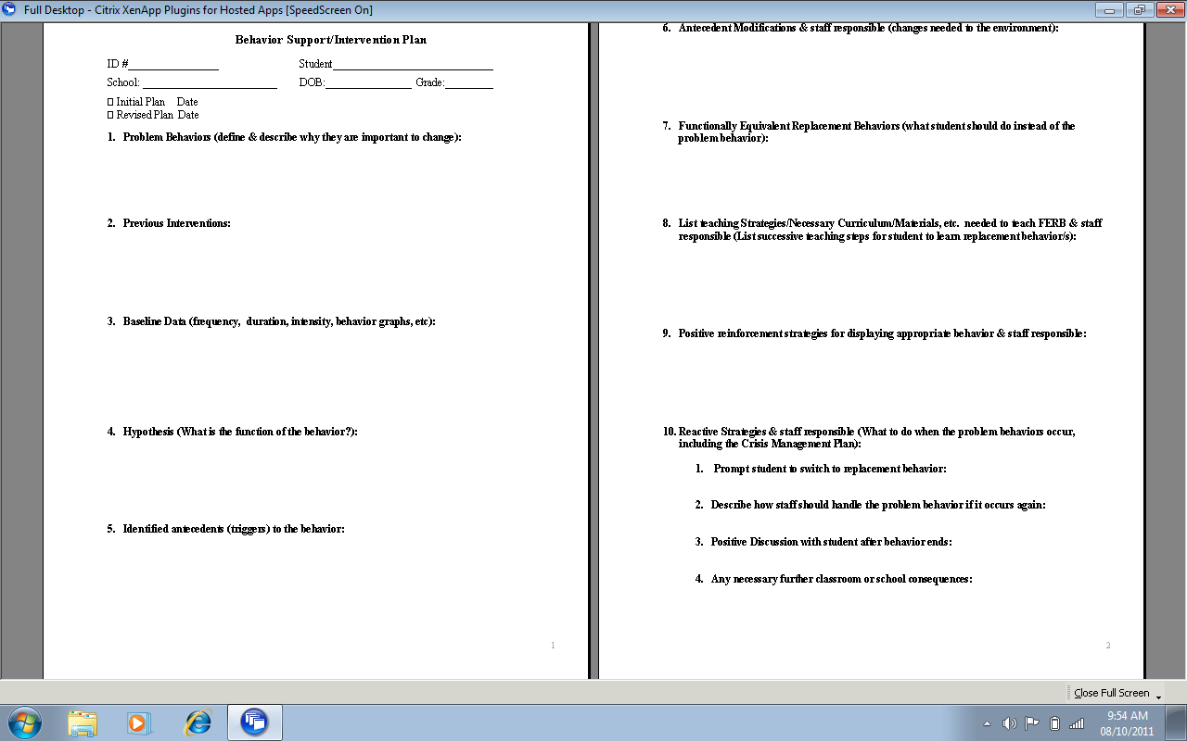

Slide 103
….why is it important to change
Consider the impact on students’ achievement.
Are there less academic or social skills learned by this student or others because of the problem behavior?
Does this behavior raise safety or welfare concerns?
Behavior Impedes Learning section of IEP

Slide 104
Examples for why it is important to change
Unavailable for Instruction
Reduced Skills Learning
Reduced Productivity
Lack of Work Production Negatively Impacts Progress/Grades
Disrupts Other Students’ Opportunity to Learn
Requires Activities/Class Instruction to Stop
Instructional Time is Lost for Disciplinary Proceedings

Slide 105
#2. Previous Interventions
Look at what has been done at home and school
If the intervention did not change behavior:
Look to see how long the intervention was implemented
Look to see who was implementing
Did parts of it work?

Slide 106
#3 Baseline Data (frequency, duration, intensity, graphs)
Do you have any??
Who is responsible for gathering it?
Don’t forget to use it!

Slide 107
#4. Hypothesis (What is the function of the behavior?) * On CBP
Specify the function of the behavior in terms of getting or rejecting (protest, escape, or avoid) something that will guide development of a functionally equivalent replacement behavior.

Slide 108
#5 Identified Antecedents (triggers) to the behavior *Done on CBP
Situations in which the behavior is likely to occur: people, time, place, object, etc.

Slide 109
#6 Antecedent Modifications and staff responsible (changes needed to the environment)
What environmental changes, structure, and supports are needed to remove the student’s need to use this behavior?
Changes in time/space/materials/ interactions to remove likelihood of behavior

Slide 110
#7 Functionally Equivalent Replacement Behavior (FERB What student should do instead of the problem behavior?) *Done on CPB
The functionally equivalent replacement behavior is a positive alternative that allows the student to obtain the same outcome that the problem behavior provided.
The FERB must be as easily performed as the problem behavior.

Slide 111
#8 List teaching strategies/necessary curriculum materials needed to teach FERB and staff responsible.
List successive teaching steps for student to learn replacement behavior/s
Teaching of underlying pivotal skills that will increase the student’s ability to perform general positive behaviors

Slide 112
#9 Positive reinforcement strategies for displaying appropriate behavior and staff responsible
A reinforcer is something proven to increase the behavior. A reward is something we hope the student will strive to earn, but there is no current evidence supporting that conclusion.

Slide 113
Rules for Reinforcers
Specificity: Be specific
Contingency: Contingently given following the desired behavior
Efficacy Evidence: Student must WANT the reinforcer
Frequency: The frequency of earning must match the students ability to delay gratification. Approximately every 10 minutes? 2x per week?
(High frequency is an especially important consideration for students with a limited history of reinforcement for desired behavior.)
Immediacy: Delivered IMMEDIATELY after each desired behavior.
Young children
Just starting behavior plan
Choice-within-Variety: Offer more than one reinforcer and allow the student to select.

Slide 114
#10 Reactive Strategies and staff responsible (What to do when the problem behaviors occur, including Crisis Management Plan)
What steps will the adults take to return the student to rule-following behavior?
How can staff best prevent escalation?
What words, items or actions work to
calm this specific student?

Slide 115
Examples for #10
Examples in a Hierarchy of Responses, Early to Late Stages:
Prompt to the FERB, or redirect to task with additional supports: (Redirecting Phase)
2. Reactive Strategies for When the Problem Behavior is Escalating Beyond Initial Redirection Phase (Managing the Problem Safely)
Strategies for After the Problem Behavior is Over (Debriefing Phase)
Possible Additional Strategies (Consequences or Punishment)

Slide 116
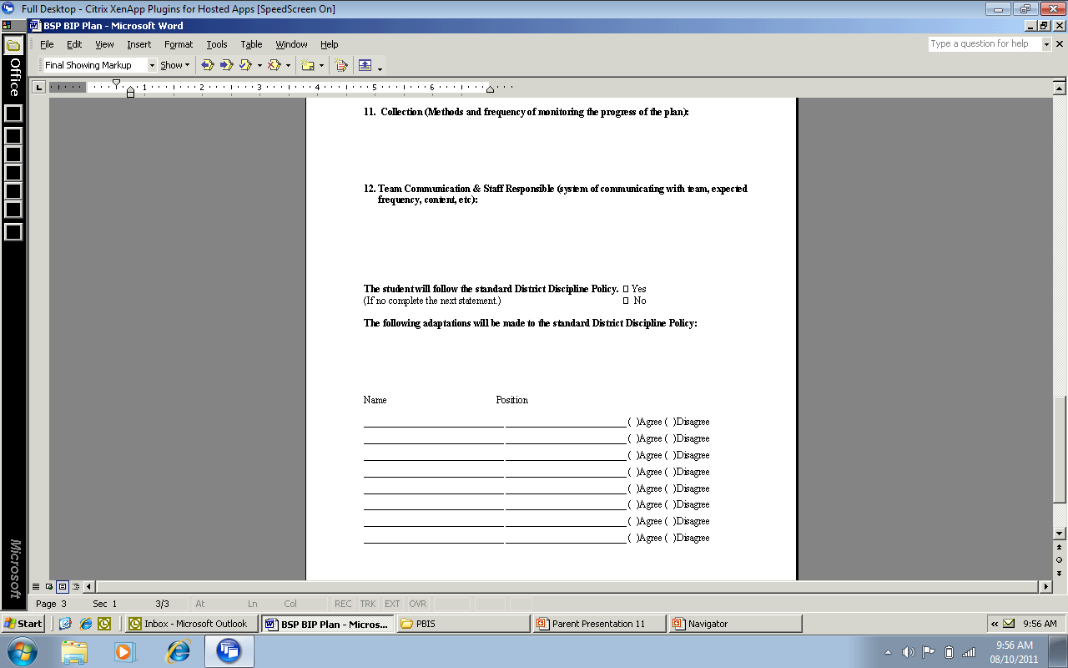

Slide 117
#11 Collections (Methods and frequency of monitoring the progress of the plan)
What forms will be used
When will plan be revisited for progress
Set a date!
How long should you give the plan to work?
Write specific names of people

Slide 118
#12 Team Communication and Staff Responsible
On-going progress monitoring to document response to intervention requires delineating:
1. the communication participants
2. under what conditions
3. manner
4. expected frequency
5. content
6. two-way specification

Slide 119
The student will follow the standard District Discipline Policy/What adaptations will be made?
Make sure the principal is in on this conversation
Get it in writing
Review it often

Slide 120
How Long Should We Give it to Work?

Slide 121
Wrap up
Behavior is a form of COMMUNICATION!
Need to teach the behaviors we want to see
Need to reinforce the behaviors we want to see
4. Acceptable Alternative=FERB
Needs to be easy for student to preform
Needs to get same results as problem behavior
Needs to be taught
Needs to be positively reinforced

Slide 123
Resources
http://sdpbis.wikispaces.com/South+Dakota+PBIS
http://doe.sd.gov/oess/specialed/index.asp
www.pent.ca.gov
http://flpbs.fmhi.usf.edu
www.pbis.org
www.behavioradvisor.com
http://www.challengingbehavior.org
www.whatworksclearinghouse.com
www.interventioncentral.org
http://www.top20training.com
Rebecca.cain@state.sd.us
Penny.McCormic-gilles@k12.

