Slide 1
Competing Behaviors Pathways and Behavior Support Plans

Slide 2
Before You Can Work on Changing a Behavior
You need to know WHY
  You can make a behavior worse
Need to know the function of the behavior
  Gain something or avoid something?

Slide 3

Think of it as a Doctor Visit
Look at the symptoms
Diagnose
Find the right level of care
If symptoms persist, may need to re-diagnose

Slide 4
Tools needed
1. Data Collection
2. Competing Behaviors Pathways
3. Behavior Support Plans (Don’t always need)

Slide 5
Where Do You Start?
Data Collection
Gather information
    Collect data on the problem behavior
      Through observations
      Through interviews
      Past information
    Look at what is happening before (antecedent)
    Look at what happens after (reinforcing behavior)

Slide 6
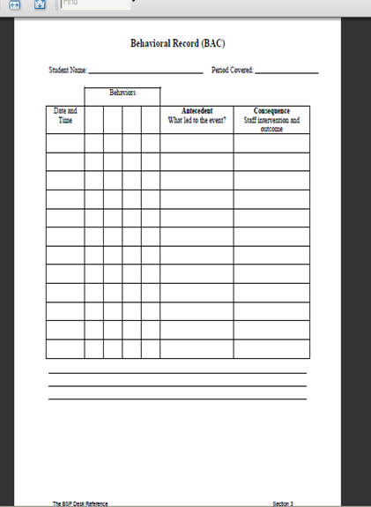
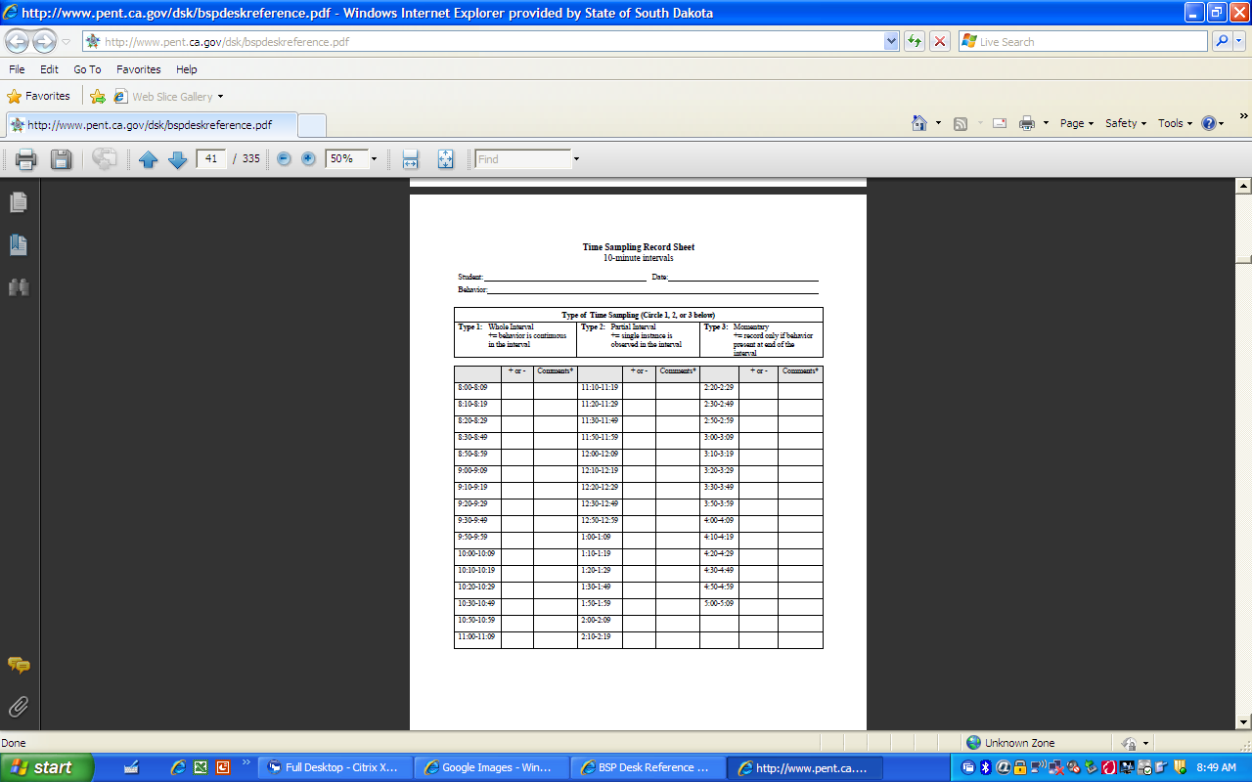
Data collection tools

Slide 7
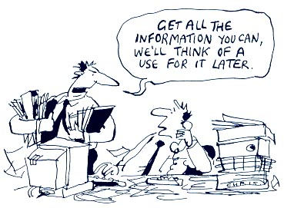

Slide 8
Why use the Pathways chart?
Consensus
Establishes buy-in
Visual of the real issues

Slide 9
Competing Pathways
Upper: Get this—general positive behavior
Middle: Prevent this—reactive strategies to prevent problem behavior escalation
Lower: Accept this—FERB in lieu of problem behavior when general positive upper pathway fails
Notes:
9

Slide 10
Summary Statement
Order of Team Discussion
What other students are doing
What is currently going on
What can we accept while working on
the behavior?
Advanced Behavior Management
Notes:
10

Slide 11
Meet Our Example Student Brian
Please read the next slide to yourself
On a piece of paper please write down
  Main behavior
  Antecedents
  Consequences

Slide 12
Brian is a kindergartener on IEP for speech
Has many features suggestive of autism
He is verbal, and uses 3-4 word sentences routinely to express needs and wants, but never to comment on something in the environment.
Brian likes routines, and becomes very upset if the bus is late, or if the bus driver is not the expected one. On those days, when Brian’s bus routine has changed, staff members say they “know he will have problems.”
Each school day Brian puts his coat away, and goes to circle time. After going to circle, on many days, Brian will run away, and kick and head butt if captured after running away, if the activity at circle time lasts more than five minutes.
Brian is more likely to leave circle by running away, on days when the bus routine has changed from the typical bus routine

Slide 13
The process:
Look at the boxes one by one
  *Very important to fill the boxes out in the order the are numbered*
Look at the information that should go there
Look at some examples
Decide what should go there for Brian

Slide 14
2. Desired
Alternative
3. Typical
Consequence
Summary Statement
Order of Team Discussion
6. Setting
Events
Not
continuous
4. Triggering
Antecedents
1. Problem
Behavior
5. Maintaining
Consequences
7. Acceptable
Alternative
(Replacement
Behavior)
Advanced Behavior Management
Notes:
14

Slide 15
1. Define Problem Behavior
Measurable
Observable
Objective

Slide 16
Examples for define problem Behavior
Off task:
Poor organization
and planning:
Tantrums:
Outbursts/Rage/
Explosive Reactions
“Naughty”
“Bullies others”
“Wastes time”
crawls on the floor; plays with objects in desk; attempts play with others
rushes to complete assignment without planning each phase; waits until the final work period to begin a long term assignment
student throws materials; student crawls under the desk and screams with high volume.
Uses profane language
Shoves, pushes students, calls names
Fiddles with things in desk during independent work time

Slide 17
2. Desired
Alternative
3. Typical
Consequence
Summary Statement
Order of Team Discussion
Gets up and
Runs into the
Hallway during
Circle time
5. Maintaining
Consequences
6. Setting
Events
Not
continuous
4. Triggering
Antecedents
1.Problem
Behavior
7. Acceptable
Alternative
(Replacement
Behavior)
Advanced Behavior Management
Notes:
17

Slide 18
2. Desired
Alternative
3. Typical
Consequence
Summary Statement
Order of Team Discussion
6. Setting
Events
Not
continuous
Gets up and
Runs into the
Hallway during
Circle time
5. Maintaining
Consequences
4. Triggering
Antecedents
1. Problem
Behavior
7. Acceptable
Alternative
(Replacement
Behavior)
Advanced Behavior Management
Notes:
18

Slide 19
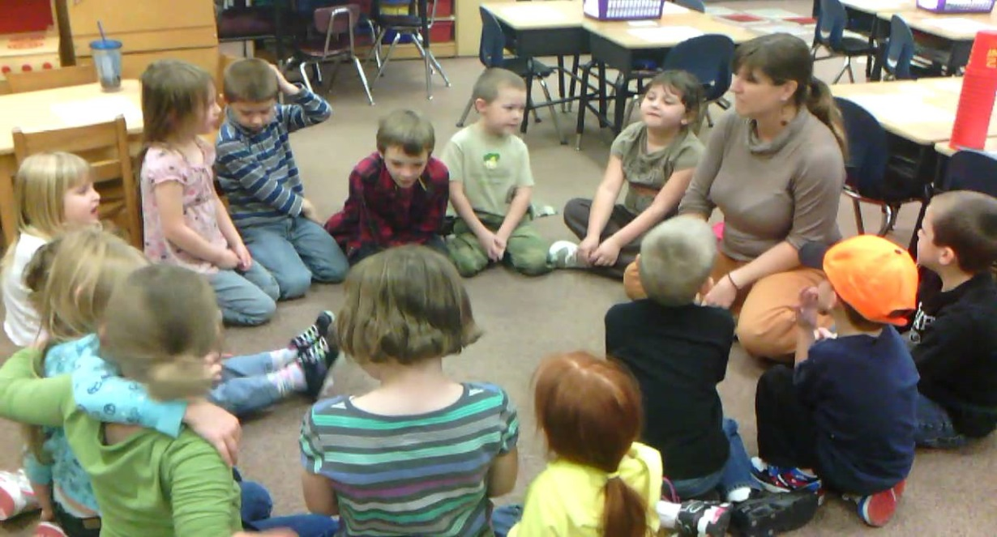
2. Desired Alternative Behavior
Supposed to do
Other students doing

Slide 20
Examples for desired alternative behavior
Sit at desk
Complete assignment during class time
Turn in neat completed homework on time
Use language that does not contain swear words while talking to peers and teachers
Keep hands and feet to self while in the lunch room

Slide 21
2. Desired
Alternative
3. Typical
Consequence
Summary Statement
Order of Team Discussion
Sit in circle time and listen to the lesson
Gets up and
Runs into the
Hallway during
Circle time
6. Setting
Events
Not
continuous
.
4. Triggering
Antecedents
1. Problem
Behavior
5. Maintaining
Consequences
7. Acceptable
Alternative
(Replacement
Behavior)
Advanced Behavior Management
Notes:
21

Slide 22
2. Desired
Alternative
Typical
Consequence
Summary Statement
Order of Team Discussion
Sit in circle time and listen to the lesson
3.
Gets up and
Runs into the
Hallway during
Circle time
5. Maintaining
Consequences
6. Setting
Events
Not
continuous
4. Triggering
Antecedents
1. Problem
Behavior
7. Acceptable
Alternative
(Replacement
Behavior)
Advanced Behavior Management
Notes:
22

Slide 23


#3 Typical Consequence for #2
What happens when the student or all the other students exhibit the desired behavior written in #2?

Slide 24
Examples for typical consequences
Students are allowed access to the computer
Students learn the material
Students are able to move on to the next lesson in the book
Students are able to stay in the classroom and participate in class
Students are able to play on the playground
Students are able to sit where they want at lunch

Slide 25
2. Desired
Alternative
3. Typical
Consequence
Summary Statement
Order of Team Discussion
Sit in circle time and listen to the lesson
Learn the information the teacher is sharing verbal praise
Gets up and
Runs into the
Hallway during
Circle time
6. Setting
Events
Not
continuous
4. Triggering
Antecedents
1. Problem
Behavior
5. Maintaining
Consequences
7. Acceptable
Alternative
(Replacement
Behavior)
Advanced Behavior Management
Notes:
25

Slide 26
2. Desired
Alternative
3. Typical
Consequence
Summary Statement
Order of Team Discussion
Sit in circle time and listen to the lesson
Learn the information the teacher is sharing verbal praise
6. Setting
Events
Not
continuous
4. Triggering
Antecedents
1. Problem
Behavior
5. Maintaining
Consequences
Gets up and
Runs into the
Hallway during
Circle time
7. Acceptable
Alternative
(Replacement
Behavior)
Advanced Behavior Management
Notes:
26

Slide 27
#4 Triggering Antecedents
Situations
People
Time
Place
Object
Etc.

Slide 28
Examples for triggering antecedents
Physical Setting
Social Setting
Instructional
Strategies
Scheduling
Factors
Sensory under or over stimulation: noise, crowding, temperature, etc.; missing or present materials, configurations of furniture;
Interaction patterns in or around the student, people present or absent; substitute teacher
Mismatch between learner accommodation needs and instructional components. An accommodation plan may be necessary to increase student success.
Specific times within the schedule; with or without sequencing and transition supports; absence of a visual schedule; unanticipated changes in routine.

Slide 29
2. Desired
Alternative
3. Typical
Consequence
Summary Statement
Order of Team Discussion
Learn the information the teacher is sharing verbal praise
Sit in circle time and listen to the lesson
Gets up and
Runs into the
Hallway during
Circle time
5. Maintaining
Consequences
6. Setting
Events
Not
continuous
4. Triggering
Antecedents
1. Problem
Behavior
Circle time lasts more than 5 minutes
7. Acceptable
Alternative
(Replacement
Behavior)
Advanced Behavior Management
Notes:
29

Slide 30
2. Desired
Alternative
3. Typical
Consequence
Summary Statement
Order of Team Discussion
Sit in circle time and listen to the lesson
Learn the information the teacher is sharing verbal praise
6. Setting
Events
Not
continuous
4. Triggering
Antecedents
1. Problem
Behavior
5. Maintaining
Consequences
Gets up and Runs into the Hallway during
Circle time
Circle time lasts more than 5 minutes
7. Acceptable
Alternative
(Replacement
Behavior)
Advanced Behavior Management
Notes:
30

Slide 31
#5 Maintaining Consequences
Why do they keep doing it?
Also know as function of the behavior
Gain- object, attention, stimulation, acceptance from peers/adults
Avoid- avoid a situation, escape a location, protest something, protest someone
It can be both
Keep it simple
Usually if the behavior stops being reinforcing it will eventually stop

Slide 32
Examples for Maintaining Consequences
Getting Examples:
To gain adult attention
To gain sustained peer attention and positive comments (use instead of “power”)
To gain a desired item or activity
To get a choice in the pacing of activities (use instead of “control”)
Reject: (Escape/Protest/Avoid) Examples:
To escape or avoid a task student states is (a) too hard or (b) too long, or (c) not meaningful to the student or (d) to escape peer comments that the task is too easy
To avoid or protest a demand or request or reprimand
To escape an environment in which the student states negative comments from peers frequently occur
To escape or avoid specific people or activities

Slide 33
2. Desired
Alternative
3. Typical
Consequence
Summary Statement
Order of Team Discussion
Learn the information the teacher is sharing verbal praise
Sit in circle time and listen to the lesson
6. Setting
Events
Not
continuous
4. Triggering
Antecedents
1. Problem
Behavior
5. Maintaining
Consequences
Gets up and
Runs into the
Hallway during
Circle time
Does not
Have to
Participate
In circle time
Circle time lasts more than 5 minutes
7. Acceptable
Alternative
(Replacement
Behavior)
Advanced Behavior Management
Notes:
33

Slide 34
2. Desired
Alternative
3. Typical
Consequence
Summary Statement
Order of Team Discussion
Learn the information the teacher is sharing verbal praise
Sit in circle time and listen to the lesson
Gets up and
Runs into the
Hallway during
Circle time
5.
5. Maintaining
Consequences
Does not
Have to
Participate
In circle time
6. Setting Events
Must be
periodic,
Not continuous!
4. Triggering
Antecedents
1. Problem
Behavior
Circle time lasts more than 5 minutes
7. Acceptable
Alternative
Advanced Behavior Management
Notes:
34

Slide 35
#6 Setting Events
ADD TO the likelihood a behavior will occur
Does not occur all the time

Slide 36
Examples Setting Event
Child refused meds
Child broke up with girl/boyfriend
Child did not get enough sleep the night before
Why is the setting event important?

Slide 37

If You Expect It, Pre-correct It!
Don’t need a formal behavior plan

Slide 38
Brian likes routines, and becomes very upset if the bus is late, or if the bus driver is not the expected one. On those days, when Brian’s bus routine has changed, staff members say they “know he will have problems.” Each school day Brian puts his coat away, and goes to circle time. After going to circle, on many days, Brian will run away, and kick and head butt if captured after running away, if the activity at circle time lasts more than five minutes. Brian is more likely to leave circle by running away, on days when the bus routine has changed from the typical bus routine.

Slide 39
2. Desired
Alternative
3. Typical
Consequence
Summary Statement
Order of Team Discussion
Learn the information the teacher is sharing verbal praise
Sit in circle time and listen to the lesson
1. Problem
Behavior
Does not
Have to
Participate
In circle time
6. Setting Events
Bus is late/not
The usual bus
driver
4. Triggering
Antecedents
5. Maintaining
Consequences
Gets up and
Runs into the
Hallway during
Circle time
Circle time lasts more than 5 minutes
seventh
7. Acceptable
Alternative
(Replacement
Behavior)
Advanced Behavior Management
Notes:
39

Slide 40
2. Desired
Alternative
3. Typical
Consequence
Summary Statement
Order of Team Discussion
Learn the information the teacher is sharing verbal praise
Sit in circle time and listen to the lesson
1. Problem
Behavior
Does not
Have to
Participate
In circle time
6. Setting
Events
Not
continuous
Bus is late/not
The usual bus
driver
4. Triggering
Antecedents
5. Maintaining
Consequences
Gets up and
Runs into the
Hallway during
Circle time
Circle time lasts more than 5 minutes
7. Acceptable
Alternative
(Replacement
Behavior)
Advanced Behavior Management
Notes:
40

Slide 41
#7 Replacement Behavior
What student should do instead of the problem behavior?
Positive alternative that allows the student to obtain the same outcome that the problem behavior provided.
Must be as easily performed as the problem behavior.

Slide 42
Examples for Replacement Behavior
Swears at teacher: protesting a lack of attention- Replacement Behavior: Verbally state a desire for attention from the teacher.
Fights: protesting not getting his way during a recess game- – Replacement Behavior: Use protest language taught in verbal conflict resolution training.
Screams: protesting an unexpected activity- Replacement Behavior: Use the printed schedule to protest and then negotiate about an upcoming unexpected activity.
Runs from room-escaping hard work- Replacement Behavior: Go to time away/break center.
Gains sustained positive peer attention from gang members for assaultive behavior–Replacement Behavior: Gain sustained positive peer attention from an alternative group for prosocial behavior.

Slide 43
2. Desired
Alternative
3. Typical
Consequence
Summary Statement
Order of Team Discussion
Sit in circle time and listen to the lesson
Learn the information the teacher is sharing verbal praise
6. Setting
Events
Not
continuous
Bus is late/not
The usual bus
driver
1. Problem
Behavior
Does not
Have to
Participate
In circle time
4. Triggering
Antecedents
5. Maintaining
Consequences
Gets up and
Runs into the
Hallway during
Circle time
Circle time lasts more than 5 minutes
7. Acceptable
Alternative
(Replacement
Behavior)
Teacher will cue
Brian to go to
Designated spot in
The classroom.
Advanced Behavior Management
Notes:
43

Slide 44
FBA Review
Need to know why the behavior is happening, or you could make the behavior worse
Need to know the function of the behavior
Is the student trying to gain something or avoid something
Before you can do the FBA you need to collect data
When defining the problem behavior, make sure the behavior is measurable, observable, and objective
Triggering antecedents can include situations, people, time, place, objects, etc.
The function of the behavior is also known as the maintaining consequence
Setting events add to the likelihood a behavior will occur
  Does not occur all the time.
Why is the setting event important? If you expect it, pre-correct it!
Questions?

Slide 45
Before The Behavior Plan…
Does the student know your concern?
Does the student know the goal?
Have you systematically tried to build a positive relationship with the student?
Can simple changes be made?

Slide 46
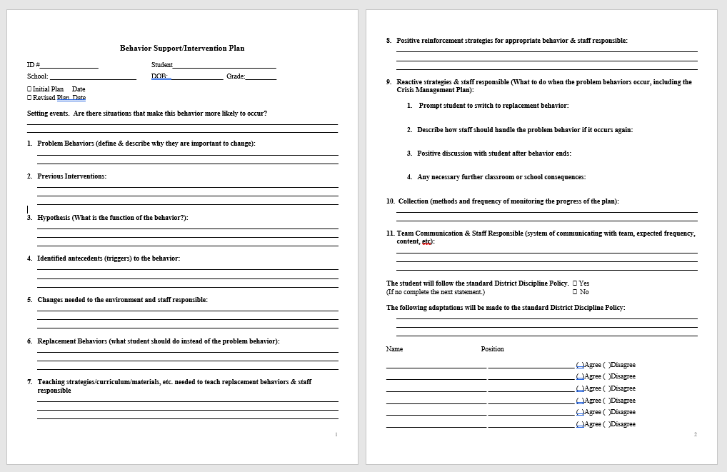

Slide 47
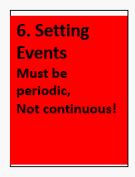
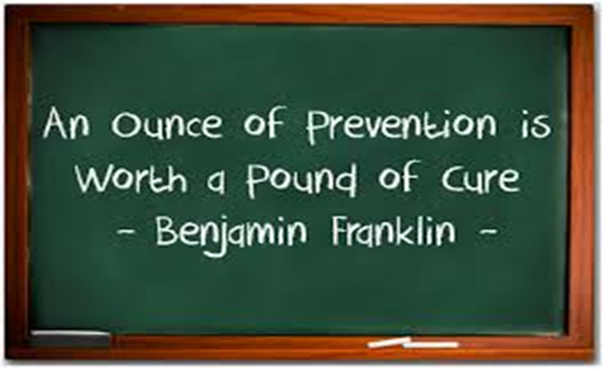
Setting Event
Are there situations that make this behavior more likely to occur?

Slide 48
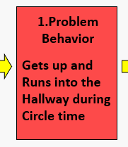
#1 What is the problem behavior….why is it important to change
Consider the impact on students’ achievement.
Are there less academic or social skills learned by this student or others because of the problem behavior?
Does this behavior raise safety or welfare concerns?
Behavior Impedes Learning section of IEP

Slide 49
#2. Previous Interventions
Look at what has been done at home and school
If the intervention did not change behavior:
  Look to see how long the intervention was implemented
  Look to see who was implementing
  Did parts of it work?

Slide 50
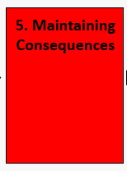
#3. Hypothesis (What is the function of the behavior?)
Using the data, what does the team think is the main function of the behavior?
Gain
Avoid
Both

Slide 51
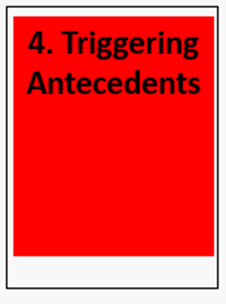
#4 Identify antecedents(triggers)
Consider:
Time of day
Staff
Students
Task
Location

Slide 52
#5 changes needed to the environment
Changes in time/space/materials/ interactions to remove likelihood of behavior

Slide 53
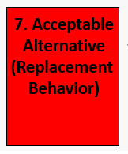
#6Replacement Behavior (What student should do instead of the problem behavior?)
The replacement behavior is a positive alternative that allows the student to obtain the same outcome that the problem behavior provided.
It must be as easily performed as the problem behavior.

Slide 54
#7 List teaching strategies/ curriculum/materials needed to teach replacement behaviors and staff responsible.
List successive teaching steps for student to learn replacement behavior/s
Teaching of underlying pivotal skills that will increase the student’s ability to perform general positive behaviors

Slide 55
#8 Positive reinforcement strategies for displaying appropriate behavior and staff responsible
A reinforcer is something proven to increase the behavior.
A reward is something we hope the student will strive to earn, but there is no current evidence supporting that conclusion.

Slide 56
Rules for Reinforcers
Specificity: Be specific
Contingency: Contingently given following the desired behavior
Efficacy Evidence: Student must WANT the reinforcer
Frequency: The frequency of earning must match the students ability to delay gratification.
Immediacy: Delivered immediately after each desired behavior.
  Young children
  Just starting behavior plan
Choice-within-Variety: Offer more than one reinforcer and allow the student to select.

Slide 57
#9 Reactive Strategies and staff responsible (What to do when the problem behaviors occur, including Crisis Management Plan)
What steps will the adults take to return the student to rule-following behavior?
How can staff best prevent escalation?
What words, items or actions work to calm this specific student?

Slide 58
#10 Collections (Methods and frequency of monitoring the progress of the plan)
What forms will be used
When will plan be revisited for progress
  Set a date!
    How long should you give the plan to work?
Write specific names of people

Slide 59
#11 Team Communication and Staff Responsible
Progress monitor to document response to intervention requires defining:
1. the communication participants
2. under what conditions
3. manner
4. expected frequency
5. content
6. two-way specification

Slide 60
The student will follow the standard District Discipline Policy/What adaptations will be made?
Make sure the principal is in on this conversation
Get it in writing
Review it often

Slide 61
How Long Should We Give it to Work?
3-5 weeks
Be aware of extinction bursts
Make sure it is being implemented with fidelity
If teachers say it’s not working, find out why
Keep taking data!!
Be Consistent!
Same response every time
Consistency means: children can expect Kindness, Fairness, and Safety in the classroom

Slide 62
BSP review
The replacement behavior is a positive alternative
The replacement behavior must be easily preformed
Deliver the reinforcer immediately after the desired behavior for young children and when starting a behavior plan
When discussing reactive strategies, make sure to include the steps the adults will take
Write steps to help staff prevent escalation
Make sure to set a date to revisit progress of the plan
The team will need to communicate and progress monitor to document response to interventions
It usually takes about 3-5 weeks to see significant change for behaviors that have been occurring for long periods of time
Make sure the plan is being implemented with fidelity!
Questions?

Slide 63
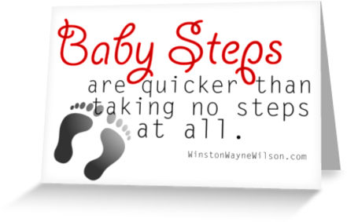
Celebrate Baby Steps
Celebrate small successes
Brian may never do exactly what all the other students do

Slide 64
things That Work
  Will Take:
      Time
        Patience
          Energy
            Caring
              Commitment

