Slide 1
Discipline in Special Education
The Manifestation Determination Process

Slide 2
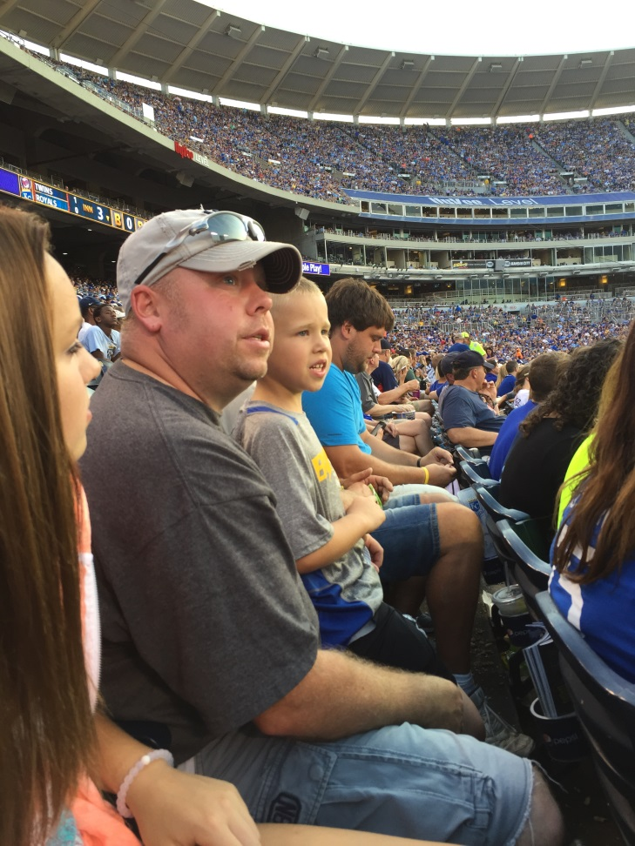

Who am I?
Becky Cain
Special Education Programs
Mother of three
Wife of one
I am not a lawyer!

Slide 3
Agenda
Definitions
Is it a pattern?
Is it a manifestation of the disability?
Protections for children suspected of having a disability
NOTE: I will take about things and then share the RULE with you so you know where to find them.
Feel free to type questions into the chat box

Slide 4
Definitions
Disciplinary removal: Any time a student is removed due to a violation of code of conduct (behavior).
Sending students home, ISS, OSS, timeout room
What about “Go to the office”?
If the child is not allowed to go back to class due to behavior it is counted as a removal.
In School Suspension (ISS)
1. Student is afforded the opportunity to continue to appropriately participate in the general curriculum
2. The student continues to receive the services specified on IEP AND
3. Student continues to participate with nondisabled peers to the extent they would have in their current placement
71 Federal Register 46715
*if your ISS does not meet these guidelines it is considered OSS and should be counted as such*

Slide 5
Definitions Cont.
FAPE Free Zone: The first 10 days of suspension are “free”. Services do not need to be provided.

Slide 6
Definitions cont.
Change of Placement (COP): Bundle of services the school is providing, not necessarily the physical placement.

Slide 7
COP RULE
24:05:26:02.01. Change of placement for disciplinary removals. For purposes of removal of a student with a disability from the student's current educational placement under this chapter, a change of placement occurs if:
(1) The removal is for more than ten consecutive school days; or
(2) The student is subjected to a series of removals that constitute a pattern because:
(a) They cumulate to more than ten school days in a school year;
(b) Of factors such as the length of each removal, the total amount of time the student is removed, and the proximity of the removals to one another; and
(c) The student's behavior is substantially similar to the student's behavior in previous incidents that resulted in the series of removals.
The public agency determines on a case-by-case basis whether a pattern of removals constitutes a change of placement. This determination is subject to review through due process and judicial proceedings.

Slide 8
Trickiest Definition:
School day: Any day, including a partial day, that students are attending school for instructional purposes.
Early out days count as a full school day
If kids have a late start or early out for weather it counts as a full school day
What about suspensions that start at noon?
Need to look at how you take attendance for all students.
Do you take attendance for all students in the morning and afternoon?
What is counted as a full day/partial day for all students?
WARNING! Is the student missing the same class every time?

Slide 9
What Happens on Day 11?
FAPE Free Zone Ends and You Enter the CHANGE OF PLACEMENT ZONE:
Services must be provided!
What is meant by services?
The school system must provide services to the child. The child must continue to receive educational services so that the child can continue to participate in the general education curriculum (although in another setting), and progress toward meeting the goals in his or her IEP.
SCHOOL must analyze on case-by-case basis to decide if it is a COP:
Is the removal greater than 10 days?
Is there a pattern in the removals?
Type of behaviors
Proximity of the removals

Slide 10
RULE
24:05:26:01.02. Case-by-case determination. School personnel may consider any unique circumstances on a case-by-case basis when determining whether a change in placement, consistent with the other requirements of this chapter, is appropriate for a student with a disability who violates a code of student conduct.

Slide 11
You Decide: Is This a COP?
Student receives 10 days of OSS for fighting
Change of Placement? Why?
YES NO

Slide 12
You Decide: Is This a COP?
Student receives 11 days of OSS for fighting.
Change of Placement? Why?
YES NO

Slide 13
You Decide: Is This a COP?
October 3, student received three days of OSS for swearing at the teacher
October 9, student receives five days OSS for starting a fight in the lunchroom
October 20, student receives three days OSS for threatening to punch a teacher
Change of Placement? Why?
YES NO

Slide 14
You Decide: Is This a COP?
September 21, student receives three days of OSS for fighting in the lunchroom
December 20, student receives five days of OSS for smoking on school grounds
March 29, student receives five days of OSS for swearing at the teacher
Change of Placement? Why?
YES NO

Slide 15
You Decide: Is This a COP?
October 21, student receives four days OSS for fighting
December 19, student receives five days OSS for fighting
March 5, student receives five days OSS for fighting
Change of Placement?
YES NO

Slide 16
School Decides “No, it is not a COP”
If there is not a pattern or one removal over 10 days then it is not COP
School and teachers determine:
What educational services the student is to receive so they can
1. Continue to participate in the general curriculum, although in another setting AND
2. Progress toward meeting the goals set out in the student’s IEP

Slide 17
School Decides “Yes, it is a COP”
If there is a pattern or one removal is over 10 days then it is a COP
IEP Team must :
1. Provide Procedural Safeguards Notice to guardians
2. Conduct a Manifestation Determination with in 10 school days of decision to change placement.
The MD meeting must be held within 10 school days of the decision to change the child’s placement because of a code of conduct removal
Not when that suspension is over or
When that suspension hits the 10th day

Slide 18
Example, Get Out Your Calendars
Student receives her first suspension on February 1 for five days
Student receives her second suspension on February 28 for three days
Student receives her third suspension on March 3 for two days
Student receives her fourth suspension on March 22 for five days
COP: Yes or No?
School team meets on March 23 and decides there was a pattern of behavior: Yes COP
When does the 10 days to hold a Manifestation Determination meeting start?
By when does the meeting need to be held?
Notes:
Let’s pretend it’s not a holiday weekend… March 22=.April 4

Slide 19
Manifestation Determination
IEP Team will go through the MD process
Review all documents in the file
Only have to consider the disability that the student is coded under
Only need to consider if the last infraction that put the student over 10 days was a manifest of disability
Document:
1. Was the behavior a direct result of a failure to implement the IEP?
Remember: If behavior plan is part of the IEP then the team must consider if it was implemented correctly
2. Was the behavior caused by or did it have a direct and substantial relationship to the students disability?

Slide 20
MD RULE
24:05:26:09.03. Manifestation determination review requirement. Within ten school days of any decision to change the placement of a student with a disability because of a violation of a code of student conduct, the school district, the parent, and relevant members of the student's IEP team, as determined by the parent and the district, shall review all relevant information in the student's file, including the student's IEP, any teacher observations, and any relevant information provided by the parents to determine:
(1) Whether the conduct in question was caused by, or had a direct and substantial relationship to, the student's disability; or
(2) Whether the conduct in question was the direct result of the school district's failure to implement the IEP.
The conduct must be determined to be a manifestation of the student's disability if the district, the parent, and relevant members of the student's IEP team determine that a condition in either subdivision (1) or (2) of this section was met.
If the district, the parent, and relevant members of the student's IEP team determine that the condition described in subdivision (2) of this section was met, the district shall take immediate steps to remedy those deficiencies.

Slide 21
You Decide
Sally is a 13 year old girl on an IEP for Emotional Disturbance. A group of girls has been harassing her since the beginning of school about her clothes, hair, and where she lives. She has been suspended three times for a total of nine days for fighting with them. In November, she is again suspended for three days for fighting.
Is it a COP?
Is it a manifest of her disability?
Notes:
Do you have the documentation to support your decision?

Slide 22
You Decide
Jill is a 15 year old on an IEP for SLD in reading. She is in 9th grade reading at a 3rd grade level.
Jill received three days of suspension for cheating on her science test in September, five days for cheating on her social studies test in October, and received five more days in November for cheating on her reading test.
Is it a COP?
Is it a manifest of her disability?

Slide 23
You Decide
Sam is a 17 year old boy on an IEP for autism. He is currently on a behavior support plan to help him learn to respond to situations that make him uncomfortable by taking deep breaths and reacting appropriately. Most of the situations that make Sam uncomfortable involve loud crowds and changes in his schedule.
BSP-Staff are to prompted Sam to take deep breaths and count to 25 when he is feeling agitated and to let him know as soon as possible if there is going to be a schedule change.
In September, a pep rally is scheduled for homecoming.
At 2:00pm, the teacher tells the class it is time to go to the gym for the pep rally. Immediately Sam becomes nervous but the teacher tells him he needs to go with his class because there is no one to supervise him in the classroom.
Sam walks to the gym but is immediately overwhelmed and punches his teacher.
He receives 15 days of suspension.
Is it a COP? Is it a manifestation of his disability? Other thoughts?

Slide 24
You Decide
Bob is a 12 year old with a cognitive disability with an IQ of 45. Some boys at school convinced Bob to walk up to the teacher and lift up her dress in front of the class. Bob does this and receives 15 days of OSS.
Is it a COP?
Is it a manifest of his disability?

Slide 25
If the IEP Team Decides “Yes, the behavior is a manifestation of the disability or the IEP was Not Implemented Correctly”
The IEP Team must:
Conduct and Functional Behavior Assessment if one has not been conducted or review the existing one
Implement a new Behavior Support Plan or modify the existing one AND
Return student to previous placement

Slide 26
Yes it was a manifestation RULE
24:05:26:09.04. Determination that behavior was a manifestation. If the school district, the parent, and relevant members of the IEP team determine that the conduct was a manifestation of the student's disability, the IEP team shall either:
(1) Conduct a functional behavioral assessment, unless the district had conducted a functional behavioral assessment before the behavior that resulted in the change of placement occurred, and implement a behavioral intervention plan for the student; or
(2) If a behavioral intervention plan already has been developed, review the behavioral intervention plan and modify it, as necessary, to address the behavior.
In addition, and except as provided in § 24:05:26:08.01, the IEP team shall return the student to the placement from which the student was removed, unless the parent and the district agree to a change of placement as part of the modification of the behavioral intervention plan.

Slide 27
If the IEP Team Decides “No, the behavior is NOT a manifestation of the disability and the IEP was Implemented Correctly”
What educational services the student is to receive so they can:
1. Continue to participate in the general curriculum, although in another setting AND
2. Progress toward meeting the goals set out in the student’s IEP AND
3. Receive, as appropriate, a Functional Behavior Assessment and Behavior Support Plan and modifications to address the behavior violations so it does not recur.

Slide 28
It was not a manifestation RULE
24:05:26:09.05. Determination that behavior was not manifestation of disability -- Additional authority of school personnel. For disciplinary changes in placement that would exceed ten consecutive school days, if the behavior that gave rise to the violation of the school code is determined not to be a manifestation of the student's disability pursuant to this chapter, school personnel may apply the relevant disciplinary procedures to students with disabilities in the same manner and for the same duration as the procedures would be applied to students without disabilities, except as provided in this section.
A student with a disability who is removed from the student's current placement pursuant to this section or § 24:05:26:08.01 must:
(1) Continue to receive educational services, as provided in this article, so as to enable the student to continue to participate in the general education curriculum, although in another setting, and to progress toward meeting the goals set out in the student's IEP; and
(2) Receive, as appropriate, a functional behavioral assessment, and behavioral intervention services and modifications, that are designed to address the behavior violation so that it does not recur.

Slide 29
Let’s Review
1. Under what circumstances must a manifestation determination be conducted?
2. What’s the time frame for conducting a manifestation determination?
3. Who is involved in conducting a manifestation determination
4. Who decides who’s a “relevant member” of the Team?
Notes:
(Whenever a decision is made to change the placement of a child with a disability because he or she has violated a code of student conduct.)
2. (The manifestation determination must occur within 10 school days of any decision to change the placement of a child with a disability because of a violation of a code of student conduct.)
3. (The LEA, parent, and relevant members of the child’s IEP Team.)
4. (The parent and the LEA.)

Slide 30

Questions?

Slide 31
The “Big 3”
Drugs: A controlled substance that is illegally possessed
Dangerous Weapon: A weapon, device, instrument, material, or substance, animate or inanimate that is used for, or is readily capable of causing death or serious bodily injury-does not include a pocket knife with a blade of less than 2 ½ inches
Serious Bodily Injury: Involves a substantial risk of death, extreme physical pain, protracted and obvious disfigurement or loss or impairment of bodily member, organ, or mental faculty.
Removal to an interim alternative educational setting (IAES) for not more than 45 days REGARDLESS IF THE BEHAVIOR IS DETERMINED TO BE A MANIFESTATION OF THE CHILD’S DISABILITY.

Slide 32
Suspensions for the “Big 3”
Weapons, Drugs, Sever Bodily Injury
Still need to do a manifestation determination but results of the meeting do not change the placement determination
Need to notify parents
Must determine the services that will be provided
Must be selected so as to enable the child to continue to participate in the general education curriculum and progress toward meeting the IEP goals

Slide 33
Interim Alternative Educational Setting Guidelines
Need to look at is on a case- by -case basis as to where services are provided.
District can not say “we provide the services in the home”
Do all services in the IEP need to be provided?
Again, need to look at it on a case- by -case basis
What are the needs of the child?
Still need to do the MD but do not have to return to regular setting even if it is a manifest of the disability.
.

Slide 34
IAES RULE
24:05:26:09.02. Determination of interim alternative educational setting. The student's IEP team shall determine the interim alternative educational setting in which a student is placed under §§ 24:05:26:08.01, 24:05:26:02.01, and 24:05:26:09.05

Slide 35
Children Suspected of Having Disabilities
Criteria for “Basis of Knowledge.”
(1) The parent of the child expressed concern in writing to supervisory or administrative personnel of the appropriate educational agency, or a teacher of the child, that the child is in need of special education and related services;
(2) The parent of the child requested an evaluation of the child…or
(3) The teacher of the child, or other personnel of the LEA, expressed specific concerns about a pattern of behavior demonstrated by the child directly to the director of special education of the agency or to other supervisory personnel of the agency.

Slide 36
Children not yet eligible RULE
24:05:26.01:13. Protections for students not yet eligible. The procedures under § 24:05:26:14 apply for students who have not been determined eligible for special education or special education and related services if an expulsion is anticipated.

Slide 37
Exceptions to Basis of Knowledge
(1) The parent of the child—
(i) Has not allowed an evaluation of the child pursuant to §§300.300 through 300.311; or
(ii) Has refused services under this part; or
(2) The child has been evaluated in accordance with §§300.300 through 300.311 and determined to not be a child with a disability under this part

Slide 38
Expulsion RULE
24:05:26.01:01. Expulsion from school. The expulsion of students in need of special education or special education and related services includes the general due process procedures used for all students and the additional steps in the process specified in this chapter that a district must take when the student is receiving special education or special education and related services under an individual education program.
What does the red mean?

Slide 39
Stay Put Placements
When a hearing is requested for disputes about the removals or the MD results the stay put rule applies.
If a student is currently in a IAES, they will remain in the IEAS until the hearing officer makes decision
Contact your school attorney!

Slide 40
Frequently Asked Questions

Slide 41
Do we have to go through this process every time a student is suspended past 10 days?
Yes
Every suspension after the initial 10 days must be looked at to determine if it is a change of placement and if so, a MD meeting must be held

Slide 42
We are getting close to the 10 days, should we hold the MD just to be safe?
No.
You can always look at conducting an FBA or changing the behavior plan but don’t set the precedence of doing them early
You need to be consistent for all students
You can look at more resource room time if the student is successful there and then work on the behaviors

Slide 43
Is it a removal if mom decides to come get the student because she is acting out?
Maybe.
Did you call mom?
Does she feel obligated to come get student?
Side note: This will more than likely increase the behaviors!

Slide 44
Is a Student Initiated Time Away Counted as a Removal?
No
Put it in the IEP under Behavior Impedes Learning or put it in the Behavior Support Plan

Slide 45
Student transfers in with 10 days of suspension. Do we count those days?
Yes
The days follow the student for the purpose of the manifestation determination
When reporting for indicator 4, these days should stay with the district they occurred in.

Slide 46
Can we hold the MD meeting if guardians refuse to attend?
Yes
Make reasonable attempts to have them attend
There is no set definition of “reasonable attempts” but look at your district policy or look at what do you do for IEP meetings

Slide 47
Do I need to get consent for the FBA
Yes
Try and get it at the MD meeting

Slide 48
Can we conduct the FBA if the parents won’t consent?
Yes
Again make the attempts but it will be like a re-eval situation
24:05:25:06.01. Consent for reevaluation. Before conducting a reevaluation of an eligible child, parental consent is required, unless:
(1) The school district can demonstrate that it has taken reasonable measures to obtain consent, and the child's parent has failed to respond; and
(2) The school district documents its efforts to obtain consent by using the procedures consistent with § 24:05:25:17.
If the parent refuses to consent to the reevaluation, the school district may, but is not required to, pursue the reevaluation by using the consent override procedures described in chapter 24:05:30 including mediation and due process hearing procedures.

Slide 49

Questions?

Slide 50
Resources
www.pent.ca.gov
www.ed.gov/school-discipline
http://www.teachsafeschools.org/alternatives-to-suspension.html
https://ici.umn.edu/products/impact/182/over5.html
http://www.pbisworld.com/tier-2/alternatives-to-suspension/

