Slide 1
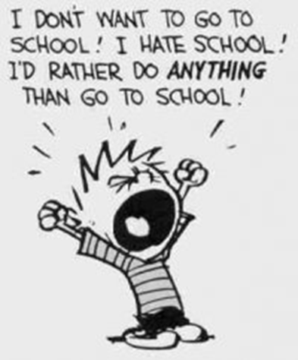
Behavior Support Training for Educational Assistants

Slide 2
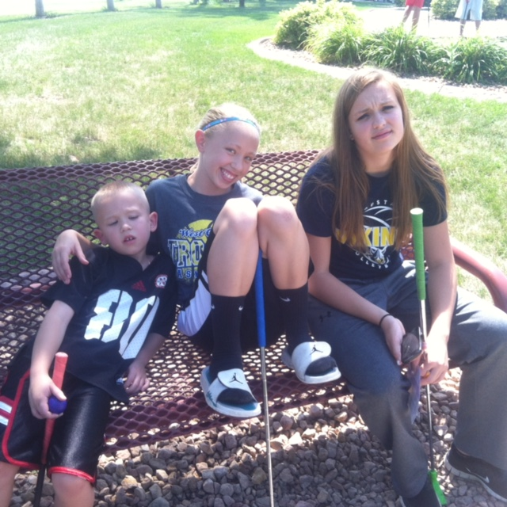
Positive Behavior Strategies for Everyone: Because Duct Tape is NOT a Good Idea.

Slide 3
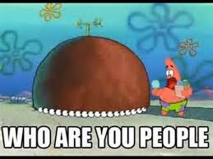
Who are you?

Slide 4
This presentation is the result of the hard work of Jeffrey Sprague, George Sugai, Rob Horner, Anne Todd, Terry Scott, Tim Lewis, Don Kincaid, Bob Algozzine, Laura Riffel, Randy Sprick, Heather Robbins and their many, many colleagues, all of whom have been willing to share the fruits of their labor in order to bring PBIS to scale in our schools.

Slide 5
Participant Expectations
Be Respectful
–Turn off cell phone ringers
–Listen attentively to others
–Participate in activities
Be Responsible
–Return promptly from breaks
–Make yourself comfortable and take care of your needs
Be Safe
–Keep work areas clear

Slide 6
Today’s Objectives
1. Understand how challenging behavior may develop
2. Discuss how to prevent problem behavior
3. Examine basic behavior principles
4. Identify behavior intervention strategies

Slide 7
Today’s Schedule
Break about 10:35-10:45
Lunch from 11:45-1:00
Finish about 3:30

Slide 8
Examples of Positive Support Sheet
Look for underlined words.
Strategies are numbered
Ask questions!!

Slide 9
Mission of Todays Schools
Develop the academic and social skills of all students—including at-risk students
• Teach academic readiness and reading skills that support academic engagement- achievement
• Teach social skills that support socially effective behavior (self control, self regulation, social reciprocity)

Slide 10
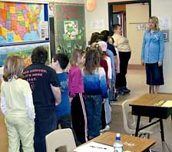
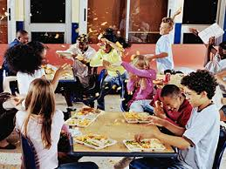
Behavior is Learned-So Who is Going to Teach it?

Slide 11
The Cycle:
Student struggles with curriculum
Student acts out to avoid looking stupid
Student misses out on new curriculum
Student sent out of the room

Slide 13
The Facts:
Problem behavior continues to be the primary reason why individuals in our society are excluded from school, recreation, community, and work.
AND….
We know that behaviors are trying to communicate
a need or a want and shouldn’t be ignored.

Slide 14


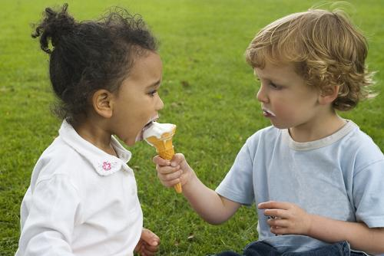
Write down the two behaviors you saw most last year. What were they communicating?
“Pair”
Share with your partner
Think and write

Slide 15
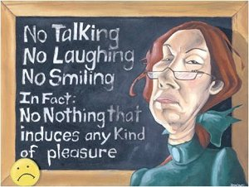

Traditional Discipline vs. Positive Supports
Traditional Discipline:
Stop undesirable behavior by:
Punishment
Student’s problem
Within child problem
Positive Supports:
Stop undesirable behavior by:
Replacing
Teaching
Reinforcing/recognizing
Within environment problem

Slide 16
Why do Some Children Grow Up to be Challenging?
Risk factor exposure
– Enabled
– Disability
– Academic Failure
– Peer Affiliation
– Family Stressors
• Abuse or neglect
• Harsh and inconsistent parenting practices
• Community Disorganization
• Divorce
– Poverty/low income

Slide 18


Why do Some Kids Turn Out Okay?

Slide 19

THE MOST IMPORTANT THING YOU CAN DO AS AN EDUCATOR IS FORM POSITVE RELATIONSHIPS!!

Slide 20
Relationships are the Foundation
Relationships
Prevention
De escalation

Slide 21

Kids that are loved at home come to school to learn, kids that aren’t, come to school to be loved.

Slide 22
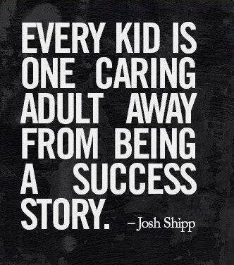
http://joshshipp.com/one-caring-adult/

Slide 23

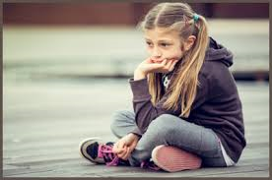

School is Stressful!!
I don’t understand any of this. I’m so stupid.
No one even cares that I’m here
I’m so far behind. I QUIT!

Slide 24
What students want to hear
1. I believe in you
2. You have a purpose
3. You matter
Ask how they are doing
Ask what they need
Ask how they are feeling

Slide 25
Strategy Time!
Strategy: (noun)
A method or plan chosen to bring about a desired future, such as achievement of a goal or solution to a problem.

Slide 26
Warning! None of these strategies:
will work for all students
will work every time
will work if not implemented with fidelity
BUT…

Slide 27
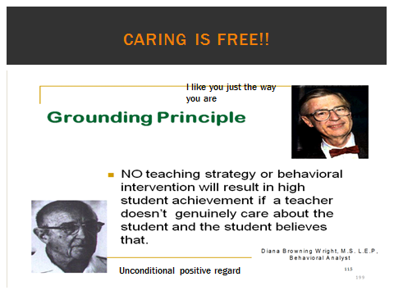
The likelihood of prevention and interventions strategies working increases drastically if there is a positive relationship already in place!

Slide 28
Heads up!
Don’t need formal behavior plan.
Behavior Impedes Learning section
Write down what you’re trying
Do share
Do collect data

Slide 29
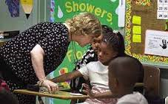

Remain Calm
YELLING= Loss of control

Slide 30
Types of Strategies
Relationships
Prevention
Interventions
De-escalation

Slide 31
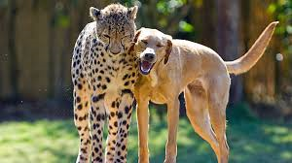
Strategies for Forming Relationships

Slide 32
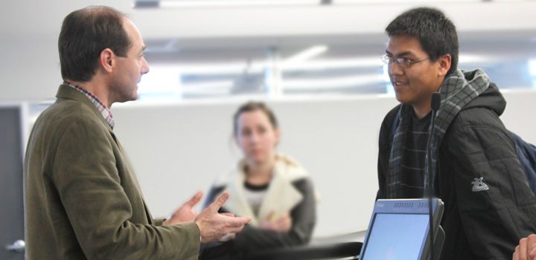
Strategy 1: 2X10
It sucked at first but it’s getting better.
How is your new job going?

Slide 33
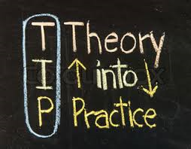
Practice Time

Slide 34
Strategy 2: Planned Discussion
Set a time
Meet with student
Discuss why the behavior is occurring
Develop a plan-TOGETHER
Monitor plan

Slide 35

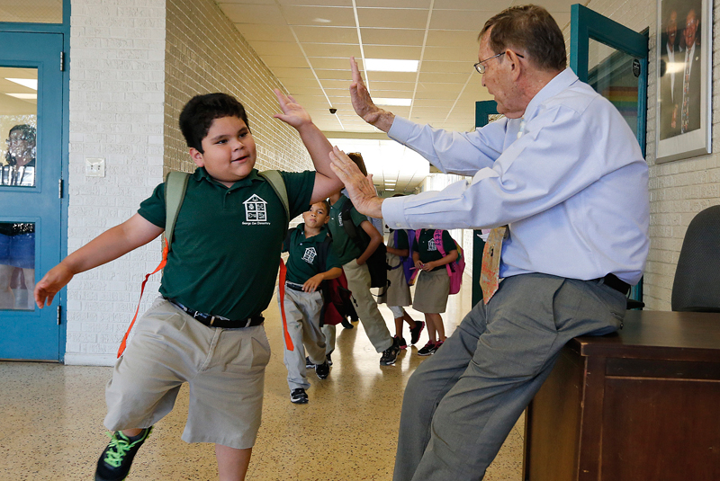
Strategy 3: Reinforcement/Recognize Systems
It’s not as much about the reinforcement as it is about the relationship.
.
OR

Slide 36
Rules for Reinforcements
Be specific
Given AFTER the desired behavior
Student must WANT the reinforcer
The frequency must match the students ability to delay gratification.
Delivered IMMEDIATELY after each desired behavior.
Young children
Just starting behavior plan
Choice-within-Variety: Offer more than one reinforcer and allow the student to select.

Slide 37
Strategy 4. Focus on Behaviors You Want to Increase
Pay attention to positive behaviors
Have student track their positives
Reinforce positive behavior

Slide 38
What’s your ratio?

Slide 39
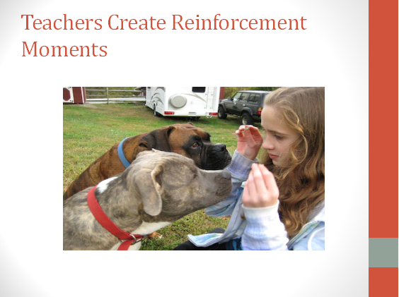

Slide 40
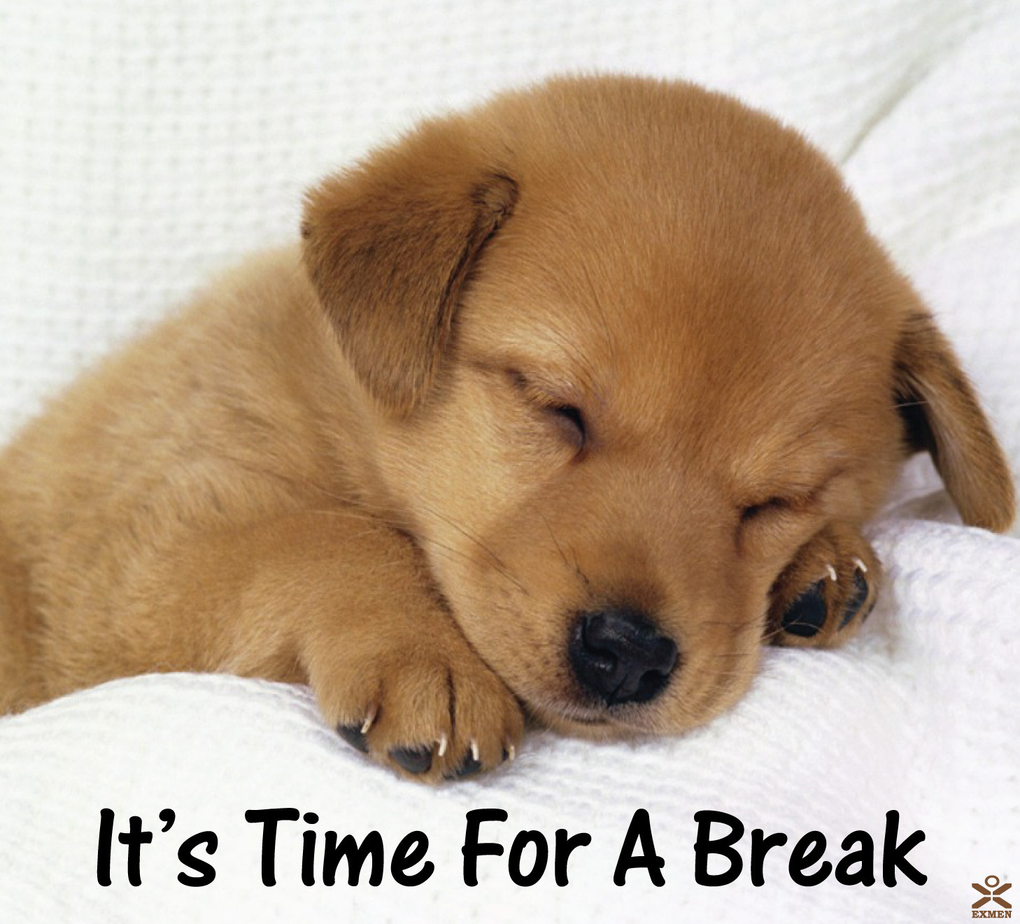
BREAK!

Slide 41
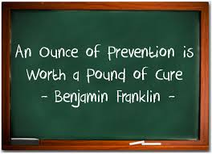
Strategies for Preventing Behaviors

Slide 42
Strategy 5: Pre correct
If you expect it,
pre correct it!

Slide 43
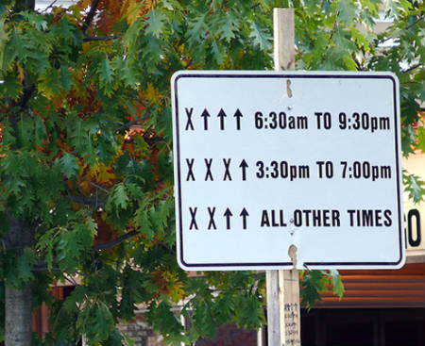
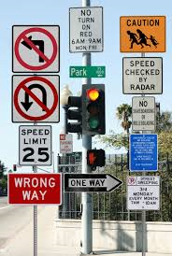
Strategy 6: Clearly define EXPECTATIONS
VS.

Slide 44
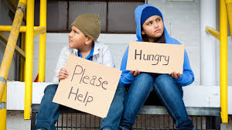
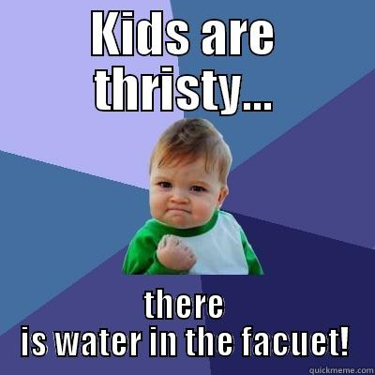
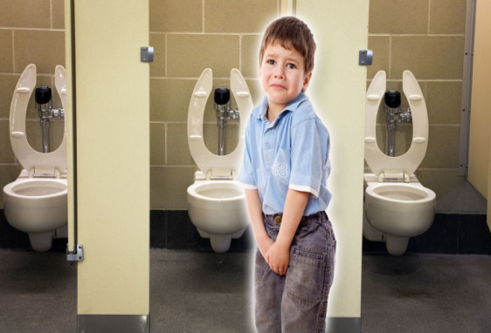
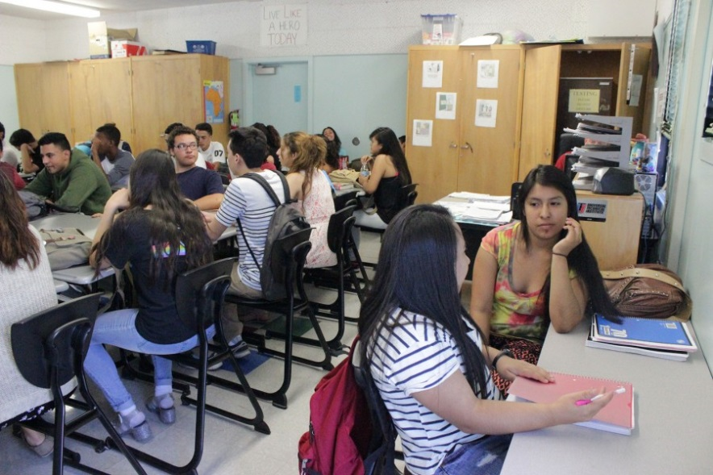
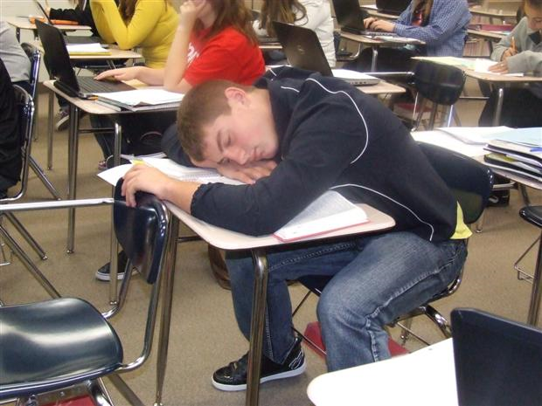
Strategy 7: Basic Needs

Slide 45
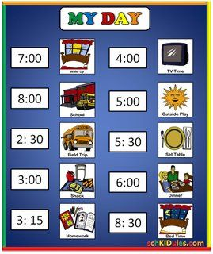
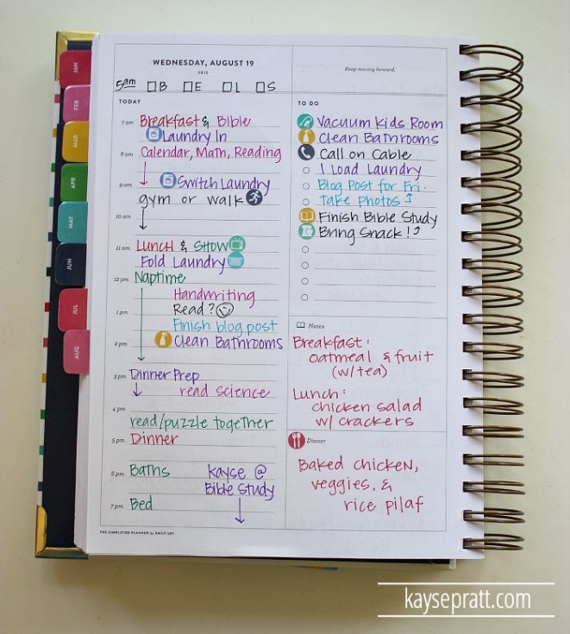
Strategy 8: Schedules
Picture schedules
Written schedules in planners
Written schedule posted for all students

Slide 46
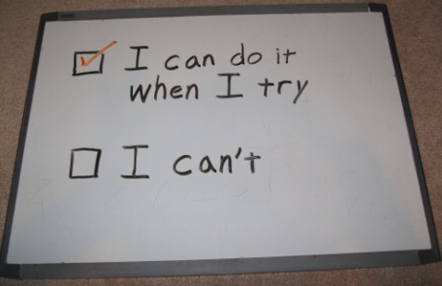
Motivation: Is it Can’t do or Won’t do?

Slide 47

Strategy 9: If it’s “Can’t do” We TEACH
Catch before it becomes WON’T DO
Have we taught the skills?
Do they have the skills?
How do we know they have the skills?
Have we reinforced the skills?
Do they have the skills in all settings?
Can’t or think they can’t?
Easier to give kids a skill set than change
their mind set.

Slide 49
Teaching Behavior
Teach what is expected in that area
Have them practice
Reteach when needed
Role play
https://www.youtube.com/watch?v=kQYL95Rj_gw

Slide 50
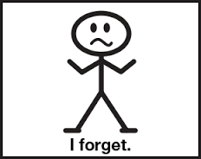
They should know this already!
But they DON’T!

Slide 51

“If a child doesn’t know how to read, we teach.”
“If a child doesn’t know how to swim, we teach.”
“If a child doesn’t know how to multiply, we teach.”
“If a child doesn’t know how to drive, we teach.”
“If a child doesn’t know how to behave, we… …teach? …punish?”
“Why can’t we finish the last sentence as automatically as we do the others?”
(Herner, 1998)
51
Notes:
51

Slide 52


Slide 53
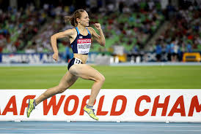
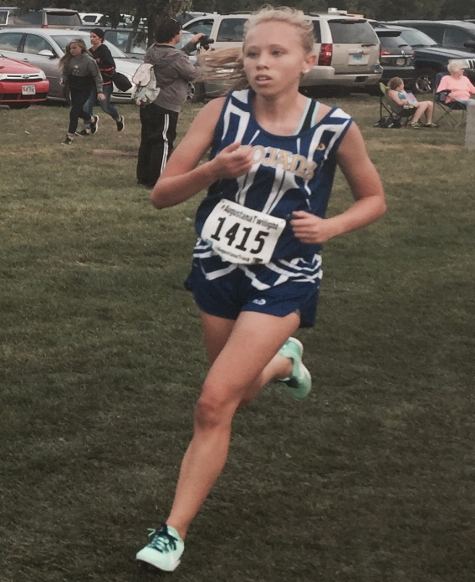
Strategy 10: If it’s a “Won’t Do” we motivate extrinsically
“Why won’t he/she?”
How can I motivate?
Plan for reinforcements and fading reinforcements.
Jenny Simpson
VS.
Abbi Cain

Slide 54
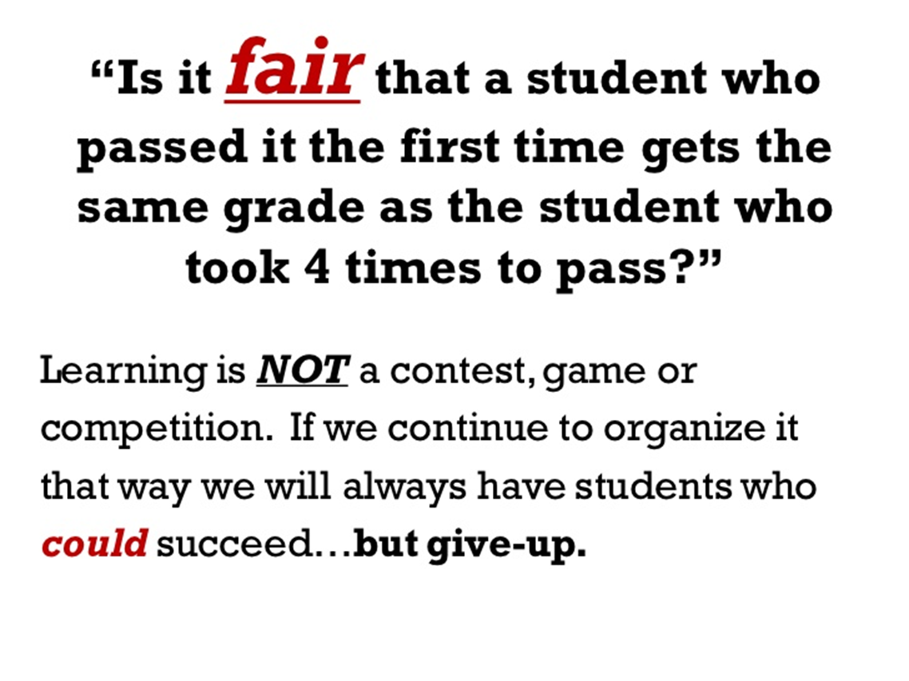
Stand up and discuss…

Slide 55
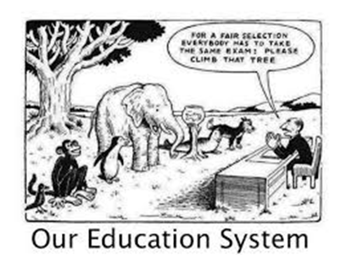
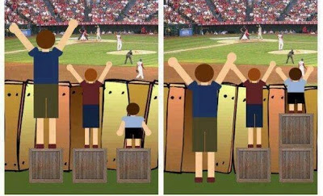
Rethink Fair

Slide 56
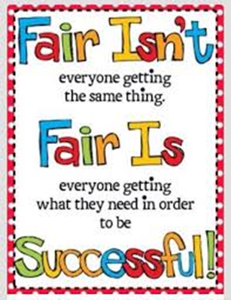
Hang this in your room!

Slide 57
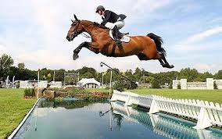
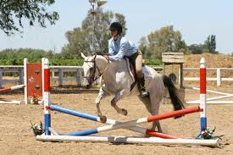
Strategy 11: Set Kids Up for Success
If you have a classroom system in place but the student has never experienced success with it, it will become meaningless and frustrating
Same is true with behavior support plan
Notes:
How many of the kids you work with have seen a lot of academic success throughout their lives?
How many are told everyday that they are awesome or are doing a great job?

Slide 58
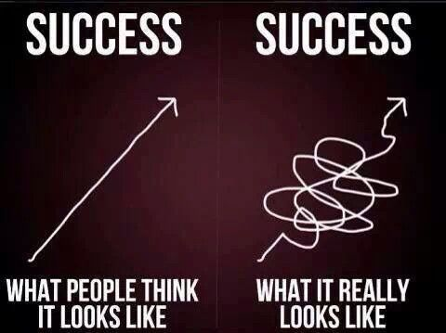

Slide 59
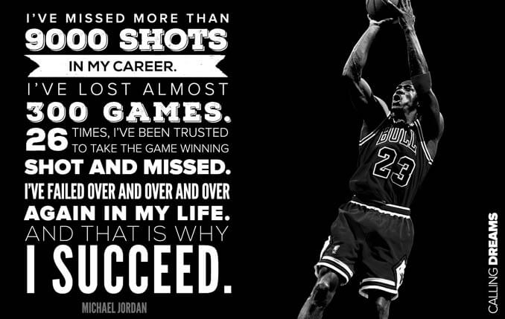

Slide 60
Strategy 12: Build Momentum
Start with what they know
Build confidence
Reinforce

Slide 61
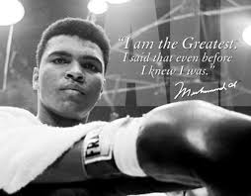
It's the repetition of affirmations that leads to belief. And once that belief becomes a deep conviction, things begin to happen. Muhammad Ali

Slide 62
Strategy 13: Goal Setting
Student track their own behavior
Use stacking
Tracking their own behavior may be the only positive reinforcement they need!

Slide 63

LUNCH!!!

Slide 64
Morning Review
Any questions?

Slide 65
Functional Behavior Assessment
The process of finding the “WHY”

Slide 66
Before You Can Work on Changing a Behavior
You need to know WHY
You can make a behavior worse
Get something or avoid something?

Slide 67
Behavior Pathways
Setting
Events
Triggering
Antecedents
Problem
Behavior
Maintaining
Consequences
Acceptable
Alternative
Advanced Behavior Management
Notes:
67

Slide 68
Define Problem Behavior
Measurable
Observable
Objective

Slide 69
Behavior Pathways
Setting
Events
Triggering
Antecedents
Problem
Behavior
Maintaining
Consequences
Acceptable
Alternative
Advanced Behavior Management
Notes:
69

Slide 70
Triggering Antecedents
Situations
People
Time
Place
Object
Etc.

Slide 71
Behavior Pathways
Setting
Events
Triggering
Antecedents
Problem
Behavior
Maintaining
Consequences
Acceptable
Alternative
Advanced Behavior Management
Notes:
71

Slide 72
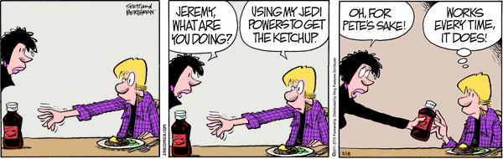
Maintaining Consequences: Why Do They Keep Doing That?
BECAUSE IT’S WORKING FOR THEM!!

Slide 73
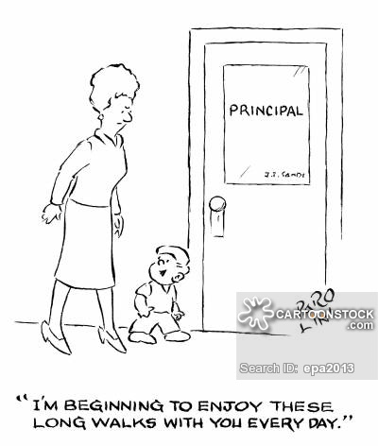
Maintaining Consequences (function)
May not be what we think!
Their function-not ours
Can be multiple functions

Slide 74
Behavior Pathways
Setting
Events
Triggering
Antecedents
Problem
Behavior
Maintaining
Consequences
Acceptable
Alternative
Advanced Behavior Management
Notes:
74

Slide 75
Setting Events
Not something that happens all the time
Special events that may INCREASE the likelihood a behavior will occur

Slide 76
Examples of Setting Events
Child refused to take meds
Broke up with girlfriend/boyfriend
Stayed with friends all weekend

Slide 77

Behavior Pathways
Setting
Events
Triggering
Antecedents
Problem
Behavior
Maintaining
Consequences
Acceptable
Alternative
Advanced Behavior Management
Notes:
77

Slide 78
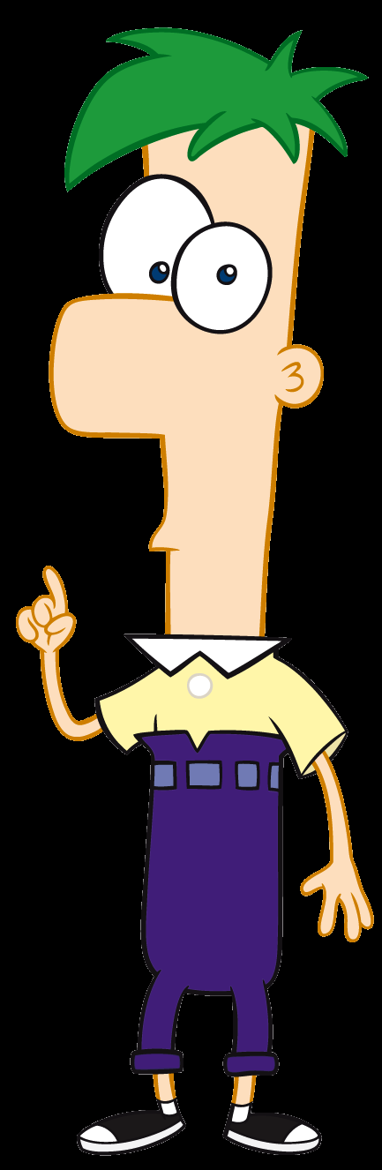
Functionally Equivalent Replacement Behavior (FERB)
FERB =What student should do instead of the problem behavior?
The FERB is a positive alternative that allows the student to obtain the same outcome that the problem behavior provided.
The FERB must be as easily performed as the problem behavior.

Slide 79
Brian is a kindergartener on IEP for speech
Has many features suggestive of autism
He is verbal, and uses 3-4 word sentences routinely to express needs and wants, but never to comment on something in the environment.
Brian likes routines, and becomes very upset if the bus is late, or if the bus driver is not the expected one. On those days, when Brian’s bus routine has changed, staff members say they “know he will have problems.”
Each school day Brian puts his coat away, and goes to circle time. After going to circle, on many days, Brian will run away, and kick and head butt if captured after running away, if the activity at circle time lasts more than five minutes.
Brian is more likely to leave circle by running away, on days when the bus routine has changed from the typical bus routine

Slide 80
Write Down:
Behavior
What MIGHT be causing it (Triggering antecedents)
What MIGHT be reinforcing it (function)
Setting events
FERB
Running away
Sits too long in circle time
He is getting out of circle time
Different bus drive/driver late
Walk back to his desk and sit, sit in a designated area

Slide 81
Your Turn
Discuss a situation you have had and list:
Behavior
What MIGHT be causing it
What MIGHT be reinforcing it
What MIGHT be some setting events contributing to the behavior
“Pair”
Share
Think and write

Slide 82
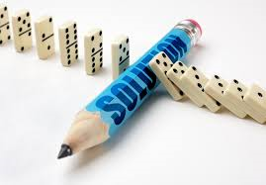
Strategies for Interventions

Slide 83
Strategy 14: Cueing System
Develop a signal
Involve the student
Practice
Reinforce for successful use
Notes:
When Billy is becoming frustrated with the material because it is too difficult for him, Billy will use the cueing system to let staff know he is frustrated. Staff will adapt the number of items he is expected to learn or number of activities student will complete prior to assessment for mastery.
- Steps for teaching Billy how to use the cueing system
- Who will teach
- Plan for re-teaching if system is not used correctly

Slide 84
Strategy 15: Taking a Break
Adults need breaks
Students need breaks
Need to teach
Break card system

Slide 85
Strategy 16: Do later systems
Do later file
Break it up
Cross out/circle

Slide 86
What typically happens with interventions…
Takes time- one month of CONSISTENT implementation per year of behavior
May get worse before it gets better
Temporary reoccurrence

Slide 87
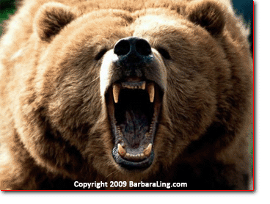
Strategies for Defusing
When a student is beginning to be agitated (before behavior intensifies)

Slide 88

Prevention is always your best route to take.

Slide 89
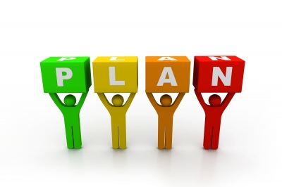
But when prevention doesn’t work…
Plan ahead
Too late when things fall apart
No excuse after the first incident!

Slide 90
https://www.youtube.com/watch?v=bTeYncx1xmI

Slide 91
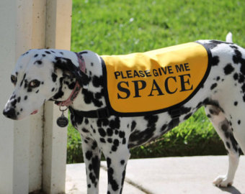
Strategy 17: Space and Time

Slide 92

Strategy 18: Provide support

Slide 93
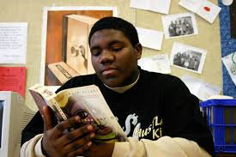
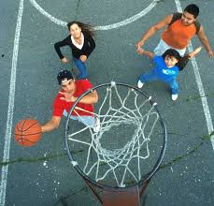
Strategy 19: Engage in preferred activities

Slide 94
Strategy 20: Use empathy statements
Use “I” and “You” statements
I can see that you are upset
Are you ok with that?
Can you tell me what is going on?
Is there something I can do to help?

Slide 95

Strategy 21: Allow for choices
Make sure you can live with whatever the student chooses!

Slide 96
Strategy 22: Sandwich Method
A. Reinforce earlier behavior
B. State inappropriate behavior with a calm voice
(Just now your….)
C. Empathy statement
D. State appropriate behavior
E. Rational statement
- Require response
- Require performance
- Give ½ consequences
F. Reinforce compliance
**Turn and burn!!
Dianna Browning Wright

Slide 97
Practice Time!
“Pair”
Practice
Think and write

Slide 98

Strategy 23: Allow for movement activities

Slide 99
Strategy 24: Relaxation activities
1. Teach the student to identify emotions
2. Teach them self calming techniques
3. Practice
https://www.responsiveclassroom.org/teaching-self-calming-skills

Slide 100
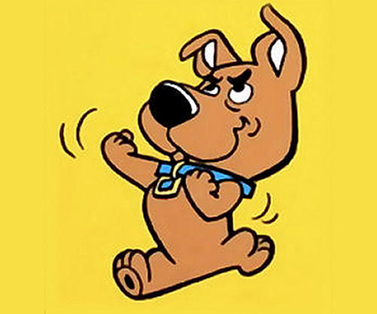
Strategy 25: PICK YOUR BATTLES
Save discipline for big problems
Don’t sweat the small stuff

Slide 101
Think/Pair/Share: Which do you use?
“Pair”
Share with your partner
Think

Slide 102
When it happens:
Be consistent: same response every time
Consistency means: children can expect Kindness, Fairness, and Safety in the classroom
Address the behavior: redirect to a positive activity

Slide 103
Correcting Inappropriate Behavior
Immediate
Non-argumentative, non-critical
Specific to behavior
Consistent (with behavior and across staff)

Slide 104
Corrective Consequences
Take the student aside
Avoid embarrassing the student
Review what you saw with the student in a calm, impersonal manner
Don't argue - don't allow yourself to be drawn into an argument
Define the Inappropriate Behavior - state the rule(s) or expectation(s) that were violated
Ask the student to state the appropriate, expected behavior for the situation –
if they can't or won't, ask them to repeat it to you
Remind the student what the consequence for the particular behavior is
Apply the consequence immediately
Focus on the BEHAVIOR not the student

Slide 105

Celebrate Baby Steps

Slide 106
Things That Work
Will Take:
Time
Patience
Energy
Caring
Commitment

Slide 107
Think/Pair/Share: One strategy you will use
“Pair”
Share with your partner
Think

Slide 108
Review
Any questions on your sheets?

Slide 109

Most kids…

Slide 110

But some kids…

Slide 111


Slide 112

Anyone can teach and easy kid
Guiding a strong-willed child through the rebellious years takes a pro with a lot of love to give! Drjamesdobson.org

Slide 113
Resources
http://sdpbis.wikispaces.com/South+Dakota+PBIS
http://doe.sd.gov/oess/specialed/index.asp
www.pent.ca.gov
http://flpbs.fmhi.usf.edu
www.pbis.org
www.toughkid.com
www.safeandcivilschools.com
www.behavioradvisor.com
http://www.challengingbehavior.org
www.whatworksclearinghouse.com
www.interventioncentral.org
http://www.top20training.com
Rebecca.cain@state.sd.us

