Slide 1

Teaching Families WHY Attendance Matters

Slide 2


Many parents are not aware of how quickly absences add up to academic trouble.
Chronic Absence
18 or more days
Warning Signs
10 – 17 days
Satisfactory 9 or fewer absences

Slide 3
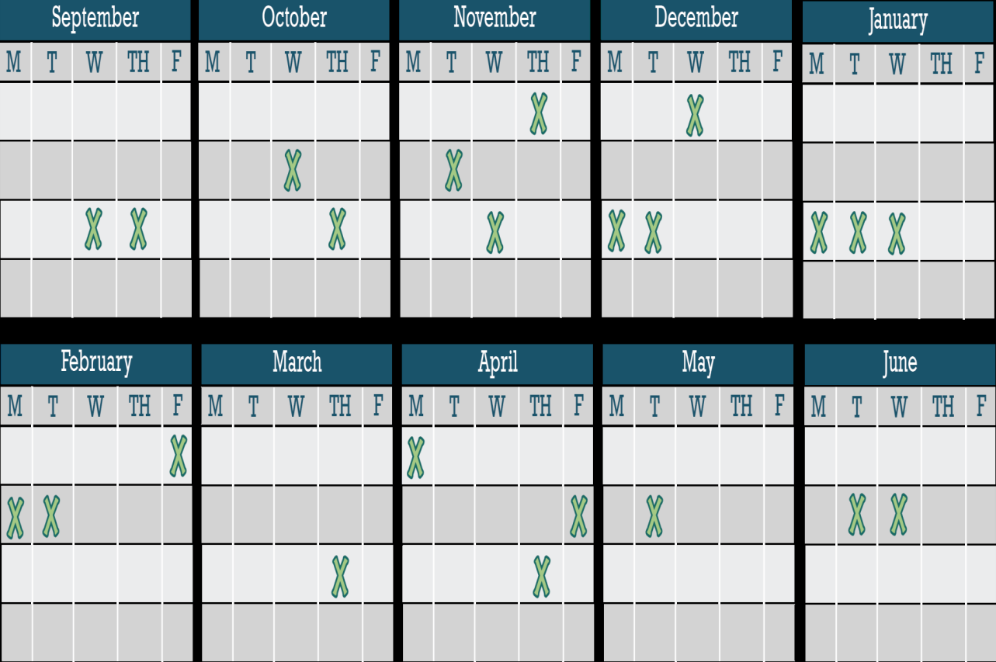

Excused and unexcused absences result in too much time lost in the classroom.
Many children miss 10% of a school year –
that is almost a month per school year!

Slide 4

Why Attendance Matters
Parents underestimate the number of year-end absences. 60% of parents said their child was absent an average of 2+ days a month, but not 10+ days a year.
If a child is absent an averages of 2+ days a month, then they are absent far more than 10+ days a year.

Slide 5

One in 10 kindergarten and 1st grade students nationally are chronically absent.
“Attendance doesn’t really matter until high school”

Slide 6

Only 17% of students considered chronically absent in kindergarten and 1st grade were reading proficiently in the 3rd grade.
Compared to 64% of those students with good attendance.

Slide 7

Over 2/3 of the
U.S. fourth grade students are NOT reading at grade level!
“Absences are ok if I say so…. vacation, rest, reward for good behavior, appointments, family time, bullying, sickness, help around the house…….”

Slide 8

By 6th grade chronic absenteeism is a leading indicator that a student will drop out of high school.

Slide 9
A student who misses 10 days
is 25% less likely to enroll in college.

Slide 10
A high school graduate makes
Students who attend school regularly are more likely to graduate and find good jobs.
$1 million more than a dropout over a lifetime.

Slide 11







Too many absences – excused or unexcused – can keep students from
succeeding in school and in life. How many are too many? 10%. of the school year – that’s 18 missed days or 2 days a month – can knock students off track.

Slide 12


Myths
Barriers
Aversion
Disengagement
~Absences are
~Lack of access to health of dental care
~Poor transportation
~Trauma
~No safe path to school
~Homelessness
~ Child struggling academically or socially
~Bullying
~Ineffective school discipline
~Parents had negative school experience
~Undiagnosed disability.
~Lack of engaging and relevant instruction
~No meaningful relationships with adults in school
~Vulnerable to being with peers out of school vs. in school
~Poor school climate
only a
problem if
they are
unexcused.
~Sporadic
versus
consecutive
absences
aren’t a
problem
~Attendance
only matters
in the older
grades.

Slide 13


The good news is – that students can
reverse their academic performance
if they improve their attendance

Slide 14
Tools for Attendance Awareness month
Attendance Awareness Toolkit

Slide 15
Ways to Emphasize Attendance from Day One
Talk with parents to share the value of good attendance and let them know you are there to help.
Send home handouts with information and tips.
Make time at parent event to demonstrate the importance of attendance.
Celebrate Attendance Awareness Month
Use your Parent-Teacher Conferences to talk about attendance

Slide 16


Slide 17

 Attendance Works website: http://www.attendanceworks.org/
Engaging Parents Toolkit
Parent Materials
Interactive Activities
Videos

Slide 18
SHARING
Share one strategy you learned today that you want to incorporate in your school or classroom to encourage students to attend school every day.

