Slide 1
Family and Community Engagement SDDOE Title Programs
Welcome to the Beach

Slide 2

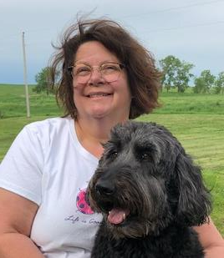
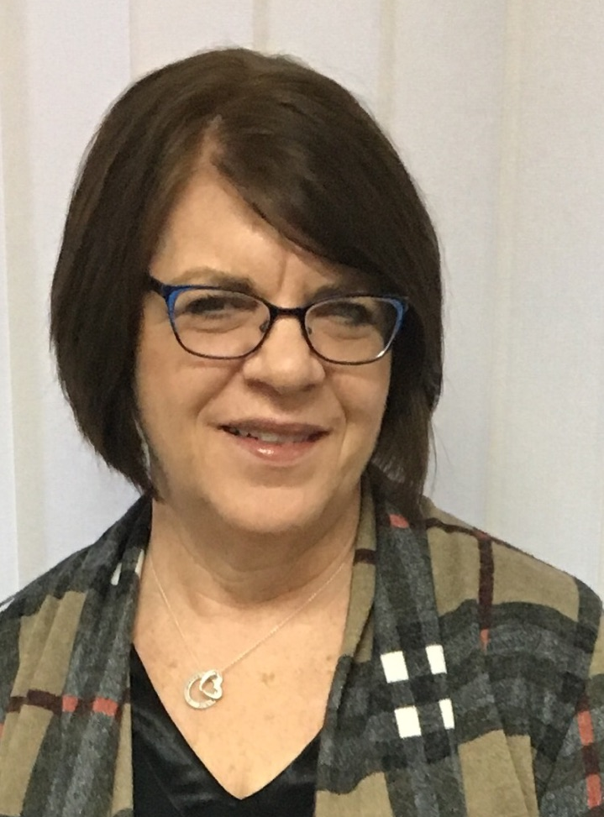
Meet your Presenters
Marta Henriksen
retired from teaching 4 years ago
taught 1st through HS for almost 30 years!
love working with Family and Community Engagement to build trust between schools, families and communities
I enjoy:
spending time with my family
reading
working in my flower garden
riding on the 4 wheeler with my husband to check cows
we have 4 grandchildren, (2 right down the road)
being a “Nena” is probably the best thing that I have ever experienced1
Dawn Smith
Prior MS teacher
Family and Community Engagement Specialist
I enjoy:
Family time & my three grand babies
Camping
Flower gardening
Time in the Hills and on the farm
©2016 EB Academic Camps, LLC

Slide 3
Building Capacity
This session will build your capacity to communicate and work with families by sharing ideas for ongoing communication, and making family nights enticing to everyone. Ideas for linking family engagement to learning will be shared. You will leave this session with the knowledge and supports to cultivate and sustain active respectful partnerships with families.
Families state that feeling welcome and being treated with respect by school staff is the number one key to their connection with a school.
When school staff construct caring and trustful relationships with parents, treating parents/families as partners in their children’s education, parents are far more likely to become involved/engaged and stay involved/engaged.
Beyond the Bake Sale The Essential Guide to Family- School Partnerships

Slide 4

Children do best if parents/families can play a variety of roles in their learning, helping at home, volunteering at school, planning their Children’s future, and taking part in key decisions about the school program
Research from- A New Wave of Evidence, The Impact of Schools, Family and Community Connections on Student Achievement.

Slide 5

We are glad you are here.
Sign in (email address on starfish to put in bowl for the raffle drawing)

Slide 6

Beach Ball Speed Dating
Toolkit Section 4 Communication
Back to School Night Speed Dating
https://laurarandazzo.com/2015/09/18/back-to-school-night-speed-dating/

Slide 7

Looking Through a Different Lens
Set timer for 5 minutes
Get yourself a paper bag with prompts, role, and school.
Set timer for 10 minutes
Break out into small group (no larger than 7) with other “teachers”, “administrators”, “parents”, “school secretary”.
Discuss in this small group what your role is for welcoming families, creating a welcoming environment, meeting the accommodations of all of your families, making each family feel welcomed, valued at your school.
What would you want to learn from each family?
How do you see your role in planning and organizing an awesome School Activity?

Slide 8
Looking Through a Different Lens
Set timer for 15 minutes
Your school will be having a meeting to plan this upcoming school years Open House. You will need to look at everyone’s role and consider their needs when making your plans. Hear their personal concerns and plan according. What will it look like, how will you get families to attend?
Each table shares out what they took into consideration when planning their event, how they are going to address these concerns and make families feel welcome and valued
How are you getting families to attend?
How are making families feel welcomed and valued?
Write out your Family Night plans on the poster with the name of your school.
Set timer for 10 minutes
Share out your plans for an amazing Family Night

Slide 9
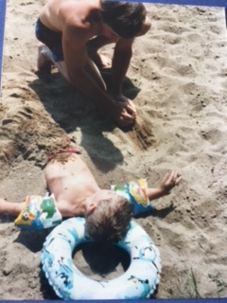
Sharing Resources
Open House Night or Parent Teacher Conferences
Post it and Share *
What about your child’s learning are you most proud of?

Slide 10
Sharing Resources
Six Types of Open Ended Questions You Should Ask *
Is Homework Good For Kids Here’s what the Research Says *
Building Parent Teacher Relationships */Great Meetings From The Start *
Family Math Night and ESEA What the Research Says *
Who’s Who of Bullying *

Slide 11
Sharing Resources
Summer STEM Activity Calendar *
The handout has the links/resources to these activities

Slide 12
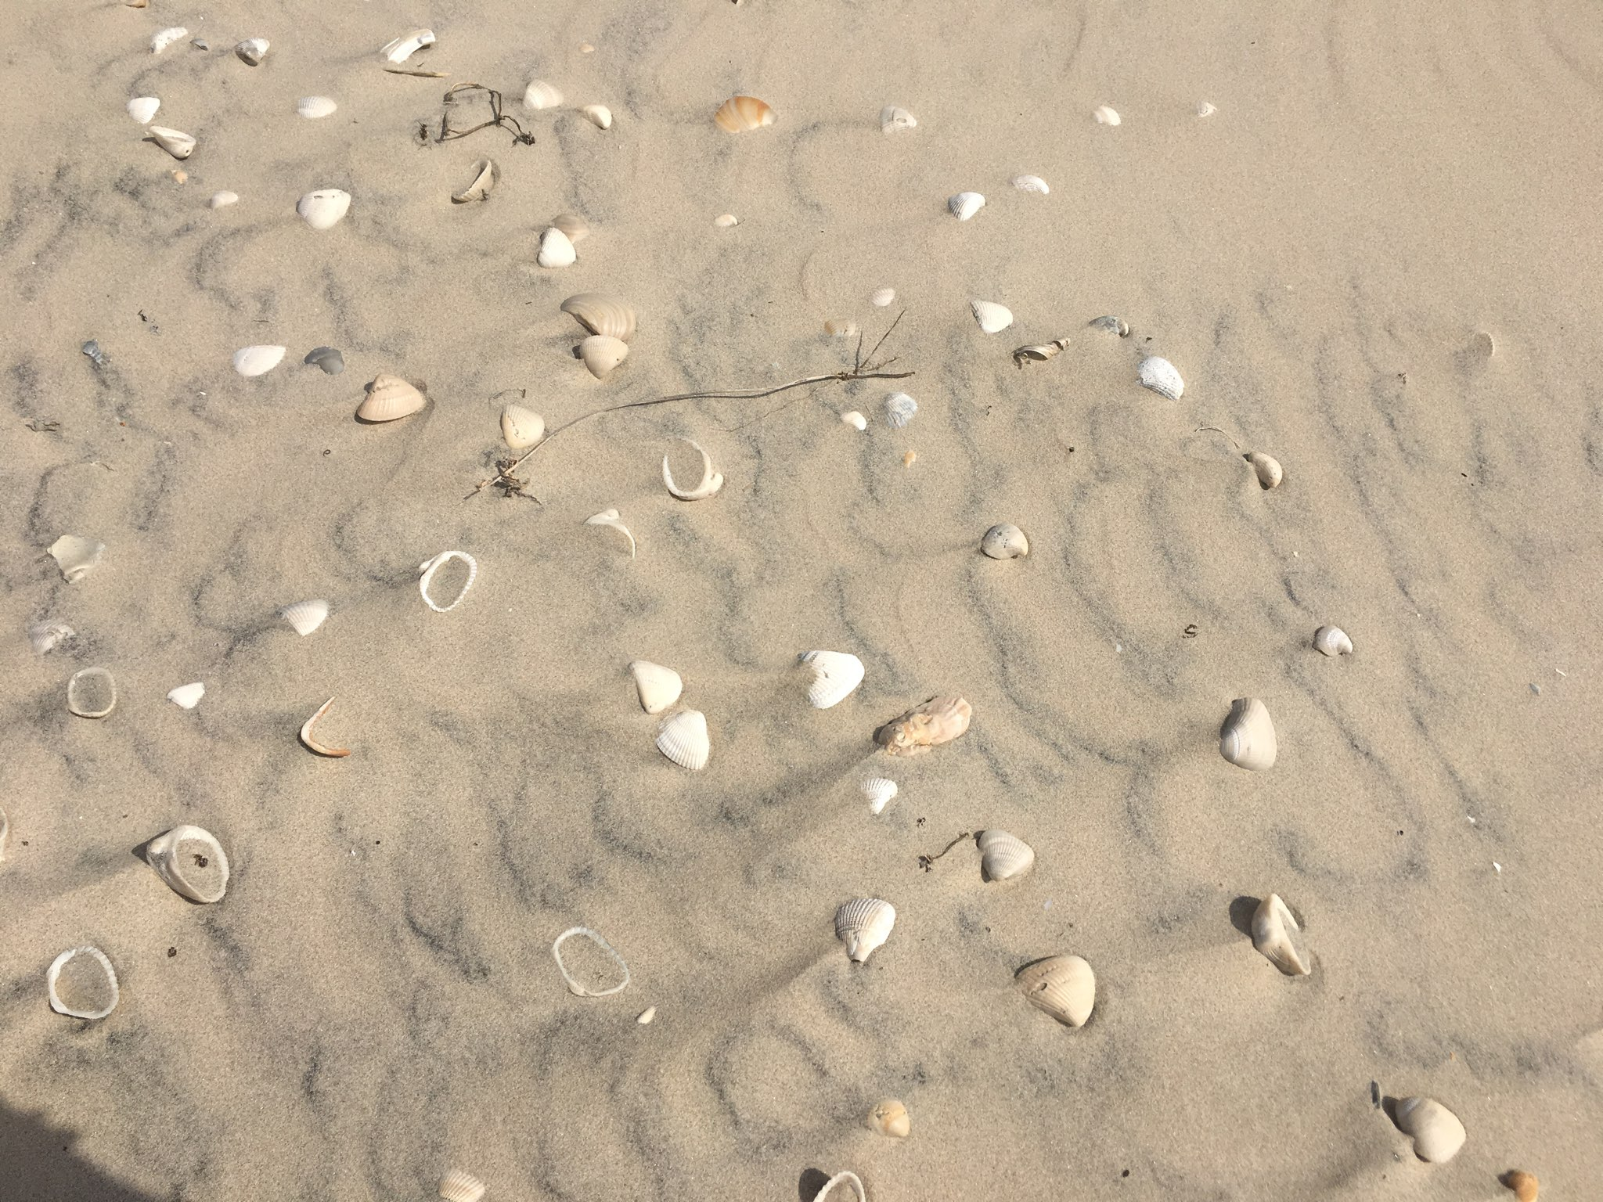
Toolkit Open House Ideas
http://doe.sd.gov/title/toolkit/documents/Section-4.pdf

Slide 13
Loop a Video
During times when families are visiting school you can set up a looping video with important information such as attendance, information on standards, or other important information for families.
https://doe.sd.gov/title/documents/AttendanceMatters.pdf

Slide 14
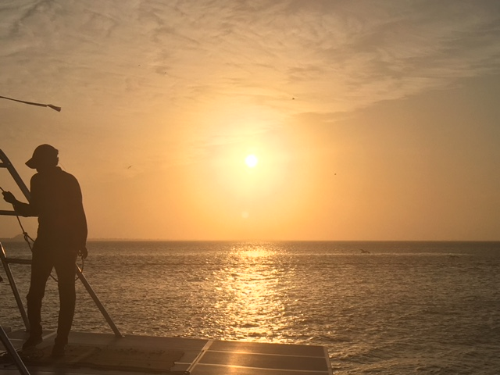
Please give us suggestions on how we could help you and your school increase Family and Community Engagement.
Dawnl.smith@state.sd.us
Marta.Henriksen57@gmail.com
Thank you for attending! Have a great Summer!!

