Slide 1
Equitable Services for Private Schools
Call-in number: 866-410-8397
8297987747

Slide 2
Private school Participation
School Districts receiving federal financial assistance under ESEA programs are required to provide equitable services to eligible private school children, teachers, and other educational personnel.

Slide 3
Eligible Private Schools
Non-Profit
State accredited elementary and secondary schools

Slide 4
Equitable Participation
Services and other benefits must be comparable to the services and other benefits provided to public school children and teachers participating in the program.

Slide 5
Do the services need to be the same?
No, if the needs of the private school students and teachers are different from the public school, the district should develop a separate program.

Slide 6
District Responsibility
Designing and implementing the programs for the private school students and teachers.
Services must be provided by an employee of the district or a 3rd party contractor.
This responsibility cannot be delegated to the private schools.

Slide 7
Control of Program and Funds
The public schools must be in control of the program.
No public funds are distributed to private schools.
District provides services and materials to benefit students and their teachers.
Title to any equipment, supplies, or materials remain in the district

Slide 8
Services Provides
Must be secular, neutral and non-ideological
Equipment, supplies, and materials to be removed if not used appropriately
Must be supplemental, and not supplant, the level of services provided.

Slide 9
Consultation
The goal of consultation is agreement between the LEA and appropriate private school officials on how to provide equitable and effective programs for eligible private school children

Slide 10
Private School Consultation
During the design and development of the programs.
Before any decision is made that could affect the ability of the private school students, teachers or other educational personnel to receive benefits.
Must continue throughout the year to ensure the needs of students and their teachers are met.

Slide 11
Consultation
Topics expanded to include:
How the proportionate share of funds is determined;
Whether services will be provided directly or through a separate government agency, consortium, entity, or third-party contractor;
Whether to provide equitable services on a school-by-school basis or pooling funds;
When, including the approximate time of day, services will be provided; and
Whether to consolidate and use Title I equitable services funds in coordination with funds available for services to private school children under other ESEA programs.

Slide 12
Consultation
Other changes:
LEAs and private school officials must have the goal of reaching agreement on how to provide equitable services, the results of which must be transmitted to the SEA ombudsman.
If an LEA disagrees with the view of the private school officials regarding any of the issues subject to consultation, it must provide private school officials written reason why it disagrees
An LEA must maintain a written affirmation of meaningful consultation, signed by the private school officials. The affirmation must provide the option for private school officials to indicate their belief that timely and meaningful consultation has not occurred or that the program design is not equitable.

Slide 13
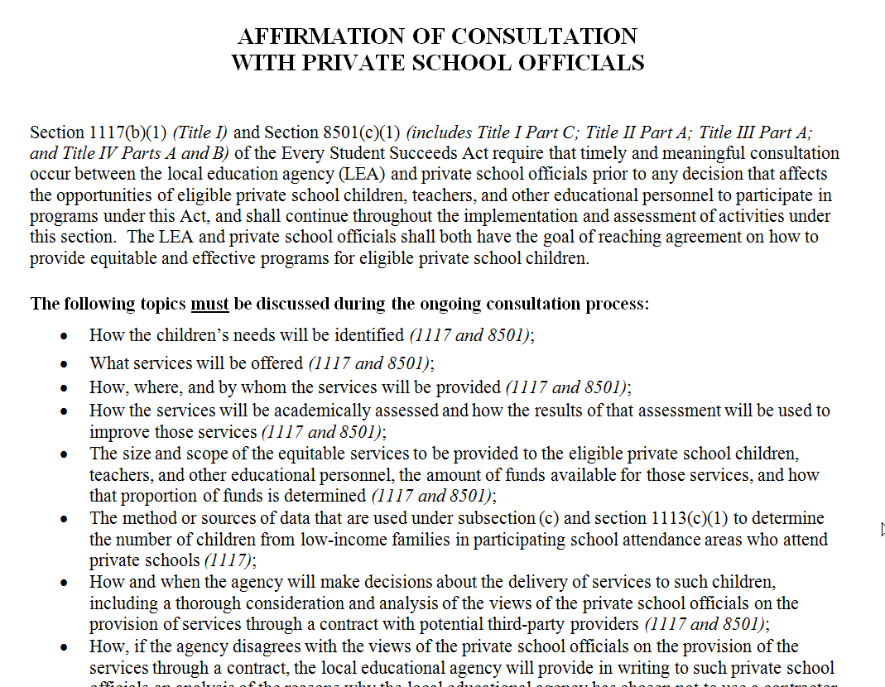

Slide 14
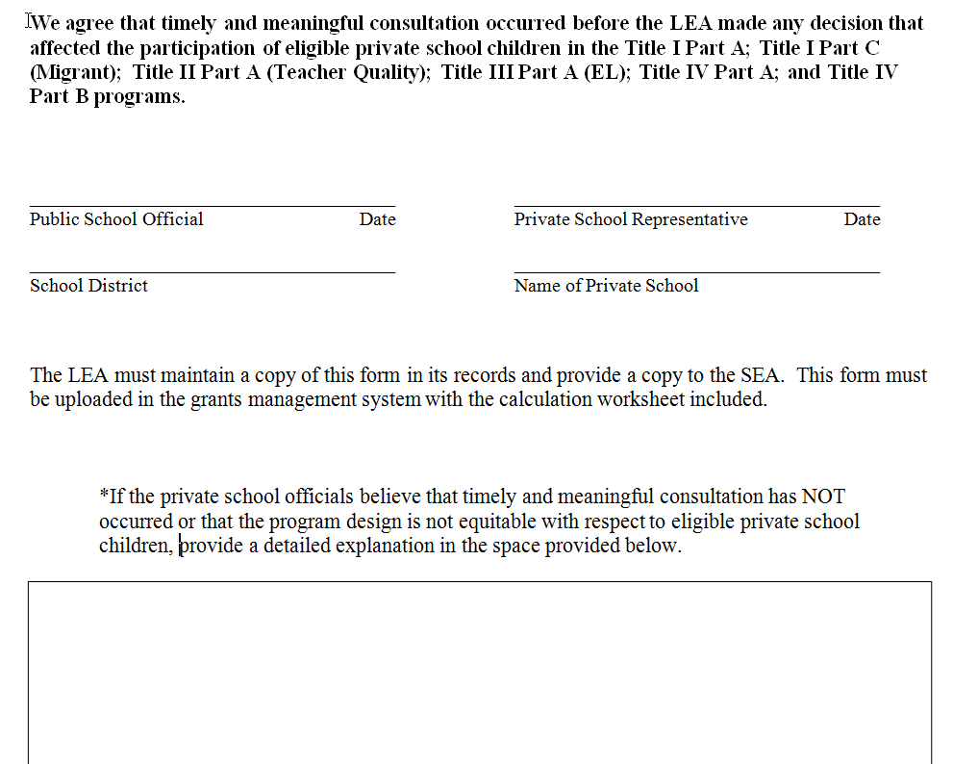

Slide 15
Complaint Process
If private school officials believe that timely and meaningful consultation has not occurred:
Add a detailed description to the consultation document.
Contact District Superintendent or Federal Programs Director to express and discuss concerns

Slide 16
Complaint Process
If not resolved at the district level
Contact the Ombudsman with:
a statement that the district has violated a requirement of the federal program
The facts or basis of the complaint
The name, address and signature of the complainant

Slide 17
What documentation should a district have?
Representative of private schools informed of availability of services
The needs the private school students and teachers were identified as part of the district-wide needs assessment
Private school officials were consulted and provided an opportunity for input
The district designed a project that permits equitable participation
District should maintain records of its efforts to resolve any complaints by private school officials

Slide 18
Ombudsman
SEA designated Ombudsman monitors and enforces Title I equitable services requirements to ensure that private school children, teachers, and other education personnel receive services equitable to those in public schools
Jordan Dueis- jordan.dueis@state.sd.us

Slide 19
SEA Compliance Role
An SEA must provide Title I equitable services directly or through contract if appropriate private school officials have:
Requested the SEA to provide such services; and
Demonstrated that the LEA has not met the Title I equitable services requirements in accordance with the procedures for making such a request, as prescribed by the SEA.

Slide 20
ESEA Programs
Title I Part A
Title I Part C
Title II Part A
Title III Part A
Title IV Part A
Title IV Part B

Slide 21
Which District is Responsible?
Title I Part A
Each district is responsible for its own resident students
Other Programs
District where the private school is located

Slide 22
Equitable Services Funding
Funds must be obligated in the fiscal year in which the funds are received
SEA must provide timely notice to appropriate private school officials of funds for Title I equitable services that LEAs have determined are available for eligible private school children

Slide 23
Title I Equitable Services Funding
The proportional share of funds for equitable services must be determined based on the total amount of Title I funds received by an LEA prior to any allowable expenditure or transfers by the LEA
Based on the number of children from low-income families residing in each participating public school attendance area who attend public schools and private schools.

Slide 24
Expenditures for equitable services to eligible private school children, teachers and other educational personnel, and families must be equal to the proportion of funds allocated to participating public school attendance areas based on the number of children from low-income families who reside in those attendance areas and attend private schools.
Notes:
Title I

Slide 25
Title I Proportionate Share for Equitable Services
Determine the total number of children from low-income families residing in each participating public school attendance are who attend public and private schools.
Determine the overall proportion of these children who attend private schools.
Based on this proportion, determine the amount of funds available for equitable services based on that proportion of the LEA’s total Title I allocation.

Slide 26
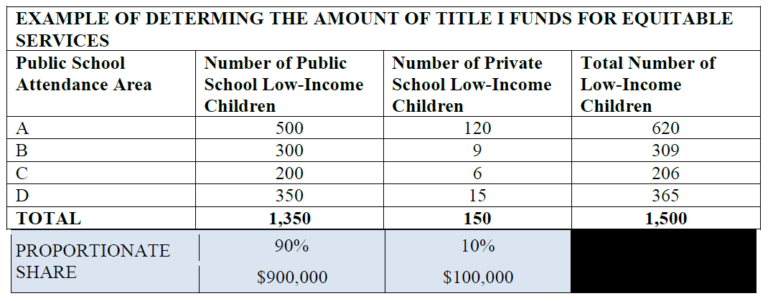
Title I Proportionate Share Example $1,000,000 LEA Allocation

Slide 27
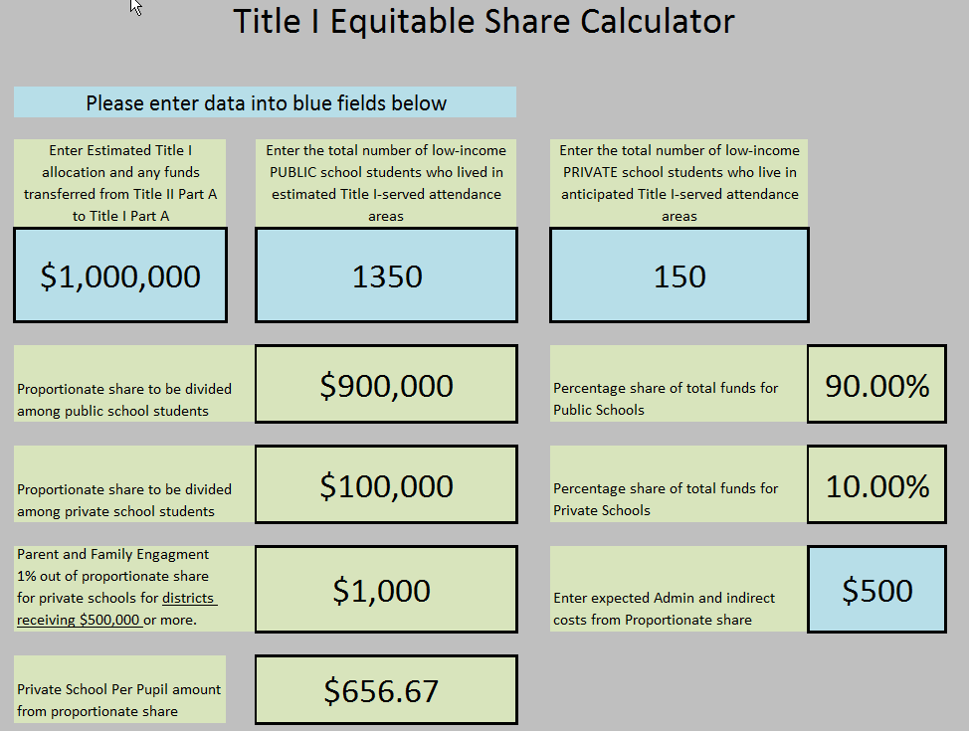

Slide 28
Parent and Family Engagement
1% applies to LEAs receiving $500,000 or more in Title I allocations. Proportionate share percentage for services to private school students to determine how much it must spend for parent and family engagement activities.
The LEA does not reserve a portion if it’s 1% reservation for parent and family engagement activities for participating private school students; rather, this amount comes from the proportionate share that the LEA already determined.

Slide 29
Title I Administrative Costs for Equitable Services
From the proportionate share of Title I funds available to provide equitable services, an LEA may reserve an amount that is reasonable and necessary to administer equitable services.
An LEA determines this amount separately from the funds needed to administer the Title I program for students in public schools.

Slide 30
Title I Part A & Private School Services
Resident district is responsible for providing services for its students, even if the students attend a private school in another district
Resident district may contract with another district to provide services

Slide 31
Which private school students may receive Title I services?
Must reside in a participating Title I school attendance area AND be failing or most at risk of failing
Selected on the basis of multiple educational related criteria
Poverty is NOT a criterion for services

Slide 32
Targeted Assistance
Private school services must be Targeted Assistance
Cannot operate a Title I Schoolwide program in a private school

Slide 33
Examples of Title I Services
Instructional services outside the regular classroom
Before/After school and summer
Family literacy
Home tutoring
Computer-assisted instruction

Slide 34
Title I Part C Migrant
Eligible children must meet the statutory definition of a migrant child
Proportional share of total migrant children in district

Slide 35
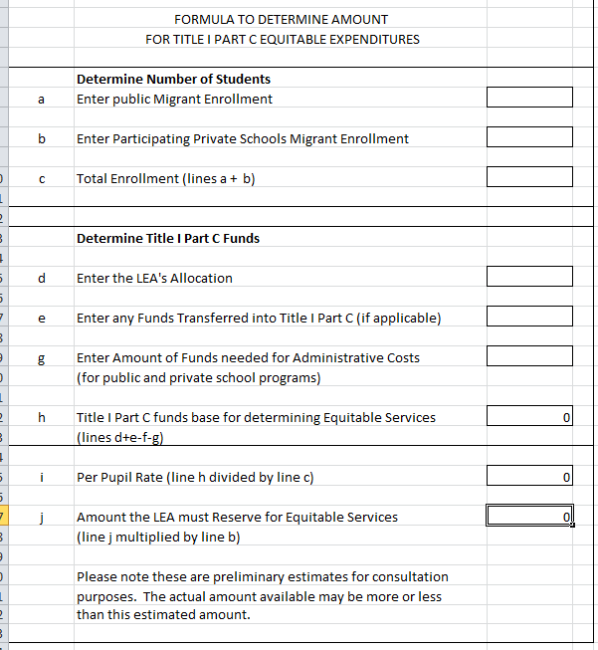

Slide 36
Title III Part A English Language Acquisition
Equitable services for English Learners and their teachers to attain English proficiency
Proportional share of EL children in district

Slide 37
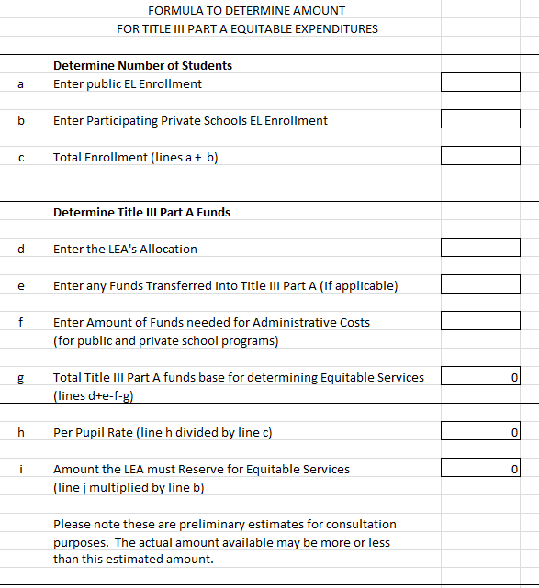

Slide 38
Title II, Part A/ REAP
The amount an LEA must reserve is based on the LEA’s total Title II, Part A allocation, less administrative costs.
Calculate on a per-pupil basis, the amount available for all public and private school students enrolled in participating private elementary and secondary schools in areas served by the LEA, taking into consideration the number and needs of the students, teachers, and other educational personnel.

Slide 39
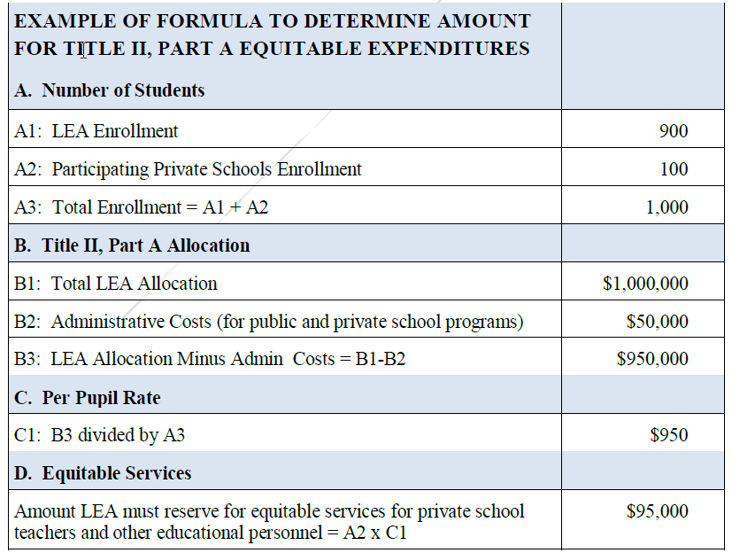

Slide 40
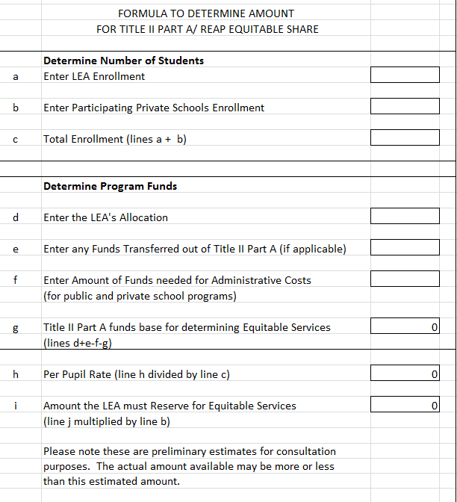

Slide 41
Title II, Part A Activities
An LEA may continue to provide professional development for teachers, principals and other school leaders to address the specific needs of their students.
May not be used for class-size reduction in private schools.

Slide 42
Professional Development
District must pay conference & travel fees directly, or reimburse teachers
District may pay stipends directly to private school teachers
District cannot pay for private school substitute teachers
Do no give any funding to the private school

Slide 43
Transferability
Must consult with the private school officials prior to making any decision that could affect their ability to benefit from programs
Private school students and teachers receive equitable services under the same program where the district uses funds

Slide 44
Timeline
New equitable services provision will apply beginning with services provided for the 2017-2018 school year.
Remember, planning generally occurs in the spring before.

Slide 45
QUESTIONS??

Slide 46
SD DOE Contacts
Grants Management: 773-3248
Title Programs: 773-6400

